Slide 1
Makefiles CSE 333 Winter 2020
Instructor: Justin Hsia
Teaching Assistants:
Andrew Hu Austin Chan Brennan Stein
Cheng Ni Cosmo Wang Diya Joy
Guramrit Singh Mengqi Chen Pat Kosakanchit
Rehaan Bhimar Renshu Gu Travis McGaha
Zachary Keyes

Slide 2
Administrivia
Exercise 7 posted yesterday, due Monday
Read a directory and open/copy text files found there
Copy exactly and only the bytes in the file(s). No extra output.
Good warm-up for…
Homework 2 due in two weeks (2/6)
File system crawler, indexer, and search engine
Spec and starter files will be pushed out tonight

Slide 3
Lecture Outline
Make and Build Tools
Makefile Basics
C++ Preview

Slide 4
make
make is a classic program for controlling what gets (re)compiled and how
Many other such programs exist (e.g. ant, maven, IDE “projects”)
make has tons of fancy features, but only two basic ideas:
Scripts for executing commands
Dependencies for avoiding unnecessary work
To avoid “just teaching make features” (boring and narrow), let’s focus more on the concepts…

Slide 5
Building Software
Programmers spend a lot of time “building”
Creating programs from source code
Both programs that they write and other people write
Programmers like to automate repetitive tasks
Repetitive: gcc -Wall -g -std=c11 -o widget foo.c bar.c baz.c
Retype this every time: 😭
Use up-arrow or history: 😐 (still retype after logout)
Have an alias or bash script: 🙂
Have a Makefile: 😊 (you’re ahead of us)

Slide 6
“Real” Build Process
On larger projects, you can’t or don’t want to have one big (set of) command(s) that redoes everything every time you change anything:
If gcc didn’t combine steps for you, you’d need to preprocess, compile, and link on your own (along with anything you used to generate the C files)
If source files have multiple outputs (e.g. javadoc), you’d have to type out the source file name(s) multiple times
You don’t want to have to document the build logic when you distribute source code
You don’t want to recompile everything every time you change something (especially if you have 10⁵-10⁷ files of source code)
A script can handle 1-3 (use a variable for filenames for 2), but 4 is trickier

Slide 7
Recompilation Management
The “theory” behind avoiding unnecessary compilation is a dependency dag (directed, acyclic graph)
To create a target $t$, you need sources $s_{1}, s_{2}, …, s_{n}$ and a command $c$ that directly or indirectly uses the sources
It $t$ is newer than every source (file-modification times), assume there is no reason to rebuild it
Recursive building: if some source $s_{i}$ is itself a target for some other sources, see if it needs to be rebuilt…
Cycles “make no sense”!

Slide 8
Theory Applied to C
Compiling a .c creates a .o – the .o depends on the .c and all included files (.h, recursively/transitively)
foo.h
foo.c
bar.c
Source files
Statically-linked libraries
libZ.a
foo.o
bar.o
Object files
bar
Executable

Slide 9
Theory Applied to C
Compiling a .c creates a .o – the .o depends on the .c and all included files (.h, recursively/transitively)
An archive (library, .a) depends on included .o files
foo.h
foo.c
bar.c
Source files
Statically-linked libraries
libZ.a
foo.o
bar.o
Object files
bar
Executable

Slide 10
Theory Applied to C
Compiling a .c creates a .o – the .o depends on the .c and all included files (.h, recursively/transitively)
An archive (library, .a) depends on included .o files
Creating an executable (“linking”) depends on .o files and archives
Archives linked by -L<path> -l<name> (e.g. -L. -lfoo to get libfoo.a from current directory)
foo.h
foo.c
bar.c
Source files
Statically-linked libraries
libZ.a
foo.o
bar.o
Object files
bar
Executable

Slide 11
Theory Applied to C
If one .c file changes, just need to recreate one .o file, maybe a library, and re-link
If a .h file changes, may need to rebuild more
Many more possibilities!
foo.h
foo.c
bar.c
Source files
Statically-linked libraries
libZ.a
foo.o
bar.o
Object files
bar
Executable

Slide 12
Lecture Outline
Make and Build Tools
Makefile Basics
C++ Preview

Slide 13
make Basics
A makefile contains a bunch of triples:
Colon after target is required
Command lines must start with a TAB, NOT SPACES
Multiple commands for same target are executed in order
Can split commands over multiple lines by ending lines with ‘\’
Example:
target: sources
command
$←$ Tab $→$
foo.o: foo.c foo.h bar.h
gcc -Wall -o foo.o -c foo.c

Slide 14
Using make
Defaults:
If no -f specified, use a file named Makefile
If no target specified, will use the first one in the file
Will interpret commands in your default shell
Set SHELL variable in makefile to ensure
Target execution:
Check each source in the source list:
If the source is a target in the makefile, then process it recursively
If some source does not exist, then error
If any source is newer than the target (or target does not exist), run command (presumably to update the target)
bash$ make -f <makefileName> target
Notes:
Configure needs to figure things out like “where is the compiler?”.

Slide 15
make Variables
You can define variables in a makefile:
All values are strings of text, no “types”
Variable names are case-sensitive and can’t contain ‘:’, ‘#’, ‘=’, or whitespace
Example:
Advantages:
Easy to change things (especially in multiple commands)
Can also specify on the command line: (e.g. make foo.o CC=clang CFLAGS=-g)
CC = gcc
CFLAGS = -Wall -std=c11
foo.o: foo.c foo.h bar.h
$(CC) $(CFLAGS) -o foo.o -c foo.c

Slide 16
More Variables
It’s common to use variables to hold lists of filenames:
clean is a convention
Remove generated files to “start over” from just the source
It’s “funny” because the target doesn’t exist and there are no sources, but it works because:
The target doesn’t exist, so it must be “remade” by running the command
These “phony” targets have several uses, such as “all”…
OBJFILES = foo.o bar.o baz.o
widget: $(OBJFILES)
gcc -o widget $(OBJFILES)
clean:
rm $(OBJFILES) widget *~

Slide 17
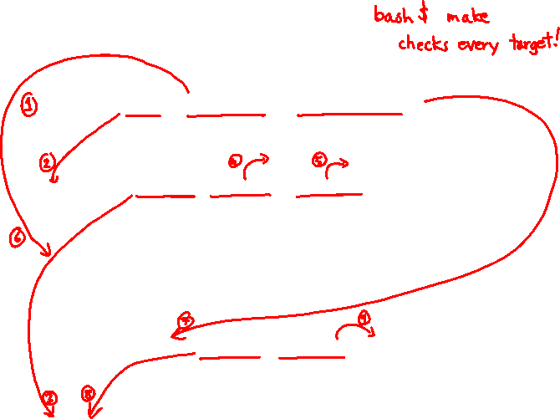
“all” Example
all: prog B.class someLib.a
# notice no commands this time
prog: foo.o bar.o main.o
gcc –o prog foo.o bar.o main.o
B.class: B.java
javac B.java
someLib.a: foo.o baz.o
ar r foo.o baz.o
foo.o: foo.c foo.h header1.h header2.h
gcc -c -Wall foo.c
# similar targets for bar.o, main.o, baz.o, etc...

Slide 18
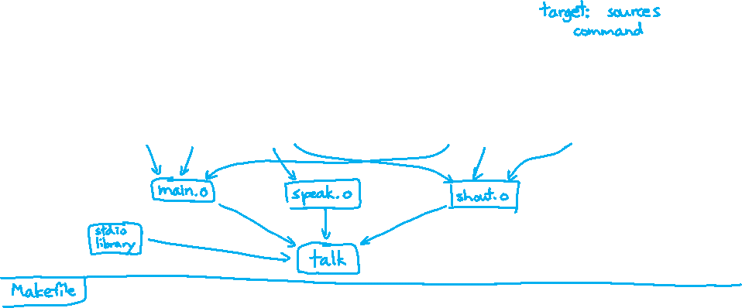
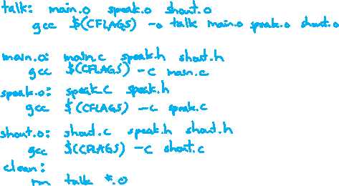
Writing a Makefile Example
“talk” program (find files on web with lecture slides)
main.c
speak.h
speak.c
shout.h
shout.c

Slide 19
Revenge of the Funny Characters
Special variables:
$@ for target name
$^ for all sources
$< for left-most source
Lots more! – see the documentation
Examples:
# CC and CFLAGS defined above
widget: foo.o bar.o
$(CC) $(CFLAGS) -o $@ $^
foo.o: foo.c foo.h bar.h
$(CC) $(CFLAGS) -c $<

Slide 20
And more…
There are a lot of “built-in” rules – see documentation
There are “suffix” rules and “pattern” rules
Example:
Remember that you can put any shell command – even whole scripts!
You can repeat target names to add more dependencies
Often this stuff is more useful for reading makefiles than writing your own (until some day…)
%.class: %.java
javac $< # we need the $< here

Slide 21
Lecture Outline
Make and Build Tools
Makefile Basics
C++ Preview

Slide 22
Programming Terminology Review
Encapsulation and Abstraction: Hiding implementation details (restricting access) and associating behaviors (methods) with data
Polymorphism: The provision of a single interface to entities of different types
Generics: Algorithms written in terms of types to-be-specified-later

Slide 23
Encapsulation and Abstraction (C)
Used header file conventions and the static specifier to separate “private” functions, definitions, and constants from “public”
Used forward-declared structs and opaque pointers (i.e. void*) to hide implementation-specific details
Can’t associate behaviors with encapsulated state
Functions that operate on a LinkedList not actually tied to the struct
Really difficult to mimic – implemented primarily via coding conventions

Slide 24
Encapsulation and Abstraction (C++)
Support for classes and objects!
Public, private, and protected access specifiers
Methods and instance variables ("this")
(Multiple!) inheritance
Polymorphism
Static polymorphism: multiple functions or methods with the same name, but different argument types (overloading)
Works for all functions, not just class members
Dynamic (subtype) polymorphism: derived classes can override methods of parents, and methods will be dispatched correctly

Slide 25
Generics (C)
Generic linked list and hash table by using void* payload
Function pointers to generalize different behavior for data structures
Comparisons, deallocation, pickling up state, etc.
Emulated generic data structures primarily by disabling type system

Slide 26
Generics (C++)
Templates facilitate generic data types
Parametric polymorphism: same idea as Java generics, but different in details, particularly implementation
A vector of ints: vector<int> x;
A vector of floats: vector<float> x;
A vector of (vectors of floats): vector<vector<float>> x;
Specialized casts to increase type safety

Slide 27
Namespaces (C)
Names are global and visible everywhere
Can use static to prevent a name from being visible outside a source file (as close as C gets to “private”)
Naming conventions help avoid collisions in the global namespace
e.g. LinkedList_Allocate, HTIterator_Next, etc.
Avoid collisions primarily via coding conventions

Slide 28
Namespaces (C++)
Explicit namespaces!
The linked list module could define an “LL” namespace while the hash table module could define an “HT” namespace
Both modules could define an Iterator class
One would be globally named LL::Iterator and the other would be globally named HT::Iterator
Classes also allow duplicate names without collisions
Classes can also define their own pseudo-namespace, very similar to Java static inner classes

Slide 29
Standard Library (C)
C does not provide any standard data structures
We had to implement our own linked list and hash table
Hopefully, you can use somebody else’s libraries
But C’s lack of abstraction, encapsulation, and generics means you’ll probably end up tweak them or tweak your code to use them
YOU implement the data structures that you need

Slide 30
Standard Library (C++)
Generic containers: bitset, queue, list, associative array (including hash table), deque, set, stack, and vector
And iterators for most of these
A string class: hides the implementation of strings
Streams: allows you to stream data to and from objects, consoles, files, strings, and so on
Generic algorithms: sort, filter, remove duplicates, etc.

Slide 31
Error Handling (C)
Error handling is a pain
Define error codes and return them
Either directly return or via a “global” like errno
No type checking: does 1 mean EXIT_FAILURE or true?
Customers and implementors need to constantly test return values
e.g. if a() calls b(), which calls c()
a depends on b to propagate an error in c back to it
Error handling is a pain – mixture of coding conventions and discipline

Slide 32
Error Handling (C++)
Supports exceptions!
try / throw / catch
If used with discipline, can simplify error processing
If used carelessly, can complicate memory management
Consider: a() calls b(), which calls c()
If c() throws an exception that b() doesn’t catch, you might not get a chance to clean up resources allocated inside b()
We will largely avoid in 333
You still benefit from having more interpretable errors!
But much C++ code still needs to work with C & old C++ libraries, so still uses return codes, exit(), etc.

Slide 33
Some Tasks Still Hurt in C++
Memory management
C++ has no garbage collector
You still have to manage memory allocation & deallocation and track
It’s still possible to have leaks, double frees, and so on
But there are some things that help
“Smart pointers”
Classes that encapsulate pointers and track reference counts
Deallocate memory when the reference count goes to zero
C++’s constructors and destructors permit a pattern known as “Resource Allocation Is Initialization” (RAII)
Useful for releasing memory, locks, database transactions, etc.

Slide 34
Some Tasks Still Hurt in C++
C++ doesn’t guarantee type or memory safety
You can still:
Forcibly cast pointers between incompatible types
Walk off the end of an array and smash memory
Have dangling pointers
Conjure up a pointer to an arbitrary address of your choosing

Slide 35
How to Think About C++
Set of styles and ways to use C++
Style guides
Good styles and robust engineering practices
Set of styles and ways to use C

Slide 36
Or…
In the hands of a disciplined programmer, C++ is a powerful tool
But if you’re not so disciplined about how you use C++…

