Slide 1
POSIX I/O, System Calls CSE 333 Winter 2020
Instructor: Justin Hsia
Teaching Assistants:
Andrew Hu Austin Chan Brennan Stein
Cheng Ni Cosmo Wang Diya Joy
Guramrit Singh Mengqi Chen Pat Kosakanchit
Rehaan Bhimar Renshu Gu Travis McGaha
Zachary Keyes

Slide 2
Administrivia
Exercise 7 posted tomorrow, due Monday (1/27)
Comment your code, check linter and valgrind
Homework 1 due tomorrow night (1/23)
Watch that HashTable doesn’t violate the modularity of LinkedList
Watch for pointer to local (stack) variables
Use a debugger (e.g. gdb) if you’re getting segfaults
Clean up “to do” comments, but leave “STEP #” markers
Late days: don’t tag hw1-final until you are really ready
Homework 2 will be released on Friday (1/24)

Slide 3
Lecture Outline
POSIX Lower-Level I/O
System Calls

Slide 4
Remember This Picture?
A brief
diversion...
C application
C++ application
Java application
C standard library (glibc)
C++ STL/boost/ standard library
JRE
OS / app interface
(system calls)
CPU memory storage network GPU clock audio radio peripherals
operating system
HW/SW interface
(x86 + devices)
hardware
Notes:
OS is CSE 451

Slide 5
We Need To Go Deeper…
So far we’ve seen the C standard library to access files
Use a provided FILE* stream abstraction
fopen(), fread(), fwrite(), fclose(), fseek()
These are convenient and portable
They are buffered*
They are implemented using lower-level OS calls

Slide 6
From C to POSIX
Most UNIX-en support a common set of lower-level file access APIs: POSIX – Portable Operating System Interface
open(), read(), write(), close(), lseek()
Similar in spirit to their f*() counterparts from the C std lib
Lower-level and unbuffered compared to their counterparts
Also less convenient
You will have to use these to read file system directories and for network I/O, so we might as well learn them now
Notes:
POSIX – Portable Operating System Interface
fopen guaranteed to work in C, implementation may change based on OS
POSIX uses open(), Windows uses CreateFile
The Portable Operating System Interface (POSIX) is a family of standards specified by the IEEE Computer Society for maintaining compatibility between operating systems.^{[1]} POSIX defines the application programming interface (API), along with command line shells and utility interfaces, for software compatibility with variants of Unix and other operating systems.

Slide 7
open()/close()
To open a file:
Pass in the filename and access mode
Similar to fopen()
Get back a “file descriptor”
Similar to FILE* from fopen(), but is just an int
Defaults: 0 is stdin, 1 is stdout, 2 is stderr
#include <fcntl.h> // for open()
#include <unistd.h> // for close()
...
int fd = open("foo.txt", O_RDONLY);
if (fd == -1) {
perror("open failed");
exit(EXIT_FAILURE);
}
...
close(fd);
Notes:
fopen() returns a pointer in user addr space, which can then be passed around.
open() just returns int because it can't return pointer in OS space.

Slide 8
Reading from a File
ssize_t read(int fd, void* buf, size_t count);
Returns the number of bytes read
Might be fewer bytes than you requested (!!!)
Returns 0 if you’re already at the end-of-file
Returns -1 on error (and sets errno)
There are some surprising error modes (check errno)
EBADF: bad file descriptor
EFAULT: output buffer is not a valid address
EINTR: read was interrupted, please try again (ARGH!!!! 😤😠)
And many others…
ssize_t read(int fd, void* buf, size_t count);

Slide 9
One way to read() $n$ bytes
Which is the correct completion of the blank below?
Vote at http://PollEv.com/justinh
char* buf = ...; // buffer of size n
int bytes_left = n;
int result; // result of read()
while (bytes_left > 0) {
result = read(fd, ______, bytes_left);
if (result == -1) {
if (errno != EINTR) {
// a real error happened,
// so return an error result
}
// EINTR happened,
// so do nothing and try again
continue;
}
bytes_left -= result;
}
A. buf
B. buf + bytes_left
C. buf + bytes_left - n
D. buf + n - bytes_left
E. We’re lost…

Slide 10
One method to read() $n$ bytes
int fd = open(filename, O_RDONLY);
char* buf = ...; // buffer of appropriate size
int bytes_left = n;
int result;
while (bytes_left > 0) {
result = read(fd, buf + (n - bytes_left), bytes_left);
if (result == -1) {
if (errno != EINTR) {
// a real error happened, so return an error result
}
// EINTR happened, so do nothing and try again
continue;
} else if (result == 0) {
// EOF reached, so stop reading
break;
}
bytes_left -= result;
}
close(fd);
readN.c

Slide 11
Other Low-Level Functions
Read man pages to learn about:
write() – write data
#include <unistd.h>
fsync() – flush data to the underlying device
#include <unistd.h>
opendir(), readdir(), closedir() – deal with directory listings
Make sure you read the section 3 version (e.g. man 3 opendir)
#include <dirent.h>
A useful shortcut sheet (from CMU): http://www.cs.cmu.edu/~guna/15-123S11/Lectures/Lecture24.pdf

Slide 12
C Standard Library vs. POSIX
C std lib implements a subset of POSIX
e.g. POSIX provides directory manipulation that C std lib doesn’t
C std lib implements automatic buffering
C std lib has a nicer API
The two are similar but C std lib builds on top of POSIX
Choice between high-level and low-level
Will depend on the requirements of your application
Notes:
Like beet and chard: we treat them as if they were two separate things, but really one builds on top of the other (chard are beets which have been bred for large tender leaves instead of fat delicious roots
Beets (Beta vulgaris var. crassa) and Swiss chard (Beta vulgaris var. cicla) are members of the Chenopodiaceae family, along with lambquarters. Both are cool-season crops that can tolerate frosts and light freezes. Chard is raised for its large leaves and stems, and beets are raised both for greens and roots.

Slide 13
Lecture Outline
POSIX Lower-Level I/O
System Calls

Slide 14
What’s an OS?
Software that:
Directly interacts with the hardware
OS is trusted to do so; user-level programs are not
OS must be ported to new hardware; user-level programs are portable
Manages (allocates, schedules, protects) hardware resources
Decides which programs can access which files, memory locations, pixels on the screen, etc. and when
Abstracts away messy hardware devices
Provides high-level, convenient, portable abstractions (e.g. files, disk blocks)

Slide 15
OS: Abstraction Provider
The OS is the “layer below”
A module that your program can call (with system calls)
Provides a powerful OS API – POSIX, Windows, etc.
a process running your program
File System
open(), read(), write(), close(), …
Network Stack
connect(), listen(), read(), write(), ...
Virtual Memory
brk(), shm_open(), …
Process Management
fork(), wait(), nice(), …
OS API
file system | network stack | virtual memory | process mgmt. | … etc …
OS
Notes:
API – Application Programming Interface
nice() – a UNIX kernel call that sets the priority of a process

Slide 16
OS: Protection System
OS isolates process from each other
But permits controlled sharing between them
Through shared name spaces (e.g. file names)
OS isolates itself from processes
Must prevent processes from accessing the hardware directly
OS is allowed to access the hardware
User-level processes run with the CPU (processor) in unprivileged mode
The OS runs with the CPU in privileged mode
User-level processes invoke system calls to safely enter the OS
Process A (untrusted)
Process B (untrusted)
Process C (untrusted)
Process D (trusted)
OS
(trusted)
HW (trusted)
Notes:
FS = File System
Trusted mode is enforced in hardware by hardware bit (part of status bits – only accessible by things with privilege).
The OS is very paranoid!

Slide 17
System Call Trace (high-level view)
Process A (untrusted)
Process B (untrusted)
Process C (untrusted)
Process D (trusted)
A CPU (thread of execution) is running user-level code in Process A; the CPU is set to unprivileged mode.
OS
(trusted)
HW (trusted)
Notes:
Let’s trace what happens on a system call…

Slide 18
System Call Trace (high-level view)
Process A (untrusted)
Process B (untrusted)
Process C (untrusted)
Process D (trusted)
Code in Process A invokes a system call; the hardware then sets the CPU to privileged mode and traps into the OS, which invokes the appropriate system call handler.
system call
OS
(trusted)
HW (trusted)

Slide 19
System Call Trace (high-level view)
Process A (untrusted)
Process B (untrusted)
Process C (untrusted)
Process D (trusted)
Because the CPU executing the thread that’s in the OS is in privileged mode, it is able to use privileged instructions that interact directly with hardware devices like disks.
OS
(trusted)
HW (trusted)

Slide 20
System Call Trace (high-level view)
Process A (untrusted)
Process B (untrusted)
Process C (untrusted)
Process D (trusted)
Once the OS has finished servicing the system call, which might involve long waits as it interacts with HW, it:
(1) Sets the CPU back to unprivileged mode and
(2) Returns out of the system call back to the user-level code in Process A.
system call return
OS
(trusted)
HW (trusted)

Slide 21
System Call Trace (high-level view)
Process A (untrusted)
Process B (untrusted)
Process C (untrusted)
Process D (trusted)
The process continues executing whatever code is next after the system call invocation.
OS
(trusted)
HW (trusted)
Useful reference: CSPP § 8.1–8.3 (the 351 book)

Slide 22
“Library calls” on x86/Linux
Your program
A more accurate picture:
Consider a typical Linux process
Its thread of execution can be in one of several places:
In your program’s code
In glibc, a shared library containing the C standard library, POSIX, support, and more
In the Linux architecture-independent code
In Linux x86-64 code
glibc
C standard
library
POSIX
Linux system calls
architecture-independent code
architecture-dependent code
Linux kernel

Slide 23
“Library calls” on x86/Linux: Option 1
Your program
Some routines your program invokes may be entirely handled by glibc without involving the kernel
e.g. strcmp() from stdio.h
There is some initial overhead when invoking functions in dynamically linked libraries (during loading)
But after symbols are resolved, invoking glibc routines is basically as fast as a function call within your program itself!
glibc
C standard
library
POSIX
architecture-independent code
architecture-dependent code
Linux kernel

Slide 24
“Library calls” on x86/Linux: Option 2
Your program
Some routines may be handled by glibc, but they in turn invoke Linux system calls
e.g. POSIX wrappers around Linux syscalls
POSIX readdir() invokes the underlying Linux readdir()
e.g. C stdio functions that read and write from files
fopen(), fclose(), fprintf() invoke underlying Linux open(), close(), write(), etc.
glibc
C standard
library
POSIX
architecture-independent code
architecture-dependent code
Linux kernel
Notes:
POSIX is directly talking to OS, not doing any real work for you (unlike the C std lib wrapper functions).

Slide 25
“Library calls” on x86/Linux: Option 3
Your program
Your program can choose to directly invoke Linux system calls as well
Nothing is forcing you to link with glibc and use it
But relying on directly-invoked Linux system calls may make your program less portable across UNIX varieties
glibc
C standard
library
POSIX
architecture-independent code
architecture-dependent code
Linux kernel
Notes:
If you really want to talk to the OS directly, you can write it in assembly!

Slide 26
Details on x86/Linux
Your program
Let’s walk through how a Linux system call actually works
We’ll assume 32-bit x86 using the modern SYSENTER / SYSEXIT x86 instructions
x86-64 code is similar, though details always change over time, so take this as an example – not a debugging guide
glibc
C standard
library
POSIX
architecture-independent code
architecture-dependent code
Linux kernel
Notes:
Changed over time, but more important to have a mental model -- OS course for details

Slide 27
System Calls on x86/Linux
0xFFFFFFFF
Your program
Remember our process address space picture?
Let’s add some details:
linux-gate.so
Linux kernel
kernel stack
glibc
C standard
library
POSIX
Stack
Shared Libraries
architecture-independent code
architecture-dependent code
Heap (malloc/free)
Read/Write Segment .data, .bss
Read-Only Segment .text, .rodata
Linux kernel
CPU
0x00000000

Slide 28
System Calls on x86/Linux
0xFFFFFFFF
Your program
Process is executing your program code
linux-gate.so
Linux kernel
kernel stack
glibc
C standard
library
POSIX
Stack
SP
Shared Libraries
architecture-independent code
architecture-dependent code
Heap (malloc/free)
Read/Write Segment .data, .bss
IP
Read-Only Segment .text, .rodata
Linux kernel
CPU
unpriv
0x00000000

Slide 29
System Calls on x86/Linux
0xFFFFFFFF
Your program
Process calls into a glibc function
e.g. fopen()
We’ll ignore the messy details of loading/linking shared libraries
linux-gate.so
Linux kernel
kernel stack
glibc
C standard
library
POSIX
Stack
SP
IP
Shared Libraries
architecture-independent code
architecture-dependent code
Heap (malloc/free)
Read/Write Segment .data, .bss
Read-Only Segment .text, .rodata
Linux kernel
CPU
unpriv
0x00000000

Slide 30
System Calls on x86/Linux
0xFFFFFFFF
Your program
IP
linux-gate.so
glibc begins the process of invoking a Linux system call
glibc’s fopen() likely invokes Linux’s open() system call
Puts the system call # and arguments into registers
Uses the call x86 instruction to call into the routine __kernel_vsyscall located in linux-gate.so
Linux kernel
kernel stack
glibc
C standard
library
POSIX
Stack
SP
Shared Libraries
architecture-independent code
architecture-dependent code
Heap (malloc/free)
Read/Write Segment .data, .bss
Read-Only Segment .text, .rodata
Linux kernel
CPU
unpriv
0x00000000
Notes:
linux-gate.so is a magic function to bridge C and ASM calling conventions (details not important).

Slide 31
System Calls on x86/Linux
0xFFFFFFFF
Your program
IP
linux-gate.so
linux-gate.so is a vdso
A virtual dynamically-linked shared object
Is a kernel-provided shared library that is plunked into a process’ address space
Provides the intricate machine code needed to trigger a system call
Linux kernel
kernel stack
glibc
C standard
library
POSIX
Stack
SP
Shared Libraries
architecture-independent code
architecture-dependent code
Heap (malloc/free)
Read/Write Segment .data, .bss
Read-Only Segment .text, .rodata
Linux kernel
CPU
unpriv
0x00000000
Notes:
linux-gate.so is a magic function to bridge C and ASM calling conventions (details not important).

Slide 32
System Calls on x86/Linux
0xFFFFFFFF
Your program
linux-gate.so eventually invokes the SYSENTER x86 instruction
SYSENTER is x86’s “fast system call” instruction
Causes the CPU to raise its privilege level
Traps into the Linux kernel by changing the SP, IP to a previously-determined location
Changes some segmentation-related registers (see CSE451)
linux-gate.so
SP
Linux kernel
kernel stack
IP
glibc
C standard
library
POSIX
Stack
Shared Libraries
architecture-independent code
architecture-dependent code
Heap (malloc/free)
Read/Write Segment .data, .bss
Read-Only Segment .text, .rodata
Linux kernel
CPU
priv
0x00000000
Notes:
Important that SP moved, too!
SYSENTER is an interrupt and SYSEXIT is a return from an interrupt.

Slide 33
System Calls on x86/Linux
0xFFFFFFFF
Your program
The kernel begins executing code at the SYSENTER entry point
Is in the architecture-dependent part of Linux
It’s job is to:
Look up the system call number in a system call dispatch table
Call into the address stored in that table entry; this is Linux’s system call handler
For open(), the handler is named sys_open, and is system call #5
linux-gate.so
SP
Linux kernel
kernel stack
IP
glibc
C standard
library
POSIX
Stack
Shared Libraries
architecture-independent code
architecture-dependent code
Heap (malloc/free)
Read/Write Segment .data, .bss
Read-Only Segment .text, .rodata
Linux kernel
CPU
priv
0x00000000

Slide 34
System Calls on x86/Linux
0xFFFFFFFF
Your program
The system call handler executes
What it does is system-call specific
It may take a long time to execute, especially if it has to interact with hardware
Linux may choose to context switch the CPU to a different runnable process
linux-gate.so
SP
Linux kernel
kernel stack
IP
glibc
C standard
library
POSIX
Stack
Shared Libraries
architecture-independent code
architecture-dependent code
Heap (malloc/free)
Read/Write Segment .data, .bss
Read-Only Segment .text, .rodata
Linux kernel
CPU
priv
0x00000000

Slide 35
System Calls on x86/Linux
0xFFFFFFFF
Your program
Eventually, the system call handler finishes
Returns back to the system call entry point
Places the system call’s return value in the appropriate register
Calls SYSEXIT to return to the user-level code
linux-gate.so
SP
Linux kernel
kernel stack
IP
glibc
C standard
library
POSIX
Stack
Shared Libraries
architecture-independent code
architecture-dependent code
Heap (malloc/free)
Read/Write Segment .data, .bss
Read-Only Segment .text, .rodata
Linux kernel
CPU
priv
0x00000000

Slide 36
System Calls on x86/Linux
0xFFFFFFFF
Your program
SYSEXIT transitions the processor back to user-mode code
Restores the IP, SP to user-land values
Sets the CPU back to unprivileged mode
Changes some segmentation-related registers (see CSE451)
Returns the processor back to glibc
linux-gate.so
Linux kernel
kernel stack
glibc
C standard
library
POSIX
Stack
SP
IP
Shared Libraries
architecture-independent code
architecture-dependent code
Heap (malloc/free)
Read/Write Segment .data, .bss
Read-Only Segment .text, .rodata
Linux kernel
CPU
unpriv
0x00000000

Slide 37
System Calls on x86/Linux
0xFFFFFFFF
Your program
glibc continues to execute
Might execute more system calls
Eventually returns back to your program code
linux-gate.so
Linux kernel
kernel stack
glibc
C standard
library
POSIX
Stack
SP
Shared Libraries
architecture-independent code
architecture-dependent code
Heap (malloc/free)
Read/Write Segment .data, .bss
IP
Read-Only Segment .text, .rodata
Linux kernel
CPU
unpriv
0x00000000

Slide 38
strace
A useful Linux utility that shows the sequence of system calls that a process makes:
bash$ strace ls 2>&1 | less
execve("/usr/bin/ls", ["ls"], [/* 41 vars */]) = 0
brk(NULL) = 0x15aa000
mmap(NULL, 4096, PROT_READ|PROT_WRITE, MAP_PRIVATE|MAP_ANONYMOUS, -1, 0) = 0x7f03bb741000
access("/etc/ld.so.preload", R_OK) = -1 ENOENT (No such file or directory)
open("/etc/ld.so.cache", O_RDONLY|O_CLOEXEC) = 3
fstat(3, {st_mode=S_IFREG|0644, st_size=126570, ...}) = 0
mmap(NULL, 126570, PROT_READ, MAP_PRIVATE, 3, 0) = 0x7f03bb722000
close(3) = 0
open("/lib64/libselinux.so.1", O_RDONLY|O_CLOEXEC) = 3
read(3, "\177ELF\2\1\1\0\0\0\0\0\0\0\0\0\3\0>\0\1\0\0\0\300j\0\0\0\0\0\0"..., 832) = 832
fstat(3, {st_mode=S_IFREG|0755, st_size=155744, ...}) = 0
mmap(NULL, 2255216, PROT_READ|PROT_EXEC, MAP_PRIVATE|MAP_DENYWRITE, 3, 0) = 0x7f03bb2fa000
mprotect(0x7f03bb31e000, 2093056, PROT_NONE) = 0
mmap(0x7f03bb51d000, 8192, PROT_READ|PROT_WRITE, MAP_PRIVATE|MAP_FIXED|MAP_DENYWRITE, 3, 0x23000) = 0x7f03bb51d000
... etc ...

Slide 39
If You’re Curious
Download the Linux kernel source code
Available from http://www.kernel.org/
man, section 2: Linux system calls
man 2 intro
man 2 syscalls
man, section 3: glibc/libc library functions
man 3 intro
The book: The Linux Programming Interface by Michael Kerrisk (keeper of the Linux man pages)
Notes:
man 1 – user commands
man 2 – Linux system calls
man 3 – library functions

Slide 40
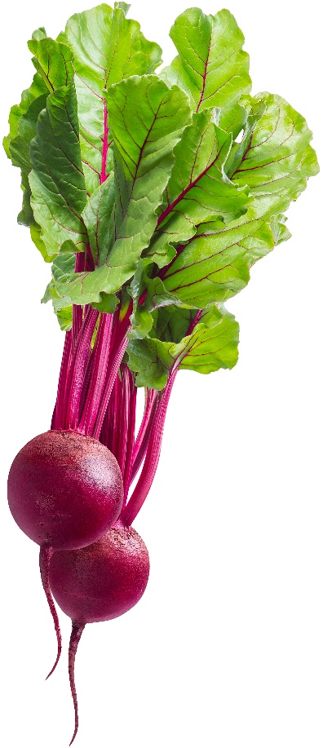
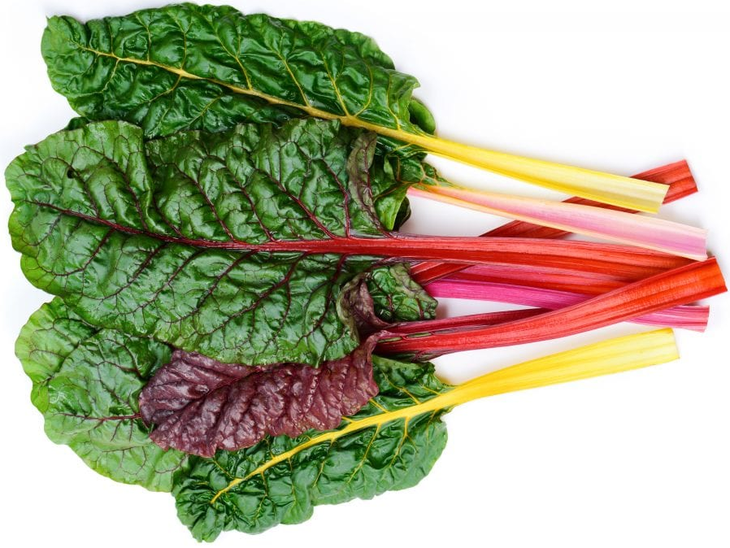
C Standard Library vs. POSIX
C std lib implements a subset of POSIX
e.g. POSIX provides directory manipulation that C std lib doesn’t
C std lib implements automatic buffering
C std lib has a nicer API
The two are similar but different levels of the same whole
+
=
Beets/
File I/O API
Chard/C Std Lib
Beetroot/POSIX
Notes:
Like beet and chard: we treat them as if they were two separate things, but really one builds on top of the other (chard are beets which have been bred for large tender leaves instead of fat delicious roots
Beets (Beta vulgaris var. crassa) and Swiss chard (Beta vulgaris var. cicla) are members of the Chenopodiaceae family, along with lambquarters. Both are cool-season crops that can tolerate frosts and light freezes. Chard is raised for its large leaves and stems, and beets are raised both for greens and roots.

