Slide 1
Modules and The C Preprocessor CSE 333 Winter 2020
Instructor: Justin Hsia
Teaching Assistants:
Andrew Hu Austin Chan Brennan Stein
Cheng Ni Cosmo Wang Diya Joy
Guramrit Singh Mengqi Chen Pat Kosakanchit
Rehaan Bhimar Renshu Gu Travis McGaha
Zachary Keyes

Slide 2
Administrivia
Exercise 4 out today and due Friday morning
Exercise 5 will rely on material covered in Section 2
Released Thursday afternoon instead
Much longer and harder than previous exercises!
Exercise 6 released on Friday (instead of Monday)
Both exercise 5 and 6 are due next Wednesday (1/22)
Homework 1 due in a week
Advice: be sure to read headers carefully while implementing
Advice: use git add/commit/push often to save your work

Slide 3
Linked List Code for Memory Diagram
Node* Push(Node* head, void* e) {
Node* n = malloc(sizeof(Node));
assert(n != NULL);
n->element = e;
n->next = head;
return n;
}
manual_list_void.c
typedef struct node_st {
void* element;
struct node_st* next;
} Node;
Node* Push(Node* head, void* e);
int main(int argc, char** argv) {
char* hello = "Hi there!";
char* goodbye = "Bye bye.";
Node* list = NULL;
list = Push(list, (void*) hello);
list = Push(list, (void*) goodbye);
return EXIT_SUCCESS;
}

Slide 4
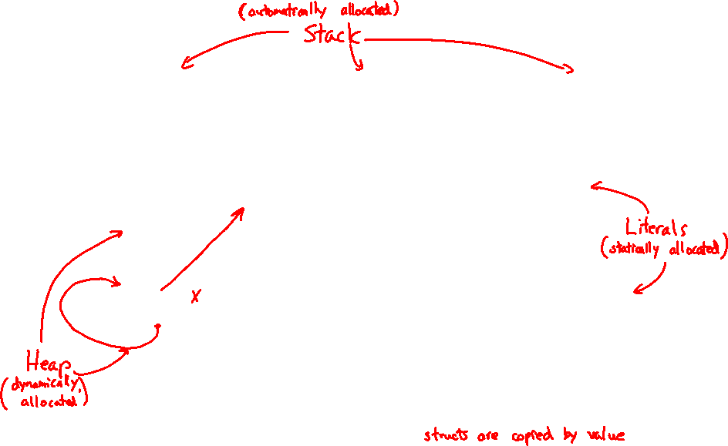
Resulting Memory Diagram
(main) list
(main) goodbye
(main) hello
element
B
y
e
b
y
e
.
\0
next
element
H
i
t
h
e
r
e
!
\0
next
$$∅$$
What would happen if we execute *(list->next) = *list?

Slide 5
Something’s Fishy… 🐟
A (benign) memory leak!
Try running with Valgrind:
int main(int argc, char** argv) {
char* hello = "Hi there!";
char* goodbye = "Bye bye.";
Node* list = NULL;
list = Push(list, (void*) hello);
list = Push(list, (void*) goodbye);
return EXIT_SUCCESS;
}
bash$ gcc –Wall -g –o manual_list_void manual_list_void.c
bash$ valgrind --leak-check=full ./manual_list_void

Slide 6
Lecture Outline
Structuring Interfaces
C Preprocessor and Header Guards
Visibility of Symbols
extern, static

Slide 7
Multi-File C Programs
Let’s create a linked list module
A module is a self-contained piece of an overall program
Has externally visible functions that customers can invoke
Has externally visible typedefs, and perhaps global variables, that customers can use
May have internal functions, typedefs, or global variables that customers should not look at
Can be developed independently and re-used in different projects
The module’s interface is its set of public functions, typedefs, and global variables
main program
linked list
hash
table

Slide 8
C Header Files
Header: a file whose only purpose is to be #include’d
Generally has a filename .h extension
Holds the variables, types, and function prototype declarations that make up the interface to a module
There are <system-defined> and "programmer-defined" headers
Main Idea:
Every name.c is intended to be a module that has a name.h
name.h declares the interface to that module
Other modules can use name by #include-ing name.h
They should assume as little as possible about the implementation in name.c

Slide 9
C Module Conventions (1 of 2)
STYLE
TIP
File contents:
.h files only contain declarations, never definitions
.c files never contain prototype declarations for functions that are intended to be exported through the module interface
Public-facing functions are ModuleName_functionname() and take a pointer to “this” as their first argument
Including:
NEVER #include a .c file – only #include .h files
#include all of headers you reference, even if another header (transitively) includes some of them
Compiling:
Any .c file with an associated .h file should be able to be compiled (together via #include) into a .o file

Slide 10
C Module Conventions (2 of 2)
STYLE
TIP
Commenting:
If a function is declared in a header file (.h) and defined in a C file (.c), the header needs full documentation because it is the public specification
Don’t copy-paste the comment into the C file (don’t want two copies that can get out of sync)
If prototype and implementation are in the same C file:
School of thought #1: Full comment on the prototype at the top of the file, no comment (or “declared above”) on code
School of thought #2: Prototype is for the compiler and doesn’t need comment; comment the code to keep them together
e.g. 333 project code

Slide 11
Lecture Outline
Structuring Interfaces
C Preprocessor and Header Guards
Visibility of Symbols
extern, static

Slide 12
#include and the C Preprocessor
The C preprocessor (cpp) is a sequential and stateful search-and-replace text-processor that transforms your source code before the compiler runs
The input is a C file (text) and the output is still a C file (text)
It processes the directives it finds in your code (#directive)
e.g. #include "ll.h" is replaced by the post-processed content of ll.h
e.g. #define PI 3.1415 defines a symbol and replaces later occurrences
Several others that we’ll see soon…
Run automatically on your behalf by gcc during compilation
#include "ll.h"
#define PI 3.1415

Slide 13
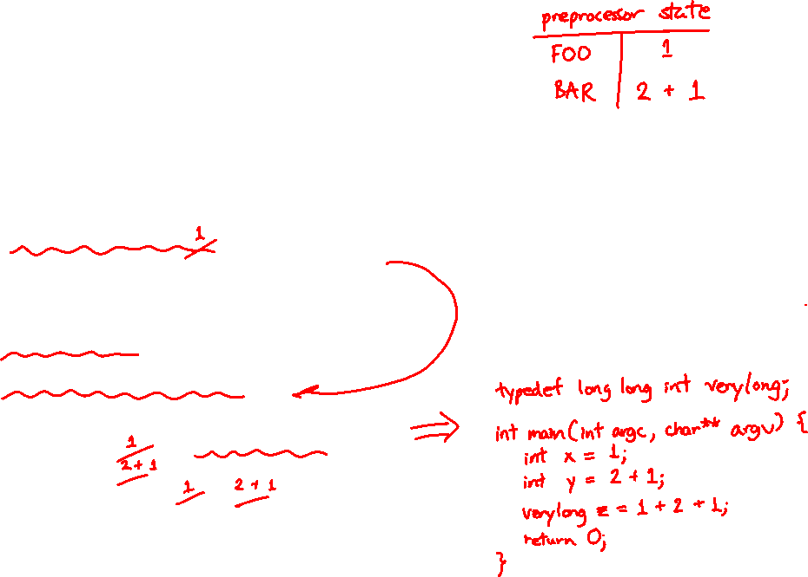
C Preprocessor Example
What do you think the preprocessor output will be?
#define BAR 2 + FOO
typedef long long int verylong;
cpp_example.h
#define FOO 1
#include "cpp_example.h"
int main(int argc, char** argv) {
int x = FOO; // a comment
int y = BAR;
verylong z = FOO + BAR;
return 0;
}
cpp_example.c
Notes:
Removed comments!
https://en.wikipedia.org/wiki/C_preprocessor#Order_of_expansion

Slide 14
C Preprocessor Example
We can manually run the preprocessor:
cpp is the preprocessor (can also use gcc -E)
“-P” option suppresses some extra debugging annotations
#define BAR 2 + FOO
typedef long long int verylong;
bash$ cpp –P cpp_example.c out.c
cpp_example.h
bash$ cpp –P cpp_example.c out.c
bash$ cat out.c
typedef long long int verylong;
int main(int argc, char **argv) {
int x = 1;
int y = 2 + 1;
verylong z = 1 + 2 + 1;
return 0;
}
#define FOO 1
#include "cpp_example.h"
int main(int argc, char** argv) {
int x = FOO; // a comment
int y = BAR;
verylong z = FOO + BAR;
return 0;
}
cpp_example.c
Notes:
Removed comments!
https://en.wikipedia.org/wiki/C_preprocessor#Order_of_expansion

Slide 15
Program Using a Linked List
#include <stdlib.h>
#include <assert.h>
#include "ll.h"
Node* Push(Node* head,
void* element) {
... // implementation here
}
#include "ll.h"
int main(int argc, char** argv) {
Node* list = NULL;
char* hi = "hello";
char* bye = "goodbye";
list = Push(list, (void*)hi);
list = Push(list, (void*)bye);
...
return 0;
}
ll.c
typedef struct node_st {
void* element;
struct node_st* next;
} Node;
Node* Push(Node* head,
void* element);
example_ll_customer.c
ll.h

Slide 16
Compiling the Program
Four parts:
1/2) Compile example_ll_customer.c into an object file
2/1) Compile ll.c into an object file
3) Link both object files into an executable
4) Test, Debug, Rinse, Repeat
bash$ gcc –Wall -g –c –o example_ll_customer.o example_ll_customer.c
bash$ gcc –Wall –g –c –o ll.o ll.c
bash$ gcc -g –o example_ll_customer ll.o example_ll_customer.o
bash$ ./example_ll_customer
Payload: 'yo!'
Payload: 'goodbye'
Payload: 'hello'
bash$ valgrind –leak-check=full ./example_ll_customer
... etc ...

Slide 17
But There’s a Problem with #include
What happens when we compile foo.c?
struct pair {
int a, b;
};
#include "pair.h"
// a useful function
struct pair* make_pair(int a, int b);
pair.h
util.h
#include "pair.h"
#include "util.h"
int main(int argc, char** argv) {
// do stuff here
...
return 0;
}
foo.c

Slide 18
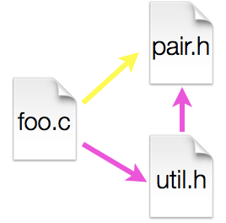
A Problem with #include
What happens when we compile foo.c?
foo.c includes pair.h twice!
Second time is indirectly via util.h
Struct definition shows up twice
Can see using cpp
bash$ gcc –Wall –g -o foo foo.c
In file included from util.h:1:0,
from foo.c:2:
pair.h:1:8: error: redefinition of 'struct pair'
struct pair { int a, b; };
^
In file included from foo.c:1:0:
pair.h:1:8: note: originally defined here
struct pair { int a, b; };
^

Slide 19
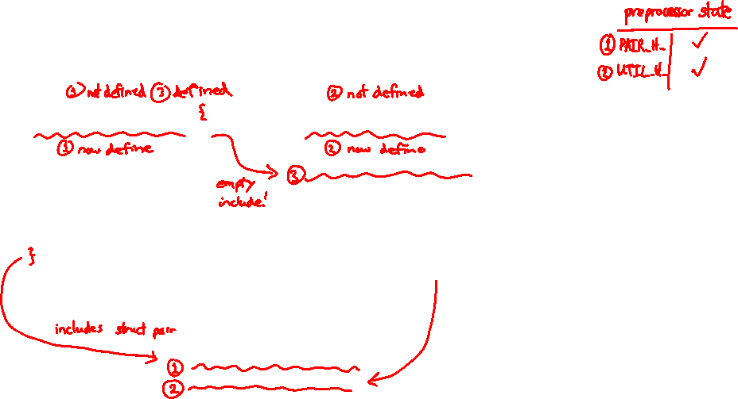
Preprocessor Tricks: Header Guards
STYLE
TIP
A standard C Preprocessor trick to deal with this
Uses macro definition (#define) in combination with conditional compilation (#ifndef and #endif)
#ifndef PAIR_H_
#define PAIR_H_
struct pair {
int a, b;
};
#endif // PAIR_H_
#ifndef UTIL_H_
#define UTIL_H_
#include "pair.h"
// a useful function
struct pair* make_pair(int a, int b);
#endif // UTIL_H_
pair.h
util.h
foo.c
#include "pair.h"
#include "util.h"
int main(int argc, char** argv) {
// do stuff here

Slide 20
Preprocessor Tricks: Constants
STYLE
TIP
A way to deal with “magic constants”
int globalbuffer[1000];
void circalc(float rad,
float* circumf,
float* area) {
*circumf = rad * 2.0 * 3.1415;
*area = rad * 3.1415 * 3.1415;
}
#define BUFSIZE 1000
#define PI 3.14159265359
int globalbuffer[BUFSIZE];
void circalc(float rad,
float* circumf,
float* area) {
*circumf = rad * 2.0 * PI;
*area = rad * PI * PI;
}
Bad code (littered with magic constants)
Better code

Slide 21
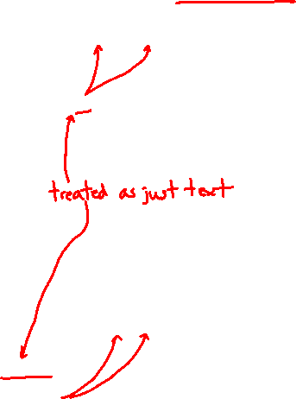
Preprocessor Tricks: Macros
You can pass arguments to macros
Beware of operator precedence issues!
Use parentheses
#define ODD(x) ((x) % 2 != 0)
void foo() {
if ( ODD(5) )
printf("5 is odd!\n");
}
void foo() {
if ( ((5) % 2 != 0) )
printf("5 is odd!\n");
}
cpp
#define ODD(x) ((x) % 2 != 0)
#define WEIRD(x) x % 2 != 0
ODD(5 + 1);
WEIRD(5 + 1);
((5 + 1) % 2 != 0);
5 + 1 % 2 != 0;
cpp

Slide 22
Preprocessor Tricks: Defining Tokens
Besides #defines in the code, preprocessor values can be given as part of the gcc command:
assert can be controlled the same way – defining NDEBUG causes assert to expand to “empty”
It’s a macro – see assert.h
bash$ gcc -Wall -g -DTRACE -o ifdef ifdef.c
bash$ gcc -Wall -g -DNDEBUG -o faster useassert.c

Slide 23
Preprocessor Tricks: Conditional Compilation
You can change what gets compiled
In this example, #define TRACE before #ifdef to include debug printfs in compiled code
#ifdef TRACE
#define ENTER(f) printf("Entering %s\n", f);
#define EXIT(f) printf("Exiting %s\n", f);
#else
#define ENTER(f)
#define EXIT(f)
#endif
// print n
void pr(int n) {
ENTER("pr");
printf("\n = %d\n", n);
EXIT("pr");
}
ifdef.c

Slide 24
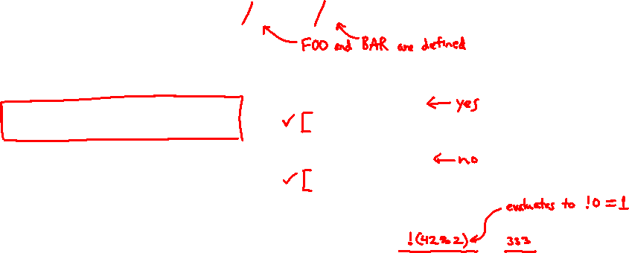
Polling Question
What will happen when we try to compile and run?
Vote at http://PollEv.com/justinh
A. Output "333"
B. Output "334"
C. Compiler message about EVEN
D. Compiler message about BAZ
E. We’re lost…
bash$ gcc -Wall –DFOO -DBAR -o condcomp condcomp.c
bash$ ./condcomp
#include <stdio.h>
#ifdef FOO
#define EVEN(x) !(x%2)
#endif
#ifndef DBAR
#define BAZ 333
#endif
int main(int argc, char** argv) {
int i = EVEN(42) + BAZ;
printf("%d\n",i);
return 0;
}

Slide 25
Extra Exercise #1
Implement and test a binary search tree
https://en.wikipedia.org/wiki/Binary_search_tree
Don’t worry about making it balanced
Implement key insert() and lookup() functions
Bonus: implement a key delete() function
Implement it as a C module
bst.c, bst.h
Implement test_bst.c
Contains main() and tests out your BST

Slide 26
Extra Exercise #2
Implement a Complex number module
complex.c, complex.h
Includes a typedef to define a complex number
a + b$i$, where a and b are doubles
Includes functions to:
add, subtract, multiply, and divide complex numbers
Implement a test driver in test_complex.c
Contains main()

Slide 27
Resulting Memory Diagram

