Slide 1
Memory, Pointers, Arrays CSE 333 Winter 2020
Instructor: Justin Hsia
Teaching Assistants:
Andrew Hu Austin Chan Brennan Stein
Cheng Ni Cosmo Wang Diya Joy
Guramrit Singh Mengqi Chen Pat Kosakanchit
Rehaan Bhimar Renshu Gu Travis McGaha
Zachary Keyes

Slide 2
Administrivia
Pre-Course Survey & Mini-Bio due tomorrow night
Exercise 0 was due this morning
Solutions posted this afternoon, grades back early next week
Some output newly-visible on Gradescope
If you haven’t been added to Gradescope yet, email your ex0 submission to Justin ASAP
Exercise 1 out today and due Friday morning @ 11 am
Homework 0 released today
Logistics and infrastructure for homework
Set up GitLab (and VM) before section – bring laptop if any issues
Using the 20wi CSE VM this quarter

Slide 3
Lecture Outline
C’s Memory Model (refresher)
Pointers (refresher)
Arrays

Slide 4
OS and Processes
The OS lets you run multiple applications at once
An application runs within an OS “process”
The OS time slices each CPU between runnable processes
This happens very quickly: ~100 times per second
Process 1
Process 2
…
Process N
operating system

Slide 5
Processes and Virtual Memory
The OS gives each process the illusion of its own private memory
Called the process’ address space
Contains the process’ virtual memory, visible only to it (via translation)
2⁶⁴ bytes on a 64-bit machine
0xFF…FF
Virtual Memory
Contains code, data, libraries, stack, etc.
process’ address space
0x00…00

Slide 6
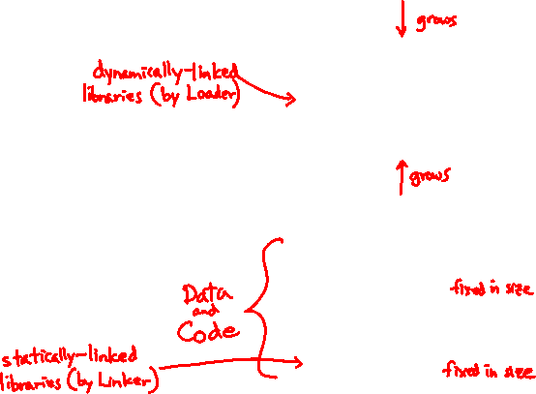
Loading
When the OS loads a program it:
Creates an address space
Inspects the executable file to see what’s in it
(Lazily) copies regions of the file into the right place in the address space
Does any final linking, relocation, or other needed preparation
0xFF…FF
OS kernel [protected]
Stack
Shared Libraries
Heap
Read/Write Segment .data, .bss
Read-Only Segment .text, .rodata
0x00…00
Notes:
.bss (block started by symbol) – statically-allocated variables that are not explicitly initialized to any value

Slide 7
Memory Management
0xFF…FF
OS kernel [protected]
Local variables on the Stack
Allocated and freed via calling conventions (push, pop, mov)
Global and static variables in Data
Allocated/freed when the process starts/exits
Dynamically-allocated data on the Heap
malloc() to request; free() to free, otherwise memory leak
Stack
Shared Libraries
Heap
Static Data
Literals
Instructions
0x00…00

Slide 8
Review: The Stack
Used to store data associated with function calls
Compiler-inserted code manages stack frames for you
Stack frame (x86-64) includes:
Address to return to
Saved registers
Based on calling conventions
Local variables
Argument build
Only if > 6 used
Caller
Frame
Arguments 7+
Return Address
%rbp
Old %rbp
Saved Registers
+
Local Variables
Callee
Frame
Arguments 7+
%rsp

Slide 9
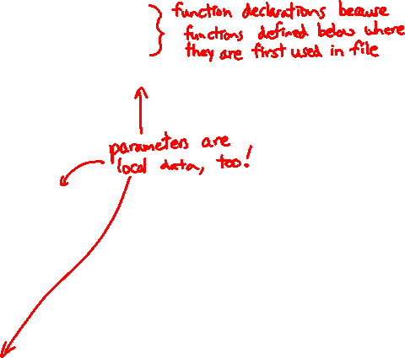
Stack in Action
Note: arrow points to next instruction to be executed (like in gdb).
stack.c
OS kernel [protected]
int32_t f(int32_t, int32_t);
int32_t g(int32_t);
int main(int argc, char** argv) {
int32_t n1 = f(3,-5);
n1 = g(n1);
return EXIT_SUCCESS;
}
int32_t f(int32_t p1, int32_t p2) {
int32_t x;
int32_t a[3];
...
x = g(a[2]);
return x;
}
int32_t g(int32_t param) {
return param * 2;
}
Stack
main argc, argv, n1
f p1, p2, x, a
g param
Heap
Read/Write Segment .data, .bss
Read-Only Segment .text, .rodata

Slide 10
Stack in Action
Note: arrow points to next instruction to be executed (like in gdb).
stack.c
OS kernel [protected]
int32_t f(int32_t, int32_t);
int32_t g(int32_t);
int main(int argc, char** argv) {
int32_t n1 = f(3,-5);
n1 = g(n1);
return EXIT_SUCCESS;
}
int32_t f(int32_t p1, int32_t p2) {
int32_t x;
int32_t a[3];
...
x = g(a[2]);
return x;
}
int32_t g(int32_t param) {
return param * 2;
}
Stack
main argc, argv, n1
f p1, p2, x, a
Heap
Read/Write Segment .data, .bss
Read-Only Segment .text, .rodata

Slide 11
Stack in Action
Note: arrow points to next instruction to be executed (like in gdb).
stack.c
OS kernel [protected]
int32_t f(int32_t, int32_t);
int32_t g(int32_t);
int main(int argc, char** argv) {
int32_t n1 = f(3,-5);
n1 = g(n1);
return EXIT_SUCCESS;
}
int32_t f(int32_t p1, int32_t p2) {
int32_t x;
int32_t a[3];
...
x = g(a[2]);
return x;
}
int32_t g(int32_t param) {
return param * 2;
}
Stack
main argc, argv, n1
g param
Heap
Read/Write Segment .data, .bss
Read-Only Segment .text, .rodata

Slide 12
Stack in Action
Note: arrow points to next instruction to be executed (like in gdb).
stack.c
OS kernel [protected]
int32_t f(int32_t, int32_t);
int32_t g(int32_t);
int main(int argc, char** argv) {
int32_t n1 = f(3,-5);
n1 = g(n1);
return EXIT_SUCCESS;
}
int32_t f(int32_t p1, int32_t p2) {
int32_t x;
int32_t a[3];
...
x = g(a[2]);
return x;
}
int32_t g(int32_t param) {
return param * 2;
}
Stack
main argc, argv, n1
Heap
Read/Write Segment .data, .bss
Read-Only Segment .text, .rodata

Slide 13
Lecture Outline
C’s Memory Model (refresher)
Pointers (refresher)
Arrays

Slide 14
Pointers
STYLE
TIP
Variables that store addresses
It points to somewhere in the process’ virtual address space
&foo produces the virtual address of foo
Generic definition: type* name; or type *name;
Recommended: do not define multiple pointers on same line: int *p1, p2; not the same as int *p1, *p2;
Instead, use:
Dereference a pointer using the unary * operator
Access the memory referred to by a pointer
type* name;
type *name;
int *p1, p2;
int *p1, *p2;
int *p1;
int *p2;

Slide 15
Pointer Example
pointy.c
#include <stdio.h>
#include <stdlib.h>
#include <stdint.h>
#include <inttypes.h>
int main(int argc, char** argv) {
int32_t x = 351;
int32_t* p; // p is a pointer to a int
p = &x; // p now contains the addr of x
printf("&x is %p\n", &x);
printf(" p is %p\n", p);
printf(" x is %" PRId32 "\n", x);
*p = 333; // change the value of x
printf(" x is %" PRId32 "\n", x);
return EXIT_SUCCESS;
}

Slide 16
Something Curious
What happens if we run pointy.c several times?
bash$ gcc –Wall –std=c11 –o pointy pointy.c
Run 1:
bash$ ./pointy
&x is 0x7ffff9e28524
p is 0x7ffff9e28524
x is 351
x is 333
Run 2:
bash$ ./pointy
&x is 0x7fffe847be34
p is 0x7fffe847be34
x is 351
x is 333
Run 3:
bash$ ./pointy
&x is 0x7fffe7b14644
p is 0x7fffe7b14644
x is 351
x is 333
Run 4:
bash$ ./pointy
&x is 0x7fffff0dfe54
p is 0x7fffff0dfe54
x is 351
x is 333

Slide 17
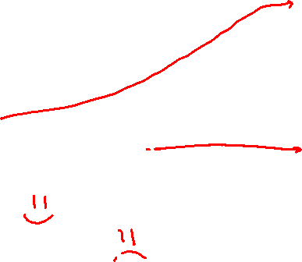
Address Space Layout Randomization
Linux uses address space layout randomization (ASLR) for added security
Randomizes:
Base of stack
Shared library (mmap) location
Makes Stack-based buffer overflow attacks tougher
Makes debugging tougher
Can be disabled (gdb does this by default); Google if curious
0xFF…FF
OS kernel [protected]
Stack
Shared Libraries
Heap
Read/Write Segment .data, .bss
Read-Only Segment .text, .rodata
0x00…00

Slide 18
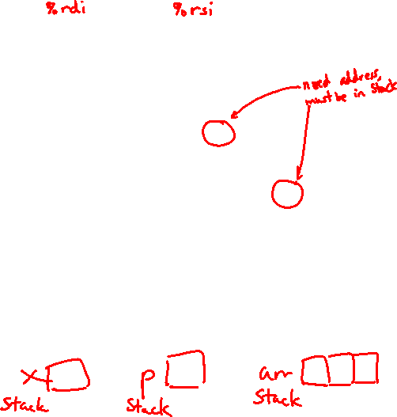
Box-and-Arrow Diagrams
boxarrow.c
int main(int argc, char** argv) {
int x = 1;
int arr[3] = {2, 3, 4};
int* p = &arr[1];
printf("&x: %p; x: %d\n", &x, x);
printf("&arr[0]: %p; arr[0]: %d\n", &arr[0], arr[0]);
printf("&arr[2]: %p; arr[2]: %d\n", &arr[2], arr[2]);
printf("&p: %p; p: %p; *p: %d\n", &p, p, *p);
return EXIT_SUCCESS;
}
address | name | value
Notes:
Draw out (ink) boxes for x, arr, and p. Where are these located?

Slide 19
Box-and-Arrow Diagrams
boxarrow.c
int main(int argc, char** argv) {
int x = 1;
int arr[3] = {2, 3, 4};
int* p = &arr[1];
printf("&x: %p; x: %d\n", &x, x);
printf("&arr[0]: %p; arr[0]: %d\n", &arr[0], arr[0]);
printf("&arr[2]: %p; arr[2]: %d\n", &arr[2], arr[2]);
printf("&p: %p; p: %p; *p: %d\n", &p, p, *p);
return EXIT_SUCCESS;
}
address | name | value
&x | x | value
&arr[2] | arr[2] | value
&arr[1] | arr[1] | value
&arr[0] | arr[0] | value
&p | p | value
stack frame for main()
Notes:
These are local variables, so located on the Stack in some ordering.
Let’s fill in the values.

Slide 20
Box-and-Arrow Diagrams
boxarrow.c
int main(int argc, char** argv) {
int x = 1;
int arr[3] = {2, 3, 4};
int* p = &arr[1];
printf("&x: %p; x: %d\n", &x, x);
printf("&arr[0]: %p; arr[0]: %d\n", &arr[0], arr[0]);
printf("&arr[2]: %p; arr[2]: %d\n", &arr[2], arr[2]);
printf("&p: %p; p: %p; *p: %d\n", &p, p, *p);
return EXIT_SUCCESS;
}
address | name | value
&x | x | 1
&arr[2] | arr[2] | 4
&arr[1] | arr[1] | 3
&arr[0] | arr[0] | 2
&p | p | &arr[1]
Notes:
Now let’s fill in the addresses.
Don’t forget about ASLR – address randomization!

Slide 21
Box-and-Arrow Diagrams
boxarrow.c
int main(int argc, char** argv) {
int x = 1;
int arr[3] = {2, 3, 4};
int* p = &arr[1];
printf("&x: %p; x: %d\n", &x, x);
printf("&arr[0]: %p; arr[0]: %d\n", &arr[0], arr[0]);
printf("&arr[2]: %p; arr[2]: %d\n", &arr[2], arr[2]);
printf("&p: %p; p: %p; *p: %d\n", &p, p, *p);
return EXIT_SUCCESS;
}
address | name | value
0x7fff…4c | x | 1
0x7fff…48 | arr[2] | 4
0x7fff…44 | arr[1] | 3
0x7fff…40 | arr[0] | 2
0x7fff…38 | p | 0x7fff…74
Notes:
Don’t forget about ASLR – address randomization!
Draw arrow from value of p to address of arr[1].

Slide 22
Inadvisable Pointer Examples 😱
inadvisable_pointers.c
// Leave them uninitialized!
int* int_ptr;
*int_ptr = 333;
// Use garbage values!
int_ptr = rand();
*int_ptr = 333;
// reinterpret raw bytes!
double d = 3.14;
int_ptr = (int*) &d;
*int_ptr = 333;
// Uninitialized!
int*** ippp;
***ippp = 333;
// Garbage values!
ippp = rand();
***ippp = 333;
// lol, typechecking
void* vp = (void*) ippp;
void** vpp = &vp;
vpp = vp;
“Pointers are just variables that contain memory addresses”
“Since pointers are variables, we can do all these things recursively!”

Slide 23
Lecture Outline
C’s Memory Model (refresher)
Pointers (refresher)
Arrays

Slide 24
Basic Data Structures
C does not support objects!!!
Arrays are contiguous chunks of memory
Arrays have no methods and do not know their own length
Can easily run off ends of arrays in C – security bugs!!!
Strings are null-terminated char arrays
Strings have no methods, but string.h has helpful utilities
Structs are the most object-like feature, but are just collections of fields – no “methods” or functions
char* x = "hello\n";
x $→$ | h | e | l | l | o | \n | \0

Slide 25
Arrays
Definition: type name[size]
Allocates size*sizeof(type) bytes of contiguous memory
Normal usage is a compile-time constant for size (e.g. int32_t scores[175];)
Initially, array values are “garbage”
Size of an array
Not stored anywhere – array does not know its own size!
sizeof(array) only works in variable scope of array definition
Recent versions of C (but not C++) allow for variable-length arrays
Uncommon and can be considered bad practice [we won’t use]
type name[size]
int32_t n = 175;
int32_t scores[n]; // OK in C99
Notes:
Can also declare variables using extern in the global scope.
Variable-length arrays: https://gcc.gnu.org/onlinedocs/gcc/Variable-Length.html

Slide 26
Using Arrays
Initialization: type name[size] = {val0,…,valN};
{} initialization can only be used at time of definition
If no size supplied, infers from length of array initializer
Array name used as identifier for “collection of data”
name[index] specifies an element of the array and can be used as an assignment target or as a value in an expression
Array name (by itself) evaluates to the address of the start of the array
Cannot be assigned to / changed
type name[size] = {val0,…,valN};
int32_t primes[6] = {2, 3, 5, 6, 11, 13};
primes[3] = 7;
primes[100] = 0; // memory smash!
Notes:
Initialization special cases:
If supplied values shorter than size, fill with zeros
If supplied values longer than size, ignore values that don’t fit (compiler gives a warning: excess elements in array initializer)

Slide 27
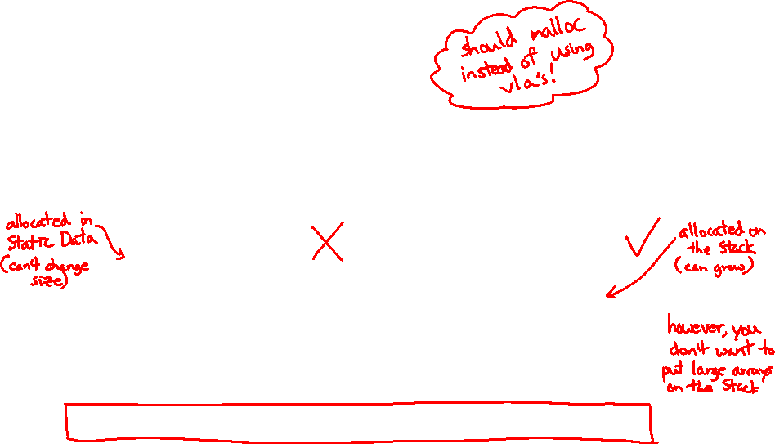
Challenge Question
The code snippets both use a variable-length array. What will happen when we compile with C99?
Vote at http://PollEv.com/justinh
Compiler Error Compiler Error
Compiler Error No Error
No Error Compiler Error
No Error No Error
We’re lost…
int32_t m = 175;
int32_t scores[m];
void foo(int32_t n) {
...
}
int32_t m = 175;
void foo(int32_t n) {
int32_t scores[n];
...
}
Notes:
Try to compile vla.c in both cases.
Running clint.py will give a warning about variable-length arrays.

Slide 28
Multi-dimensional Arrays
Generic 2D format: type name[rows][cols] = {{values},…,{values}};
Still allocates a single, contiguous chunk of memory
C is row-major
// a 2-row, 3-column array of doubles
double grid[2][3];
// a 3-row, 5-column array of ints
int32_t matrix[3][5] = {
{0, 1, 2, 3, 4},
{0, 2, 4, 6, 8},
{1, 3, 5, 7, 9}
};

Slide 29
Arrays as Parameters
It’s tricky to use arrays as parameters
What happens when you use an array name as an argument?
Recall: arrays do not know their own size
// prototype
int32_t sumAll(int32_t a[]);
int main(int argc, char** argv) {
int32_t numbers[] = {9, 8, 1, 9, 5};
int32_t sum = sumAll(numbers);
return EXIT_SUCCESS;
}
int32_t sumAll(int32_t a[]) {
int32_t i, sum = 0;
for (i = 0; i < ...???
}

Slide 30
Solution 1: Declare Array Size
Problem: loss of generality/flexibility
// prototype
int32_t sumAll(int32_t a[5]);
int main(int argc, char** argv) {
int32_t numbers[] = {9, 8, 1, 9, 5};
int32_t sum = sumAll(numbers);
printf("sum is: %" PRId32 "\n", sum);
return EXIT_SUCCESS;
}
int32_t sumAll(int32_t a[5]) {
int32_t i, sum = 0;
for (i = 0; i < 5; i++) {
sum += a[i];
}
return sum;
}

Slide 31
Solution 2: Pass Size as Parameter
STYLE
TIP
// prototype
int32_t sumAll(int32_t a[], int size);
int main(int argc, char** argv) {
int32_t numbers[] = {9, 8, 1, 9, 5};
int32_t sum = sumAll(numbers, 5);
printf("sum is: %" PRId32 "\n", sum);
return EXIT_SUCCESS;
}
int32_t sumAll(int32_t a[], int size) {
int32_t i, sum = 0;
for (i = 0; i < size; i++) {
sum += a[i];
}
return sum;
}
arraysum.c
This is the standard idiom in C programs

Slide 32
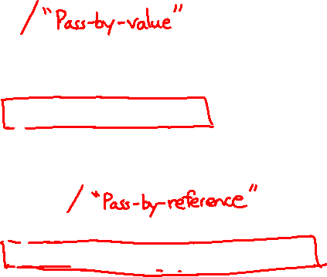
Parameters: reference vs. value
There are two fundamental parameter-passing schemes in programming languages
Call-by-value
Parameter is a local variable initialized with a copy of the calling argument when the function is called; manipulating the parameter only changes the copy, not the calling argument
C, Java, C++ (most things)
Call-by-reference
Parameter is an alias for the supplied argument; manipulating the parameter manipulates the calling argument
C++ references (we’ll see more later)
Notes:
It’s more important to understand the mechanics of what’s going on.

Slide 33
Arrays: Call-By-Value or Call-By-Reference?
Technical answer: a T[] array parameter is “decayed” to a pointer of type T*, and the pointer is passed by value
So it acts like a call-by-reference array (if callee changes the array parameter elements it changes the caller’s array)
But it’s really a call-by-value pointer (the callee can change the pointer parameter to point to something else(!))
void copyArray(int32_t src[], int32_t dst[], int32_t size) {
int32_t i;
int32_t copy[size]; // OK in C99, still stylistically bad
for (i = 0; i < size; i++) {
copy[i] = src[i];
}
dst = copy; // doesn’t change caller’s array
}

Slide 34
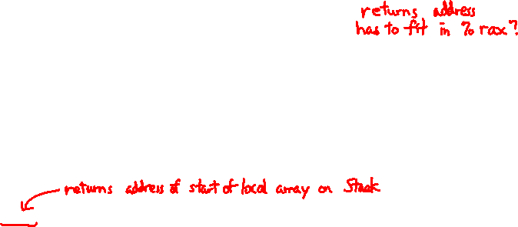
Returning an Array
Local variables, including arrays, are allocated on the Stack
They “disappear” when a function returns!
Can’t safely return local arrays from functions
Can’t return an array as a return value – why not?
int32_t* copyArray(int32_t src[], int32_t size) {
int32_t i, dst[size]; // OK in C99
for (i = 0; i < size; i++) {
dst[i] = src[i];
}
return dst; // no compiler error, but wrong!
}
buggy_copyarray.c
Notes:
Recommend playing around with buggy_copyarray.c – problematic for other reasons as well (attempt to assign to an array variable).

Slide 35
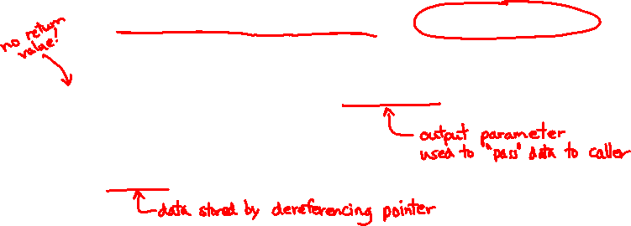
Solution: Output Parameter
Create the “returned” array in the caller
Pass it as an output parameter to copyarray()
A pointer parameter that allows the called function to store values that the caller can use
Works because arrays are “passed” as pointers
“Feels” like call-by-reference, but technically it’s not
void copyArray(int32_t src[], int32_t dst[], int32_t size) {
int32_t i;
for (i = 0; i < size; i++) {
dst[i] = src[i];
}
}
copyarray.c
Notes:
REALLY STRESS THIS!

Slide 36
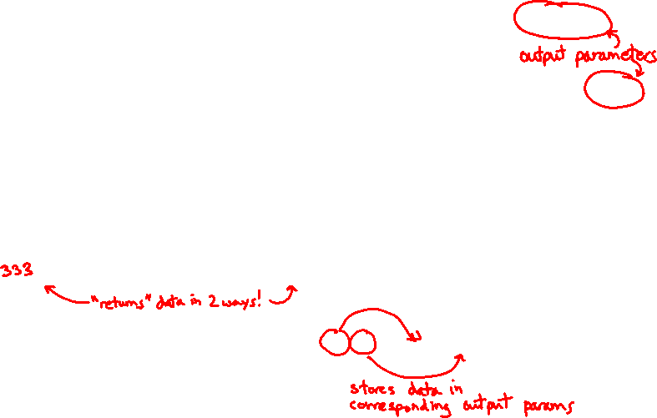
Output Parameters
Output parameters are common in library functions
long int strtol(char* str, char** endptr, int base);
int sscanf(char* str, char* format, ...);
int32_t num, i;
char *pEnd, *str1 = "333 rocks";
char str2[10];
// converts "333 rocks" into long -- pEnd is conversion end
num = (int) strtol(str1, &pEnd, 10);
// reads string into arguments based on format string
num = sscanf("3 blind mice", "%d %s", &i, str2);
outparam.c
Notes:
Leaving off const for brevity.
http://www.cplusplus.com/reference/cstdio/sscanf/
http://www.cplusplus.com/reference/cstdlib/strtol/

Slide 37
Extra Exercises
Some lectures contain “Extra Exercise” slides
Extra practice for you to do on your own without the pressure of being graded
You may use libraries and helper functions as needed
Early ones may require reviewing 351 material or looking at documentation for things we haven’t reviewed in 333 yet
Always good to provide test cases in main()
Solutions for these exercises will be posted on the course website
You will get the most benefit from implementing your own solution before looking at the provided one

Slide 38
Extra Exercise #1
Write a function that:
Accepts an array of 32-bit unsigned integers and a length
Reverses the elements of the array in place
Returns nothing (void)

Slide 39
Extra Exercise #2
Write a function that:
Accepts a string as a parameter
Returns:
The first white-space separated word in the string as a newly-allocated string
AND the size of that word

