Slide 1
Concurrency: Processes
CSE 333 Spring 2020
Instructor: Hal Perkins
Teaching Assistants:
Ramya Challa Mengqi Chen John Depaszthory
Greg Guo Zachary Keyes CJ Lin
Travis McGaha Arjun Singh Guramrit Singh
Cosmo Wang Yifan Xu Robin Yang
Haoran Yu Velocity Yu

Slide 2
Administrivia
hw4 due Thur. night
  (Plus late days – max 2 – if you have them)
Please nominate great TAs for the Bandes award
Please fill out course evals while they are available
  Try to get to the extra questions at the end about this unusual online quarter – thanks
Wrapup class on Friday. What about Wednesday?
Current situation: how to we react?

Slide 3
Outline
searchserver
  Sequential
  Concurrent via forking threads – pthread_create()
  Concurrent via forking processes – fork()
  Concurrent via non-blocking, event-driven I/O – select()
    We won’t get to this ☹
Reference: Computer Systems: A Programmer’s Perspective, Chapter 12 (CSE 351 book)

Slide 4
Creating New Processes
  Creates a new process (the “child”) that is an exact clone* of the current process (the “parent”)
    *Everything is cloned except threads: variables, file descriptors, open sockets, the virtual address space (code, globals, heap, stack), etc.
  Primarily used in two patterns:
    Servers: fork a child to handle a connection
    Shells: fork a child that then exec’s a new program
pid_t fork(void);

Slide 5
fork() and Address Spaces
0xFF…FF
OS kernel [protected]
A process executes within an address space
  Includes segments for different parts of memory
  Process tracks its current state using the stack pointer (SP) and program counter (PC)
Stack
SP
Shared Libraries
Heap (malloc/free)
Read/Write Segment
.data, .bss
Read-Only Segment
.text, .rodata
PC
0x00…00

Slide 6
fork() and Address Spaces
OS kernel [protected]
OS kernel [protected]
Fork cause the OS to clone the
address space
  The copies of the memory segments are (nearly) identical
  The new process has copies of the parent’s data, stack-allocated variables, open file descriptors, etc.
Stack
Stack
SP
SP
Shared Libraries
Shared Libraries
Heap (malloc/free)
Heap (malloc/free)
Read/Write Segment
.data, .bss
Read/Write Segment
.data, .bss
Read-Only Segment
.text, .rodata
Read-Only Segment
.text, .rodata
PC
PC
PARENT
fork()
CHILD

Slide 7
fork()
fork() has peculiar semantics
  The parent invokes fork()
  The OS clones the parent
  Both the parent and the child return from fork
    Parent receives child’s pid
    Child receives a 0
parent
fork()
OS

Slide 8
fork()
fork() has peculiar semantics
  The parent invokes fork()
  The OS clones the parent
  Both the parent and the child return from fork
    Parent receives child’s pid
    Child receives a 0
parent
child
clone
OS

Slide 9
fork()
fork() has peculiar semantics
  The parent invokes fork()
  The OS clones the parent
  Both the parent and the child return from fork
    Parent receives child’s pid
    Child receives a 0
See fork_example.cc
parent
child
child pid
0
OS

Slide 10
Concurrent Server with Processes
The parent process blocks on accept(), waiting for a new client to connect
  When a new connection arrives, the parent calls fork() to create a child process
  The child process handles that new connection and exit()’s when the connection terminates
Remember that children become “zombies” after death
  Option A: Parent calls wait() to “reap” children
  Option B: Use a double-fork trick

Slide 11
Double-fork Trick
server

Slide 12
Double-fork Trick
client
connect
server
accept()

Slide 13
Double-fork Trick
client
server
fork() child
server
Notes:
Because fork() copies file descriptors, child has connection to client, too.

Slide 14
Double-fork Trick
client
server
fork() grandchild
server
server

Slide 15
Double-fork Trick
client
server
child exit()’s / parent wait()’s
server

Slide 16
Double-fork Trick
client
server
server
parent closes its
client connection

Slide 17
Double-fork Trick
client
server
server

Slide 18
Double-fork Trick
client
server
server
fork() child
server
fork() grandchild
exit()
client
server

Slide 19
Double-fork Trick
client
server
server
client
server

Slide 20
Double-fork Trick
client
server
client
server
client
server
server
client
server
client
server
client
server
client
server
client
server
client
server

Slide 21
Peer Instruction Question
What will happen when one of the grandchildren processes finishes?
A. Zombie until grandparent exits
B. Zombie until grandparent reaps
C. Zombie until init reaps
D. ZOMBIE FOREVER!!!
E. We’re lost…

Slide 22
Concurrent with Processes
See searchserver_processes/

Slide 23
Whither Concurrent Processes?
Advantages:
  Almost as simple to code as sequential
    In fact, most of the code is identical!
  Concurrent execution leads to better CPU, network utilization
Disadvantages:
  Processes are heavyweight
    Relatively slow to fork
    Context switching latency is high
  Communication between processes is complicated

Slide 24
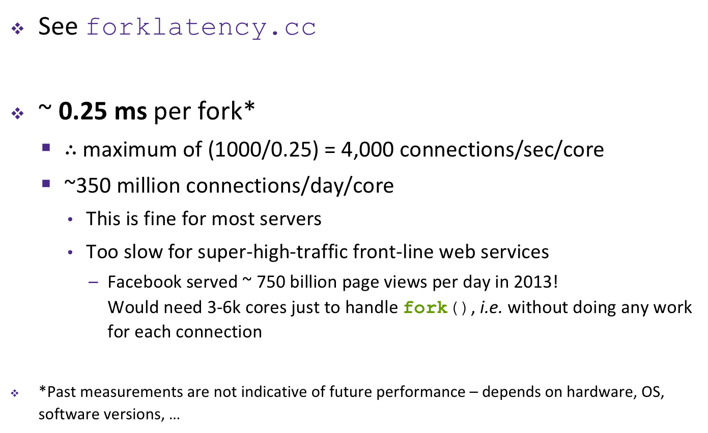
How Fast is fork()?
See forklatency.cc
~ 0.25 ms per fork*
  $∴$ maximum of (1000/0.25) = 4,000 connections/sec/core
  ~350 million connections/day/core
    This is fine for most servers
    Too slow for super-high-traffic front-line web services
      Facebook served ~ 750 billion page views per day in 2013!
      Would need 3-6k cores just to handle fork(), i.e. without doing any work for each connection
*Past measurements are not indicative of future performance – depends on hardware, OS, software versions, …

Slide 25
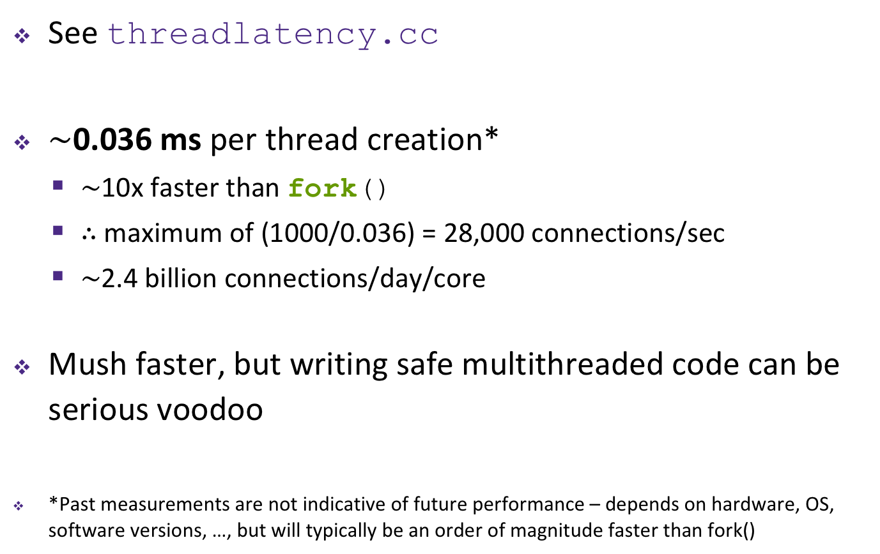
How Fast is pthread_create()?
See threadlatency.cc
$\sim$0.036 ms per thread creation*
  $\sim$10x faster than fork()
  $∴$ maximum of (1000/0.036) = 28,000 connections/sec
  $\sim$2.4 billion connections/day/core
Mush faster, but writing safe multithreaded code can be serious voodoo
*Past measurements are not indicative of future performance – depends on hardware, OS, software versions, …, but will typically be an order of magnitude faster than fork()

Slide 26
Aside: Thread Pools
In real servers, we’d like to avoid overhead needed to create a new thread or process for every request
Idea: Thread Pools:
  Create a fixed set of worker threads or processes on server startup and put them in a queue
  When a request arrives, remove the first worker thread from the queue and assign it to handle the request
  When a worker is done, it places itself back on the queue and then sleeps until dequeued and handed a new request

