Slide 1
Networking Introduction
CSE 333 Spring 2020
Instructor: Hal Perkins
Teaching Assistants:
Ramya Challa Mengqui Chen John Depaszthory
Greg Guo Zachary Keyes CJ Lin
Travis McGaha Arjun Singh Guramrit Singh
Cosmo Wang Yifan Xu Robin Yang
Haoran Yu Velocity Yu

Slide 2
Administrivia
No exercises due for a while!
  First networking exercise out next Thursday, due following Monday
    DNS and TCP client-side (covered in class/sections next week); somewhat longer than usual exercise, but good warmup for hw4
hw3 due next Thursday night
  Usual reminders: don’t forget to tag, then be sure to clone elsewhere and recompile / retest
  Usual latedays apply (if you have any left – be sure to check)

Slide 3
Administrivia
Rest of the quarter:
  Topics: Networking; Concurrency, Processes, and Threads
  A few more exercises (~3)
    Networking client side, server side, concurrency
  hw4: file-search web server
    Out next week; due Thursday, June 4 (last week of classes)
    Demo in class next week

Slide 4

Lecture Outline
Introduction to Networks
  Layers upon layers upon layers…

Slide 5


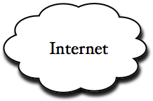




Networks From 10,000 ft
clients
servers

Slide 6
The Physical Layer
Individual bits are modulated onto a wire or transmitted over radio
  Physical layer specifies how bits are encoded at a signal level
  Many choices, e.g., encode “1” as +1v, “0” as -0v; or “0”=+1v, “1”=-1v, …
0 1 0 1
computer
computer
copper wire
optical cable
radio frequency band
NIC
NIC
physical
physical
Notes:
NIC = network interface controller

Slide 7
The Data Link Layer
Multiple computers on a LAN contend for the network medium
  Media access control (MAC) specifies how computers cooperate
  Link layer also specifies how bits are “packetized” and network interface controllers (NICs) are addressed
00:1d:4f:47:0d:48
4c:44:1e:8f:12:0e
7a:37:8e:fc:1a:ea
de:ad:be:ef:ca:fe
01:23:32:10:ab:ba
computer
computer
computer
computer
computer
NIC
NIC
NIC
NIC
NIC
ethernet
destination address | source address | data
ethernet header |  | ethernet payload
data link
data link
physical
physical
Notes:
https://en.wikipedia.org/wiki/MAC_address

Slide 8
The Network Layer (IP)
Internet Protocol (IP) routes packets across multiple networks
  Every computer has a unique IP address
  Individual networks are connected by routers that span networks
128.95.10.55
128.95.10.72
128.95.10.95
host
host
host
128.95.10.1
ethernet
router
128.95.4.1
ethernet
host
host
host
network
network
128.95.4.3
128.95.4.10
128.95.4.12
data link
data link
physical
physical

Slide 9
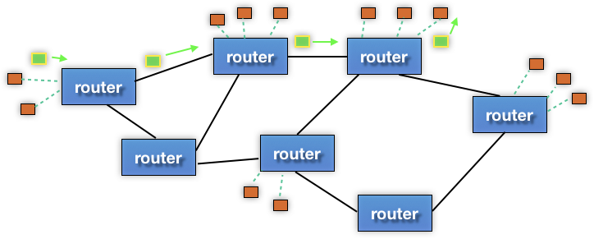
The Network Layer (IP)
There are protocols to:
  Let a host map an IP to MAC address on the same network
  Let a router learn about other routers to get IP packets one step closer to their destination
destination
source
network
network
network
data link
data link
data link
physical
physical
physical

Slide 10
The Network Layer (IP)
Packet encapsulation:
  An IP packet is encapsulated as the payload of an Ethernet frame
  As IP packets traverse networks, routers pull out the IP packet from an Ethernet frame and plunk it into a new one on the next network
IP header | IP payload
destination address | source address | data
ethernet header |  | ethernet payload
network
network
network
data link
data link
data link
physical
physical
physical

Slide 11
The Transport Layer (TCP)
Transmission Control Protocol (TCP):
  Provides applications with reliable, ordered, congestion-controlled byte streams
    Sends stream data as multiple IP packets (differentiated by sequence numbers) and retransmits them as necessary
    When receiving, puts packets back in order and detects missing packets
  A single host (IP address) can have up to 2¹⁶ = 65,535 “ports”
    Kind of like an apartment number at a postal address (your applications are the residents who get mail sent to an apt. #)
transport
transport
network
network
network
data link
data link
data link
physical
physical
physical
Notes:
Useful analogy: How would you send a book by mail via postcards? (postal service stops delivering packages – only letters & postcards)
Split the book into multiple postcards, marking each with a sequence number for ordering.
Send each one-by-one through the mail.
Receiver sends back postcards to acknowledge receipt and indicate which got lost in the mail.
https://en.wikipedia.org/wiki/List_of_TCP_and_UDP_port_numbers#Well-known_ports

Slide 12
The Transport Layer (TCP)
Packet encapsulation – one more nested layer!
src, dst, port |  | TCP payload
+ seq #
TCP header | TCP chunk 1
TCP header | TCP chunk 2
IP header | IP payload
IP header | IP payload
ethernet header | ethernet payload
ethernet header | ethernet payload
transport
transport
network
network
network
data link
data link
data link
physical
physical
physical

Slide 13
The Transport Layer (TCP)
Applications use OS services to establish TCP streams:
  The “Berkeley sockets” API
    A set of OS system calls
  Clients connect() to a server IP address + application port number
  Servers listen() for and accept() client connections
  Clients and servers read() and write() data to each other
transport
transport
network
network
network
data link
data link
data link
physical
physical
physical
Notes:
BSD – Berkeley Software Distribution

Slide 14
The Transport Layer (UDP)
User Datagram Protocol (UDP):
  Provides applications with unreliable packet delivery
  UDP is a really thin, simple layer on top of IP
    Datagrams still are fragmented into multiple IP packets
transport
transport
network
network
network
data link
data link
data link
physical
physical
physical
Notes:
BSD – Berkeley Software Distribution

Slide 15
The (Mostly Missing) Layers 5 & 6
Layer 5: Session Layer
  Supposedly handles establishing and terminating application sessions
  Remote Procedure Call (RPC) kind of fits in here
Layer 6: Presentation Layer
  Supposedly maps application-specific data units into a more network-neutral representation
  Encryption (SSL) kind of fits in here
presentation
presentation
session
session
transport
transport
network
network
network
data link
data link
data link
physical
physical
physical
Notes:
Open Systems Interconnection (OSI) is an effort to standardize computer networking that was started in 1977.
https://en.wikipedia.org/wiki/OSI_model

Slide 16
The Application Layer
Application protocols
  The format and meaning of messages between application entities
  Example: HTTP is an application-level protocol that dictates how web browsers and web servers communicate
    HTTP is implemented on top of TCP streams
application
application
presentation
presentation
session
session
transport
transport
network
network
network
data link
data link
data link
physical
physical
physical

Slide 17
The Application Layer
Packet encapsulation:
HTTP header | HTTP payload (e.g. chunk of HTML page)
TCP header | TCP payload
IP header | IP payload
destination address | source address | data
ethernet header |  | ethernet payload

Slide 18
The Application Layer
Packet encapsulation:
ethernet header | IP header | TCP header | HTTP header | HTTP payload (e.g. chunk of HTML page)

Slide 19
The Application Layer
Popular application-level protocols:
  DNS: translates a domain name (e.g. www.google.com) into one or more IP addresses (e.g. 74.125.197.106)
    Domain Name System
    An hierarchy of DNS servers cooperate to do this
  HTTP: web protocols
    Hypertext Transfer Protocol
  SMTP, IMAP, POP: mail delivery and access protocols
    Secure Mail Transfer Protocol, Internet Message Access Protocol, Post Office Protocol
  SSH: secure remote login protocol
    Secure Shell
  bittorrent: peer-to-peer, swarming file sharing protocol

Slide 20
netcat demo (if time)
netcat (nc) is “a computer networking utility for reading from and writing to network connections using TCP or UDP”
  https://en.wikipedia.org/wiki/Netcat
  Listen on port: nc -l <port>
  Connect: nc <IPaddr> <port>
    Local host: 127.0.0.1

Slide 21
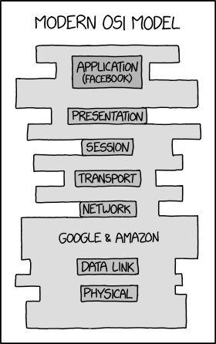
The Future of Networking?

