Slide 1
Build Tools (make)
CSE 333 Spring 2020
Instructor: Hal Perkins
Teaching Assistants:
Ramya Challa Mengqui Chen John Depaszthory
Greg Guo Zachary Keyes CJ Lin
Travis McGaha Arjun Singh Guramrit Singh
Cosmo Wang Yifan Xu Robin Yang
Haoran Yu Velocity Yu

Slide 2
Lecture Outline
Make and Build Tools

Slide 3
make
make is a classic program for controlling what gets (re)compiled and how
  Many other such programs exist (e.g. ant, maven, IDE “projects”)
make has tons of fancy features, but only two basic ideas:
  Scripts for executing commands
  Dependencies for avoiding unnecessary work
To avoid “just teaching make features” (boring and narrow), let’s focus more on the concepts…

Slide 4
Building Software
Programmers spend a lot of time “building”
  Creating programs from source code
  Both programs that they write and other people write
Programmers like to automate repetitive tasks
  Repetitive: gcc -Wall -g -std=c11 -o widget foo.c bar.c baz.c
    Retype this every time: 😭
    Use up-arrow or history: 😐 (still retype after logout)
    Have an alias or bash script: 🙂
    Have a Makefile: 😊 (you’re ahead of us)

Slide 5
“Real” Build Process
On larger projects, you can’t or don’t want to have one big (set of) command(s) that redoes everything every time you change anything:
  If gcc didn’t combine steps for you, you’d need to preprocess, compile, and link on your own (along with anything you used to generate the C files)
  If source files have multiple outputs (e.g. javadoc), you’d have to type out the source file name(s) multiple times
  You don’t want to have to document the build logic when you distribute source code
  You don’t want to recompile everything every time you change something (especially if you have 10⁵-10⁷ files of source code)
A script can handle 1-3 (use a variable for filenames for 2), but 4 is trickier

Slide 6
An Example
We have a small program that is split into multiple tiny modules (code on the web linked to this lecture):
Modules:
  speak.h/speak.c: write a string to stdout
  shout.h/shout.c: write a string to stdout LOUDLY
  main.c: client program
Demo: build this program incrementally, and recompile only necessary parts when something changes
How do we automate this “minimal rebuild”?
main.c
speak.h
speak.c
shout.h
shout.c

Slide 7
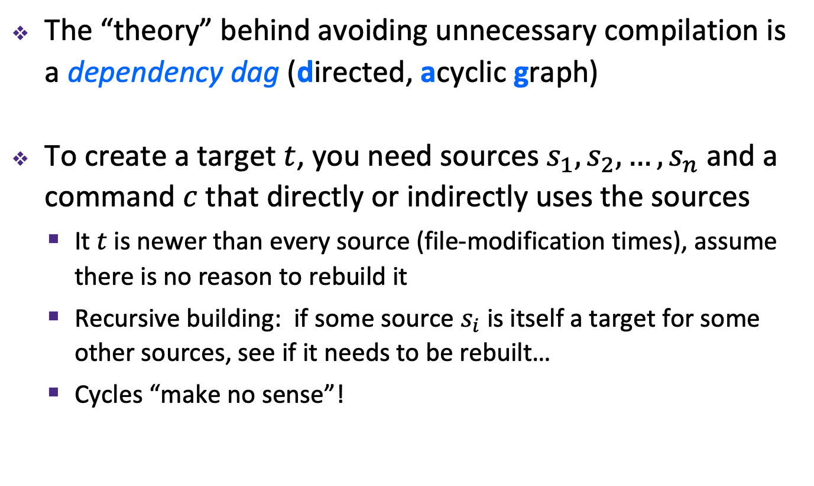
Recompilation Management
The “theory” behind avoiding unnecessary compilation is a dependency dag (directed, acyclic graph)
To create a target $t$, you need sources $s_{1}, s_{2}, …, s_{n}$ and a command $c$ that directly or indirectly uses the sources
  It $t$ is newer than every source (file-modification times), assume there is no reason to rebuild it
  Recursive building: if some source $s_{i}$ is itself a target for some other sources, see if it needs to be rebuilt…
  Cycles “make no sense”!

Slide 8
Theory Applied to Our Example
What are the dependencies between built and source files?
What needs to be rebuilt if something changes?
main.c
speak.h
speak.c
shout.h
shout.c
main.o
speak.o
shout.o
talk

Slide 9

make Basics
A makefile contains a bunch of triples:
  Colon after target is required
  Command lines must start with a TAB, NOT SPACES
  Multiple commands for same target are executed in order
    Can split commands over multiple lines by ending lines with ‘\’
Example:
Demo: look at Makefile for our example program
target: sources
command
$←$ Tab $→$
foo.o: foo.c foo.h bar.h
gcc -Wall -o foo.o -c foo.c

Slide 10
Using make
Defaults:
  If no -f specified, use a file named Makefile
  If no target specified, will use the first one in the file
  Will interpret commands in your default shell
    Set SHELL variable in makefile to ensure
Target execution:
  Check each source in the source list:
    If the source is a target in the Makefile, then process it recursively
    If some source does not exist, then error
    If any source is newer than the target (or target does not exist), run command (presumably to update the target)
bash% make -f <makefileName> target
Notes:
Configure needs to figure things out like “where is the compiler?”.

Slide 11
make Variables
You can define variables in a makefile:
  All values are strings of text, no “types”
  Variable names are case-sensitive and can’t contain ‘:’, ‘#’, ‘=’, or whitespace
Example:
Advantages:
  Easy to change things (especially in multiple commands)
  Can also specify on the command line (CC=clang FLAGS=-g)
CC = gcc
CFLAGS = -Wall -std=c11
foo.o: foo.c foo.h bar.h
$(CC) $(CFLAGS) -o foo.o -c foo.c

Slide 12
More Variables
It’s common to use variables to hold list of filenames:
clean is a convention
  Remove generated files to “start over” from just the source
  It’s “funny” because the target doesn’t exist and there are no sources, but it works because:
    The target doesn’t exist, so it must be “remade” by running the command
    These “phony” targets have several uses, such as “all”…
OBJFILES = foo.o bar.o baz.o
widget: $(OBJFILES)
gcc -o widget $(OBJFILES)
clean:
rm $(OBJFILES) widget *~

Slide 13
“all” Example
all: prog B.class someLib.a
# notice no commands this time
prog: foo.o bar.o main.o
gcc –o prog foo.o bar.o main.o
B.class: B.java
javac B.java
someLib.a: foo.o baz.o
ar r foo.o baz.o
foo.o: foo.c foo.h header1.h header2.h
gcc -c -Wall foo.c
# similar targets for bar.o, main.o, baz.o, etc...

Slide 14
Revenge of the Funny Characters
Special variables:
  $@ for target name
  $^ for all sources
  $< for left-most source
  Lots more! – see the documentation
Examples:
# CC and CFLAGS defined above
widget: foo.o bar.o
$(CC) $(CFLAGS) -o $@ $^
foo.o: foo.c foo.h bar.h
$(CC) $(CFLAGS) -c $<

Slide 15
And more…
There are a lot of “built-in” rules – see documentation
There are “suffix” rules and “pattern” rules
  Example:
Remember that you can put any shell command – even whole scripts!
You can repeat target names to add more dependencies
Often this stuff is more useful for reading makefiles than writing your own (until some day…)
%.class: %.java
javac $< # we need the $< here

Slide 16
Theory Applied to C
Compiling a .c creates a .o – the .o depends on the .c and all included files (.h, recursively/transitively)
foo.h
foo.c
bar.c
Source files
Statically-linked
libraries
libZ.a
foo.o
bar.o
Object files
bar
Executable

Slide 17
Theory Applied to C
Compiling a .c creates a .o – the .o depends on the .c and all included files (.h, recursively/transitively)
An archive (library, .a) depends on included .o files
foo.h
foo.c
bar.c
Source files
Statically-linked
libraries
libZ.a
foo.o
bar.o
Object files
bar
Executable

Slide 18
Theory Applied to C
Compiling a .c creates a .o – the .o depends on the .c and all included files (.h, recursively/transitively)
An archive (library, .a) depends on included .o files
Creating an executable (“linking”) depends on .o files and archives
  Archives linked by -L<path> -l<name>
  (e.g. -L. -lfoo to get libfoo.a from current directory)
foo.h
foo.c
bar.c
Source files
Statically-linked
libraries
libZ.a
foo.o
bar.o
Object files
bar
Executable

Slide 19
Theory Applied to C
If one .c file changes, just need to recreate one .o file, maybe a library, and re-link
If a .h file changes, may need to rebuild more
Many more possibilities!
foo.h
foo.c
bar.c
Source files
Statically-linked
libraries
libZ.a
foo.o
bar.o
Object files
bar
Executable

Slide 20
Extra Exercise #1
Modify the linked list code from Lecture 5 Extra Exercise #1
  Add static declarations to any internal functions you implemented in linkedlist.h
  Add a header guard to the header file
  Write a Makefile
    Use Google to figure out how to add rules to the Makefile to produce a library (liblinkedlist.a) that contains the linked list code

