Slide 1
Data Structures and Modules
CSE 333 Spring 2018
Instructor: Justin Hsia
Teaching Assistants:
Danny Allen Dennis Shao Eddie Huang
Kevin Bi Jack Xu Matthew Neldam
Michael Poulain Renshu Gu Robby Marver
Waylon Huang Wei Lin

Slide 2
Administrivia
Exercise 3 was due this morning
Exercise 4 out today and due Friday morning
Exercise 5 will rely on material covered in Section 2
  Released Thursday afternoon instead
Homework 1 due in a week
  Advice: be sure to read headers carefully while implementing
  Advice: use git add/commit/push often to save your work

Slide 3
Lecture Outline
Implementing Data Structures in C
Multi-file C Programs
  C Preprocessor Intro

Slide 4

Simple Linked List in C
Each node in a linear, singly-linked list contains:
  Some element as its payload
  A pointer to the next node in the linked list
    This pointer is NULL (or some other indicator) in the last node in the list
Element Z
Element Y
Element X
$$∅$$
head

Slide 5

Linked List Node
Let’s represent a linked list node with a struct
  For now, assume each element is an int
#include <stdio.h>
typedef struct node_st {
int element;
struct node_st* next;
} Node;
int main(int argc, char** argv) {
Node n1, n2;
n1.element = 1;
n1.next = &n2;
n2.element = 2;
n2.next = NULL;
return 0;
}
element
next
n1
1
element
next
n2
2
$$∅$$
manual_list.c

Slide 6

Push Onto List
Arrow points to
next instruction.
typedef struct node_st {
int element;
struct node_st* next;
} Node;
Node* Push(Node* head, int e) {
Node* n = (Node*) malloc(sizeof(Node));
assert(n != NULL); // crashes if false
n->element = e;
n->next = head;
return n;
}
int main(int argc, char** argv) {
Node* list = NULL;
list = Push(list, 1);
list = Push(list, 2);
return 0;
}
(main) list
$$∅$$
push_list.c

Slide 7

Push Onto List
Arrow points to
next instruction.
typedef struct node_st {
int element;
struct node_st* next;
} Node;
Node* Push(Node* head, int e) {
Node* n = (Node*) malloc(sizeof(Node));
assert(n != NULL); // crashes if false
n->element = e;
n->next = head;
return n;
}
int main(int argc, char** argv) {
Node* list = NULL;
list = Push(list, 1);
list = Push(list, 2);
return 0;
}
(main) list
$$∅$$
(Push) head
$$∅$$
(Push) e
1
(Push) n
element
next
push_list.c

Slide 8
Push Onto List
Arrow points to
next instruction.
typedef struct node_st {
int element;
struct node_st* next;
} Node;
Node* Push(Node* head, int e) {
Node* n = (Node*) malloc(sizeof(Node));
assert(n != NULL); // crashes if false
n->element = e;
n->next = head;
return n;
}
int main(int argc, char** argv) {
Node* list = NULL;
list = Push(list, 1);
list = Push(list, 2);
return 0;
}
(main) list
$$∅$$
(Push) head
$$∅$$
(Push) e
1
(Push) n
element
next
push_list.c

Slide 9
Push Onto List
Arrow points to
next instruction.
typedef struct node_st {
int element;
struct node_st* next;
} Node;
Node* Push(Node* head, int e) {
Node* n = (Node*) malloc(sizeof(Node));
assert(n != NULL); // crashes if false
n->element = e;
n->next = head;
return n;
}
int main(int argc, char** argv) {
Node* list = NULL;
list = Push(list, 1);
list = Push(list, 2);
return 0;
}
(main) list
$$∅$$
(Push) head
$$∅$$
(Push) e
1
(Push) n
element
next
push_list.c

Slide 10
Push Onto List
Arrow points to
next instruction.
typedef struct node_st {
int element;
struct node_st* next;
} Node;
Node* Push(Node* head, int e) {
Node* n = (Node*) malloc(sizeof(Node));
assert(n != NULL); // crashes if false
n->element = e;
n->next = head;
return n;
}
int main(int argc, char** argv) {
Node* list = NULL;
list = Push(list, 1);
list = Push(list, 2);
return 0;
}
(main) list
$$∅$$
(Push) head
$$∅$$
(Push) e
1
(Push) n
element
next
1
push_list.c

Slide 11
Push Onto List
Arrow points to
next instruction.
typedef struct node_st {
int element;
struct node_st* next;
} Node;
Node* Push(Node* head, int e) {
Node* n = (Node*) malloc(sizeof(Node));
assert(n != NULL); // crashes if false
n->element = e;
n->next = head;
return n;
}
int main(int argc, char** argv) {
Node* list = NULL;
list = Push(list, 1);
list = Push(list, 2);
return 0;
}
(main) list
$$∅$$
(Push) head
$$∅$$
(Push) e
1
(Push) n
element
next
1
$$∅$$
push_list.c

Slide 12
Push Onto List
Arrow points to
next instruction.
typedef struct node_st {
int element;
struct node_st* next;
} Node;
Node* Push(Node* head, int e) {
Node* n = (Node*) malloc(sizeof(Node));
assert(n != NULL); // crashes if false
n->element = e;
n->next = head;
return n;
}
int main(int argc, char** argv) {
Node* list = NULL;
list = Push(list, 1);
list = Push(list, 2);
return 0;
}
(main) list
(Push) head
(Push) e
1
(Push) n
element
next
1
$$∅$$
push_list.c

Slide 13
Push Onto List
Arrow points to
next instruction.
typedef struct node_st {
int element;
struct node_st* next;
} Node;
Node* Push(Node* head, int e) {
Node* n = (Node*) malloc(sizeof(Node));
assert(n != NULL); // crashes if false
n->element = e;
n->next = head;
return n;
}
int main(int argc, char** argv) {
Node* list = NULL;
list = Push(list, 1);
list = Push(list, 2);
return 0;
}
(main) list
(Push) head
(Push) e
2
(Push) n
element
next
1
$$∅$$
element
next
push_list.c

Slide 14
Push Onto List
Arrow points to
next instruction.
typedef struct node_st {
int element;
struct node_st* next;
} Node;
Node* Push(Node* head, int e) {
Node* n = (Node*) malloc(sizeof(Node));
assert(n != NULL); // crashes if false
n->element = e;
n->next = head;
return n;
}
int main(int argc, char** argv) {
Node* list = NULL;
list = Push(list, 1);
list = Push(list, 2);
return 0;
}
(main) list
(Push) head
(Push) e
2
(Push) n
element
next
1
$$∅$$
element
next
push_list.c

Slide 15
Push Onto List
Arrow points to
next instruction.
typedef struct node_st {
int element;
struct node_st* next;
} Node;
Node* Push(Node* head, int e) {
Node* n = (Node*) malloc(sizeof(Node));
assert(n != NULL); // crashes if false
n->element = e;
n->next = head;
return n;
}
int main(int argc, char** argv) {
Node* list = NULL;
list = Push(list, 1);
list = Push(list, 2);
return 0;
}
(main) list
(Push) head
(Push) e
2
(Push) n
element
next
1
$$∅$$
element
next
push_list.c

Slide 16
Push Onto List
Arrow points to
next instruction.
typedef struct node_st {
int element;
struct node_st* next;
} Node;
Node* Push(Node* head, int e) {
Node* n = (Node*) malloc(sizeof(Node));
assert(n != NULL); // crashes if false
n->element = e;
n->next = head;
return n;
}
int main(int argc, char** argv) {
Node* list = NULL;
list = Push(list, 1);
list = Push(list, 2);
return 0;
}
(main) list
(Push) head
(Push) e
2
(Push) n
element
next
1
$$∅$$
element
next
2
push_list.c

Slide 17
Push Onto List
Arrow points to
next instruction.
typedef struct node_st {
int element;
struct node_st* next;
} Node;
Node* Push(Node* head, int e) {
Node* n = (Node*) malloc(sizeof(Node));
assert(n != NULL); // crashes if false
n->element = e;
n->next = head;
return n;
}
int main(int argc, char** argv) {
Node* list = NULL;
list = Push(list, 1);
list = Push(list, 2);
return 0;
}
(main) list
(Push) head
(Push) e
2
(Push) n
element
next
1
$$∅$$
element
next
2
push_list.c

Slide 18
Push Onto List
Arrow points to
next instruction.
typedef struct node_st {
int element;
struct node_st* next;
} Node;
Node* Push(Node* head, int e) {
Node* n = (Node*) malloc(sizeof(Node));
assert(n != NULL); // crashes if false
n->element = e;
n->next = head;
return n;
}
int main(int argc, char** argv) {
Node* list = NULL;
list = Push(list, 1);
list = Push(list, 2);
return 0;
}
(main) list
(Push) head
(Push) e
2
(Push) n
element
next
1
$$∅$$
element
next
2
push_list.c

Slide 19
Push Onto List
Arrow points to
next instruction.
typedef struct node_st {
int element;
struct node_st* next;
} Node;
Node* Push(Node* head, int e) {
Node* n = (Node*) malloc(sizeof(Node));
assert(n != NULL); // crashes if false
n->element = e;
n->next = head;
return n;
}
int main(int argc, char** argv) {
Node* list = NULL;
list = Push(list, 1);
list = Push(list, 2);
return 0;
}
A (benign) memory leak!
Try running with Valgrind:
bash$ gcc –Wall -g –o push_list push_list.c
bash$ valgrind --leak-check=full ./push_list
element
next
1
$$∅$$
element
next
2
push_list.c

Slide 20
A Generic Linked List
Let’s generalize the linked list element type
  Let customer decide type (instead of always int)
  Idea: let them use a generic pointer (i.e. a void*)
typedef struct node_st {
void* element;
struct node_st* next;
} Node;
Node* Push(Node* head, void* e) {
Node* n = (Node*) malloc(sizeof(Node));
assert(n != NULL); // crashes if false
n->element = e;
n->next = head;
return n;
}
element
next
element
next
$$∅$$

Slide 21
Using a Generic Linked List
Type casting needed to deal with void* (raw address)
  Before pushing, need to convert to void*
  Convert back to data type when accessing
typedef struct node_st {
void* element;
struct node_st* next;
} Node;
Node* Push(Node* head, void* e); // assume last slide’s code
int main(int argc, char** argv) {
char* hello = "Hi there!";
char* goodbye = "Bye bye.";
Node* list = NULL;
list = Push(list, (void*) hello);
list = Push(list, (void*) goodbye);
printf("payload: '%s'\n", (char*) ((list->next)->element) );
return 0;
}
manual_list_void.c

Slide 22
Resulting Memory Diagram
(main) list
(main) goodbye
(main) hello
element
B
y
e
b
y
e
.
\0
next
element
H
i
t
h
e
r
e
!
\0
next
$$∅$$

Slide 23
Lecture Outline
Implementing Data Structures in C
Multi-file C Programs
  C Preprocessor Intro

Slide 24
Multi-File C Programs
Let’s create a linked list module
  A module is a self-contained piece of an overall program
    Has externally visible functions that customers can invoke
    Has externally visible typedefs, and perhaps global variables, that customers can use
    May have internal functions, typedefs, or global variables that customers should not look at
  The module’s interface is its set of public functions, typedefs, and global variables

Slide 25
Modularity
The degree to which components of a system can be separated and recombined
  “Loose coupling” and “separation of concerns”
  Modules can be developed independently
  Modules can be re-used in different projects
main program
linked
list
hash
table

Slide 26
C Header Files
Header: a C file whose only purpose is to be #include’d
  Generally has a filename .h extension
  Holds the variables, types, and function prototype declarations that make up the interface to a module
Main Idea:
  Every name.c is intended to be a module that has a name.h
  name.h declares the interface to that module
  Other modules can use name by #include-ing name.h
    They should assume as little as possible about the implementation in name.c

Slide 27
C Module Conventions
Most C projects adhere to the following rules:
  .h files only contain declarations, never definitions
  .c files never contain prototype declarations for functions that are intended to be exported through the module interface
    Those function prototype declarations belong in the .h file
  NEVER #include a .c file – only #include .h files
  #include all of headers you reference, even if another header (accidentally or not) includes some of them
  Any .c file with an associated .h file should be able to be compiled into a .o file
    The .c file should include the .h file; the compiler will check definitions and declarations

Slide 28
#include and the C Preprocessor
The C preprocessor (cpp) transforms your source code before the compiler runs
  Input is a C file (text) and output is still a C file (text)
  Processes the directives it finds in your code (#directive)
    e.g. #include "ll.h“ is replaced by the post-processed content of ll.h
    e.g. #define PI 3.1415 defines a symbol and replaces later occurrences
    Several others that we’ll see soon…
  Run on your behalf by gcc during compilation
#include "ll.h"
#define PI 3.1415

Slide 29
C Preprocessor Example
What do you think the preprocessor output will be?
#define BAR 2 + FOO
typedef long long int verylong;
cpp_example.h
#define FOO 1
#include "cpp_example.h"
int main(int argc, char** argv) {
int x = FOO; // a comment
int y = BAR;
verylong z = FOO + BAR;
return 0;
}
cpp_example.c
Notes:
Removed comments!

Slide 30
C Preprocessor Example
We can manually run the preprocessor:
  cpp is the preprocessor (can also use gcc -E)
  “-P” option suppresses some extra debugging annotations
#define BAR 2 + FOO
typedef long long int verylong;
bash$ cpp –P cpp_example.c out.c
cpp_example.h
bash$ cpp –P cpp_example.c out.c
bash$ cat out.c
typedef long long int verylong;
int main(int argc, char **argv) {
int x = 1;
int y = 2 + 1;
verylong z = 1 + 2 + 1;
return 0;
}
#define FOO 1
#include "cpp_example.h"
int main(int argc, char** argv) {
int x = FOO; // a comment
int y = BAR;
verylong z = FOO + BAR;
return 0;
}
cpp_example.c
Notes:
Removed comments!

Slide 31
Program Using a Linked List
#include <stdlib.h>
#include <assert.h>
#include "ll.h"
Node* Push(Node* head,
void* element) {
... // implementation here
}
#include "ll.h"
int main(int argc, char** argv) {
Node* list = NULL;
char* hi = "hello";
char* bye = "goodbye";
list = Push(list, (void*)hi);
list = Push(list, (void*)bye);
...
return 0;
}
ll.c
typedef struct node_st {
void* element;
struct node_st* next;
} Node;
Node* Push(Node* head,
void* element);
example_ll_customer.c
ll.h

Slide 32
Compiling the Program
Four parts:
  1/2) Compile example_ll_customer.c into an object file
  2/1) Compile ll.c into an object file
  3) Link both object files into an executable
  4) Test, Debug, Rinse, Repeat
bash$ gcc –Wall -g –c –o example_ll_customer.o example_ll_customer.c
bash$ gcc –Wall –g –c –o ll.o ll.c
bash$ gcc -g –o example_ll_customer ll.o example_ll_customer.o
bash$ ./example_ll_customer
Payload: 'yo!'
Payload: 'goodbye'
Payload: 'hello'
bash$ valgrind –leak-check=full ./example_ll_customer
... etc ...

Slide 33
Where Do the Comments Go?
If a function is declared in a header file (.h) and defined in a C file (.c):
  The header needs full documentation because it is the public specification
  No need to cut/paste the comment into the C file
    Don’t want two copies that can get out of sync
    Recommended to leave “specified in <filename>.h” comment in C file code to help the reader

Slide 34
Where Do the Comments Go?
If a function has a prototype and implementation in same C file:
  One school of thought: Full comment on the prototype at the top of the file, no comment (or “declared above”) on code
    333 project code is like this
  Another school: Prototype is for the compiler and doesn’t need comment; put the comments with the code to keep them together
    Not used in 333

Slide 35
Extra Exercise #1
Extend the linked list program we covered in class:
  Add a function that returns the number of elements in a list
  Implement a program that builds a list of lists
    i.e. it builds a linked list where each element is a (different) linked list
  Bonus: design and implement a “Pop” function
    Removes an element from the head of the list
    Make sure your linked list code, and customers’ code that uses it, contains no memory leaks

Slide 36
Extra Exercise #2
Implement and test a binary search tree
  https://en.wikipedia.org/wiki/Binary_search_tree
    Don’t worry about making it balanced
  Implement key insert() and lookup() functions
    Bonus: implement a key delete() function
  Implement it as a C module
    bst.c, bst.h
  Implement test_bst.c
    Contains main() and tests out your BST

Slide 37
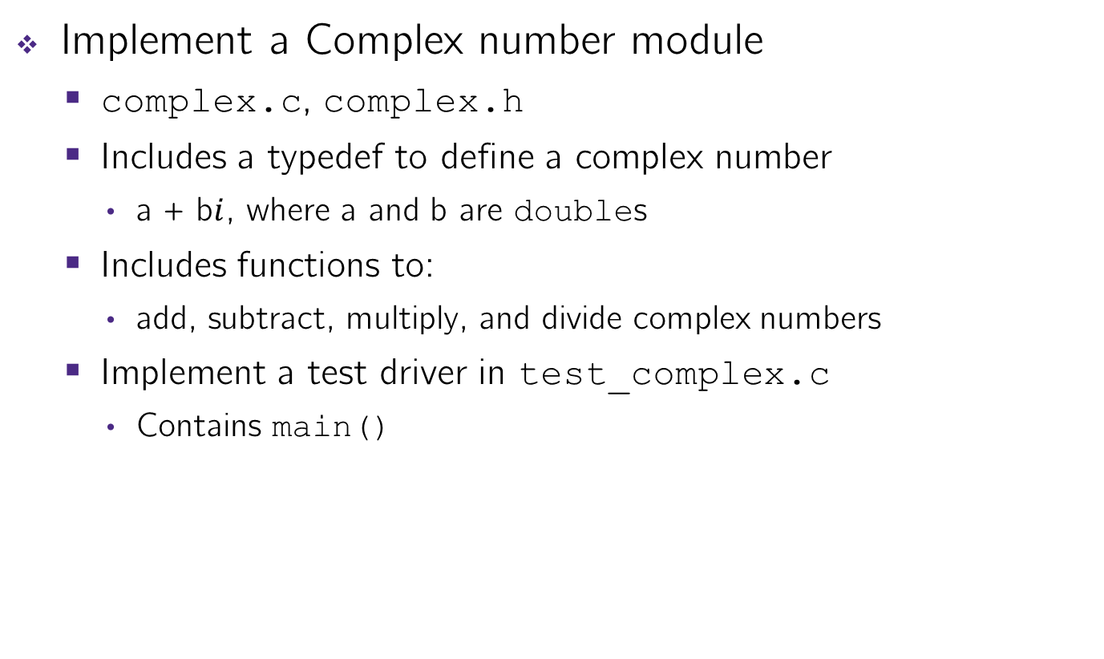
Extra Exercise #3
Implement a Complex number module
  complex.c, complex.h
  Includes a typedef to define a complex number
    a + b$i$, where a and b are doubles
  Includes functions to:
    add, subtract, multiply, and divide complex numbers
  Implement a test driver in test_complex.c
    Contains main()

