Slide 1
CSE 333 – Section 4
HW3, MVC, GTK+

Slide 2
HW3 online now.
Start early!
You must work in groups.
Agenda:
MVC model
HW3 specifications
GTK+

Slide 3
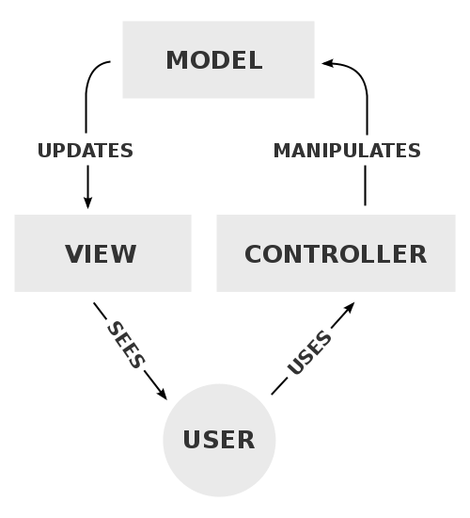
Model–view–controller (MVC)
The model directly manages the data, logic, and rules of the application.
A view can be any output representation of information, such as a chart or a diagram.
The controller accepts input and converts it to commands for the model or view.
Notes:
Multiple views of the same information are possible, such as a bar chart for management and a tabular view for accountants.
Illegal moves are prevented by the controller

Slide 4
MVC interactions
A model stores data that is retrieved according to commands from the controller and displayed in the view.
A view generates new output to the user based on changes in the model.
A controller can send commands to the model to update the model's state. It can also change the view's presentation of the model

Slide 5
See HW3
https://courses.cs.washington.edu/courses/cse333/16au/assignments/hw3/hw3.html
What you’ll be doing in HW3: a first version of the view component of Candy Crush. Make sure you can display a board, can provide some way for the user to select and swap adjacent candies, and can update the number of moves left field.

Slide 6
MVC version of Candy Crush
Eventually you will be splitting the view/controller from the model, across the Internet.

Slide 7
GTK+
GTK+ is Installed on attu
The X Window System (X11, or X)
A windowing system for bitmap displays, common on UNIX-like computer operating systems
Provides the basic framework for a GUI environment
Notes:
https://en.wikipedia.org/wiki/X_Window_System
The X Window System (X11) is a windowing system for bitmap displays, common on UNIX-like computer operating systems.

Slide 8
For you to remotely use GTK+ and run X11 applications on MAC/Linux
1) SSH –X usr@attu.cs.washington.edu
2) X-Server
X11
For you to remotely use GTK+ and run X11 applications on Windows, we need 2 additional pieces of software.
1) SSH Client
Eg. PuTTY
2) X-Server
Eg. Xming X-Server
Another option: Cygwin/X

Slide 9
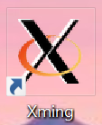
Xming
Download: https://sourceforge.net/projects/xming/
1. Double click on the Xming shortcut on the desktop
Note: If you have a firewall installed on your computer you will need to allow remote hosts access to the X-server
2. After a short while, you will see the X logo in the system tray.
3. Launch Putty and check ‘Enable X11 forwarding’ under SSH.

Slide 10
GTK+
Basic drawing model
Hierarchical containers
Reference counted (but mostly you don't see it)
Event driven
Notes:
Gtk+ seems not interested in changing layouts/updating the view.
Switching widgets could turn out to be error prone.
One strategy: just redraw everything

Slide 11
GTK+ intro example
Getting started
https://developer.gnome.org/gtk3/stable/gtk-getting-started.html#id-1.2.3.5
See example-0.c
pkg-config provides the necessary details for compiling and linking a program to a library
pkg-config --cflags
Man pkg-config
[Demo]Compile using gcc
gcc `pkg-config --cflags gtk+-3.0` -o example-0 example-0.c `pkg-config --libs gtk+-3.0`

Slide 12
GTK+ intro example
See example-1.c

Slide 13
GTK+ intro example
See example-2.c

Slide 14
Review of GTK+ features
Basic drawing model
Hierarchical containers
Reference counted (but mostly you don't see it)
Event driven
Notes:
Gtk+ seems not interested in changing layouts/updating the view.
Switching widgets could turn out to be error prone ( explosions).
One strategy: just redraw everything

Slide 15
Event driven
While the program is running, GTK+ is receiving events.
Typically input events caused by the user interacting with your program
Could also be messages from the window manager or other applications
Signals may be emitted on your widgets
Connecting handlers for these signals => respond to user input

Slide 16
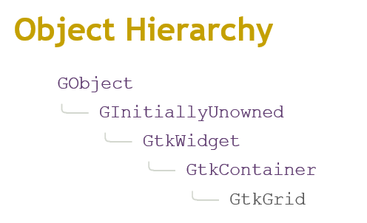
Hierarchical containers
Example:
https://developer.gnome.org/gtk3/stable/GtkGrid.html

Slide 17
Reference counted
https://developer.gnome.org/gobject/stable/gobject-memory.html
g_object_unref ()

