Slide 1
CSE 333 – SECTION 1
C, Introduction to and Working with

Slide 2
Your TAs
Renshu Gu – PhD Student, EE
Johnny Yan – PhD Student, CSE
Cortney Corbin – Undergrad, CSE
Sunjay Cauligi – Undergrad, CSE
Email are posted on the course website
But try to use the staff email instead of our individual emails
Office hours will be posted soon
Please use the discussion board!

Slide 3
Questions, Comments, Concerns
Do you have any?
Exercises going ok?
Lectures make sense?

Slide 4
Quick Refresher on C
General purpose programming language
Procedural
Often used in low-level system programming
Supports use of pointer arithmetic
Provides facilities for managing memory
C passes all of its arguments by value
Pass-by-reference is simulated by passing the address of a variable

Slide 5
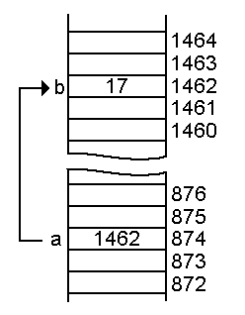
Pointers
A data type that stores an address
Used to indirectly refer to values
Can add/subtract to the address
It’s just another number
Address
Value
Address
a
p

Slide 6
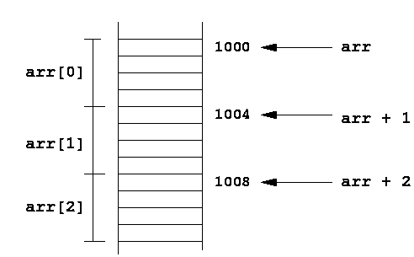
Arrays and pointers
a[0] <==> *a
a[3] <==> *(a + 3)
How about a, a+3,
*a+3 or *a++?

Slide 7
Example
[basic_pointer.c]
#include <stdio.h>
void f(int *j) {
(*j)++;
}
int main() {
int i = 20;
int *p = &i;
f(p);
printf("i = %d\n", i);
return 0;
}

Slide 8
Pointers to pointers
char *c = “hello”;
char **cp = &c;
char ***cpp = &cp;
Why could this be useful?

Slide 9
Function pointers
We can have pointers to functions as well
Syntax is a little awkward
Example: int (*ptr_to_int_fn)(int, int)
Makes sense if you think about it hard
We will be using these in the homework assignments!
Demo: [function_pointer.c]

Slide 10
Debugging with gdb
Just like in CSE 351, gdb is your friend
Unlike CSE 351, we will be debugging C/C++ code, not assembly
Instead of n(ext)i and s(tep)i, use n(ext) and s(tep)
Your first instinct for bug fixing should be gdb, not printf
Demo: [buggy.c]

Slide 11
Looking up documentation
Don’t go straight to Google / Stack Overflow / etc.
Use the built-in man pages
man <program/utility/function>
man -f <name> or whatis <name>
apropos <keyword>
Much more documentation is linked on the 333 home page
Under “Resources” on the left side of the page

