Slide 1
CSE 332 Winter 2026 Lecture 4: Algorithm Analysis and Priority Queues
Nathan Brunelle
http://www.cs.uw.edu/332

Slide 2
Goals for Algorithm Analysis
Identify a function which maps the algorithm’s input size to a measure of resources used
Domain of the function: sizes of the input
Number of characters in a string, number of items in a list, number of pixels in an image
Codomain of the function: counts of resources used
Number of times the algorithm adds two numbers together, number times the algorithm does a > or < comparison, maximum number of bytes of memory the algorithm uses at any time
Important note: Make sure you know the “units” of your domain and codomain!
Domain = inputs to the function
Codomain = outputs to the function

Slide 3
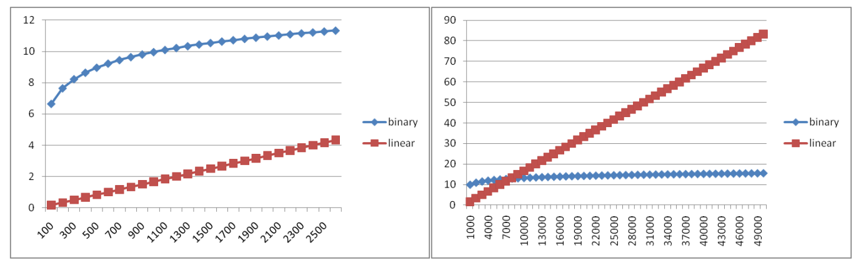
Comparing

Slide 4
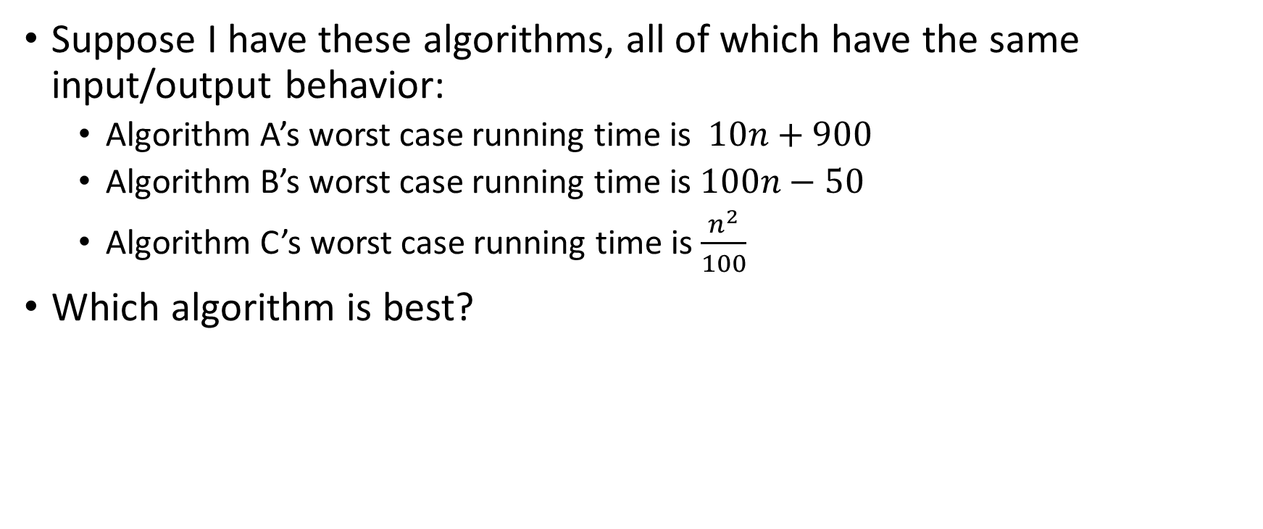
Comparing Running Times
Suppose I have these algorithms, all of which have the same input/output behavior:
Algorithm A’s worst case running time is $10n+900$
Algorithm B’s worst case running time is $100n−50$
Algorithm C’s worst case running time is $\frac{n^{2}}{100}$
Which algorithm is best?

Slide 5
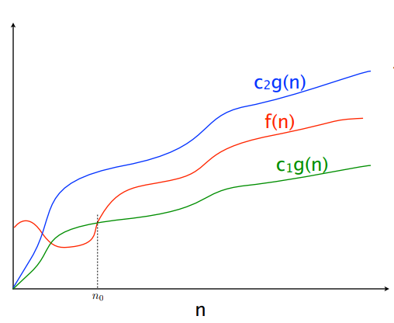



$$f(n)=O(g\left(n\right))$$
$$f(n)=Θ(g\left(n\right))$$
$$f(n)=Ω(g\left(n\right))$$

Slide 6
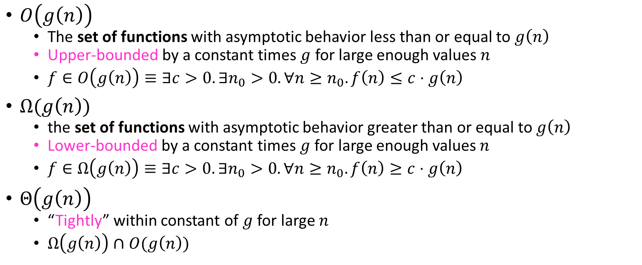
Asymptotic Notation
$O\left(g\left(n\right)\right)$
The set of functions with asymptotic behavior less than or equal to $g\left(n\right)$
Upper-bounded by a constant times $g$ for large enough values $n$
$f∈O\left(g\left(n\right)\right)≡∃c>0. ∃n_{0}>0. ∀n≥n_{0}. f\left(n\right)≤c⋅g\left(n\right)$
$Ω(g\left(n\right))$
the set of functions with asymptotic behavior greater than or equal to $g\left(n\right)$
Lower-bounded by a constant times $g$ for large enough values $n$
$f∈Ω\left(g\left(n\right)\right)≡∃c>0. ∃n_{0}>0. ∀n≥n_{0}. f\left(n\right)≥c⋅g\left(n\right)$
$Θ\left(g\left(n\right)\right)$
“Tightly” within constant of $g$ for large $n$
$Ω\left(g\left(n\right)\right)∩O(g\left(n\right))$

Slide 7

Asymptotic Notation Example
Show: $10n+100∈O\left(n^{2}\right)$
Technique: find values $c>0$ and $n_{0}>0$ such that $∀n>n_{0}. 10n+100≤c⋅n^{2}$
Scratch work:

Slide 8

Asymptotic Notation Example
Show: $10n+100∈O\left(n^{2}\right)$
Technique: find values $c>0$ and $n_{0}>0$ such that $∀n≥n_{0}. 10n+100≤c⋅n^{2}$
Proof:

Slide 9

Asymptotic Notation Example
Show: $13n^{2}−50n∈Ω\left(n^{2}\right)$
Technique: find values $c>0$ and $n_{0}>0$ such that $∀n≥n_{0}. 13n^{2}−50n≥c⋅n^{2}$
Scratch work:

Slide 10

Asymptotic Notation Example
Show: $13n^{2}−50n∈Ω\left(n^{2}\right)$
Technique: find values $c>0$ and $n_{0}>0$ such that $∀n≥n_{0}. 13n^{2}−50n≥c⋅n^{2}$
Proof:

Slide 11

Asymptotic Notation Example
Show: $n^{2}∉O\left(n\right)$

Slide 12
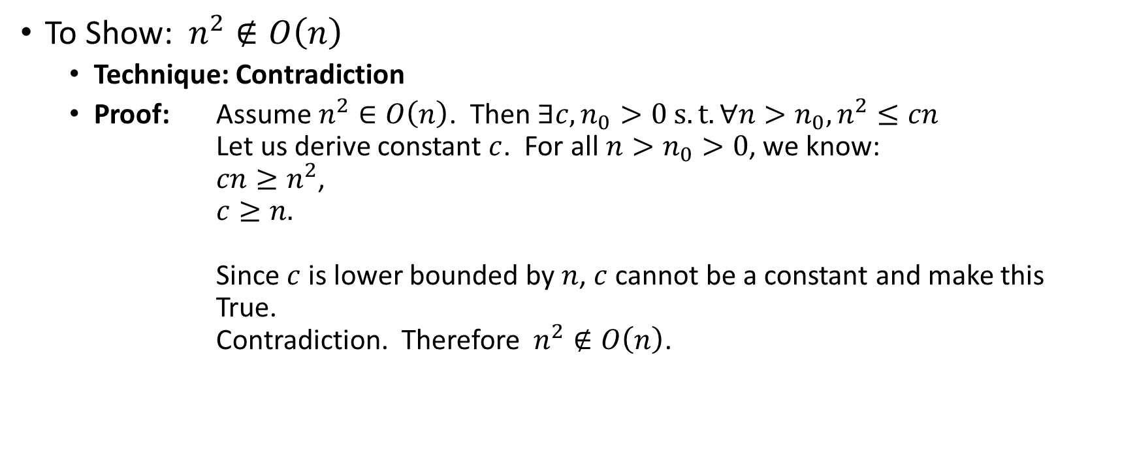
Asymptotic Notation Example
Proof by Contradiction!
To Show:$n^{2}∉O\left(n\right)$
Technique: Contradiction
Proof: Assume $n^{2}∈O\left(n\right)$. Then $∃c,n_{0}>0 s.t. ∀n>n_{0},n^{2}≤cn$ Let us derive constant $c$. For all $n>n_{0}>0$, we know: $cn≥n^{2}$, $c≥n.$ Since $c$ is lower bounded by $n$, $c$ cannot be a constant and make this True. Contradiction. Therefore$n^{2}∉O\left(n\right)$.

Slide 13
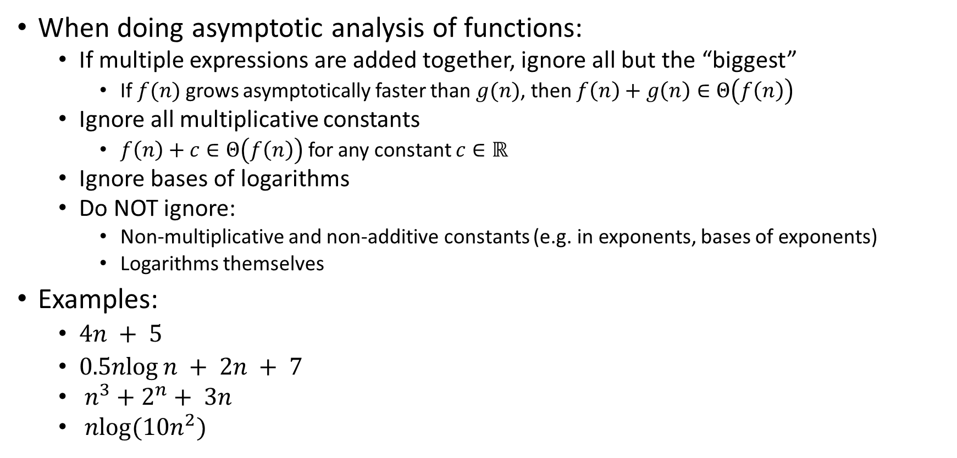
Gaining Intuition
When doing asymptotic analysis of functions:
If multiple expressions are added together, ignore all but the “biggest”
If $f(n)$ grows asymptotically faster than $g(n)$, then $f\left(n\right)+g\left(n\right)∈Θ\left(f\left(n\right)\right)$
Ignore all multiplicative constants
$f\left(n\right)+c∈Θ\left(f\left(n\right)\right)$ for any constant $c∈ℝ$
Ignore bases of logarithms
Do NOT ignore:
Non-multiplicative and non-additive constants (e.g. in exponents, bases of exponents)
Logarithms themselves
Examples:
$4n + 5$
$0.5nlog⁡n + 2n + 7$
$n^{3}+2^{n}+ 3n$
$nlog(10n^{2})$

Slide 14

More Examples
Is each of the following True or False?
$4+3n∈ O(n)$
$n+2\log{n}∈ O(\log{n})$
$\log{n}+2∈ O(1)$
$n^{50}∈ O({1.1}^{n})$
$3^{n}∈Θ(2^{n})$

Slide 15

Common Categories
$O(1)$ “constant”
$O\left(\log{n}\right)$ “logarithmic”
$O\left(n\right)$ “linear”
$O\left(n\log{n}\right)$ “log-linear”
$O\left(n^{2}\right)$ “quadratic”
$O\left(n^{3}\right)$ “cubic”
$O\left(n^{k}\right)$ “polynomial”
$O\left(k^{n}\right)$ “exponential”

Slide 16
ADT: Queue
What is it?
A “First In First Out” (FIFO) collection of items
What Operations do we need?
Enqueue
Add a new item to the queue
Dequeue
Remove the “oldest” item from the queue
Is_empty
Indicate whether or not there are items still on the queue

Slide 17
ADT: Priority Queue
What is it?
A collection of items and their “priorities”
Allows quick access/removal to the “top priority” thing
What Operations do we need?
insert(item, priority)
Add a new item to the PQ with indicated priority
Usually, smaller priority value means more important
extract
Remove and return the “top priority” item from the queue
Is_empty
Indicate whether or not there are items still on the queue
Note: the “priority” value can be any type/class so long as it’s comparable (i.e. you can use “<“ or “compareTo” with it)

Slide 18
Priority Queue, example
PriorityQueue PQ = new PriorityQueue();
PQ.insert(5,5)
PQ.insert(6,6)
PQ.insert(1,1)
PQ.insert(3,3)
PQ.insert(8,8)
Print(PQ.extract)
Print(PQ.extract)
Print(PQ.extract)
Print(PQ.extract)
Print(PQ.extract)

Slide 19
Priority Queue, example
PriorityQueue PQ = new PriorityQueue();
PQ.insert(5,5)
PQ.insert(6,6)
PQ.insert(1,1)
Print(PQ.extract)
PQ.insert(3,3)
Print(PQ.extract)
Print(PQ.extract)
PQ.insert(8,8)
Print(PQ.extract)
Print(PQ.extract)

Slide 20
Applications?

Slide 21
Thinking through implementations
Data Structure | Worst case time to insert | Worst case time to extract
Unsorted Array
Unsorted Linked List
Sorted Array
Sorted Linked List
Binary Search Tree
For simplicity, Assume we know the maximum size of the PQ in advance (otherwise we’d do an amortized analysis, but get the same answers…)

Slide 22
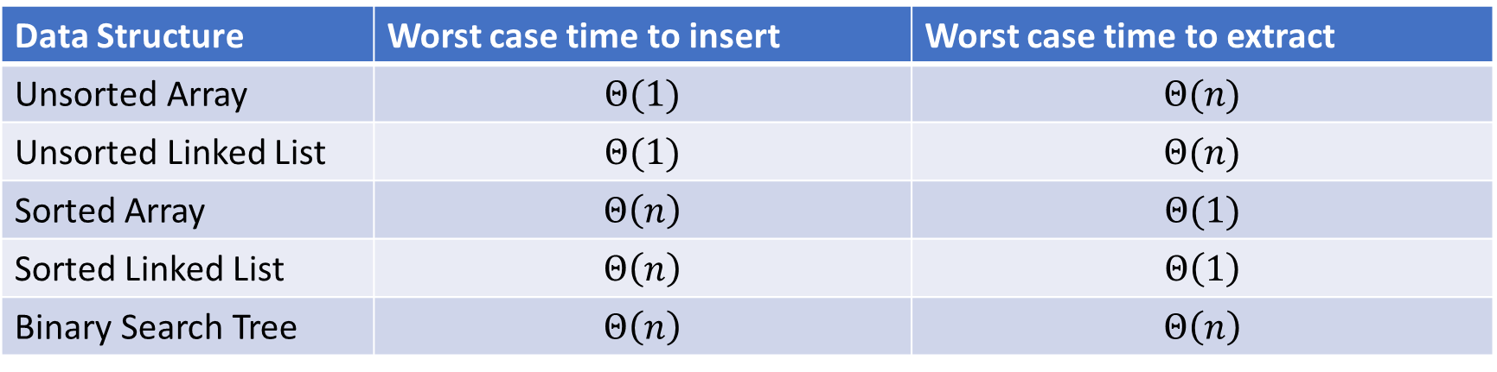
Thinking through implementations
Data Structure | Worst case time to insert | Worst case time to extract
Unsorted Array | $$Θ(1)$$ | $$Θ(n)$$
Unsorted Linked List | $$Θ(1)$$ | $$Θ(n)$$
Sorted Array | $$Θ\left(n\right)$$ | $$Θ(1)$$
Sorted Linked List | $$Θ\left(n\right)$$ | $$Θ\left(1\right)$$
Binary Search Tree | $$Θ\left(n\right)$$ | $$Θ\left(n\right)$$
For simplicity, Assume we know the maximum size of the PQ in advance (otherwise we’d do an amortized analysis, but get the same answers…)

Slide 23
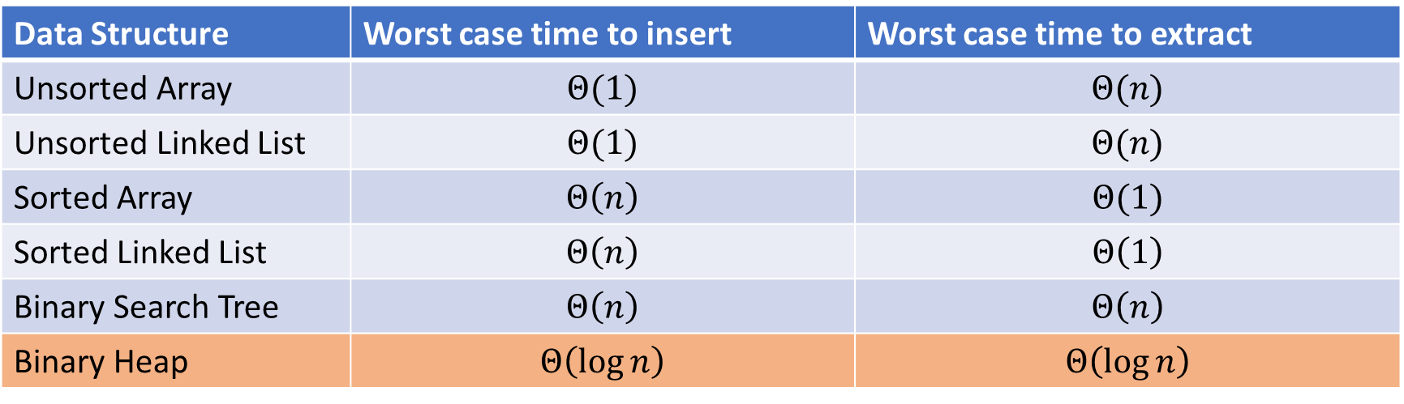
Thinking through implementations
Data Structure | Worst case time to insert | Worst case time to extract
Unsorted Array | $$Θ(1)$$ | $$Θ(n)$$
Unsorted Linked List | $$Θ(1)$$ | $$Θ(n)$$
Sorted Array | $$Θ\left(n\right)$$ | $$Θ(1)$$
Sorted Linked List | $$Θ\left(n\right)$$ | $$Θ\left(1\right)$$
Binary Search Tree | $$Θ\left(n\right)$$ | $$Θ\left(n\right)$$
Binary Heap | $$Θ\left(\log{n}\right)$$ | $$Θ\left(\log{n}\right)$$
For simplicity, Assume we know the maximum size of the PQ in advance (otherwise we’d do an amortized analysis, but get the same answers…)

Slide 24

Trees for Heaps
Binary Trees:
The branching factor is 2
Every node has $≤$ 2 children
Complete Tree:
All “layers” are full, except the bottom
Bottom layer filled left-to-right
1
3
2
4
7
5
6
5
9

Slide 25

Heap – Priority Queue Data Structure
Idea: We need to keep some ordering, but it doesn’t need to be entirely sorted
$Θ(\log{n})$ worst case for extract and insert
1
3
2
4
7
5
6
5
9

Slide 26
Heap – Priority Queue Data Structure
Idea: We need to keep some ordering, but it doesn’t need to be entirely sorted
$Θ(\log{n})$ worst case for extract and insert
1
1
3
2
4
2
7
5
3
6
4
5
6
7
5
9
8
9

Slide 27
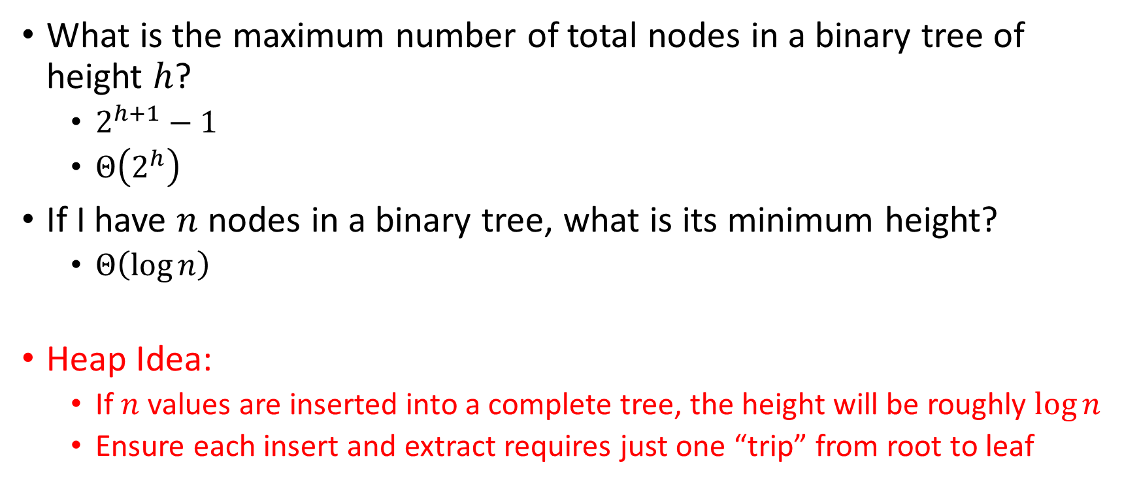
Challenge!
What is the maximum number of total nodes in a binary tree of height $h$?
$2^{h+1}−1$
$Θ\left(2^{h}\right)$
If I have $n$ nodes in a binary tree, what is its minimum height?
$Θ\left(\log{n}\right)$
Heap Idea:
If $n$ values are inserted into a complete tree, the height will be roughly $\log{n}$
Ensure each insert and extract requires just one “trip” from root to leaf

Slide 28
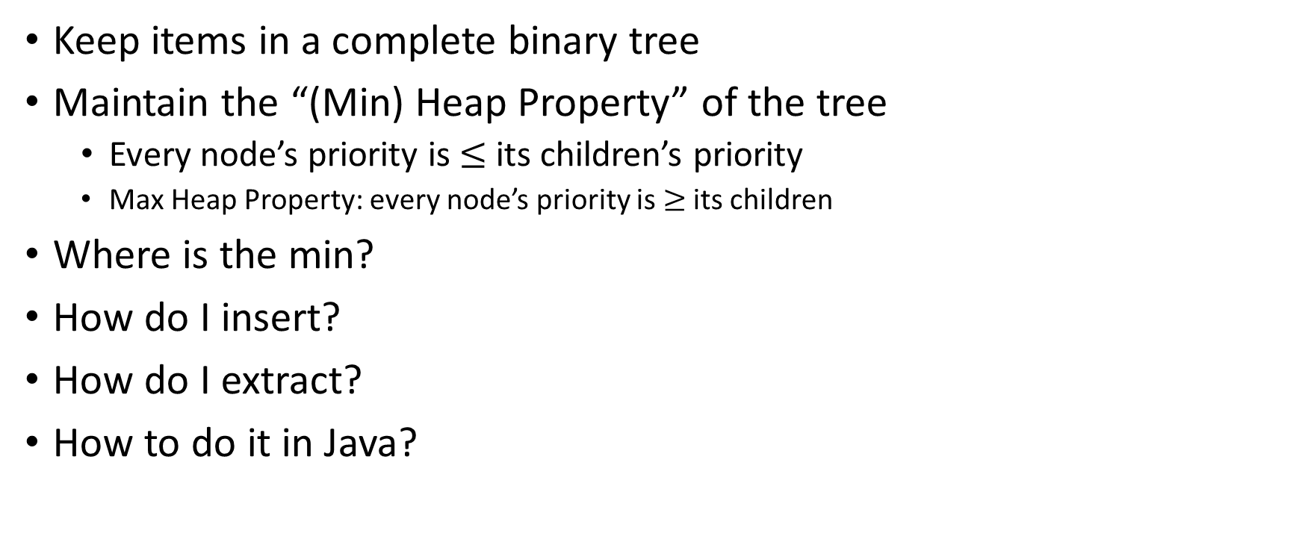
(Min) Heap Data Structure
Keep items in a complete binary tree
Maintain the “(Min) Heap Property” of the tree
Every node’s priority is $≤$ its children’s priority
Max Heap Property: every node’s priority is $≥$ its children
Where is the min?
How do I insert?
How do I extract?
How to do it in Java?
1
3
2
4
7
5
6
5
9

