Slide 1
CSE 332 Winter 2026
Lecture 3: Algorithm Analysis pt.2
Nathan Brunelle
http://www.cs.uw.edu/332

Slide 2
Running Time Analysis
Units of “time”
  Operations
    Whichever operations we pick
How do we express running time?
  Function
    Domain (input): size of the input
    Range: count of operations

Slide 3
Defining your running time function
Worst-case complexity:
  max number of steps algorithm takes on “most challenging” input
Best-case complexity:
  min number of steps algorithm takes on “easiest” input
Average/expected complexity:
  avg number of steps algorithm takes on random inputs (context-dependent)
Amortized complexity:
  max total number of steps algorithm takes on M “most challenging” consecutive inputs, divided by M (i.e., divide the max total sum by M).

Slide 4

Worst Case Running Time Analysis
If an algorithm has a worst case running time of $f(n)$
  Among all possible size-$n$ inputs, the “worst” one will do $f(n)$ “operations”
  $f(n)$ gives the maximum count of operations needed from among all inputs of size $n$

Slide 5
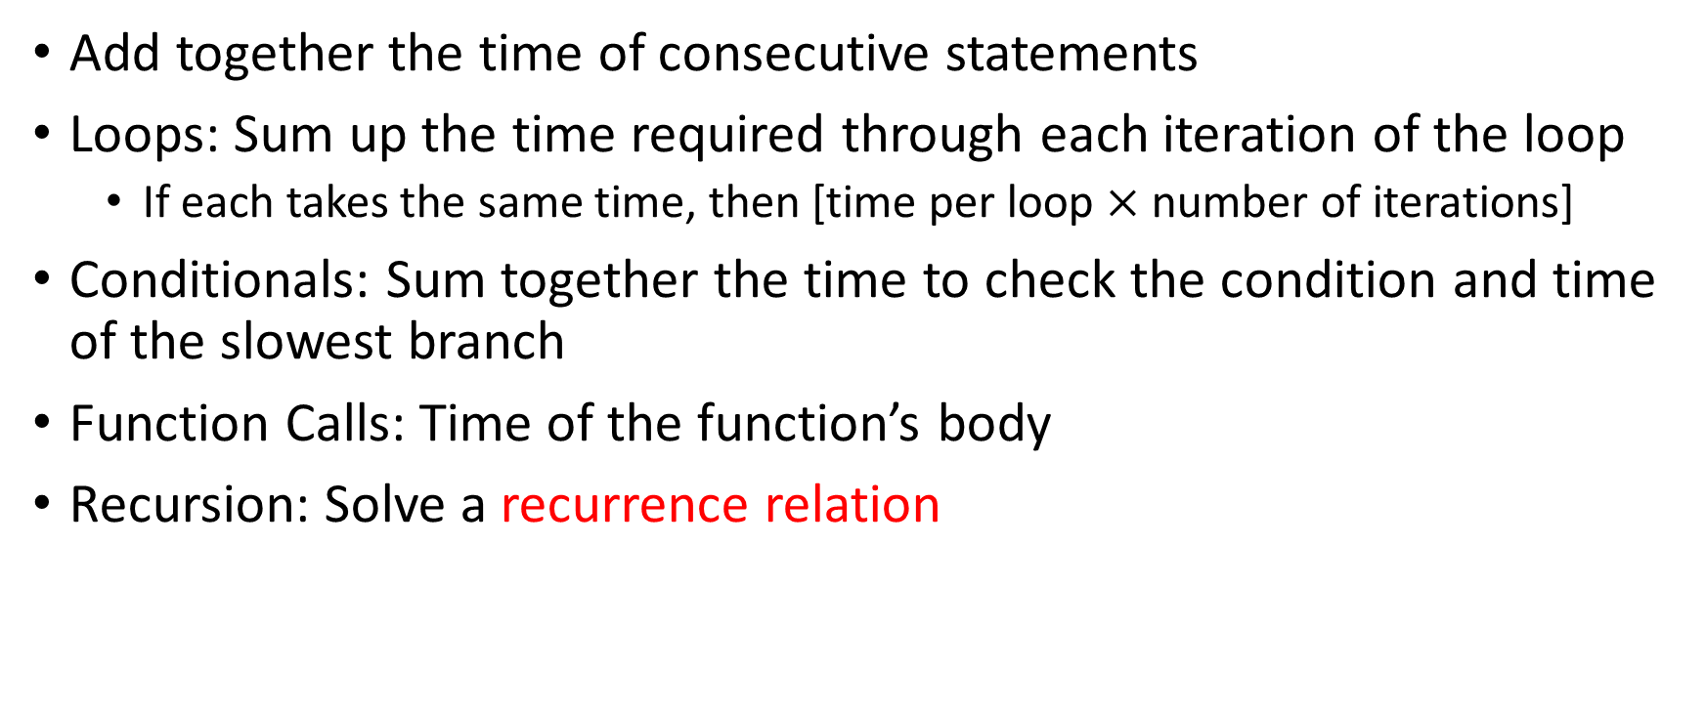
Worst Case Running Time – General Guide
Add together the time of consecutive statements
Loops: Sum up the time required through each iteration of the loop
  If each takes the same time, then [time per loop $×$ number of iterations]
Conditionals: Sum together the time to check the condition and time of the slowest branch
Function Calls: Time of the function’s body
Recursion: Solve a recurrence relation

Slide 6
Worst Case Running Time - Example
myFunction(List n){
b = 55 + 5;
c = b / 3;
b = c + 100;
for (i = 0; i < n.size(); i++) {
b++;
}
if (b % 2 == 0) {
c++;
}
else {
for (i = 0; i < n.size(); i++) {
c++;
}
}
return c;
}
Questions to ask:
What are the units of the input size?
What are the operations we’re counting?
For each line:
  How many times will it run?
  How long does it take to run?
  Does this change with different inputs?
Answer:

Slide 7

Worst Case Running Time - Example
myFunction(List n){
b = 55 + 5; // 1
c = b / 3; // 1
b = c + 100; // 1
for (i = 0; i < n.size(); i++) { // 1, n times
b++; // 1
}
if (b % 2 == 0) { // 1
c++; // 1
}
else {
for (i = 0; i < n.size(); i++) { // 1, n times
c++; // 1
}
}
return c;
}
Questions to ask:
What are the units of the input size?
  # of items in the list
What are the operations we’re counting?
  Arithmetic ops (+-*/)
For each line:
  How many times will it run?
  How long does it take to run?
  Does this change with different inputs?
Answer:
  $3+2n+1+2n=4n+4$
  $O(n)$

Slide 8
Worst Case Running Time – Example 2
beAnnoying(List n){
List m = [];
for (i=0; i < n.size(); i++){
m.add(n[i]);
for (j=0; j< n.size(); j++){
print (“Hi, I’m annoying”);
}
}
}
Questions to ask:
What are the units of the input size?
What are the operations we’re counting?
For each line:
  How many times will it run?
  How long does it take to run?
  Does this change with the input size?

Slide 9

Worst Case Running Time – Example 2
beAnnoying(List n){
List m = [];
for (i=0; i < n.size(); i++){ // n times
m.add(n[i]);
for (j=0; j< n.size(); j++){ // n times
print (“Hi, I’m annoying”); // 1
}
}
}
Questions to ask:
What are the units of the input size?
  # items
What are the operations we’re counting?
  Adding or printing
  Printing: $O\left(n^{2}\right)$
For each line:
  How many times will it run?
  How long does it take to run?
  Does this change with the input size?

Slide 10
Amortized Analysis Analogy
Suppose I’d like to park in a lot where they charge $10 per day to park
If you are caught in the lot without paying you are given a warning
If you get 3 warnings, you are charged a $25 fine, and your warnings reset.
Should you actually pay to park?
  If you pay every day then you pay an average of $10 per day
  If you do not pay then for every three days parking costs $0+$0+$25, for an average of $8.33 per day
    Worst case analysis: parking costs $25
    Amortized analysis: parking costs $8.33

Slide 11

Amortized Complexity Example - ArrayList
public void add(T value){
if(data.length == size)
resize();
data[size] = value;
size++;
}
private void resize(){
T[] oldData = data;
data = (T[]) new Object[data.length*2];
for(int i = 0; i < oldData.length; i++)
data[i] = oldData[i];
}
What is the worst case running time of add?
  Input size: size of “this”
  Operations counted: indexing
  $O\left(n\right)$

Slide 12
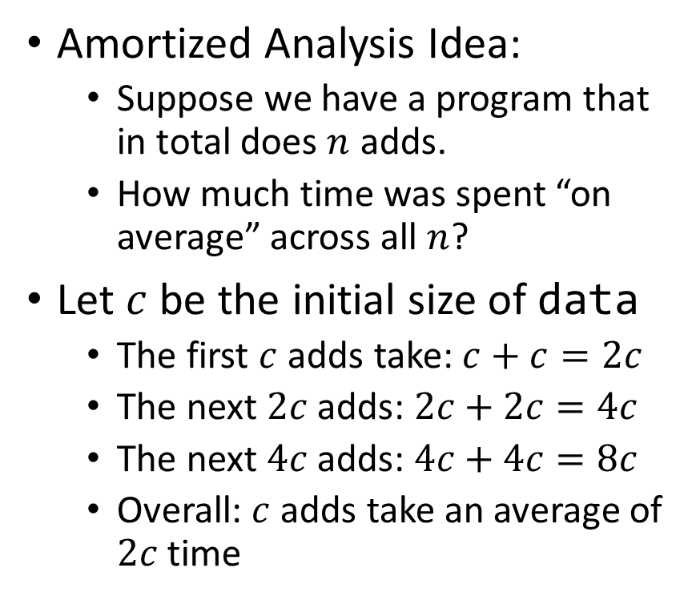
Amortized Complexity Example - ArrayList
public void add(T value){
if(data.length == size)
resize();
data[size] = value;
size++;
}
private void resize(){
T[] oldData = data;
data = (T[]) new Object[data.length*2];
for(int i = 0; i < oldData.length; i++)
data[i] = oldData[i];
}
Amortized Analysis Idea:
  Suppose we have a program that in total does $n$ adds.
  How much time was spent “on average” across all $n$?
Let $c$ be the initial size of data
  The first $c$ adds take: $c+c=2c$
  The next $2c$ adds: $2c+2c=4c$
  The next $4c$ adds: $4c+4c=8c$
  Overall: $c$ adds take an average of $2c$ time
Every time we resize, we earn data.length more adds guaranteed to not resize!
Notes:
Amortized: “running average”

Slide 13
Searching in a Sorted List
5
8
13
42
75
79
88
90
95
99
0
1
2
3
4
5
6
7
8
9
public static boolean contains(List<Integer> a, int k){
for(int i=0; i< a.size(); i++){
if (a.get(i) == k)
return true;
}
return false;
}

Slide 14
Faster way?
5
8
13
42
75
79
88
90
95
99
0
1
2
3
4
5
6
7
8
9
Can you think of a faster algorithm to solve this problem?

Slide 15
Binary Search
5
8
13
42
75
79
88
90
95
99
0
1
2
3
4
5
6
7
8
9
public static boolean contains(List<Integer> a, int k){
int start = 0;
int end = a.size();
while(start < end){
int mid = start + (end-start)/2;
if(a.get(mid) == k)
return true;
else if(a.get(mid) < k)
start = mid+1;
else
end = mid;
}
return false;
}

Slide 16
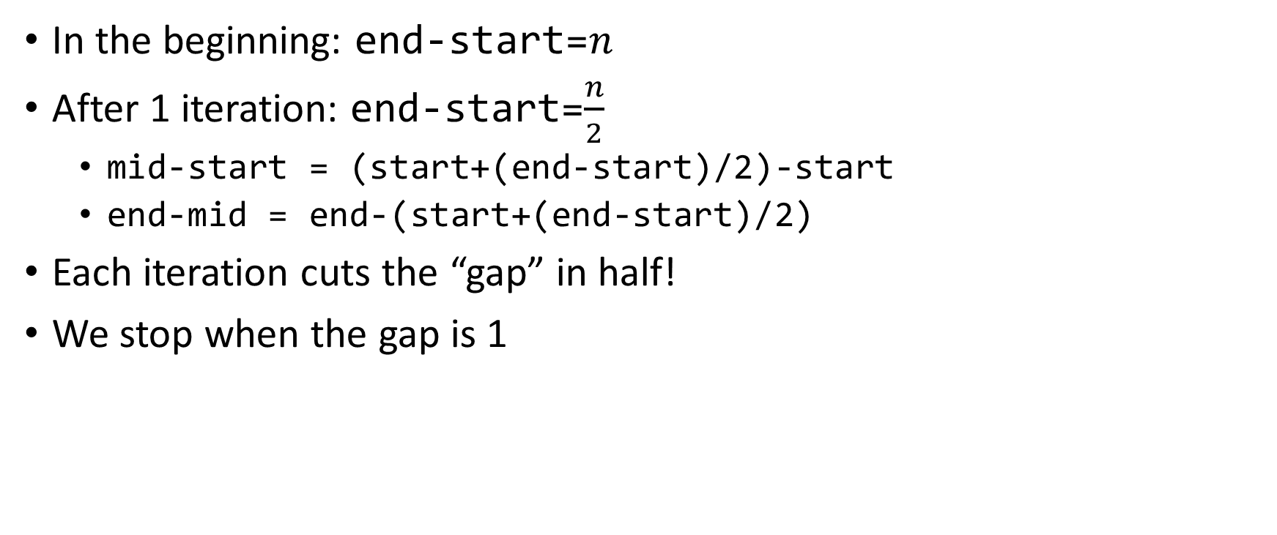

Why is this $\log_{2}{n}$?
In the beginning: end-start=$n$
After 1 iteration: end-start=$\frac{n}{2}$
  mid-start = (start+(end-start)/2)-start
  end-mid = end-(start+(end-start)/2)
Each iteration cuts the “gap” in half!
We stop when the gap is 1

Slide 17
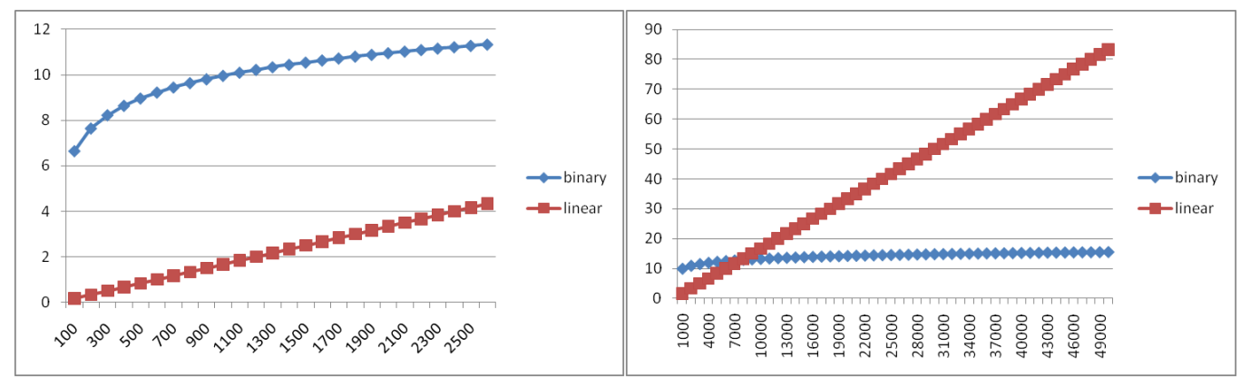
Comparing

Slide 18
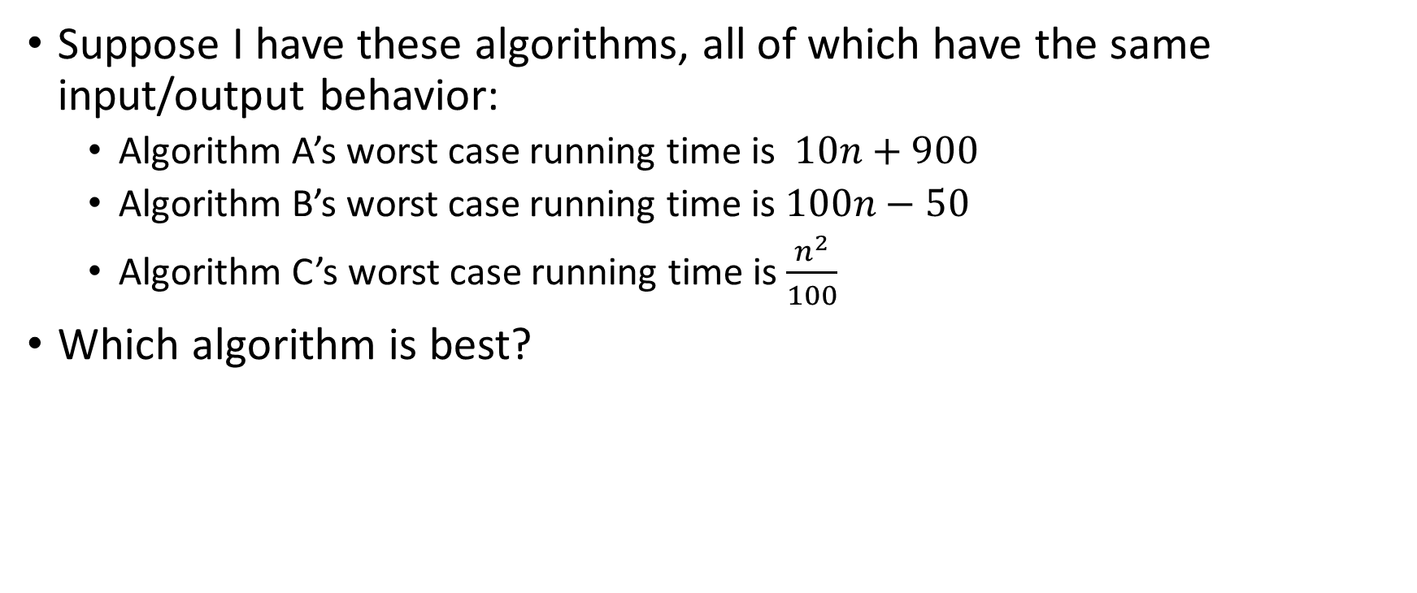
Comparing Running Times
Suppose I have these algorithms, all of which have the same input/output behavior:
  Algorithm A’s worst case running time is $10n+900$
  Algorithm B’s worst case running time is $100n−50$
  Algorithm C’s worst case running time is $\frac{n^{2}}{100}$
Which algorithm is best?

Slide 19
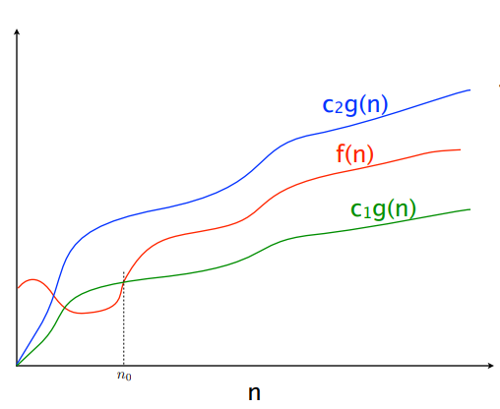



$$f(n)=O(g\left(n\right))$$
$$f(n)=Θ(g\left(n\right))$$
$$f(n)=Ω(g\left(n\right))$$

Slide 20
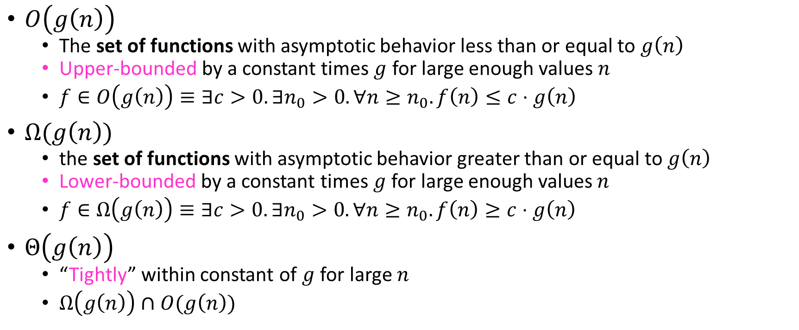
Asymptotic Notation
$O\left(g\left(n\right)\right)$
  The set of functions with asymptotic behavior less than or equal to $g\left(n\right)$
  Upper-bounded by a constant times $g$ for large enough values $n$
  $f∈O\left(g\left(n\right)\right)≡∃c>0. ∃n_{0}>0. ∀n≥n_{0}. f\left(n\right)≤c⋅g\left(n\right)$
$Ω(g\left(n\right))$
  the set of functions with asymptotic behavior greater than or equal to $g\left(n\right)$
  Lower-bounded by a constant times $g$ for large enough values $n$
  $f∈Ω\left(g\left(n\right)\right)≡∃c>0. ∃n_{0}>0. ∀n≥n_{0}. f\left(n\right)≥c⋅g\left(n\right)$
$Θ\left(g\left(n\right)\right)$
  “Tightly” within constant of $g$ for large $n$
  $Ω\left(g\left(n\right)\right)∩O(g\left(n\right))$

Slide 21


Idea of $Θ$
$x=y$
  $x≤y∧x≥y$

Slide 22

Asymptotic Notation Example
Show: $10n+100∈O\left(n^{2}\right)$
  Technique: find values $c>0$ and $n_{0}>0$ such that $∀n>n_{0}. 10n+100≤c⋅n^{2}$
  Proof:

Slide 23
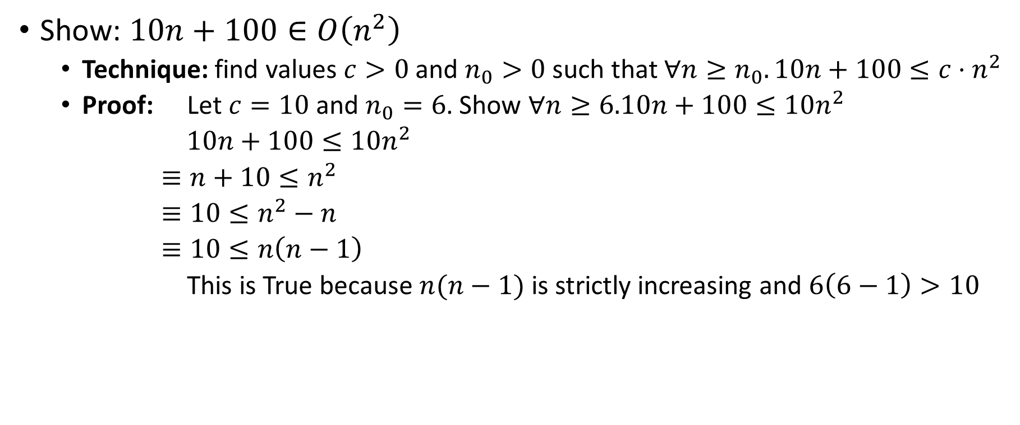
Asymptotic Notation Example
Show: $10n+100∈O\left(n^{2}\right)$
  Technique: find values $c>0$ and $n_{0}>0$ such that $∀n≥n_{0}. 10n+100≤c⋅n^{2}$
  Proof: Let $c=10$ and $n_{0}=6$. Show $∀n≥6.10n+100≤10n^{2}$
  $10n+100≤10n^{2}$
  $≡n+10≤n^{2}$
  $≡10≤n^{2}−n$
  $≡10≤n\left(n−1\right)$
  This is True because $n(n−1)$ is strictly increasing and $6\left(6−1\right)>10$

Slide 24

Asymptotic Notation Example
Show: $13n^{2}−50n∈Ω\left(n^{2}\right)$
  Technique: find values $c>0$ and $n_{0}>0$ such that $∀n≥n_{0}. 13n^{2}−50n≥c⋅n^{2}$
  Proof:
  $c=$
  $n_{0}=$

Slide 25
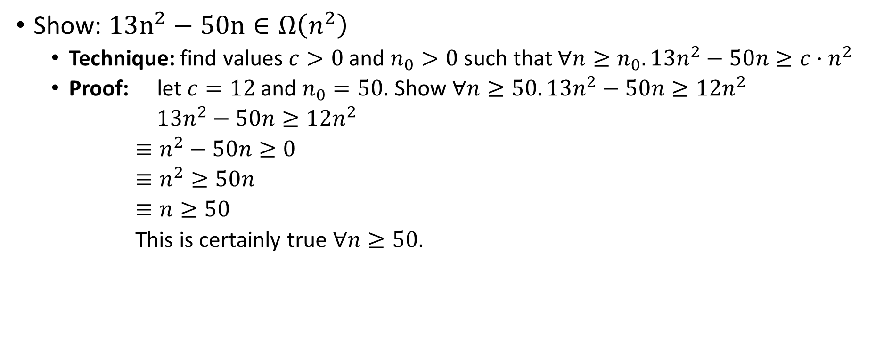
Asymptotic Notation Example
Show: $13n^{2}−50n∈Ω\left(n^{2}\right)$
  Technique: find values $c>0$ and $n_{0}>0$ such that $∀n≥n_{0}. 13n^{2}−50n≥c⋅n^{2}$
  Proof: let $c=12$ and $n_{0}=50$. Show $∀n≥50. 13n^{2}−50n≥12n^{2}$
  $13n^{2}−50n≥12n^{2}$
  $≡n^{2}−50n≥0$
  $≡n^{2}≥50n$
  $≡n≥50$
  This is certainly true $∀n≥50$.

Slide 26

Asymptotic Notation Example
Show: $n^{2}∉O\left(n\right)$
Want to show that there does not exist a pair of $c$ and $n_{0}$ such that $∀n_{0}>n. n^{2}≤c⋅n$

Slide 27
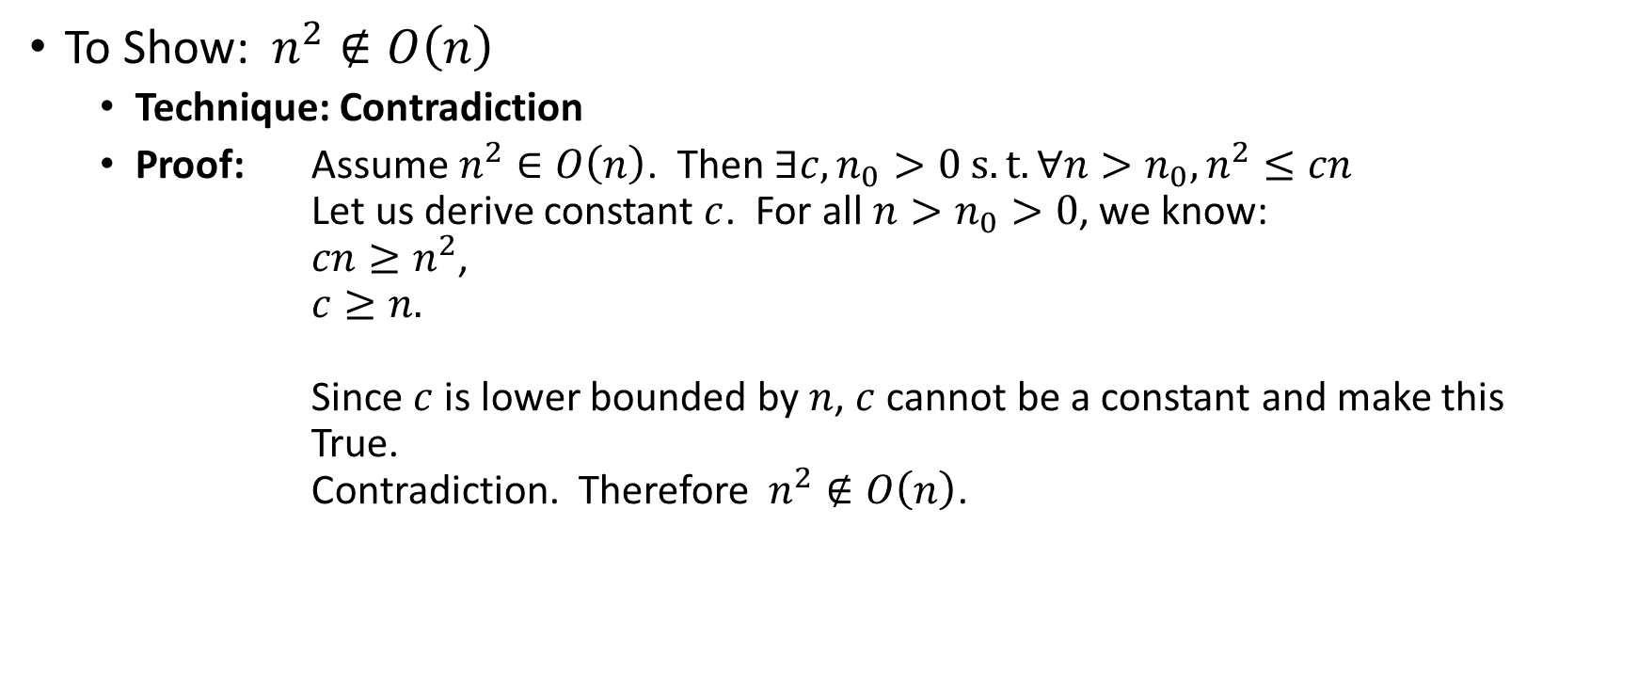
Asymptotic Notation Example
Proof by Contradiction!
To Show:$n^{2}∉O\left(n\right)$
  Technique: Contradiction
  Proof: Assume $n^{2}∈O\left(n\right)$. Then $∃c,n_{0}>0 s.t. ∀n>n_{0},n^{2}≤cn$
  Let us derive constant $c$. For all $n>n_{0}>0$, we know:
  $cn≥n^{2}$,
  $c≥n.$
  Since $c$ is lower bounded by $n$, $c$ cannot be a constant and make this True.
  Contradiction. Therefore$n^{2}∉O\left(n\right)$.

Slide 28
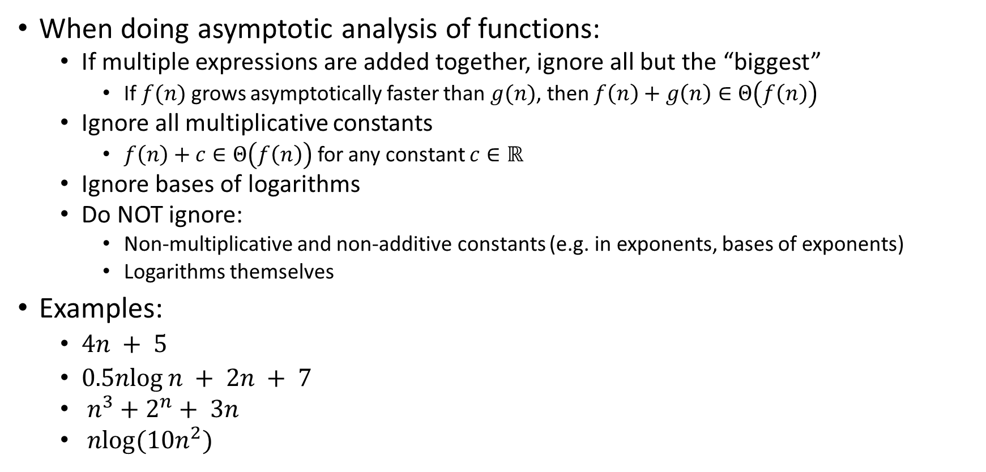
Gaining Intuition
When doing asymptotic analysis of functions:
  If multiple expressions are added together, ignore all but the “biggest”
    If $f(n)$ grows asymptotically faster than $g(n)$, then $f\left(n\right)+g\left(n\right)∈Θ\left(f\left(n\right)\right)$
  Ignore all multiplicative constants
    $f\left(n\right)+c∈Θ\left(f\left(n\right)\right)$ for any constant $c∈ℝ$
  Ignore bases of logarithms
  Do NOT ignore:
    Non-multiplicative and non-additive constants (e.g. in exponents, bases of exponents)
    Logarithms themselves
Examples:
  $4n + 5$
  $0.5nlog⁡n + 2n + 7$
  $n^{3}+2^{n}+ 3n$
  $nlog(10n^{2})$

Slide 29

More Examples
Is each of the following True or False?
  $4+3n∈ O(n)$
  $n+2\log{n}∈ O(\log{n})$
  $\log{n}+2∈ O(1)$
  $n^{50}∈ O({1.1}^{n})$
  $3^{n}∈Θ(2^{n})$

Slide 30

Common Categories
$O(1)$ “constant”
$O\left(\log{n}\right)$ “logarithmic”
$O\left(n\right)$ “linear”
$O\left(n\log{n}\right)$ “log-linear”
$O\left(n^{2}\right)$ “quadratic”
$O\left(n^{3}\right)$ “cubic”
$O\left(n^{k}\right)$ “polynomial”
$O\left(k^{n}\right)$ “exponential”

Slide 31
Defining your running time function
Worst-case complexity:
  max number of steps algorithm takes on “most challenging” input
Best-case complexity:
  min number of steps algorithm takes on “easiest” input
Average/expected complexity:
  avg number of steps algorithm takes on random inputs (context-dependent)
Amortized complexity:
  max total number of steps algorithm takes on M “most challenging” consecutive inputs, divided by M (i.e., divide the max total sum by M).

Slide 32
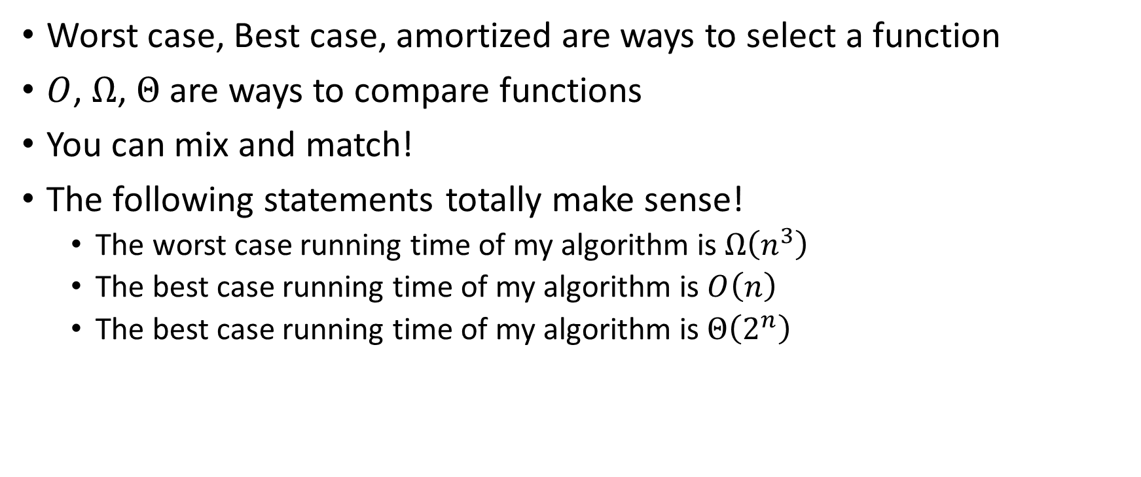
Beware!
Worst case, Best case, amortized are ways to select a function
$O$, $Ω$, $Θ$ are ways to compare functions
You can mix and match!
The following statements totally make sense!
  The worst case running time of my algorithm is $Ω\left(n^{3}\right)$
  The best case running time of my algorithm is $O\left(n\right)$
  The best case running time of my algorithm is $Θ\left(2^{n}\right)$

