Slide 1
CSE 332 Winter 2026
Lecture 2: Algorithm Analysis pt.1
Nathan Brunelle
http://www.cs.uw.edu/332

Slide 2
Announcements
Exercise 0 released
  Due Wednesday 1/14
  There are 2 separate gradescope submissions
Concept check 0 released
  Helps us to get more familiar with each other!
  Gradescope submission due 1/15
  Meet the staff activity due by 1/30
    Come to any office hours, chat with us, ask us to mark you off for this

Slide 3
Linked Queue Data Structure (Algorithms)
front
5
8
3
4
7
Queue represented as a “chain” of items
  A “front” reference to the oldest item
  A “back” reference to the most recent item
  Each Node references the item enqueued after it
enqueue Procedure:
dequeue Procedure:
isEmpty Procedure:
back
enqueue(x){
last = new ListNode(x);
back.next = last;
back = last;
}
dequeue(){
first = front.value;
front = front.next;
if (front == null) {back = null;}
return first
}
isEmpty(){
return front == null;
}

Slide 4
“Circular” Array Queue (Idea)
front=0
5
8
3
4
7
0
1
2
3
4
5
6
7
8
9
back=5
Queue represented as an array of items
  A “front” index to indicate the oldest item in the queue
  A “back” index to indicate the most recent item in the queue
    Actually, the first “open” slot in the array
enqueue Procedure:
dequeue Procedure:
isEmpty Procedure:

Slide 5
“Circular” Array
Intuitively, An array of values arranged in a “circle” rather than a line
  If you go beyond the last index, to wrap back around to 0
5
8
3
4
7
…
5
0
1
2
3
4
5
6
7
8
9
…
9
0
8
8
1
front=0
…
7
2
3
back=5
6
3
…
5
4
4
…
7

Slide 6
“Circular” Array Queue (Algorithms)
front=0
5
8
3
4
7
0
1
2
3
4
5
6
7
8
9
back=5
Queue represented as an array of items
  A “front” index to indicate the oldest item in the queue
  A “back” index to indicate the most recent item in the queue
enqueue Procedure:
dequeue Procedure:
isEmpty Procedure:
enqueue(x){
queue[back] = x;
back = (back + 1) % queue.length;
size++;
}
dequeue(){
// Assumes queue is not empty
first = queue[front];
front = (front + 1) % queue.length;
size--;
return first;
}
What if we run out of space?!
isEmpty(){
return size == 0;
}

Slide 7
Resizing “Circular” Array Queue
front=0
5
8
3
4
7
0
1
2
3
4
5
6
7
8
9
back=5
How do you resize?
That’s for Exercise 0!
Queue represented as an array of items
  A “front” index to indicate the oldest item in the queue
  A “back” index to indicate the most recent item in the queue
enqueue Procedure:
dequeue Procedure:
isEmpty Procedure:
enqueue(x){
if (size == queue.length-1) {resize();}
queue[back] = x;
back = (back + 1) % queue.length;
size++;
}
dequeue(){
// Assumes queue is not empty
first = queue[front];
front = (front + 1) % queue.length;
size--;
return first;
}
isEmpty(){
return size == 0;
}

Slide 8
Linked List vs. Circular Array
Let’s Summarize the benefits and drawbacks of each

Slide 9
ADT: Stack
What is it?
  A “Last In First Out” (LIFO) collection of items (sometimes called FILO)
What operations do we need?
  push
    Add a new item onto the stack
  peek
    Return the value of the most recently pushed item
  pop
    Return the value of the most recently pushed item and remove it from the stack
  isEmpty
    Indicate whether or not there are items still on the stack

Slide 10
Motivating Example

Slide 11

Let’s design an algorithm
I have a pile of string
I have one end of the string in-hand
I need to find the other end in the pile
How can I do this efficiently?

Slide 12
Algorithm Ideas
Whatcha got?

Slide 13
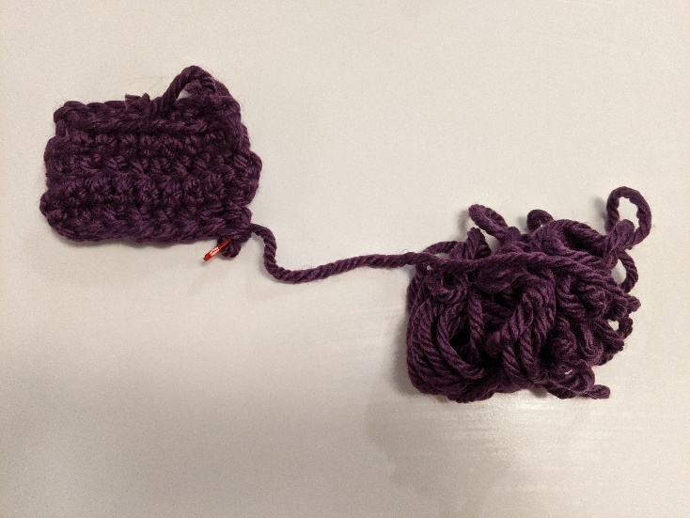
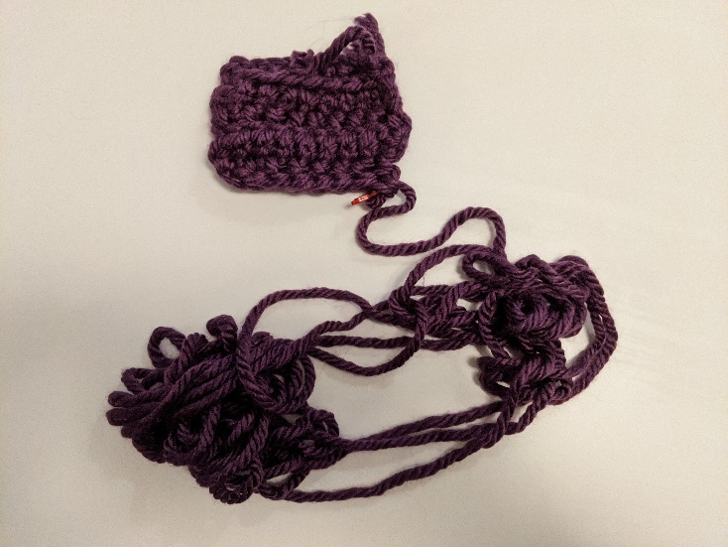
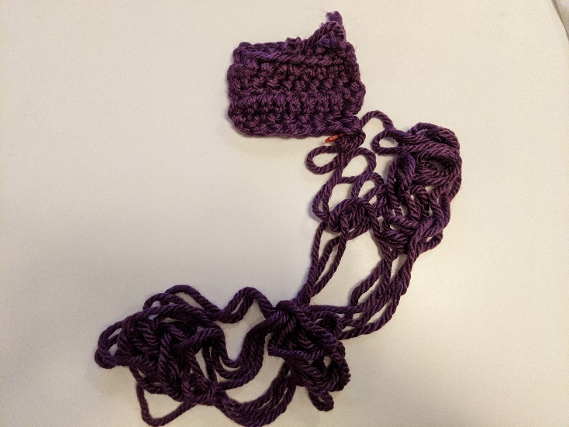

My Approach

Slide 14
End-of-Yarn Finding Algorithm
Set aside the already-obtained beginning
Do the following until you find the end:
Separate the pile of yarn into 2 piles
Label A to be the pile that the beginning enters
Label B to be the other pile
Count the number of strands crossing the piles
If count is even, set the pile to be A
Otherwise set the pile to be B.
A
B

Slide 15
Resource Analysis

Slide 16
Why do resource analysis?
Allows us to compare algorithms, not implementations
  Using observations necessarily couples the algorithm with its implementation
  If my implementation on my computer takes more time than your implementation on your computer, we cannot conclude your algorithm is better
We can predict an algorithm’s running time before implementing
Understand where the bottlenecks are in our algorithm

Slide 17
Process for resource Analysis
End Result: A function which maps the algorithm’s input size to count of resources used
  Input of the function: sizes of the input
    Number of characters in a string, number of items in a list, number of pixels in an image
  Output of the function: counts of resources used
    Number of times the algorithm adds two numbers together, number times the algorithm does a > or < comparison, maximum number of bytes of memory the algorithm uses at any time
Important note: Make sure you know the “units” of your input and output!

Slide 18
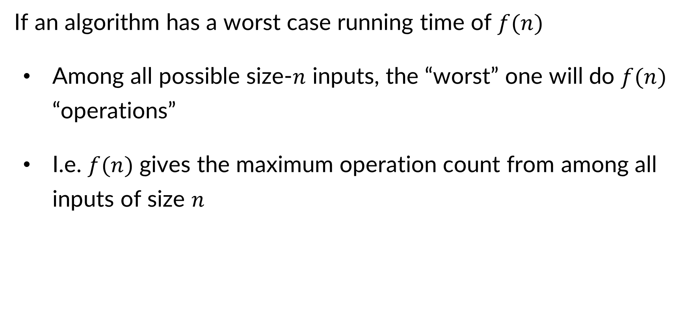
Resource Analysis – Worst Case Running Time
If an algorithm has a worst case running time of $f(n)$
  Among all possible size-$n$ inputs, the “worst” one will do $f(n)$ “operations”
  I.e. $f(n)$ gives the maximum operation count from among all inputs of size $n$

Slide 19
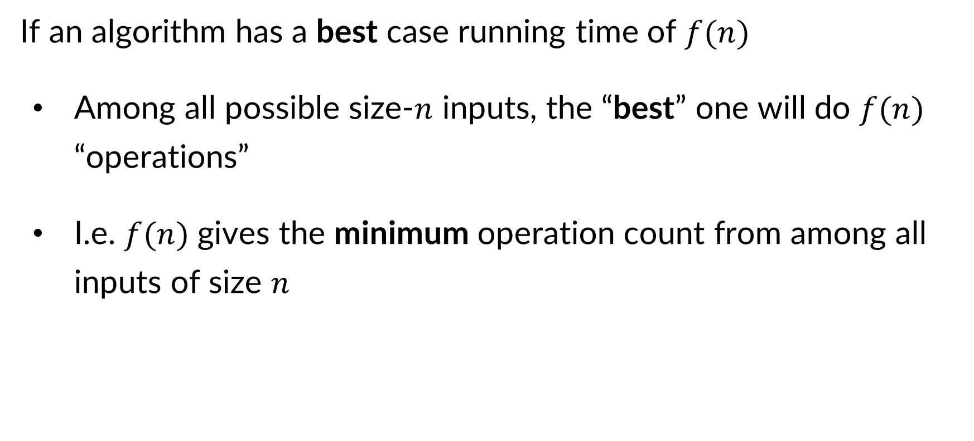
Resource Analysis – Best Case Running Time
If an algorithm has a best case running time of $f(n)$
  Among all possible size-$n$ inputs, the “best” one will do $f(n)$ “operations”
  I.e. $f(n)$ gives the minimum operation count from among all inputs of size $n$

Slide 20
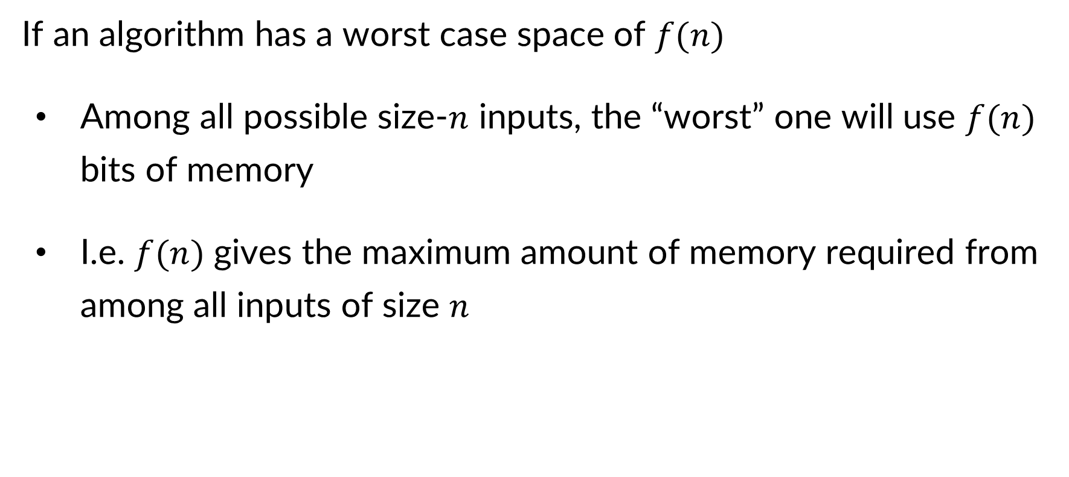
Resource Analysis – Worst Case Space
If an algorithm has a worst case space of $f(n)$
  Among all possible size-$n$ inputs, the “worst” one will use $f(n)$ bits of memory
  I.e. $f(n)$ gives the maximum amount of memory required from among all inputs of size $n$

Slide 21
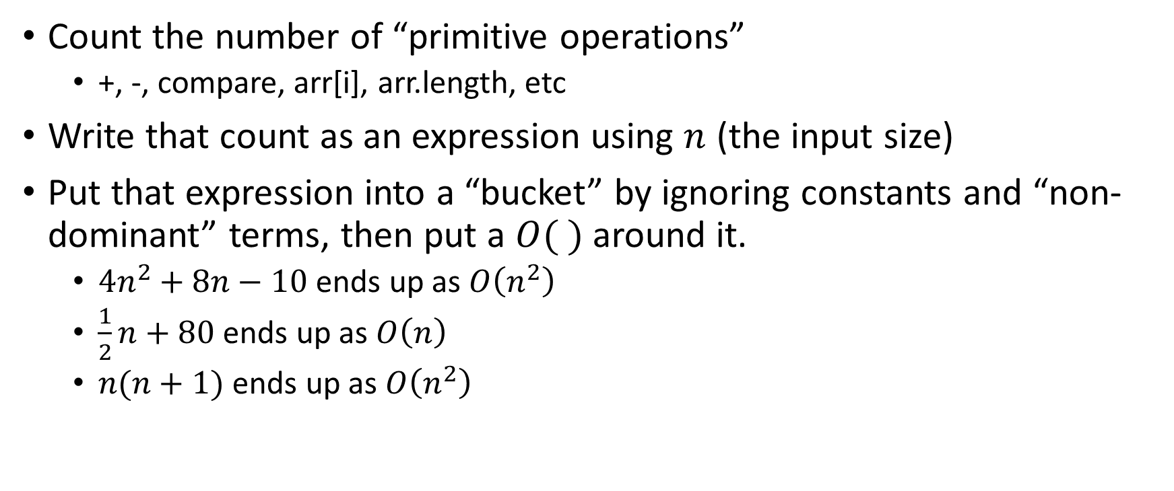
Analysis Process From 123/143
Count the number of “primitive operations”
  +, -, compare, arr[i], arr.length, etc
Write that count as an expression using $n$ (the input size)
Put that expression into a “bucket” by ignoring constants and “non-dominant” terms, then put a $O( )$ around it.
  $4n^{2}+8n−10$ ends up as $O\left(n^{2}\right)$
  $\frac{1}{2}n+80$ ends up as $O\left(n\right)$
  $n(n+1)$ ends up as $O\left(n^{2}\right)$

Slide 22
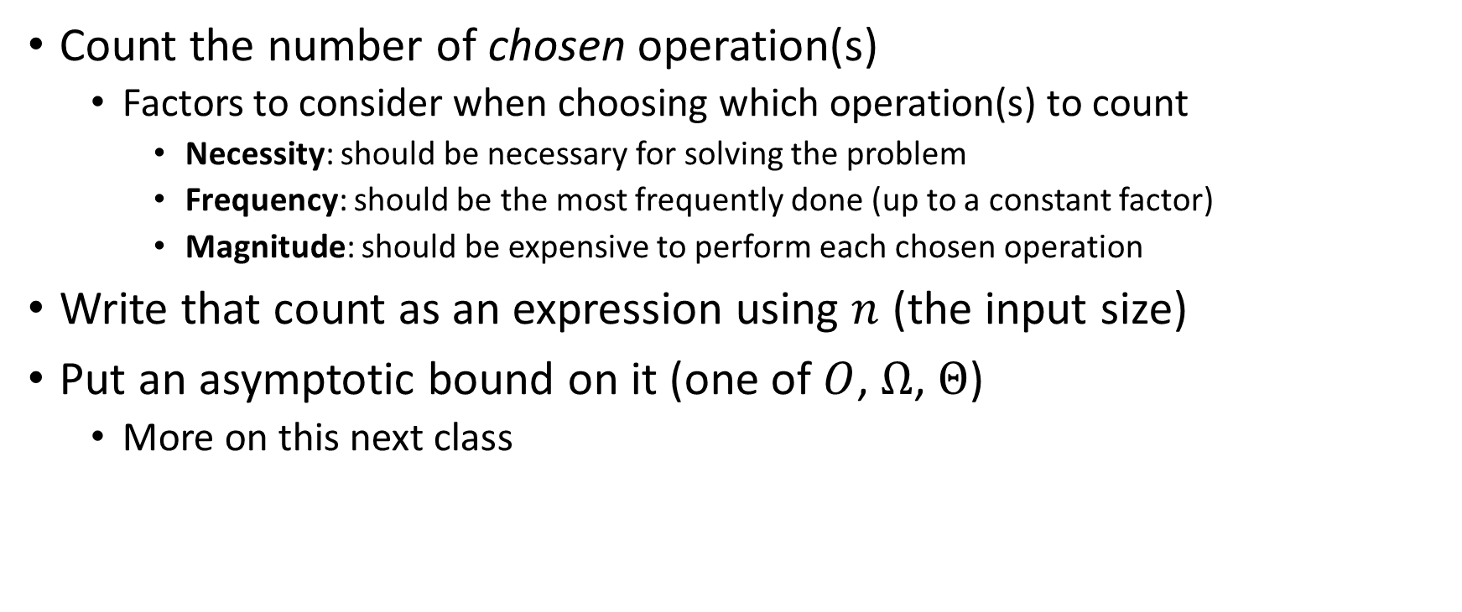
Analysis Process For Us
Count the number of chosen operation(s)
  Factors to consider when choosing which operation(s) to count
    Necessity: should be necessary for solving the problem
    Frequency: should be the most frequently done (up to a constant factor)
    Magnitude: should be expensive to perform each chosen operation
Write that count as an expression using $n$ (the input size)
Put an asymptotic bound on it (one of $O$, $Ω$, $Θ$)
  More on this next class

Slide 23
Worst Case Running Time - Example
myFunction(List n){
b = 55 + 5;
c = b / 3;
b = c + 100;
for (i = 0; i < n.size(); i++) {
b++;
}
if (b % 2 == 0) {
c++;
}
else {
for (i = 0; i < n.size(); i++) {
c++;
}
}
return c;
}
Questions to ask:
What are the units of the input size?
What are the operations we’re counting?
For each line:
  How many times will it run?
  How long does it take to run?
  Does this change with different inputs?
Answer:

Slide 24

Worst Case Running Time - Example
myFunction(List n){
b = 55 + 5; // 1
c = b / 3; // 1
b = c + 100; // 1
for (i = 0; i < n.size(); i++) { // 1, n times
b++; // 1
}
if (b % 2 == 0) { // 1
c++; // 1
}
else {
for (i = 0; i < n.size(); i++) { // 1, n times
c++; // 1
}
}
return c;
}
Questions to ask:
What are the units of the input size?
  # of items in the list
What are the operations we’re counting?
  Arithmetic ops (+-*/)
For each line:
  How many times will it run?
  How long does it take to run?
  Does this change with different inputs?
Answer:
  $3+2n+1+2n=4n+4$
  $O(n)$

Slide 25
Worst Case Running Time – Example 2
beAnnoying(List n){
List m = [];
for (i=0; i < n.size(); i++){
m.add(n[i]);
for (j=0; j< n.size(); j++){
print (“Hi, I’m annoying”);
}
}
}
Questions to ask:
What are the units of the input size?
What are the operations we’re counting?
For each line:
  How many times will it run?
  How long does it take to run?
  Does this change with the input size?

Slide 26

Worst Case Running Time – Example 2
beAnnoying(List n){
List m = [];
for (i=0; i < n.size(); i++){ // n times
m.add(n[i]);
for (j=0; j< n.size(); j++){ // n times
print (“Hi, I’m annoying”); // 1
}
}
}
Questions to ask:
What are the units of the input size?
  # items
What are the operations we’re counting?
  Adding or printing
  Printing: $O\left(n^{2}\right)$
For each line:
  How many times will it run?
  How long does it take to run?
  Does this change with the input size?

Slide 27
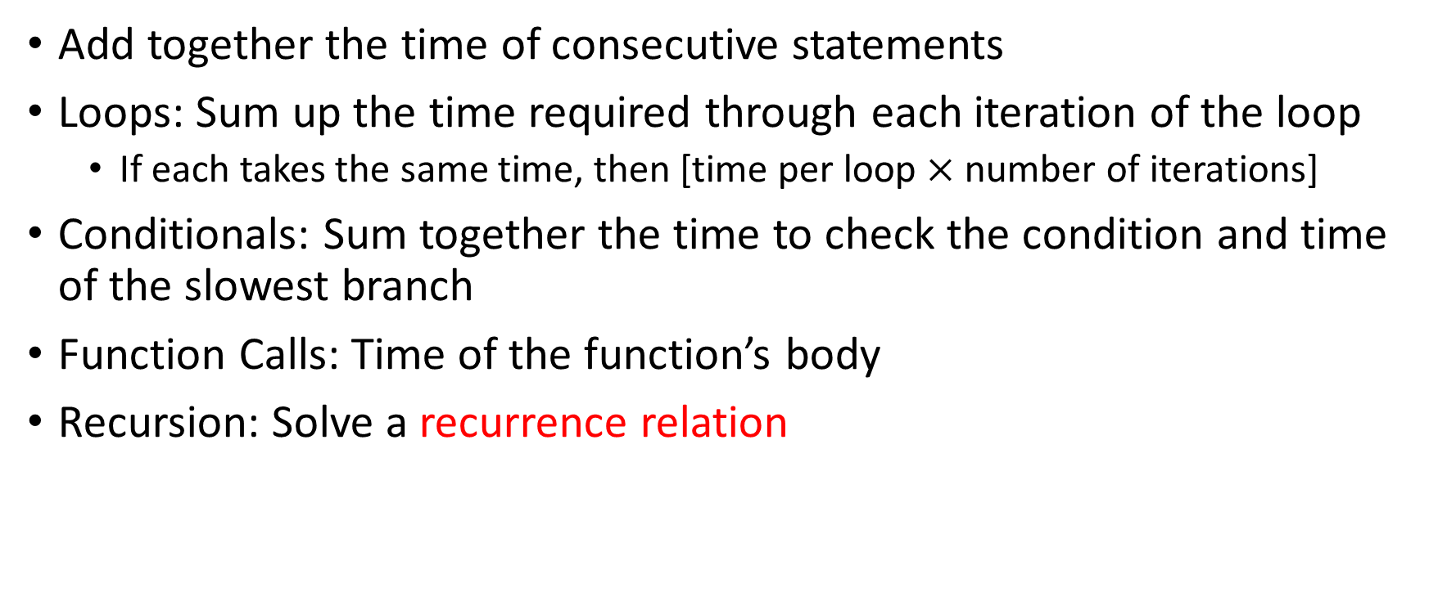
Worst Case Running Time – General Guide
Add together the time of consecutive statements
Loops: Sum up the time required through each iteration of the loop
  If each takes the same time, then [time per loop $×$ number of iterations]
Conditionals: Sum together the time to check the condition and time of the slowest branch
Function Calls: Time of the function’s body
Recursion: Solve a recurrence relation

Slide 28
Defining your running time function
Worst-case complexity:
  max number of steps algorithm takes on “most challenging” input
Best-case complexity:
  min number of steps algorithm takes on “easiest” input
Average/expected complexity:
  avg number of steps algorithm takes on random inputs (distribution-dependent)
Amortized complexity:
  max total number of steps algorithm takes on M “most challenging” consecutive inputs, divided by M (i.e., divide the max total sum by M).

Slide 29

Amortized Complexity Example - ArrayList
public void add(int value){
if(data.length == size)
resize();
data[size] = value;
size++;
}
private void resize(){
int[] oldData = data;
data = new int[data.length*2];
for(int i = 0; i < oldData.length; i++)
data[i] = oldData[i];
}
What is the worst case running time of add?
  Input size: size of “this”
  Operations counted: indexing
  $O\left(n\right)$

Slide 30
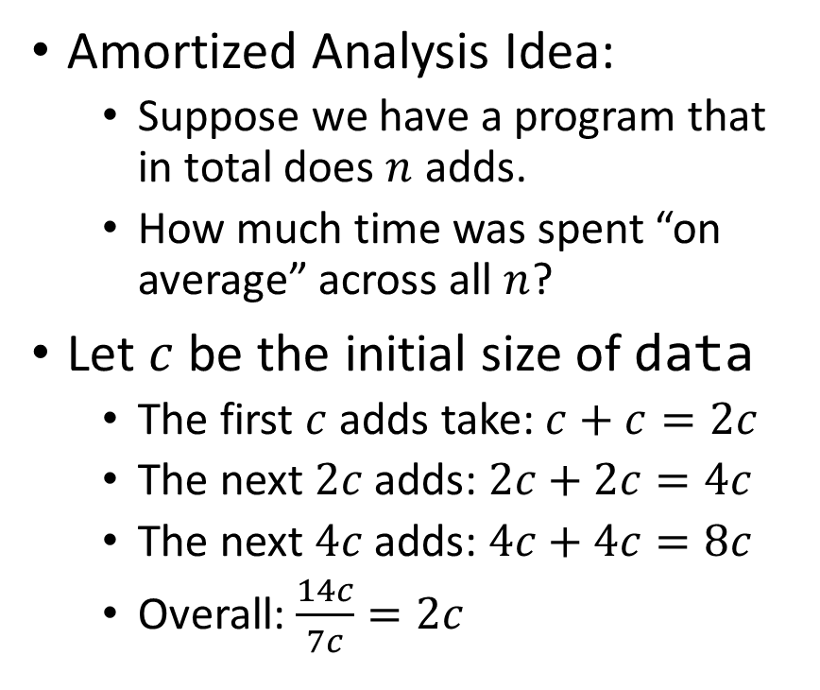
Amortized Complexity Example - ArrayList
public void add(int value){
if(data.length == size)
resize();
data[size] = value;
size++;
}
private void resize(){
int[] oldData = data;
data = new int[data.length*2];
for(int i = 0; i < oldData.length; i++)
data[i] = oldData[i];
}
Amortized Analysis Idea:
  Suppose we have a program that in total does $n$ adds.
  How much time was spent “on average” across all $n$?
Let $c$ be the initial size of data
  The first $c$ adds take: $c+c=2c$
  The next $2c$ adds: $2c+2c=4c$
  The next $4c$ adds: $4c+4c=8c$
  Overall: $\frac{14c}{7c}=2c$
Every time we resize, we earn data.length more adds before the next resize!
Notes:
Amortized: “running average”

Slide 31
Amortized Analysis Analogy
Suppose I’d like to park in a lot where they charge $10 per day to park
If you are caught in the lot without paying you are given a warning
If you get 3 warnings, you are charged a $25 fine, and your warnings reset.
Should you actually pay to park?
  If you pay every day then you pay an average of $10 per day
  If you do not pay then for every three days parking costs $0+$0+$25, for an average of $8.33 per day
    This is an amortized analysis

