Slide 1
CSE 332 Winter 2026
Lecture 21: Concurrency 3 and Amdahls Law
Nathan Brunelle
http://www.cs.uw.edu/332

Slide 2
Deadlock
Occurs when two or more threads are mutually blocking each other
T1 is blocked by T2, which is blocked by T3, …, Tn is blocked by T1
  A cycle of blocking
Three requirements for deadlock:
  Multiple threads each need to acquire multiple locks
  The locks need to be held at the same time by the threads
  The locks may be acquired in multiple orders

Slide 3
Bank Account
class BankAccount {
…
synchronized void withdraw(int amt) {…}
synchronized void deposit(int amt) {…}
synchronized void transferTo(int amt, BankAccount a) {
this.withdraw(amt);
a.deposit(amt);
}
}

Slide 4
Deadlock Example
Thread 1:
Thread 2:
x.transferTo(1,y);
y.transferTo(1,x);
acquire lock for account x b/c transferTo is synchronized
acquire lock for account y b/c deposit is synchronized
release lock for account y after depost
release lock for account x at end of transferTo
acquire lock for account y b/c transferTo is synchronized
acquire lock for account x b/c deposit is synchronized
release lock for account x after deposit
release lock for account y at end of transferTo

Slide 5
Deadlock Example
Thread 1:
Thread 2:
x.transferTo(1,y);
y.transferTo(1,x);
acquire lock for account x b/c transferTo is synchronized
acquire lock for account y b/c deposit is synchronized
release lock for account y after depost
release lock for account x at end of transferTo
acquire lock for account y b/c transferTo is synchronized
acquire lock for account x b/c deposit is synchronized
release lock for account x after deposit
release lock for account y at end of transferTo

Slide 6
Resolving Deadlocks
Option 1: Address the “multiple locks” requirement
  Merge critical sections so you only need one lock
  E.g. one lock for ALL bank accounts
Option 2: Address the “held at the same time” requirement
  Break up critical sections so that only one lock is needed at a time
  E.g. instead of a synchronized transferTo, have the withdraw and deposit steps locked separately
Option 3: Address the “acquired in multiple orders” requirement
  Force all threads to always acquire the locks in the same order
  E.g. make transferTo acquire both locks before doing either the withdraw or deposit, make sure both threads agree on the order to acquire

Slide 7
Option 1: Coarser Locking
static final Object BANK = new Object();
class BankAccount {
…
synchronized void withdraw(int amt) {…}
synchronized void deposit(int amt) {…}
void transferTo(int amt, BankAccount a) {
synchronized(BANK){
this.withdraw(amt);
a.deposit(amt);
}
}
}

Slide 8
Option 2: Finer Critical Section
class BankAccount {
…
synchronized void withdraw(int amt) {…}
synchronized void deposit(int amt) {…}
void transferTo(int amt, BankAccount a) {
synchronized(this){
this.withdraw(amt);
}
synchronized(a){
a.deposit(amt);
}
}
}

Slide 9
Option 3: Get All Locks In A Fixed Order
class BankAccount {
…
synchronized void withdraw(int amt) {…}
synchronized void deposit(int amt) {…}
void transferTo(int amt, BankAccount a) {
if (this.acctNum < a.acctNum){
synchronized(this){
synchronized(a){
this.withdraw(amt);
a.deposit(amt);
} } }
else {
synchronized(a){
synchronized(this){
this.withdraw(amt);
a.deposit(amt);
} } }
}
}

Slide 10
Parallel Algorithm Analysis
How to define efficiency
  Want asymptotic bounds
  Want to analyze the algorithm without regard to a specific number of processors

Slide 11
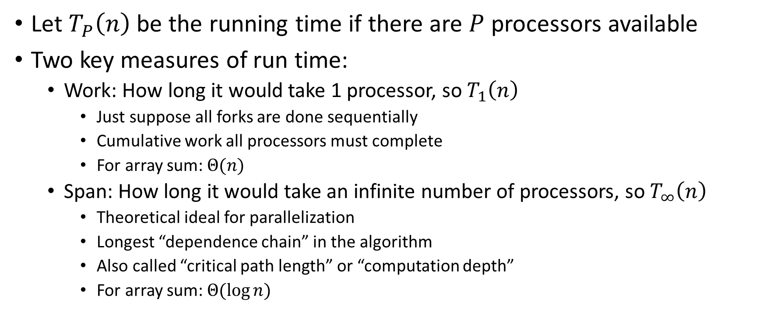
Work and Span
Let $T_{P}\left(n\right)$ be the running time if there are $P$ processors available
Two key measures of run time:
  Work: How long it would take 1 processor, so $T_{1}\left(n\right)$
    Just suppose all forks are done sequentially
    Cumulative work all processors must complete
    For array sum: $Θ(n)$
  Span: How long it would take an infinite number of processors, so $T_{∞}\left(n\right)$
    Theoretical ideal for parallelization
    Longest “dependence chain” in the algorithm
    Also called “critical path length” or “computation depth”
    For array sum: $Θ(log{n})$

Slide 12
Directed Acyclic Graph (DAG)
A directed graph that has no cycles
Often used to depict dependencies
  E.g. software dependencies, Java inheritance, dependencies among threads!
1
3
2

Slide 13
ForkJoin DAG
“Sketches” what parts of the algorithm may be done in parallel vs. must be done in-order
  Each node is a “step” of the algorithm that may depend on other steps (draw an edge) or not
Fork/Compute each create a new node
  When calling fork/compute
    Algorithm creates new threads, there is a dependency from the creating code to the code done by these threads
  When calling join
    There is a dependency from the code done by the other thread to the code after join
Divide
Span
Base Cases
Combine

Slide 14
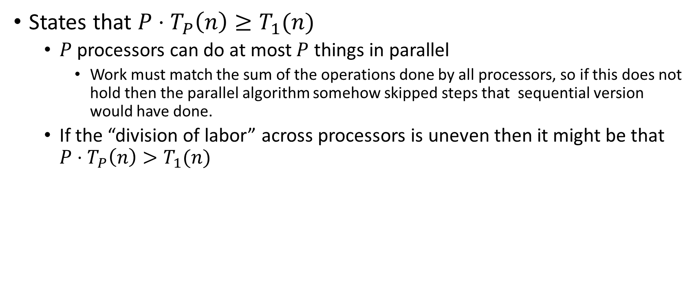
Work Law
States that $P⋅T_{P}\left(n\right)≥T_{1}(n)$
  $P$ processors can do at most $P$ things in parallel
    Work must match the sum of the operations done by all processors, so if this does not hold then the parallel algorithm somehow skipped steps that sequential version would have done.
  If the “division of labor” across processors is uneven then it might be that $P⋅T_{P}\left(n\right)>T_{1}(n)$

Slide 15
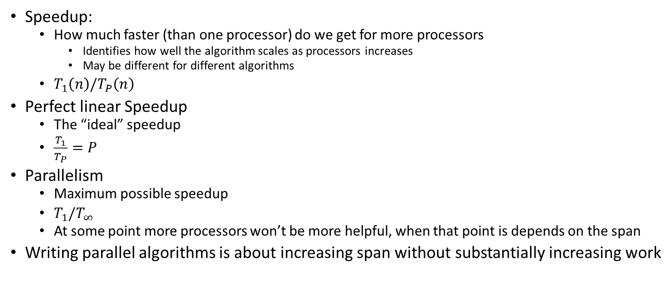
More Vocab
Speedup:
  How much faster (than one processor) do we get for more processors
    Identifies how well the algorithm scales as processors increases
    May be different for different algorithms
  $T_{1}\left(n\right)/T_{P}\left(n\right)$
Perfect linear Speedup
  The “ideal” speedup
  $\frac{T_{1}}{T_{P}}=P$
Parallelism
  Maximum possible speedup
  $T_{1}/T_{∞}$
  At some point more processors won’t be more helpful, when that point is depends on the span
Writing parallel algorithms is about increasing span without substantially increasing work

Slide 16
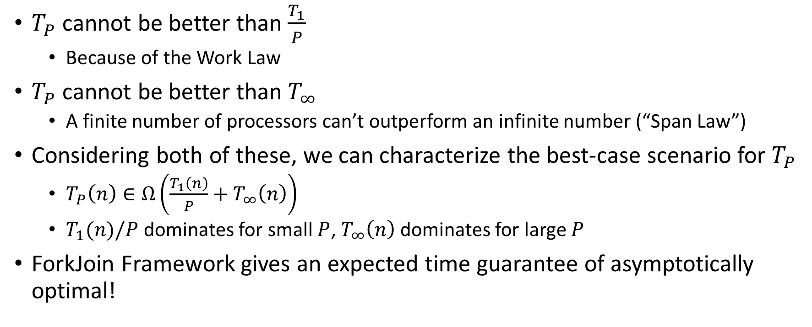

Asymptotically Optimal $T_{P}$
$T_{P}$ cannot be better than $\frac{T_{1}}{P}$
  Because of the Work Law
$T_{P}$ cannot be better than $T_{∞}$
  A finite number of processors can’t outperform an infinite number (“Span Law”)
Considering both of these, we can characterize the best-case scenario for $T_{P}$
  $T_{P}\left(n\right)∈Ω\left(\frac{T_{1}\left(n\right)}{P}+T_{∞}\left(n\right)\right)$
  $T_{1}(n)/P$ dominates for small $P$, $T_{∞}\left(n\right)$ dominates for large $P$
ForkJoin Framework gives an expected time guarantee of asymptotically optimal!

Slide 17
And now for some bad news…
In practice it’s common for your program to have:
  Parts that parallelize well
    Maps/reduces/filters over arrays and other data structures
    Anything ForkJoin!
    Tasks that don’t need to access a shared data structure
  Parts that don’t parallelize at all
    Reading a linked list, getting input, computations where each step needs the results of previous step, concurrency concerns forcing mutual exclusion
These unparallelizable parts can turn out to be a big bottleneck

Slide 18
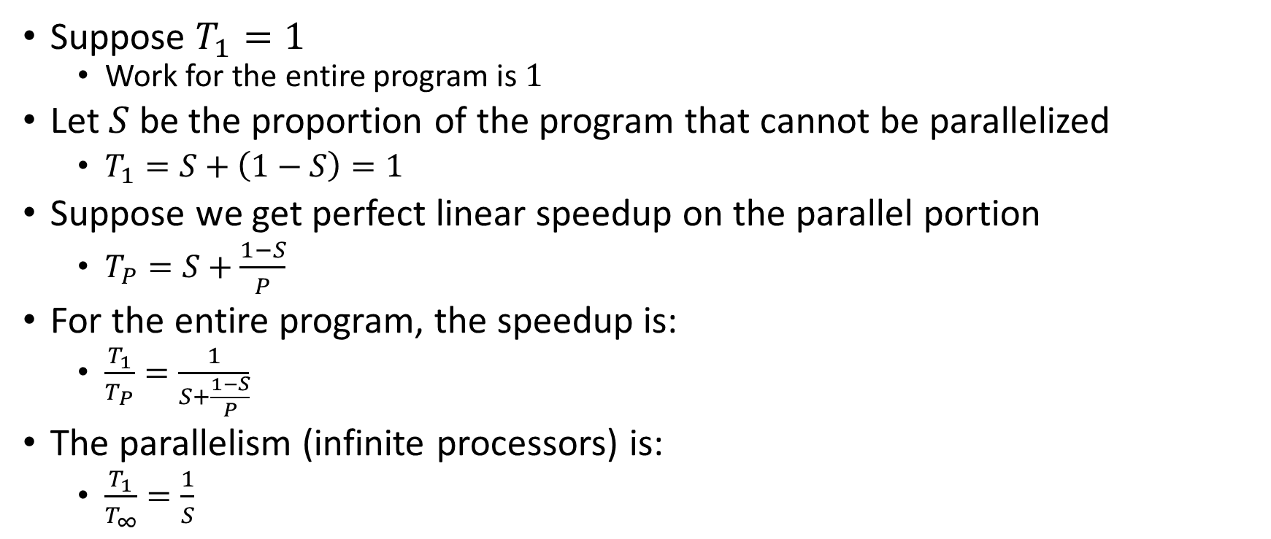
Amdahl’s Law (mostly bad news)
Suppose $T_{1}=1$
  Work for the entire program is $1$
Let $S$ be the proportion of the program that cannot be parallelized
  $T_{1}=S+\left(1−S\right)=1$
Suppose we get perfect linear speedup on the parallel portion
  $T_{P}=S+\frac{1−S}{P}$
For the entire program, the speedup is:
  $\frac{T_{1}}{T_{P}}=\frac{1}{S+\frac{1−S}{P}}$
The parallelism (infinite processors) is:
  $\frac{T_{1}}{T_{∞}}=\frac{1}{S}$

Slide 19

Amdahl’s Law Example
Suppose 2/3 of your program is parallelizable, but 1/3 is not.
  $S=\frac{1}{3}$
  $T_{1}=\frac{2}{3}+\frac{1}{3}=1$
$T_{P}=S+\frac{1−S}{P}=\frac{1}{3}+\frac{2/3}{P}$
If $T_{1}$ is 100 seconds:
  $T_{P}=33+\frac{67}{P}$
  $T_{2}=33+\frac{67}{2}≈67$
  $T_{3}=33+\frac{67}{3}≈55$
  $T_{6}=33+\frac{67}{6}≈44$
  $T_{12}=33+\frac{67}{12}≈39$
Notice:
We got a lot of speedup with the second processor (23%)
Adding a third processor only gave half as much speedup (12%)
After going up to 6 processors, we still only got 11% speedup
No matter how many processors we add, we will never get more 11% additional improvement
Conclusion:
When a portion of our code is sequential, the improvement gained from more and more processors diminishes very quickly.
Notes:
Suppose 2/3 of your program is parallelizable, but 1/3 is not.
$$S=\frac{1}{3}$$
$$T_{1}=\frac{2}{3}+\frac{1}{3}=1$$
$$T_{P}=S+\frac{1−S}{P}=\frac{1}{3}+\frac{2/3}{P}$$
If $T_{1}$ is 100 seconds:
$$T_{P}=33+\frac{67}{P}$$
$$T_{3}=33+\frac{67}{3}=33+22=55$$
$$T_{6}=33+\frac{67}{6}=33+11=44$$
$$T_{12}=33+\frac{67}{12}=33+5.5=38.5$$

Slide 20
Conclusion
Even with many many processors the sequential part of your program becomes a bottleneck
Parallelizable code requires skill and insight from the developer to recognize where parallelism is possible, and how to do it well.

Slide 21
Parallel Code Conventional Wisdom

Slide 22
Reasons to Use Parallelism
Code Responsiveness:
  While doing an expensive computation, you don’t what your interface to freeze
Processor Utilization:
  If one thread is waiting on a deep-hierarchy memory access you can still use that processor time
Failure Isolation:
  If one portion of your code fails, it will only crash that one portion.

Slide 23
Memory Categories
All memory must fit one of three categories:
Thread Local: Each thread has its own copy
Shared and Immutable: There is just one copy, but nothing will ever write to it
Shared and Mutable: There is just one copy, it may change
  Requires Synchronization!

Slide 24
Thread Local Memory
Whenever possible, avoid sharing resources
Dodges all race conditions, since no other threads can touch it!
  No synchronization necessary!
Use whenever threads do not need to communicate using the resource
  E.g., each thread should have its own Random object
In most cases, most objects should be in this category

Slide 25
Immutable Objects
Whenever possible, avoid changing objects
  Make new objects instead
Parallel reads are not data races
  If an object is never written to, no synchronization necessary!
Many programmers over-use mutation, minimize it

Slide 26
Shared and Mutable Objects
For everything else, use locks
Avoid all data races
  Every read and write should be projected with a lock, even if it “seems safe”
  Almost every Java/C program with a data race is wrong
Even without data races, it still may be incorrect
  Watch for bad interleavings as well!

Slide 27

Consistent Locking
For each location needing synchronization, have a lock that is always held when reading or writing the location
The same lock can (and often should) “guard” multiple fields/objects
  Clearly document what each lock guards!
  In Java, the lock should usually be the object itself (i.e. “this”)
Have a mapping between memory locations and lock objects and stick to it!

Slide 28
Lock Granularity
Coarse Grained: Fewer locks guarding more things each
  One lock for an entire data structure
  One lock shared by multiple objects (e.g. one lock for all bank accounts)
Fine Grained: More locks guarding fewer things each
  One lock per data structure location (e.g. array index)
  One lock per object or per field in one object (e.g. one lock for each account)
Note: there’s really a continuum between them…

Slide 29
Example: Separate Chaining Hashtable
Maximally Coarse-grained: One lock for the entire hashtable
Maximally Fine-grained: One lock for each bucket
Which supports more parallelism in insert and find?
Which makes rehashing easier?
What happens if you want to have a size field?

Slide 30
Example: Separate Chaining Hashtable
Maximally Coarse-grained: One lock for the entire hashtable
Maximally Fine-grained: One lock for each bucket
Which supports more parallelism in insert and find?
  Fine-grained, since inserts and finds can happen in parallel when there is no collision
Which makes rehashing easier?
  Course-grained, as with fine-grained you would need to acquire ALL of the locks
What happens if you want to have a size field?
  For fine-grained, every insert would need to update the size, so there’s risk of a data race

Slide 31
Tradeoffs
Coarse-Grained Locking:
  Simpler to implement and avoid race conditions
  Faster/easier to implement operations that access multiple locations (because all guarded by the same lock)
  Much easier for operations that modify data-structure shape
Fine-Grained Locking:
  More simultaneous access (performance when coarse grained would lead to unnecessary blocking)
  Can make multi-location operations more difficult: say, rotations in an AVL tree
Guideline:
  Start with coarse-grained, make finer only as necessary to improve performance

Slide 32
Similar But Separate Issue: Critical Section Granularity
Coarse-grained
  For every method that needs a lock, put the entire method body in a lock
Fine-grained
  Keep the lock only for the sections of code where it’s necessary
Guideline:
  Try to structure code so that expensive operations (like I/O) can be done outside of your critical section
  E.g., if you’re trying to print all the values in a tree, maybe copy items into an array inside your critical section, then print the array’s contents outside.

Slide 33
Atomicity
Atomic: indivisible
Atomic operation: one that should be thought of as a single step
Some sequences of operations should behave as if they are one unit
  Between two operations you may need to avoid exposing an intermediate state
  Usually ADT operations should be atomic
    You don’t want another thread trying to do an insert while another thread is rotating the AVL tree
Think first in terms of what operations need to be atomic
  Design critical sections and locking granularity based on these decisions

Slide 34
Use Pre-Tested Code
Whenever possible, use built-in libraries!
Other people have already invested tons of effort into making things both efficient and correct, use their work when you can!
  Especially true for concurrent data structures
  Use thread-safe data structures when available
    E.g. Java as ConcurrentHashMap

