Slide 1
CSE 332 Winter 2026
Lecture 18: Parallel Prefix
Michael Whitmeyer
http://www.cs.uw.edu/332

Slide 2
Which Data Structures are “Suitable” for Parallelism?
For each data structure, can we write a parallel algorithm to sum all of its values that’s more efficient than a sequential one?
  Array
  Linked List
  Binary Tree

Slide 3
ForkJoin Framework
This strategy is common enough that Java (and C++, and C#, and…) provides a library to do it for you!
What you would do in Threads | What to instead in ForkJoin
Subclass Thread | Subclass RecursiveTask<V>
Override run | Override compute
Store the answer in a field | Return a V from compute
Call start | Call fork
join synchronizes only | join synchronizes and returns the answer
Call run to execute sequentially | Call compute to execute sequentially
Have a topmost thread and call run | Create a pool and call invoke

Slide 4
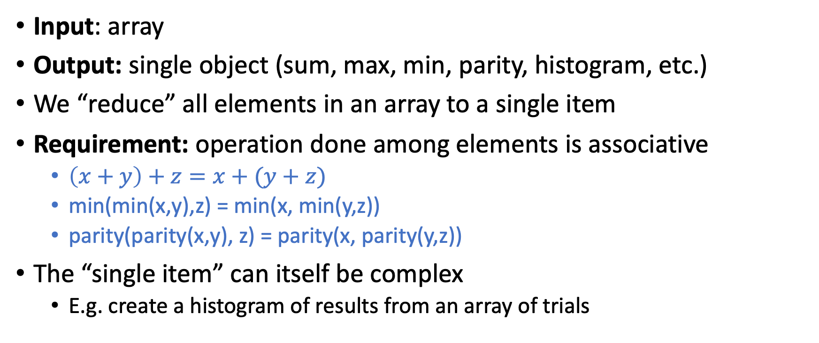
Reduction/Fold
Input: array
Output: single object (sum, max, min, parity, histogram, etc.)
We “reduce” all elements in an array to a single item
Requirement: operation done among elements is associative
  $\left(x+y\right)+z=x+(y+z)$
  min(min(x,y),z) = min(x, min(y,z))
  parity(parity(x,y), z) = parity(x, parity(y,z))
The “single item” can itself be complex
  E.g. create a histogram of results from an array of trials

Slide 5
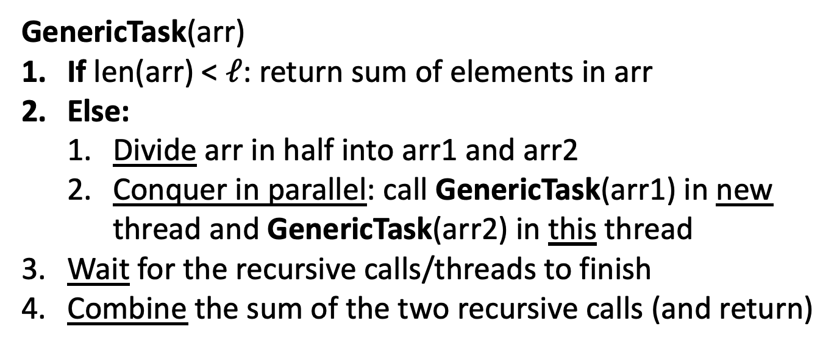
ForkJoin Pseudocode for Summing
Finding Max
GenericTask(arr)
If len(arr) < $ℓ$: return sum of elements in arr
Else:
  Divide arr in half into arr1 and arr2
  Conquer in parallel: call GenericTask(arr1) in new thread and GenericTask(arr2) in this thread
Wait for the recursive calls/threads to finish
Combine the sum of the two recursive calls (and return)
max
fork()
compute()
Take the max of the two
join()

Slide 6
Divide and Conquer with ForkJoin
class SumTask extends RecursiveTask<Integer> {
int lo; int hi; int[] arr; // fields to know what to do
SumTask(int[] a, int l, int h) { … }
protected Integer compute(){// return answer
if(hi – lo < SEQUENTIAL_CUTOFF) { // base case
int ans = 0; // local var, not a field
for(int i=lo; i < hi; i++) {
ans += arr[i]; return ans; }
else {
SumTask left = new SumTask(arr,lo,(hi+lo)/2); // divide
SumTask right= new SumTask(arr,(hi+lo)/2,hi); // divide
left.fork(); // fork a thread and calls compute (conquer)
int rightAns = right.compute(); //call compute directly (conquer)
int leftAns = left.join(); // get result from left
return leftAns + rightAns; // combine
}
}
}

Slide 7
Divide and Conquer with ForkJoin (continued)
static final ForkJoinPool POOL = new ForkJoinPool();
static int parallelSum(int[] arr){
SumTask task = new SumTask(arr,0,arr.length)
return POOL.invoke(task); // invoke returns the value compute returns
}

Slide 8
Find Max with ForkJoin
class MaxTask extends RecursiveTask<Integer> {
int lo; int hi; int[] arr; // fields to know what to do
SumTask(int[] a, int l, int h) { … }
protected Integer compute(){// return answer
if(hi – lo < SEQUENTIAL_CUTOFF) { // base case
int ans = Integer.MIN_VALUE; // local var, not a field
for(int i=lo; i < hi; i++) {
ans = Math.max(ans, arr[i]);}
return ans;
else {
MaxTask left = new MaxTask(arr,lo,(hi+lo)/2); // divide
MaxTask right= new MaxTask(arr,(hi+lo)/2,hi); // divide
left.fork(); // fork a thread and calls compute (conquer)
int rightAns = right.compute(); //call compute directly (conquer)
int leftAns = left.join(); // get result from left
return Math.max(rightAns, leftAns); // combine
}
}
}

Slide 9
Other Problems that can be solved similarly
Element Search
  Is the value 17 in the array?
Counting items with a certain property
  How many elements of the array are divisible by 5?
Checking if the array is sorted
Find the smallest rectangle that covers all points in the array
Find the first thing that satisfies a property
  What is the leftmost item that is divisible by 20?

Slide 10
Reduction (sum an array)
5
8
2
9
4
1
5
Base Case:
  If the list’s length is smaller than the Sequential Cutoff, reduce things sequentially
Divide:
  Split the list into two “sublists” of (roughly) equal length, create a thread to reduce each sublist.
Conquer:
  Call start() for each thread
Combine:
  Reduce the answers from each thread
5
8
2
9
4
1
ans=15
ans=14
ans=29

Slide 11
Map
Input: array(s)
Output: array (of same size)
Requirement: apply some function to individual array elements.
Examples:
  Vector addition:
    sum[i] = arr1[i] + arr2[i]
  Function application:
    out[i] = f(arr[i]);

Slide 12
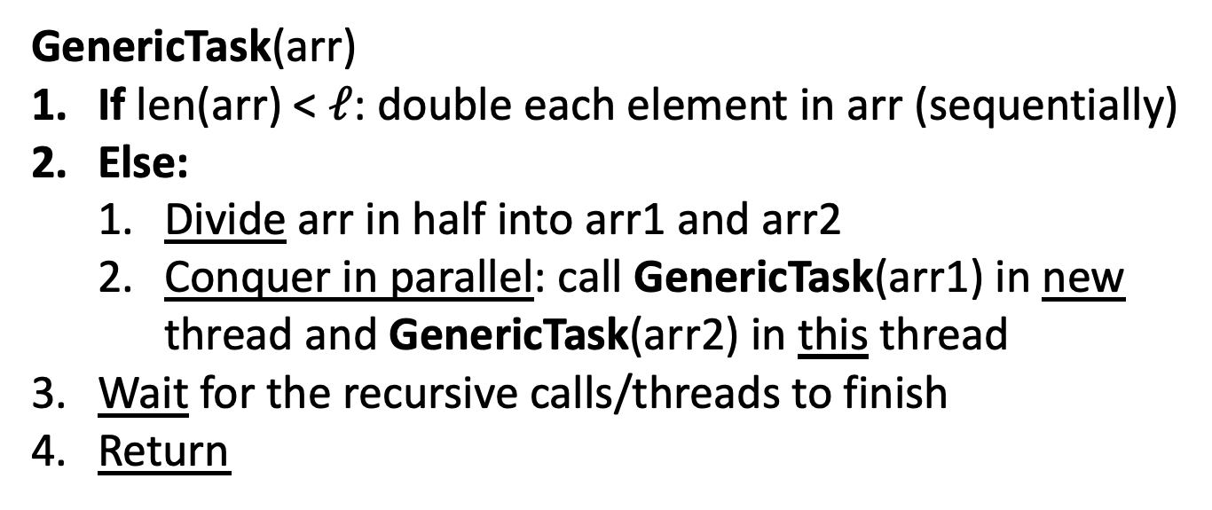
ForkJoin Pseudocode for Doubling each element
Applying map f
GenericTask(arr)
If len(arr) < $ℓ$: double each element in arr (sequentially)
Else:
  Divide arr in half into arr1 and arr2
  Conquer in parallel: call GenericTask(arr1) in new thread and GenericTask(arr2) in this thread
Wait for the recursive calls/threads to finish
Return
Apply f to
fork()
compute()
join()

Slide 13
Map (double each value)
5
8
2
9
4
1
5
10
Base Case:
  If the list’s length is smaller than the Sequential Cutoff, convert each thing sequentially
Divide:
  Split the list into two “sublists” of (roughly) equal length, create a thread to map each sublist.
Conquer:
  Call start() for each thread
Combine:
  No additional work necessary
5
8
2
9
4
1
10
16
4
18
8
2
10
16
4
18
8
2

Slide 14
Map with ForkJoin
class AddTask extends RecursiveAction {
int lo; int hi; int[] arr; // fields to know what to do
AddTask(int[] a, int[] b, int[] sum, int l, int h) { … }
protected void compute(){// return answer
if(hi – lo < SEQUENTIAL_CUTOFF) { // base case
for(int i=lo; i < hi; i++) {
sum[i] = a[i] + b[i];}
else {
AddTask left = new AddTask(a,b,sum,lo,(hi+lo)/2); // divide
AddTask right= new AddTask(a,b,sum,(hi+lo)/2,hi); // divide
left.fork(); // fork a thread and calls compute (conquer)
right.compute(); //call compute directly (conquer)
left.join(); // get result from left
return; // combine
}
}
}

Slide 15
Map with ForkJoin (continued)
static final ForkJoinPool POOL = new ForkJoinPool();
Int[] add(int[] a, int[] b){
ans = new int[a.length];
AddTask task = new AddTask(a, b, ans, 0, a.length)
POOL.invoke(task);
return ans;
}

Slide 16
Maps and Reductions
“Workhorse” constructs in parallel programming
Many problems can be written in terms of maps and reductions
With practice, writing them will become second nature
  Like how over time for loops and if statements have gotten easier

Slide 17
ForkJoin Picture
range: [0,8)
Thread:
range: [4,8)
Thread:
range: [0,4)
Thread:
range: [0,2)
Thread:
range: [2,4)
Thread:
range: [4,6)
Thread:
range: [6,8)
Thread:

Slide 18
ForkJoin Picture
.fork()
range: [0,8)
Thread: 1
.compute()
range: [4,8)
Thread: 1
.fork()
range: [0,4)
Thread: 2
.fork()
.compute()
.compute()
range: [0,2)
Thread: 3
range: [2,4)
Thread: 2
range: [4,6)
Thread: 4
range: [6,8)
Thread: 1

Slide 19
Map/Reduction Example
Task: Multiply together the lengths of all the odd-length strings in array
  Apply map to convert the array of strings into an array of their lengths
  Then do a map on that array so each value maps to 1 if it’s even and itself if it’s odd
  Then do a reduction to multiply together that final result
Note: You could do this in a single ForkJoin RecursiveTask
  but “deconstructing” useful since some languages designed specifically for parallelism have Map/Reduce built in.
  Map and Reduce are two from a trio, with Pack/Filter being the third

Slide 20

Pack/Filter
Given an array of values and a Boolean function, return a new array which contains only elements that were “true”
10
16
4
18
8
2
10
16
18
$$f\left(x\right)=x>9$$
Question: Can we Pack/Filter in parallel?
Answer: yes, with help of parallel Prefix Sum

Slide 21
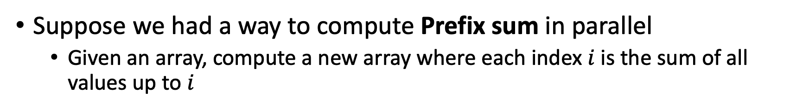
Question: Can we Pack/Filter in parallel?
Suppose we had a way to compute Prefix sum in parallel
  Given an array, compute a new array where each index $i$ is the sum of all values up to $i$
10
16
4
18
8
2
10
26
30
48
56
58
Computing filter f(x) > 9
10
16
4
18
8
2
1
1
0
1
0
0
Map: f(x) = 1 if x > 9
1
2
2
3
3
3
Prefix sum!

Slide 22

Prefix Sum
Given an array, compute a new array where each index $i$ is the sum of all values up to $i$
10
16
4
18
8
2
10
26
30
48
56
58
Later: will be useful for parallel packing/filtering!

Slide 23

Parallel Prefix Sum
Algorithm will have two major parallel steps
  Called a “two pass” parallel algorithm
First step:
  Create a tree data structure
Second Step:
  Use the tree to fill in the output array
Richard Ladner
Allen School Faculty
The “subproblem” this node represents
lower bound is inclusive, upper is exclusive
range: [lo,hi)
sum:
leftSum:
Tree Node:
The sum of all values in the range
The sum of all values to the left of the range
i.e. in the range [0, lo)

Slide 24
Step 1: Using D&C
Create a Tree, Fill in sum
14
9
Input:
10
16
4
18
8
2
Output:
For this pass we will only fill in sum
In the next pass we will find leftSum
range: [0,8)
sum:
leftSum:
0
1
2
3
4
5
6
7
range: [0,4)
sum:
leftSum:
range: [4,8)
sum:
leftSum:
range: [0,2)
sum:
leftSum:
range: [2,4)
sum:
leftSum:
range: [4,6)
sum:
leftSum:
range: [6,8)
sum:
leftSum:
range: [0,1)
sum:
leftSum:
range: [1,2)
sum:
leftSum:
range: [2,3)
sum:
leftSum:
range: [3,4)
sum:
leftSum:
range: [4,5)
sum:
leftSum:
range: [5,6)
sum:
leftSum:
range: [6,7)
sum:
leftSum:
range: [7,8)
sum:
leftSum:

Slide 25
Step 1: Create a Tree,
Fill in sum
10
16
4
18
8
2
14
9
range: [2,3)
sum: 4
leftSum:
Base Case:
  If the range is smaller than the Sequential Cutoff, create a node for that range and find the sum sequentially
Divide:
  Split the list into two “sublists” of (roughly) equal length, create a thread for each sublist.
Conquer:
  Compute the left and right subtrees in parallel
Combine:
  Create parent node, connect to children, fill in sum
4
8
2
14
9
10
16
4
18
range: [0,4)
sum: 48
leftSum:
range: [4,8)
sum: 33
leftSum:
range: [0,8)
sum: 81
leftSum:
range: [0,4)
sum: 48
leftSum:
range: [4,8)
sum: 33
leftSum:

Slide 26
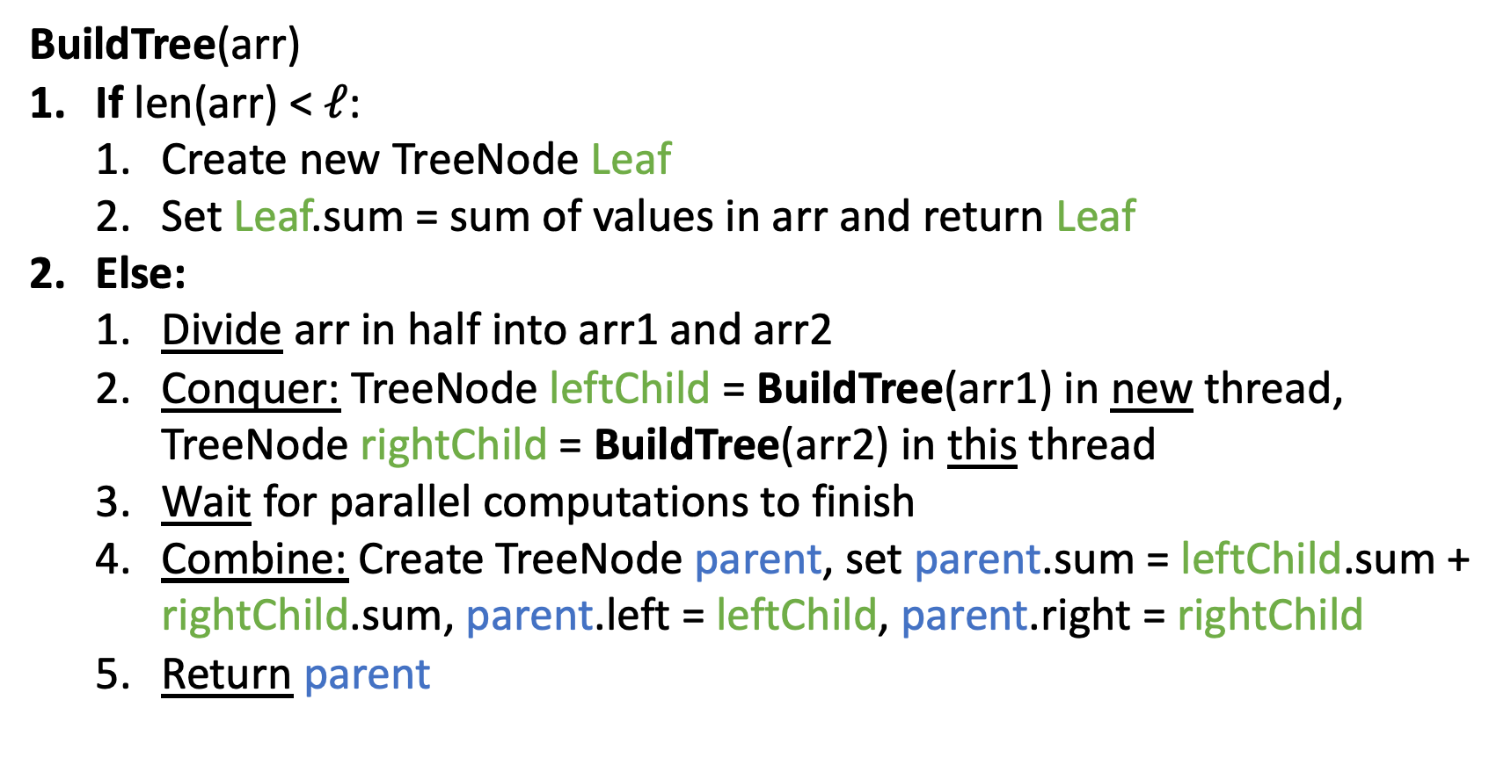
Step 1 pseudocode (create tree, compute sum)
BuildTree(arr)
If len(arr) < $ℓ$:
  Create new TreeNode Leaf
  Set Leaf.sum = sum of values in arr and return Leaf
Else:
  Divide arr in half into arr1 and arr2
  Conquer: TreeNode leftChild = BuildTree(arr1) in new thread, TreeNode rightChild = BuildTree(arr2) in this thread
  Wait for parallel computations to finish
  Combine: Create TreeNode parent, set parent.sum = leftChild.sum + rightChild.sum, parent.left = leftChild, parent.right = rightChild
  Return parent

Slide 27
class BuildTree extends RecursiveTask<PrefixSumNode> {
protected PrefixSumNode compute(){
if(hi – lo < SEQUENTIAL_CUTOFF) { // base case
int ans = 0; // local var, not a field
for(int i=lo; i < hi; i++)
ans += arr[i];
return new PrefixSumNode(lo, hi, ans); }
else {
BuildTree left = new BuildTree(arr,lo,(hi+lo)/2);
BuildTree right= new BuildTree(arr,(hi+lo)/2,hi);
left.fork();
PrefixSumNode rightChild = right.compute();
PrefixSumNode leftChild = left.join();
int ans = rightChild.sum + leftChild.sum;
parent = new PrefixSumNode(lo, hi, ans);
parent.left = leftChild;
parent.right = rightChild;
return parent; }
}
}

Slide 28
After Step 1
Input:
10
16
4
18
8
2
14
9
All sums filled in per node
In the next pass we will find leftSum
leftSum is the sum of all elements strictly to the left of the current range
Output:
range: [0,8)
sum: 81
leftSum:
0
1
2
3
4
5
6
7
range: [0,4)
sum: 48
leftSum:
range: [4,8)
sum: 33
leftSum:
range: [0,2)
sum: 26
leftSum:
range: [2,4)
sum: 22
leftSum:
range: [4,6)
sum: 10
leftSum:
range: [6,8)
sum: 23
leftSum:
range: [0,1)
sum: 10
leftSum:
range: [1,2)
sum: 16
leftSum:
range: [2,3)
sum: 4
leftSum:
range: [3,4)
sum: 18
leftSum:
range: [4,5)
sum: 8
leftSum:
range: [5,6)
sum: 2
leftSum:
range: [6,7)
sum: 14
leftSum:
range: [7,8)
sum: 9
leftSum:

Slide 29
Step 2: fill in leftSum and Output
Input:
10
16
4
18
8
2
14
9
Output:
leftSum is the sum of all elements strictly to the left of the current range
We’re going to go root-down, so we can use: any node’s sum, parent’s leftSum
range: [0,8)
sum: 81
leftSum:
0
1
2
3
4
5
6
7
range: [0,4)
sum: 48
leftSum:
range: [4,8)
sum: 33
leftSum:
range: [0,2)
sum: 26
leftSum:
range: [2,4)
sum: 22
leftSum:
range: [4,6)
sum: 10
leftSum:
range: [6,8)
sum: 23
leftSum:
range: [0,1)
sum: 10
leftSum:
range: [1,2)
sum: 16
leftSum:
range: [2,3)
sum: 4
leftSum:
range: [3,4)
sum: 18
leftSum:
range: [4,5)
sum: 8
leftSum:
range: [5,6)
sum: 2
leftSum:
range: [6,7)
sum: 14
leftSum:
range: [7,8)
sum: 9
leftSum:

Slide 30
Step 2: fill in leftSum
and Output
Input:
10
16
4
18
8
2
14
9
Output:
If this is a left child:
leftSum = parent.leftSum
If this is a right child:
leftSum = parent.leftSum + sibling.sum
range: [0,8)
sum: 81
leftSum:
0
1
2
3
4
5
6
7
range: [0,4)
sum: 48
leftSum:
range: [4,8)
sum: 33
leftSum:
range: [0,2)
sum: 26
leftSum:
range: [2,4)
sum: 22
leftSum:
range: [4,6)
sum: 10
leftSum:
range: [6,8)
sum: 23
leftSum:
range: [0,1)
sum: 10
leftSum:
range: [1,2)
sum: 16
leftSum:
range: [2,3)
sum: 4
leftSum:
range: [3,4)
sum: 18
leftSum:
range: [4,5)
sum: 8
leftSum:
range: [5,6)
sum: 2
leftSum:
range: [6,7)
sum: 14
leftSum:
range: [7,8)
sum: 9
leftSum:

Slide 31
Step 2: fill in leftSum and Output
Input:
10
16
4
18
8
2
14
9
If this is a left child:
leftSum = parent.leftSum
If this is a right child:
leftSum = parent.leftSum + sibling.sum
For the leaves:
use leftSum+sum
to complete output
Output:
range: [0,8)
sum: 81
leftSum: 0
0
1
2
3
4
5
6
7
range: [0,4)
sum: 48
leftSum: 0
range: [4,8)
sum: 33
leftSum: 48
range: [0,2)
sum: 26
leftSum: 0
range: [2,4)
sum: 22
leftSum: 26
range: [4,6)
sum: 10
leftSum: 48
range: [6,8)
sum: 23
leftSum: 58
range: [0,1)
sum: 10
leftSum: 0
range: [1,2)
sum: 16
leftSum: 10
range: [2,3)
sum: 4
leftSum: 26
range: [3,4)
sum: 18
leftSum: 30
range: [4,5)
sum: 8
leftSum: 48
range: [5,6)
sum: 2
leftSum: 56
range: [6,7)
sum: 14
leftSum: 58
range: [7,8)
sum: 9
leftSum: 72

Slide 32
Step 2: fill in leftSum and Output
Input:
10
16
4
18
8
2
14
9
If this is a left child:
leftSum = parent.leftSum
If this is a right child:
leftSum = parent.leftSum + sibling.sum
For the leaves:
use leftSum+sum
to complete output
Output:
10
26
30
48
56
58
72
81
range: [0,8)
sum: 81
leftSum: 0
0
1
2
3
4
5
6
7
range: [0,4)
sum: 48
leftSum: 0
range: [4,8)
sum: 33
leftSum: 48
range: [0,2)
sum: 26
leftSum: 0
range: [2,4)
sum: 22
leftSum: 26
range: [4,6)
sum: 10
leftSum: 48
range: [6,8)
sum: 23
leftSum: 58
range: [0,1)
sum: 10
leftSum: 0
range: [1,2)
sum: 16
leftSum: 10
range: [2,3)
sum: 4
leftSum: 26
range: [3,4)
sum: 18
leftSum: 30
range: [4,5)
sum: 8
leftSum: 48
range: [5,6)
sum: 2
leftSum: 56
range: [6,7)
sum: 14
leftSum: 58
range: [7,8)
sum: 9
leftSum: 72

Slide 33
Step 2 pseudocode (Compute Leftsum)
CompleteTree(Node curr)
If curr is a left child of curr.parent:
  Set curr.LeftSum = curr.parent.LeftSum
Else:
  Set curr.LeftSum = curr.parent.LeftSum + curr.sibling.Sum
If curr is not a leaf:
  Divide and conquer: call CompleteTree(curr.left) and CompleteTree(curr.right) in parallel threads
  Wait for parallel computations to finish
Else (curr is a leaf):
  Set output[curr.lo] = curr.LeftSum + input[curr.lo]
  for i = curr.lo + 1 to curr.hi:
    Set output[i] = output[i-1] + input[i]
Base Case

Slide 34
class CompleteTree extends RecursiveAction {
public CompleteTree(PrefixSumNode curr, PrefixSumNode parent, PrefixSumNode sibling, boolean isLeftChild, int[] output, int[] input){…}
protected void compute(){
if(isLeftChild)
curr.sumLeft = parent.sumLeft;
else
curr.sumLeft = parent.sumLeft + sibling.sum;
if (curr.leftChild != null && curr.rightChild != null){ // if this isn’t a leaf
CompleteTree left = new CompleteTree(curr.leftChild, curr, curr.rightChild, true, output, input);
left.fork();
CompleteTree right = new CompleteTree(curr.rightChild, curr, curr.leftChild, false, output, input);
right.compute();
left.join();
}
else{
output[curr.lo] = curr.sumLeft + input[curr.lo];
for(int i = curr.lo+1; i < curr.hi; i++){
output[i] = output[i-1] + input[i]
}
}
}
}

Slide 35
Whew! Back to Pack/Filter
Given an array of values and a Boolean function, return a new array which contains only elements that were “true”
10
16
4
18
8
2
14
9
10
16
18
14
$$f\left(x\right)=x>9$$

Slide 36
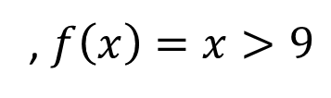
Parallel Pack
Input:
10
16
4
18
8
2
14
9
, $f\left(x\right)=x>9$
Output:
10
16
18
14
0
1
2
3
4
5
6
7
Do a map to identify the true elements
Do prefix sum on the result → count of true elements seen to the left of each position
Fill in the output in parallel:
1
1
0
1
0
0
1
0
1
2
2
3
3
3
4
4
10
16
18
14

Slide 37
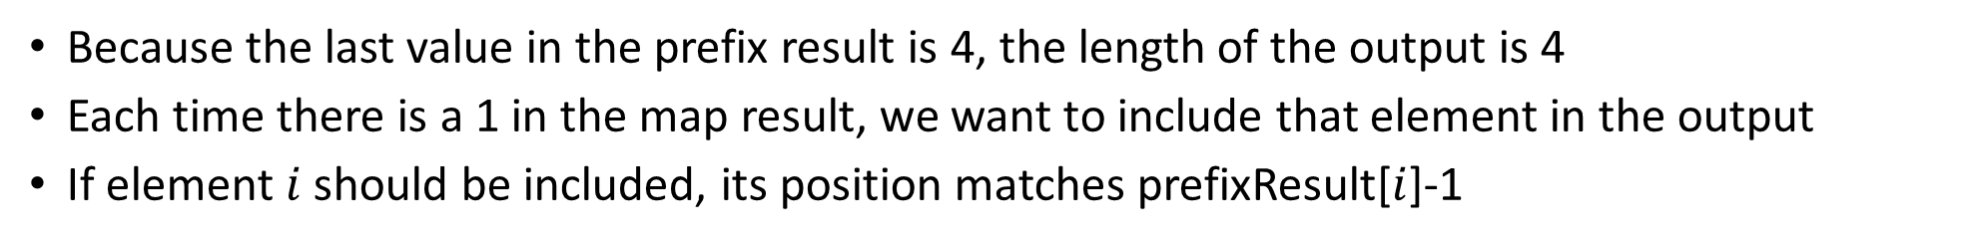
3. Fill in the output in parallel:
Input:
10
16
4
18
8
2
14
9
Map Result:
1
1
0
1
0
0
1
0
Prefix Result:
1
2
2
3
3
3
4
4
Output:
Because the last value in the prefix result is 4, the length of the output is 4
Each time there is a 1 in the map result, we want to include that element in the output
If element $i$ should be included, its position matches prefixResult[$i$]-1
Int[] output = new int[prefixResult[input.length-1]];
FORALL(int i = 0; i < input.length; i++){
if (mapResult[i] == 1)
output[prefixResult[i]-1] = input[i];
}

Slide 38
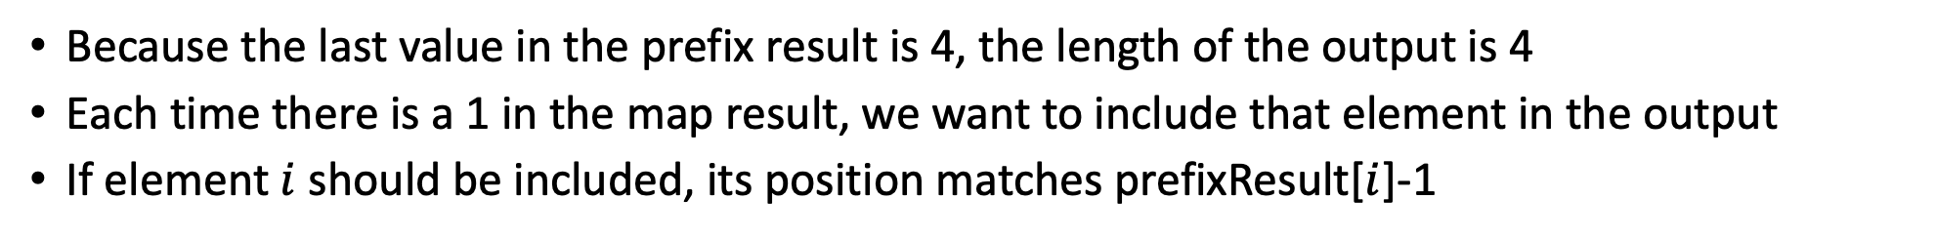
3. Fill in the output in parallel:
Input:
10
16
4
18
8
2
14
9
Map Result:
1
1
0
1
0
0
1
0
Prefix Result:
1
2
2
3
3
3
4
4
Output:
Because the last value in the prefix result is 4, the length of the output is 4
Each time there is a 1 in the map result, we want to include that element in the output
If element $i$ should be included, its position matches prefixResult[$i$]-1
In parallel: if mapResult[i] == 1:
output[prefixResult[i]-1] = input[i]

Slide 39
Map/Reduction/Pack Example
Multiply together the lengths of all of the odd-length strings in a given array
  First, do a map to covert the array of strings into an array of their lengths
  Then do a map on that array so each value maps to 1 if it’s even and itself if it’s odd
    Alternatively, do a pack on the array to remove all even values
  Then do a reduction to multiply together that final result

