Slide 1
CSE 332 Winter 2026
Lecture 12: Sorting
Nathan Brunelle
http://www.cs.uw.edu/332

Slide 2


Linear Probing: Delete
Option 1 (harder): Plug the hole with other items in a way that makes probes behave correctly
Option 2 (easier): “Tombstone” deletion. Leave a special object that indicates an something was deleted from there
  The tombstone does not act as an open space when finding (so keep looking after its reached)
  When inserting you can replace a tombstone with a new item
$$k,v$$
$$k,v$$
$$k,v$$
$$k,v$$
0
1
2
3
4
5
6
7
8
9

Slide 3
Linear Probing + Tombstone: Find
To find key k
  Calculate i = h(k) % table.length
  While table[i] has a key other than k, set i = (i+1) % table.length
  If you come across k return table[i]
  If you come across an empty index, the find was unsuccessful
0
1
2
3
4
5
6
7
8
9

Slide 4
Linear Probing + Tombstone: Insert
To insert k,v
  Calculate i = h(k) % table.length
  While table[i] has a key other than k, set i = (i+1) % table.length
    If table[i] has a tombstone, set x = i
      That is where we will insert if the find is unsuccessful
  If you come across k, set table[i] = k,v
  If you come across an empty index, the find was unsuccessful
    Set table[x] = k,v if we saw a tombstone
    Set table[x] = k,v otherwise
0
1
2
3
4
5
6
7
8
9

Slide 5
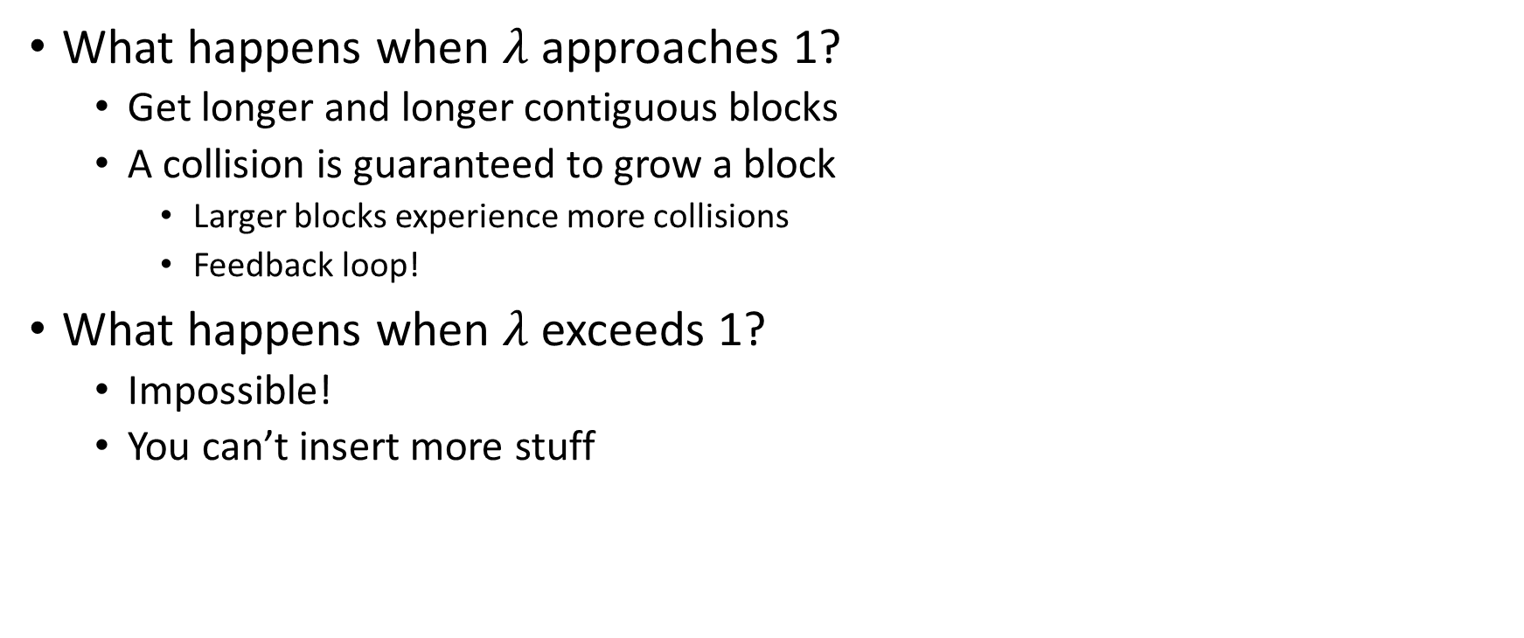
Downsides of Linear Probing
What happens when $λ$ approaches 1?
  Get longer and longer contiguous blocks
  A collision is guaranteed to grow a block
    Larger blocks experience more collisions
    Feedback loop!
What happens when $λ$ exceeds 1?
  Impossible!
  You can’t insert more stuff

Slide 6
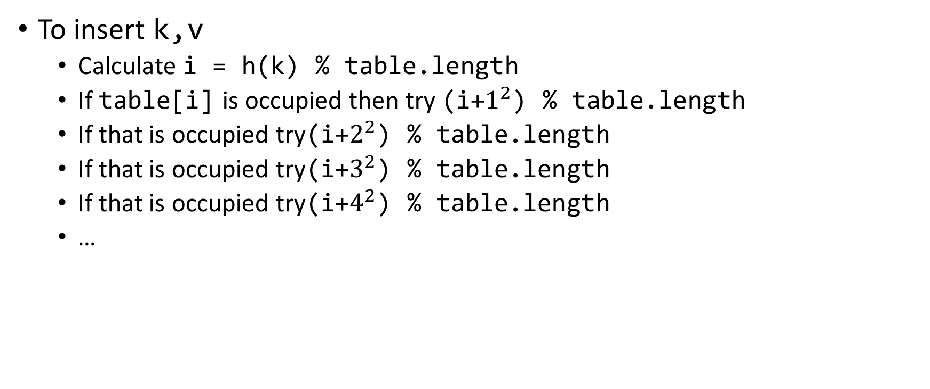
Quadratic Probing: Insert Procedure
To insert k,v
  Calculate i = h(k) % table.length
  If table[i] is occupied then try (i+$1^{2}$) % table.length
  If that is occupied try(i+$2^{2}$) % table.length
  If that is occupied try(i+$3^{2}$) % table.length
  If that is occupied try(i+$4^{2}$) % table.length
  …
0
1
2
3
4
5
6
7
8
9

Slide 7
Quadratic Probing: Example
Insert:
  76
  40
  48
  5
  55
  47
0
1
2
3
4
5
6

Slide 8
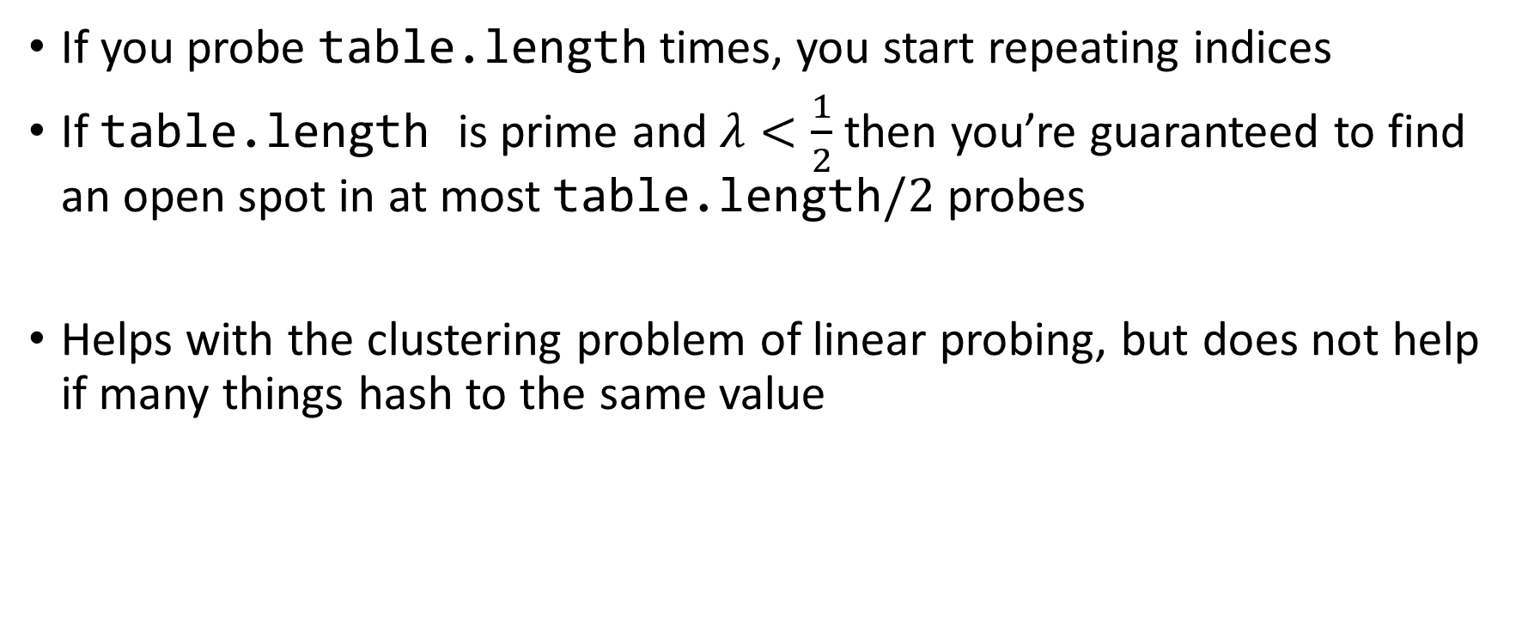
Using Quadratic Probing
If you probe table.length times, you start repeating indices
If table.length is prime and $λ<\frac{1}{2}$ then you’re guaranteed to find an open spot in at most table.length$/2$ probes
Helps with the clustering problem of linear probing, but does not help if many things hash to the same value

Slide 9
Double Hashing: Insert Procedure
Given h and g are both good hash functions
To insert k,v
  Calculate i = h(k) % table.length
  If table[i] is occupied then try (i+g(k)) % table.length
  If that is occupied try (i+2*g(k)) % table.length
  If that is occupied try (i+3*g(k)) % table.length
  If that is occupied try (i+4*g(k)) % table.length
  …
0
1
2
3
4
5
6
7
8
9

Slide 10
Sorting
Rearrangement of items into some defined sequence
  Usually: reordering a list from smallest to largest according to some metric
Why sort things?
  Enable things like binary search
    It makes some algorithms faster
  Nicer for human algorithms too
  Data organization

Slide 11
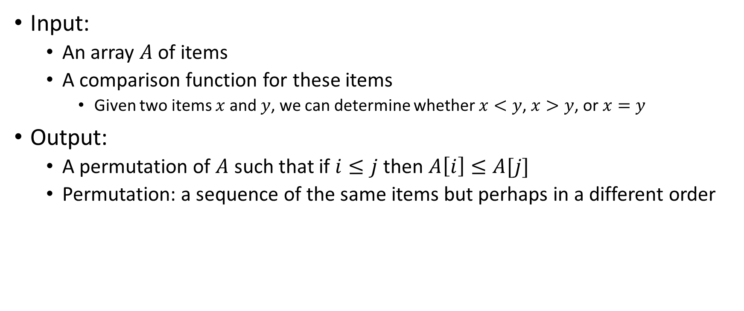
More Formal Definition
Input:
  An array $A$ of items
  A comparison function for these items
    Given two items $x$ and $y$, we can determine whether $x<y$, $x>y$, or $x=y$
Output:
  A permutation of $A$ such that if $i≤j$ then $A\left[i\right]≤A[j]$
  Permutation: a sequence of the same items but perhaps in a different order

Slide 12
Sorting “Landscape”
There is no singular best algorithm for sorting
Some are faster, some are slower
Some use more memory, some use less
Some are super extra fast if your data matches particular assumptions
Some have other special properties that make them valuable
No sorting algorithm can have only all the “best” attributes

Slide 13
Insertion Sort
Idea: Maintain a sorted list prefix, extend that prefix by “inserting” the next element
Sorted Prefix
3
5
7
8
10
12
9
2
4
6
1
11
3
5
7
8
10
9
12
2
4
6
1
11
3
5
7
8
9
10
12
2
4
6
1
11
Sorted Prefix
3
5
7
8
9
10
12
2
4
6
1
11

Slide 14
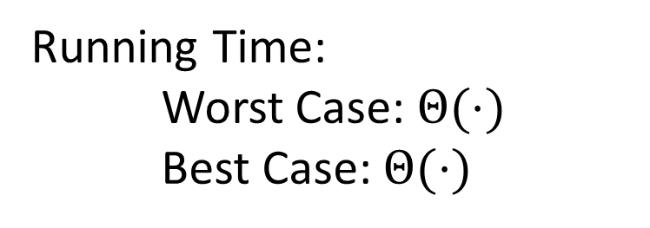
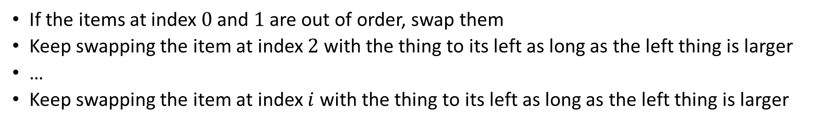
Insertion Sort
If the items at index $0$ and $1$ are out of order, swap them
Keep swapping the item at index $2$ with the thing to its left as long as the left thing is larger
…
Keep swapping the item at index $i$ with the thing to its left as long as the left thing is larger
for (i=1; i<a.length; i++){
prev = i-1;
while(a[i] < a[prev] && prev > -1){
temp = a[i];
a[i] = a[prev];
a[prev] = a[i];
i--;
prev--;
}
}
Running Time:
Worst Case: $Θ(⋅)$
Best Case: $Θ(⋅)$
10
77
5
15
2
22
64
41
18
19
30
21
3
24
23
33
0
1
2
3
4
5
6
7
8
9
10
11
12
13
14
15

Slide 15
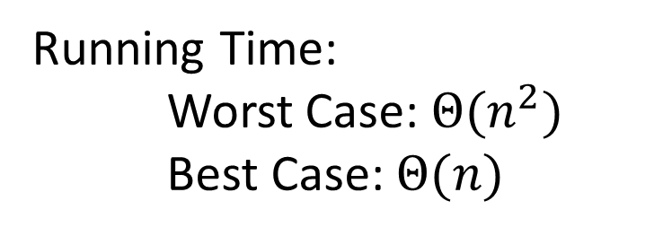
Insertion Sort
If the items at index $0$ and $1$ are out of order, swap them
Keep swapping the item at index $2$ with the thing to its left as long as the left thing is larger
…
Keep swapping the item at index $i$ with the thing to its left as long as the left thing is larger
for (i=1; i<a.length; i++){
prev = i-1;
while(a[i] < a[prev] && prev > -1){
temp = a[i];
a[i] = a[prev];
a[prev] = a[i];
i--;
prev--;
}
}
Running Time:
Worst Case: $Θ(n^{2})$
Best Case: $Θ(n)$
10
77
5
15
2
22
64
41
18
19
30
21
3
24
23
33
0
1
2
3
4
5
6
7
8
9
10
11
12
13
14
15

Slide 16
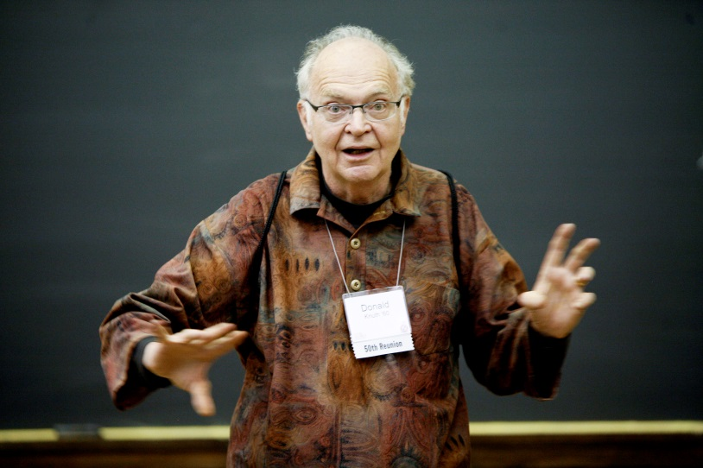
Aside: Bubble Sort – we won’t cover it
"the bubble sort seems to have nothing to recommend it, except a catchy name and the fact that it leads to some interesting theoretical problems” –Donald Knuth, The Art of Computer Programming

Slide 17
Heap Sort
Idea: Build a maxHeap, repeatedly extract the max element from the heap to build sorted list Right-to-Left
10
9
6
8
7
5
2
4
1
3
0
1
2
3
4
5
6
7
8
9
Max Heap Property: Each node is larger than its children
10
9
0
6
8
1
7
5
2
2
3
4
5
6
4
1
3
7
8
9

Slide 18
Heap Sort
Remove the Max element (i.e. the root) from the Heap: replace with last element, call percolateDown(root)
3
9
6
8
7
5
2
4
1
0
1
2
3
4
5
6
7
8
9
3
9
0
6
8
1
7
5
2
2
3
4
5
6
4
1
Percolate Down(node): if node satisfies heap property, done. Else swap with largest child and repeat on that subtree
7
8

Slide 19
Heap Sort
Remove the Max element (i.e. the root) from the Heap: replace with last element, call percolateDown(root)
9
3
6
8
7
5
2
4
1
0
1
2
3
4
5
6
7
8
9
9
3
0
6
8
1
7
5
2
2
3
4
5
6
4
1
Percolate Down(node): if node satisfies heap property, done. Else swap with largest child and repeat on that subtree
7
8

Slide 20
Heap Sort
Remove the Max element (i.e. the root) from the Heap: replace with last element, call percolateDown(root)
9
8
6
3
7
5
2
4
1
0
1
2
3
4
5
6
7
8
9
9
8
0
6
3
1
7
5
2
2
3
4
5
6
4
1
Percolate Down(node): if node satisfies heap property, done. Else swap with largest child and repeat on that subtree
7
8

Slide 21
Heap Sort
Remove the Max element (i.e. the root) from the Heap: replace with last element, call percolateDown(root)
9
8
6
4
7
5
2
3
1
0
1
2
3
4
5
6
7
8
9
9
8
0
6
4
1
7
5
2
2
3
4
5
6
3
1
Percolate Down(node): if node satisfies heap property, done. Else swap with largest child and repeat on that subtree
7
8

Slide 22
Heap Sort
Build a max heap
Call extract
Put that at the end of the array
myHeap = buildMaxHeap(a);
for (int i = a.length-1; i>=0; i--){
item = myHeap.extract();
a[i] = item;
}
Running Time:
Worst Case: $Θ(⋅)$
Best Case: $Θ(⋅)$

Slide 23
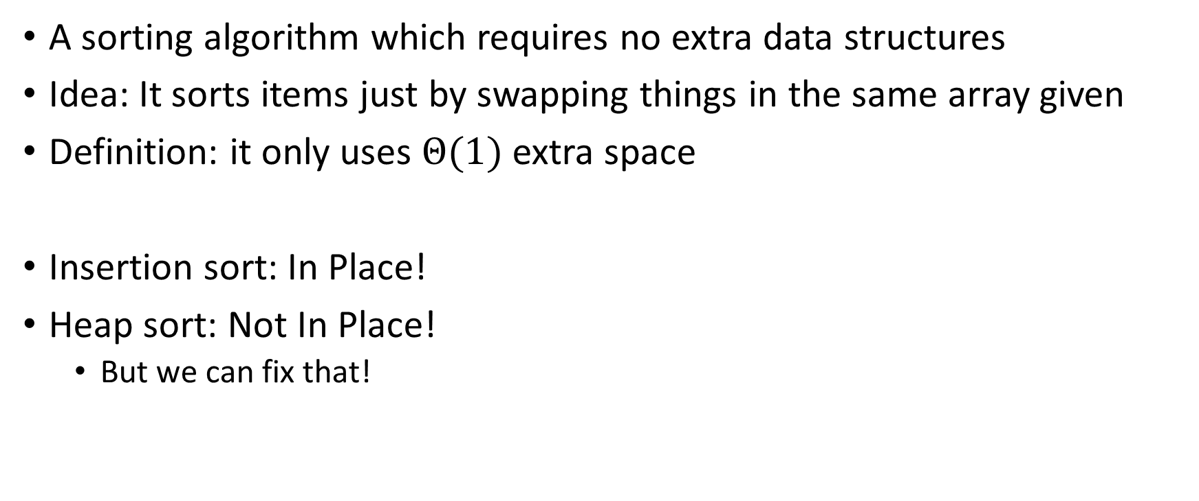
“In Place” Sorting Algorithm
A sorting algorithm which requires no extra data structures
Idea: It sorts items just by swapping things in the same array given
Definition: it only uses $Θ(1)$ extra space
Insertion sort: In Place!
Heap sort: Not In Place!
  But we can fix that!

Slide 24
In Place Heap Sort
Idea: When “removing” an element from the heap, swap it with the last item of the heap then “pretend” the heap is one item shorter
10
9
6
8
7
5
2
4
1
3
0
1
2
3
4
5
6
7
8
9
10
9
0
6
8
1
7
5
2
2
3
4
5
6
4
1
3
7
8
9

Slide 25
Heap Sort
Idea: When “removing” an element from the heap, swap it with the last item of the heap then “pretend” the heap is one item shorter
3
9
6
8
7
5
2
4
1
10
0
1
2
3
4
5
6
7
8
9
3
9
0
6
8
1
7
5
2
2
3
4
5
6
4
1
7
8

Slide 26
Heap Sort
Idea: When “removing” an element from the heap, swap it with the last item of the heap then “pretend” the heap is one item shorter
9
8
6
4
7
5
2
3
1
10
0
1
2
3
4
5
6
7
8
9
9
8
0
6
4
1
7
5
2
2
3
4
5
6
3
1
7
8

Slide 27
Heap Sort
Idea: When “removing” an element from the heap, swap it with the last item of the heap then “pretend” the heap is one item shorter
1
8
6
4
7
5
2
3
9
10
0
1
2
3
4
5
6
7
8
9
1
8
0
6
4
1
7
5
2
2
3
4
5
6
3
7

Slide 28
Heap Sort
Idea: When “removing” an element from the heap, swap it with the last item of the heap then “pretend” the heap is one item shorter
1
8
6
4
7
5
2
3
9
10
0
1
2
3
4
5
6
7
8
9
8
7
0
6
4
1
1
5
2
2
3
4
5
6
3
7

Slide 29
Heap Sort
Idea: When “removing” an element from the heap, swap it with the last item of the heap then “pretend” the heap is one item shorter
3
8
6
4
7
5
2
8
9
10
0
1
2
3
4
5
6
7
8
9
3
7
0
6
4
1
1
5
2
2
3
4
5
6

Slide 30
Heap Sort
Idea: When “removing” an element from the heap, swap it with the last item of the heap then “pretend” the heap is one item shorter
3
8
6
4
7
5
2
8
9
10
0
1
2
3
4
5
6
7
8
9
7
4
0
6
3
1
1
5
2
2
3
4
5
6

Slide 31
In Place Heap Sort
Build a heap using the same array (Floyd’s build heap algorithm works)
Call extract
Put that at the end of the array
buildHeap(a);
for (int i = a.length-1; i>=0; i--){
temp=a[i]
a[i] = a[0];
a[0] = temp;
percolateDown(0);
}
Running Time:
Worst Case: $Θ(⋅)$
Best Case: $Θ(⋅)$

Slide 32
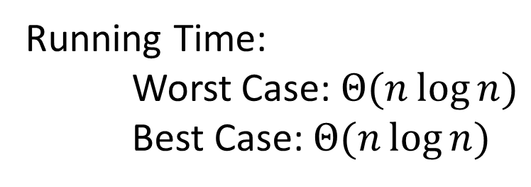
In Place Heap Sort
Build a heap using the same array (Floyd’s build heap algorithm works)
Call extract
Put that at the end of the array
buildHeap(a);
for (int i = a.length-1; i>=0; i--){
temp=a[i]
a[i] = a[0];
a[0] = temp;
percolateDown(0);
}
Running Time:
Worst Case: $Θ(n\log{n})$
Best Case: $Θ(n\log{n})$

Slide 33
Floyd’s buildHeap method
Working towards the root, one row at a time, percolate down
buildHeap(){
for(int i = size; i>0; i--){
percolateDown(i);
}
}

Slide 34
Divide And Conquer Sorting
Divide and Conquer:
  Recursive algorithm design technique
  Solve a large problem by breaking it up into smaller versions of the same problem

Slide 35

Divide and Conquer
Base Case:
  If the problem is “small” then solve directly and return
Divide:
  Break the problem into subproblem(s), each smaller instances
Conquer:
  Solve subproblem(s) recursively
Combine:
  Use solutions to subproblems to solve original problem
A
B

Slide 36
Divide and Conquer Template Pseudocode
def my_DandC(problem){
// Base Case
if (problem.size() <= small_value){
return solve(problem); // directly solve (e.g., brute force)
}
// Divide
List subproblems = divide(problem);
// Conquer
solutions = new List();
for (sub : subproblems){
subsolution = my_DandC(sub);
solutions.add(subsolution);
}
// Combine
return combine(solutions);
}

Slide 37
Merge Sort
5
8
2
9
4
1
Base Case:
  If the list is of length 1 or 0, it’s already sorted, so just return it
Divide:
  Split the list into two “sublists” of (roughly) equal length
Conquer:
  Sort both lists recursively
Combine:
  Merge sorted sublists into one sorted list
5
5
8
2
9
4
1
2
5
8
1
4
9
2
5
8
1
4
9
1
2
4
5
8
9

Slide 38








Merge Sort In Action!
Sort between indices $low$ and $high$
5
8
2
9
4
1
3
7
$$low$$
$$high$$
Base Case: if $low$ == $high$ then that range is already sorted!
Divide and Conquer: Otherwise call mergesort on ranges $\left(low,\frac{low+high}{2}\right)$ and $\left(\frac{low+high}{2}+1, high\right)$
5
8
2
9
4
1
3
7
$$low$$
$$\frac{low+high}{2}$$
$$\frac{low+high}{2}+1$$
$$high$$
2
5
8
9
1
3
4
7
After Recursion:
$$low$$
$$high$$

Slide 39



Merge (the combine part)
2
5
8
9
1
3
4
7
L next
R next
$$\frac{low+high}{2}+1$$
$$low$$
$$\frac{low+high}{2}$$
$$high$$
M next
Create a new array to merge into, and 3 pointers/indices:
L_next: the smallest “unmerged” thing on the left
R_next: the smallest “unmerged” thing on the right
M_next: where the next smallest thing goes in the merged array
One-by-one: put the smallest of L_next and R_next into M_next, then advance both M_next and whichever of L/R was used.

Slide 40
Merge Sort Pseudocode
void mergesort(myArray){
ms_helper(myArray, 0, myArray.length());
}
void mshelper(myArray, low, high){
if (low == high){return;} // Base Case
mid = (low+high)/2;
ms_helper(low, mid);
ms_helper(mid+1, high);
merge(myArray, low, mid, high);
}

Slide 41
Merge Pseudocode
void merge(myArray, low, mid, high){
merged = new int[high-low+1]; // or whatever type is in myArray
l_next = low;
r_next = high;
m_next = 0;
while (l_next <= mid && r_next <= high){
if (myArray[l_next] <= myArray[r_next]){
merged[m_next++] = myArray[l_next++];
}
else{
merged[m_next++] = myArray[r_next++];
}
}
while (l_next <= mid){ merged[m_next++] = myArray[l_next++]; }
while (r_next <= high){ merged[m_next++] = myArray[r_next++]; }
for(i=0; i<=merged.length; i++){ myArray[i+low] = merged[i];}
}

Slide 42
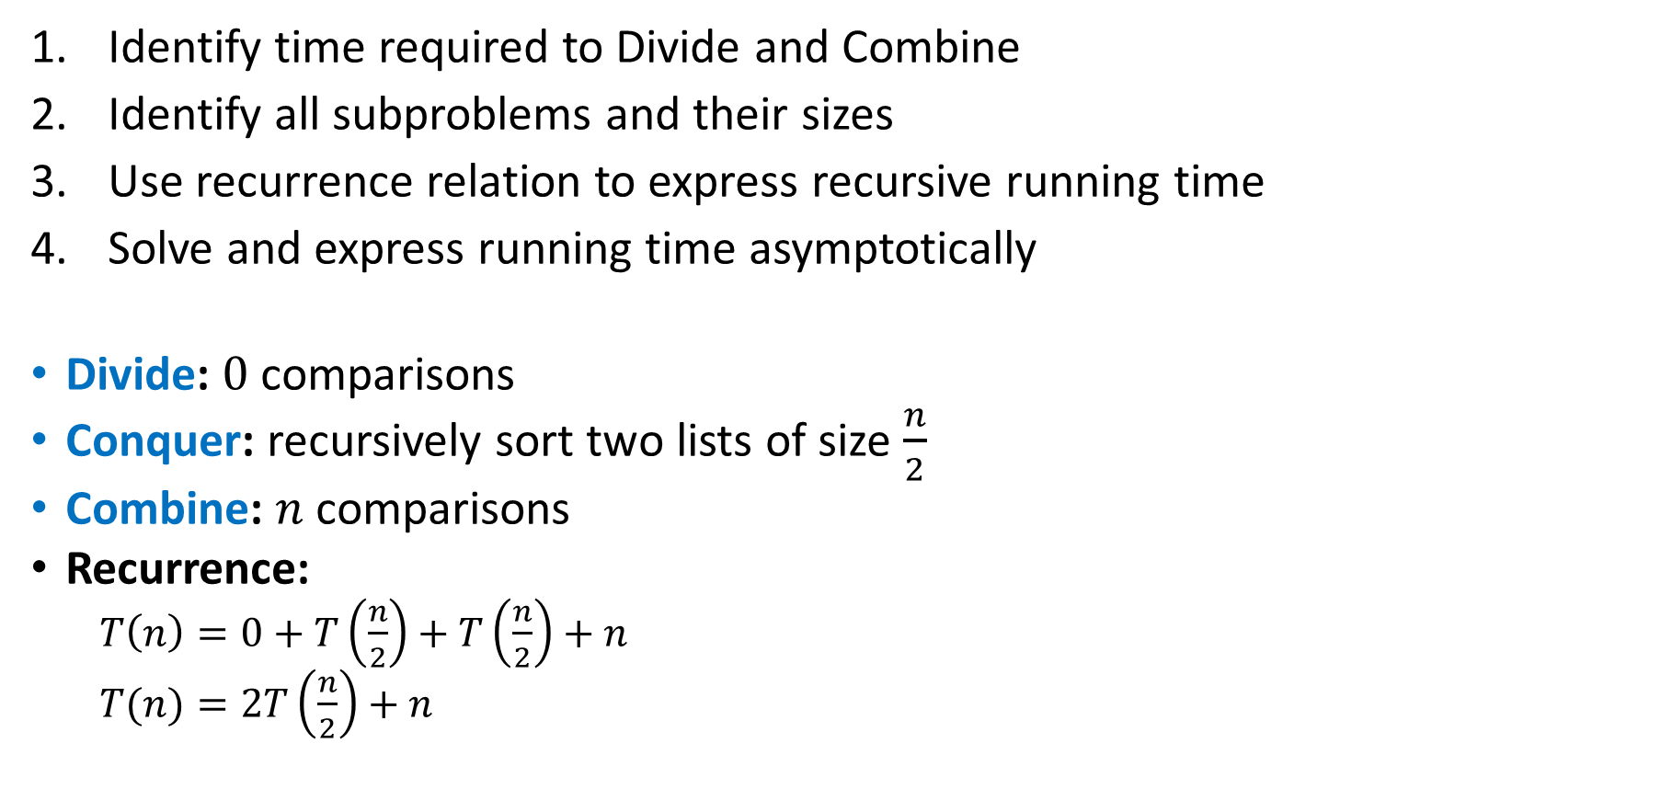
Analyzing Merge Sort
Identify time required to Divide and Combine
Identify all subproblems and their sizes
Use recurrence relation to express recursive running time
Solve and express running time asymptotically
Divide: $0$ comparisons
Conquer: recursively sort two lists of size $\frac{n}{2}$
Combine: $n$ comparisons
Recurrence:
  $T\left(n\right)=0+T\left(\frac{n}{2}\right)+T\left(\frac{n}{2}\right)+n$
  $T(n)=2T\left(\frac{n}{2}\right)+n$

Slide 43
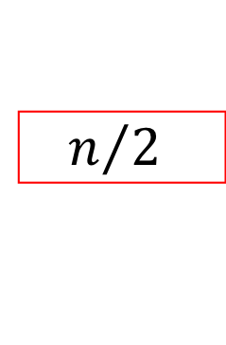


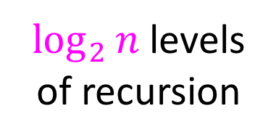




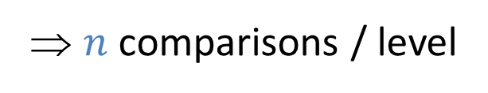


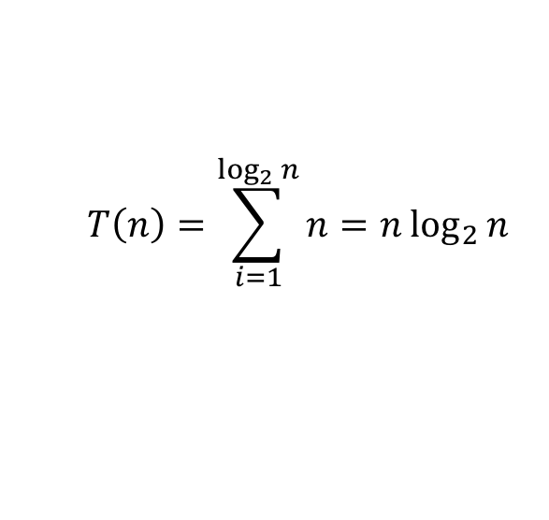
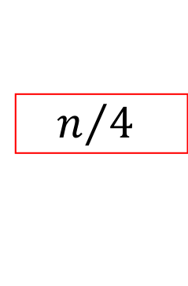
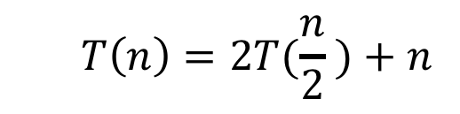








Red box represents a problem instance
Blue value represents time spent at that level of recursion
  $$T\left(n\right)=2T(\frac{n}{2} )+n$$
$$n$$
⇒ $n$ comparisons / level
$$n$$
$$n/2$$
$$\frac{n}{2}$$
$$n/2$$
$$\frac{n}{2}$$
$$\frac{n}{4}$$
$$\frac{n}{4}$$
$$\frac{n}{4}$$
$$\frac{n}{4}$$
$\log_{2}⁡n$ levels
of recursion
$$n/4$$
$$n/4$$
$$n/4$$
$$n/4$$
…
…
…
…
…
$$1$$
$$1$$
$$1$$
$$1$$
$$1$$
$$1$$
$$1$$
$$1$$
$$1$$
$$1$$
$$1$$
$$1$$
  $$T\left(n\right)=\sum_{i=1}^{\log_{2}{n}}{n}=n\log_{2}{n}$$

Slide 44

Properties of Merge Sort
Worst Case Running time:
  $Θ(n\log{n})$
In-Place?
  No!
Adaptive?
  No!
Stable?
  Yes!
  As long as in a tie you always pick l_next

Slide 45

Quicksort
Like Mergesort:
  Divide and conquer
  $O(n\log{n})$ run time (kind of…)
Unlike Mergesort:
  Divide step is the “hard” part
  Typically faster than Mergesort

Slide 46
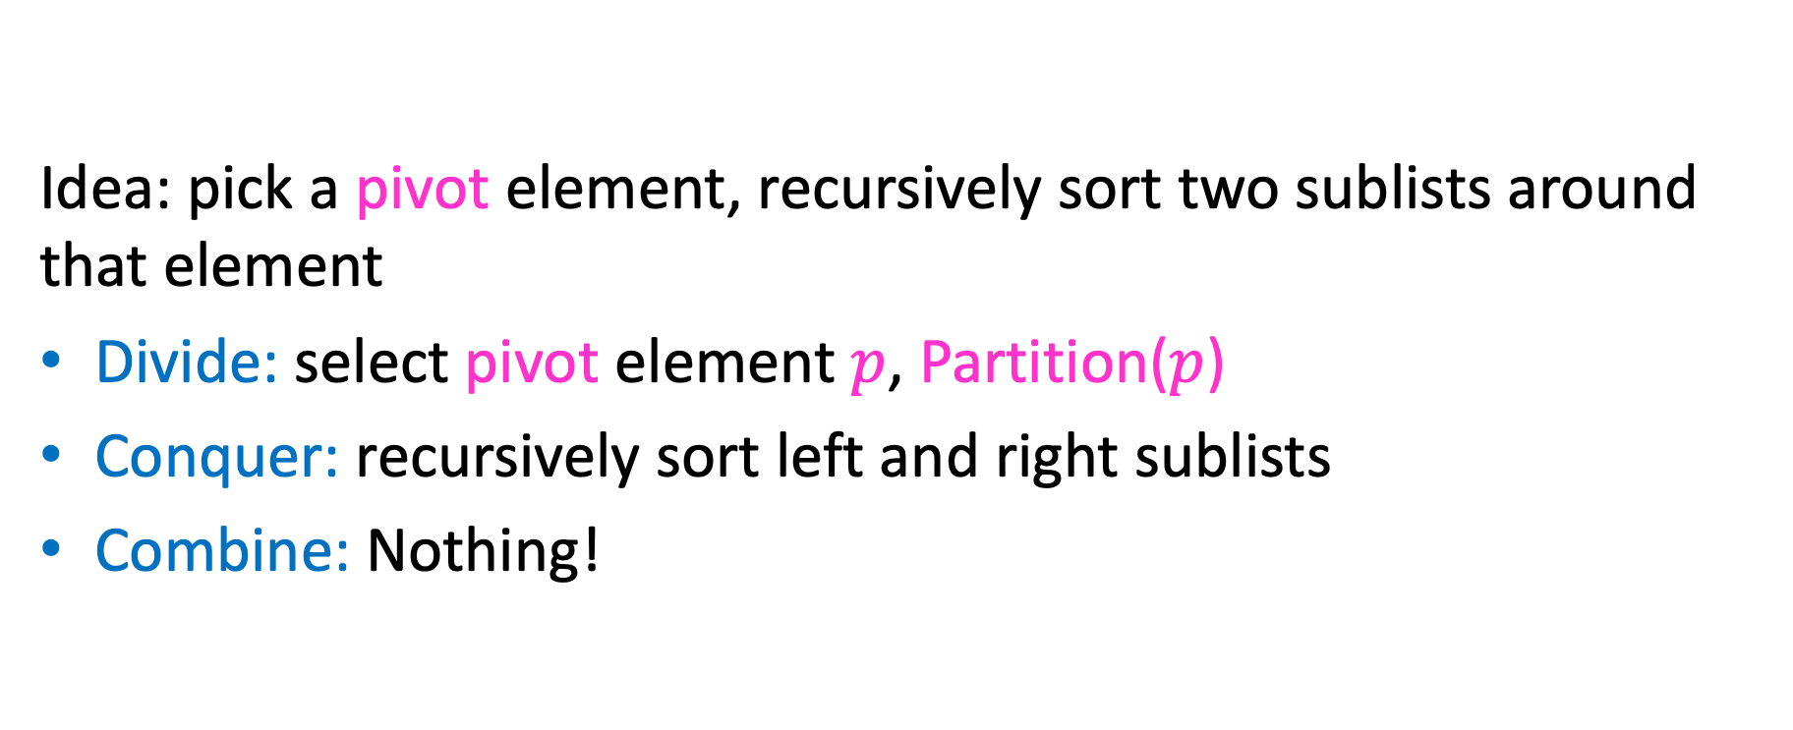
Quicksort
Idea: pick a pivot element, recursively sort two sublists around that element
Divide: select pivot element $p$, Partition($p$)
Conquer: recursively sort left and right sublists
Combine: Nothing!

Slide 47


Partition (Divide step)
Given: a list, a pivot $p$
Start: unordered list
8
5
7
3
12
10
1
2
4
9
6
11
Goal: All elements $<p$ on left, all $>p$ on right
5
7
3
1
2
4
6
8
12
10
9
11

Slide 48
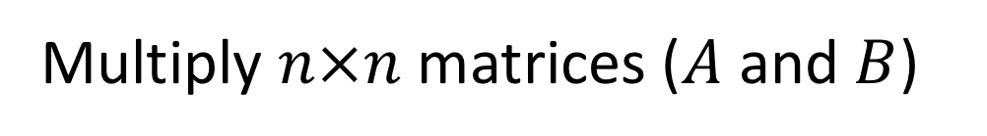
Partition, Procedure
If Begin value $< p$, move Begin right
Else swap Begin value with End value, move End Left
Done when Begin = End
8
5
7
3
12
10
1
2
4
9
6
11
8
5
7
3
12
10
1
2
4
9
6
11
8
5
7
3
12
10
1
2
4
9
6
11
8
5
7
3
11
10
1
2
4
9
6
12

Slide 49
Partition, Procedure
If Begin value $< p$, move Begin right
Else swap Begin value with End value, move End Left
Done when Begin = End
8
5
7
3
11
10
1
2
4
9
6
12
8
5
7
3
6
10
1
2
4
9
11
12
8
5
7
3
6
10
1
2
4
9
11
12
8
5
7
3
6
10
1
2
4
9
11
12

Slide 50
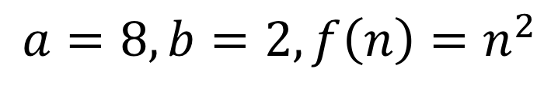
Partition, Procedure
If Begin value $< p$, move Begin right
Else swap Begin value with End value, move End Left
Done when Begin = End
8
5
7
3
6
4
1
2
10
9
11
12
Case 1: meet at element $<p$
Swap $p$ with pointer position (2 in this case)
2
5
7
3
6
4
1
8
10
9
11
12

Slide 51
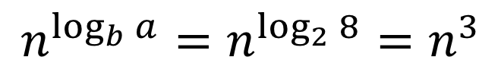
Partition, Procedure
If Begin value $< p$, move Begin right
Else swap Begin value with End value, move End Left
Done when Begin = End
8
5
7
3
6
4
1
2
10
9
11
12
Case 2: meet at element $>p$
Swap $p$ with value to the left (2 in this case)
2
5
7
3
6
4
1
8
10
9
11
12

Slide 52
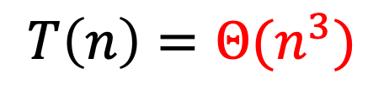
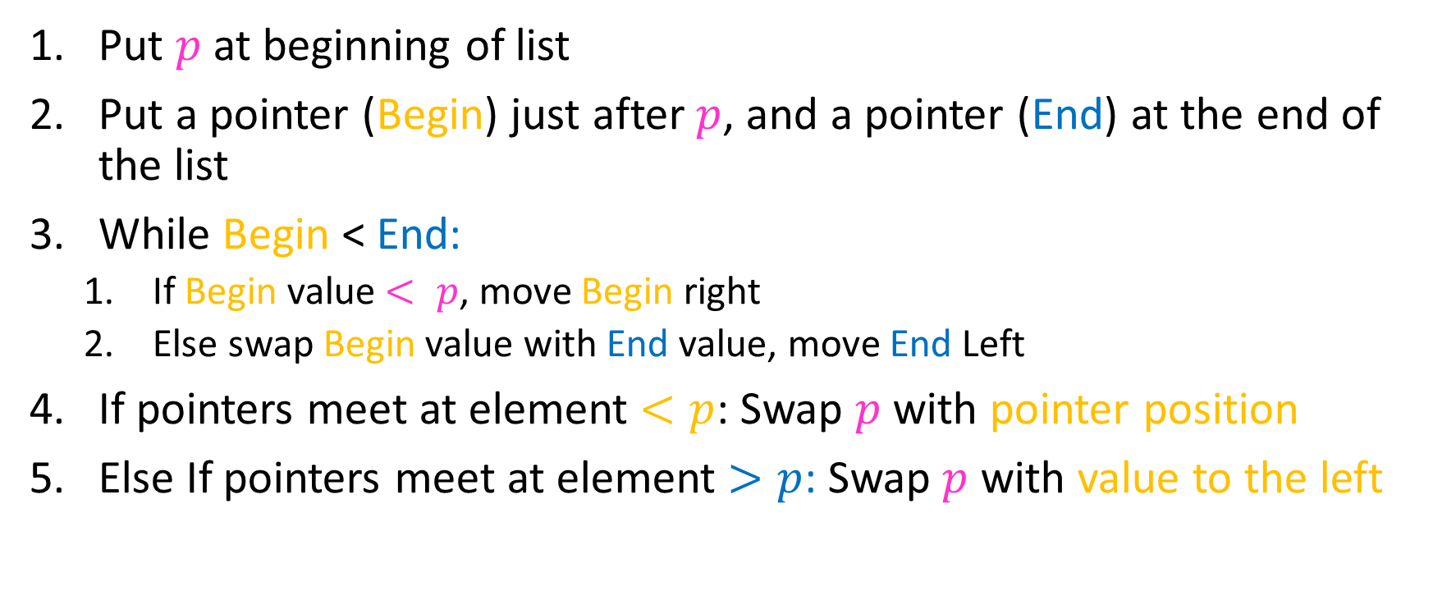
Partition Summary
Put $p$ at beginning of list
Put a pointer (Begin) just after $p$, and a pointer (End) at the end of the list
While Begin < End:
  If Begin value $< p$, move Begin right
  Else swap Begin value with End value, move End Left
If pointers meet at element $<p$: Swap $p$ with pointer position
Else If pointers meet at element $>p$: Swap $p$ with value to the left
Run time?
$$O(n)$$

Slide 53
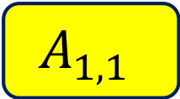
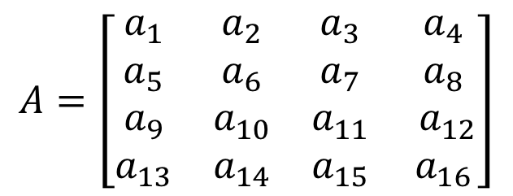
Conquer
2
5
7
3
6
4
1
8
10
9
11
12
All elements $<p$
All elements $>p$
Exactly where it belongs!
Recursively sort Left and Right sublists

Slide 54


Quicksort Run Time (Best)
If the pivot is always the median:
2
5
1
3
6
4
7
8
10
9
11
12
2
1
3
5
6
4
7
8
9
10
11
12
Then we divide in half each time
$$T\left(n\right)=2T\left(\frac{n}{2}\right)+n$$
$$T\left(n\right)=O(n\log{n})$$

Slide 55

Quicksort Run Time (Worst)
If the pivot is always at the extreme:
1
5
2
3
6
4
7
8
10
9
11
12
1
2
3
5
6
4
7
8
10
9
11
12
Then we shorten by 1 each time
$$T\left(n\right)=T\left(n−1\right)+n$$
$$T\left(n\right)=O(n^{2})$$

Slide 56
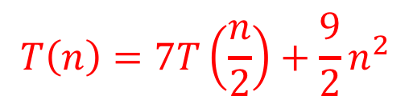



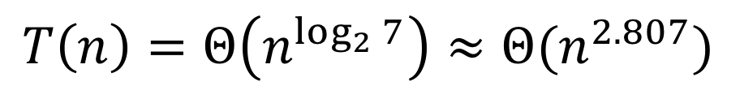

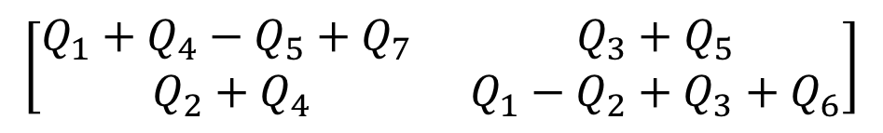

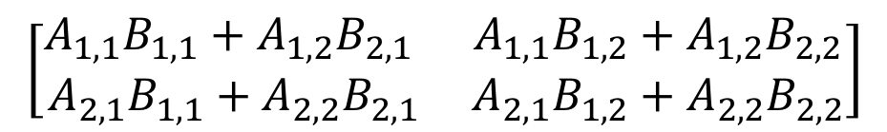
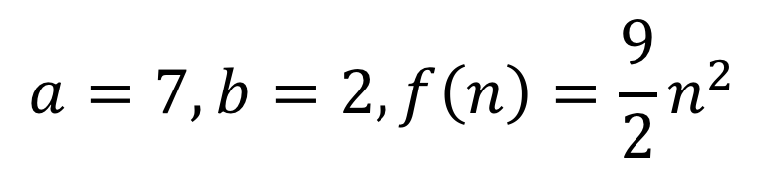

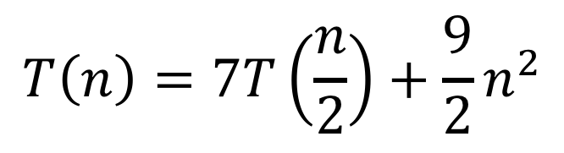
Quicksort Run Time (Worst)
$$T\left(n\right)=T\left(n−1\right)+n$$
$$n$$
$$n$$
$$n−1$$
$$n−1$$
$$T\left(n\right)=1+2+3+…+n$$
$$n−2$$
$$n−2$$
$$T\left(n\right)=\frac{n\left(n+1\right)}{2}$$
…
$$1$$
$$1$$
$$T\left(n\right)=O(n^{2})$$

Slide 57
Quicksort on a (nearly) Sorted List
First element always yields unbalanced pivot
1
2
3
4
5
6
7
8
9
10
11
12
1
2
3
4
5
6
7
8
9
10
11
12
So we shorten by 1 each time
$$T\left(n\right)=T\left(n−1\right)+n$$
$$T\left(n\right)=O(n^{2})$$

Slide 58
Good Pivot
What makes a good Pivot?
  Roughly even split between left and right
  Ideally: median
There are ways to find the median in linear time, but it’s complicated and slow and you’re better off using mergesort
In Practice:
  Pick a random value as a pivot
  Pick the middle of 3 random values as the pivot

Slide 59

Properties of Quick Sort
Worst Case Running time:
  $Θ(n^{2})$
  But $Θ(n\log{n})$ average! And typically faster than mergesort!
In-Place?
  ….Debatable
Adaptive?
  No!
Stable?
  No!

Slide 60
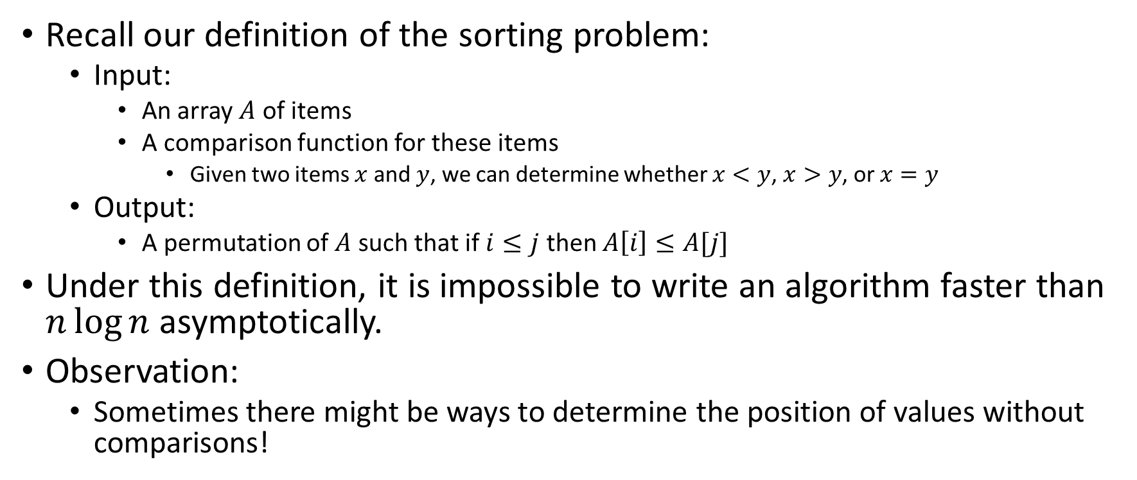
Improving Running time
Recall our definition of the sorting problem:
  Input:
    An array $A$ of items
    A comparison function for these items
      Given two items $x$ and $y$, we can determine whether $x<y$, $x>y$, or $x=y$
  Output:
    A permutation of $A$ such that if $i≤j$ then $A\left[i\right]≤A[j]$
Under this definition, it is impossible to write an algorithm faster than $n\log{n}$ asymptotically.
Observation:
  Sometimes there might be ways to determine the position of values without comparisons!

