Slide 1
CSE 332 Winter 2026 Lecture 11: hashing 2
Nathan Brunelle
http://www.cs.uw.edu/332

Slide 2
Dictionary (Map) ADT
Contents:
Sets of key+value pairs
Keys must be comparable Keys have a hash function
Operations:
insert(key, value)
Adds the (key,value) pair into the dictionary
If the key already has a value, overwrite the old value
Consequence: Keys cannot be repeated
find(key)
Returns the value associated with the given key
delete(key)
Remove the key (and its associated value)

Slide 3
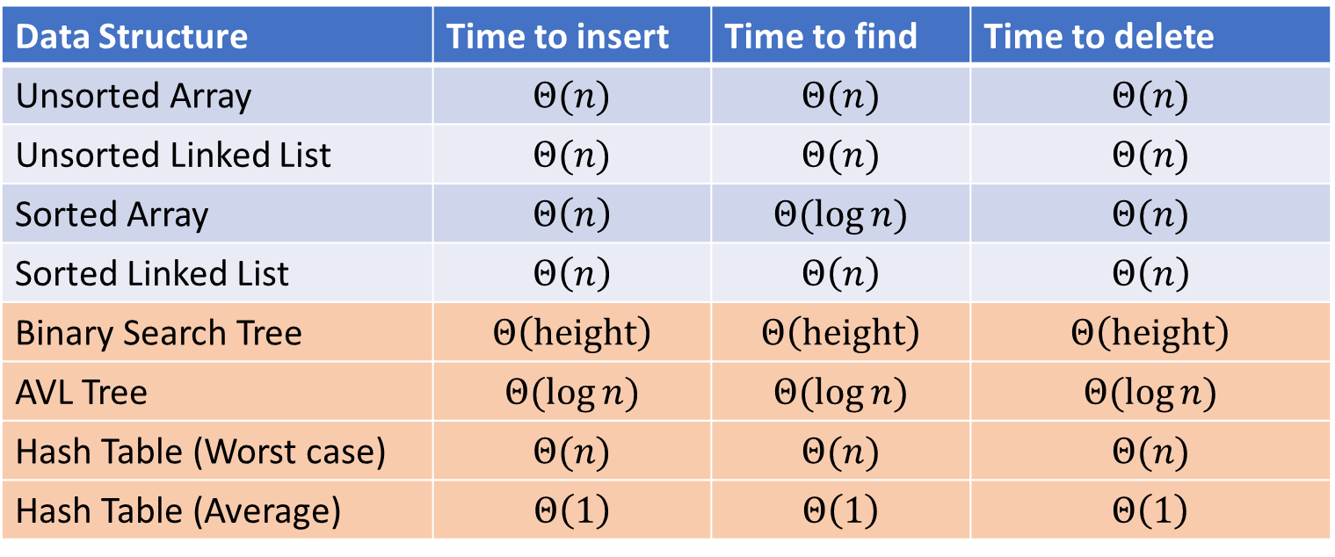
Next topic: Hash Tables
Data Structure | Time to insert | Time to find | Time to delete
Unsorted Array | $$Θ(n)$$ | $$Θ(n)$$ | $$Θ(n)$$
Unsorted Linked List | $$Θ(n)$$ | $$Θ(n)$$ | $$Θ(n)$$
Sorted Array | $$Θ\left(n\right)$$ | $$Θ(\log{n})$$ | $$Θ(n)$$
Sorted Linked List | $$Θ\left(n\right)$$ | $$Θ\left(n\right)$$ | $$Θ\left(n\right)$$
Binary Search Tree | $$Θ\left(height\right)$$ | $$Θ\left(height\right)$$ | $$Θ\left(height\right)$$
AVL Tree | $$Θ(\log{n})$$ | $$Θ(\log{n})$$ | $$Θ(\log{n})$$
Hash Table (Worst case) | $$Θ(n)$$ | $$Θ(n)$$ | $$Θ(n)$$
Hash Table (Average) | $$Θ\left(1\right)$$ | $$Θ\left(1\right)$$ | $$Θ\left(1\right)$$

Slide 4

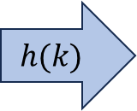
Hash Tables
Idea:
Have a small array to store information
Use a hash function to convert the key into an index
Hash function should “scatter” the keys, behave as if it randomly assigned keys to indices
Store key at the index given by the hash function
Do something if two keys map to the same place (should be very rare)
Collision resolution
Insert / find /
delete
$$h(k)$$
Index between 0 and length-1
& value
Key Object

Slide 5
Properties of a “Good” Hash
Definition: A hash function maps objects to integers
Consistent
Objects considered “equal” should hash to the same value
Deterministic: running the hash function on the same object twice should yield the same result
Uniform
Should be able to use every index in a fixed-size array
Should use every index at roughly equal rates
Effective
It should be difficult to find two objects which hash to the same value
Given on object, it should be hard to find a different object which hashes to the same value
“Avalanche effect”: making a small change to the object yields big changes in the value it hashes to
Efficient
Time to calculate the hash should be very small

Slide 6
Ideal Insert procedure
Supposing we have a “good” hash function:
insert(key, value){
h = key.hash();
table[h % table.length] = value;
}
Problem: It’s possible that two different keys map to the same index!
This is called a “collision”

Slide 7
Collision Resolution
A Collision occurs when we want to insert something into an already-occupied position in the hash table
2 main strategies:
Separate Chaining
Use a secondary data structure to contain the items
E.g. each index in the hash table is itself a linked list
Open Addressing
Use a different spot in the table instead
Linear Probing
Quadratic Probing
Double Hashing
0
1
2
3
4
5
6
7
8
9

Slide 8
Separate Chaining Insert
To insert k, v:
Compute the index using i = h(k) % table.length
Add the key-value pair to the data structure at table[i]
k,v
k,v
k,v
0
1
2
3
4
5
6
7
8
9

Slide 9
Separate Chaining Find
To find k:
Compute the index using i = h(k) % table.length
Call find with the key on the data structure at table[i]
k,v
k,v
k,v
0
1
2
3
4
5
6
7
8
9

Slide 10
Separate Chaining Delete
To delete k:
Compute the index using i = h(k) % table.length
Call delete with the key on the data structure at table[i]
k,v
k,v
k,v
0
1
2
3
4
5
6
7
8
9

Slide 11
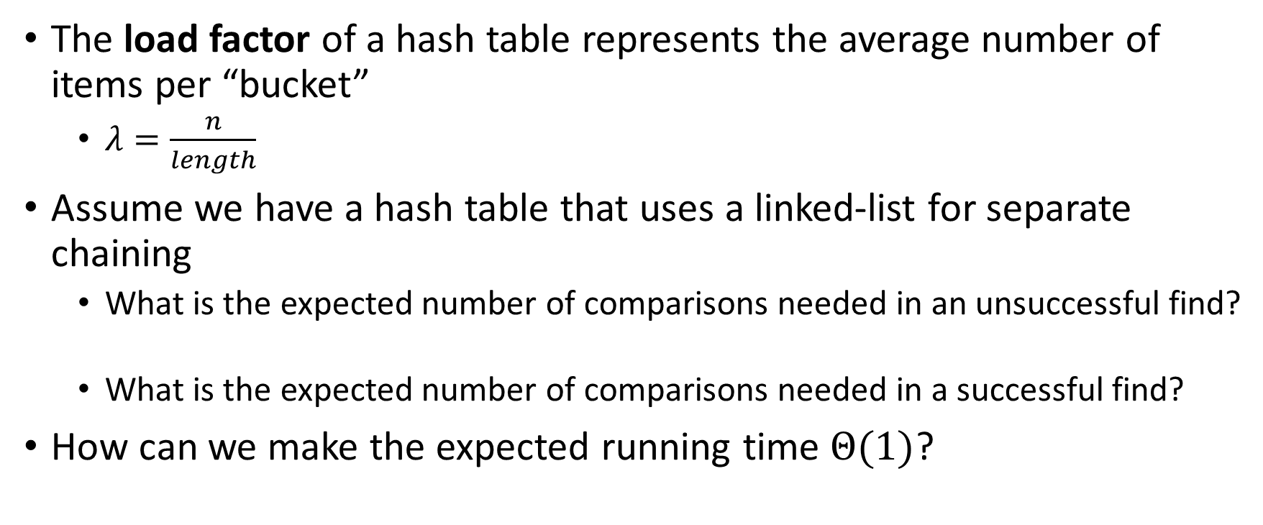
Formal Running Time Analysis
The load factor of a hash table represents the average number of items per “bucket”
$λ=\frac{n}{length}$
Assume we have a hash table that uses a linked-list for separate chaining
What is the expected number of comparisons needed in an unsuccessful find?
What is the expected number of comparisons needed in a successful find?
How can we make the expected running time $Θ(1)$?

Slide 12
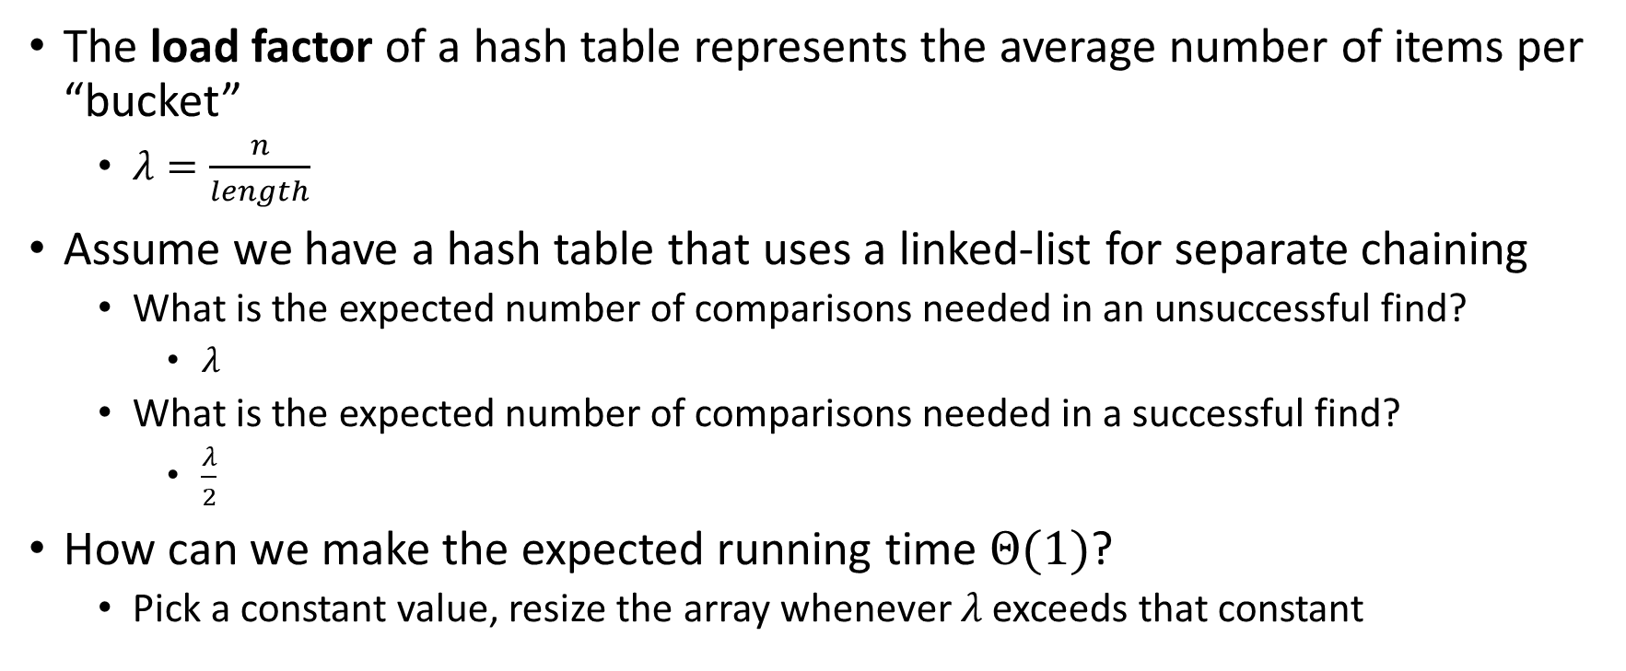
Formal Running Time Analysis
The load factor of a hash table represents the average number of items per “bucket”
$λ=\frac{n}{length}$
Assume we have a hash table that uses a linked-list for separate chaining
What is the expected number of comparisons needed in an unsuccessful find?
$λ$
What is the expected number of comparisons needed in a successful find?
$\frac{λ}{2}$
How can we make the expected running time $Θ(1)$?
Pick a constant value, resize the array whenever $λ$ exceeds that constant

Slide 13
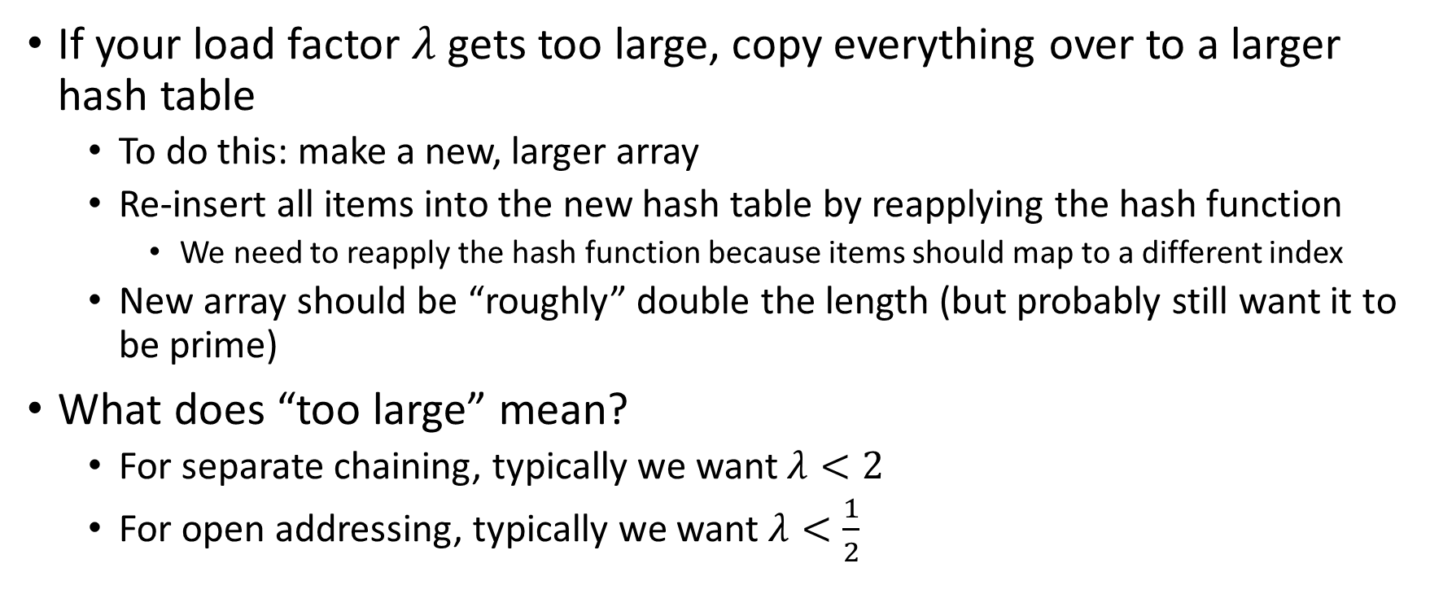
Rehashing
If your load factor $λ$ gets too large, copy everything over to a larger hash table
To do this: make a new, larger array
Re-insert all items into the new hash table by reapplying the hash function
We need to reapply the hash function because items should map to a different index
New array should be “roughly” double the length (but probably still want it to be prime)
What does “too large” mean?
For separate chaining, typically we want $λ<2$
For open addressing, typically we want $λ<\frac{1}{2}$

Slide 14



Load Factor?
$$k,v$$
$$k,v$$
$$k,v$$
0
1
2
3
4
5
6
7
8
9

Slide 15





Load Factor?
$$k,v$$
$$k,v$$
$$k,v$$
$$k,v$$
$$k,v$$
$$k,v$$
$$k,v$$
$$k,v$$
0
1
2
3
4
5
6
7
8
9

Slide 16







Load Factor?
$$k,v$$
$$k,v$$
$$k,v$$
$$k,v$$
$$k,v$$
$$k,v$$
$$k,v$$
$$k,v$$
$$k,v$$
$$k,v$$
$$k,v$$
$$k,v$$
$$k,v$$
$$k,v$$
$$k,v$$
0
1
2
3
4
5
6
7
8
9

Slide 17
Formal Running Time Analysis
The load factor of a hash table represents the average number of items per “bucket”
$λ=\frac{n}{length}$
Assume we have a hash table that uses a linked-list for separate chaining
What is the expected number of comparisons needed in an unsuccessful find?
What is the expected number of comparisons needed in a successful find?
How can we make the expected running time $Θ(1)$?

Slide 18
Formal Running Time Analysis
The load factor of a hash table represents the average number of items per “bucket”
$λ=\frac{n}{length}$
Assume we have a hash table that uses a linked-list for separate chaining
What is the expected number of comparisons needed in an unsuccessful find?
$λ$
What is the expected number of comparisons needed in a successful find?
$\frac{λ}{2}$
How can we make the expected running time $Θ(1)$?
Pick a constant value, resize the array whenever $λ$ exceeds that constant

Slide 19
Rehashing
If your load factor $λ$ gets too large, copy everything over to a larger hash table
To do this: make a new, larger array
Re-insert all items into the new hash table by reapplying the hash function
We need to reapply the hash function because items should map to a different index
New array should be “roughly” double the length (but probably still want it to be prime)
What does “too large” mean?
For separate chaining, typically we want $λ<2$
For open addressing, typically we want $λ<\frac{1}{2}$

Slide 20
Collision Resolution: Linear Probing
When there’s a collision, use the next open space in the table
0
1
2
3
4
5
6
7
8
9

Slide 21
Linear Probing: Insert Procedure
To insert k,v
Calculate i = h(k) % table.length
If table[i] is occupied then try index (i+1) % table.length
If that is occupied try index (i+2) % table.length
If that is occupied try index (i+3) % table.length
…
0
1
2
3
4
5
6
7
8
9

Slide 22
Linear Probing: Find
0
1
2
3
4
5
6
7
8
9

Slide 23
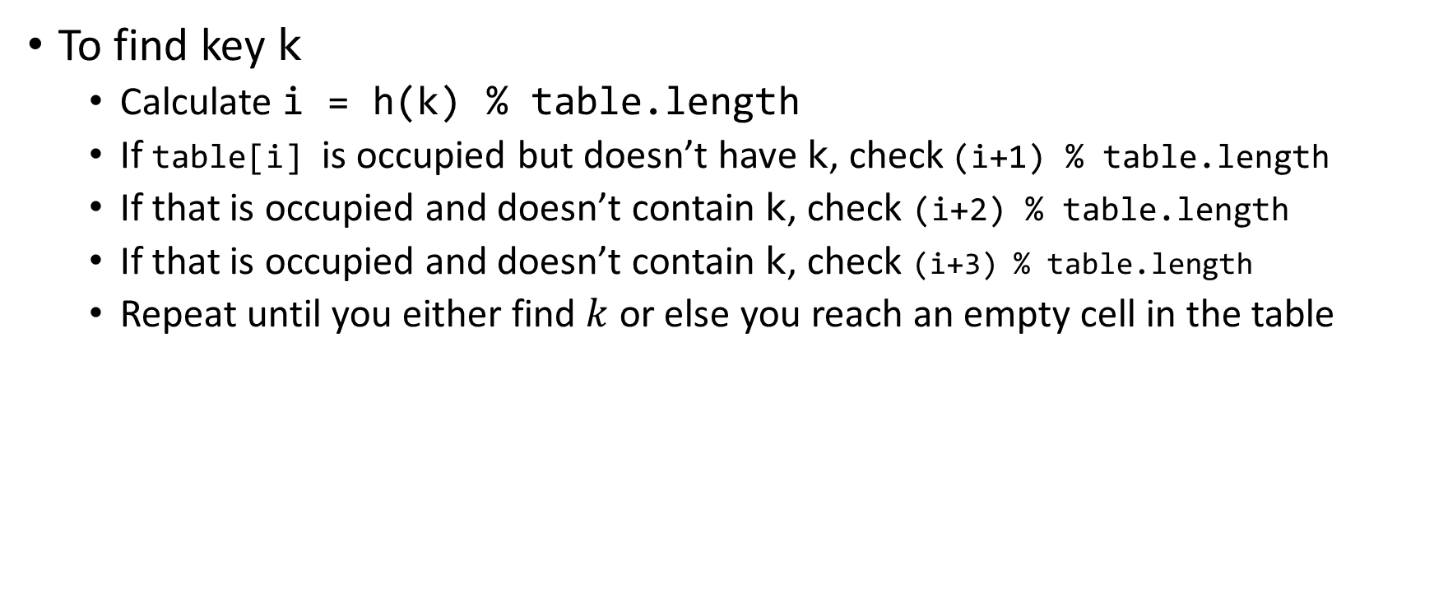
Linear Probing: Find
To find key k
Calculate i = h(k) % table.length
If table[i] is occupied but doesn’t have k, check (i+1) % table.length
If that is occupied and doesn’t contain k, check (i+2) % table.length
If that is occupied and doesn’t contain k, check (i+3) % table.length
Repeat until you either find $k$ or else you reach an empty cell in the table
0
1
2
3
4
5
6
7
8
9

Slide 24
Linear Probing: Delete
Suppose A, B, C, D, and E all hashed to 3
Now let’s delete B
Before:
A
B
C
D
E
0
1
2
3
4
5
6
7
8
9
After:
0
1
2
3
4
5
6
7
8
9

Slide 25
Linear Probing: Delete
Suppose A, B, and E all hashed to 3, and C and D hashed to 5
Now let’s delete B
Before:
A
B
C
D
E
0
1
2
3
4
5
6
7
8
9
After:
0
1
2
3
4
5
6
7
8
9

Slide 26
Linear Probing: Delete
Suppose A and E hashed to 3, and B,C, and D hashed to 4
Now let’s delete B
Before:
A
B
C
D
E
0
1
2
3
4
5
6
7
8
9
After:
0
1
2
3
4
5
6
7
8
9

Slide 27


Linear Probing: Delete
Option 1 (harder): Plug the hole with other items in a way that makes probes behave correctly
Option 2 (easier): “Tombstone” deletion. Leave a special object that indicates an something was deleted from there
The tombstone does not act as an open space when finding (so keep looking after its reached)
When inserting you can replace a tombstone with a new item
$$k,v$$
$$k,v$$
$$k,v$$
$$k,v$$
0
1
2
3
4
5
6
7
8
9

Slide 28
Linear Probing + Tombstone: Find
To find key k
Calculate i = h(k) % table.length
While table[i] has a key other than k, set i = (i+1) % table.length
If you come across k return table[i]
If you come across an empty index, the find was unsuccessful
0
1
2
3
4
5
6
7
8
9

Slide 29
Linear Probing + Tombstone: Insert
To insert k,v
Calculate i = h(k) % table.length
While table[i] has a key other than k, set i = (i+1) % table.length
If table[i] has a tombstone, set x = i
That is where we will insert if the find is unsuccessful
If you come across k, set table[i] = k,v
If you come across an empty index, the find was unsuccessful
Set table[x] = k,v if we saw a tombstone
Set table[x] = k,v otherwise
0
1
2
3
4
5
6
7
8
9

Slide 30
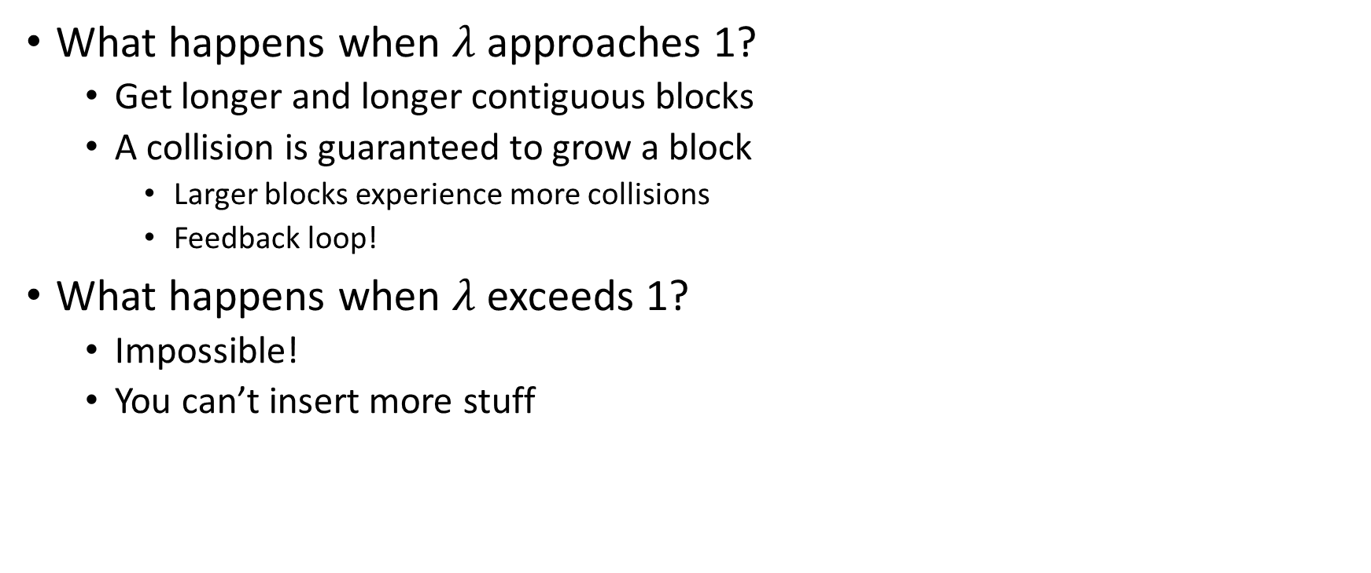
Downsides of Linear Probing
What happens when $λ$ approaches 1?
Get longer and longer contiguous blocks
A collision is guaranteed to grow a block
Larger blocks experience more collisions
Feedback loop!
What happens when $λ$ exceeds 1?
Impossible!
You can’t insert more stuff

Slide 31
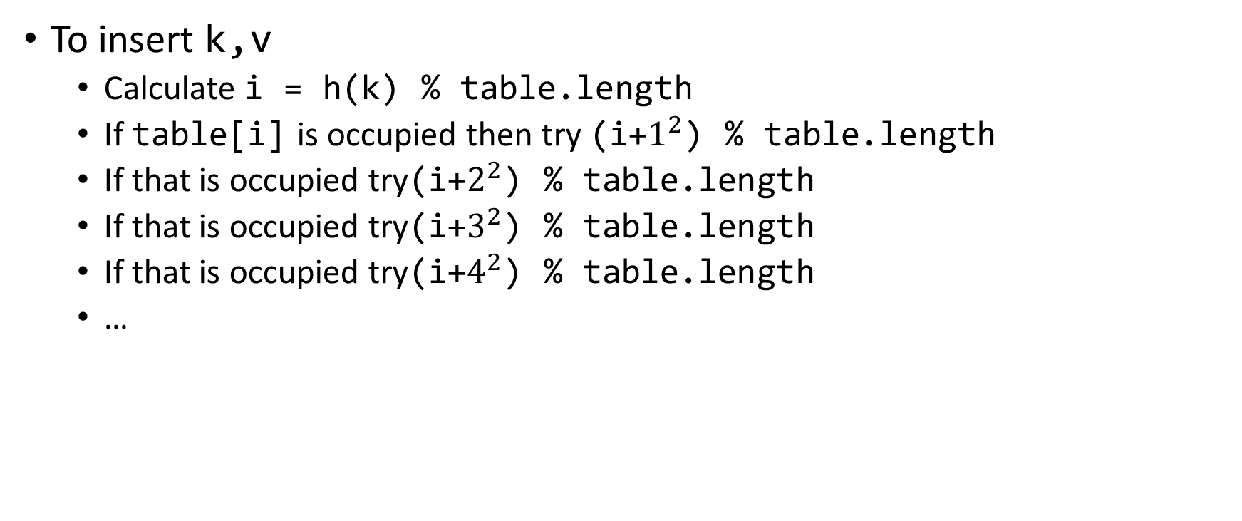
Quadratic Probing: Insert Procedure
To insert k,v
Calculate i = h(k) % table.length
If table[i] is occupied then try (i+$1^{2}$) % table.length
If that is occupied try(i+$2^{2}$) % table.length
If that is occupied try(i+$3^{2}$) % table.length
If that is occupied try(i+$4^{2}$) % table.length
…
0
1
2
3
4
5
6
7
8
9

Slide 32
Quadratic Probing: Example
Insert:
76
40
48
5
55
47
0
1
2
3
4
5
6

Slide 33
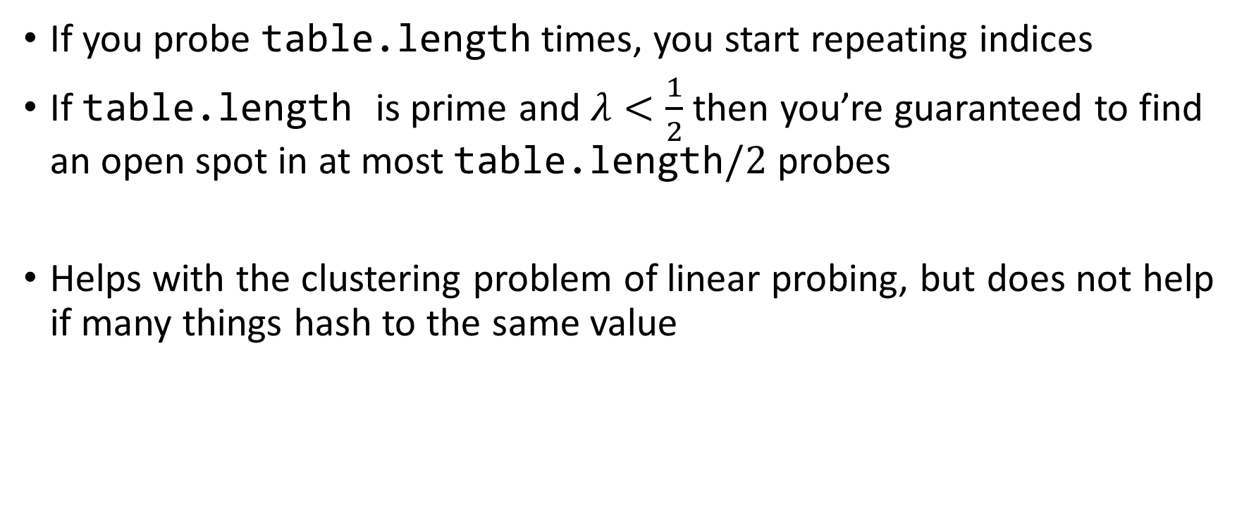
Using Quadratic Probing
If you probe table.length times, you start repeating indices
If table.length is prime and $λ<\frac{1}{2}$ then you’re guaranteed to find an open spot in at most table.length$/2$ probes
Helps with the clustering problem of linear probing, but does not help if many things hash to the same value

Slide 34
Double Hashing: Insert Procedure
Given h and g are both good hash functions
To insert k,v
Calculate i = h(k) % table.length
If table[i] is occupied then try (i+g(k)) % table.length
If that is occupied try (i+2*g(k)) % table.length
If that is occupied try (i+3*g(k)) % table.length
If that is occupied try (i+4*g(k)) % table.length
…
0
1
2
3
4
5
6
7
8
9

