Slide 1
CSE 332 Summer 2026
Lecture 9: Hashing 2
Michael Whitmeyer
http://www.cs.uw.edu/332

Slide 2

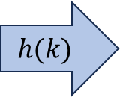
Hash Tables
Idea:
  Have a small array to store information
  Use a hash function to convert the key into an index
    Hash function should “scatter” the keys, behave as if it randomly assigned keys to indices
  Store key at the index given by the hash function
  Do something if two keys map to the same place (should be very rare)
    Collision resolution
Insert / find /
delete
$$h(k)$$
Some Integer
& value
Key Object

Slide 3
Separate Chaining Insert
To insert k, v:
  Compute the index using i = h(k) % table.length
  Add the key-value pair to the data structure at table[i]
k,v
k,v
k,v
0
1
2
3
4
5
6
7
8
9

Slide 4
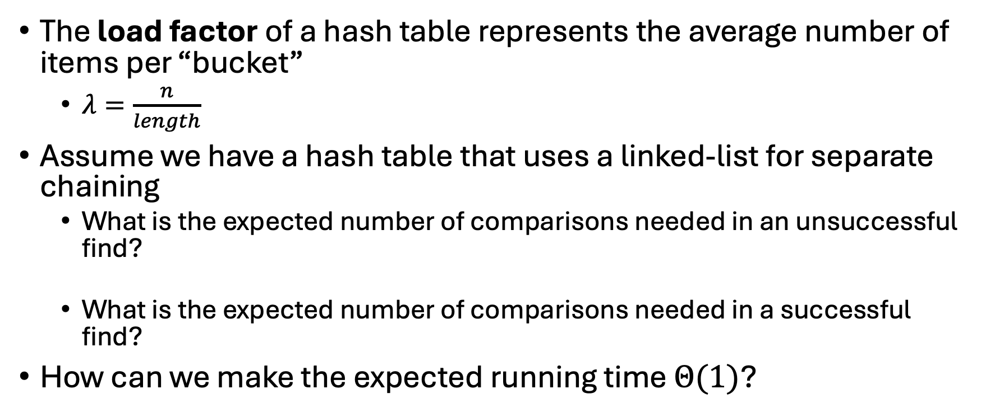
Separate Chaining Runtime Analysis
The load factor of a hash table represents the average number of items per “bucket”
  $λ=\frac{n}{length}$
Assume we have a hash table that uses a linked-list for separate chaining
  What is the expected number of comparisons needed in an unsuccessful find?
  What is the expected number of comparisons needed in a successful find?
How can we make the expected running time $Θ(1)$?

Slide 5
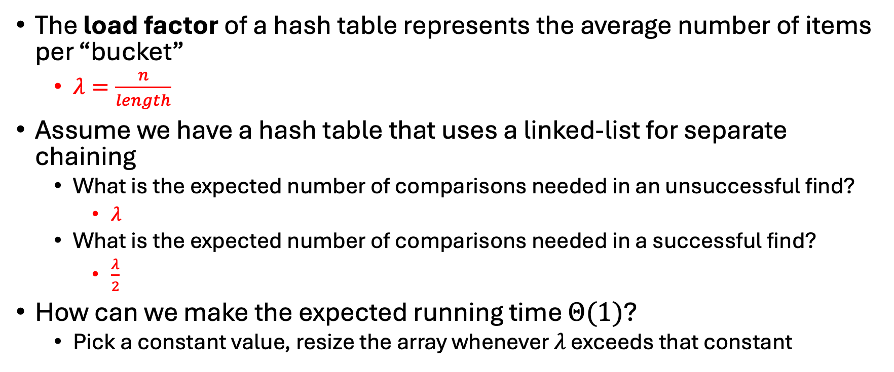
Separate Chaining Runtime Analysis (answers)
The load factor of a hash table represents the average number of items per “bucket”
  $λ=\frac{n}{length}$
Assume we have a hash table that uses a linked-list for separate chaining
  What is the expected number of comparisons needed in an unsuccessful find?
    $λ$
  What is the expected number of comparisons needed in a successful find?
    $\frac{λ}{2}$
How can we make the expected running time $Θ(1)$?
  Pick a constant value, resize the array whenever $λ$ exceeds that constant

Slide 6



Load Factor Example 1
$$k,v$$
$$k,v$$
$$k,v$$
0
1
2
3
4
5
6
7
8
9

Slide 7





Load Factor Example 2
$$k,v$$
$$k,v$$
$$k,v$$
$$k,v$$
$$k,v$$
$$k,v$$
$$k,v$$
$$k,v$$
0
1
2
3
4
5
6
7
8
9

Slide 8
Collision Resolution: Linear Probing
When there’s a collision, use the next open space in the table
0
1
2
3
4
5
6
7
8
9

Slide 9
Linear Probing: Insert Procedure
To insert k,v
  Calculate i = h(k) % table.length
  If table[i] is occupied then try index (i+1) % table.length
  If that is occupied try index (i+2) % table.length
  If that is occupied try index (i+3) % table.length
  …
0
1
2
3
4
5
6
7
8
9

Slide 10
Linear Probing: How to find?
What do you think?
0
1
2
3
4
5
6
7
8
9

Slide 11
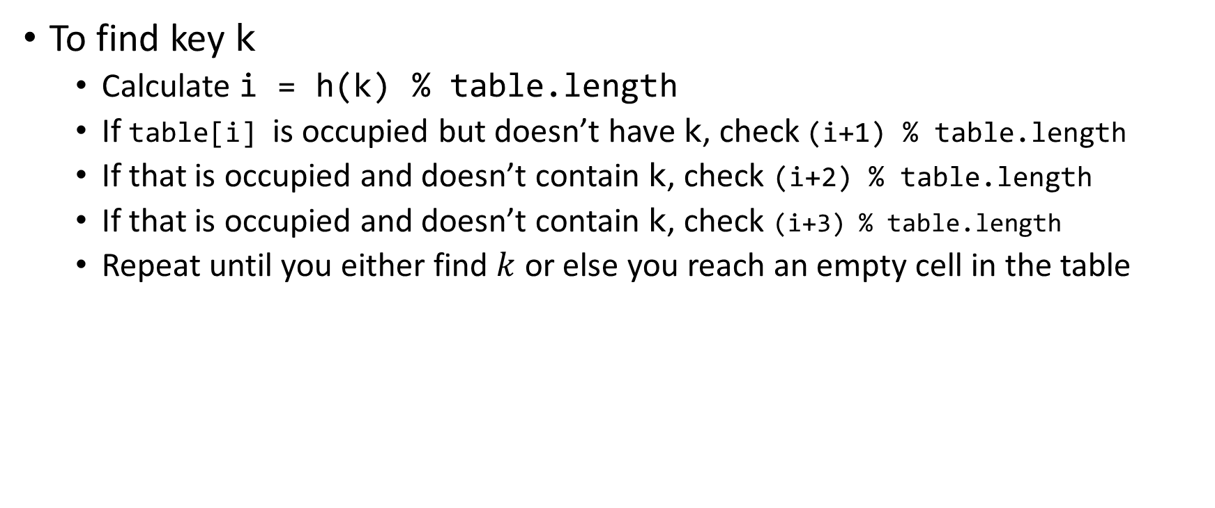
Linear Probing: Find
To find key k
  Calculate i = h(k) % table.length
  If table[i] is occupied but doesn’t have k, check (i+1) % table.length
  If that is occupied and doesn’t contain k, check (i+2) % table.length
  If that is occupied and doesn’t contain k, check (i+3) % table.length
  Repeat until you either find $k$ or else you reach an empty cell in the table
0
1
2
3
4
5
6
7
8
9

Slide 12
Linear Probing: Delete is Hard (Example 1)
Suppose we insert A, B, C, D, and E in that order, where all map to 3
How should we delete B?
Before:
A
B
C
D
E
0
1
2
3
4
5
6
7
8
9
After:
0
1
2
3
4
5
6
7
8
9

Slide 13
Linear Probing: Delete is Hard (Example 1)
Suppose we insert A, B, C, D, and E in that order, where all map to 3
How should we delete B?
Before:
A
B
C
D
E
0
1
2
3
4
5
6
7
8
9
We need future probing to work correctly, so we must fill in the hole.
After:
A
C
D
E
0
1
2
3
4
5
6
7
8
9

Slide 14
Linear Probing: Delete is Hard (Example 2)
Suppose we insert A, B, C, D, and E in that order, where A,B,E all map to 3 and C,D map to 5.
How should we delete B?
Before:
A
B
C
D
E
0
1
2
3
4
5
6
7
8
9
We need future probing to work correctly, so we must fill in the hole.
After:
0
1
2
3
4
5
6
7
8
9

Slide 15
Linear Probing: Delete is Hard (Example 2)
Suppose we insert A, B, C, D, and E in that order, where A,B,E all map to 3 and C,D map to 5.
How should we delete B?
Before:
A
B
C
D
E
0
1
2
3
4
5
6
7
8
9
We need future probing to work correctly, so we must fill in the hole.
We cannot move C or D over because they map to an index later in the probe path
After:
A
E
C
D
0
1
2
3
4
5
6
7
8
9

Slide 16
Linear Probing: Delete is Hard (Example 3)
Suppose we insert A, B, C, D, and E in that order, where A,B,E map to 8 and C,D map to 0.
How should we delete B?
Before:
C
D
E
A
B
0
1
2
3
4
5
6
7
8
9
We cannot move C or D over because they map to an index later in the probe path, even though the index number happens to be smaller.
After:
C
D
A
E
0
1
2
3
4
5
6
7
8
9

Slide 17


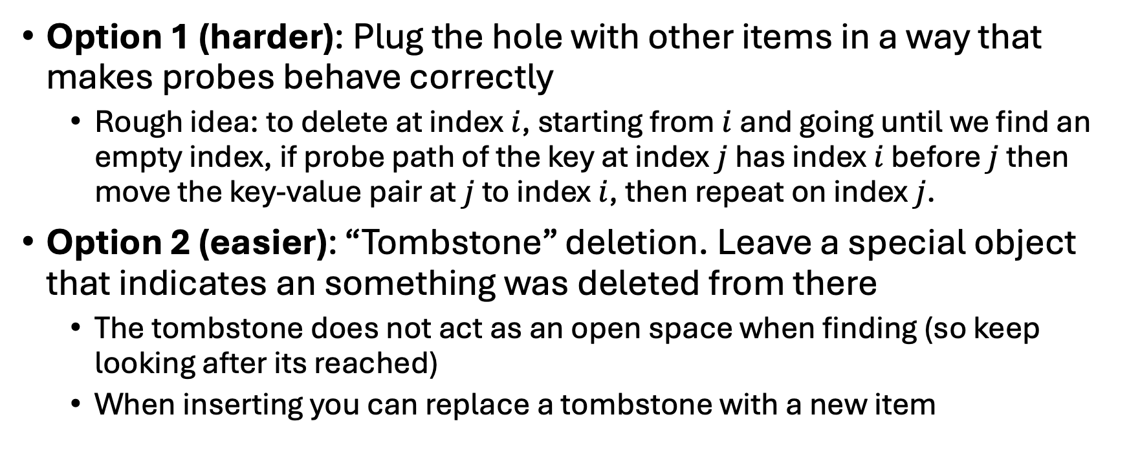
Linear Probing: Delete
Option 1 (harder): Plug the hole with other items in a way that makes probes behave correctly
  Rough idea: to delete at index $i$, starting from $i$ and going until we find an empty index, if probe path of the key at index $j$ has index $i$ before $j$ then move the key-value pair at $j$ to index $i$, then repeat on index $j$.
Option 2 (easier): “Tombstone” deletion. Leave a special object that indicates an something was deleted from there
  The tombstone does not act as an open space when finding (so keep looking after its reached)
  When inserting you can replace a tombstone with a new item
$$k,v$$
$$k,v$$
$$k,v$$
$$k,v$$
0
1
2
3
4
5
6
7
8
9

Slide 18
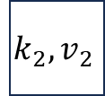
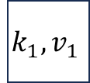
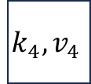

Linear Probing + Tombstone: Find
To find key k
  Calculate i = h(k) % table.length
  While table[i] has a key other than k, set i = (i+1) % table.length
  If you come across k return table[i]
  If you come across an empty index, the find was unsuccessful
    Tombstones do not count as empty!
$$k_{1},v_{1}$$
$$k_{2},v_{2}$$
$$k_{3},v_{3}$$
$$k_{4},v_{4}$$
0
1
2
3
4
5
6
7
8
9

Slide 19
Linear Probing + Tombstone: Insert
To insert k,v
  Calculate i = h(k) % table.length
  While table[i] has a key other than k, set i = (i+1) % table.length
    If table[i] has a tombstone, set dest = i
      That is where we will insert if the find is unsuccessful
    If you come across k, set table[i] = k,v
    If you come across an empty index, the find was unsuccessful
      Set table[x] = k,v if we saw a tombstone
    Set table[x] = k,v otherwise
$$k_{1},v_{1}$$
$$k_{2},v_{2}$$
$$k_{3},v_{3}$$
$$k_{4},v_{4}$$
0
1
2
3
4
5
6
7
8
9

Slide 20
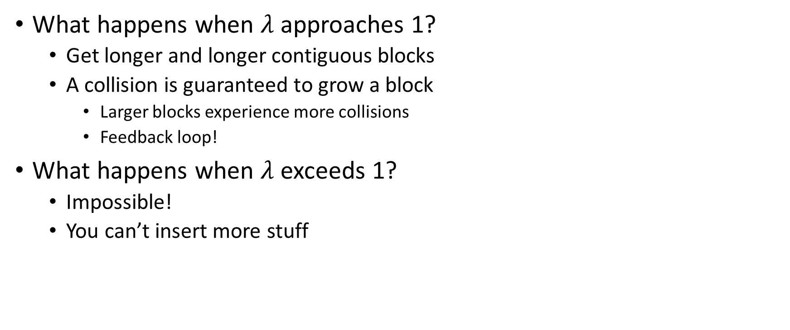
Downsides of Linear Probing
What happens when $λ$ approaches 1?
  Get longer and longer contiguous blocks
  A collision is guaranteed to grow a block
    Larger blocks experience more collisions
    Feedback loop!
What happens when $λ$ exceeds 1?
  Impossible!
  You can’t insert more stuff

Slide 21
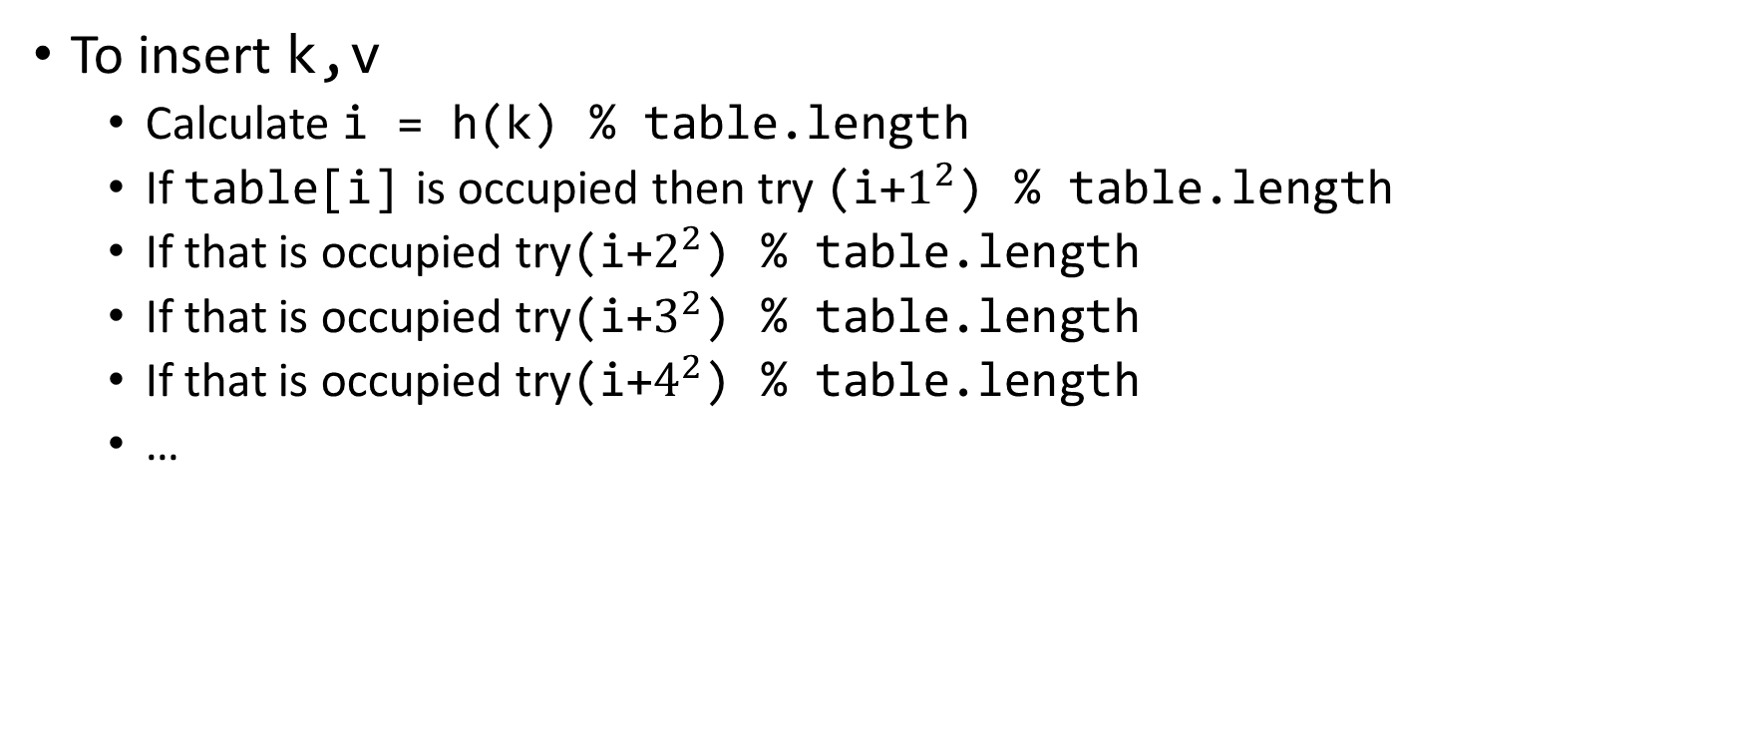
Quadratic Probing: Insert Procedure
To insert k,v
  Calculate i = h(k) % table.length
  If table[i] is occupied then try (i+$1^{2}$) % table.length
  If that is occupied try(i+$2^{2}$) % table.length
  If that is occupied try(i+$3^{2}$) % table.length
  If that is occupied try(i+$4^{2}$) % table.length
  …
0
1
2
3
4
5
6
7
8
9

Slide 22
Quadratic Probing: Example
Insert:
  76
  40
  48
  5
  55
  47
0
1
2
3
4
5
6

Slide 23
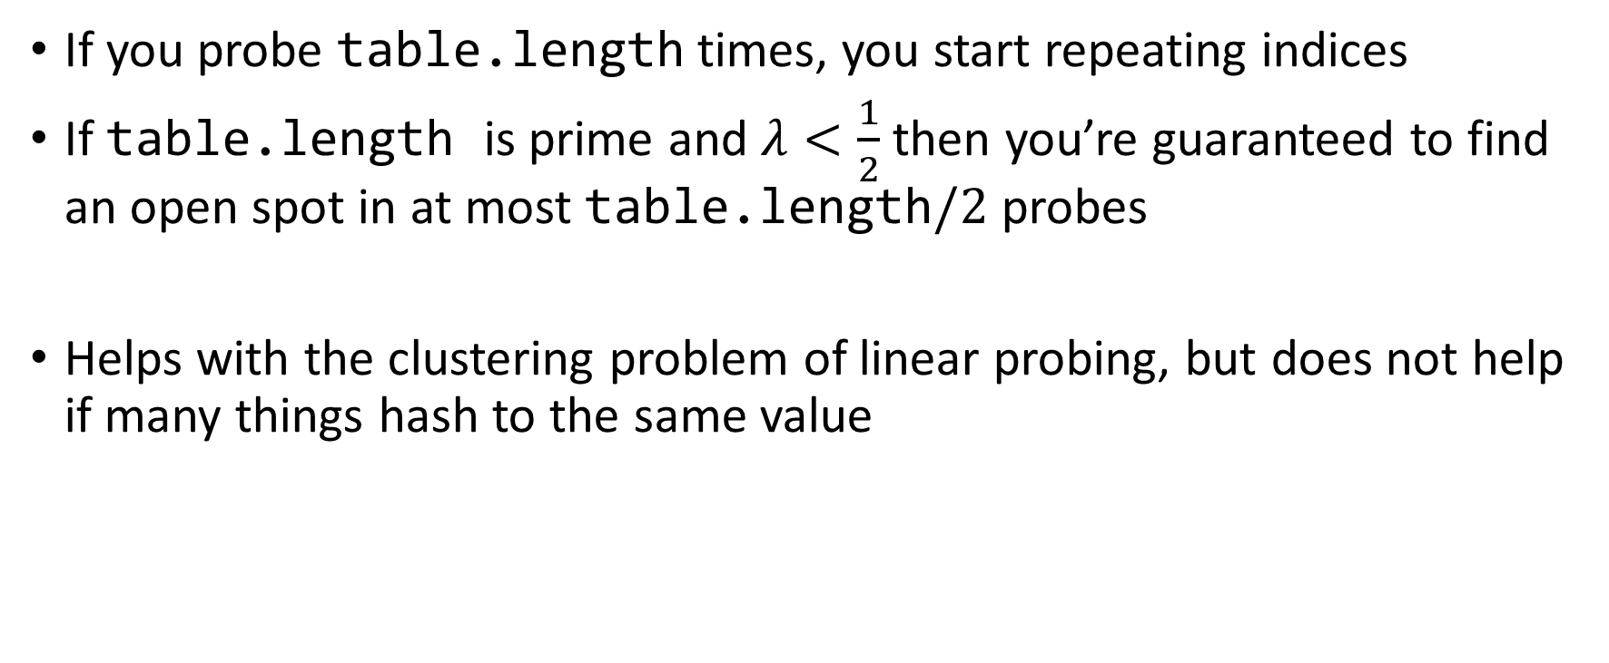
Using Quadratic Probing
If you probe table.length times, you start repeating indices
If table.length is prime and $λ<\frac{1}{2}$ then you’re guaranteed to find an open spot in at most table.length$/2$ probes
Helps with the clustering problem of linear probing, but does not help if many things hash to the same value

Slide 24
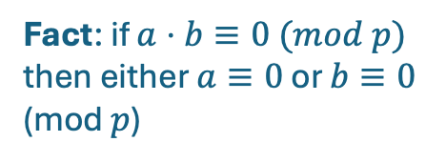

Quadratic Load Factor Lemma
Fact: if $a⋅b≡0 (mod p)$ then either $a≡0$ or $b≡0$ (mod $p$)
Lemma: $1^{2},2^{2},…, {\left\lfloor \frac{p}{2}\right\rfloor }^{2}$ are distinct mod $p$.
Proof:

Slide 25
Double Hashing: Insert Procedure
Given h and g are both good hash functions
To insert k,v
  Calculate i = h(k) % table.length
  If table[i] is occupied then try (i+g(k)) % table.length
  If that is occupied try (i+2*g(k)) % table.length
  If that is occupied try (i+3*g(k)) % table.length
  If that is occupied try (i+4*g(k)) % table.length
  …
0
1
2
3
4
5
6
7
8
9

Slide 26
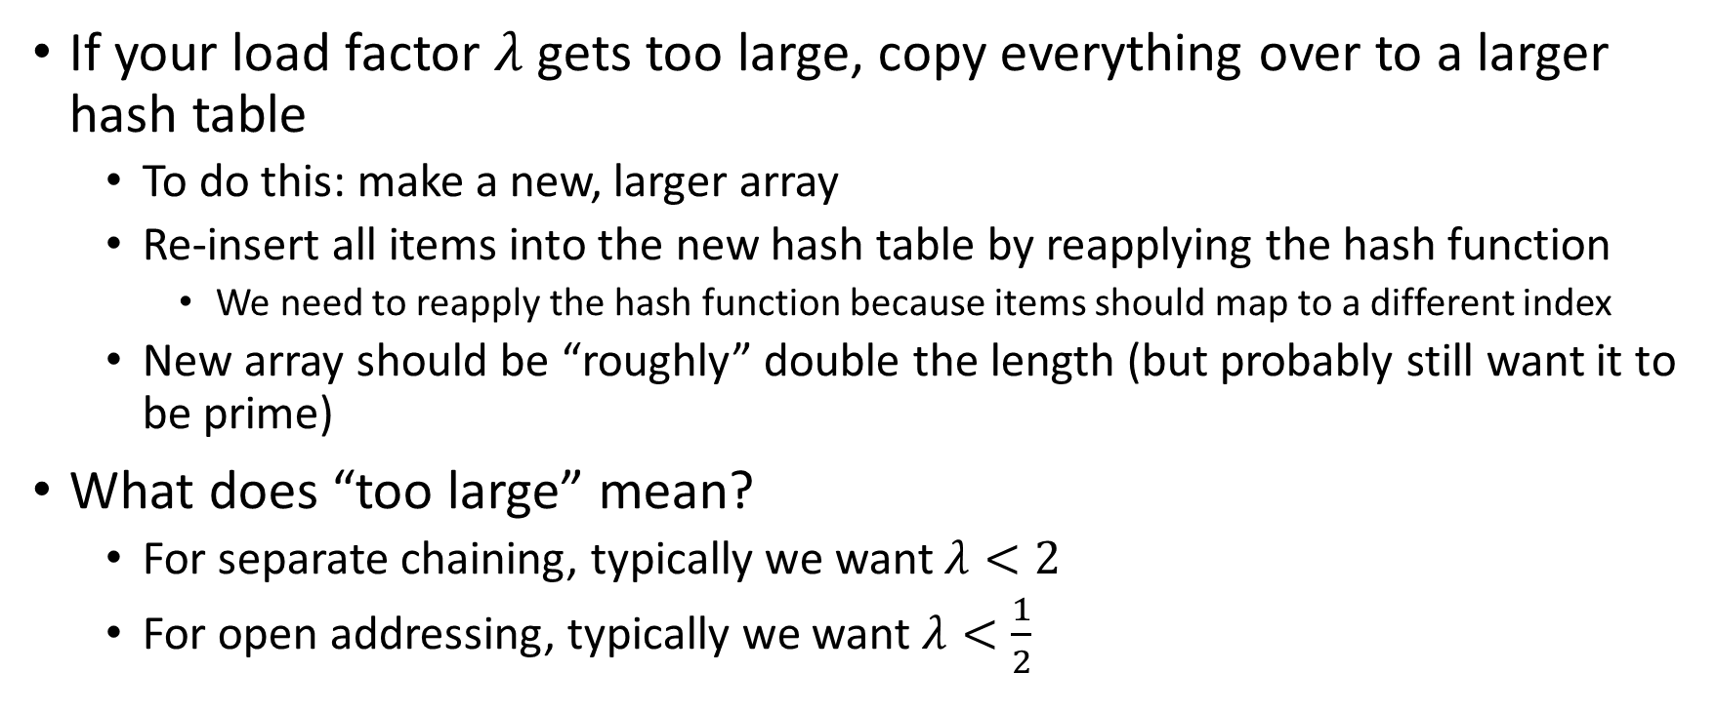
Rehashing
If your load factor $λ$ gets too large, copy everything over to a larger hash table
  To do this: make a new, larger array
  Re-insert all items into the new hash table by reapplying the hash function
    We need to reapply the hash function because items should map to a different index
  New array should be “roughly” double the length (but probably still want it to be prime)
What does “too large” mean?
  For separate chaining, typically we want $λ<2$
  For open addressing, typically we want $λ<\frac{1}{2}$

Slide 27
Sorting
Rearrangement of items into some defined sequence
  Usually: reordering a list from smallest to largest according to some metric
Why sort things?
  Enable things like binary search
    It makes some algorithms faster
  Nicer for human algorithms too
  Data organization

Slide 28
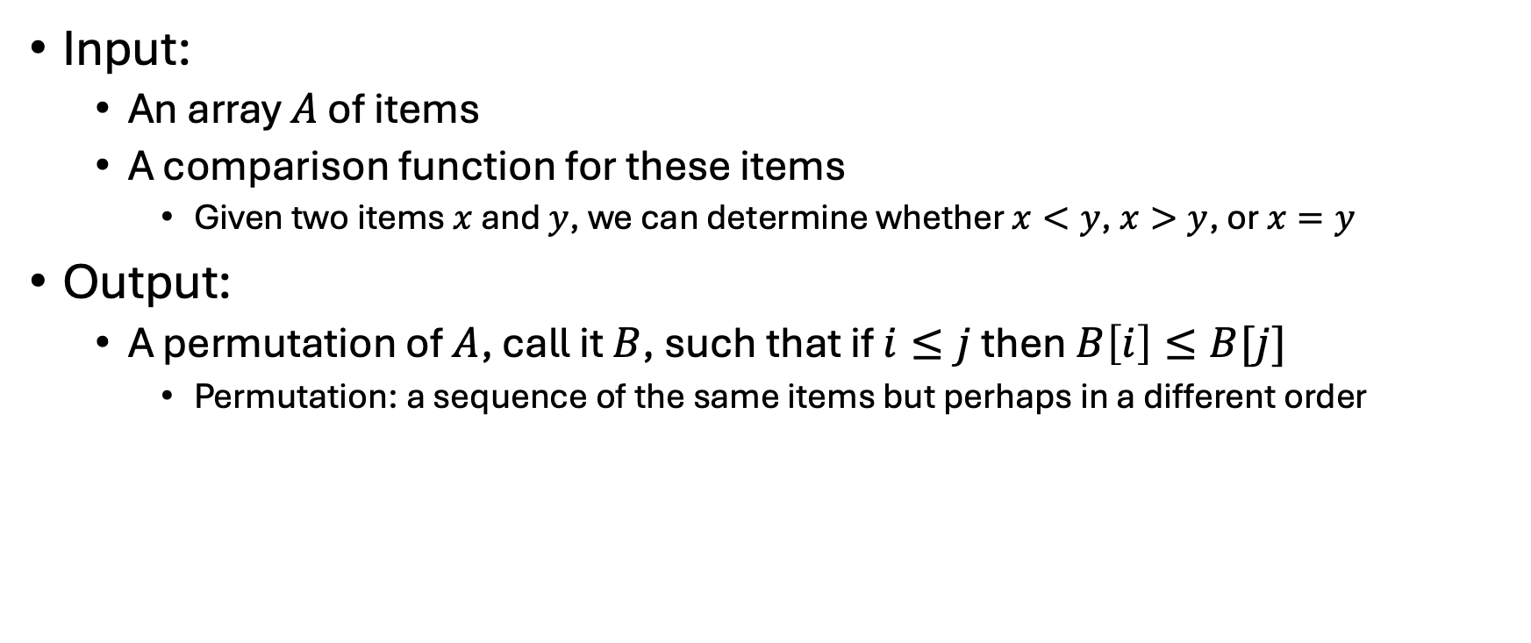
More Formal Definition
Input:
  An array $A$ of items
  A comparison function for these items
    Given two items $x$ and $y$, we can determine whether $x<y$, $x>y$, or $x=y$
Output:
  A permutation of $A$, call it $B$, such that if $i≤j$ then$B\left[i\right]≤B[j]$
    Permutation: a sequence of the same items but perhaps in a different order

Slide 29
Sorting “Landscape”
There is no singular best algorithm for sorting
Some are faster, some are slower
Some use more memory, some use less
Some are super extra fast if your data matches particular assumptions
Some have other special properties that make them valuable
No sorting algorithm can have only all the “best” attributes

