Slide 1
CSE 332 Summer 2026
Lecture 8: AVL Wrapup, Hashing
Michael Whitmeyer
http://www.cs.uw.edu/332

Slide 2
Dictionary (Map) ADT - Ordered
Contents:
  Sets of key+value pairs
  Keys must be comparable
Operations:
  insert(key, value)
    Adds the (key,value) pair into the dictionary
    If the key already has a value, overwrite the old value
      Consequence: Keys cannot be repeated
  find(key)
    Returns the value associated with the given key
  delete(key)
    Remove the key (and its associated value)

Slide 3
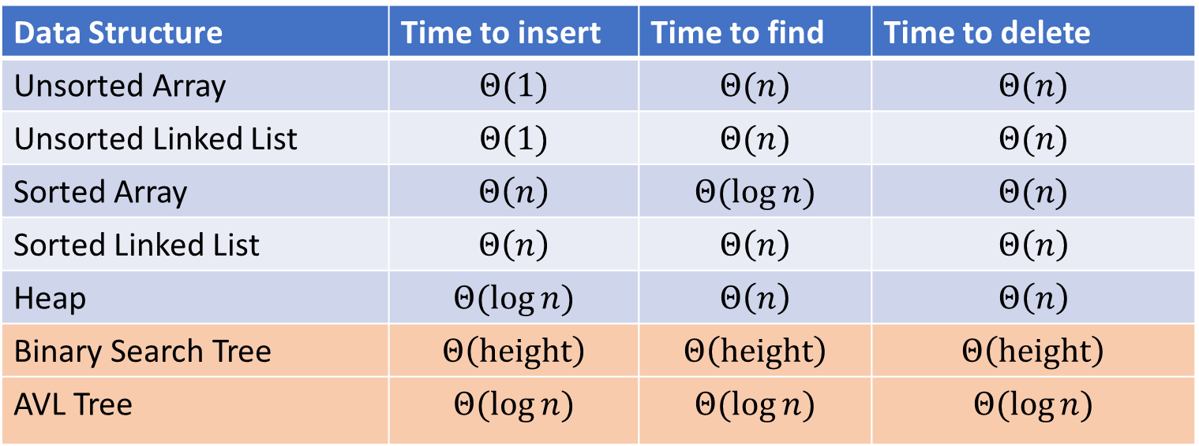
Dictionary Data Structures
Data Structure | Time to insert | Time to find | Time to delete
Unsorted Array | $$Θ(1)$$ | $$Θ(n)$$ | $$Θ(n)$$
Unsorted Linked List | $$Θ(1)$$ | $$Θ(n)$$ | $$Θ(n)$$
Sorted Array | $$Θ\left(n\right)$$ | $$Θ(\log{n})$$ | $$Θ(n)$$
Sorted Linked List | $$Θ\left(n\right)$$ | $$Θ\left(n\right)$$ | $$Θ\left(n\right)$$
Heap | $$Θ(\log{n})$$ | $$Θ\left(n\right)$$ | $$Θ\left(n\right)$$
Binary Search Tree | $$Θ\left(height\right)$$ | $$Θ\left(height\right)$$ | $$Θ\left(height\right)$$
AVL Tree | $$Θ(\log{n})$$ | $$Θ(\log{n})$$ | $$Θ(\log{n})$$

Slide 4
AVL Trees
AVL Tree:
  A binary search tree where for each node, the height of its left subtree and the height of its right subtree are off by at most 1.
  Find:
    Same as BST
  Insert:
    Do a BST insert, then rotate if tree is unbalanced (apply one LL, RR, LR, RL case)
  Delete:
    Do a BST delete, then rotate if the tree is unbalanced (apply LL, RR, LR, RL cases as needed from leaf to root)

Slide 5
Other Tree-based Dictionaries
Red-Black Trees
  Similar to AVL Trees in that we add shape rules to BSTs
  More “relaxed” shape than an AVL Tree
    Trees can be taller (though not asymptotically so)
    Needs to move nodes less frequently
  This is what Java’s TreeMap uses!
Tries
  Similar to a Huffman Tree
  Requires keys to be sequences (e.g. Strings)
  Combines shared prefixes among keys to save space
  Often used for text-based searches
    Web search
    Genomes

Slide 6
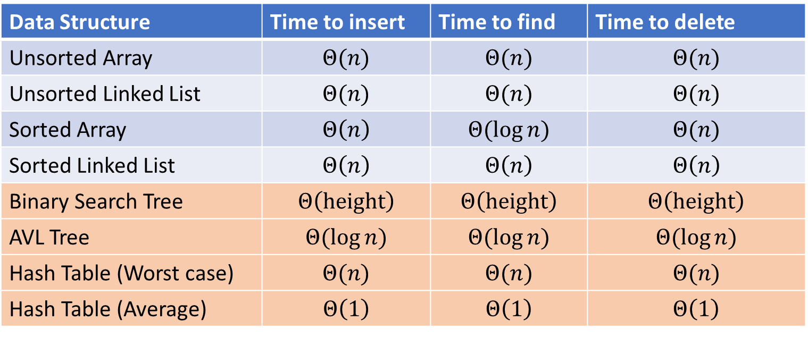
Next topic: Hash Tables
Data Structure | Time to insert | Time to find | Time to delete
Unsorted Array | $$Θ(n)$$ | $$Θ(n)$$ | $$Θ(n)$$
Unsorted Linked List | $$Θ(n)$$ | $$Θ(n)$$ | $$Θ(n)$$
Sorted Array | $$Θ\left(n\right)$$ | $$Θ(\log{n})$$ | $$Θ(n)$$
Sorted Linked List | $$Θ\left(n\right)$$ | $$Θ\left(n\right)$$ | $$Θ\left(n\right)$$
Binary Search Tree | $$Θ\left(height\right)$$ | $$Θ\left(height\right)$$ | $$Θ\left(height\right)$$
AVL Tree | $$Θ(\log{n})$$ | $$Θ(\log{n})$$ | $$Θ(\log{n})$$
Hash Table (Worst case) | $$Θ(n)$$ | $$Θ(n)$$ | $$Θ(n)$$
Hash Table (Average) | $$Θ\left(1\right)$$ | $$Θ\left(1\right)$$ | $$Θ\left(1\right)$$

Slide 7
Dictionary (Map) ADT - Unordered
Contents:
  Sets of key+value pairs
  Keys must be comparable Keys have a hash function
Operations:
  insert(key, value)
    Adds the (key,value) pair into the dictionary
    If the key already has a value, overwrite the old value
      Consequence: Keys cannot be repeated
  find(key)
    Returns the value associated with the given key
  delete(key)
    Remove the key (and its associated value)

Slide 8
The Best Dictionary Data Structure!
Think of every key as a number
Give each key its own index in an array
insert(key, value){
arr[key]=value;
}
find(key){
return arr[key];
}
delete(key){
arr[key] = null;
}

Slide 9
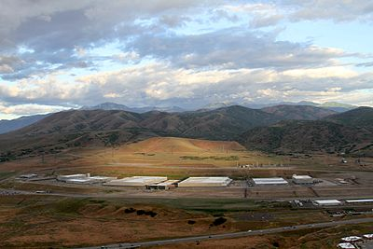
Problem?

Slide 10

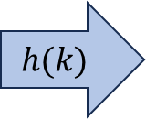
Hash Tables
Idea:
  Have a small array to store information
  Use a hash function to convert the key into an index
    Hash function should “scatter” the keys, behave as if it randomly assigned keys to indices
  Store key at the index given by the hash function
  Do something if two keys map to the same place (should be very rare)
    Collision resolution
Insert / find /
delete
$$h(k)$$
Some Integer
& value
Key Object

Slide 11

Example
0
1
2
3
4
5
6
7
8
9
Key: Phone Number
Value: People
Table size: 10
$h\left(phone\right)=$ number as an integer
$h\left(8675309\right)\%10=9$

Slide 12
What Influences Running time?
How long hashing itself takes
Likelihood of collisions
  Size of the array vs number of values in the array
  “quality” of our hash function
What we do when we have a collision

Slide 13
Properties of a “Good” Hash
Definition: A hash function maps objects to integers
Consistent
  Objects considered “equal” should hash to the same value
  Deterministic: running the hash function on the same object twice should yield the same result
Uniform
  Should be able to use every index in a fixed-size array
  Should use every index at roughly equal rates
Effective
  It should be difficult to find two objects which hash to the same value
  Given on object, it should be hard to find a different object which hashes to the same value
  “Avalanche effect”: making a small change to the object yields big changes in the value it hashes to
Efficient
  Time to calculate the hash should be very small

Slide 14
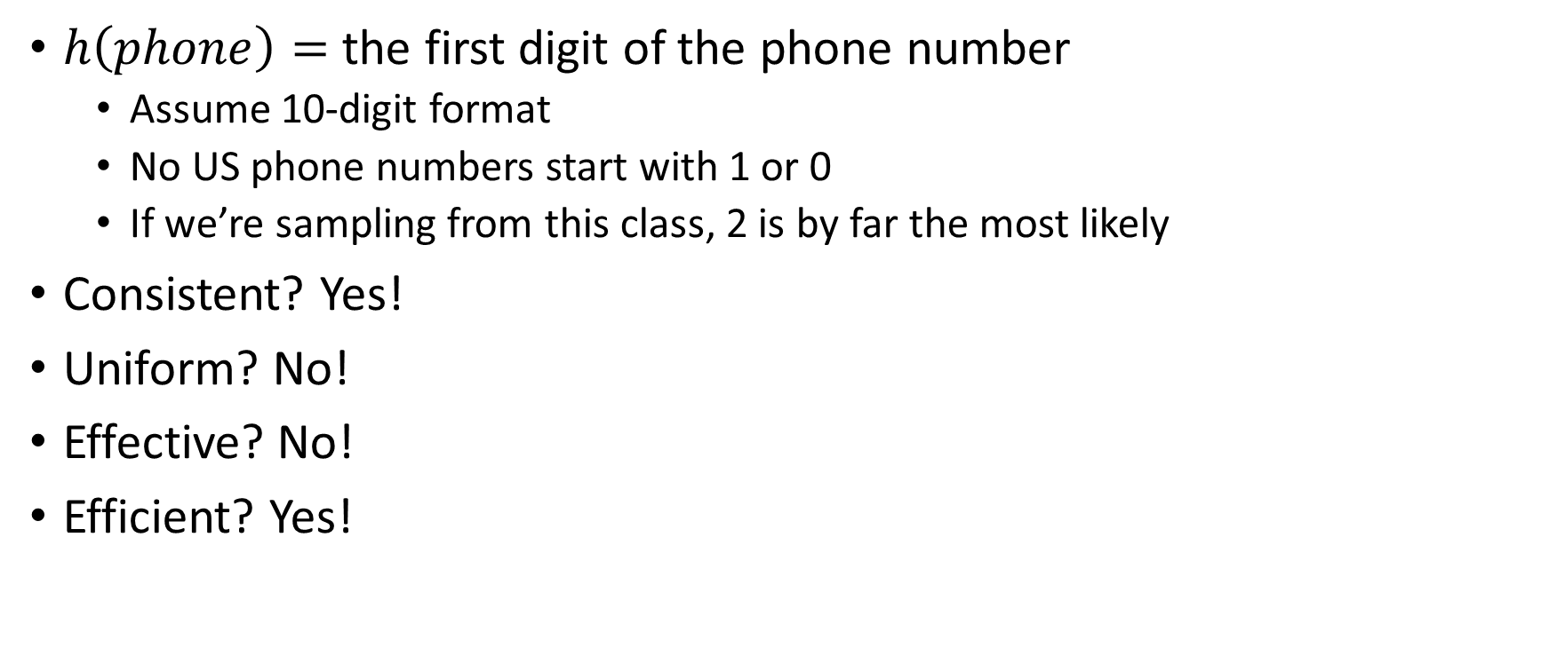
A Bad Hash (and phone number trivia)
$h\left(phone\right)=$ the first digit of the phone number
  Assume 10-digit format
  No US phone numbers start with 1 or 0
  If we’re sampling from this class, 2 is by far the most likely
Consistent? Yes!
Uniform? No!
Effective? No!
Efficient? Yes!
0
1
2
3
4
5
6
7
8
9

Slide 15
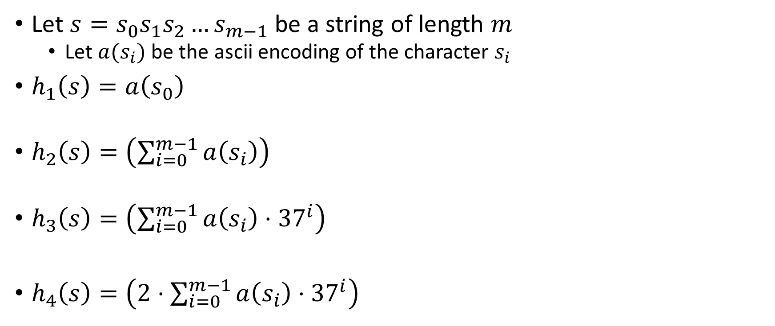
Compare These Hash Functions (for strings)
Let $s=s_{0}s_{1}s_{2}…s_{m−1}$ be a string of length $m$
  Let $a(s_{i})$ be the ascii encoding of the character $s_{i}$
$h_{1}\left(s\right)=a\left(s_{0}\right)$
$h_{2}\left(s\right)=\left(\sum_{i=0}^{m−1}{a\left(s_{i}\right)}\right)$
$h_{3}\left(s\right)=\left(\sum_{i=0}^{m−1}{a\left(s_{i}\right)⋅{37}^{i}}\right)$
$h_{4}\left(s\right)=\left(2⋅\sum_{i=0}^{m−1}{a\left(s_{i}\right)⋅{37}^{i}}\right)$

Slide 16
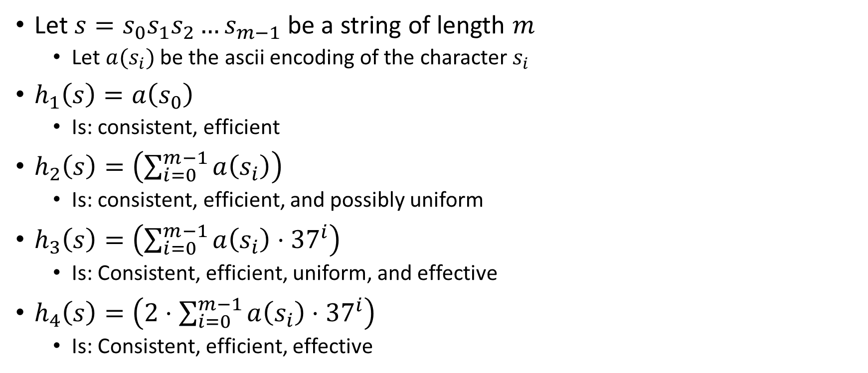
Properties of Those Example Hash Functions
Let $s=s_{0}s_{1}s_{2}…s_{m−1}$ be a string of length $m$
  Let $a(s_{i})$ be the ascii encoding of the character $s_{i}$
$h_{1}\left(s\right)=a\left(s_{0}\right)$
  Is: consistent, efficient
$h_{2}\left(s\right)=\left(\sum_{i=0}^{m−1}{a\left(s_{i}\right)}\right)$
  Is: consistent, efficient, and possibly uniform
$h_{3}\left(s\right)=\left(\sum_{i=0}^{m−1}{a\left(s_{i}\right)⋅{37}^{i}}\right)$
  Is: Consistent, efficient, uniform, and effective
$h_{4}\left(s\right)=\left(2⋅\sum_{i=0}^{m−1}{a\left(s_{i}\right)⋅{37}^{i}}\right)$
  Is: Consistent, efficient, effective

Slide 17
Ideal Insert procedure
Supposing we have a “good” hash function:
insert(key, value){
h = key.hash();
arr[h % table.length] = value;
}
Problem: It’s possible that two different keys map to the same index!
This is called a “collision”

Slide 18
Collision Resolution
A Collision occurs when we want to insert something into an already-occupied position in the hash table
2 main strategies:
  Separate Chaining
    Use a secondary data structure to contain the items
      E.g. each index in the hash table is itself a linked list
  Open Addressing
    Use a different spot in the table instead
      Linear Probing
      Quadratic Probing
      Double Hashing
0
1
2
3
4
5
6
7
8
9

Slide 19
Separate Chaining Insert
To insert k, v:
  Compute the index using i = h(k) % table.length
  Add the key-value pair to the data structure at table[i]
k,v
k,v
k,v
0
1
2
3
4
5
6
7
8
9

Slide 20
Separate Chaining Find
To find k:
  Compute the index using i = h(k) % table.length
  Call find with the key on the data structure at table[i]
k,v
k,v
k,v
0
1
2
3
4
5
6
7
8
9

Slide 21
Separate Chaining Delete
To delete k:
  Compute the index using i = h(k) % table.length
  Call delete with the key on the data structure at table[i]
k,v
k,v
k,v
0
1
2
3
4
5
6
7
8
9

Slide 22
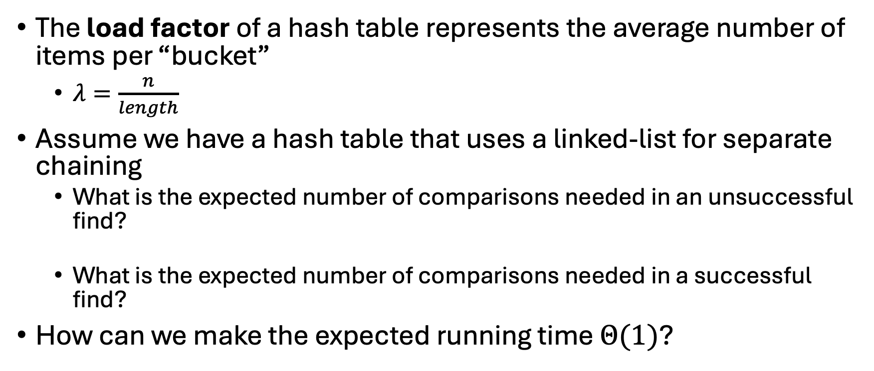
Formal Running Time Analysis
The load factor of a hash table represents the average number of items per “bucket”
  $λ=\frac{n}{length}$
Assume we have a hash table that uses a linked-list for separate chaining
  What is the expected number of comparisons needed in an unsuccessful find?
  What is the expected number of comparisons needed in a successful find?
How can we make the expected running time $Θ(1)$?

Slide 23
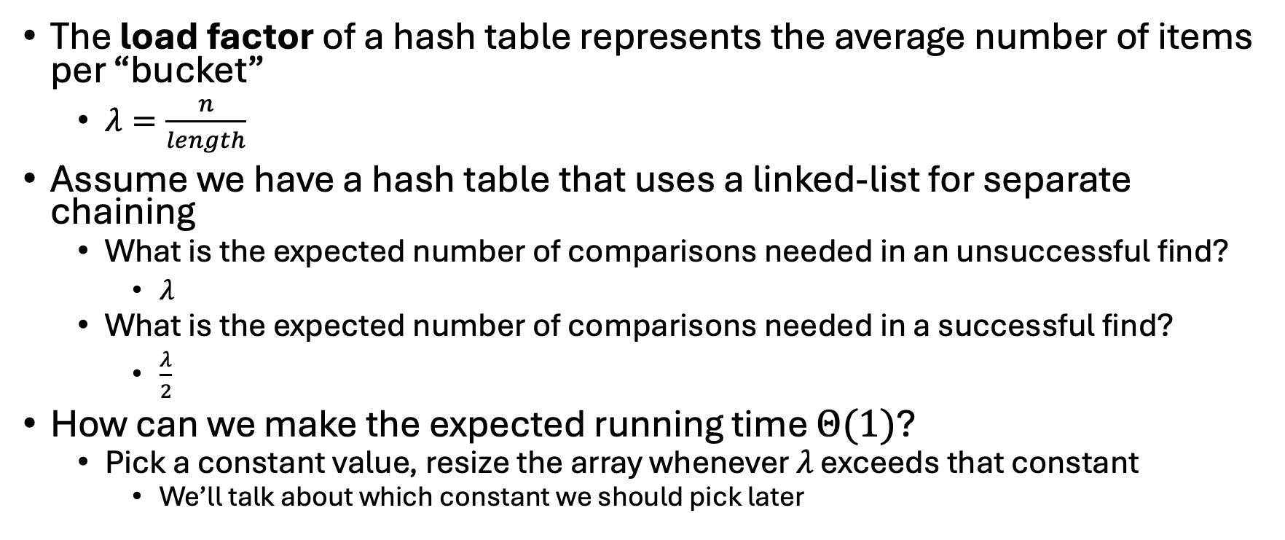
Formal Running Time Analysis (Answers)
The load factor of a hash table represents the average number of items per “bucket”
  $λ=\frac{n}{length}$
Assume we have a hash table that uses a linked-list for separate chaining
  What is the expected number of comparisons needed in an unsuccessful find?
    $λ$
  What is the expected number of comparisons needed in a successful find?
    $\frac{λ}{2}$
How can we make the expected running time $Θ(1)$?
  Pick a constant value, resize the array whenever $λ$ exceeds that constant
    We’ll talk about which constant we should pick later

