Slide 1
CSE 332 Summer 2026
Lecture 7: AVL Trees
Michael Whitmeyer
http://www.cs.uw.edu/332

Slide 2
Reminder: Dictionary (Map) ADT
Contents:
  Sets of key+value pairs
  Keys must be comparable
Operations:
  insert(key, value)
    Adds the (key,value) pair into the dictionary
    If the key already has a value, overwrite the old value
      Consequence: Keys cannot be repeated
  find(key)
    Returns the value associated with the given key
  delete(key)
    Remove the key (and its associated value)

Slide 3
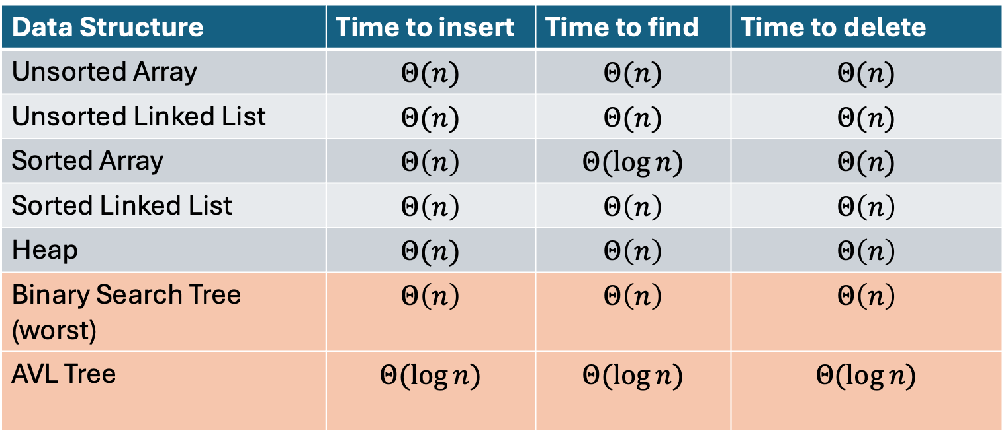
Naïve attempts
Data Structure | Time to insert | Time to find | Time to delete
Unsorted Array | $$Θ(n)$$ | $$Θ(n)$$ | $$Θ(n)$$
Unsorted Linked List | $$Θ(n)$$ | $$Θ(n)$$ | $$Θ(n)$$
Sorted Array | $$Θ\left(n\right)$$ | $$Θ(\log{n})$$ | $$Θ(n)$$
Sorted Linked List | $$Θ\left(n\right)$$ | $$Θ\left(n\right)$$ | $$Θ\left(n\right)$$
Heap | $$Θ(n)$$ | $$Θ\left(n\right)$$ | $$Θ\left(n\right)$$
Binary Search Tree (worst) | $$Θ\left(n\right)$$ | $$Θ\left(n\right)$$ | $$Θ\left(n\right)$$
AVL Tree | $$Θ(\log{n})$$ | $$Θ(\log{n})$$ | $$Θ(\log{n})$$

Slide 4

Worst Case Analysis
For each of Find, insert, Delete:
  Worst case running time matches height of the tree
What is the maximum height of a BST with $n$ nodes?
  $Θ(n)$

Slide 5
Improving the worst case
How can we get a better worst case running time?
  Add rules about the shape of our BST
AVL Tree
  A BST with some shape rules
    Find/Insert/Delete need to change to accommodate those

Slide 6
“Balanced” Binary Search Trees
We get better running times by having “shorter” trees
Trees get tall due to them being “sparse” (many one-child nodes)
Idea: modify how we insert/delete to keep the tree more “full”
  Encourage Branches!

Slide 7
Idea 1: Both Subtrees of Root have same # Nodes

Slide 8
Idea 1: Both Subtrees of Root have same # Nodes - Issue
16
10
17
7
18
3
19
1
20
0
21

Slide 9
Idea 2: Both Subtrees of Root have same height

Slide 10
Idea 2: Both Subtrees of Root have same height - Issue
16
10
17
7
18
3
19
1
20
0
21

Slide 11
Idea 3: Both Subtrees of every Node have same # Nodes

Slide 12
Idea 3: Both Subtrees of every Node have same # Nodes - Issue
Not all tree sizes are possible!
For example, cannot have a tree of size 2.

Slide 13
Idea 4: Both Subtrees of every Node have same height

Slide 14
Idea 4: Both Subtrees of every Node have same height - Issue
Not all tree sizes are possible!
For example, cannot have a tree of size 2.

Slide 15
AVL Tree
A Binary Search tree that maintains that the left and right subtrees of every node have heights that differ by at most one.
  height of left subtree and height of right subtree off by at most 1
  Not too weak (ensures trees are short)
  Not too strong (works for any number of nodes)
Idea of AVL Tree:
  When you insert/delete nodes, if tree is “out of balance” then modify the tree
  Modification = “rotation”

Slide 16
Is it an AVL Tree?
9
9
3
10
3
10
6
16
1
1
6
0
5
0
5
9
9
3
10
3
10
6
16
1
6
16
5
0
5
7

Slide 17
Is it an AVL Tree? (Answers)
9
Not Balanced!
9
3
10
“Problem” Node
Its children’s heights differ by more than 1
3
10
1
6
16
1
6
0
5
Balanced!
0
5
9
9
3
10
3
10
6
16
1
6
16
5
Not Balanced!
0
5
7
Balanced!

Slide 18
Using AVL Trees
Key = 9
Value = “hello”
Height = 3
Left = Node 3
Right = Node 10
Each node has:
  Key
  Value
  Height
  Left child
  Right child
9
3
10
1
6
16
0
5
7

Slide 19
Inserting into an AVL Tree
Starts out the same way as BST:
  “Find” where the new node should go
  Put it in the right place (it will be a leaf)
Next check the balance
  If the tree is still balanced, you’re done!
  Otherwise we need to do rotations

Slide 20
Insert Example (Insert 10)
10
9
3
11
1
6
16
0
2
7

Slide 21
Insert Example (Insert 10) - After
9
3
11
1
6
10
16
0
2
7

Slide 22
Insert 10 (After)
Is the tree still balanced?
Only need to check nodes in the path from root to the new node
Why? Tree was balanced before the insert, so unchanged subtrees cannot be unbalanced.
Height=3
9
Height=2
Height=1
3
11
Height=0
Height=0
1
6
10
16
0
2
7

Slide 23
Insert Example (Insert -1)
-1
9
3
11
1
6
16
0
2
7

Slide 24
Insert -1, BST Insert Step
Not Balanced!
Node 9 is a “problem node” Left and right children of node 9 are different by 2.
Idea: “shorten” the left subtree, “lengthen” the right
Height=4
9
Height=3
Height=1
3
11
Height=2
Height=1
1
6
16
Height=1
Height=0
0
2
7
Height=0
-1
Height=-1

Slide 25
Not Balanced after Inserting -1
Solution:
Take the subtree starting with the problem node,
“Rotate” that tree to the right
9
Height = 3
Height = 1
3
11
1
6
16
0
2
7
-1

Slide 26
Final Result of Inserting -1
3
1
9
0
2
6
11
-1
7
16

Slide 27


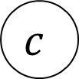
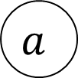







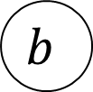







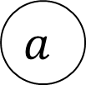



Right Rotation
We just inserted $c$, node $a$ is the deepest “problem” node
Make the left child the new root
Make the old root the right child of the new
Make the new root’s right subtree the old root’s left subtree
$$h+3$$
$$h+2$$
$$b$$
$$a$$
$$h+2$$
$$h$$
$$h+1$$
$$b$$
$$z$$
$$x$$
$$h+1$$
$$a$$
Right Rotation
$$h+1$$
$$h$$
$$h$$
$$h$$
$$x$$
$$y$$
$$y$$
$$z$$
$$c$$
$$c$$

Slide 28
Insert Example (Insert 20)
9
20
3
11
1
6
10
16
0
2
18

Slide 29
Not Balanced! Multiple Problem Nodes
Here, nodes 11 and 16 are problem nodes.
There may be multiple places where we can do a rotation to rebalance the tree, but the deepest problem node always works!
9
Height=2
Height=3
3
11
Height=0
Height=2
1
6
10
16
Height=1
0
2
Height=-1
18
Height=0
20
Height=-1

Slide 30
Not Balanced After inserting 20
Solution:
Take the subtree starting with the problem node,
“Rotate” that tree to the left
9
3
11
1
6
10
16
0
2
18
Height = 1
Height =-1
20

Slide 31
Final Result of Inserting 20
9
3
11
1
6
10
18
0
2
16
20

Slide 32
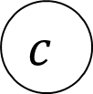


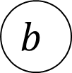



















Left Rotation
We just inserted $c$, node $a$ is the deepest “problem” node
Make the right child the new root
Make the old root the left child of the new
Make the new root’s left subtree the old root’s right subtree
$$h+3$$
$$a$$
$$h+2$$
$$b$$
$$h$$
$$h+1$$
$$h+1$$
$$x$$
$$h+2$$
$$b$$
$$a$$
$$z$$
Left Rotation
$$h$$
$$h+1$$
$$h$$
$$h$$
$$y$$
$$z$$
$$x$$
$$y$$
$$c$$
$$c$$

Slide 33
Insertion Story So Far
After insertion, update the heights of the node’s ancestors
Check for unbalance
If unbalanced then at the deepest unbalanced root:
  If the left subtree was deeper then rotate right
  If the right subtree was deeper then rotate left
This is incomplete!
There are some cases where this doesn’t work!
9
9
5
Insert 7
Right Rotation
5
5
9
7
7

Slide 34
Insertion Cases
After insertion, update the heights of the node’s ancestors
Check for unbalance
If unbalanced then at the deepest unbalanced root:
  Case LL: If we inserted in the left subtree of the left child then rotate right
  Case RR: If we inserted in the right subtree of the right child then rotate left
  Case LR: If we inserted into the right subtree of the left child then ???
  Case RL: If we inserted into the left subtree of the right child then ???
Cases LR and RL require 2 rotations!

Slide 35
Case LR
From deepest problem node:
  Rotate left at the left child
  Rotate right at the problem node
9
9
9
Insert 7
Rotate Left at 5
5
Rotate Right at 9
7
5
7
7
5
9
5

Slide 36



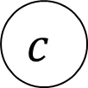
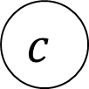
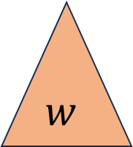





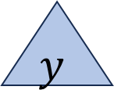
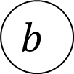







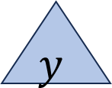









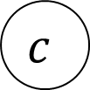
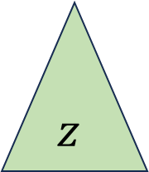













Case LR in General
We just inserted $d$, node $a$ is the deepest “problem” node
Imbalance caused by inserting in the left child’s right subtree
Rotate left at the left child
Rotate right at the unbalanced node
$$h+3$$
$$h+3$$
$$a$$
$$h+2$$
$$a$$
$$c$$
Rotate
Left at $b$
Rotate Right at $a$
$$h+2$$
$$h+2$$
$$h$$
$$h+1$$
$$h$$
$$c$$
$$z$$
$$a$$
$$b$$
$$z$$
$$b$$
$$h+1$$
$$h+1$$
$$h$$
$$h+1$$
$$c$$
$$b$$
$$y$$
$$h$$
$$h$$
$$w$$
$$w$$
$$x$$
$$y$$
$$z$$
$$h$$
$$x$$
$$y$$
$$w$$
$$x$$
$$d$$
$$d$$
$$d$$
$$d$$
$$d$$
$$d$$

Slide 37

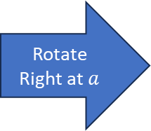
Case LR Implementation
b=a.left
c=b.right
b.right=c.left
a.left=c.right
c.right=a
c.left=b
return c
$$h+3$$
$$h+3$$
$$a$$
$$h+2$$
$$a$$
$$c$$
Rotate
Left at $b$
Rotate Right at $a$
$$h+2$$
$$h+2$$
$$h$$
$$h+1$$
$$h$$
$$c$$
$$z$$
$$a$$
$$b$$
$$z$$
$$b$$
$$h+1$$
$$h+1$$
$$h$$
$$h+1$$
$$c$$
$$b$$
$$y$$
$$h$$
$$h$$
$$w$$
$$w$$
$$x$$
$$y$$
$$z$$
$$h$$
$$x$$
$$y$$
$$w$$
$$x$$
$$d$$
$$d$$
$$d$$
$$d$$
$$d$$
$$d$$

Slide 38
















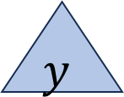








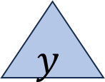
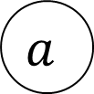
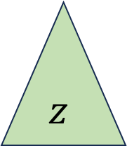






Case RL in General
We just inserted $d$, node $a$ is the deepest “problem” node
Imbalance caused by inserting in the right child’s left subtree
Rotate right at the right child
Rotate left at the unbalanced node
$$h+3$$
$$a$$
$$h+2$$
$$c$$
$$h+3$$
$$a$$
Rotate Right at $b$
Rotate Left at $a$
$$h+2$$
$$b$$
$$h$$
$$c$$
$$h+1$$
$$b$$
$$h$$
$$w$$
$$h+2$$
$$a$$
$$h+1$$
$$w$$
$$h+1$$
$$c$$
$$h$$
$$h+1$$
$$b$$
$$h$$
$$h$$
$$z$$
$$x$$
$$w$$
$$x$$
$$y$$
$$z$$
$$h$$
$$x$$
$$y$$
$$y$$
$$z$$
$$d$$
$$d$$
$$d$$
$$d$$
$$d$$
$$d$$

Slide 39
Insert Summary
After a BST insertion, update the heights of the node’s ancestors
From leaf to root, check if each node is balanced
If a node is unbalanced then at the deepest unbalanced node:
  Case LL: If we inserted in the left subtree of the left child then: rotate right
  Case RR: If we inserted in the right subtree of the right child then: rotate left
  Case LR: If we inserted into the right subtree of the left child then: rotate left at the left child and then rotate right at the root
  Case RL: If we inserted into the left subtree of the right child then: rotate right at the right child and then rotate left at the root
Done after either reaching the root or applying one of the above cases

Slide 40
Delete Summary
TLDR: same cases, reverse direction of rotation, may need to repeat with ancestors
After a BST deletion, update the heights of the node’s ancestors
From leaf to root, check if each node is unbalanced
If a node is unbalanced then at the deepest unbalanced node:
  Case LL: If we deleted in the left subtree of the left child then: rotate left
  Case RR: If we deleted in the right subtree of the right child then: rotate right
  Case LR: If we deleted into the right subtree of the left child then: rotate right at the left child and then rotate left at the root
  Case RL: If we deleted into the left subtree of the right child then: rotate left at the right child and then rotate right at the root
Continue checking until reach the root

Slide 41
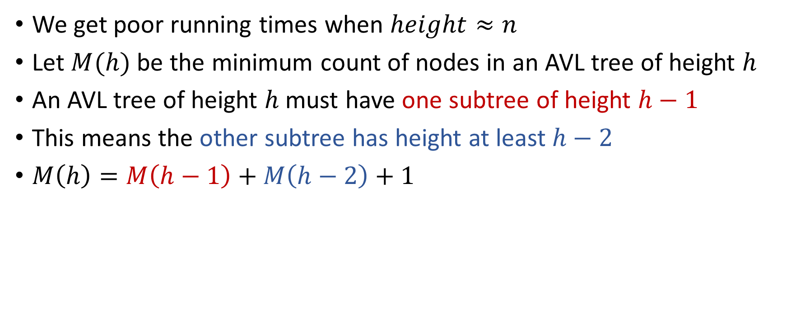

Why is this $Θ(\log{n})$ time?
We get poor running times when $height≈n$
Let $M(h)$ be the minimum count of nodes in an AVL tree of height $h$
An AVL tree of height $h$ must have one subtree of height $h−1$
This means the other subtree has height at least $h−2$
$M\left(h\right)=M\left(h−1\right)+M\left(h−2\right)+1$

Slide 42
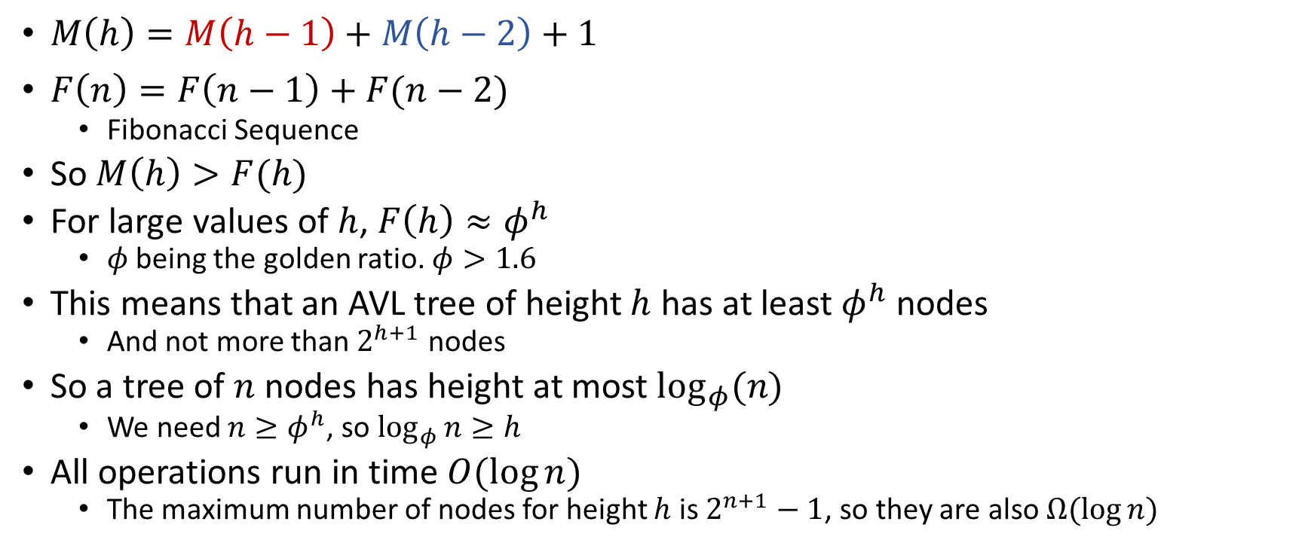
Comparing to Fibonacci Sequence
$M\left(h\right)=M\left(h−1\right)+M\left(h−2\right)+1$
$F\left(n\right)=F\left(n−1\right)+F(n−2)$
  Fibonacci Sequence
So $M\left(h\right)>F(h)$
For large values of $h$, $F\left(h\right)≈φ^{h}$
  $φ$ being the golden ratio. $φ>1.6$
This means that an AVL tree of height $h$ has at least $φ^{h}$ nodes
  And not more than $2^{h+1}$ nodes
So a tree of $n$ nodes has height at most $\log_{φ}(n)$
  We need $n≥φ^{h}$, so $\log_{φ}{n}≥h$
All operations run in time $O(\log{n})$
  The maximum number of nodes for height $h$ is $2^{n+1}−1$, so they are also $Ω(\log{n})$

