Slide 1
CSE 332 Summer 2026
Lecture 6: Heap Wrapup, Dictionaries
Michael Whitmeyer
http://www.cs.uw.edu/332

Slide 2
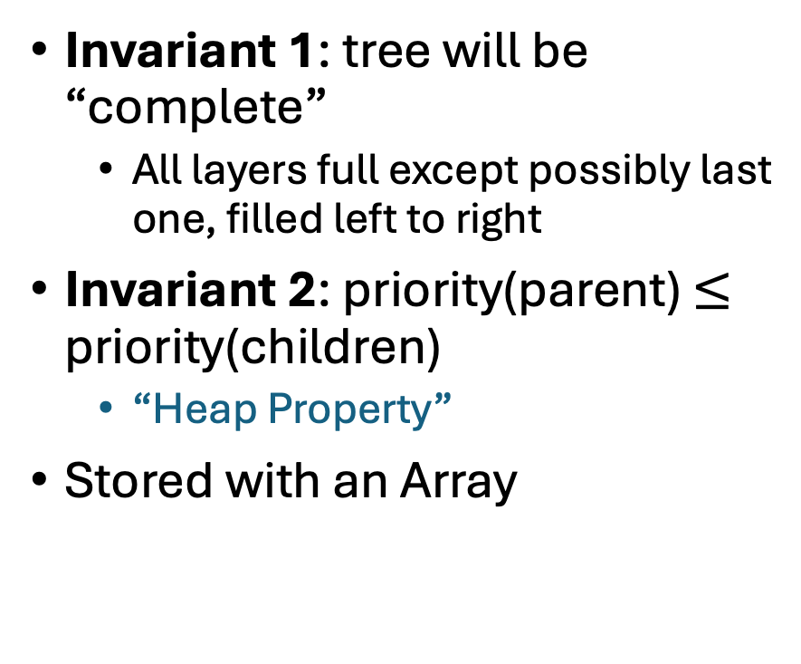
Reminder: Heap Data Structure (for priority queue ADT)
Invariant 1: tree will be “complete”
  All layers full except possibly last one, filled left to right
Invariant 2: priority(parent) $≤$ priority(children)
  “Heap Property”
Stored with an Array
1
3
2
4
7
5
6
5
9

Slide 3

Building a Heap From “Scratch”
Suppose we had $n$ items and wanted to “heapify” them
5
6
10
3
15
8
7
14
2
1
5
0
1
2
3
4
5
6
7
8
9
10
Violate Heap Property!
1
6
10
3
2
15
8
3
7
Two ways for “fix” the heap:
Percolate Up
Percolate Down
4
5
6
7
14
2
1
8
9
10

Slide 4
Floyd’s buildHeap method
Starting from the leaves, one row at a time, percolate down
buildHeap(){
for(int i = size; i>0; i--){
percolateDown(i);
}
}

Slide 5
Floyd’s buildHeap method (Percolate 15)
Suppose we had $n$ items and wanted to “heapify” them
5
6
10
3
15
8
7
14
2
1
Violate Heap Property!
Nodes bigger than a child
5
0
1
2
3
4
5
6
7
8
9
10
1
6
10
buildHeap(){
for(int i = size; i>0; i--){
percolateDown(i);
}
}
3
2
15
8
3
7
4
5
6
7
14
2
1
8
9
10

Slide 6
Floyd’s buildHeap method (Percolate 3)
Suppose we had $n$ items and wanted to “heapify” them
Violate Heap Property!
Nodes bigger than a child
5
5
6
10
3
1
8
7
14
2
15
1
0
1
2
3
4
5
6
7
8
9
10
6
10
3
2
8
3
7
buildHeap(){
for(int i = size; i>0; i--){
percolateDown(i);
}
}
1
4
5
6
7
14
2
15
8
9
10

Slide 7
Floyd’s buildHeap method (Percolate 10)
Suppose we had $n$ items and wanted to “heapify” them
5
5
6
10
2
1
8
7
14
3
15
Violate Heap Property!
1
0
1
2
3
4
5
6
7
8
9
10
6
10
2
2
8
3
7
buildHeap(){
for(int i = size; i>0; i--){
percolateDown(i);
}
}
1
4
5
6
7
14
3
15
8
9
10

Slide 8
Floyd’s buildHeap method (Percolate 6)
Suppose we had $n$ items and wanted to “heapify” them
5
5
6
7
2
1
8
10
14
3
15
Violate Heap Property!
1
0
1
2
3
4
5
6
7
8
9
10
6
7
2
2
8
3
10
buildHeap(){
for(int i = size; i>0; i--){
percolateDown(i);
}
}
1
4
5
6
7
14
3
15
8
9
10

Slide 9
Floyd’s buildHeap method (Percolate 5)
Suppose we had $n$ items and wanted to “heapify” them
5
5
1
7
2
6
8
10
14
3
15
Violate Heap Property!
1
0
1
2
3
4
5
6
7
8
9
10
1
7
2
2
8
3
10
buildHeap(){
for(int i = size; i>0; i--){
percolateDown(i);
}
}
6
4
5
6
7
14
3
15
8
9
10

Slide 10
Floyd’s buildHeap method (Done)
Suppose we had $n$ items and wanted to “heapify” them
1
1
2
7
3
6
8
10
14
5
15
Violate Heap Property!
1
0
1
2
3
4
5
6
7
8
9
10
2
7
3
2
8
3
10
buildHeap(){
for(int i = size; i>0; i--){
percolateDown(i);
}
}
6
4
5
6
7
14
5
15
8
9
10

Slide 11
How long did this take?
Worst case running time of buildHeap:
No node can percolate down more than the height of its subtree
  When i is a leaf:
  When i is second-from-last level:
  When i is third-from-last level:
Overall Running time:
buildHeap(){
for(int i = size; i>0; i--){
percolateDown(i);
}
}

Slide 12
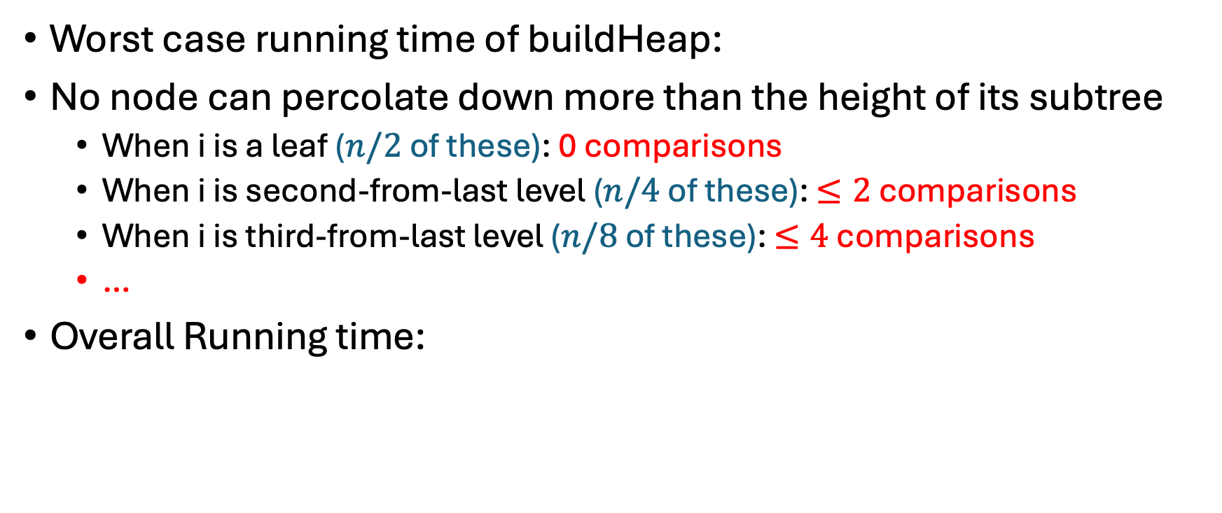
How long did this take?
Worst case running time of buildHeap:
No node can percolate down more than the height of its subtree
  When i is a leaf ($n/2$ of these): 0 comparisons
  When i is second-from-last level ($n/4$ of these): $≤2$ comparisons
  When i is third-from-last level ($n/8$ of these): $≤4$ comparisons
  …
Overall Running time:
buildHeap(){
for(int i = size; i>0; i--){
percolateDown(i);
}
}

Slide 13
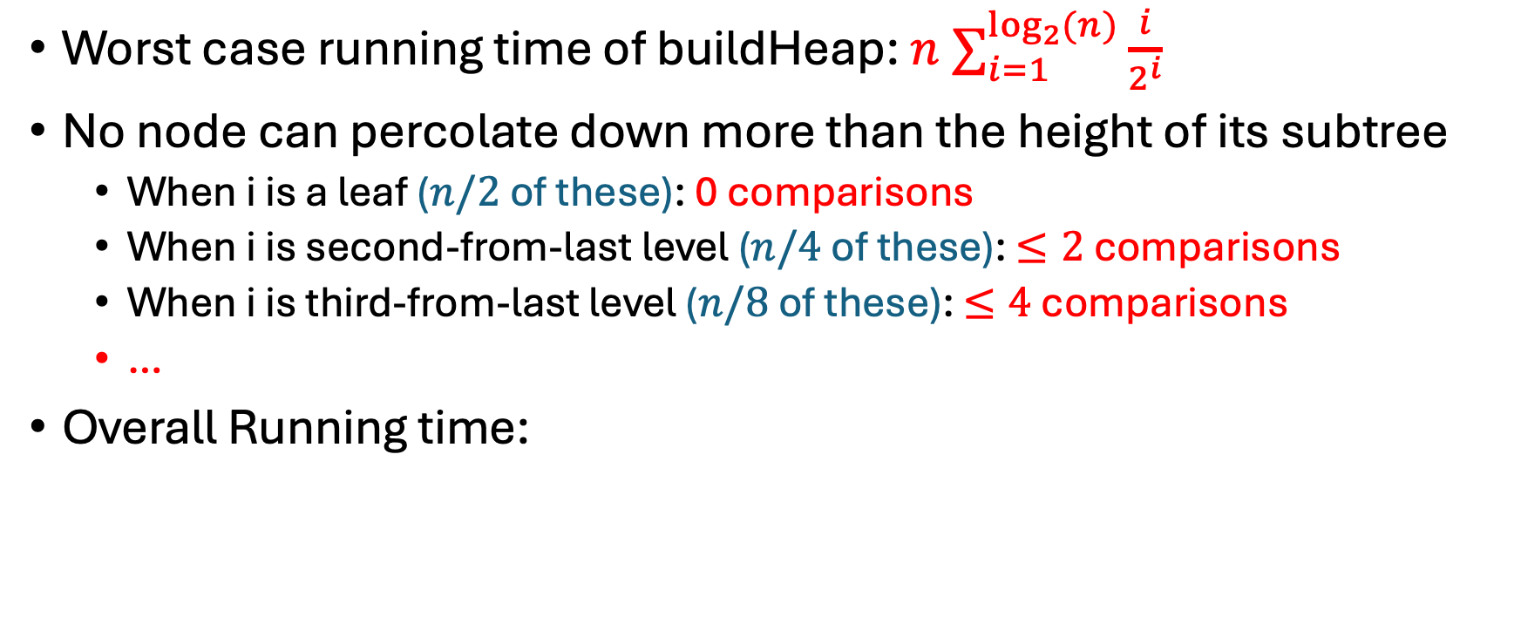
How long did this take?
Worst case running time of buildHeap: ${n ∑}_{i=1}^{\log_{2}{(n})}\frac{i}{2^{i}}$
No node can percolate down more than the height of its subtree
  When i is a leaf ($n/2$ of these): 0 comparisons
  When i is second-from-last level ($n/4$ of these): $≤2$ comparisons
  When i is third-from-last level ($n/8$ of these): $≤4$ comparisons
  …
Overall Running time:
buildHeap(){
for(int i = size; i>0; i--){
percolateDown(i);
}
}

Slide 14

A Serious Series Calculation
Lemma: ${E≔ n ∑}_{i=1}^{\log_{2}{(n})}\frac{i}{2^{i}}∈Θ(n)$
Proof: First term is $n/2$, so $E∈Ω(n)$ is immediate.

Slide 15
A Serious Series Calculation
Lemma: ${E≔ n ∑}_{i=1}^{\log_{2}{(n})}\frac{i}{2^{i}}∈Θ(n)$
Proof: First term is $n/2$, so $E∈Ω(n)$ is immediate.

Slide 16

A Serious Series Calculation
Lemma: ${E≔ n ∑}_{i=1}^{\log_{2}{(n})}\frac{i}{2^{i}}∈Θ(n)$
Proof: First term is $n/2$, so $E∈Ω(n)$ is immediate.
Next, observe $∑_{i=1}^{\log_{2}{(n})}\frac{i}{2^{i}}≤∑_{i=1}^{∞}\frac{i}{2^{i}}$

Slide 17
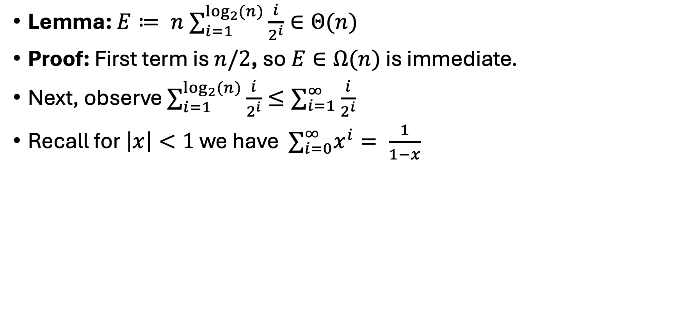
A Serious Series Calculation
Lemma: ${E≔ n ∑}_{i=1}^{\log_{2}{(n})}\frac{i}{2^{i}}∈Θ(n)$
Proof: First term is $n/2$, so $E∈Ω(n)$ is immediate.
Next, observe $∑_{i=1}^{\log_{2}{(n})}\frac{i}{2^{i}}≤∑_{i=1}^{∞}\frac{i}{2^{i}}$
Recall for $\left|x\right|<1$ we have $∑_{i=0}^{∞}x^{i}= \frac{1}{1−x}$

Slide 18
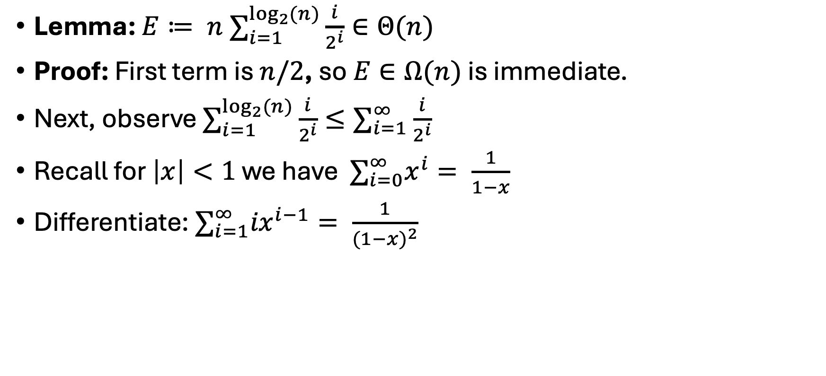
A Serious Series Calculation
Lemma: ${E≔ n ∑}_{i=1}^{\log_{2}{(n})}\frac{i}{2^{i}}∈Θ(n)$
Proof: First term is $n/2$, so $E∈Ω(n)$ is immediate.
Next, observe $∑_{i=1}^{\log_{2}{(n})}\frac{i}{2^{i}}≤∑_{i=1}^{∞}\frac{i}{2^{i}}$
Recall for $\left|x\right|<1$ we have $∑_{i=0}^{∞}x^{i}= \frac{1}{1−x}$
Differentiate: $∑_{i=1}^{∞}{ix}^{i−1}= \frac{1}{{(1−x)}^{2}}$

Slide 19
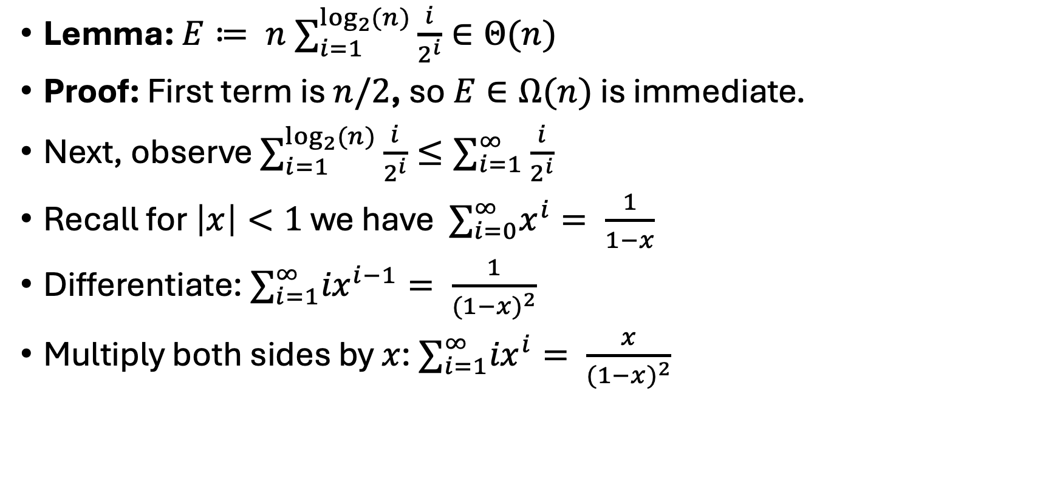
A Serious Series Calculation
Lemma: ${E≔ n ∑}_{i=1}^{\log_{2}{(n})}\frac{i}{2^{i}}∈Θ(n)$
Proof: First term is $n/2$, so $E∈Ω(n)$ is immediate.
Next, observe $∑_{i=1}^{\log_{2}{(n})}\frac{i}{2^{i}}≤∑_{i=1}^{∞}\frac{i}{2^{i}}$
Recall for $\left|x\right|<1$ we have $∑_{i=0}^{∞}x^{i}= \frac{1}{1−x}$
Differentiate: $∑_{i=1}^{∞}{ix}^{i−1}= \frac{1}{{(1−x)}^{2}}$
Multiply both sides by $x$: $∑_{i=1}^{∞}{ix}^{i}= \frac{x}{{(1−x)}^{2}}$

Slide 20
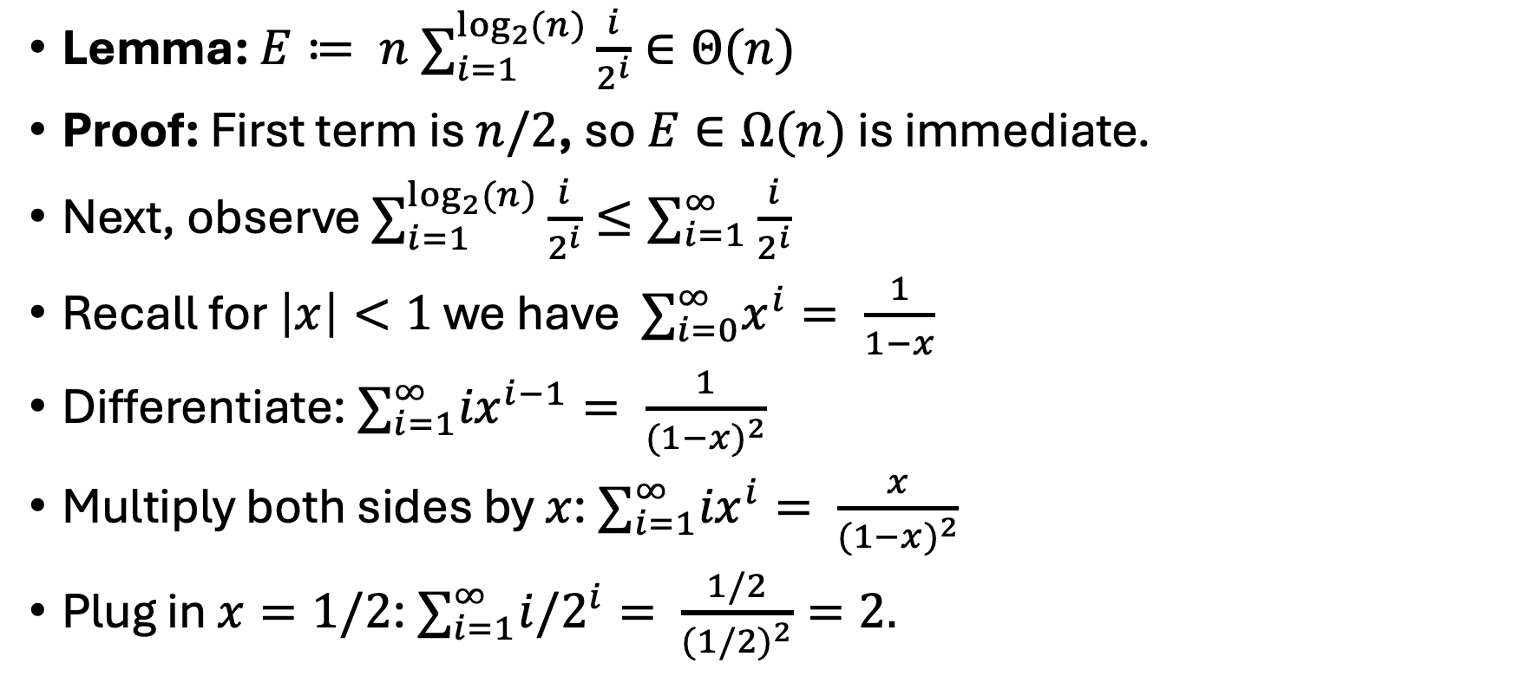
A Serious Series Calculation
Lemma: ${E≔ n ∑}_{i=1}^{\log_{2}{(n})}\frac{i}{2^{i}}∈Θ(n)$
Proof: First term is $n/2$, so $E∈Ω(n)$ is immediate.
Next, observe $∑_{i=1}^{\log_{2}{(n})}\frac{i}{2^{i}}≤∑_{i=1}^{∞}\frac{i}{2^{i}}$
Recall for $\left|x\right|<1$ we have $∑_{i=0}^{∞}x^{i}= \frac{1}{1−x}$
Differentiate: $∑_{i=1}^{∞}{ix}^{i−1}= \frac{1}{{(1−x)}^{2}}$
Multiply both sides by $x$: $∑_{i=1}^{∞}{ix}^{i}= \frac{x}{{(1−x)}^{2}}$
Plug in $x=1/2$: $∑_{i=1}^{∞}{i/2}^{i}= \frac{1/2}{{(1/2)}^{2}}=2.$

Slide 21
Next up: Dictionaries!

Slide 22
Dictionary (Map) ADT
Contents:
  Sets of key+value pairs
  Keys must be comparable
Operations:
  insert(key, value)
    Adds the (key,value) pair into the dictionary
    If the key already has a value, overwrite the old value
      Consequence: Keys cannot be repeated
  find(key)
    Returns the value associated with the given key
  delete(key)
    Remove the key (and its associated value)

Slide 23
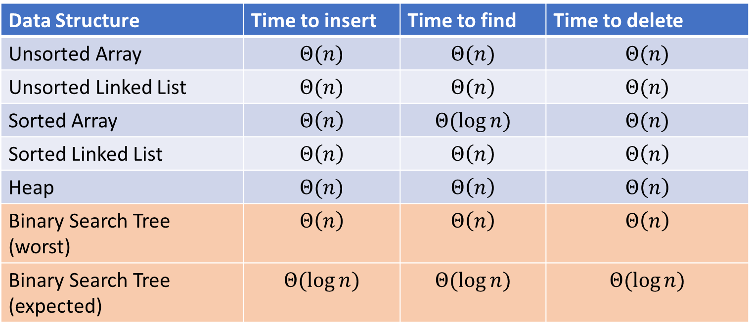
Naïve attempts
Data Structure | Time to insert | Time to find | Time to delete
Unsorted Array | $$Θ(n)$$ | $$Θ(n)$$ | $$Θ(n)$$
Unsorted Linked List | $$Θ(n)$$ | $$Θ(n)$$ | $$Θ(n)$$
Sorted Array | $$Θ\left(n\right)$$ | $$Θ(\log{n})$$ | $$Θ(n)$$
Sorted Linked List | $$Θ\left(n\right)$$ | $$Θ\left(n\right)$$ | $$Θ\left(n\right)$$
Heap | $$Θ(n)$$ | $$Θ\left(n\right)$$ | $$Θ\left(n\right)$$
Binary Search Tree (worst) | $$Θ\left(n\right)$$ | $$Θ\left(n\right)$$ | $$Θ\left(n\right)$$
Binary Search Tree (expected) | $$Θ(\log{n})$$ | $$Θ(\log{n})$$ | $$Θ(\log{n})$$

Slide 24
Tree “Vocab”
D
U
B
Traversal:
  An algorithm for “visiting/processing” every node in a tree
Pre-Order Traversal:
  Root, Left Subtree, Right Subtree
In-Order Traversal:
  Left Subtree, Root, Right Subtree
Post-Order Traversal
  Left Subtree, Right Subtree, Root
S
2

Slide 25
Tree “Vocab”
D
U
B
Traversal:
  An algorithm for “visiting/processing” every node in a tree
Pre-Order Traversal:
  Root, Left Subtree, Right Subtree
  D U S 2 B
In-Order Traversal:
  Left Subtree, Root, Right Subtree
  S U 2 D B
Post-Order Traversal
  Left Subtree, Right Subtree, Root
  S 2 U B D
S
2

Slide 26
Pre/In/Post Order Trick
D
U
B
S
2

Slide 27
Name that Traversal!
aOrder(root){
if (root.left != Null){
aOrder(root.left);
}
if (root.right != Null){
aOrder(root.right);
}
process(root);
}
bOrder(root){
process(root);
if (root.left != Null){
bOrder(root.left);
}
if (root.right != Null){
bOrder(root.right);
}
}
cOrder(root){
if (root.left != Null){
cOrder(root.left);
}
process(root)
if (root.right != Null){
cOrder(root.right);
}
}

Slide 28
Name that Traversal! (Answers)
postOrder(root){
if (root.left != Null){
postOrder(root.left);
}
if (root.right != Null){
postOrder(root.right);
}
process(root);
}
preOrder(root){
process(root);
if (root.left != Null){
preOrder(root.left);
}
if (root.right != Null){
preOrder(root.right);
}
}
inOrder(root){
if (root.left != Null){
inOrder(root.left);
}
process(root)
if (root.right != Null){
inOrder(root.right);
}
}

Slide 29
Binary Search Tree
7
3
10
1
6
8
16
Binary Tree
  Definition:
    Tree where each node has at most 2 children
Order Property
  All keys in the left subtree are smaller than the parent
  All keys in the right subtree are larger than the parent
  Consequence: cannot have repeated values
0
2

Slide 30
Are these BSTs?
7
3
10
7
7
16
1
3
10
0
1
16
16
10
0
7
7
3
10
3
1
8
16
1
0
0

Slide 31
Are these BSTs? (Answers)
7
3
10
7
7
16
1
3
10
0
NO!
1
16
16
YES!
10
0
7
7
3
10
3
YES!
1
8
16
1
NO!
0
0

Slide 32
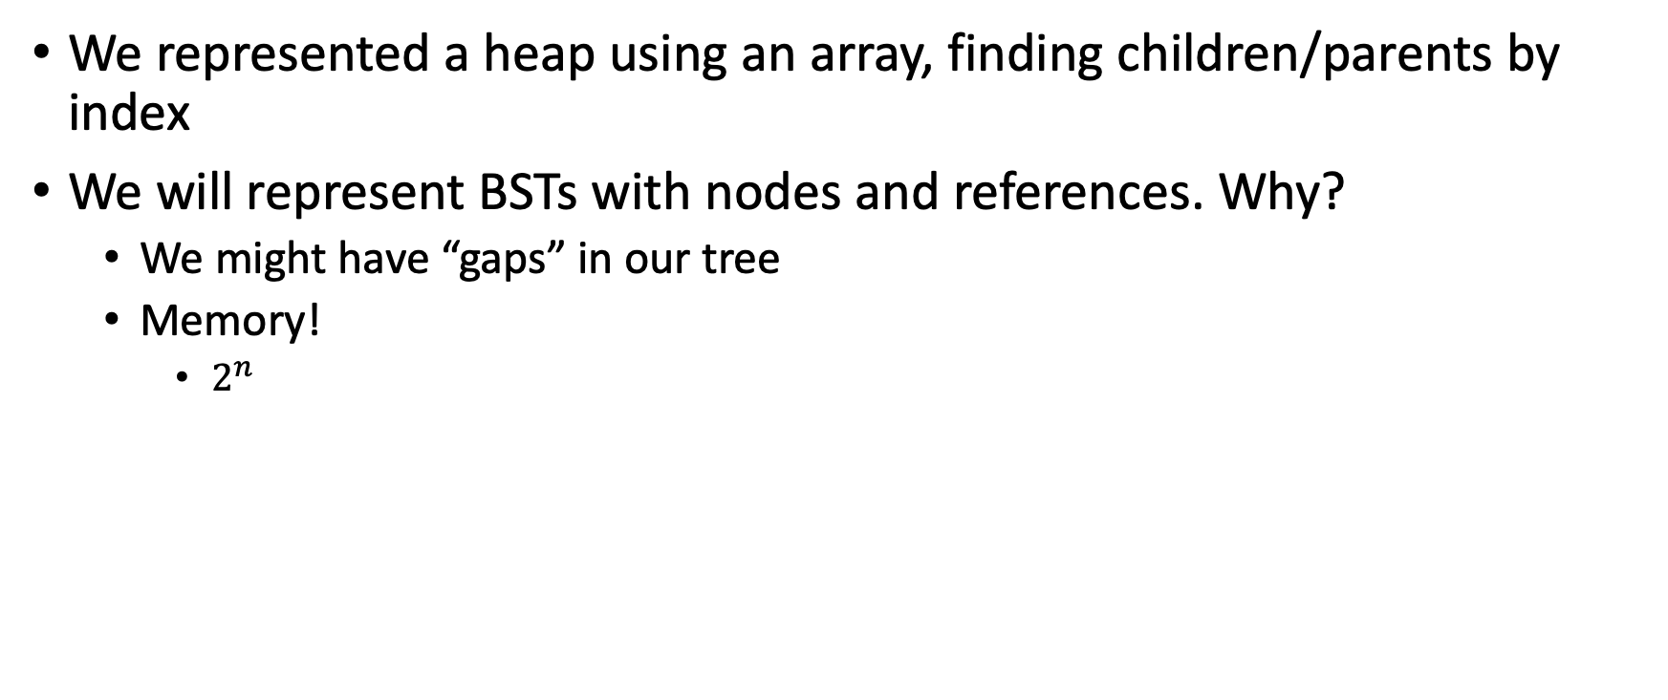
Aside: Why not use an array?
We represented a heap using an array, finding children/parents by index
We will represent BSTs with nodes and references. Why?
  We might have “gaps” in our tree
  Memory!
    $2^{n}$

Slide 33
Find Operation (recursive)
7
3
10
find(key, root):
IF (root == Null):
RETURN Null
IF (key == root.key):
RETURN root.value
ELSE IF (key < root.key):
RETURN find(key, root.left)
ELSE IF (key > root.key):
RETURN find(key, root.right);
RETURN Null
1
6
16
0

Slide 34
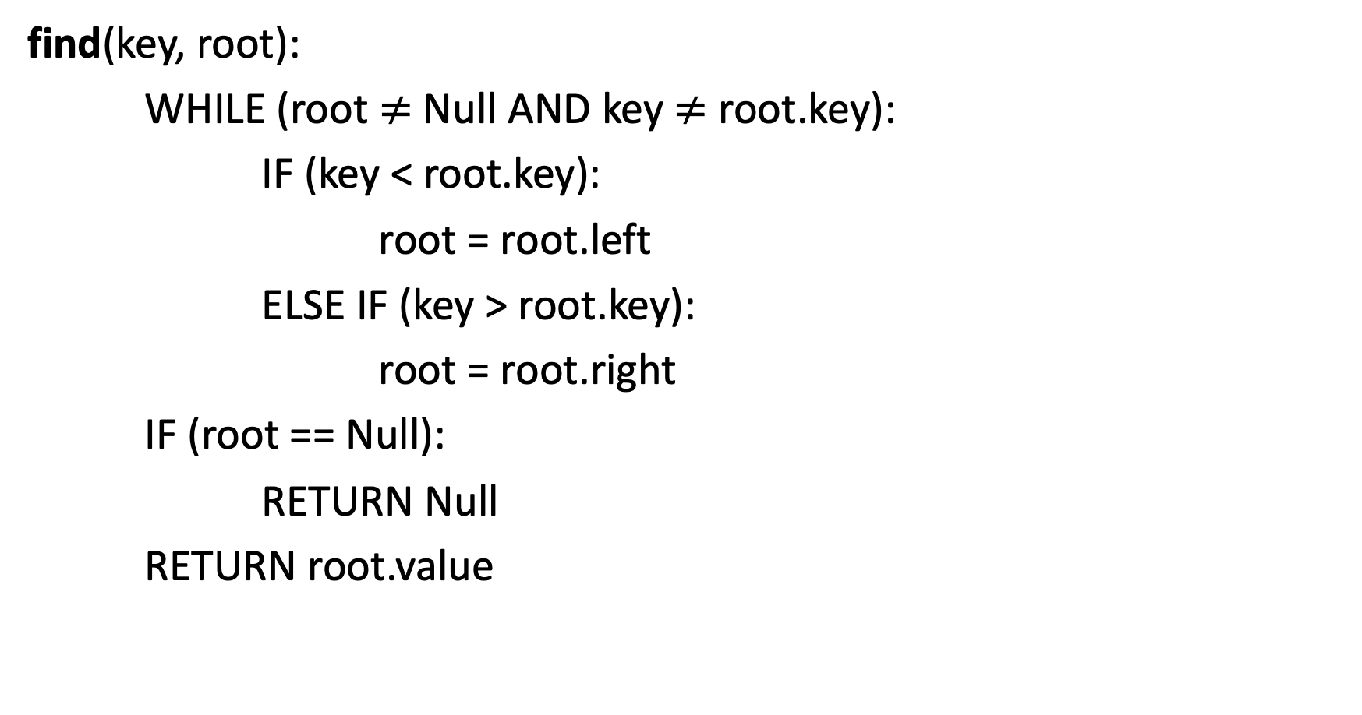
Find Operation (iterative)
7
3
10
find(key, root):
WHILE (root $≠$ Null AND key $≠$ root.key):
IF (key < root.key):
root = root.left
ELSE IF (key > root.key):
root = root.right
IF (root == Null):
RETURN Null
RETURN root.value
1
6
16
0

Slide 35
Insert Operation (recursive)
7
3
10
insert(key, value, root):
root = insertHelper(key, value, root)
insertHelper(key, value, root){
IF(root == null):
RETURN new Node(key, value)
IF (root.key < key):
root.right = insertHelper(key, value, root.right)
ELSE:
root.left = insertHelper(key, value, root.left)
RETURN root
1
6
16
0
Note: Insert happens only at the leaves!

Slide 36
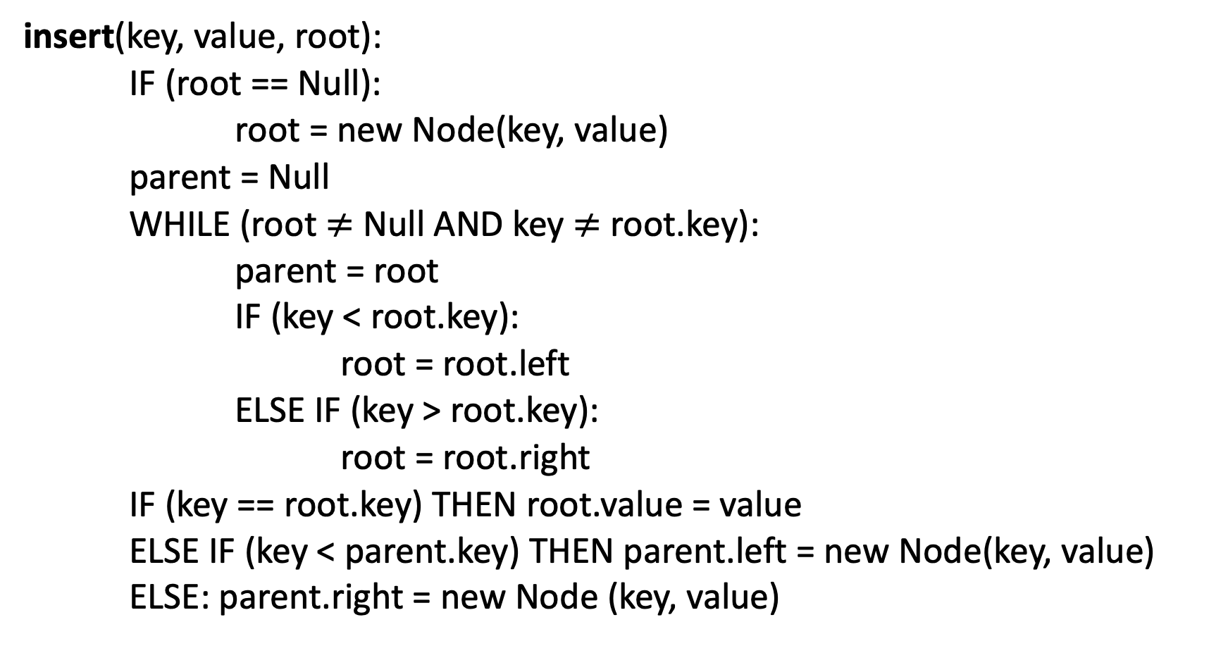
Insert Operation (iterative)
7
3
10
insert(key, value, root):
IF (root == Null):
root = new Node(key, value)
parent = Null
WHILE (root $≠$ Null AND key $≠$ root.key):
parent = root
IF (key < root.key):
root = root.left
ELSE IF (key > root.key):
root = root.right
IF (key == root.key) THEN root.value = value
ELSE IF (key < parent.key) THEN parent.left = new Node(key, value)
ELSE: parent.right = new Node (key, value)
1
6
16
0
Note: Insert happens only at the leaves!

Slide 37
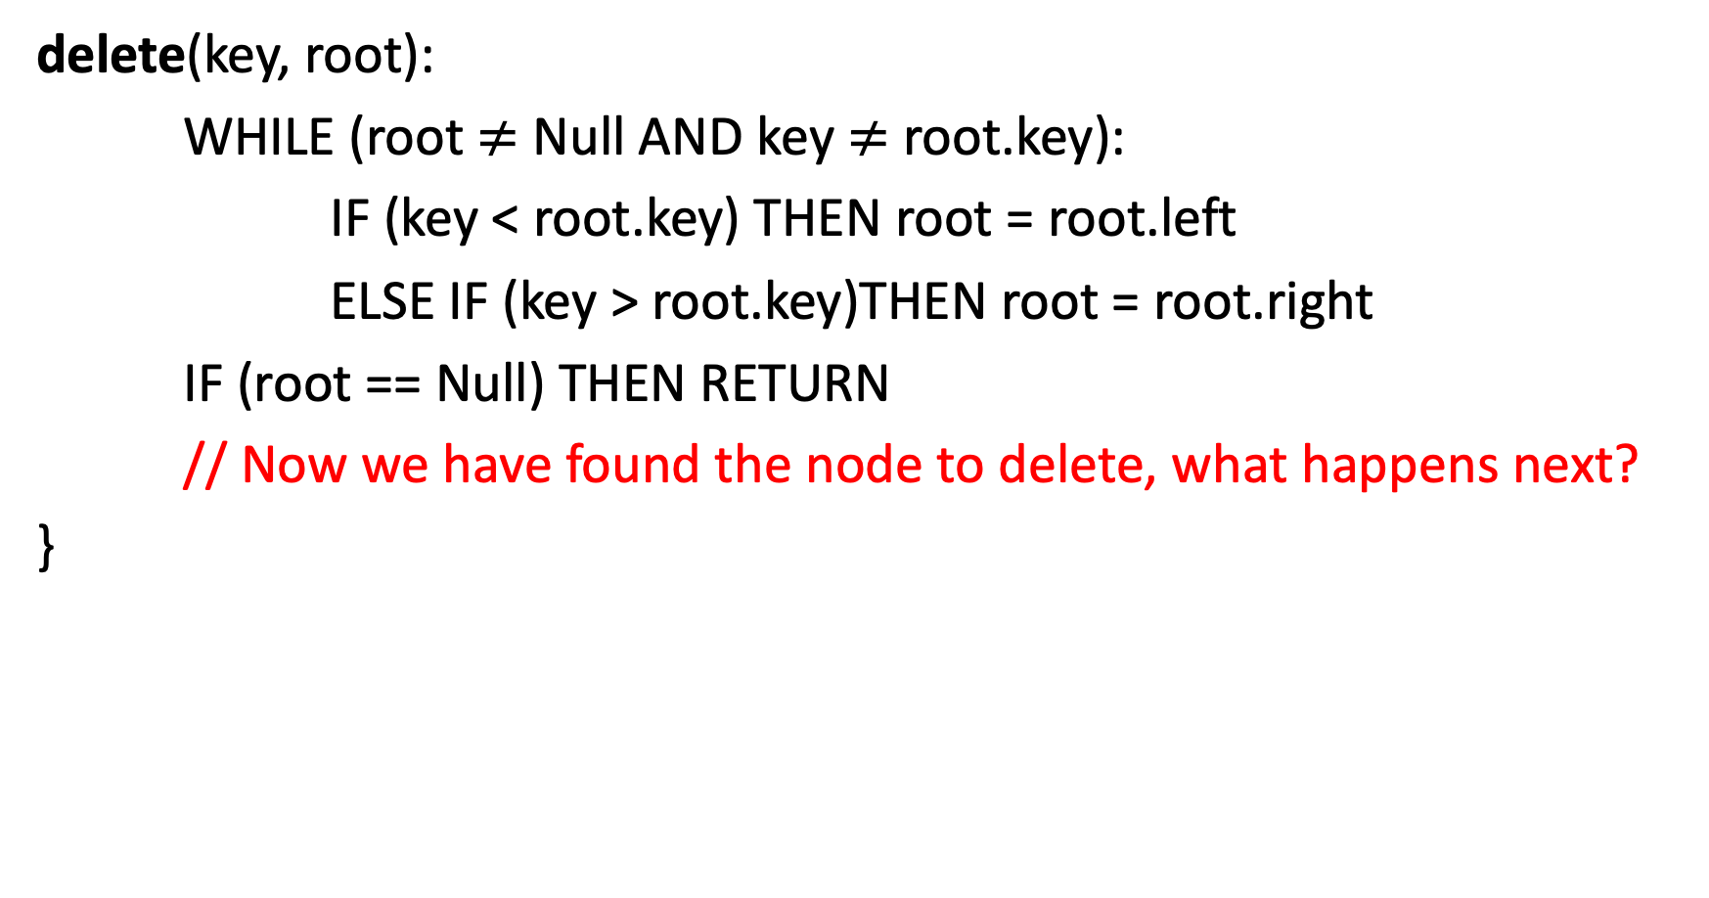
Delete Operation (iterative, incomplete)
9
3
10
delete(key, root):
WHILE (root $≠$ Null AND key $≠$ root.key):
IF (key < root.key) THEN root = root.left
ELSE IF (key > root.key)THEN root = root.right
IF (root == Null) THEN RETURN
// Now we have found the node to delete, what happens next?
}
1
6
16
0
5
7

Slide 38
Delete – 3 Cases
9
3
10
1
6
16
0 Children (i.e. it’s a leaf)
1 Child
  Replace the deleted node with its child
2 Children
  Replace the deleted with the largest node to its left or alternatively the smallest node to its right
0
5
7

Slide 39
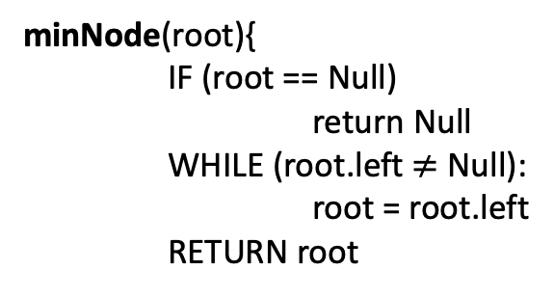

Finding the Max and Min
9
3
10
maxNode(root):
IF (root == Null):
RETURN Null
WHILE (root.right $≠$ Null):
root = root.right
RETURN root
1
6
16
Max of a BST:
  Right-most Thing
Min of a BST:
  Left-most Thing
0
5
7
minNode(root){
IF (root == Null)
return Null
WHILE (root.left $≠$ Null):
root = root.left
RETURN root

Slide 40
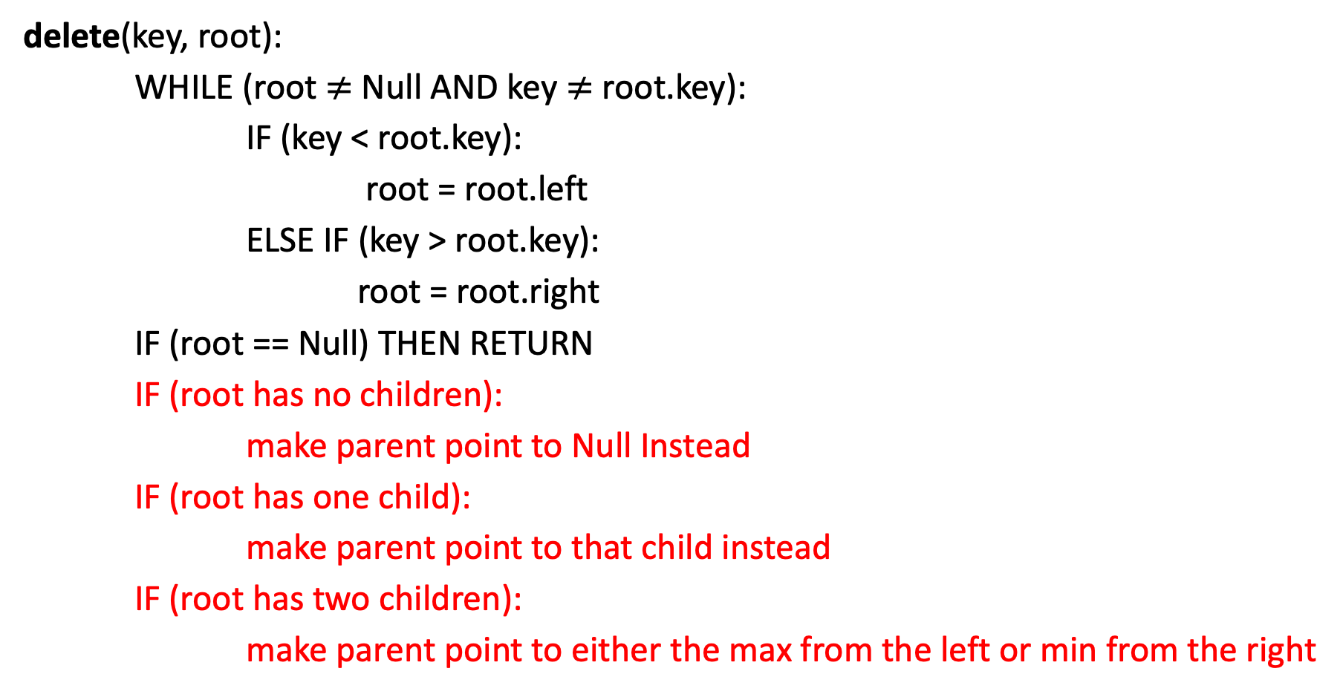
Delete Operation (iterative)
9
3
10
delete(key, root):
WHILE (root $≠$ Null AND key $≠$ root.key):
IF (key < root.key):
root = root.left
ELSE IF (key > root.key):
root = root.right
IF (root == Null) THEN RETURN
IF (root has no children):
make parent point to Null Instead
IF (root has one child):
make parent point to that child instead
IF (root has two children):
make parent point to either the max from the left or min from the right
1
6
16
0
5
7

Slide 41
Delete Operation (recursive)
9
3
10
delete(key, root){
IF (root == Null) THEN RETURN // key not present
IF (root.key == key):
IF (root has no children):
RETURN Null
IF (root has one child):
RETURN that child
IF (root has two children)
RETURN removeMax(root.left)
IF (root.key < key): THEN root.right = delete(key, root.right)
ELSE: root.left = delete(key, root.left)
1
6
16
0
5
7

Slide 42

Worst Case Analysis
For each of Find, insert, Delete:
  Worst case running time matches height of the tree
What is the maximum height of a BST with $n$ nodes?
  $Θ(n)$

Slide 43
Improving the worst case
How can we get a better worst case running time?
  Add rules about the shape of our BST
AVL Tree
  A BST with some shape rules
    Algorithms need to change to accommodate those

Slide 44
“Balanced” Binary Search Trees
We get better running times by having “shorter” trees
Trees get tall due to them being “sparse” (many one-child nodes)
Idea: modify how we insert/delete to keep the tree more “full”
  Encourage Branches!

Slide 45
Idea 1: Both Subtrees of Root have same # Nodes

Slide 46
Idea 1: Both Subtrees of Root have same # Nodes - Issue
16
10
17
7
18
3
19
1
20
0
21

Slide 47
Idea 2: Both Subtrees of Root have same height

Slide 48
Idea 2: Both Subtrees of Root have same height - Issue
16
10
17
7
18
3
19
1
20
0
21

Slide 49
Idea 3: Both Subtrees of every Node have same # Nodes

Slide 50
Idea 3: Both Subtrees of every Node have same # Nodes - Issue
Not all tree sizes are possible!
For example, cannot have a tree of size 2.

Slide 51
Idea 4: Both Subtrees of every Node have same height

Slide 52
Idea 4: Both Subtrees of every Node have same height - Issue
Not all tree sizes are possible!
For example, cannot have a tree of size 2.

Slide 53
AVL Tree
A Binary Search tree that maintains that the left and right subtrees of every node have heights that differ by at most one.
  height of left subtree and height of right subtree off by at most 1
  Not too weak (ensures trees are short)
  Not too strong (works for any number of nodes)
Idea of AVL Tree:
  When you insert/delete nodes, if tree is “out of balance” then modify the tree
  Modification = “rotation”

Slide 54
Is it an AVL Tree?
9
9
3
10
3
10
6
16
1
1
6
0
5
0
5
9
9
3
10
3
10
6
16
1
6
16
5
0
5
7

Slide 55
Is it an AVL Tree? (Answers)
9
Not Balanced!
9
3
10
“Problem” Node
Its children’s heights differ by more than 1
3
10
1
6
16
1
6
0
5
Balanced!
0
5
9
9
3
10
3
10
6
16
1
6
16
5
Not Balanced!
0
5
7
Balanced!

