Slide 1
CSE 332 Summer 2026
Lecture 3: Algorithm Analysis pt.2
Michael Whitmeyer
http://www.cs.uw.edu/332

Slide 2
Announcements
CC0 due tonight
Assignment 1 should be released today

Slide 3
Running Time Analysis
Units of “time”
  Operations
    Whichever operations we pick
How do we express running time?
  Function
    Domain (input): size of the input
    Range: count of operations

Slide 4
Options for your running time function
Worst-case complexity:
  max number of steps algorithm takes on “most challenging” input
Best-case complexity:
  min number of steps algorithm takes on “easiest” input
Average/expected complexity:
  avg number of steps algorithm takes on random inputs (context-dependent)
Amortized complexity:
  max total number of steps algorithm takes on M “most challenging” consecutive inputs, divided by M (i.e., divide the max total sum by M).

Slide 5

Worst Case Running Time Analysis
If an algorithm has a worst case running time of $f(n)$
  Among all possible size-$n$ inputs, the “worst” one will do $f(n)$ “operations”
  $f(n)$ gives the maximum count of operations needed from among all inputs of size $n$

Slide 6
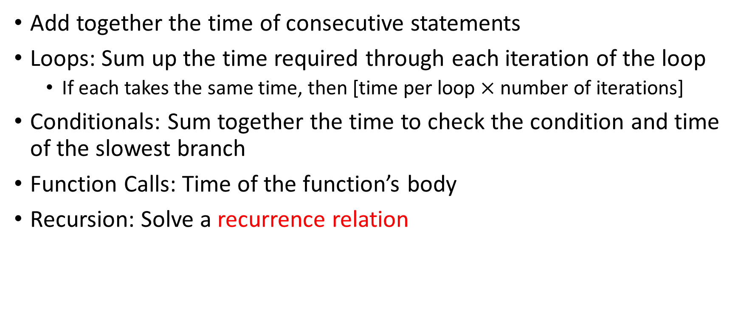
Worst Case Running Time – General Guide
Add together the time of consecutive statements
Loops: Sum up the time required through each iteration of the loop
  If each takes the same time, then [time per loop $×$ number of iterations]
Conditionals: Sum together the time to check the condition and time of the slowest branch
Function Calls: Time of the function’s body
Recursion: Solve a recurrence relation

Slide 7
Amortized Analysis Analogy
Suppose I’d like to park in a lot where they charge $10 per day to park
If you are caught in the lot without paying you are given a warning
If you get 3 warnings, you are charged a $25 fine, and your warnings reset.
Should you actually pay to park?
  If you pay every day then you pay an average of $10 per day
  If you do not pay then for every three days parking costs $0+$0+$25, for an average of $8.33 per day
    This is an amortized analysis

Slide 8

ArrayList - Worst Case Time of Add
public void add(int value){
if(data.length == size)
resize();
data[size] = value;
size++;
}
private void resize(){
int[] oldData = data;
data = new int[data.length*2];
for(int i = 0; i < oldData.length; i++)
data[i] = oldData[i];
}
What is the worst case running time of add?
  Input size: size of “this”
  Operations counted: indexing
  $O\left(n\right)$

Slide 9
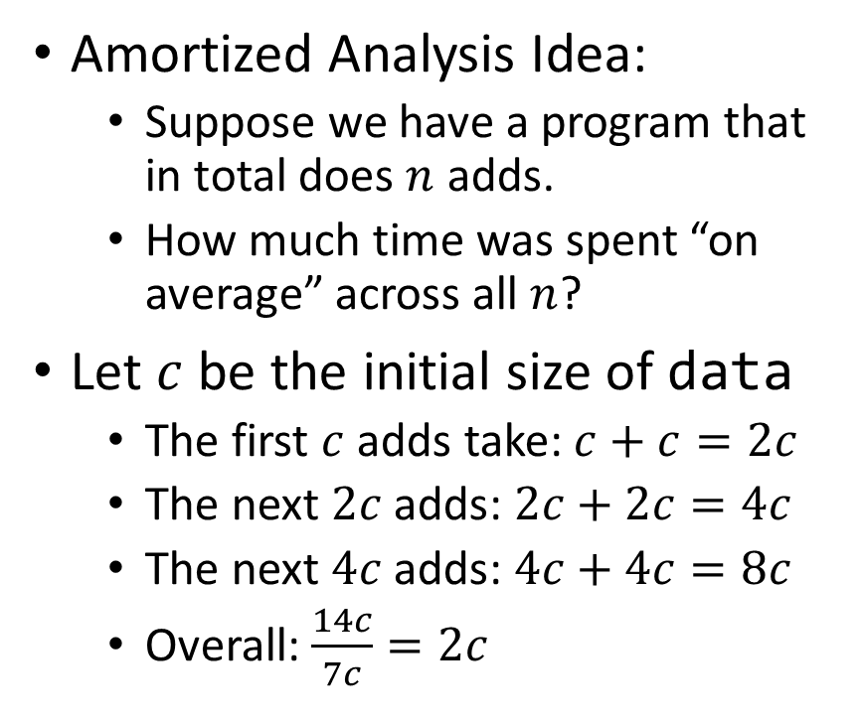
ArrayList – Amortized Time of Add
public void add(int value){
if(data.length == size)
resize();
data[size] = value;
size++;
}
private void resize(){
int[] oldData = data;
data = new int[data.length*2];
for(int i = 0; i < oldData.length; i++)
data[i] = oldData[i];
}
Amortized Analysis Idea:
  Suppose we have a program that in total does $n$ adds.
  How much time was spent “on average” across all $n$?
Let $c$ be the initial size of data
  The first $c$ adds take: $c+c=2c$
  The next $2c$ adds: $2c+2c=4c$
  The next $4c$ adds: $4c+4c=8c$
  Overall: $\frac{14c}{7c}=2c$
Every time we resize, we earn data.length more adds before the next resize!
Notes:
Amortized: “running average”

Slide 10
Searching in a Sorted List
5
8
13
42
75
79
88
90
95
99
0
1
2
3
4
5
6
7
8
9
contains(int k, List L):
for i=0 to L.size:
if L[i] == k:
return true
return false

Slide 11
Faster way?
5
8
13
42
75
79
88
90
95
99
0
1
2
3
4
5
6
7
8
9
Can you think of a faster algorithm to solve this problem?

Slide 12
Binary Search
5
8
13
42
75
79
88
90
95
99
0
1
2
3
4
5
6
7
8
9
contains(List L, int k):
start = 0
end = L.size
while(start < end):
mid = start + (end-start)/2;
if L[mid] == k:
return true
else if L[mid] < k:
start = mid+1
else:
end = mid
return false

Slide 13
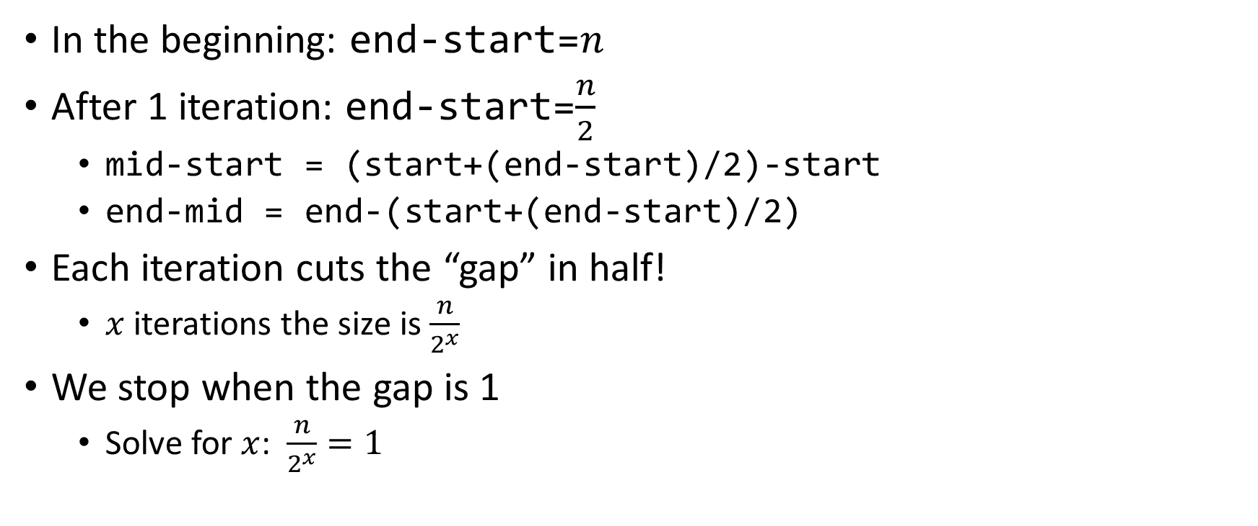

Why is this $\log_{2}{n}$?
In the beginning: end-start=$n$
After 1 iteration: end-start=$\frac{n}{2}$
  mid-start = (start+(end-start)/2)-start
  end-mid = end-(start+(end-start)/2)
Each iteration cuts the “gap” in half!
  $x$ iterations the size is $\frac{n}{2^{x}}$
We stop when the gap is 1
  Solve for $x$: $\frac{n}{2^{x}}=1$

Slide 14
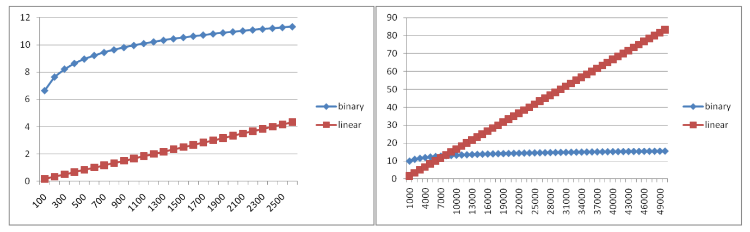
Running Time Graphed

Slide 15
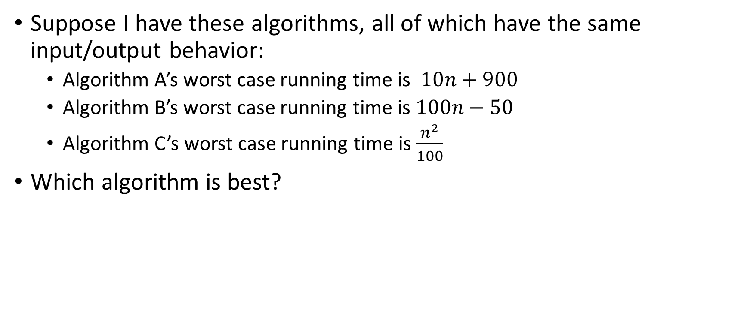
Comparing Running Times
Suppose I have these algorithms, all of which have the same input/output behavior:
  Algorithm A’s worst case running time is $10n+900$
  Algorithm B’s worst case running time is $100n−50$
  Algorithm C’s worst case running time is $\frac{n^{2}}{100}$
Which algorithm is best?

Slide 16
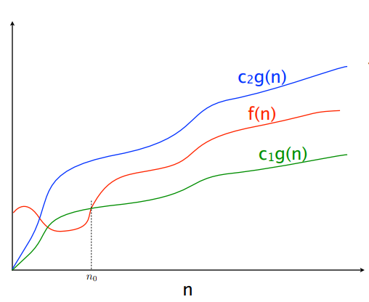

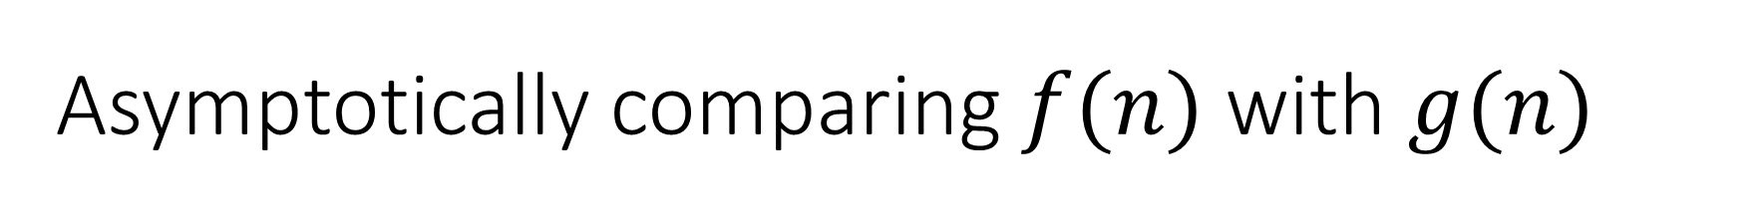


Asymptotically comparing $f(n)$ with $g(n)$
$$f(n)=O(g\left(n\right))$$
$$f(n)=Θ(g\left(n\right))$$
$$f(n)=Ω(g\left(n\right))$$

Slide 17
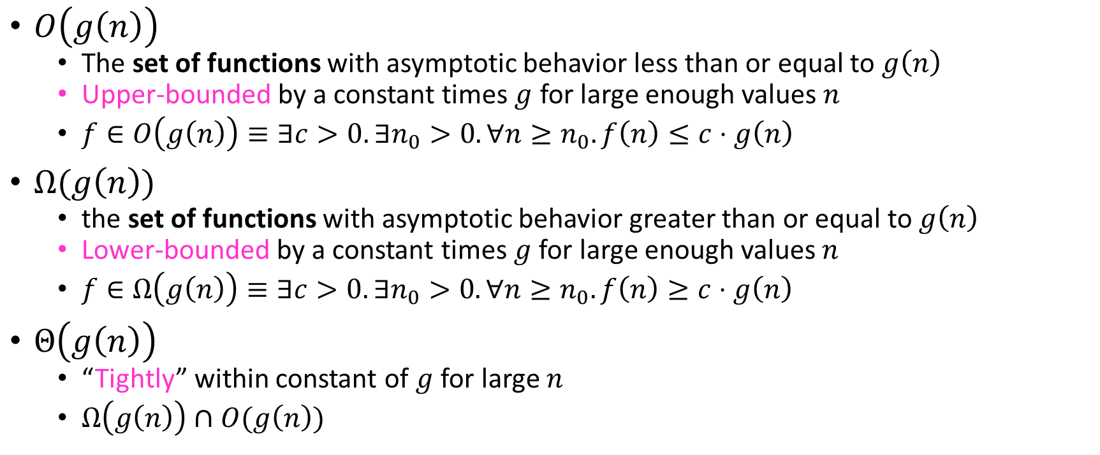
Asymptotic Notation
$O\left(g\left(n\right)\right)$
  The set of functions with asymptotic behavior less than or equal to $g\left(n\right)$
  Upper-bounded by a constant times $g$ for large enough values $n$
  $f∈O\left(g\left(n\right)\right)≡∃c>0. ∃n_{0}>0. ∀n≥n_{0}. f\left(n\right)≤c⋅g\left(n\right)$
$Ω(g\left(n\right))$
  the set of functions with asymptotic behavior greater than or equal to $g\left(n\right)$
  Lower-bounded by a constant times $g$ for large enough values $n$
  $f∈Ω\left(g\left(n\right)\right)≡∃c>0. ∃n_{0}>0. ∀n≥n_{0}. f\left(n\right)≥c⋅g\left(n\right)$
$Θ\left(g\left(n\right)\right)$
  “Tightly” within constant of $g$ for large $n$
  $Ω\left(g\left(n\right)\right)∩O(g\left(n\right))$

Slide 18


Idea of $Θ$
$x=y$
  $x≤y∧x≥y$

Slide 19

Asymptotic Notation Example 1
Show: $10n+100∈O\left(n^{2}\right)$
  Technique: find values $c>0$ and $n_{0}>0$ such that $∀n>n_{0}. 10n+100≤c⋅n^{2}$
  Proof:

Slide 20
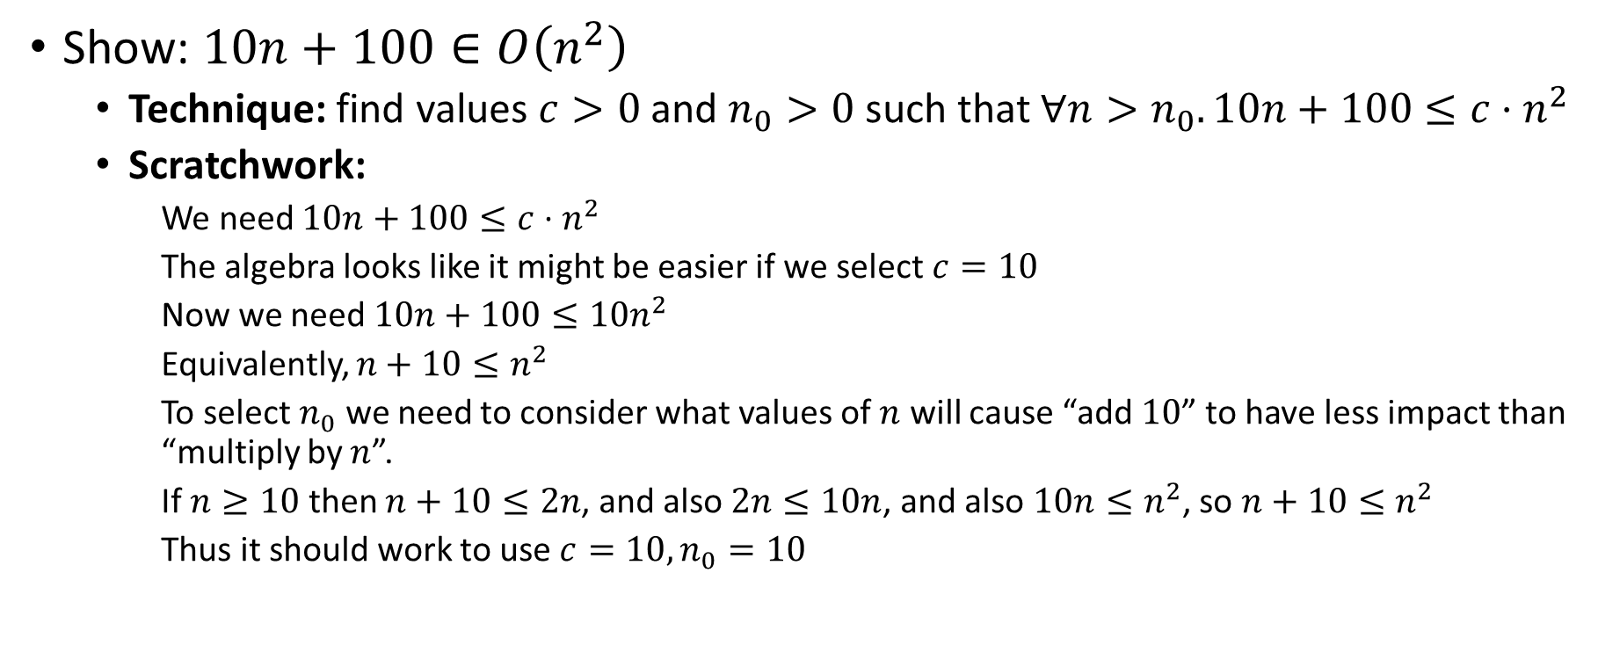
Asymptotic Notation Example 1 (Scratchwork)
Show: $10n+100∈O\left(n^{2}\right)$
  Technique: find values $c>0$ and $n_{0}>0$ such that $∀n>n_{0}. 10n+100≤c⋅n^{2}$
  Scratchwork:
    We need $10n+100≤c⋅n^{2}$
    The algebra looks like it might be easier if we select $c=10$
    Now we need $10n+100≤10n^{2}$
    Equivalently, $n+10≤n^{2}$
    To select $n_{0}$ we need to consider what values of $n$ will cause “add $10$” to have less impact than “multiply by $n$”.
    If $n≥10$ then $n+10≤2n$, and also $2n≤10n$, and also $10n≤n^{2}$, so $n+10≤n^{2}$
    Thus it should work to use $c=10, n_{0}=10$

Slide 21
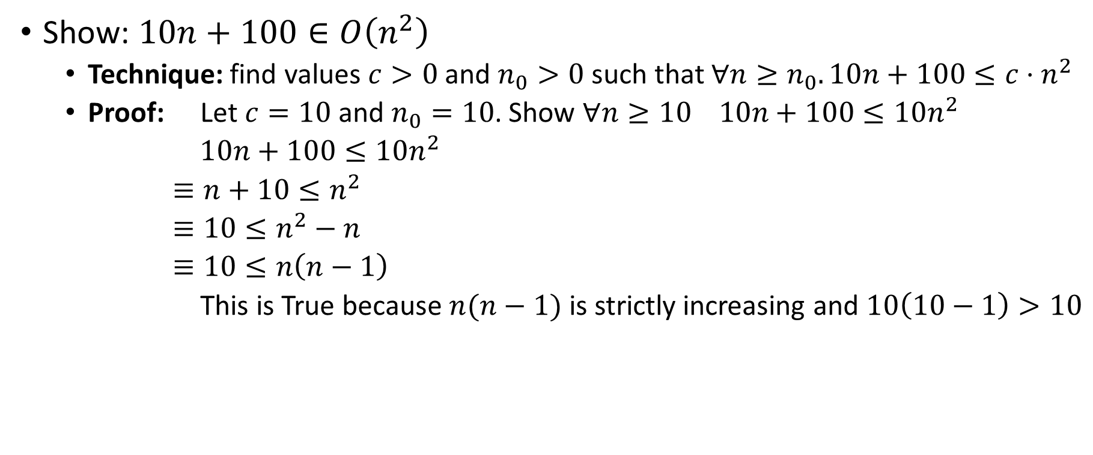
Asymptotic Notation Example 1 (Proof)
Show: $10n+100∈O\left(n^{2}\right)$
  Technique: find values $c>0$ and $n_{0}>0$ such that $∀n≥n_{0}. 10n+100≤c⋅n^{2}$
  Proof: Let $c=10$ and $n_{0}=10$. Show $∀n≥10 10n+100≤10n^{2}$
  $10n+100≤10n^{2}$
  $≡n+10≤n^{2}$
  $≡10≤n^{2}−n$
  $≡10≤n\left(n−1\right)$
  This is True because $n(n−1)$ is strictly increasing and $10\left(10−1\right)>10$

Slide 22

Asymptotic Notation Example 2
Show: $13n^{2}−50n∈Ω\left(n^{2}\right)$
  Technique: find values $c>0$ and $n_{0}>0$ such that $∀n≥n_{0}. 13n^{2}−50n≥c⋅n^{2}$

Slide 23
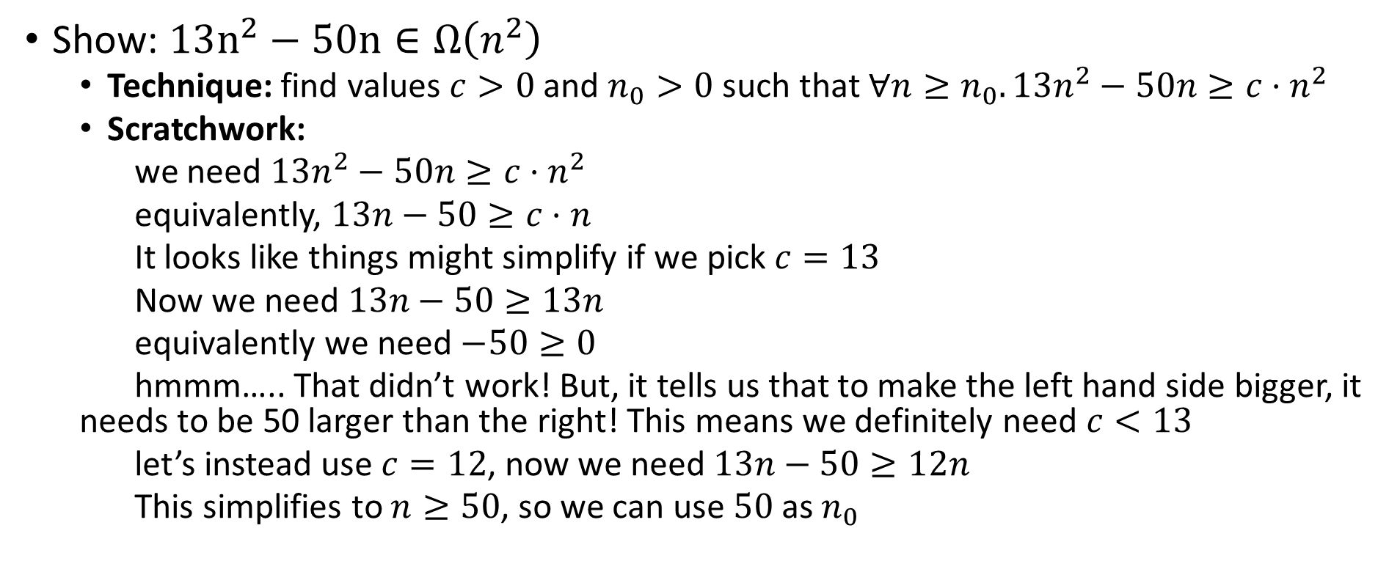
Asymptotic Notation Example 2 (Scratchwork)
Show: $13n^{2}−50n∈Ω\left(n^{2}\right)$
  Technique: find values $c>0$ and $n_{0}>0$ such that $∀n≥n_{0}. 13n^{2}−50n≥c⋅n^{2}$
  Scratchwork:
  we need $13n^{2}−50n≥c⋅n^{2}$
  equivalently, $13n−50≥c⋅n$
  It looks like things might simplify if we pick $c=13$
  Now we need $13n−50≥13n$
  equivalently we need $−50≥0$
  hmmm….. That didn’t work! But, it tells us that to make the left hand side bigger, it needs to be 50 larger than the right! This means we definitely need $c<13$
  let’s instead use $c=12$, now we need $13n−50≥12n$
  This simplifies to $n≥50$, so we can use $50$ as $n_{0}$

Slide 24
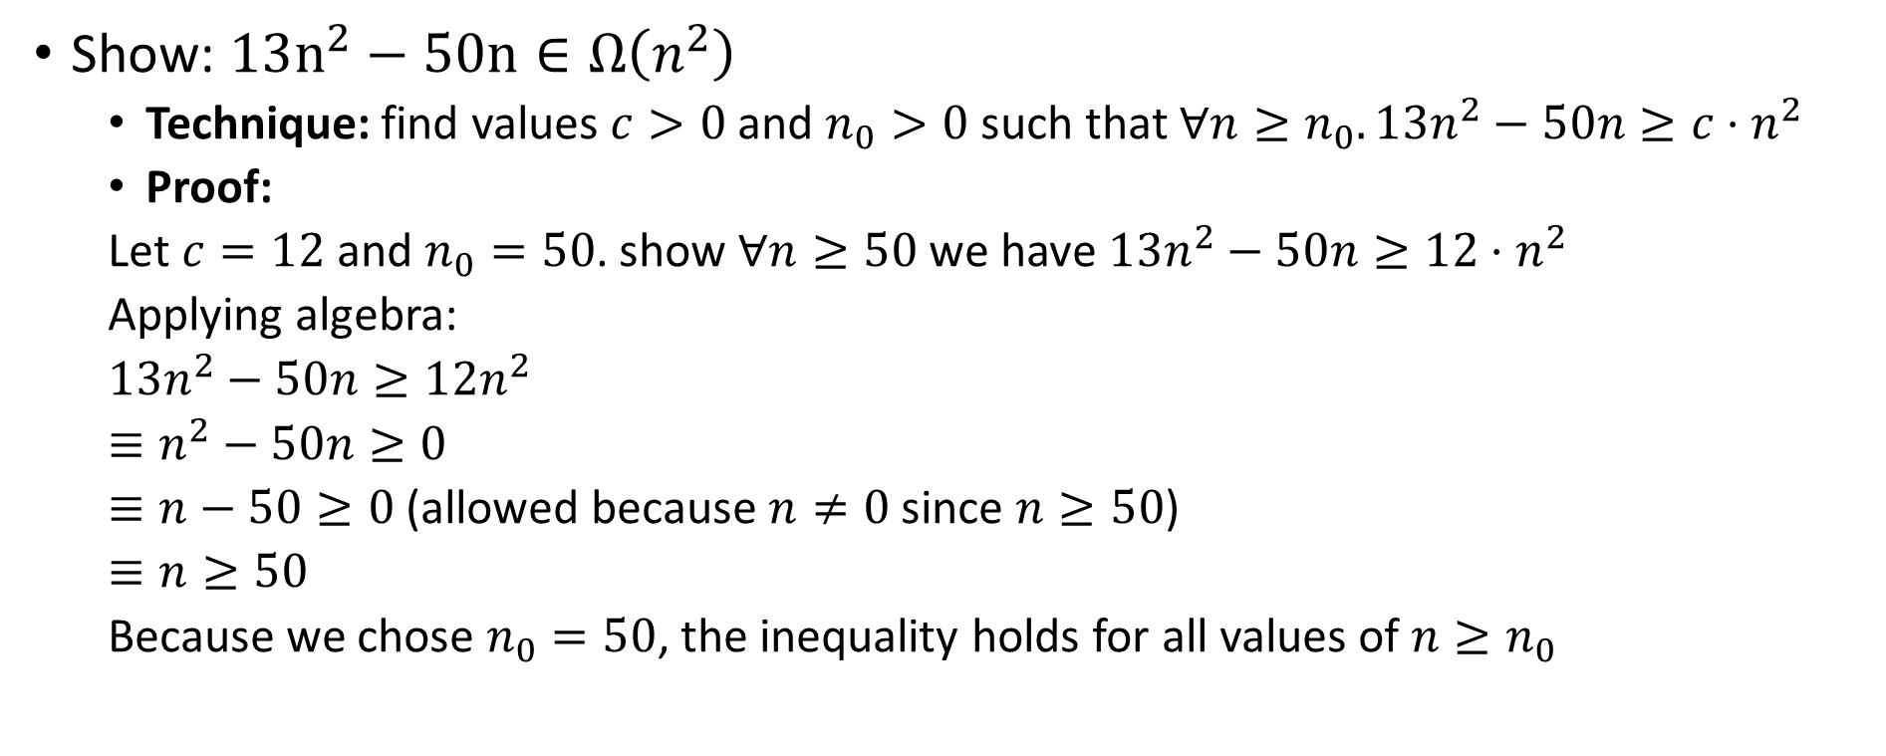
Asymptotic Notation Example 2 (Proof)
Show: $13n^{2}−50n∈Ω\left(n^{2}\right)$
  Technique: find values $c>0$ and $n_{0}>0$ such that $∀n≥n_{0}. 13n^{2}−50n≥c⋅n^{2}$
  Proof:
  Let $c=12$ and $n_{0}=50$. show $∀n≥50$ we have $13n^{2}−50n≥12⋅n^{2}$
  Applying algebra:
  $13n^{2}−50n≥12n^{2}$
  $≡n^{2}−50n≥0$
  $≡n−50≥0$ (allowed because $n≠0$ since $n≥50$)
  $≡n≥50$
  Because we chose $n_{0}=50$, the inequality holds for all values of $n≥n_{0}$

Slide 25

Asymptotic Notation Example 3
Show: $n^{2}∉O\left(n\right)$
Want to show that there does not exist a pair of $c$ and $n_{0}$ such that $∀n_{0}>n. n^{2}≤c⋅n$

Slide 26
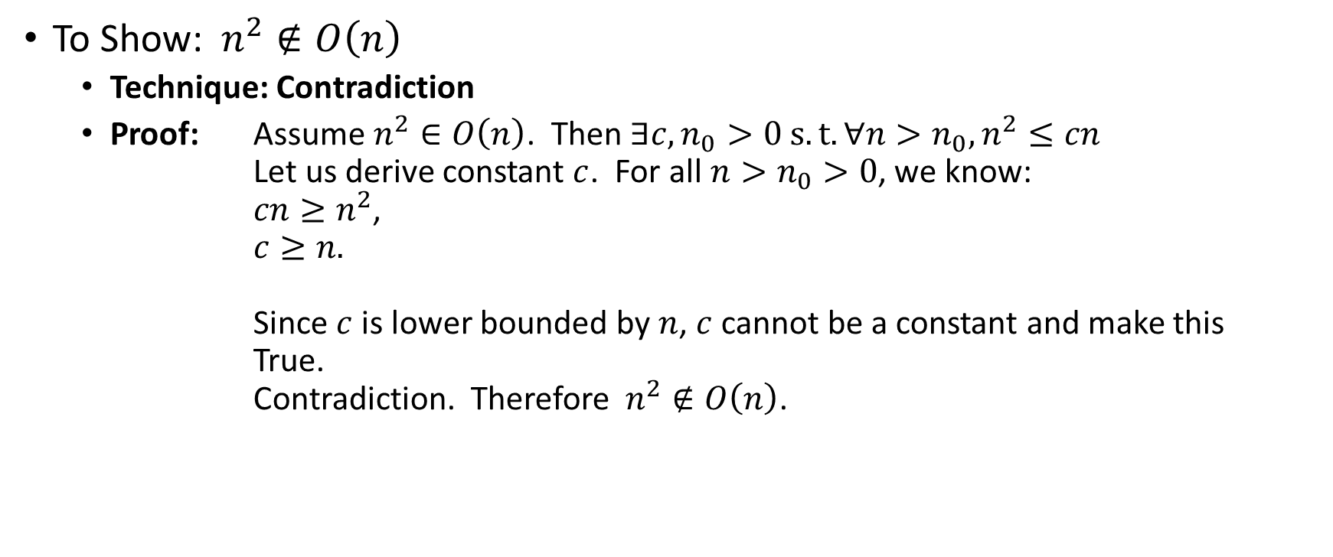
Asymptotic Notation Example 3 (Proof)
Proof by Contradiction!
To Show:$n^{2}∉O\left(n\right)$
  Technique: Contradiction
  Proof: Assume $n^{2}∈O\left(n\right)$. Then $∃c,n_{0}>0 s.t. ∀n>n_{0},n^{2}≤cn$
  Let us derive constant $c$. For all $n>n_{0}>0$, we know:
  $cn≥n^{2}$,
  $c≥n.$
  Since $c$ is lower bounded by $n$, $c$ cannot be a constant and make this True.
  Contradiction. Therefore$n^{2}∉O\left(n\right)$.

Slide 27
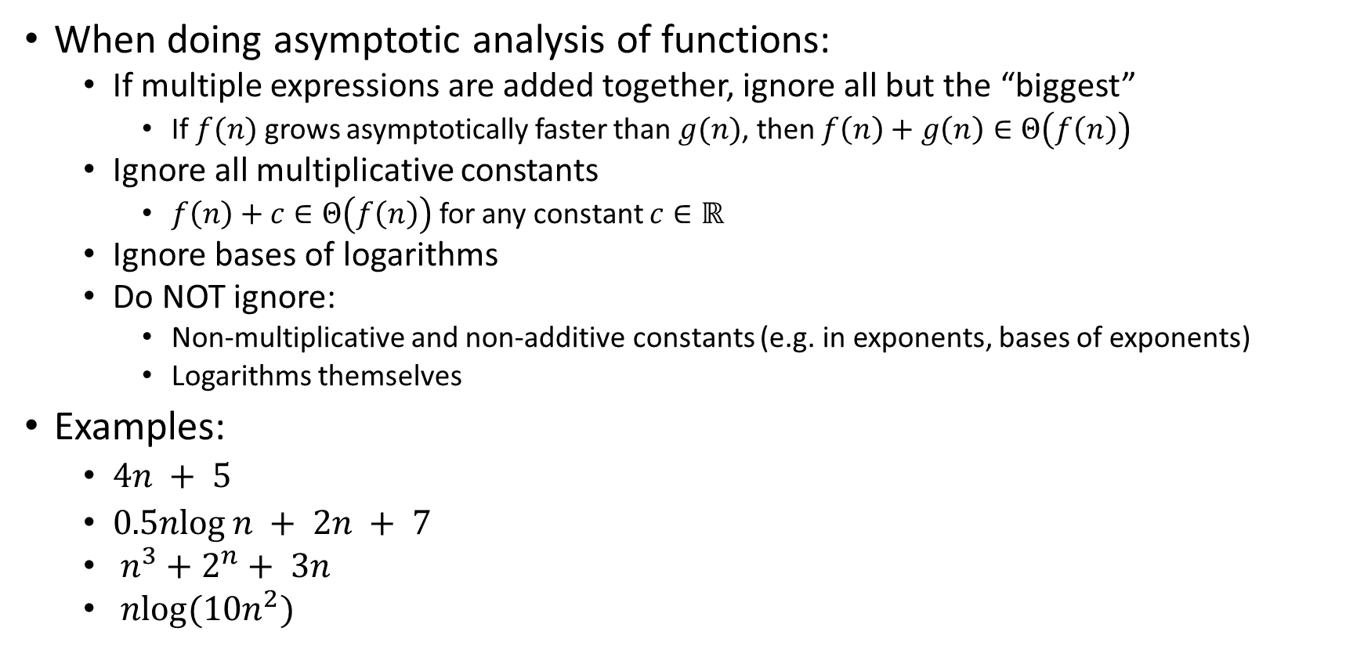
Gaining Intuition
When doing asymptotic analysis of functions:
  If multiple expressions are added together, ignore all but the “biggest”
    If $f(n)$ grows asymptotically faster than $g(n)$, then $f\left(n\right)+g\left(n\right)∈Θ\left(f\left(n\right)\right)$
  Ignore all multiplicative constants
    $f\left(n\right)+c∈Θ\left(f\left(n\right)\right)$ for any constant $c∈ℝ$
  Ignore bases of logarithms
  Do NOT ignore:
    Non-multiplicative and non-additive constants (e.g. in exponents, bases of exponents)
    Logarithms themselves
Examples:
  $4n + 5$
  $0.5nlog⁡n + 2n + 7$
  $n^{3}+2^{n}+ 3n$
  $nlog(10n^{2})$

Slide 28

More Examples
Is each of the following True or False?
  $4+3n∈ O(n)$
  $n+2\log{n}∈ O(\log{n})$
  $\log{n}+2∈ O(1)$
  $n^{50}∈ O({1.1}^{n})$
  $3^{n}∈Θ(2^{n})$

Slide 29

Common Categories
$O(1)$ “constant”
$O\left(\log{n}\right)$ “logarithmic”
$O\left(n\right)$ “linear”
$O\left(n\log{n}\right)$ “log-linear”
$O\left(n^{2}\right)$ “quadratic”
$O\left(n^{3}\right)$ “cubic”
$O\left(n^{k}\right)$ “polynomial”
$O\left(k^{n}\right)$ “exponential”

Slide 30
Defining your running time function
Worst-case complexity:
  max number of steps algorithm takes on “most challenging” input
Best-case complexity:
  min number of steps algorithm takes on “easiest” input
Average/expected complexity:
  avg number of steps algorithm takes on random inputs (context-dependent)
Amortized complexity:
  max total number of steps algorithm takes on M “most challenging” consecutive inputs, divided by M (i.e., divide the max total sum by M).

Slide 31
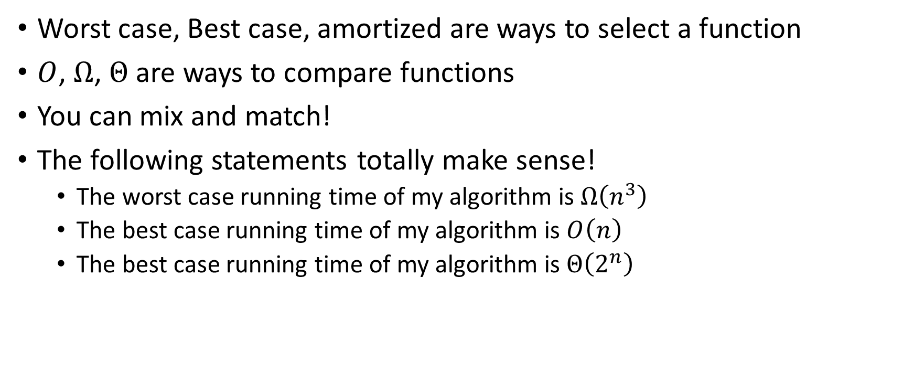
Beware!
Worst case, Best case, amortized are ways to select a function
$O$, $Ω$, $Θ$ are ways to compare functions
You can mix and match!
The following statements totally make sense!
  The worst case running time of my algorithm is $Ω\left(n^{3}\right)$
  The best case running time of my algorithm is $O\left(n\right)$
  The best case running time of my algorithm is $Θ\left(2^{n}\right)$

