Slide 1

CSE 332 Spring 2026
Lecture 2: Algorithm Analysis pt.1
Michael Whitmeyer
http://www.cs.uw.edu/332

Slide 2
Announcements
Exercise 0 released
  Due Tuesday 6/30
  There are 2 separate gradescope submissions
Concept check 0 released
  Helps us to get more familiar with each other!
  Gradescope submission due Friday 6/26
  Meet the staff activity due by 7/17
    Come to any office hours, chat with us, ask us to mark you off for this

Slide 3
Circular Array Queue
front=0
back=0

Slide 4
Circular Array Queue
front=0
back=0
Enqueue(7)

Slide 5
Circular Array Queue
front=0
7
back=1
Enqueue(7)

Slide 6
Circular Array Queue
front=0
7
back=1
Enqueue(7)
Enqueue(10)

Slide 7
Circular Array Queue
front=0
7 | 10
back=2
Enqueue(7)
Enqueue(10)

Slide 8
Circular Array Queue
front=0
7 | 10
back=2
Enqueue(7)
Enqueue(10)
Dequeue()

Slide 9
Circular Array Queue
front=1
 | 10
back=2
Enqueue(7)
Enqueue(10)
Dequeue()

Slide 10
Circular Array Queue
front=1
 | 10
back=2
Enqueue(7)
Enqueue(10)
Dequeue()
Enqueue(5); Enqueue(8); Enqueue(2)

Slide 11
Circular Array Queue
front=1
 | 10 | 5
back=3
Enqueue(7)
Enqueue(10)
Dequeue()
Enqueue(5); Enqueue(8); Enqueue(2)

Slide 12
Circular Array Queue
front=1
 | 10 | 5 | 8
back=0
Enqueue(7)
Enqueue(10)
Dequeue()
Enqueue(5); Enqueue(8); Enqueue(2)

Slide 13
Circular Array Queue
front=5
2 |  |  |  |  | 10 | 5 | 8
back=1
Enqueue(7)
Enqueue(10)
Dequeue()
Enqueue(5); Enqueue(8); Enqueue(2)

Slide 14
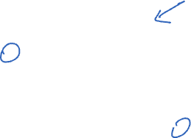
Resizing “Circular” Array Queue
front=0
5
8
3
4
7
0
1
2
3
4
5
6
7
8
9
back=5
Queue represented as an array of items
  A “front” index to indicate the oldest item in the queue
  A “back” index to indicate the most recent item in the queue
enqueue Procedure:
dequeue Procedure:
isEmpty Procedure:
enqueue(x):
if (size == queue.length-1) then resize()
queue[back] = x
back = (back + 1) % queue.length
size = size + 1
How do you resize?
That’s for Exercise 0!
dequeue():
// Assumes queue is not empty
first = queue[front]
front = (front + 1) % queue.length
size = size - 1
return first
isEmpty():
return size == 0

Slide 15
Runtime/Resource Analysis

Slide 16

Why do resource analysis?
Allows us to compare algorithms, not implementations
  If my implementation on my computer is slower than your implementation on your computer, we cannot conclude your algorithm is better
  Using observations couples the algorithm and implementation
We can predict an algorithm’s resource use before implementing
Understand where the bottlenecks are in our algorithm

Slide 17
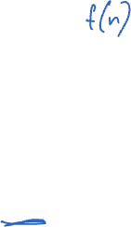
Process for resource Analysis
End Result: A function which maps the algorithm’s input size to count of resources used
  Input of the function: sizes of the input
    Number of characters in a string, number of items in a list, number of pixels in an image
  Output of the function: counts of resources used
    Number of times the algorithm adds two numbers together, number times the algorithm does a > or < comparison, maximum number of bytes of memory the algorithm uses at any time
Important note: Make sure you know the “units” of your input and output!

Slide 18

Input Size: Examples
Example 1 (factoring): Suppose I want to factor a number N into two primes, p and q
Used in (email) encryption: assumes computers cannot factor large numbers quickly!

Slide 19
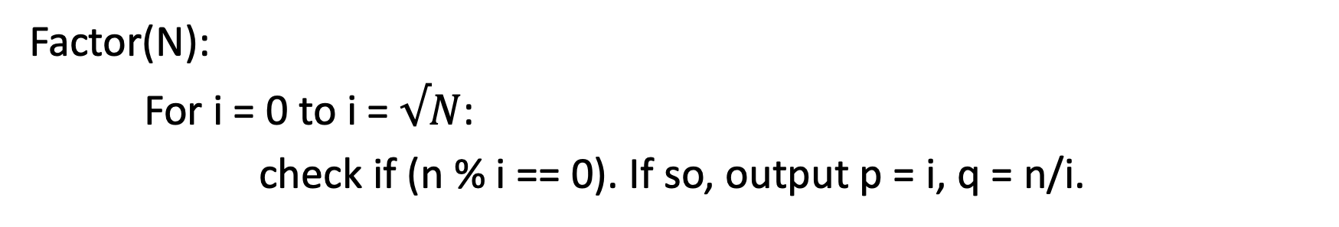

Input Size: Examples
Example 1 (factoring): Suppose I want to factor a number N into two primes, p and q
Used in (email) encryption: assumes computers cannot factor large numbers quickly!
Factor(N):
For i = 0 to i = $√N$:
check if (n % i == 0). If so, output p = i, q = n/i.

Slide 20
Input Size: Examples
Example 1 (factoring): Suppose I want to factor a number N into two primes, p and q
Used in (email) encryption: assumes computers cannot factor large numbers quickly!
Factor(N):
For i = 0 to i = $√N$:
check if (n % i == 0). If so, output p = i, q = n/i.
Runtime? (assume mod and division are constant time)

Slide 21
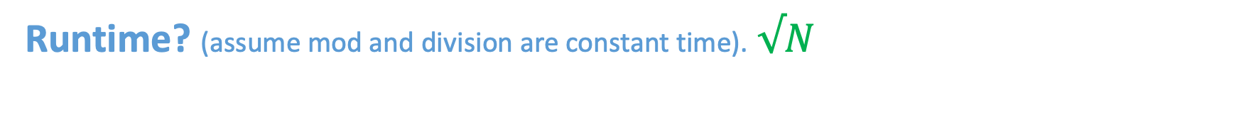
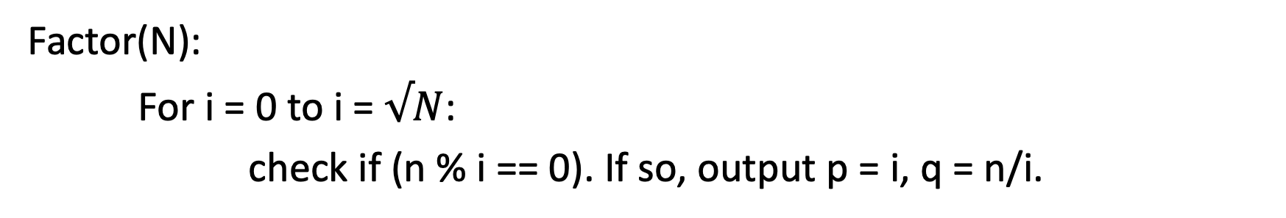
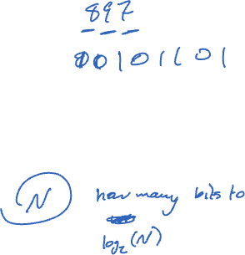
Input Size: Examples
Example 1 (factoring): Suppose I want to factor a number N into two primes, p and q
Used in (email) encryption: assumes computers cannot factor large numbers quickly!
Factor(N):
For i = 0 to i = $√N$:
check if (n % i == 0). If so, output p = i, q = n/i.
Runtime? (assume mod and division are constant time). $√N$

Slide 22

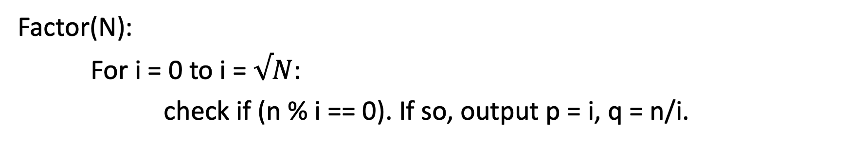
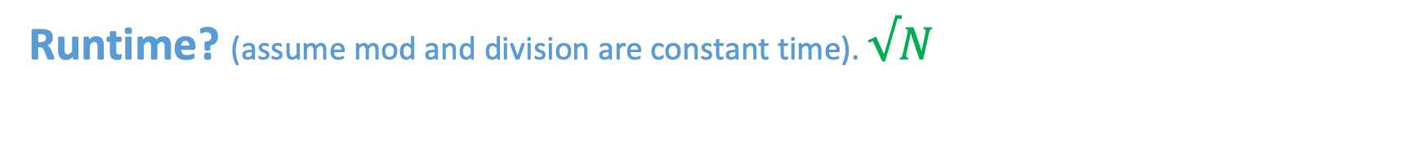
Input Size: Examples
Example 1 (factoring): Suppose I want to factor a number N into two primes, p and q
Used in (email) encryption: assumes computers cannot factor large numbers quickly!
Factor(N):
For i = 0 to i = $√N$:
check if (n % i == 0). If so, output p = i, q = n/i.
Runtime? (assume mod and division are constant time). $√N$
Input Size: $n= log{N}$

Slide 23
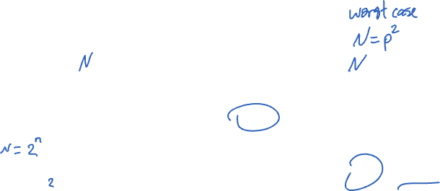
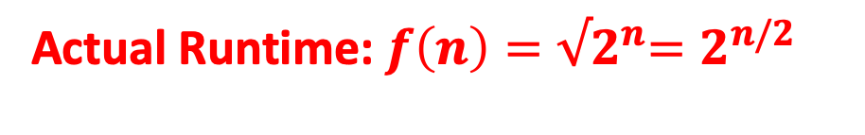
Input Size: Examples
Example 1 (factoring): Suppose I want to factor a number N into two primes, p and q
Factor(N):
For i = 0 to i = $√N$:
check if (n % i == 0). If so, output p = i, q = n/i.
Runtime? (assume mod and division are constant time). $√N$
Input Size: $n= log{N}$
Actual Runtime: $f\left(n\right)={√2}^{n}=2^{n/2}$

Slide 24


Resource Analysis – Worst Case Running Time
Space
space
An algorithm has a worst case running time of $f(n)$ if
  Among all possible size-$n$ inputs, the “worst” one will do $f(n)$ “operations”
  i.e. $f(n)$ gives the maximum operation count from among all inputs of size $n$
use $f\left(n\right)$ bits of memory
memory usage

Slide 25

Resource Analysis – Best Case Running Time
An algorithm has a best case running time of $f(n)$ if
  Among all possible size-$n$ inputs, the “best” one will do $f(n)$ “operations”
  i.e. $f(n)$ gives the minimum operation count from among all inputs of size $n$

Slide 26
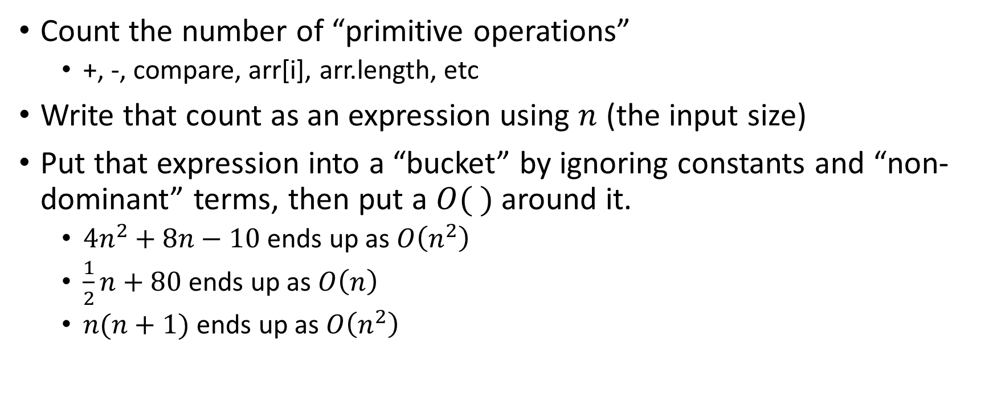
Analysis Process From 123/143
Count the number of “primitive operations”
  +, -, compare, arr[i], arr.length, etc
Write that count as an expression using $n$ (the input size)
Put that expression into a “bucket” by ignoring constants and “non-dominant” terms, then put a $O( )$ around it.
  $4n^{2}+8n−10$ ends up as $O\left(n^{2}\right)$
  $\frac{1}{2}n+80$ ends up as $O\left(n\right)$
  $n(n+1)$ ends up as $O\left(n^{2}\right)$

Slide 27
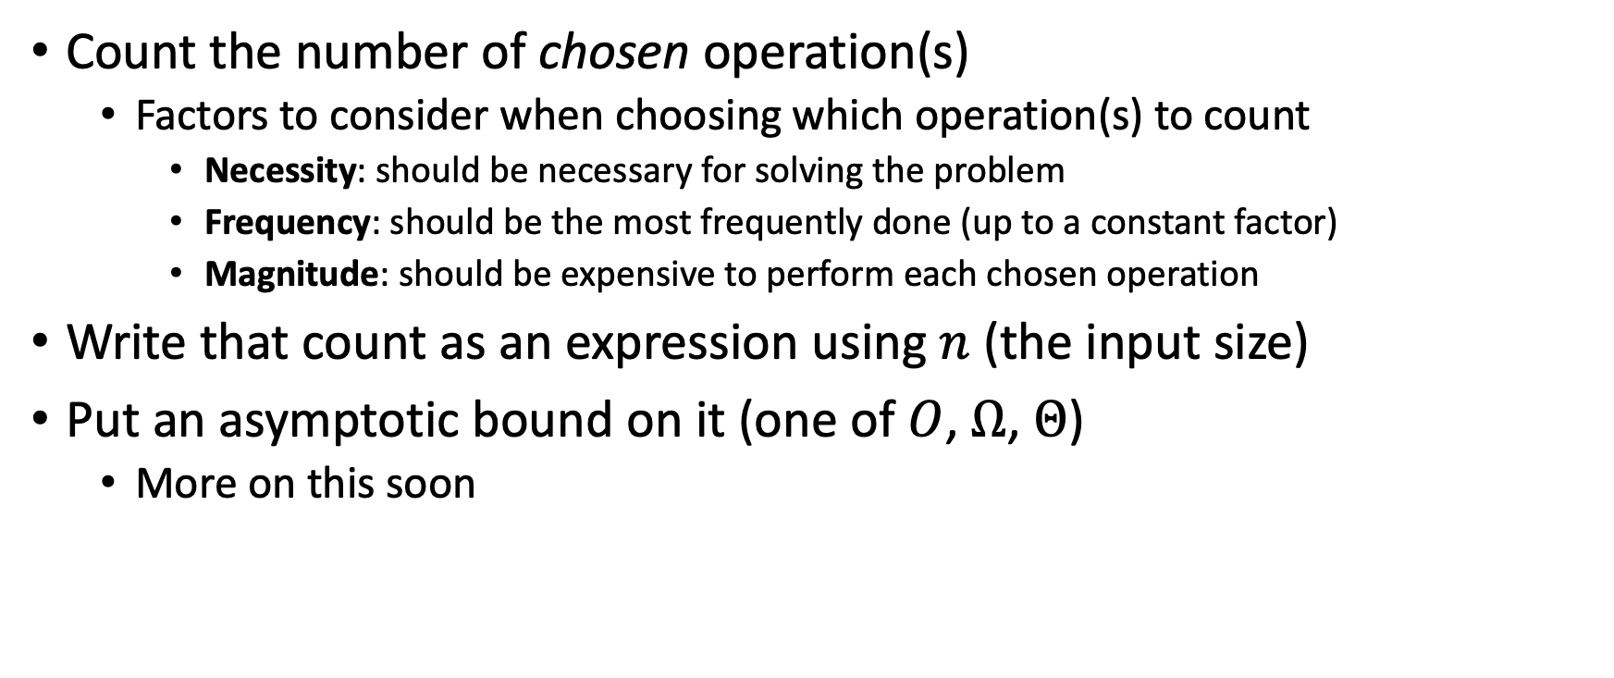

Analysis Process For Us
Count the number of chosen operation(s)
  Factors to consider when choosing which operation(s) to count
    Necessity: should be necessary for solving the problem
    Frequency: should be the most frequently done (up to a constant factor)
    Magnitude: should be expensive to perform each chosen operation
Write that count as an expression using $n$ (the input size)
Put an asymptotic bound on it (one of $O$, $Ω$, $Θ$)
  More on this soon

Slide 28
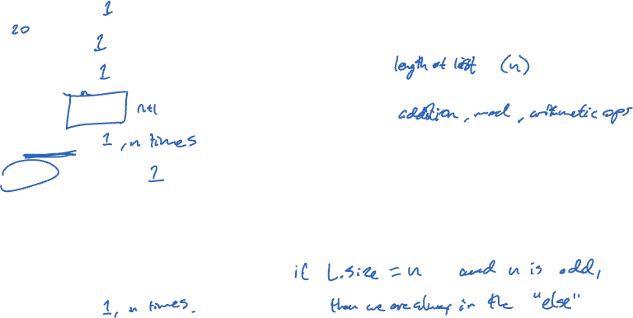
Worst Case – Example 1 (Questions)
myFunction(List L):
b = 55 + 5
c = b / 3
b = c + 100
for i=0 to L.size:
b = b+1
if (b % 2 == 0):
c = c + 1
else:
for i = 0 to L.size:
c = c+1;
return c
Questions to ask:
What are the units of the input size?
What are the operations we’re counting?
For each line:
  How many times will it run?
  How long does it take to run?
  Does this change with different inputs?
Answer:

Slide 29
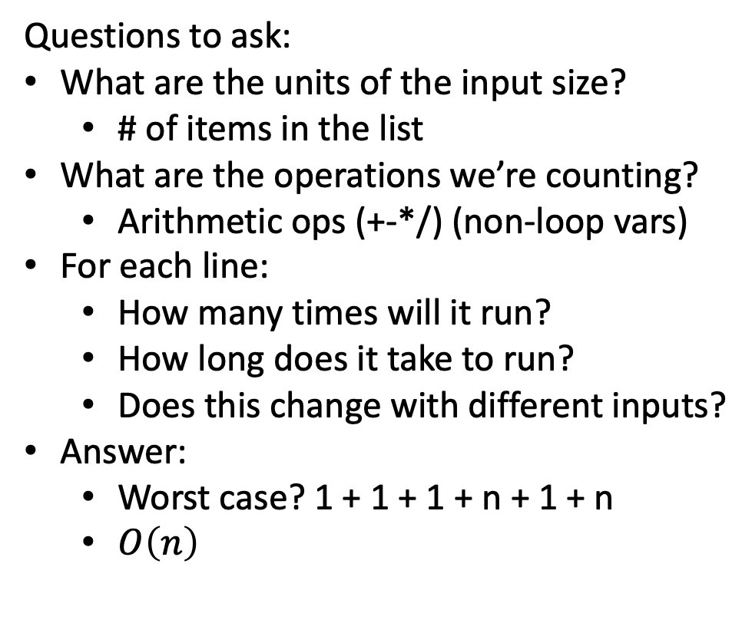
Worst Case – Example 1 (Answers)
myFunction(List L)
b = 55 + 5 } 1
c = b / 3 } 1
b = c + 100 } 1
for i=0 to L.size: } 0
b = b + 1 } 1, n times
if (b % 2 == 0): } 1
c = c + 1 } 1
else:
for i = 0 to L.size: } 0
c = c + 1 } 1, n times
return c
Questions to ask:
What are the units of the input size?
  # of items in the list
What are the operations we’re counting?
  Arithmetic ops (+-*/) (non-loop vars)
For each line:
  How many times will it run?
  How long does it take to run?
  Does this change with different inputs?
Answer:
  $\text{Worst} \text{case}\text{? 1 + 1 + 1 + }\text{n}\text{ + 1 + }\text{n}$
  $O\left(n\right)$

Slide 30
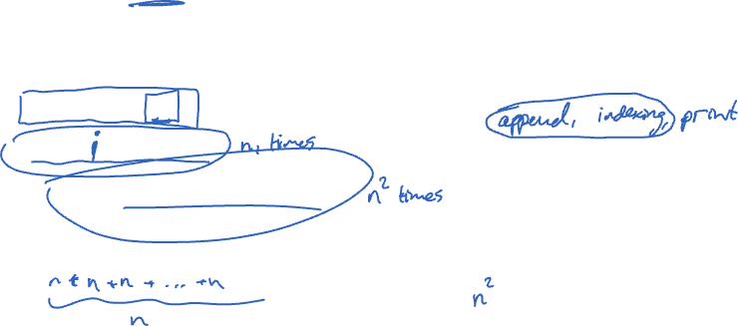
Worst Case – Example 2 (Questions)
beAnnoying(List L)
List A = []
for i=0 i to L.size:
A.append(L[i])
for j=0 to L.size:
print (“Hi, I’m annoying”)
Questions to ask:
What are the units of the input size?
What are the operations we’re counting?
For each line:
  How many times will it run?
  How long does it take to run?
  Does this change with the input size?

Slide 31
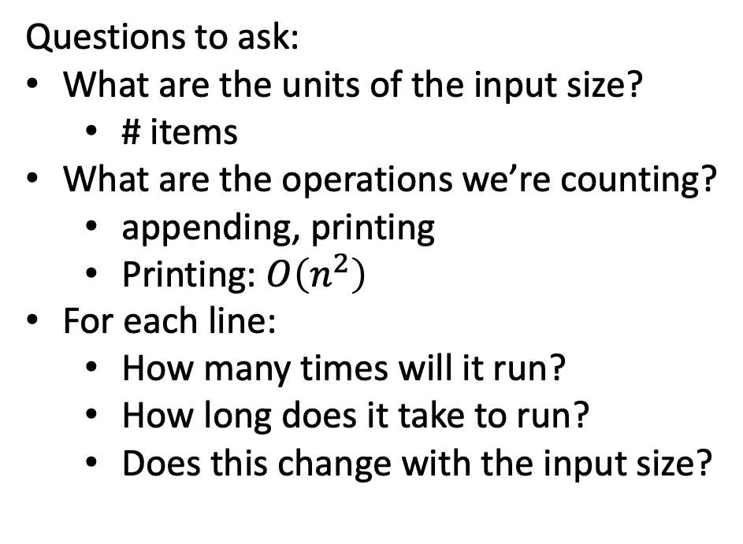

Worst Case – Example 2 (Answers)
beAnnoying(List L)
List A = [] } 1
for i=0 i to L.size: } 0
A.append(L[i]) } 1, n times
for j=0 to L.size: } 0
print (“Hi, I’m annoying”) } 1, $n^{2}$ times
Questions to ask:
What are the units of the input size?
  # items
What are the operations we’re counting?
  appending, printing
  Printing: $O\left(n^{2}\right)$
For each line:
  How many times will it run?
  How long does it take to run?
  Does this change with the input size?

Slide 32
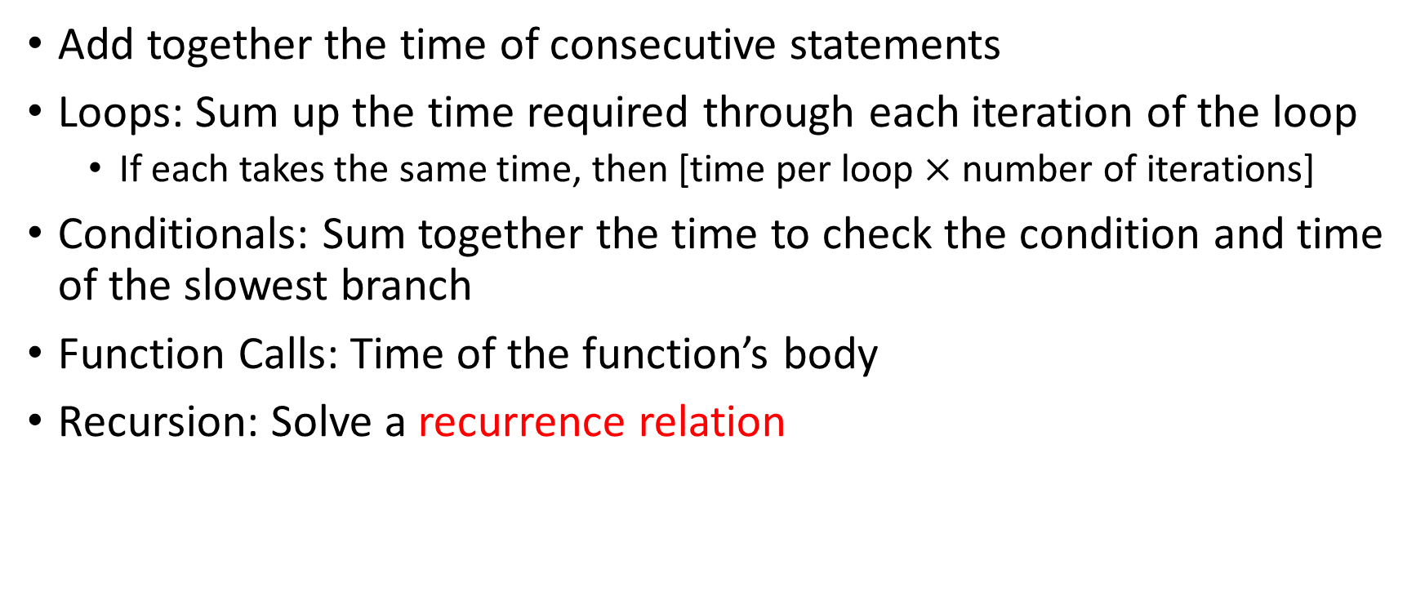
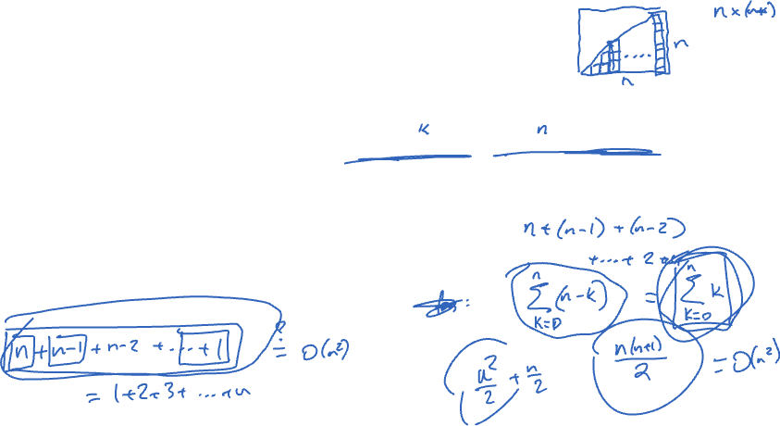
Worst Case Running Time – General Guide
Add together the time of consecutive statements
Loops: Sum up the time required through each iteration of the loop
  If each takes the same time, then [time per loop $×$ number of iterations]
Conditionals: Sum together the time to check the condition and time of the slowest branch
Function Calls: Time of the function’s body
Recursion: Solve a recurrence relation

Slide 33
Defining your running time function
Worst-case complexity:
  max number of steps algorithm takes on “most challenging” input
Best-case complexity:
  min number of steps algorithm takes on “easiest” input
Average/expected complexity:
  avg number of steps algorithm takes on random inputs (distribution-dependent)
Amortized complexity:
  max total number of steps algorithm takes on M “most challenging” consecutive inputs, divided by M (i.e., divide the max total sum by M).

Slide 34
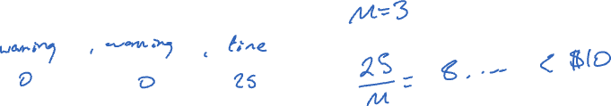
Amortized Analysis Analogy
Suppose I’d like to park in a lot where they charge $10 per day to park
If you are caught in the lot without paying you are given a warning
If you get 3 warnings, you are charged a $25 fine, and your warnings reset.
Should you actually pay to park?

Slide 35
Amortized Analysis Analogy
Suppose I’d like to park in a lot where they charge $10 per day to park
If you are caught in the lot without paying you are given a warning
If you get 3 warnings, you are charged a $25 fine, and your warnings reset.
Should you actually pay to park?
  If you pay every day then you pay an average of $10 per day
  If you do not pay then for every three days parking costs $0+$0+$25, for an average of $8.33 per day
    This is an amortized analysis

Slide 36

ArrayList - Worst Case Time of Add
public void add(int value){
if(data.length == size)
resize();
data[size] = value;
size++;
}
private void resize(){
int[] oldData = data;
data = new int[data.length*2];
for(int i = 0; i < oldData.length; i++)
data[i] = oldData[i];
}
What is the worst case running time of add?
  Input size: size of “this”
  Operations counted: indexing
  $O\left(n\right)$

Slide 37
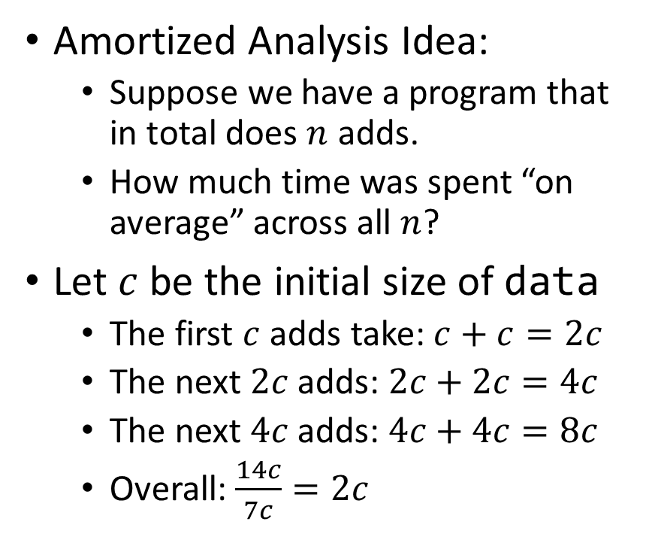
ArrayList – Amortized Time of Add
public void add(int value){
if(data.length == size)
resize();
data[size] = value;
size++;
}
private void resize(){
int[] oldData = data;
data = new int[data.length*2];
for(int i = 0; i < oldData.length; i++)
data[i] = oldData[i];
}
Amortized Analysis Idea:
  Suppose we have a program that in total does $n$ adds.
  How much time was spent “on average” across all $n$?
Let $c$ be the initial size of data
  The first $c$ adds take: $c+c=2c$
  The next $2c$ adds: $2c+2c=4c$
  The next $4c$ adds: $4c+4c=8c$
  Overall: $\frac{14c}{7c}=2c$
Every time we resize, we earn data.length more adds before the next resize!
Notes:
Amortized: “running average”

