Slide 1
CSE 332 Summer 2026
Lecture 1: Intro to ADTs, Stacks, Queues
Michael Whitmeyer
http://www.cs.uw.edu/332

Slide 2


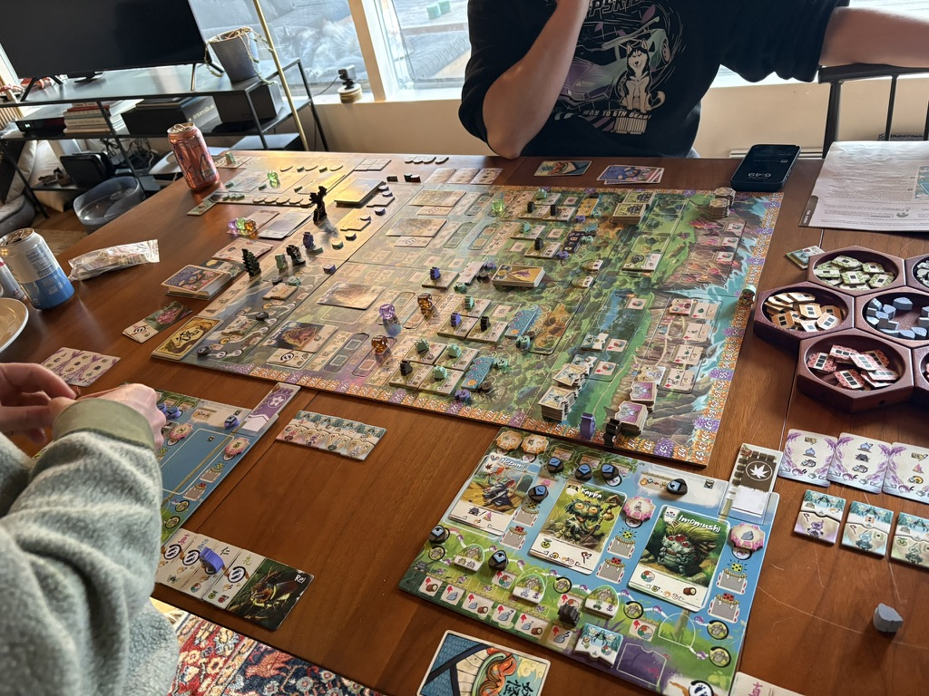
Michael Whitmeyer
From NC, undergrad at Berkeley, PhD at UW!
  I study complexity theory
TA’ed many many times
  Data structures, probability, discrete math, complexity, quantum, etc.
First time instructor!
  I hope to apply for teaching positions after this class concludes!

Slide 3
Topics
Data Structures
  Specific “classic” data structures
Introduction to Algorithms and Analysis
Parallelism and Concurrency
  Parallelism: Use multiple processors to finish sooner
  Concurrency: Correct access to shared resources
Very brief intro to complexity theory

Slide 4
Warm Up!
Put up one hand (you can switch if it gets tired)!
Set your counter to 1
While you and at least 1 other person have their hand up:
1) Make a partnership with someone whose hand is still raised
2) Share your name with your partner
3) Add together your counter and your partner’s counter
4) Identify which of you woke up earliest this morning
5) Release partnership
6) If you woke up later, then put your hand down and return to your seat

Slide 5
Course Staff
Instructor:
  Me (Michael Whitmeyer)
TAs:
  http://www.cs.uw.edu/332/staff.html#tas

Slide 6
Course Info
Text (optional):
  Data Structures & Algorithm Analysis in Java, (Mark Allen Weiss), 3rd edition, 2012
  (2nd edition also o.k.)
Course Page:
  http://www.cs.uw.edu/332
Topic Summaries
  Posted on the website, a work in progress over the last couple quarters (mostly by Nathan, some by me)
  Hopefully will eventually replace textbook

Slide 7
Communication
Ed STEM Discussion board
  Your first stop for questions about course content & assignments
If emailing me, please include “332” or “CSE332” in subject

Slide 8
Course Meetings
Lecture
  Materials posted (slides before class, inked slides after)
  Recorded using Panopto
  Ask questions, focus on key ideas (rarely coding details)
Section
  Practice problems!
  Answer Java/homework questions, etc.
  Occasionally may introduce new material
  An important part of the course

Slide 9
Office Hours
Use them (come visit us!)
See website for all OH
I have 15 min 1-1 meetings available ☺

Slide 10
Grading
Homework exercises (31% total, split evenly)
  The lowest 2 will be dropped
Midterm and final exam (65% total)
  Midterm weighted 25%
  Final weighted 40%
  In-person
  Midterm in class on Wednesday 07/22
  Final at 5-7pm on Thursday 08/20
    Makeup available if you have unavoidable conflict
17 Concept Checks (4% total)
  The lowest 2 will be dropped
  One per “concept” in the course
  We instantly tell you whether you got each question correct
  Unlimited submissions, so keep at it!

Slide 11
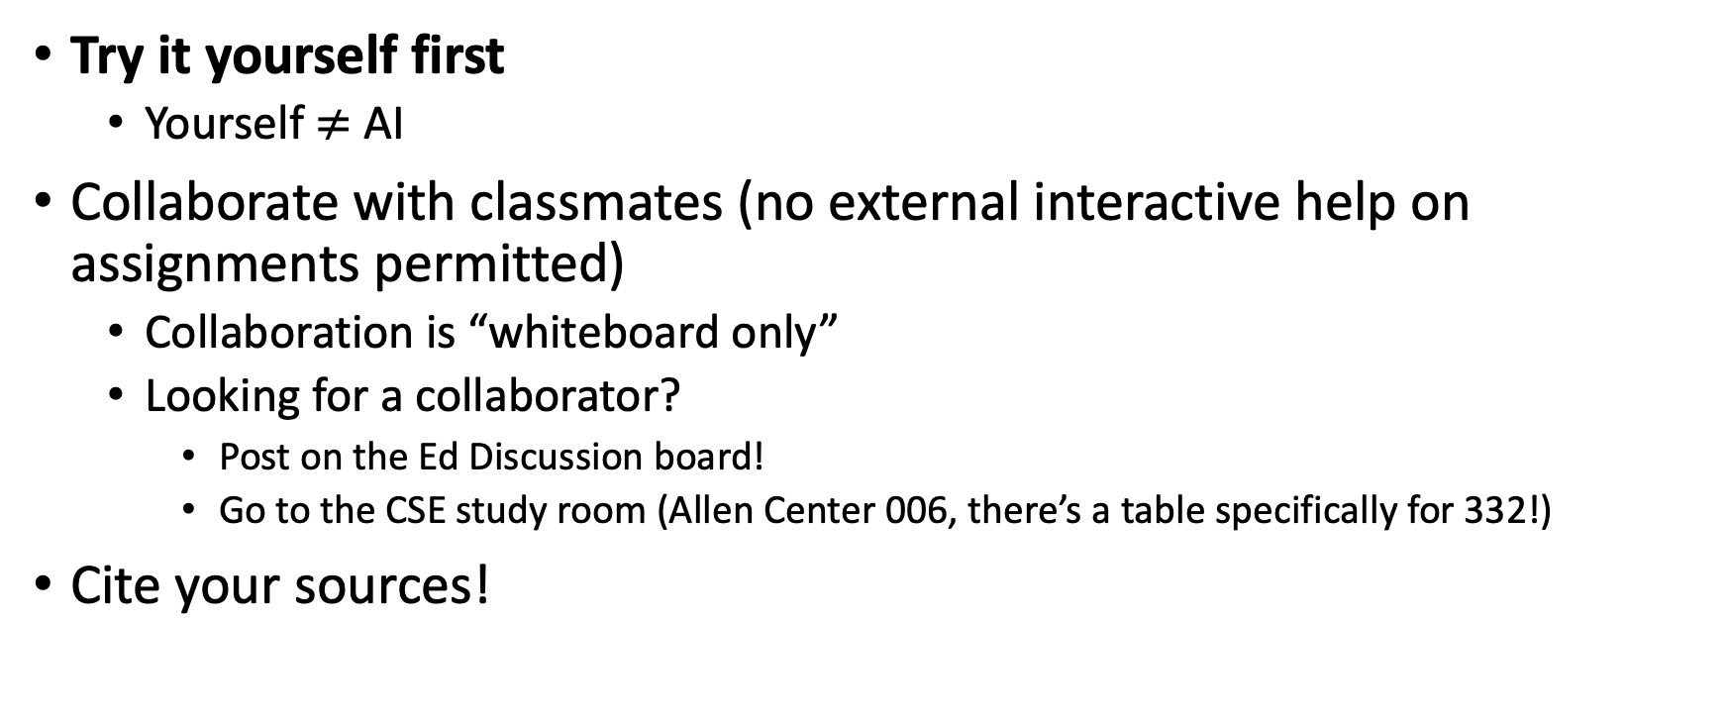
Collaboration
Try it yourself first
  Yourself $≠$ AI
Collaborate with classmates (no external interactive help on assignments permitted)
  Collaboration is “whiteboard only”
  Looking for a collaborator?
    Post on the Ed Discussion board!
    Go to the CSE study room (Allen Center 006, there’s a table specifically for 332!)
Cite your sources!

Slide 12
Terminology
Abstract Data Type (ADT)
  Mathematical description of a “thing” with set of operations on that “thing”
Algorithm
  A high level, language-independent description of a step-by-step process
Data structure
  An organization of data and family of algorithms for implementing an ADT
Implementation of a data structure
  The data organization and algorithms written in a programming language

Slide 13
ADT: Queue (Activity)
What is it?
What operations do we need?
Suggested data structures?

Slide 14
ADT: Queue
What is it?
  A collection of items that we interact with in a “First In First Out” (FIFO) way
What operations do we need?
  Enqueue
    Add a new item to the queue
  Dequeue
    Remove the “oldest” item from the queue
  IsEmpty
    Indicate whether or not there are items still on the queue

Slide 15
Linked Queue Data Structure (Idea)
front
5
8
3
4
7
Queue represented as a “chain” of items
  A “front” reference to the oldest item
  A “back” reference to the most recent item
  Each Node references the item enqueued after it
enqueue Procedure:
dequeue Procedure:
isEmpty Procedure:
back

Slide 16
Linked Queue Data Structure
front
5
8
3
4
7
Queue represented as a “chain” of items
  A “front” reference to the oldest item
  A “back” reference to the most recent item
  Each Node references the item enqueued after it
enqueue Procedure:
dequeue Procedure:
isEmpty Procedure:
back
enqueue(x):
make new Node newBack containing x
set back.next = newBack
set back = newBack
dequeue():
x = front.value
front = front.next
return x
Any Issues?
What if back == front before dequeue?
isEmpty():
return (front == null)

Slide 17
Linked Queue Data Structure
front
5
8
3
4
7
Queue represented as a “chain” of items
  A “front” reference to the oldest item
  A “back” reference to the most recent item
  Each Node references the item enqueued after it
enqueue Procedure:
dequeue Procedure:
isEmpty Procedure:
back
enqueue(x):
make new Node newBack containing x
set back.next = newBack
set back = newBack
dequeue():
x = front.value
front = front.next
if (front == null): set back = null
return x
Any Issues?
What if back == front before dequeue?
isEmpty():
return (front == null)

Slide 18
“Circular” Array Queue (Idea)
front=0
5
8
3
4
7
0
1
2
3
4
5
6
7
8
9
back=5
Queue represented as an array of items
  A “front” index to indicate the oldest item in the queue
  A “back” index to indicate where the end of the queue is
    Actually, the first “open” slot in the array
enqueue Procedure:
dequeue Procedure:
isEmpty Procedure:

Slide 19
“Circular” Array
Intuitively, An array of values arranged in a “circle” rather than a line
  If you go beyond the last index, to wrap back around to 0
5
8
3
4
7
…
5
0
1
2
3
4
5
6
7
8
9
…
9
0
8
8
1
front=0
…
7
2
3
back=5
6
3
…
5
4
4
…
7

Slide 20
“Circular” Array Queue (Algorithms)
front=0
5
8
3
4
7
0
1
2
3
4
5
6
7
8
9
back=5
Queue represented as an array of items
  A “front” index to indicate the oldest item in the queue
  A “back” index to indicate the most recent item in the queue
enqueue Procedure:
dequeue Procedure:
isEmpty Procedure:
enqueue(x):
queue[back] = x
back = (back + 1) % queue.length;
size = size + 1
Any Issues?
dequeue():
first = queue[front]
front = (front + 1) % queue.length;
size = size - 1
return first
isEmpty():
return (size == 0)

Slide 21
“Circular” Array Queue (Algorithms)
front=0
5
8
3
4
7
0
1
2
3
4
5
6
7
8
9
back=5
Queue represented as an array of items
  A “front” index to indicate the oldest item in the queue
  A “back” index to indicate the most recent item in the queue
enqueue Procedure:
dequeue Procedure:
isEmpty Procedure:
enqueue(x):
if (size == queue.length-1) then resize()
queue[back] = x
back = (back + 1) % queue.length;
size = size + 1
How do you resize?
That’s for Exercise 0!
dequeue():
first = queue[front]
front = (front + 1) % queue.length;
size = size - 1
return first
isEmpty():
return (size == 0)

Slide 22
Linked List vs. Circular Array
Let’s Summarize the benefits and drawbacks of each

Slide 23
ADT: Stack
What is it?
  A “Last In First Out” (LIFO) collection of items (sometimes called FILO)
What operations do we need?
  push
    Add a new item onto the stack
  peek
    Return the value of the most recently pushed item
  pop
    Return the value of the most recently pushed item and remove it from the stack
  isEmpty
    Indicate whether or not there are items still on the stack

Slide 24
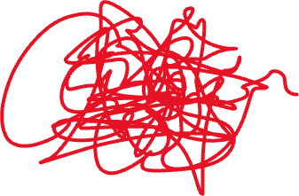
Runtime Analysis (motivating example)
Suppose I am tied into my climbing rope, but the rest of it is a big mess
I need to find the other end of the rope!
How can I do this efficiently?

Slide 25
Algorithm Ideas
Whatcha got?

Slide 26
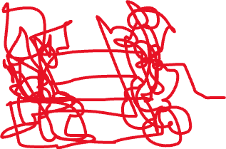
A Possible Algorithm
Set aside the already-obtained beginning
Do the following until you find the end:
Separate the pile of rope into 2 piles
Label A to be the pile that the beginning enters
Label B to be the other pile
Count the number of strands crossing the piles
If count is even, set the pile to be A
Otherwise set the pile to be B.
A

