Slide 1
CSE 332 Summer 2026
Lecture 18: Parallel Prefix Sum, Parallel Runtime
Michael Whitmeyer
http://www.cs.uw.edu/332

Slide 2

Pack/Filter
Given an array of values and a Boolean function, return a new array which contains only elements that were “true”
10
16
4
18
8
2
10
16
18
$$f\left(x\right)=x>9$$
Question: Can we Pack/Filter in parallel?
Answer: yes, with help of parallel Prefix Sum

Slide 3

Prefix Sum
Given an array, compute a new array where each index $i$ is the sum of all values up to $i$
10
16
4
18
8
2
10
26
30
48
56
58
Later: will be useful for parallel packing/filtering!

Slide 4

Parallel Prefix Sum
Algorithm will have two major parallel steps
  Called a “two pass” parallel algorithm
First step:
  Create a tree data structure
Second Step:
  Use the tree to fill in the output array
Richard Ladner
Allen School Faculty
The “subproblem” this node represents
lower bound is inclusive, upper is exclusive
range: [lo,hi)
sum:
leftSum:
Tree Node:
The sum of all values in the range
The sum of all values to the left of the range
i.e. in the range [0, lo)

Slide 5
Step 1: Using D&C
Create a Tree, Fill in sum
14
9
Input:
10
16
4
18
8
2
Output:
For this pass we will only fill in sum
In the next pass we will find leftSum
range: [0,8)
sum:
leftSum:
0
1
2
3
4
5
6
7
range: [0,4)
sum:
leftSum:
range: [4,8)
sum:
leftSum:
range: [0,2)
sum:
leftSum:
range: [2,4)
sum:
leftSum:
range: [4,6)
sum:
leftSum:
range: [6,8)
sum:
leftSum:
range: [0,1)
sum:
leftSum:
range: [1,2)
sum:
leftSum:
range: [2,3)
sum:
leftSum:
range: [3,4)
sum:
leftSum:
range: [4,5)
sum:
leftSum:
range: [5,6)
sum:
leftSum:
range: [6,7)
sum:
leftSum:
range: [7,8)
sum:
leftSum:

Slide 6
Step 1: Create a Tree,
Fill in sum
10
16
4
18
8
2
14
9
range: [2,3)
sum: 4
leftSum:
Base Case:
  If the range is smaller than the Sequential Cutoff, create a node for that range and find the sum sequentially
Divide:
  Split the list into two “sublists” of (roughly) equal length, create a thread for each sublist.
Conquer:
  Compute the left and right subtrees in parallel
Combine:
  Create parent node, connect to children, fill in sum
4
8
2
14
9
10
16
4
18
range: [0,4)
sum: 48
leftSum:
range: [4,8)
sum: 33
leftSum:
range: [0,8)
sum: 81
leftSum:
range: [0,4)
sum: 48
leftSum:
range: [4,8)
sum: 33
leftSum:

Slide 7
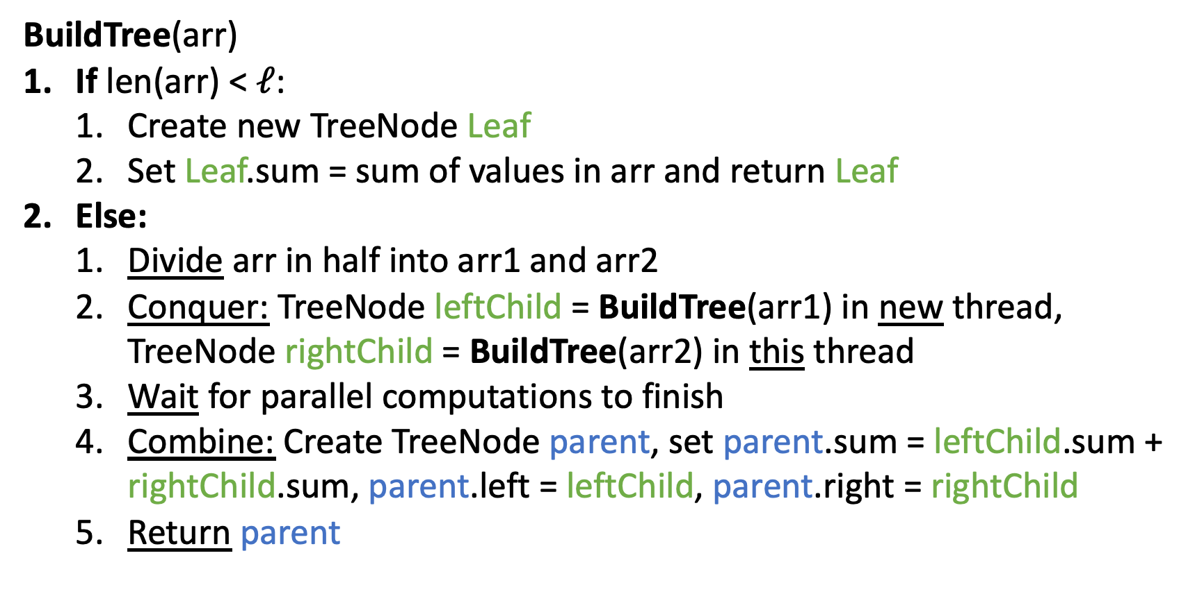
Step 1 pseudocode (create tree, compute sum)
BuildTree(arr)
If len(arr) < $ℓ$:
  Create new TreeNode Leaf
  Set Leaf.sum = sum of values in arr and return Leaf
Else:
  Divide arr in half into arr1 and arr2
  Conquer: TreeNode leftChild = BuildTree(arr1) in new thread, TreeNode rightChild = BuildTree(arr2) in this thread
  Wait for parallel computations to finish
  Combine: Create TreeNode parent, set parent.sum = leftChild.sum + rightChild.sum, parent.left = leftChild, parent.right = rightChild
  Return parent

Slide 8
After Step 1
Input:
10
16
4
18
8
2
14
9
All sums filled in per node
In the next pass we will find leftSum
leftSum is the sum of all elements strictly to the left of the current range
Output:
range: [0,8)
sum: 81
leftSum:
0
1
2
3
4
5
6
7
range: [0,4)
sum: 48
leftSum:
range: [4,8)
sum: 33
leftSum:
range: [0,2)
sum: 26
leftSum:
range: [2,4)
sum: 22
leftSum:
range: [4,6)
sum: 10
leftSum:
range: [6,8)
sum: 23
leftSum:
range: [0,1)
sum: 10
leftSum:
range: [1,2)
sum: 16
leftSum:
range: [2,3)
sum: 4
leftSum:
range: [3,4)
sum: 18
leftSum:
range: [4,5)
sum: 8
leftSum:
range: [5,6)
sum: 2
leftSum:
range: [6,7)
sum: 14
leftSum:
range: [7,8)
sum: 9
leftSum:

Slide 9
Step 2: fill in leftSum and Output
Input:
10
16
4
18
8
2
14
9
Output:
leftSum is the sum of all elements strictly to the left of the current range
We’re going to go root-down, so we can use: any node’s sum, parent’s leftSum
range: [0,8)
sum: 81
leftSum:
0
1
2
3
4
5
6
7
range: [0,4)
sum: 48
leftSum:
range: [4,8)
sum: 33
leftSum:
range: [0,2)
sum: 26
leftSum:
range: [2,4)
sum: 22
leftSum:
range: [4,6)
sum: 10
leftSum:
range: [6,8)
sum: 23
leftSum:
range: [0,1)
sum: 10
leftSum:
range: [1,2)
sum: 16
leftSum:
range: [2,3)
sum: 4
leftSum:
range: [3,4)
sum: 18
leftSum:
range: [4,5)
sum: 8
leftSum:
range: [5,6)
sum: 2
leftSum:
range: [6,7)
sum: 14
leftSum:
range: [7,8)
sum: 9
leftSum:

Slide 10
Step 2: fill in leftSum
and Output
Input:
10
16
4
18
8
2
14
9
Output:
If this is a left child:
leftSum = parent.leftSum
If this is a right child:
leftSum = parent.leftSum + sibling.sum
range: [0,8)
sum: 81
leftSum:
0
1
2
3
4
5
6
7
range: [0,4)
sum: 48
leftSum:
range: [4,8)
sum: 33
leftSum:
range: [0,2)
sum: 26
leftSum:
range: [2,4)
sum: 22
leftSum:
range: [4,6)
sum: 10
leftSum:
range: [6,8)
sum: 23
leftSum:
range: [0,1)
sum: 10
leftSum:
range: [1,2)
sum: 16
leftSum:
range: [2,3)
sum: 4
leftSum:
range: [3,4)
sum: 18
leftSum:
range: [4,5)
sum: 8
leftSum:
range: [5,6)
sum: 2
leftSum:
range: [6,7)
sum: 14
leftSum:
range: [7,8)
sum: 9
leftSum:

Slide 11
Step 2: fill in leftSum and Output
Input:
10
16
4
18
8
2
14
9
If this is a left child:
leftSum = parent.leftSum
If this is a right child:
leftSum = parent.leftSum + sibling.sum
For the leaves:
use leftSum+sum
to complete output
Output:
range: [0,8)
sum: 81
leftSum: 0
0
1
2
3
4
5
6
7
range: [0,4)
sum: 48
leftSum: 0
range: [4,8)
sum: 33
leftSum: 48
range: [0,2)
sum: 26
leftSum: 0
range: [2,4)
sum: 22
leftSum: 26
range: [4,6)
sum: 10
leftSum: 48
range: [6,8)
sum: 23
leftSum: 58
range: [0,1)
sum: 10
leftSum: 0
range: [1,2)
sum: 16
leftSum: 10
range: [2,3)
sum: 4
leftSum: 26
range: [3,4)
sum: 18
leftSum: 30
range: [4,5)
sum: 8
leftSum: 48
range: [5,6)
sum: 2
leftSum: 56
range: [6,7)
sum: 14
leftSum: 58
range: [7,8)
sum: 9
leftSum: 72

Slide 12
Step 2: fill in leftSum and Output
Input:
10
16
4
18
8
2
14
9
If this is a left child:
leftSum = parent.leftSum
If this is a right child:
leftSum = parent.leftSum + sibling.sum
For the leaves:
use leftSum+sum
to complete output
Output:
10
26
30
48
56
58
72
81
range: [0,8)
sum: 81
leftSum: 0
0
1
2
3
4
5
6
7
range: [0,4)
sum: 48
leftSum: 0
range: [4,8)
sum: 33
leftSum: 48
range: [0,2)
sum: 26
leftSum: 0
range: [2,4)
sum: 22
leftSum: 26
range: [4,6)
sum: 10
leftSum: 48
range: [6,8)
sum: 23
leftSum: 58
range: [0,1)
sum: 10
leftSum: 0
range: [1,2)
sum: 16
leftSum: 10
range: [2,3)
sum: 4
leftSum: 26
range: [3,4)
sum: 18
leftSum: 30
range: [4,5)
sum: 8
leftSum: 48
range: [5,6)
sum: 2
leftSum: 56
range: [6,7)
sum: 14
leftSum: 58
range: [7,8)
sum: 9
leftSum: 72

Slide 13
Step 2 pseudocode (Compute Leftsum)
CompleteTree(Node curr)
If curr is a left child of curr.parent:
  Set curr.LeftSum = curr.parent.LeftSum
Else:
  Set curr.LeftSum = curr.parent.LeftSum + curr.sibling.Sum
If curr is not a leaf:
  Divide and conquer: call CompleteTree(curr.left) and CompleteTree(curr.right) in parallel threads
  Wait for parallel computations to finish
Else (curr is a leaf):
  Set output[curr.lo] = curr.LeftSum + input[curr.lo]
  for i = curr.lo + 1 to curr.hi:
    Set output[i] = output[i-1] + input[i]
Base Case

Slide 14
Whew! Back to Pack/Filter
Given an array of values and a Boolean function, return a new array which contains only elements that were “true”
10
16
4
18
8
2
14
9
10
16
18
14
$$f\left(x\right)=x>9$$

Slide 15
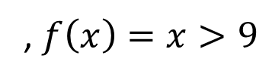
Parallel Filter
Input:
10
16
4
18
8
2
14
9
, $f\left(x\right)=x>9$
Output:
10
16
18
14
0
1
2
3
4
5
6
7
Do a map to identify the true elements
Do prefix sum on the result → count of true elements seen to the left of each position
Fill in the output in parallel:
1
1
0
1
0
0
1
0
1
2
2
3
3
3
4
4
10
16
18
14

Slide 16
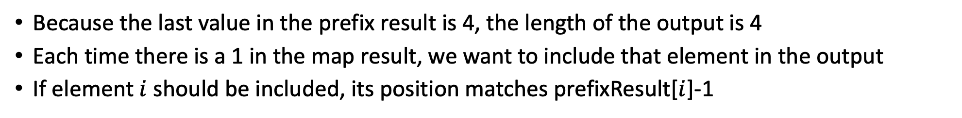
3. Fill in the output in parallel:
Input:
10
16
4
18
8
2
14
9
Map Result:
1
1
0
1
0
0
1
0
Prefix Result:
1
2
2
3
3
3
4
4
Output:
Because the last value in the prefix result is 4, the length of the output is 4
Each time there is a 1 in the map result, we want to include that element in the output
If element $i$ should be included, its position matches prefixResult[$i$]-1
In parallel: if mapResult[i] == 1:
output[prefixResult[i]-1] = input[i]

Slide 17
Map/Reduction/Filter Example
Multiply together the lengths of all of the odd-length strings in a given array
  First, do a map to covert the array of strings into an array of their lengths
  Then do a map on that array so each value maps to 1 if it’s even and itself if it’s odd
    Alternatively, do a filter on the array to remove all even values
  Then do a reduction to multiply together that final result

Slide 18
Runtime of Parallel Algorithms

Slide 19
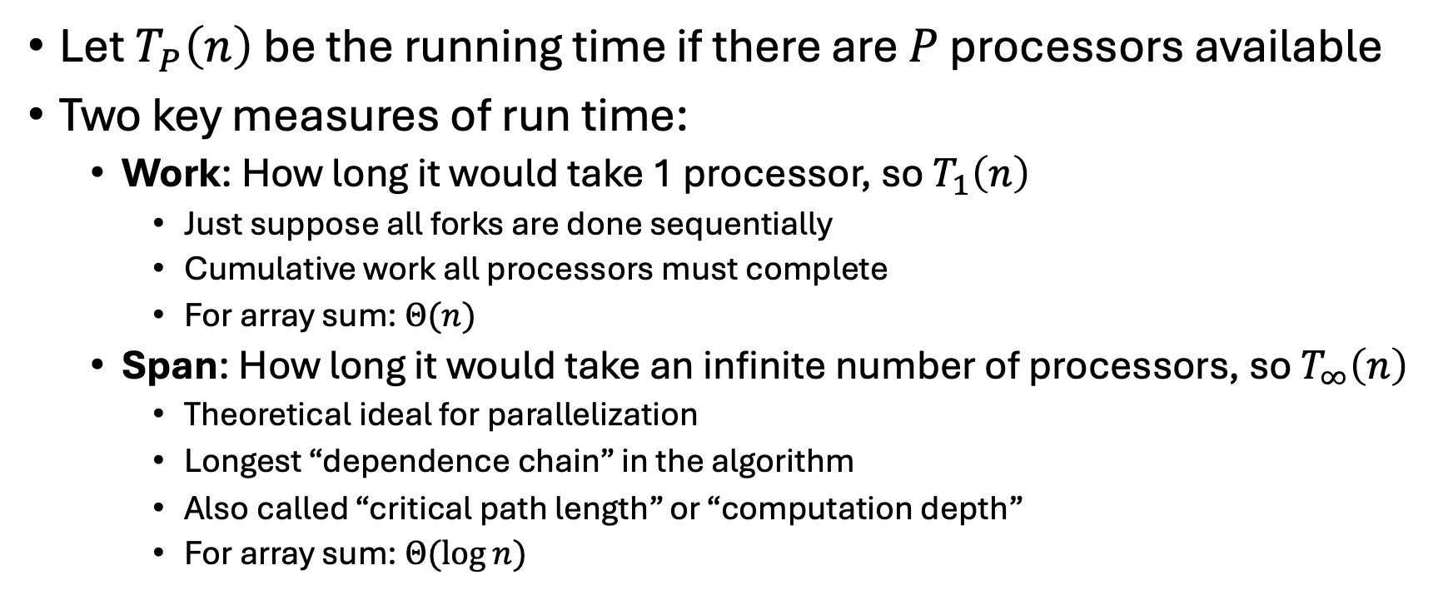
Work and Span
Let $T_{P}\left(n\right)$ be the running time if there are $P$ processors available
Two key measures of run time:
  Work: How long it would take 1 processor, so $T_{1}\left(n\right)$
    Just suppose all forks are done sequentially
    Cumulative work all processors must complete
    For array sum: $Θ(n)$
  Span: How long it would take an infinite number of processors, so $T_{∞}\left(n\right)$
    Theoretical ideal for parallelization
    Longest “dependence chain” in the algorithm
    Also called “critical path length” or “computation depth”
    For array sum: $Θ(log{n})$

Slide 20
Directed Acyclic Graph (DAG)
A directed graph that has no cycles
Often used to depict dependencies
  E.g. software dependencies, Java inheritance, dependencies among sequential tasks!
1
3
2

Slide 21
Task Dependency Graph
“Sketches” what parts of the algorithm may be done in parallel vs. must be done in-order
  Each node is a step of the algorithm that may depend on other steps (draw an edge)
  This graph depicts a forkjoin algorithm. Each node takes constant time.
Fork and Join each create a new node
  When calling fork/compute
    Algorithm creates two new threads, there is a dependency from the creating code to the code done by these threads
  When calling join
    There is a dependency from the code done by the other thread to the code after join
Divide
Work = sum of the running times of all nodes
Span = longest path from start node to end node.
Base Cases
Combine

Slide 22
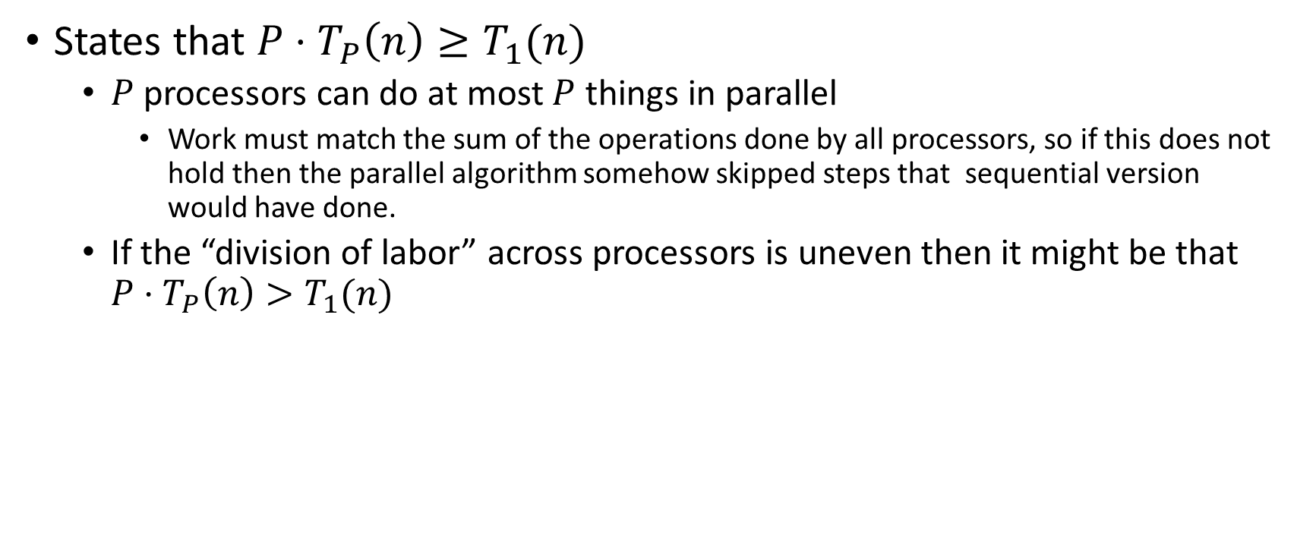
Work Law
States that $P⋅T_{P}\left(n\right)≥T_{1}(n)$
  $P$ processors can do at most $P$ things in parallel
    Work must match the sum of the operations done by all processors, so if this does not hold then the parallel algorithm somehow skipped steps that sequential version would have done.
  If the “division of labor” across processors is uneven then it might be that $P⋅T_{P}\left(n\right)>T_{1}(n)$

Slide 23
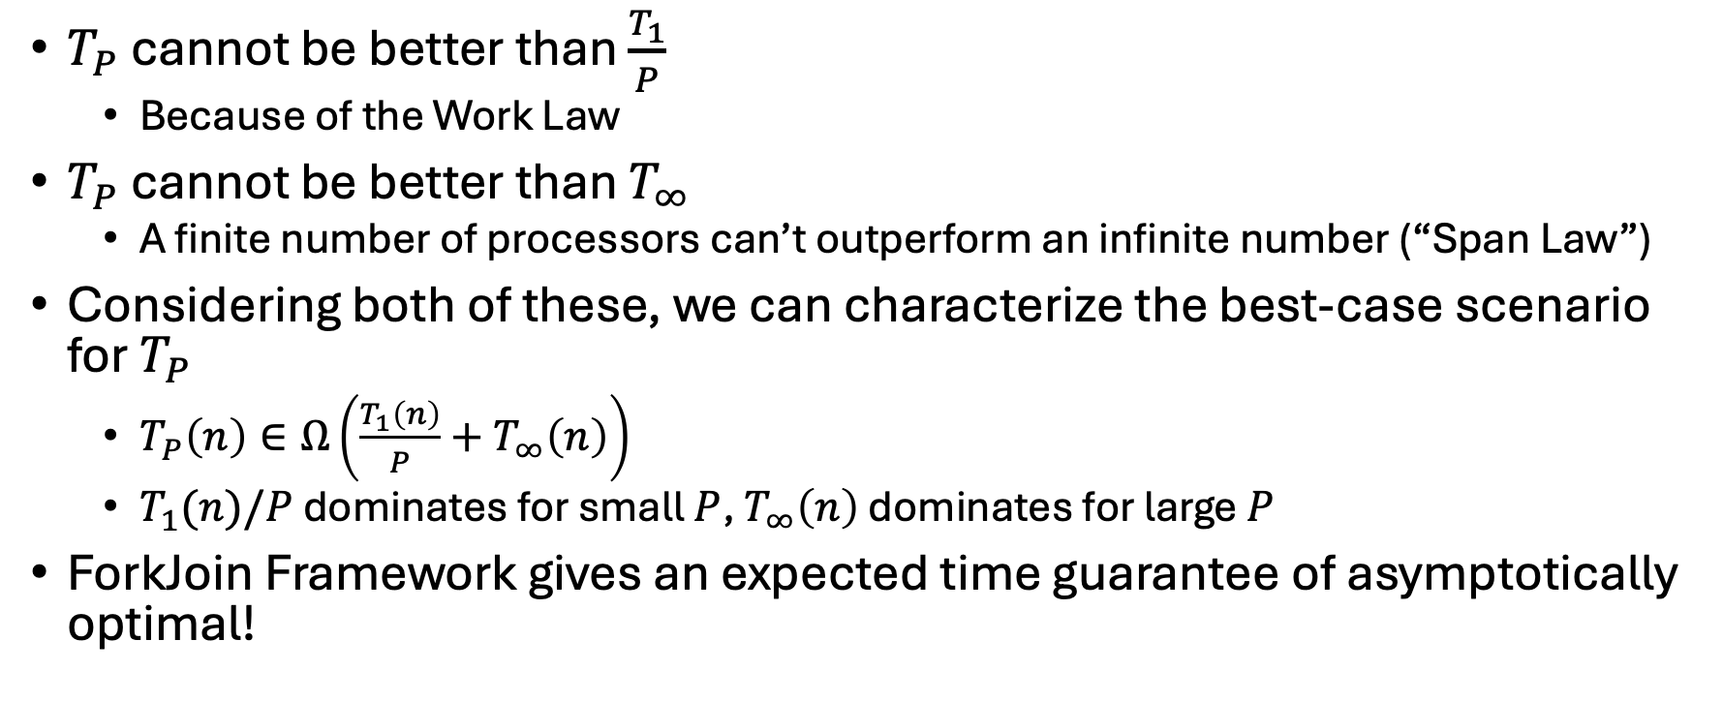

Asymptotically Optimal $T_{P}$
$T_{P}$ cannot be better than $\frac{T_{1}}{P}$
  Because of the Work Law
$T_{P}$ cannot be better than $T_{∞}$
  A finite number of processors can’t outperform an infinite number (“Span Law”)
Considering both of these, we can characterize the best-case scenario for $T_{P}$
  $T_{P}\left(n\right)∈Ω\left(\frac{T_{1}\left(n\right)}{P}+T_{∞}\left(n\right)\right)$
  $T_{1}(n)/P$ dominates for small $P$, $T_{∞}\left(n\right)$ dominates for large $P$
ForkJoin Framework gives an expected time guarantee of asymptotically optimal!

Slide 24
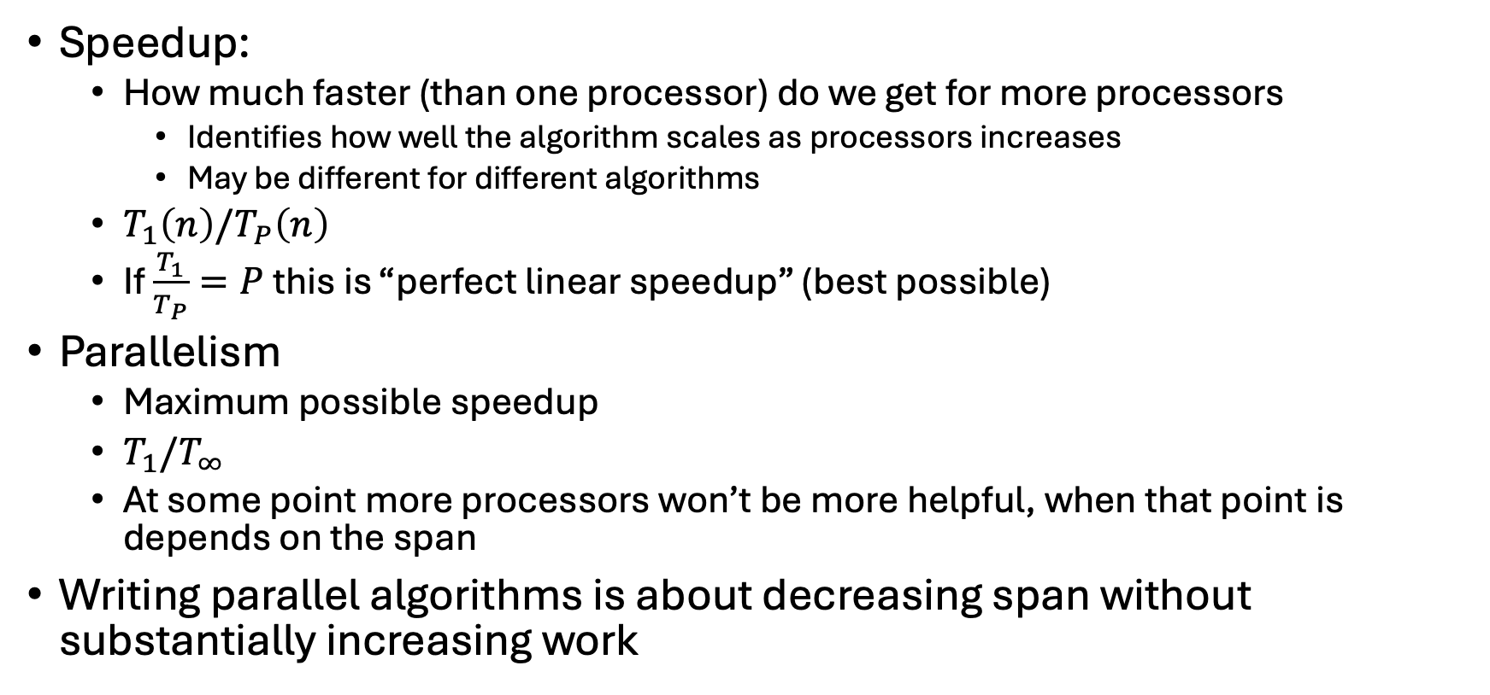
More Vocab
Speedup:
  How much faster (than one processor) do we get for more processors
    Identifies how well the algorithm scales as processors increases
    May be different for different algorithms
  $T_{1}\left(n\right)/T_{P}\left(n\right)$
  If $\frac{T_{1}}{T_{P}}=P$ this is “perfect linear speedup” (best possible)
Parallelism
  Maximum possible speedup
  $T_{1}/T_{∞}$
  At some point more processors won’t be more helpful, when that point is depends on the span
Writing parallel algorithms is about decreasing span without substantially increasing work

Slide 25
And now for some bad news…
In practice it’s common for your program to have:
  Parts that parallelize well
    Maps/reduces/filters over arrays and other data structures
    Anything ForkJoin!
    Tasks that don’t need to access a shared data structure
  Parts that don’t parallelize at all
    Reading a linked list, getting input, computations where each step needs the results of previous step, concurrency concerns forcing mutual exclusion
These unparallelizable parts can turn out to be a big bottleneck

Slide 26
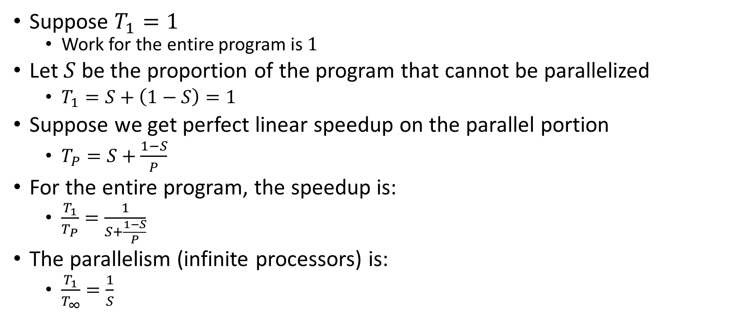
Amdahl’s Law (the bad news)
Suppose $T_{1}=1$
  Work for the entire program is $1$
Let $S$ be the proportion of the program that cannot be parallelized
  $T_{1}=S+\left(1−S\right)=1$
Suppose we get perfect linear speedup on the parallel portion
  $T_{P}=S+\frac{1−S}{P}$
For the entire program, the speedup is:
  $\frac{T_{1}}{T_{P}}=\frac{1}{S+\frac{1−S}{P}}$
The parallelism (infinite processors) is:
  $\frac{T_{1}}{T_{∞}}=\frac{1}{S}$

Slide 27

Amdahl’s Law Example
Suppose 2/3 of your program is parallelizable, but 1/3 is not.
  $S=\frac{1}{3}$
  $T_{1}=\frac{2}{3}+\frac{1}{3}=1$
$T_{P}=S+\frac{1−S}{P}=\frac{1}{3}+\frac{2/3}{P}$
If $T_{1}$ is 100 seconds:
  $T_{P}=33+\frac{67}{P}$
  $T_{2}=33+\frac{67}{2}≈67$
  $T_{3}=33+\frac{67}{3}≈55$
  $T_{6}=33+\frac{67}{6}≈44$
  $T_{12}=33+\frac{67}{12}≈39$
Notice:
We got a lot of speedup with the second processor (23%)
Adding a third processor only gave half as much speedup (12%)
After going up to 6 processors, we still only got 11% speedup
No matter how many processors we add, we will never get more 11% additional improvement
Conclusion:
When a portion of our code is sequential, the improvement gained from more and more processors diminishes very quickly.
Notes:
Suppose 2/3 of your program is parallelizable, but 1/3 is not.
$$S=\frac{1}{3}$$
$$T_{1}=\frac{2}{3}+\frac{1}{3}=1$$
$$T_{P}=S+\frac{1−S}{P}=\frac{1}{3}+\frac{2/3}{P}$$
If $T_{1}$ is 100 seconds:
$$T_{P}=33+\frac{67}{P}$$
$$T_{3}=33+\frac{67}{3}=33+22=55$$
$$T_{6}=33+\frac{67}{6}=33+11=44$$
$$T_{12}=33+\frac{67}{12}=33+5.5=38.5$$

Slide 28
Conclusion
Even with many many processors the sequential part of your program becomes a bottleneck
Parallelizable code requires skill and insight from the developer to recognize where parallelism is possible, and how to do it well.

Slide 29
Concurrency

Slide 30
Memory Sharing With ForkJoin
Structure of ForkJoin:
  All threads are executing the same algorithm
  Each task is responsible for its own portion of the input/output
  If one task needs another’s result, use join() to ensure it uses the final answer
This does not help when:
  Memory accessed by threads is overlapping or unpredictable
  Threads are doing independent tasks using same resources (rather than implementing the same algorithm)

Slide 31
Example: Shared Queue
Imagine two threads are both using the same linked list based queue.
What could go wrong?
enqueue(x){
if ( back == null ){
back = new Node(x);
front = back;
}
else {
back.next = new Node(x);
back = back.next;
}
}

Slide 32
Shared Queue Interleaving
Thread 1
Thread 2
enqueue(x){
if ( back == null ){
back = new Node(x);
front = back;
}
else {
back.next = new Node(x);
back = back.next;
}
}
enqueue(x){
if ( back == null ){
back = new Node(x);
front = back;
}
else {
back.next = new Node(x);
back = back.next;
}
}
back
front
5
8
3
4
7

Slide 33
Empty Shared Queue
Suppose the Queue is empty, and the threads execute in this order.
Assume Thread 1 enqueues 1, and Thread 2 enqueues 2.
Thread 1
Thread 2
enqueue(x){
if ( back == null ){
back = new Node(x);
front = back;
}
else {
back.next = new Node(x);
back = back.next;
}
}
enqueue(x){
if ( back == null ){
back = new Node(x);
front = back;
}
else {
back.next = new Node(x);
back = back.next;
}
}
front
back

Slide 34
Thread 1 – first two lines
Thread 1 has decided the queue is empty
Thread 1
Thread 2
enqueue(x){
if ( back == null ){
back = new Node(x);
front = back;
}
else {
back.next = new Node(x);
back = back.next;
}
}
enqueue(x){
if ( back == null ){
back = new Node(x);
front = back;
}
else {
back.next = new Node(x);
back = back.next;
}
}
front
back

Slide 35
Thread 2 – all lines
Thread 1 has decided the queue is empty
Meanwhile, thread 2 enqueues 2
Thread 1
Thread 2
enqueue(x){
if ( back == null ){
back = new Node(x);
front = back;
}
else {
back.next = new Node(x);
back = back.next;
}
}
enqueue(x){
if ( back == null ){
back = new Node(x);
front = back;
}
else {
back.next = new Node(x);
back = back.next;
}
}
front
2
back

Slide 36
Thread 1 – remaining lines
Thread 1 has decided the queue is empty
Meanwhile, thread 2 enqueues 2
Thread 1 continues as if the queue is still empty, overwriting Thread 2’s work
Thread 1
Thread 2
enqueue(x){
if ( back == null ){
back = new Node(x);
front = back;
}
else {
back.next = new Node(x);
back = back.next;
}
}
enqueue(x){
if ( back == null ){
back = new Node(x);
front = back;
}
else {
back.next = new Node(x);
back = back.next;
}
}
front
1
back

Slide 37
Interleaving
Due to time slicing, a thread can be interrupted at any time
  Between any two lines of code
  Within a single line of code
The sequence that operations occur across two threads is called an interleaving
Without doing anything else, we have no control over how different threads might be interleaved

Slide 38
Concurrent Programming
Concurrency:
  Correctly and efficiently managing access to shared resources across multiple possibly-simultaneous tasks
Requires synchronization to avoid incorrect simultaneous access
  Use some way of “blocking” other tasks from using a resource when another modifies it or makes decisions based on its state
  That blocking task will free up the resource when it’s done
Warning:
  Because we have no control over when threads are scheduled by the OS, even correct implementations are highly non-deterministic
  Errors are hard to reproduce, which complicates debugging

Slide 39
Analogue Example – Data Race
Count to 10 aloud
Clap three times
Erase the contents of the box
Write your name in the box,
  pausing 2 seconds between letters
Wave your arms in the air

Slide 40
Analogue Example – With “Mutual Exclusion”
There is only one trident, so no two threads (both executing this same code) can execute lines 4 and 5 at the same time.
All threads after the first must wait at line 3 for the trident to become available.
The trident causes any one thread to “lock out” (exclude) all other threads.
Any thread being between lines 3 and 6 excludes all other threads, so this is called “mutual exclusion”.
The trident itself we call a “lock”
Count to 10 aloud
Clap three times
Pick up the trident
Erase the contents of the box
Write your name in the box
Put down the trident
Wave your arms in the air

