Slide 1
CSE 332 Summer 2026
Lecture 17: Forkjoin
Michael Whitmeyer
http://www.cs.uw.edu/332

Slide 2
New Story
Heap Containing Objects and Static Fields
Threads, each with its own unshared:
Call Stack
Program Counter
Local Variables (primitives and references to Heap objects)

Slide 3
Accomplishing this in Java (Java.lang.Thread)
Create class C extending java.lang.Thread
  C must have a run method (acts as main)
Call C’s start method to
  create a new thread (i.e. parallel task, not Thread object in java)
  execute run in that separate, parallel thread
Calling “run” directly causes the program to execute “run” sequentially

Slide 4
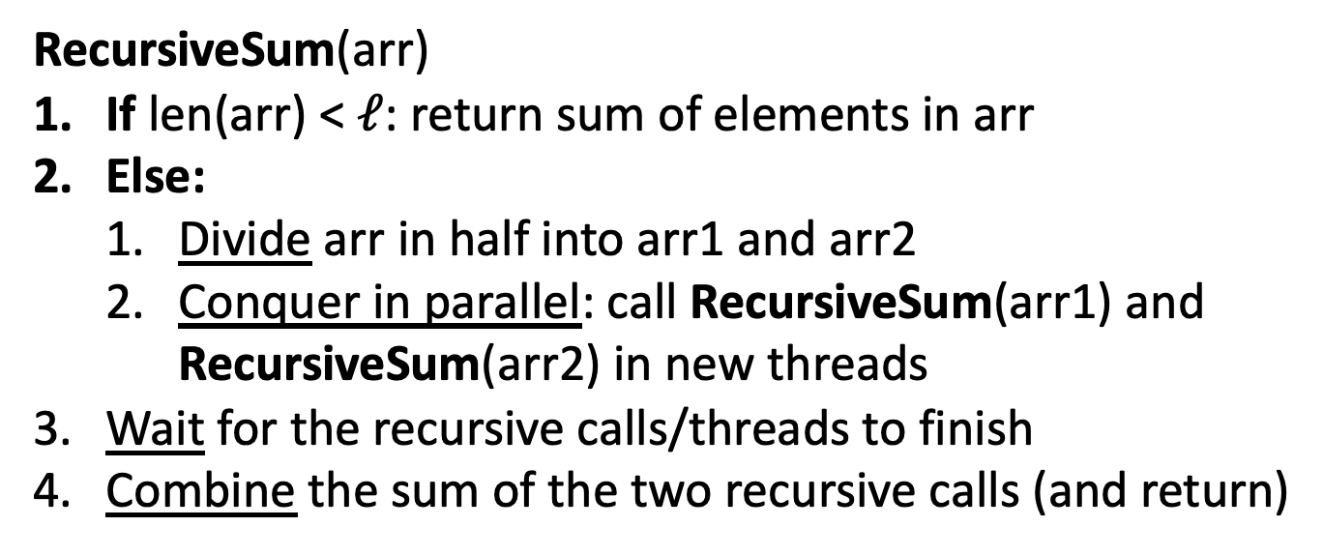
Parallel Divide and Conquer Pseudocode
RecursiveSum(arr)
If len(arr) < $ℓ$: return sum of elements in arr
Else:
  Divide arr in half into arr1 and arr2
  Conquer in parallel: call RecursiveSum(arr1) and RecursiveSum(arr2) in new threads
Wait for the recursive calls/threads to finish
Combine the sum of the two recursive calls (and return)

Slide 5
Divide and Conquer with Threads (optimized)
class SumThread extends java.lang.Thread {
public void run(){ // override
if(hi – lo < SEQUENTIAL_CUTOFF) // “base case”
for(int i=lo; i < hi; i++) ans += arr[i];
else {
SumThread left = new SumThread(arr,lo,(hi+lo)/2); // divide
SumThread right= new SumThread(arr,(hi+lo)/2,hi); // divide
left.start(); // conquer in parallel in new thread
right.run(); // conquer in this thread
left.join(); // don’t move this up a line – why?
//right.join();
ans = left.ans + right.ans; // combine
}
}
}
int sum(int[] arr){ // just make one thread!
SumThread t = new SumThread(arr,0,arr.length);
t.run();
return t.ans; }

Slide 6
ForkJoin Framework
This strategy is common enough that Java (and C++, and C#, and…) provides a library to do it for you!
What you would do in Threads | What to instead in ForkJoin
Subclass Thread | Subclass RecursiveTask<V>
Override run | Override compute
Store the answer in a field | Return a V from compute
Call start | Call fork
join synchronizes only | join synchronizes and returns the answer
Call run to execute sequentially | Call compute to execute sequentially
Have a topmost thread and call run | Create a pool and call invoke

Slide 7
Divide and Conquer with ForkJoin
class SumTask extends RecursiveTask<Integer> {
int lo; int hi; int[] arr; // fields to know what to do
SumTask(int[] a, int l, int h) { … } // constructor
protected Integer compute(){ // return answer
if(hi – lo < SEQUENTIAL_CUTOFF) { // base case
int ans = 0; // local var, not a field
for(int i=lo; i < hi; i++) {
ans += arr[i]; return ans; }
else {
SumTask left = new SumTask(arr,lo,(hi+lo)/2); // divide
SumTask right= new SumTask(arr,(hi+lo)/2,hi); // divide
left.fork(); // conquer in parallel
int rightAns = right.compute(); // conquer in this thread
int leftAns = left.join(); // wait
return leftAns + rightAns; // combine
}
}
}

Slide 8
Divide and Conquer with ForkJoin (continued)
static final ForkJoinPool POOL = new ForkJoinPool();
static int parallelSum(int[] arr){
SumTask task = new SumTask(arr,0,arr.length)
return POOL.invoke(task); // invoke returns the value compute returns
}

Slide 9
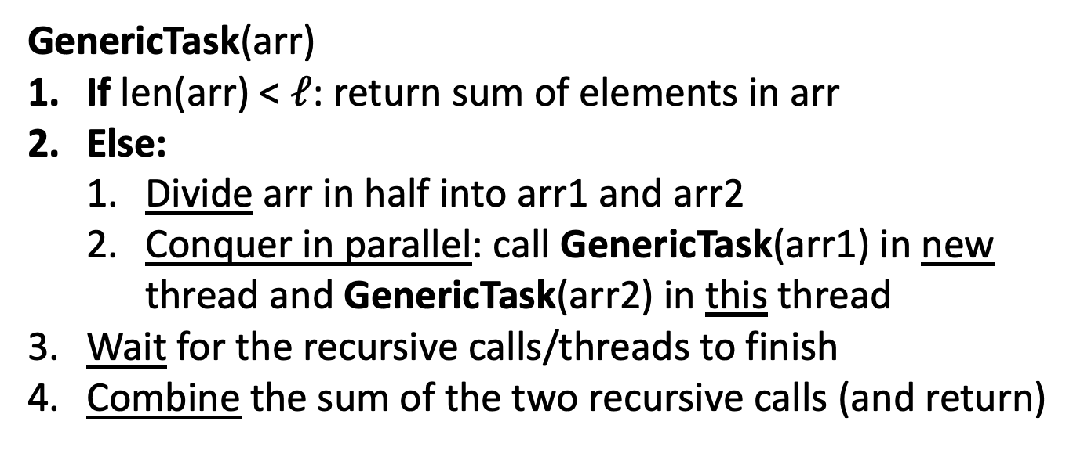
ForkJoin Pseudocode for Summing
GenericTask(arr)
If len(arr) < $ℓ$: return sum of elements in arr
Else:
  Divide arr in half into arr1 and arr2
  Conquer in parallel: call GenericTask(arr1) in new thread and GenericTask(arr2) in this thread
Wait for the recursive calls/threads to finish
Combine the sum of the two recursive calls (and return)
fork()
compute()
join()

Slide 10
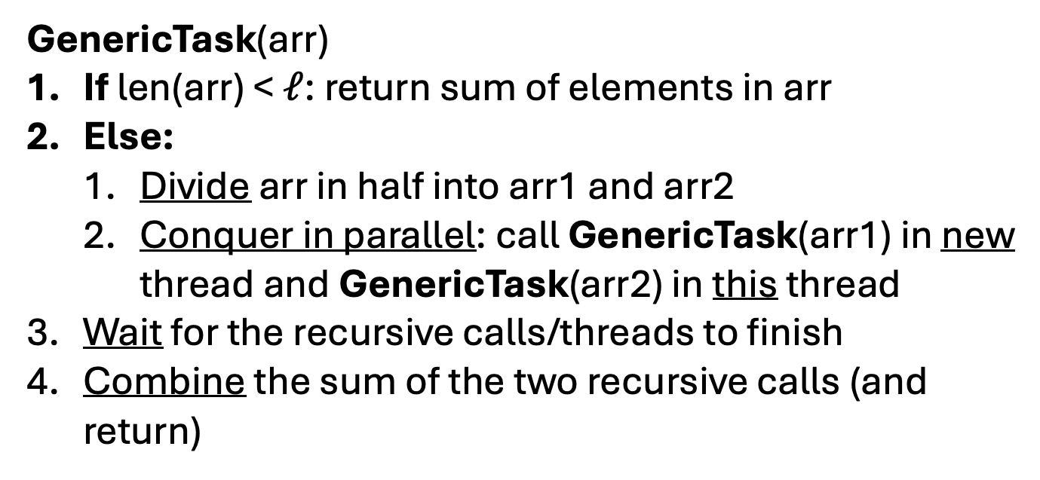
ForkJoin Pseudocode for Summing
Finding Max
GenericTask(arr)
If len(arr) < $ℓ$: return sum of elements in arr
Else:
  Divide arr in half into arr1 and arr2
  Conquer in parallel: call GenericTask(arr1) in new thread and GenericTask(arr2) in this thread
Wait for the recursive calls/threads to finish
Combine the sum of the two recursive calls (and return)
max
fork()
compute()
Take the max of the two
join()

Slide 11
ForkJoin Picture
range: [0,8)
Thread:
range: [4,8)
Thread:
range: [0,4)
Thread:
range: [0,2)
Thread:
range: [2,4)
Thread:
range: [4,6)
Thread:
range: [6,8)
Thread:

Slide 12
ForkJoin Picture
.fork()
range: [0,8)
Thread: 1
.compute()
range: [4,8)
Thread: 1
.fork()
range: [0,4)
Thread: 2
.fork()
.compute()
.compute()
range: [0,2)
Thread: 3
range: [2,4)
Thread: 2
range: [4,6)
Thread: 4
range: [6,8)
Thread: 1

Slide 13
Find Max with ForkJoin
class MaxTask extends RecursiveTask<Integer> {
int lo; int hi; int[] arr; // fields to know what to do
SumTask(int[] a, int l, int h) { … }
protected Integer compute(){// return answer
if(hi – lo < SEQUENTIAL_CUTOFF) { // base case
int ans = Integer.MIN_VALUE; // local var, not a field
for(int i=lo; i < hi; i++) {
ans = Math.max(ans, arr[i]);}
return ans;
else {
MaxTask left = new MaxTask(arr,lo,(hi+lo)/2); // divide
MaxTask right= new MaxTask(arr,(hi+lo)/2,hi); // divide
left.fork(); // fork a thread and calls compute (conquer)
int rightAns = right.compute(); //call compute directly (conquer)
int leftAns = left.join(); // get result from left
return Math.max(rightAns, leftAns); // combine
}
}
}

Slide 14
Other Problems that can be solved similarly
Element Search
  Is the value 17 in the array?
Counting items with a certain property
  How many elements of the array are divisible by 5?
Checking if the array is sorted
Find the smallest rectangle that covers all points in the array
Find the first thing that satisfies a property
  What is the leftmost item that is divisible by 20?

Slide 15
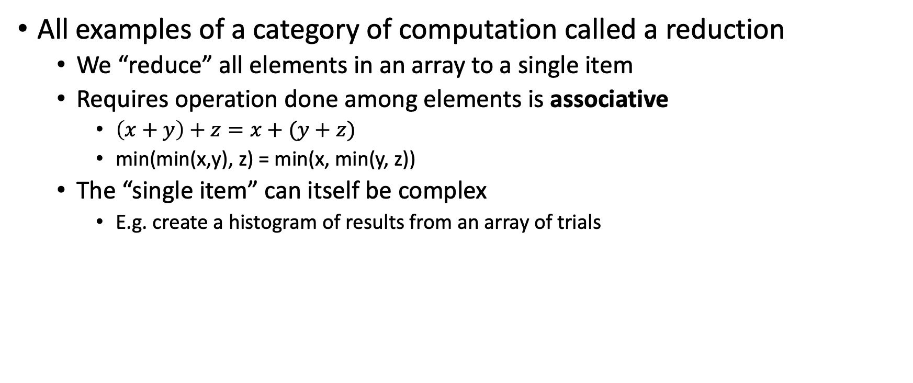
Reductions/Folds
All examples of a category of computation called a reduction
  We “reduce” all elements in an array to a single item
  Requires operation done among elements is associative
    $\left(x+y\right)+z=x+(y+z)$
    min(min(x,y), z) = min(x, min(y, z))
  The “single item” can itself be complex
    E.g. create a histogram of results from an array of trials

Slide 16
Map
New task: Apply a function (map) to each element of an array
Examples:
  Vector addition:
    sum[i] = arr1[i] + arr2[i]
  Function application:
    out[i] = f(arr[i]);
Observation: maps also parallelizable in the same way!
  No need for combination step

Slide 17
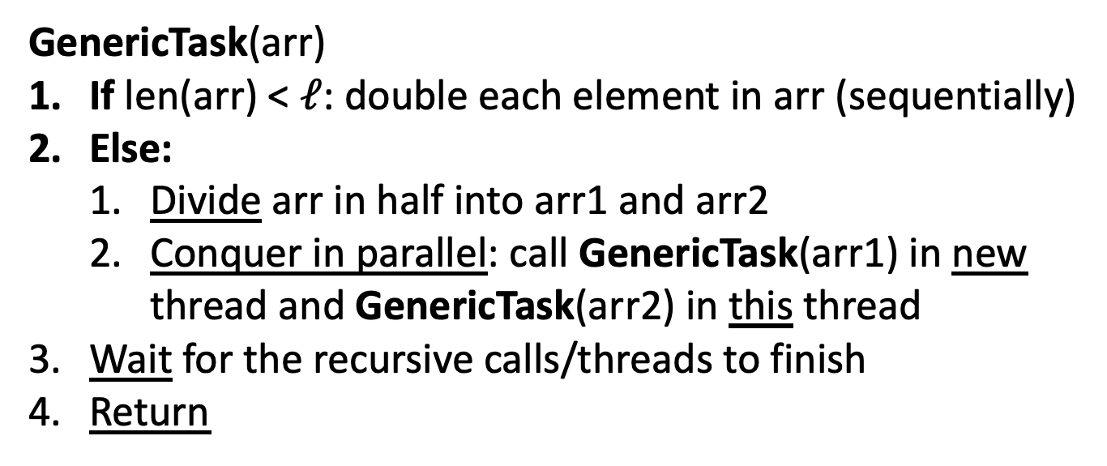
ForkJoin Pseudocode for Doubling each element
GenericTask(arr)
If len(arr) < $ℓ$: double each element in arr (sequentially)
Else:
  Divide arr in half into arr1 and arr2
  Conquer in parallel: call GenericTask(arr1) in new thread and GenericTask(arr2) in this thread
Wait for the recursive calls/threads to finish
Return
fork()
compute()
join()

Slide 18
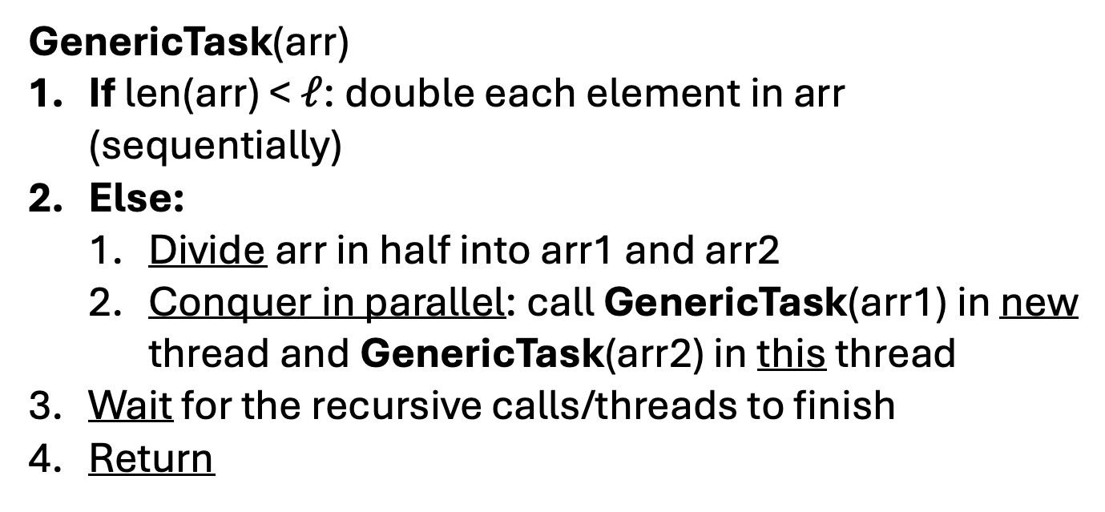
ForkJoin Pseudocode for Doubling each element
Applying map f
GenericTask(arr)
If len(arr) < $ℓ$: double each element in arr (sequentially)
Else:
  Divide arr in half into arr1 and arr2
  Conquer in parallel: call GenericTask(arr1) in new thread and GenericTask(arr2) in this thread
Wait for the recursive calls/threads to finish
Return
Apply f to
fork()
compute()
join()

Slide 19
Map with ForkJoin
class AddVecs extends RecursiveAction {
int lo; int hi; int[] arr; // fields to know what to do
AddVecs(int[] a, int[] b, int[] sum, int l, int h) { … }
protected void compute(){// return answer
if(hi – lo < SEQUENTIAL_CUTOFF) { // base case
for(int i=lo; i < hi; i++) {
sum[i] = a[i] + b[i];}
else {
AddTask left = new AddVecs(a,b,sum,lo,(hi+lo)/2); // divide
AddTask right= new AddVecs(a,b,sum,(hi+lo)/2,hi); // divide
left.fork(); // fork a thread and calls compute (conquer)
right.compute(); //call compute directly (conquer)
left.join(); // wait for thread to finish
return; // combine
}
}
}

Slide 20
Map with ForkJoin (continued)
static final ForkJoinPool POOL = new ForkJoinPool();
int[] add(int[] a, int[] b){
int[] ans = new int[a.length];
AddVecs task = new AddVecs(a, b, ans, 0, a.length)
POOL.invoke(task);
return ans;
}

Slide 21
Maps and Reductions
“Workhorse” constructs in parallel programming
Many problems can be written in terms of maps and reductions
With practice, writing them will become second nature
  Like how over time for loops and if statements have gotten easier

Slide 22
Map/Reduction Example
Task: Multiply together the lengths of all the odd-length strings in array

Slide 23
Map/Reduction Example
Task: Multiply together the lengths of all the odd-length strings in array
  Apply map to convert the array of strings into an array of their lengths
  Then do a map on that array so each value maps to 1 if it’s even and itself if it’s odd
  Then do a reduction to multiply together that final result
Note: You could do this in a single ForkJoin RecursiveTask
  but “deconstructing” useful since some languages designed specifically for parallelism have Map/Reduce built in.
  Map and Reduce are two from a trio, with Pack/Filter being the third

Slide 24
Which Data Structures are “Suitable” for Parallelism?
For each data structure, can we write a parallel algorithm to sum all of its values that’s more efficient than a sequential one?
  Array
  Linked List
  Binary Tree

Slide 25

Pack/Filter
Given an array of values and a Boolean function, return a new array which contains only elements that were “true”
10
16
4
18
8
2
10
16
18
$$f\left(x\right)=x>9$$
Question: Can we Pack/Filter in parallel?
Answer: yes, with help of parallel Prefix Sum

Slide 26
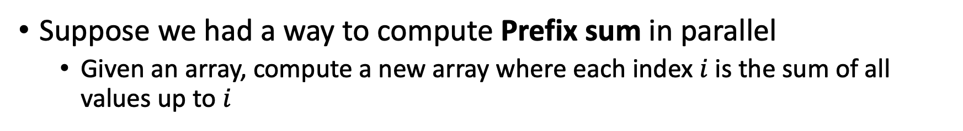
Question: Can we Pack/Filter in parallel?
Suppose we had a way to compute Prefix sum in parallel
  Given an array, compute a new array where each index $i$ is the sum of all values up to $i$
10
16
4
18
8
2
10
26
30
48
56
58
Computing filter f(x) > 9
10
16
4
18
8
2
1
1
0
1
0
0
Map: f(x) = 1 if x > 9
1
2
2
3
3
3
Prefix sum!

Slide 27

Prefix Sum
Given an array, compute a new array where each index $i$ is the sum of all values up to $i$
10
16
4
18
8
2
10
26
30
48
56
58
Later: will be useful for parallel packing/filtering!

Slide 28

Parallel Prefix Sum
Algorithm will have two major parallel steps
  Called a “two pass” parallel algorithm
First step:
  Create a tree data structure
Second Step:
  Use the tree to fill in the output array
Richard Ladner
Allen School Faculty
The “subproblem” this node represents
lower bound is inclusive, upper is exclusive
range: [lo,hi)
sum:
leftSum:
Tree Node:
The sum of all values in the range
The sum of all values to the left of the range
i.e. in the range [0, lo)

Slide 29
Step 1: Using D&C
Create a Tree, Fill in sum
14
9
Input:
10
16
4
18
8
2
Output:
For this pass we will only fill in sum
In the next pass we will find leftSum
range: [0,8)
sum:
leftSum:
0
1
2
3
4
5
6
7
range: [0,4)
sum:
leftSum:
range: [4,8)
sum:
leftSum:
range: [0,2)
sum:
leftSum:
range: [2,4)
sum:
leftSum:
range: [4,6)
sum:
leftSum:
range: [6,8)
sum:
leftSum:
range: [0,1)
sum:
leftSum:
range: [1,2)
sum:
leftSum:
range: [2,3)
sum:
leftSum:
range: [3,4)
sum:
leftSum:
range: [4,5)
sum:
leftSum:
range: [5,6)
sum:
leftSum:
range: [6,7)
sum:
leftSum:
range: [7,8)
sum:
leftSum:

Slide 30
Step 1: Create a Tree,
Fill in sum
10
16
4
18
8
2
14
9
range: [2,3)
sum: 4
leftSum:
Base Case:
  If the range is smaller than the Sequential Cutoff, create a node for that range and find the sum sequentially
Divide:
  Split the list into two “sublists” of (roughly) equal length, create a thread for each sublist.
Conquer:
  Compute the left and right subtrees in parallel
Combine:
  Create parent node, connect to children, fill in sum
4
8
2
14
9
10
16
4
18
range: [0,4)
sum: 48
leftSum:
range: [4,8)
sum: 33
leftSum:
range: [0,8)
sum: 81
leftSum:
range: [0,4)
sum: 48
leftSum:
range: [4,8)
sum: 33
leftSum:

Slide 31
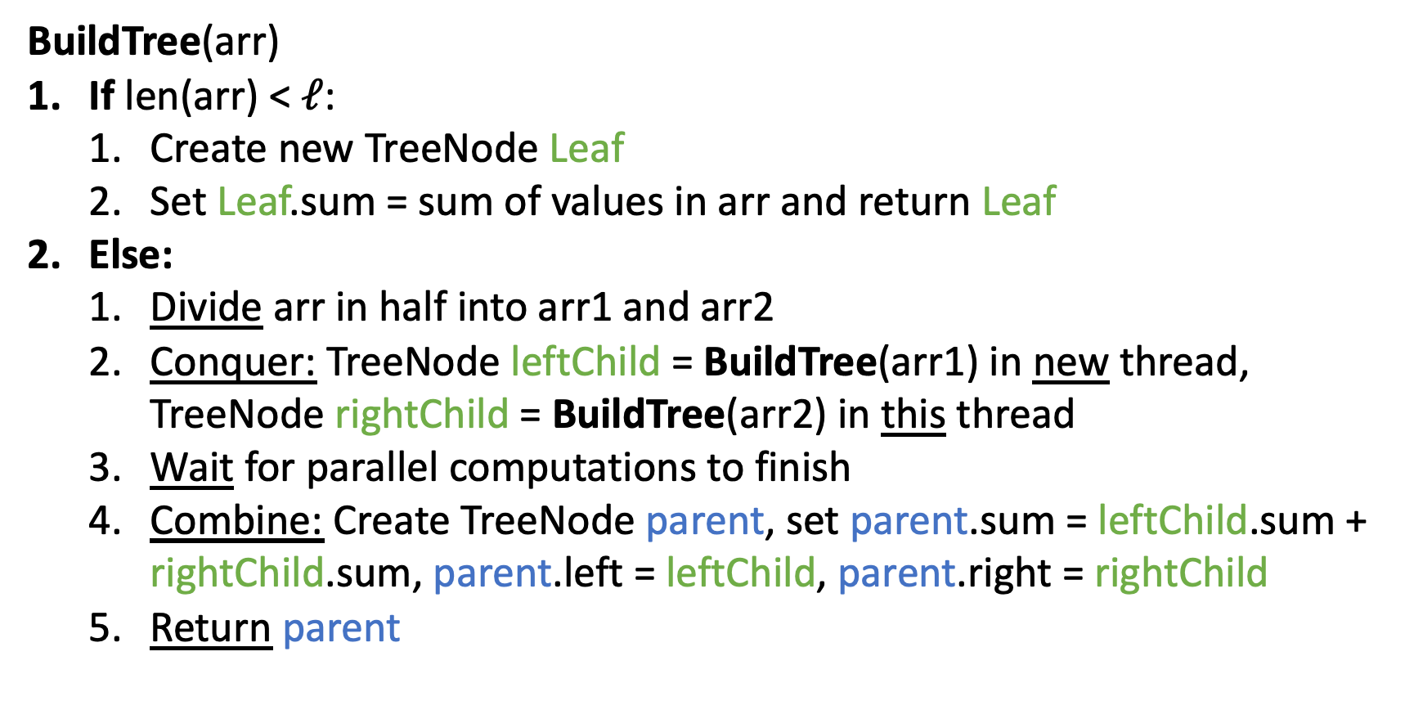
Step 1 pseudocode (create tree, compute sum)
BuildTree(arr)
If len(arr) < $ℓ$:
  Create new TreeNode Leaf
  Set Leaf.sum = sum of values in arr and return Leaf
Else:
  Divide arr in half into arr1 and arr2
  Conquer: TreeNode leftChild = BuildTree(arr1) in new thread, TreeNode rightChild = BuildTree(arr2) in this thread
  Wait for parallel computations to finish
  Combine: Create TreeNode parent, set parent.sum = leftChild.sum + rightChild.sum, parent.left = leftChild, parent.right = rightChild
  Return parent

Slide 32
After Step 1
Input:
10
16
4
18
8
2
14
9
All sums filled in per node
In the next pass we will find leftSum
leftSum is the sum of all elements strictly to the left of the current range
Output:
range: [0,8)
sum: 81
leftSum:
0
1
2
3
4
5
6
7
range: [0,4)
sum: 48
leftSum:
range: [4,8)
sum: 33
leftSum:
range: [0,2)
sum: 26
leftSum:
range: [2,4)
sum: 22
leftSum:
range: [4,6)
sum: 10
leftSum:
range: [6,8)
sum: 23
leftSum:
range: [0,1)
sum: 10
leftSum:
range: [1,2)
sum: 16
leftSum:
range: [2,3)
sum: 4
leftSum:
range: [3,4)
sum: 18
leftSum:
range: [4,5)
sum: 8
leftSum:
range: [5,6)
sum: 2
leftSum:
range: [6,7)
sum: 14
leftSum:
range: [7,8)
sum: 9
leftSum:

Slide 33
Step 2: fill in leftSum and Output
Input:
10
16
4
18
8
2
14
9
Output:
leftSum is the sum of all elements strictly to the left of the current range
We’re going to go root-down, so we can use: any node’s sum, parent’s leftSum
range: [0,8)
sum: 81
leftSum:
0
1
2
3
4
5
6
7
range: [0,4)
sum: 48
leftSum:
range: [4,8)
sum: 33
leftSum:
range: [0,2)
sum: 26
leftSum:
range: [2,4)
sum: 22
leftSum:
range: [4,6)
sum: 10
leftSum:
range: [6,8)
sum: 23
leftSum:
range: [0,1)
sum: 10
leftSum:
range: [1,2)
sum: 16
leftSum:
range: [2,3)
sum: 4
leftSum:
range: [3,4)
sum: 18
leftSum:
range: [4,5)
sum: 8
leftSum:
range: [5,6)
sum: 2
leftSum:
range: [6,7)
sum: 14
leftSum:
range: [7,8)
sum: 9
leftSum:

Slide 34
Step 2: fill in leftSum
and Output
Input:
10
16
4
18
8
2
14
9
Output:
If this is a left child:
leftSum = parent.leftSum
If this is a right child:
leftSum = parent.leftSum + sibling.sum
range: [0,8)
sum: 81
leftSum:
0
1
2
3
4
5
6
7
range: [0,4)
sum: 48
leftSum:
range: [4,8)
sum: 33
leftSum:
range: [0,2)
sum: 26
leftSum:
range: [2,4)
sum: 22
leftSum:
range: [4,6)
sum: 10
leftSum:
range: [6,8)
sum: 23
leftSum:
range: [0,1)
sum: 10
leftSum:
range: [1,2)
sum: 16
leftSum:
range: [2,3)
sum: 4
leftSum:
range: [3,4)
sum: 18
leftSum:
range: [4,5)
sum: 8
leftSum:
range: [5,6)
sum: 2
leftSum:
range: [6,7)
sum: 14
leftSum:
range: [7,8)
sum: 9
leftSum:

Slide 35
Step 2: fill in leftSum and Output
Input:
10
16
4
18
8
2
14
9
If this is a left child:
leftSum = parent.leftSum
If this is a right child:
leftSum = parent.leftSum + sibling.sum
For the leaves:
use leftSum+sum
to complete output
Output:
range: [0,8)
sum: 81
leftSum: 0
0
1
2
3
4
5
6
7
range: [0,4)
sum: 48
leftSum: 0
range: [4,8)
sum: 33
leftSum: 48
range: [0,2)
sum: 26
leftSum: 0
range: [2,4)
sum: 22
leftSum: 26
range: [4,6)
sum: 10
leftSum: 48
range: [6,8)
sum: 23
leftSum: 58
range: [0,1)
sum: 10
leftSum: 0
range: [1,2)
sum: 16
leftSum: 10
range: [2,3)
sum: 4
leftSum: 26
range: [3,4)
sum: 18
leftSum: 30
range: [4,5)
sum: 8
leftSum: 48
range: [5,6)
sum: 2
leftSum: 56
range: [6,7)
sum: 14
leftSum: 58
range: [7,8)
sum: 9
leftSum: 72

Slide 36
Step 2: fill in leftSum and Output
Input:
10
16
4
18
8
2
14
9
If this is a left child:
leftSum = parent.leftSum
If this is a right child:
leftSum = parent.leftSum + sibling.sum
For the leaves:
use leftSum+sum
to complete output
Output:
10
26
30
48
56
58
72
81
range: [0,8)
sum: 81
leftSum: 0
0
1
2
3
4
5
6
7
range: [0,4)
sum: 48
leftSum: 0
range: [4,8)
sum: 33
leftSum: 48
range: [0,2)
sum: 26
leftSum: 0
range: [2,4)
sum: 22
leftSum: 26
range: [4,6)
sum: 10
leftSum: 48
range: [6,8)
sum: 23
leftSum: 58
range: [0,1)
sum: 10
leftSum: 0
range: [1,2)
sum: 16
leftSum: 10
range: [2,3)
sum: 4
leftSum: 26
range: [3,4)
sum: 18
leftSum: 30
range: [4,5)
sum: 8
leftSum: 48
range: [5,6)
sum: 2
leftSum: 56
range: [6,7)
sum: 14
leftSum: 58
range: [7,8)
sum: 9
leftSum: 72

Slide 37
Step 2 pseudocode (Compute Leftsum)
CompleteTree(Node curr)
If curr is a left child of curr.parent:
  Set curr.LeftSum = curr.parent.LeftSum
Else:
  Set curr.LeftSum = curr.parent.LeftSum + curr.sibling.Sum
If curr is not a leaf:
  Divide and conquer: call CompleteTree(curr.left) and CompleteTree(curr.right) in parallel threads
  Wait for parallel computations to finish
Else (curr is a leaf):
  Set output[curr.lo] = curr.LeftSum + input[curr.lo]
  for i = curr.lo + 1 to curr.hi:
    Set output[i] = output[i-1] + input[i]
Base Case

