Slide 1
CSE 332 Summer 2026
Lecture 16: MST Wrap/Parallelism
Michael Whitmeyer
http://www.cs.uw.edu/332

Slide 2
Announcements
Graph exercises are out!
  Ex07 cycle detection
  Ex08 Dijkstra
Fill out feedback form for +2 points on midterm!
  By next Wednesday

Slide 3
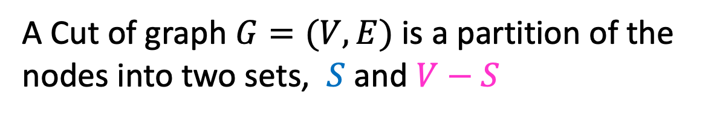
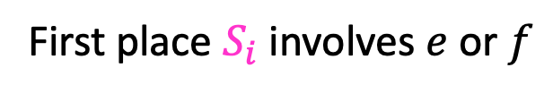


Definition: Cut
A Cut of graph $G=(V,E)$ is a partition of the nodes into two sets, $S$ and $V−S$
B
8
10
E
8
7
H
A
9
2
D
5
9
$$S$$
I
12
3
C
3
11
G
1
F
6
Edge $\left(v_{1},v_{2}\right)∈E$ crosses a cut if $v_{1}∈S$ and $v_{2}∈V−S$ (or opposite), e.g. $(A,C)$
A set of edges $R$ Respects a cut if no edges cross the cut
e.g. $R=\{\left(A,B\right),\left(E,G\right),\left(F,G\right)\}$
Notes:
Go over some examples of edges that cross the cut and edges that do not

Slide 4

Cut Theorem
If a set of edges $A$ is a subset of a minimum spanning tree $T$, let $(S, V−S)$ be any cut which $A$ respects. Let $e$ be the least-weight edge which crosses $(S, V−S)$. $A∪\{e\}$ is also a subset of a minimum spanning tree.
Notes:
If I take any cut at all in the graph, then the least weight edge across that cut is guaranteed to be part of some minimum spanning tree. The least weight edge that crosses any cut in .
We need a bit more mechanics to make this work for kruskals.
Suppose A is a subset of a minimum spanning tree, meaning, we are on our way to building. There is a minimum spanning tree T, where every edge in A is part of this minimum spanning tree T
Define some cut (S,V-S), which A respects. It is safe to add e to A and we will have made more progress
Repeat v-1 times. If we know we can start with some arbitrary subset, then we can add this edge e . There is some minimum spanning tree that has this edge f,g. If I used some other edge instead, an

Slide 5

Cut Theorem
If a set of edges $A$ is a subset of a minimum spanning tree $T$, let $(S, V−S)$ be any cut which $A$ respects. Let $e$ be the least-weight edge which crosses $(S, V−S)$. $A∪\{e\}$ is also a subset of a minimum spanning tree.
B
8
10
E
8
7
H
A
9
2
D
5
9
I
12
3
C
3
11
G
1
F
6
Notes:
If I take any cut at all in the graph, then the least weight edge across that cut is guaranteed to be part of some minimum spanning tree. The least weight edge that crosses any cut in .
We need a bit more mechanics to make this work for kruskals.
Suppose A is a subset of a minimum spanning tree, meaning, we are on our way to building. There is a minimum spanning tree T, where every edge in A is part of this minimum spanning tree T
Define some cut (S,V-S), which A respects. It is safe to add e to A and we will have made more progress
Repeat v-1 times. If we know we can start with some arbitrary subset, then we can add this edge e . There is some minimum spanning tree that has this edge f,g. If I used some other edge instead, an

Slide 6

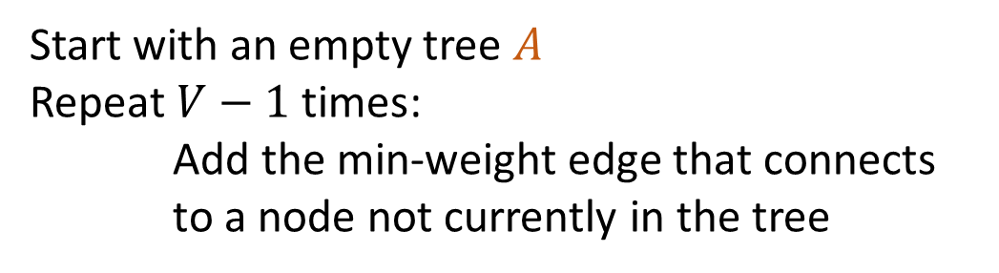

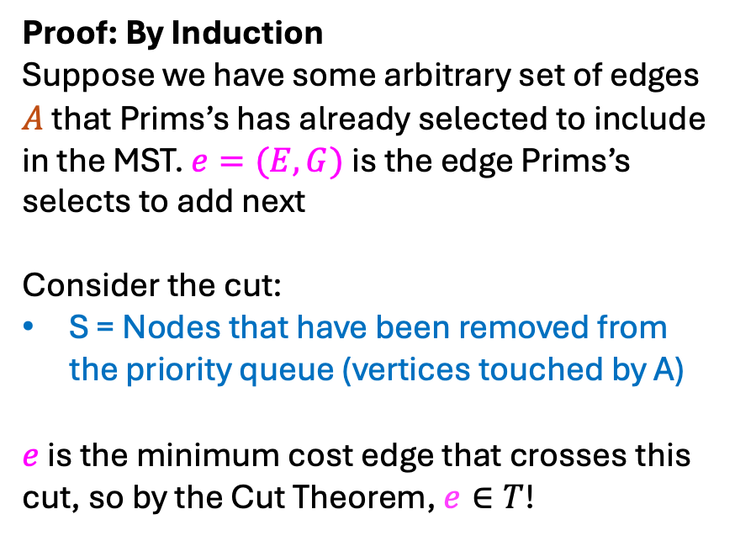
Proof of Prim’s Algorithm
Proof: By Induction
Suppose we have some arbitrary set of edges $A$ that Prims’s has already selected to include in the MST. $e=(E,G)$is the edge Prims’s selects to add next
Consider the cut:
S = Nodes that have been removed from the priority queue (vertices touched by A)
$e$ is the minimum cost edge that crosses this cut, so by the Cut Theorem, $e∈T$!
Start with an empty tree $A$
Repeat $V−1$ times:
Add the min-weight edge that connects
to a node not currently in the tree
$$S$$
B
8
10
E
6
7
H
A
9
$$e$$
2
D
5
9
I
12
3
C
3
11
G
1
F
7

Slide 7
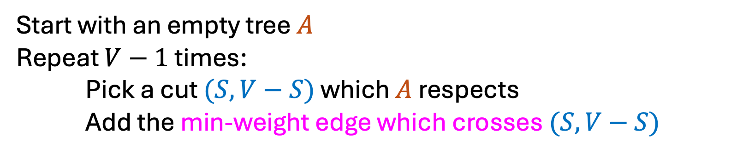
General MST Algorithm
Start with an empty tree $A$
Repeat $V−1$ times:
Pick a cut $(S,V−S)$ which $A$ respects
Add the min-weight edge which crosses $(S,V−S)$
B
8
10
E
8
7
H
A
9
2
D
5
9
I
12
3
C
3
11
G
1
F
6

Slide 8

Kruskal’s Algorithm
Start with an empty tree $A$
Add to $A$ the lowest-weight edge that does not create a cycle
B
8
10
E
8
7
H
A
9
2
D
5
9
I
12
3
C
3
11
G
1
F
6

Slide 9
Kruskal’s Algorithm
Start with an empty tree $A$
Add to $A$ the lowest-weight edge that does not create a cycle
B
8
10
E
8
7
H
A
9
2
D
5
9
I
12
3
C
3
11
G
1
F
6

Slide 10
Kruskal’s Algorithm
Start with an empty tree $A$
Add to $A$ the lowest-weight edge that does not create a cycle
B
8
10
E
8
7
H
A
9
2
D
5
9
I
12
3
C
3
11
G
1
F
6

Slide 11
Kruskal’s Algorithm
Start with an empty tree $A$
Add to $A$ the lowest-weight edge that does not create a cycle
B
8
10
E
8
7
H
A
9
2
D
5
9
I
12
3
C
3
11
G
1
F
6

Slide 12
Kruskal’s Algorithm
Start with an empty tree $A$
Add to $A$ the lowest-weight edge that does not create a cycle
B
8
10
E
8
7
H
A
9
2
D
5
9
I
12
3
C
3
11
G
1
F
6

Slide 13
Kruskal’s Algorithm
Start with an empty tree $A$
Add to $A$ the lowest-weight edge that does not create a cycle
B
8
10
E
8
7
H
A
9
2
D
5
9
I
12
3
C
3
11
G
1
F
6

Slide 14
Correctness of Kruskal’s Algorithm
It’s sufficient to just show that it follows the template of our “General MST Algorithm”
  Show that for every edge chosen, it is the least-weight edge which crosses some cut that respects all already-chosen edges.

Slide 15

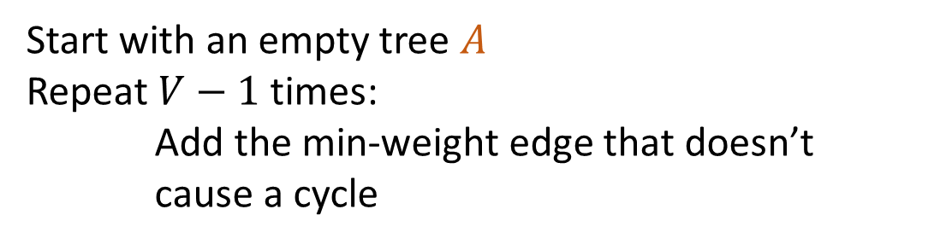
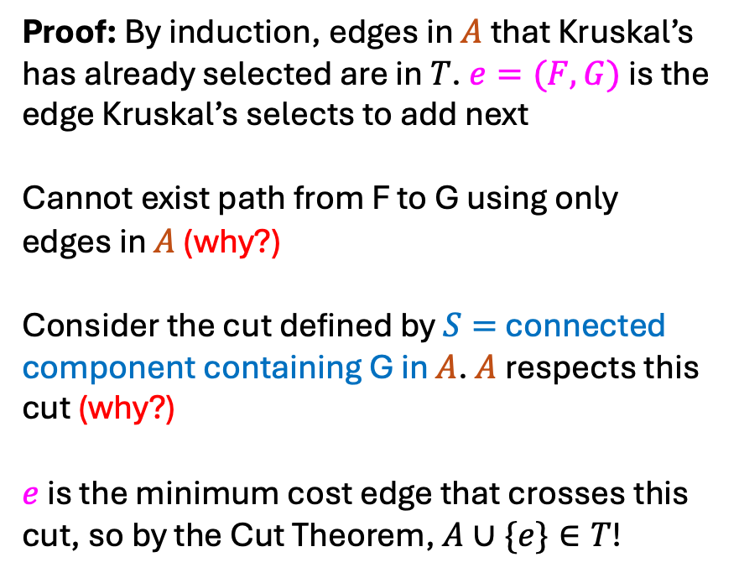

Proof of Kruskal’s Algorithm
Start with an empty tree $A$
Repeat $V−1$ times:
Add the min-weight edge that doesn’t cause a cycle
Proof: By induction, edges in $A$ that Kruskal’s has already selected are in $T$. $e=(F,G)$is the edge Kruskal’s selects to add next
Cannot exist path from F to G using only edges in $A$ (why?)
Consider the cut defined by $S=$ connected component containing G in $A$. $A$respects this cut (why?)
$e$ is the minimum cost edge that crosses this cut, so by the Cut Theorem, $A∪\{e\}∈T$!
B
8
10
E
8
7
H
A
9
2
D
5
9
I
12
3
C
3
$$e$$
11
G
1
F
6
$$S$$

Slide 16
Parallelism

Slide 17
Parallelism Vs. Concurrency (with Potatoes)
Sequential:
  The task is completed by just one processor doing one thing at a time
  There is one cook who peels all the potatoes
Parallelism:
  One task being completed by many threads/processors
  Recruit several cooks to peel a lot of potatoes faster
Concurrency:
  Parallel tasks using a shared resource
  Several cooks are making their own recipes, but there is only 1 oven

Slide 18
New Story of Code Execution
Old Story:
  One program counter (current line of code)
  One call stack (with each stack frame holding local variables)
  Objects in the heap created by memory allocation (i.e., new ___)
    (nothing to do with data structure called a heap)
New Story:
  Collection of threads each with its own:
    Program Counter
    Call Stack
    Local Variables
    References to objects in a shared heap

Slide 19
Old Story
Heap Containing Objects and Static Fields
Call Stack
Program Counter
Local Variables (primitives and references to Heap objects)

Slide 20
New Story
Heap Containing Objects and Static Fields
Threads, each with its own unshared:
Call Stack
Program Counter
Local Variables (primitives and references to Heap objects)

Slide 21
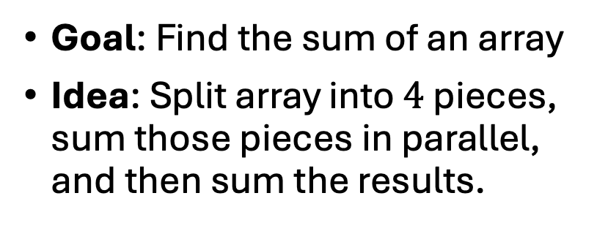
Running Example: Summing an Array
Goal: Find the sum of an array
Idea: Split array into $4$ pieces, sum those pieces in parallel, and then sum the results.
Input: array (arr) of integers
In parallel: split array into 4 equal pieces, sum up those four pieces.
  res[i] = sum arr[i*len/4, (i+1)*len/4]
Return res[0] + res[1] + res[2] + res[3]
Needs from Programming language
  Way to create threads, and run them in parallel
  Way to access shared memory (refs to common objects)
  Way to synchronize threads (wait until finished)
    Cannot sum res[0] + … + res[3] until each thread has finished!

Slide 22
Accomplishing this in Java (Java.lang.Thread)
Create class C extending java.lang.Thread
  C must have a run method (acts as main)
Call C’s start method to
  create a new thread (i.e. parallel task, not Thread object in java)
  execute run in that separate, parallel thread
Calling “run” directly causes the program to execute “run” sequentially

Slide 23
First Attempt (part 1, Defining Thread Object)
class SumThread extends java.lang.Thread {
int lo; int hi; int[] arr; int ans = 0;
SumThread(int[] a, int l, int h) {
lo=l; hi=h; arr=a;
}
public void run() { //override, must have this signature
// no arguments and no return allowed
// must use the object’s fields for input/output
for(int i=lo; i < hi; i++)
ans += arr[i];
}

Slide 24
First Attempt (part 2, Creating Thread Objects)
static int parallelSum(int[] arr){ // this method could be anywhere
int len = arr.length;
int ans = 0;
SumThread[] threads = new SumThread[4];
for(int i=0; i < 4; i++) // create threads
threads[i] = new SumThread(arr, i*len/4, (i+1)*len/4);
// more stuff to follow
}
class SumThread extends java.lang.Thread {
int lo, int hi, int[] arr; int ans = 0;
SumThread(int[] a, int l, int h) { … }
public void run(){ … } // override
}

Slide 25
First Attempt (part 3, Running Thread Objects)
static int parallelSum(int[] arr){ // this method could be anywhere
int len = arr.length;
int ans = 0;
SumThread[] threads = new SumThread[4];
for(int i=0; i < 4; i++){ // create threads, do parallel computations
threads[i] = new SumThread(arr,i*len/4,(i+1)*len/4);
threads[i].start(); // start not run
}
for(int i=0; i < 4; i++) // combine results
ans += threads[i].ans;
return ans;
}
class SumThread extends java.lang.Thread {
int lo, int hi, int[] arr; int ans = 0;
SumThread(int[] a, int l, int h) { … }
public void run(){ … } // override
}

Slide 26
First Attempt (part 4, Synchronizing)
static int parallelSum(int[] arr){ // this method could be anywhere
int len = arr.length;
int ans = 0;
SumThread[] threads = new SumThread[4];
for(int i=0; i < 4; i++){ // do parallel computations
threads[i] = new SumThread(arr,i*len/4,(i+1)*len/4);
threads[i].start(); // start not run
}
for(int i=0; i < 4; i++){ // combine results
threads[i].join(); // wait for thread to finish!
ans += threads[i].ans;
}
return ans;
}
class SumThread extends java.lang.Thread {
int lo, int hi, int[] arr; int ans = 0;
SumThread(int[] a, int l, int h) { … }
public void run(){ … } // override
}

Slide 27
Join
Causes program to pause until the other thread completes its run method
Avoids a race condition
  Without join the other thread’s ans field may not have its final answer yet

Slide 28
Recap so far
Way to create threads, and run them in parallel
  C extends java.lang.Thread
  C.start()
Way to wait for threads to finish
  C.join()

Slide 29
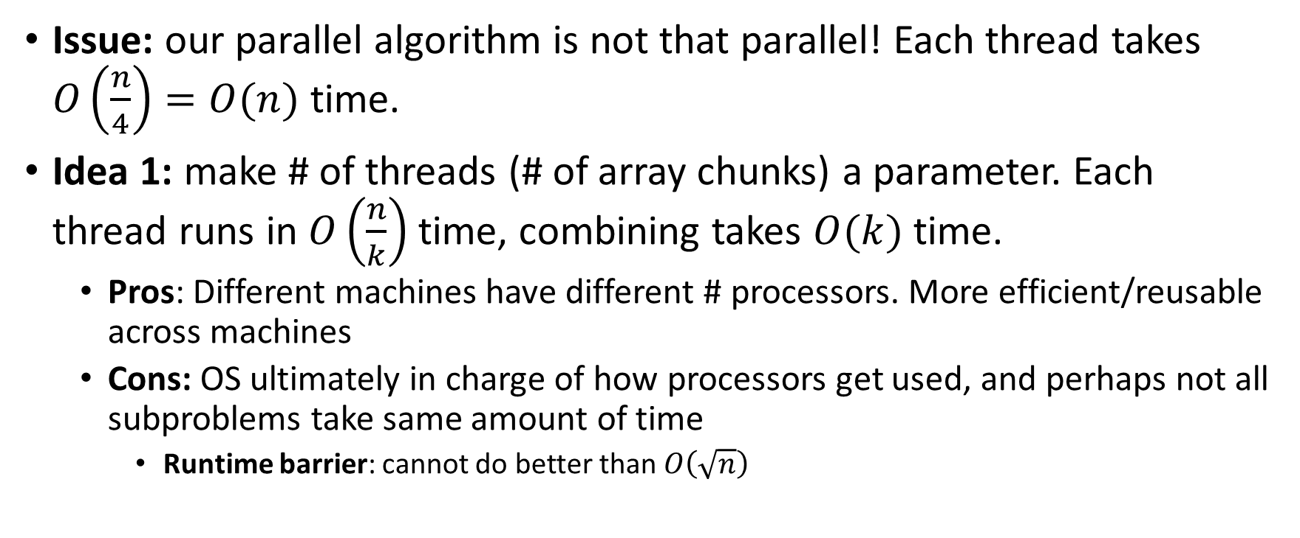
More Threads?
Issue: our parallel algorithm is not that parallel! Each thread takes $O\left(\frac{n}{4}\right)=O(n)$ time.
Idea 1: make # of threads (# of array chunks) a parameter. Each thread runs in $O\left(\frac{n}{k}\right)$ time, combining takes $O(k)$ time.
  Pros: Different machines have different # processors. More efficient/reusable across machines
  Cons: OS ultimately in charge of how processors get used, and perhaps not all subproblems take same amount of time
    Runtime barrier: cannot do better than $O\left(\sqrt{n}\right)$

Slide 30
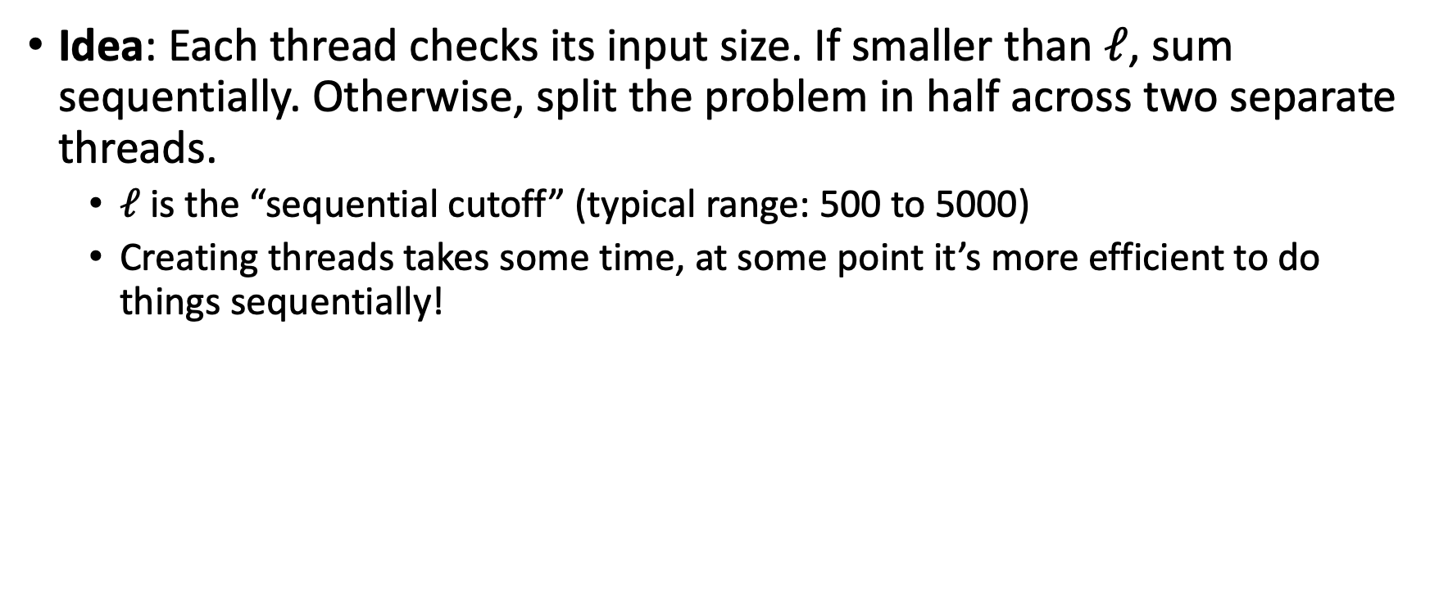
A Better Solution: Divide and Conquer!
Idea: Each thread checks its input size. If smaller than $ℓ$, sum sequentially. Otherwise, split the problem in half across two separate threads.
  $ℓ$ is the “sequential cutoff” (typical range: 500 to 5000)
  Creating threads takes some time, at some point it’s more efficient to do things sequentially!

Slide 31
Merge Sort
5
8
2
9
4
1
Base Case:
  If the list is of length 1 or 0, it’s already sorted, so just return it
Divide:
  Split the list into two “sublists” of (roughly) equal length
Conquer:
  Sort both lists recursively
Combine:
  Merge sorted sublists into one sorted list
5
5
8
2
9
4
1
2
5
8
1
4
9
2
5
8
1
4
9
1
2
4
5
8
9

Slide 32
Parallel Sum
5
8
2
9
4
1
5
Base Case:
  If the list’s length is smaller than the Sequential Cutoff, find the sum sequentially
Divide:
  Split the list into two “sublists” of (roughly) equal length, create a thread to sum each sublist.
Conquer:
  Call start() for each thread
Combine:
  Sum together the answers from each thread
5
8
2
9
4
1
ans=15
ans=14
ans=29

Slide 33
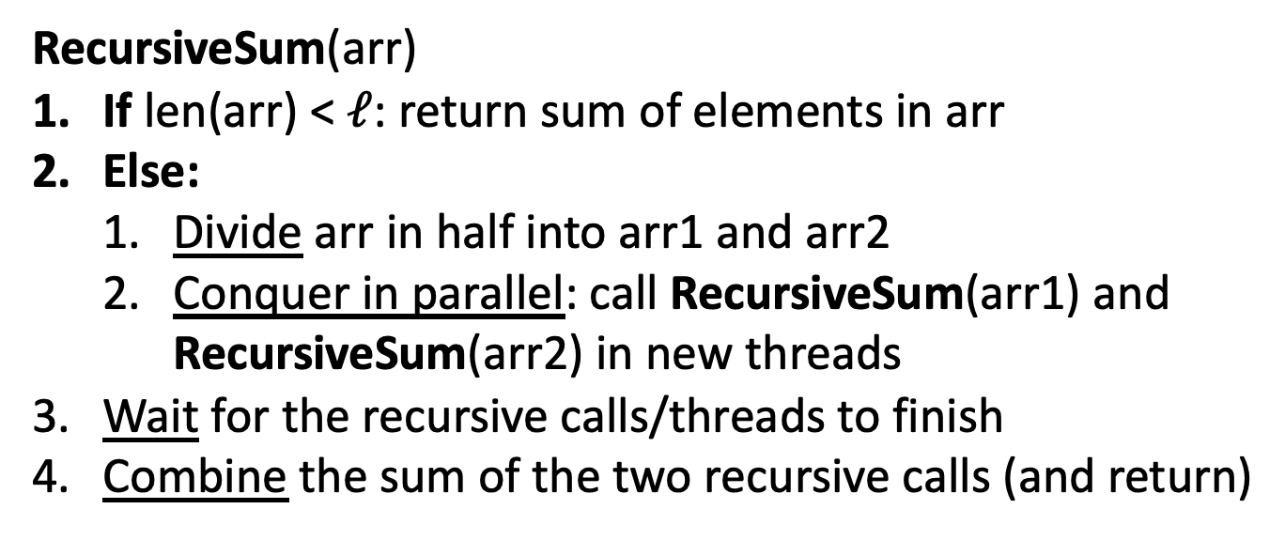
Parallel Divide and Conquer Pseudocode
RecursiveSum(arr)
If len(arr) < $ℓ$: return sum of elements in arr
Else:
  Divide arr in half into arr1 and arr2
  Conquer in parallel: call RecursiveSum(arr1) and RecursiveSum(arr2) in new threads
Wait for the recursive calls/threads to finish
Combine the sum of the two recursive calls (and return)

Slide 34
Divide and Conquer with Java Threads
class SumThread extends java.lang.Thread {
public void run(){ // override
if(hi – lo < SEQUENTIAL_CUTOFF) // “base case”
for(int i=lo; i < hi; i++) ans += arr[i];
else {
SumThread left = new SumThread(arr,lo,(hi+lo)/2); // divide
SumThread right= new SumThread(arr,(hi+lo)/2,hi); // divide
left.start(); right.start(); // conquer
left.join(); right.join(); // wait
ans = left.ans + right.ans; // combine
}
}
}
int sum(int[] arr){ // just make one thread!
SumThread t = new SumThread(arr,0,arr.length);
t.run();
return t.ans; }

Slide 35
Small optimization
Instead of calling two separate threads for the two subproblems, create one parallel thread (using start) and one sequential thread (using run)

Slide 36
Divide and Conquer with Threads (optimized)
class SumThread extends java.lang.Thread {
public void run(){ // override
if(hi – lo < SEQUENTIAL_CUTOFF) // “base case”
for(int i=lo; i < hi; i++) ans += arr[i];
else {
SumThread left = new SumThread(arr,lo,(hi+lo)/2); // divide
SumThread right= new SumThread(arr,(hi+lo)/2,hi); // divide
left.start(); // conquer in parallel in new thread
right.run(); // conquer in this thread
left.join(); // don’t move this up a line – why?
//right.join();
ans = left.ans + right.ans; // combine
}
}
}
int sum(int[] arr){ // just make one thread!
SumThread t = new SumThread(arr,0,arr.length);
t.run();
return t.ans; }

