Slide 1
CSE 332 Summer 2026
Lecture 11: Sorting 2
Michael Whitmeyer
http://www.cs.uw.edu/332

Slide 2
Properties To Consider
Worst case running time
In place:
  We only need to use the pre-existing array to do sorting
  Constant extra space (only some additional variables needed)
Adaptive
  The running improves as the given list is closer to being sorted
  It should be linear time for a pre-sorted list, and nearly linear time if the list is nearly sorted
Online
  We can start sorting before we have the entire list.
Stable
  “Tied” elements keep their original order

Slide 3
Divide And Conquer Sorting
Divide and Conquer:
  Recursive algorithm design technique
  Solve a large problem by breaking it up into smaller versions of the same problem

Slide 4
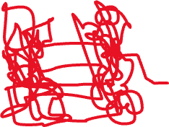

Divide and Conquer
Base Case:
  If the problem is “small” then solve directly and return
Divide:
  Break the problem into subproblem(s), each smaller instances
Conquer:
  Solve subproblem(s) recursively
Combine:
  Use solutions to subproblems to solve original problem
A

Slide 5
Merge Sort Pseudocode
mergesort(L):
ms_helper(L, 0, L.length())
mshelper(L, low, high):
IF (low == high) RETURN // Base Case
mid = (low+high)/2
ms_helper(low, mid)
ms_helper(mid+1, high)
merge(L, low, mid, high)

Slide 6
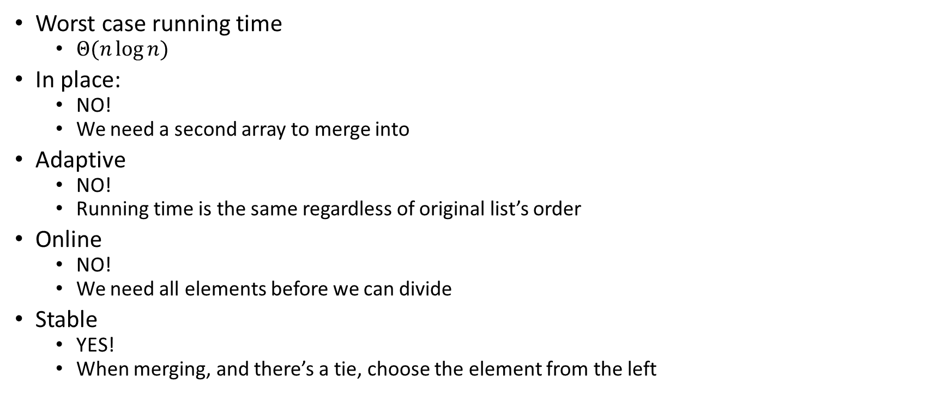
Merge Sort Properties
Worst case running time
  $Θ(n\log{n})$
In place:
  NO!
  We need a second array to merge into
Adaptive
  NO!
  Running time is the same regardless of original list’s order
Online
  NO!
  We need all elements before we can divide
Stable
  YES!
  When merging, and there’s a tie, choose the element from the left

Slide 7

Quicksort Vs. Mergesort
Like Mergesort:
  Divide and conquer
  $O(n\log{n})$ run time (kind of…)
Unlike Mergesort:
  Divide step is the “hard” part
  Typically faster than Mergesort

Slide 8
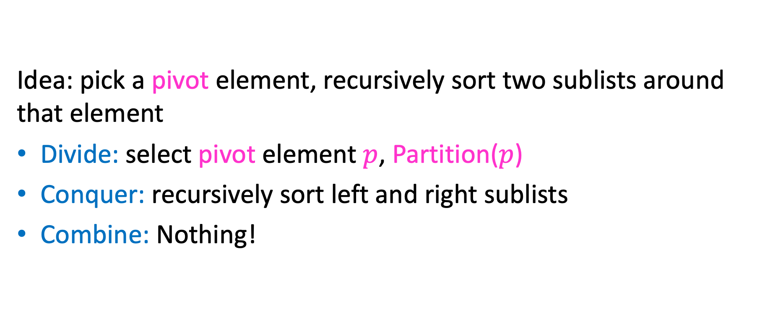
Quicksort Overview
Idea: pick a pivot element, recursively sort two sublists around that element
Divide: select pivot element $p$, Partition($p$)
Conquer: recursively sort left and right sublists
Combine: Nothing!

Slide 9


Partition (Divide step)
Given: a list, a pivot $p$
Start: unordered list
8
5
7
3
12
10
1
2
4
9
6
11
Goal: All elements $<p$ on left, all $>p$ on right
5
7
3
1
2
4
6
8
12
10
9
11

Slide 10
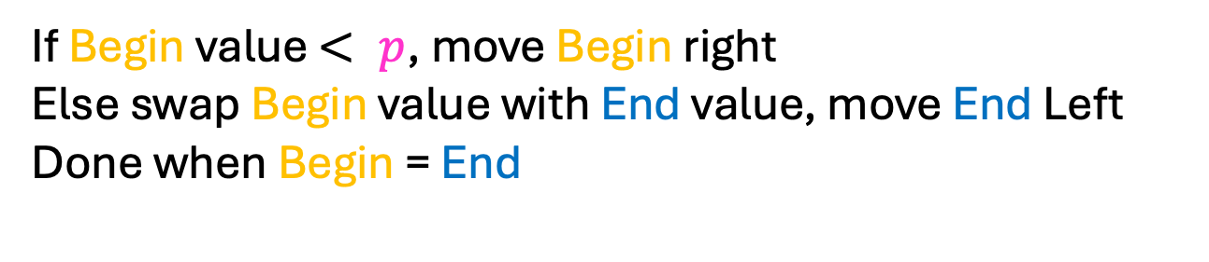
Partition Procedure (Slide 1 of 2)
If Begin value $< p$, move Begin right
Else swap Begin value with End value, move End Left
Done when Begin = End
8
5
7
3
12
10
1
2
4
9
6
11
8
5
7
3
12
10
1
2
4
9
6
11
8
5
7
3
12
10
1
2
4
9
6
11
8
5
7
3
11
10
1
2
4
9
6
12

Slide 11
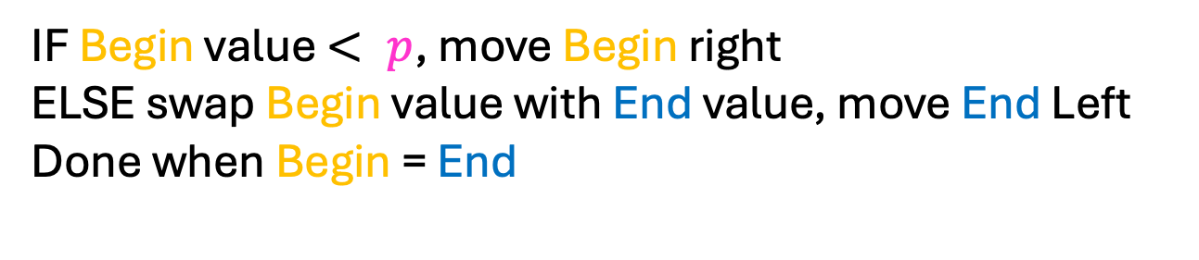
Partition Procedure (Slide 2 of 2)
IF Begin value $< p$, move Begin right
ELSE swap Begin value with End value, move End Left
Done when Begin = End
8
5
7
3
11
10
1
2
4
9
6
12
8
5
7
3
6
10
1
2
4
9
11
12
8
5
7
3
6
10
1
2
4
9
11
12
8
5
7
3
6
9
1
2
4
10
11
12

Slide 12
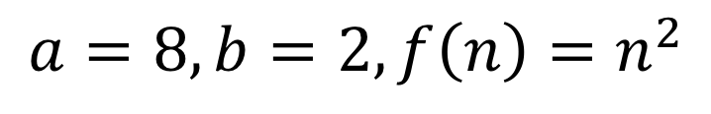
Partition – Begin Meets End (Case 1)
If Begin value $< p$, move Begin right
Else swap Begin value with End value, move End Left
Done when Begin = End
8
5
7
3
6
4
1
2
10
9
11
12
Case 1: meet at element $<p$
Swap $p$ with pointer position (2 in this case)
2
5
7
3
6
4
1
8
10
9
11
12

Slide 13
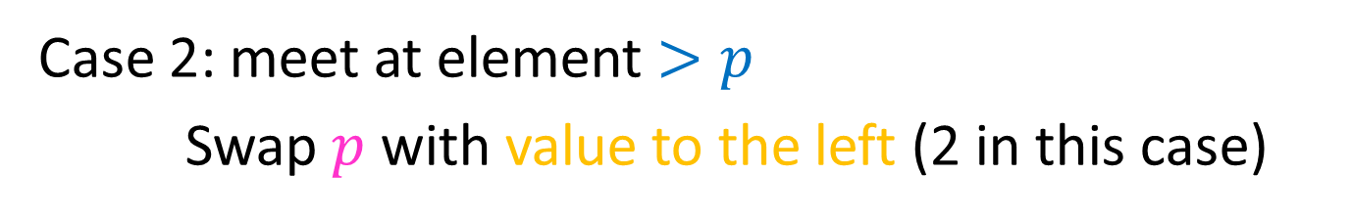
Partition – Begin Meets End (Case 2)
If Begin value $< p$, move Begin right
Else swap Begin value with End value, move End Left
Done when Begin = End
8
5
7
3
6
4
1
2
10
9
11
12
Case 2: meet at element $>p$
Swap $p$ with value to the left (2 in this case)
2
5
7
3
6
4
1
8
10
9
11
12

Slide 14
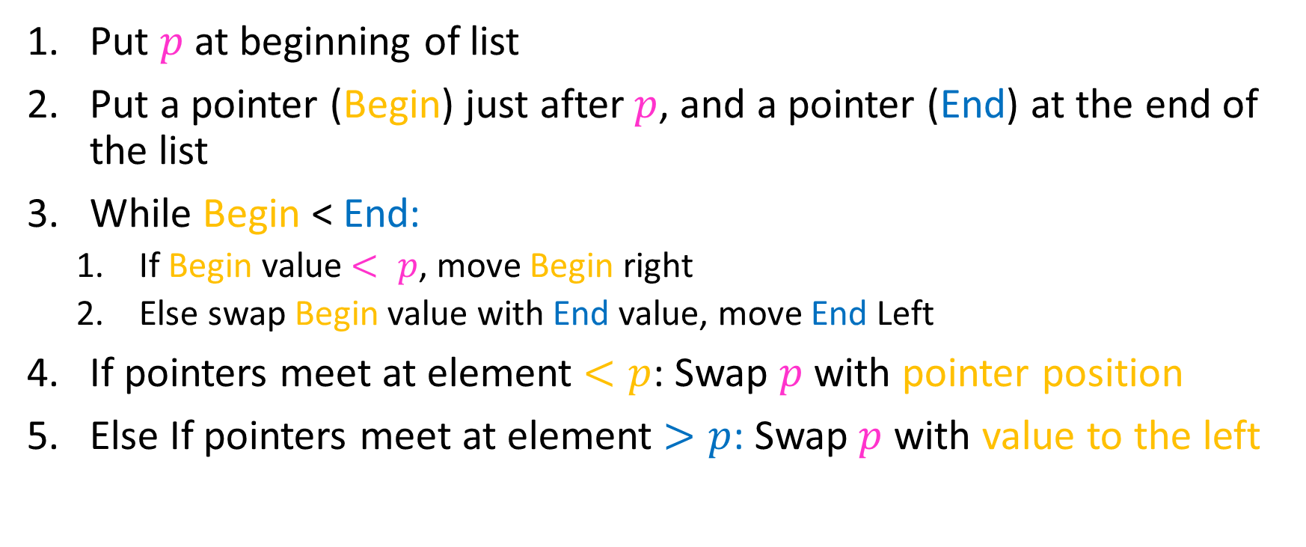
Partition Summary
Put $p$ at beginning of list
Put a pointer (Begin) just after $p$, and a pointer (End) at the end of the list
While Begin < End:
  If Begin value $< p$, move Begin right
  Else swap Begin value with End value, move End Left
If pointers meet at element $<p$: Swap $p$ with pointer position
Else If pointers meet at element $>p$: Swap $p$ with value to the left
Run time?

Slide 15
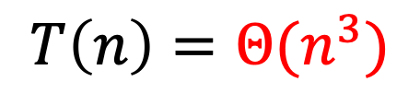
Partition Summary
Put $p$ at beginning of list
Put a pointer (Begin) just after $p$, and a pointer (End) at the end of the list
While Begin < End:
  If Begin value $< p$, move Begin right
  Else swap Begin value with End value, move End Left
If pointers meet at element $<p$: Swap $p$ with pointer position
Else If pointers meet at element $>p$: Swap $p$ with value to the left
Run time?
$$O(n)$$

Slide 16
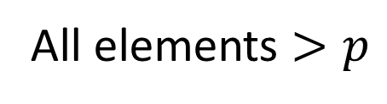
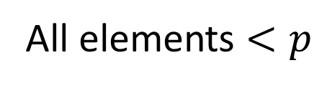
Conquer
2
5
7
3
6
4
1
8
10
9
11
12
All elements $<p$
All elements $>p$
Exactly where it belongs!
Recursively Quicksort™️ Left and Right sublists

Slide 17
Quicksort Run Time (Best)
If the pivot is always the median:
2
5
1
3
6
4
7
8
10
9
11
12
2
1
3
5
6
4
7
8
9
10
11
12
Then we divide in half each time
$$T\left(n\right)=$$

Slide 18


Quicksort Run Time (Best)
If the pivot is always the median:
2
5
1
3
6
4
7
8
10
9
11
12
2
1
3
5
6
4
7
8
9
10
11
12
Then we divide in half each time
$$T\left(n\right)=2T\left(\frac{n}{2}\right)+n$$
$$T\left(n\right)=O(n\log{n})$$

Slide 19
Quicksort Run Time (Worst)
If the pivot is always at the extreme:
1
5
2
3
6
4
7
8
10
9
11
12
1
2
3
5
6
4
7
8
10
9
11
12
Then we shorten by 1 each time
$$T\left(n\right)=$$

Slide 20

Quicksort Run Time (Worst)
If the pivot is always at the extreme:
1
5
2
3
6
4
7
8
10
9
11
12
1
2
3
5
6
4
7
8
10
9
11
12
Then we shorten by 1 each time
$$T\left(n\right)=T\left(n−1\right)+n$$
$$T\left(n\right)=O(n^{2})$$

Slide 21


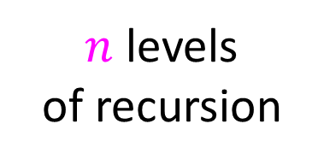


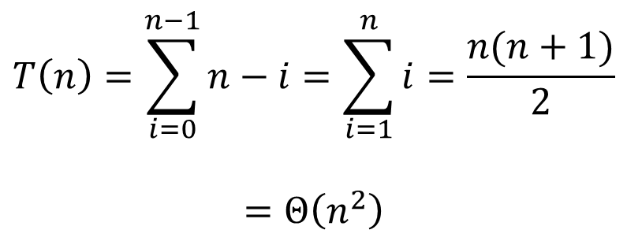







Quicksort Worst Case Tree Method
$$T\left(n\right)=T\left(n−1\right)+n$$
$$n$$
$$T\left(n\right)=\sum_{i=0}^{n−1}{n−i}=\sum_{i=1}^{n}{i}=\frac{n(n+1)}{2}$$
$$=Θ\left(n^{2}\right)$$
$$n$$
$$n−1$$
$$n−1$$
$$n−2$$
$$n−2$$
$n$ levels
of recursion
$$n−3$$
$$n−3$$
…
$$1$$
$$1$$

Slide 22
Good Pivot
What makes a good Pivot?
  Roughly even split between left and right
  Ideally: median
There are ways to find the median in linear time, but it’s complicated and slow and you’re better off using mergesort
In Practice:
  Pick a random value as a pivot
  Pick the middle of 3 random values as the pivot

Slide 23
Quick Sort Properties
Worst case running time?
In place?
Adaptive?
Online?
Stable?

Slide 24
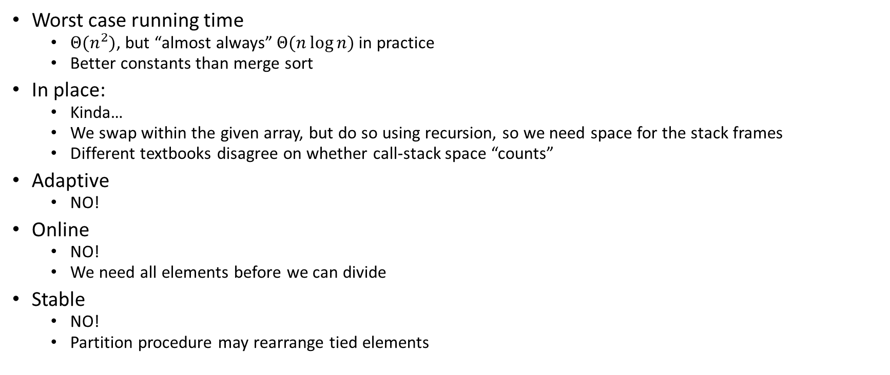
Quick Sort Properties
Worst case running time
  $Θ(n^{2})$, but “almost always” $Θ(n\log{n})$ in practice
  Better constants than merge sort
In place:
  Kinda…
  We swap within the given array, but do so using recursion, so we need space for the stack frames
  Different textbooks disagree on whether call-stack space “counts”
Adaptive
  NO!
Online
  NO!
  We need all elements before we can divide
Stable
  NO!
  Partition procedure may rearrange tied elements

Slide 25


$$O(n log n )$$
We keep seeing a worst case $O(n\log{n})$ runtime
  Merge, heap, quick (with a good pivot)
Can we do better?

Slide 26
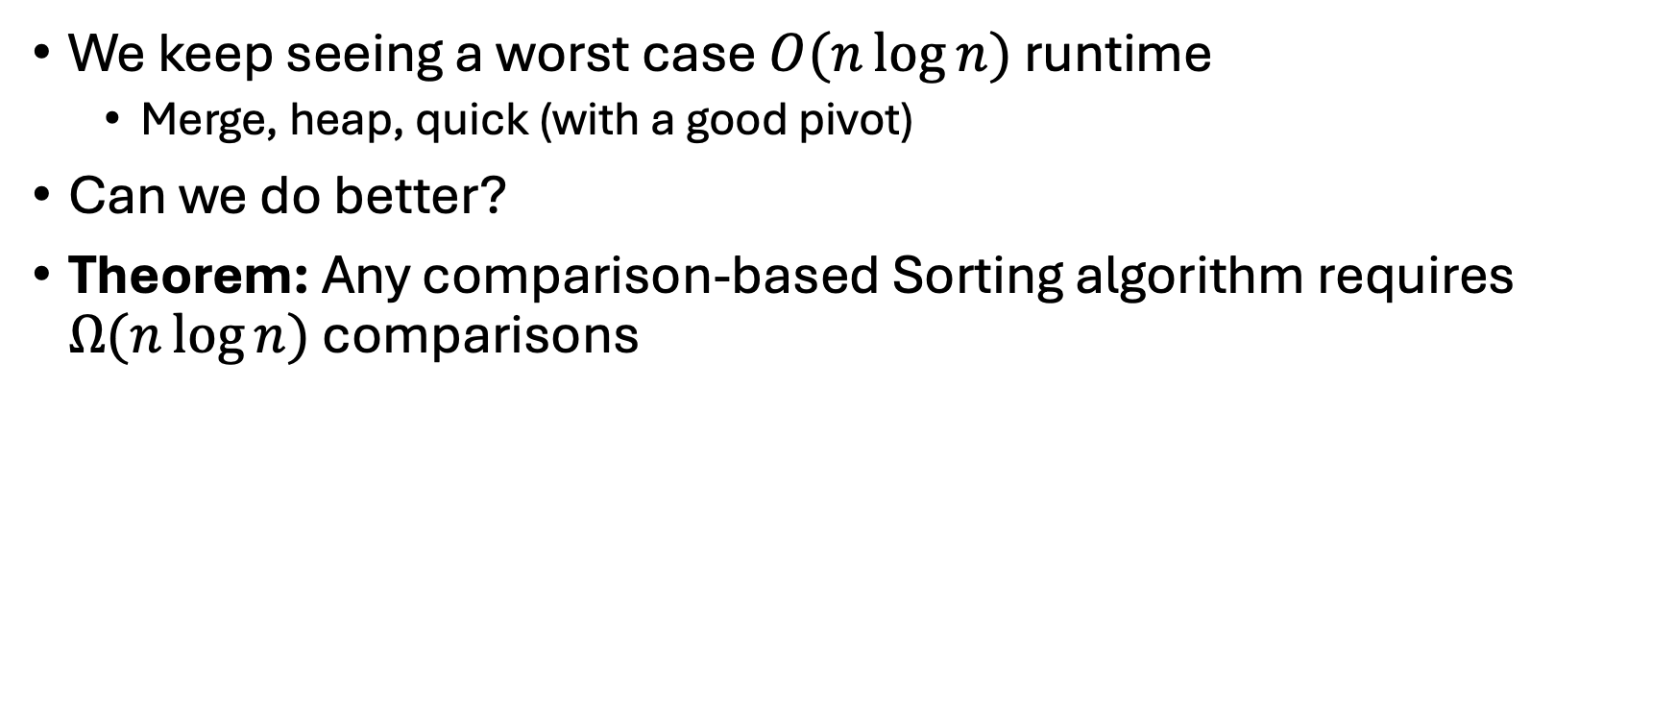

Theorem: $Ω(n log n)$
We keep seeing a worst case $O(n\log{n})$ runtime
  Merge, heap, quick (with a good pivot)
Can we do better?
Theorem: Any comparison-based Sorting algorithm requires $Ω(n\log{n})$ comparisons

Slide 27

Proving the Lower Bound
Theorem: Any comparison-based sorting algorithm requires $Ω(n\log{n})$ comparisons
Proof uses “decision trees”
  A tree showing the decisions our code will make
  Nodes of tree labelled with “$a<b$?”

Slide 28
a<b<c; a<c<b; b<a<c;
b<c<a; c<b<a; c<a<b
Ask: is
a < b?
a<b<c; a<c<b; c<a<b
b<a<c; b<c<a; c<b<a
Ask: is
b<c?
Ask: is
a<c?
a<b<c
a<c<b; c<a<b
b<a<c
b<c<a; c<b<a
Ask: is
a<c?
Ask: is
b<c?
a<c<b
c<a<b
b<c<a
c<b<a

Slide 29
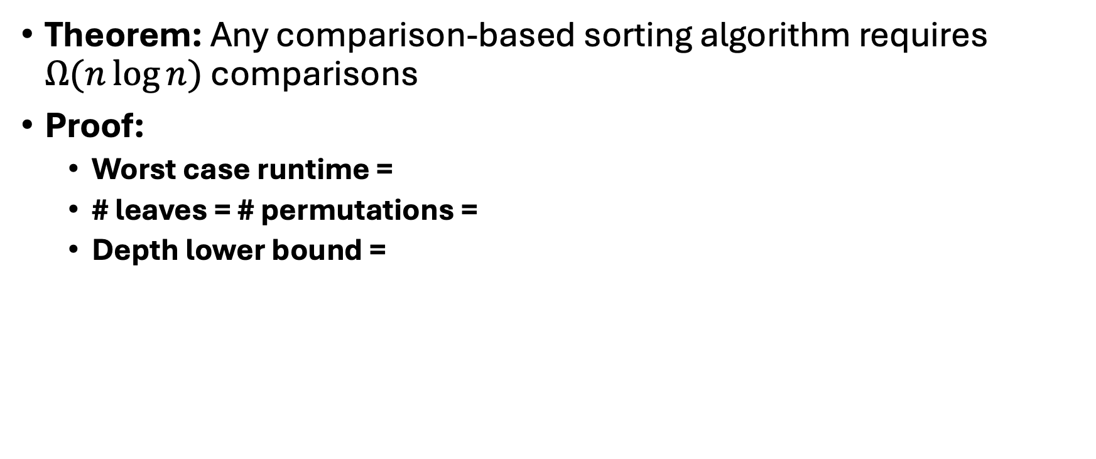
Proving the Lower Bound
Theorem: Any comparison-based sorting algorithm requires $Ω(n\log{n})$ comparisons
Proof:
  Worst case runtime =
  # leaves = # permutations =
  Depth lower bound =

Slide 30
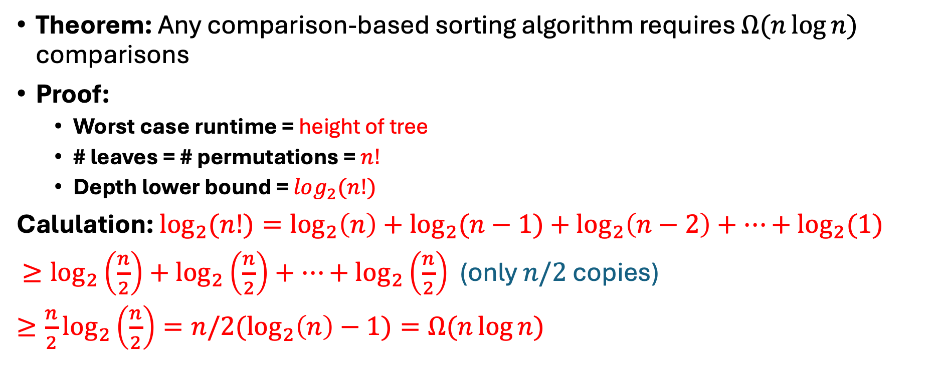
Proving the Lower Bound
Theorem: Any comparison-based sorting algorithm requires $Ω(n\log{n})$ comparisons
Proof:
  Worst case runtime = height of tree
  # leaves = # permutations = $n!$
  Depth lower bound = $log_{2}(n!)$
Calulation: $\log_{2}{(n!)}=\log_{2}\left(n\right)+\log_{2}{(n−1)}+\log_{2}\left(n−2\right)+…+\log_{2}{(1)}$
$≥\log_{2}\left(\frac{n}{2}\right)+\log_{2}\left(\frac{n}{2}\right)+…+\log_{2}\left(\frac{n}{2}\right)$ (only $n/2$ copies)
$≥\frac{n}{2}\log_{2}\left(\frac{n}{2}\right)=n/2(\log_{2}\left(n\right)−1)=Ω(n\log{n)}$

Slide 31
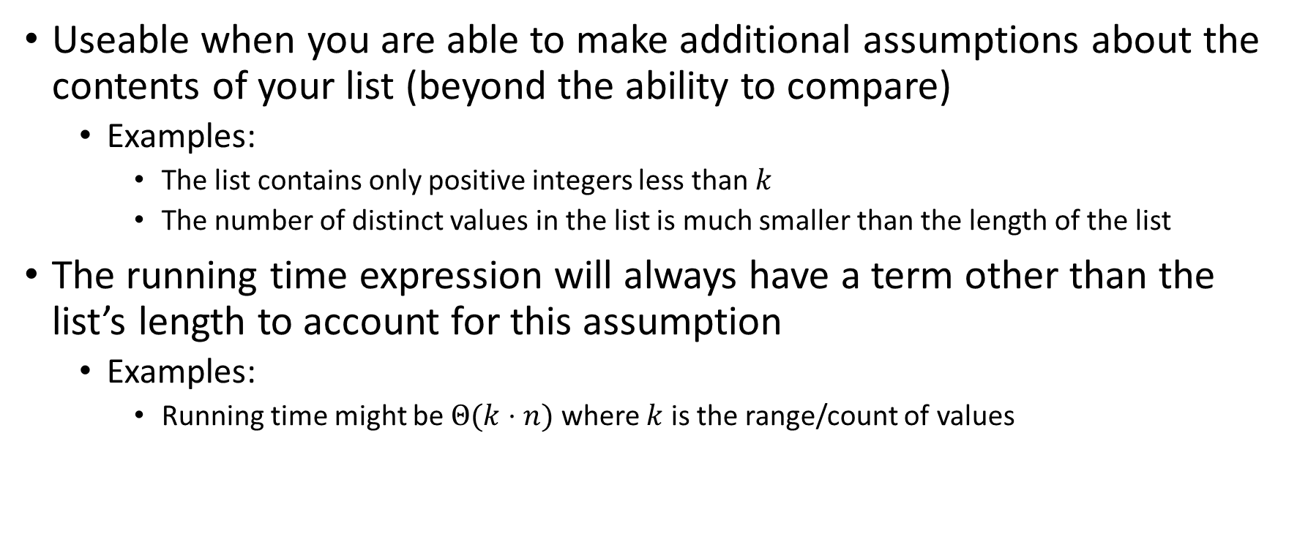
“Linear Time” Sorting Algorithms
Useable when you are able to make additional assumptions about the contents of your list (beyond the ability to compare)
  Examples:
    The list contains only positive integers less than $k$
    The number of distinct values in the list is much smaller than the length of the list
The running time expression will always have a term other than the list’s length to account for this assumption
  Examples:
    Running time might be $Θ(k⋅n)$ where $k$ is the range/count of values

Slide 32
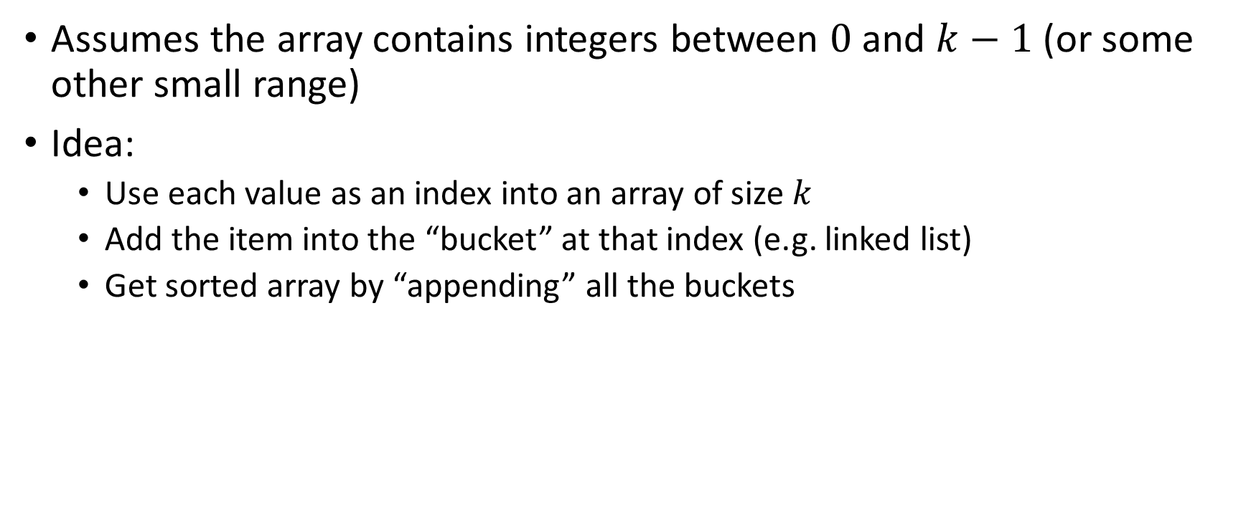
BucketSort
Assumes the array contains integers between $0$ and $k−1$ (or some other small range)
Idea:
  Use each value as an index into an array of size $k$
  Add the item into the “bucket” at that index (e.g. linked list)
  Get sorted array by “appending” all the buckets
0
0
0
0
0
1
1
2
2
2
3
3
0
2
3
0
0
1
2
1
3
0
2
0
0
0
0
0
0
1
1
2
2
2
3
3
0
1
2
3

Slide 33
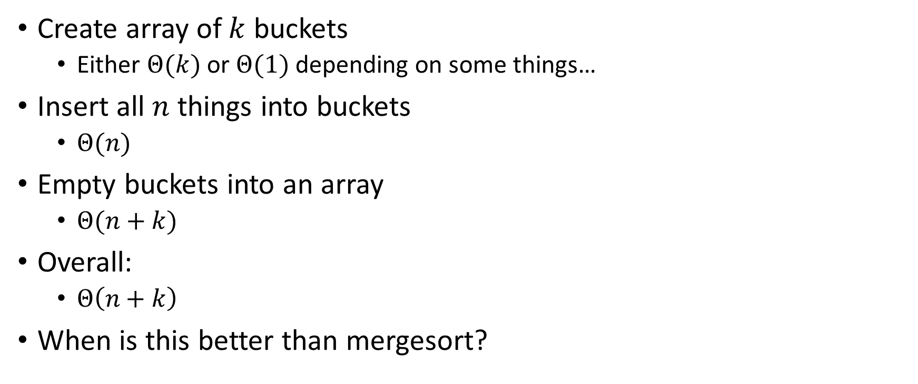
BucketSort Running Time
Create array of $k$ buckets
  Either $Θ(k)$ or $Θ(1)$ depending on some things…
Insert all $n$ things into buckets
  $Θ(n)$
Empty buckets into an array
  $Θ(n+k)$
Overall:
  $Θ\left(n+k\right)$
When is this better than mergesort?

Slide 34
Properties of BucketSort
In-Place?
Adaptive?
Stable?

Slide 35
Properties of BucketSort
In-Place?
  No
Adaptive?
  No
Stable?
  Yes!

Slide 36
RadixSort
Radix: The base of a number system
  We’ll use base 10, most implementations will use larger bases
Idea:
  BucketSort by each digit, one at a time, from least significant to most significant
103
801
401
323
255
823
999
101
113
901
555
512
245
800
018
121
0
1
2
3
4
5
6
7
8
9
10
11
12
13
14
15
800
801
401
101
901
121
512
103
323
823
113
255
555
245
018
999
Place each element into a “bucket” according to its 1’s place
0
1
2
3
4
5
6
7
8
9

Slide 37
RadixSort – Re-Bucket by 10s
Radix: The base of a number system
  We’ll use base 10, most implementations will use larger bases
Idea:
  BucketSort by each digit, one at a time, from least significant to most significant
800
801
401
101
901
121
512
103
323
823
113
255
555
245
018
999
800
801
401
101
901
103
512
113
018
121
323
823
245
255
555
999
0
1
2
3
4
5
6
7
8
9
Place each element into a “bucket” according to its 10’s place
0
1
2
3
4
5
6
7
8
9

Slide 38
RadixSort – Re-Bucket by 100s
Radix: The base of a number system
  We’ll use base 10, most implementations will use larger bases
Idea:
  BucketSort by each digit, one at a time, from least significant to most significant
800
801
401
101
901
103
512
113
018
121
323
823
245
255
555
999
018
101
103
113
121
245
255
323
401
512
555
800
801
823
901
999
0
1
2
3
4
5
6
7
8
9
Place each element into a “bucket” according to its 100’s place
0
1
2
3
4
5
6
7
8
9

Slide 39
RadixSort – Empty Buckets into Output Array
Radix: The base of a number system
  We’ll use base 10, most implementations will use larger bases
Idea:
  BucketSort by each digit, one at a time, from least significant to most significant
018
101
103
113
121
245
255
323
401
512
555
800
801
823
901
999
Convert back into an array
0
1
2
3
4
5
6
7
8
9
018
101
103
113
121
245
255
323
401
512
555
800
801
823
901
999
0
1
2
3
4
5
6
7
8
9
10
11
12
13
14
15

Slide 40
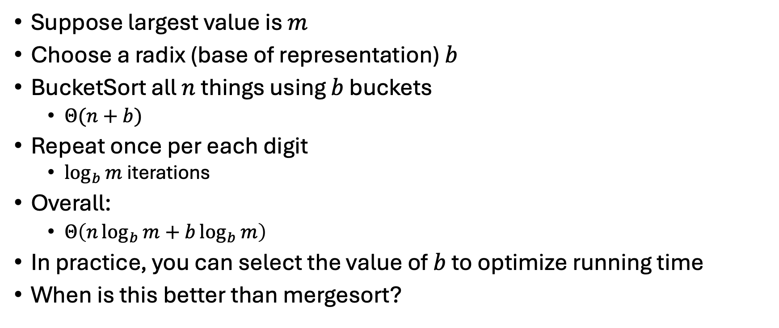
RadixSort Running Time
Suppose largest value is $m$
Choose a radix (base of representation) $b$
BucketSort all $n$ things using $b$ buckets
  $Θ(n+b)$
Repeat once per each digit
  $\log_{b}{m}$ iterations
Overall:
  $Θ\left(n\log_{b}{m}+b\log_{b}{m}\right)$
In practice, you can select the value of $b$ to optimize running time
When is this better than mergesort?

