Slide 1
CSE 332 Summer 2026
Lecture 10: Sorting
Michael Whitmeyer
http://www.cs.uw.edu/332

Slide 2
Sorting
Rearrangement of items into some defined sequence
  Usually: reordering a list from smallest to largest according to some metric
Why sort things?
  Enable things like binary search
    It makes some algorithms faster
  Nicer for human algorithms too
  Data organization

Slide 3
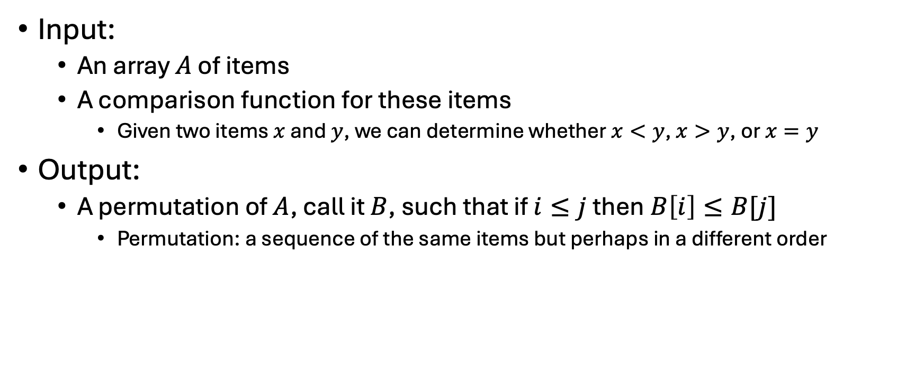
Sorting Algorithm: Formal Definition
Input:
  An array $A$ of items
  A comparison function for these items
    Given two items $x$ and $y$, we can determine whether $x<y$, $x>y$, or $x=y$
Output:
  A permutation of $A$, call it $B$, such that if $i≤j$ then$B\left[i\right]≤B[j]$
    Permutation: a sequence of the same items but perhaps in a different order

Slide 4
Sorting “Landscape”
There is no singular best algorithm for sorting
Some are faster, some are slower
Some use more memory, some use less
Some are super fast if your data satisfies assumptions
Some have other special properties that make them valuable
No sorting algorithm can have only all the “best” attributes

Slide 5
Insertion Sort
Idea: Maintain a sorted list prefix, extend that prefix by “inserting” the next element
Sorted Prefix
3
5
7
8
10
12
9
2
4
6
1
11

Slide 6
Insertion Sort
Idea: Maintain a sorted list prefix, extend that prefix by “inserting” the next element
Sorted Prefix
3
5
7
8
10
12
9
2
4
6
1
11
3
5
7
8
10
9
12
2
4
6
1
11

Slide 7
Insertion Sort
Idea: Maintain a sorted list prefix, extend that prefix by “inserting” the next element
Sorted Prefix
3
5
7
8
10
12
9
2
4
6
1
11
3
5
7
8
10
9
12
2
4
6
1
11
3
5
7
8
9
10
12
2
4
6
1
11

Slide 8
Insertion Sort
Idea: Maintain a sorted list prefix, extend that prefix by “inserting” the next element
Sorted Prefix
3
5
7
8
10
12
9
2
4
6
1
11
3
5
7
8
10
9
12
2
4
6
1
11
3
5
7
8
9
10
12
2
4
6
1
11
Sorted Prefix
3
5
7
8
9
10
12
2
4
6
1
11

Slide 9
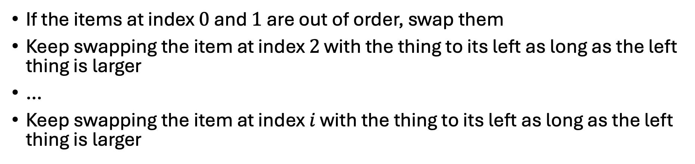
Insertion Sort - Summary
If the items at index $0$ and $1$ are out of order, swap them
Keep swapping the item at index $2$ with the thing to its left as long as the left thing is larger
…
Keep swapping the item at index $i$ with the thing to its left as long as the left thing is larger
Running Time?
Worst Case:
Best Case:

Slide 10
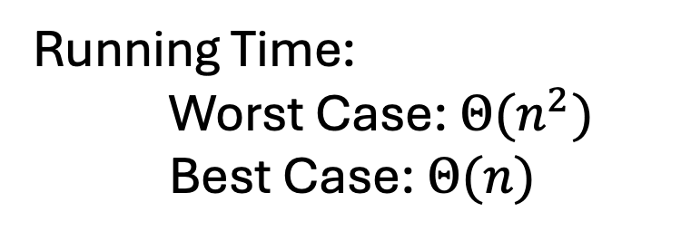
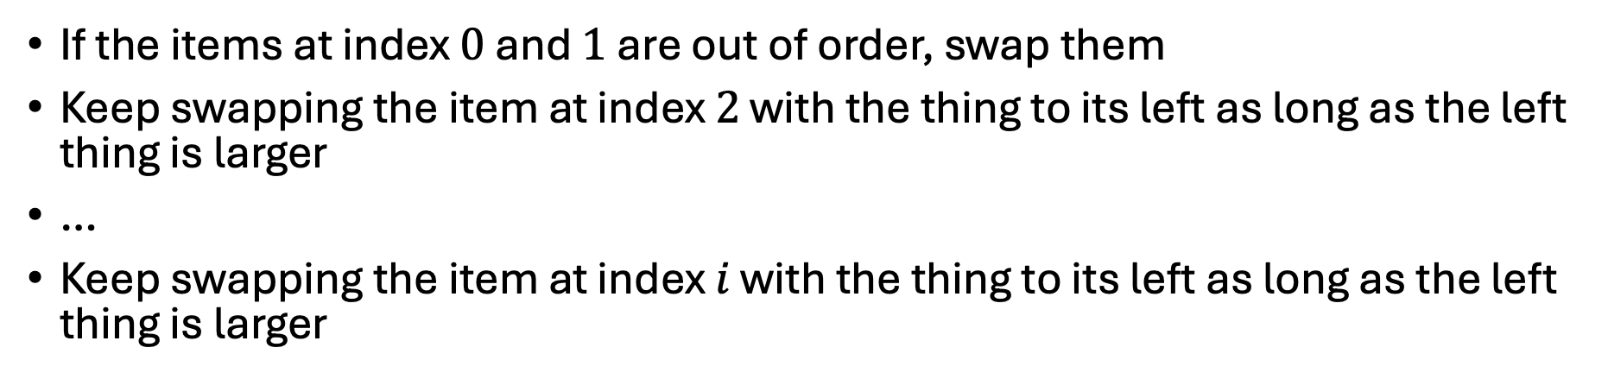
Insertion Sort - Summary
If the items at index $0$ and $1$ are out of order, swap them
Keep swapping the item at index $2$ with the thing to its left as long as the left thing is larger
…
Keep swapping the item at index $i$ with the thing to its left as long as the left thing is larger
Running Time:
Worst Case: $Θ(n^{2})$
Best Case: $Θ(n)$

Slide 11
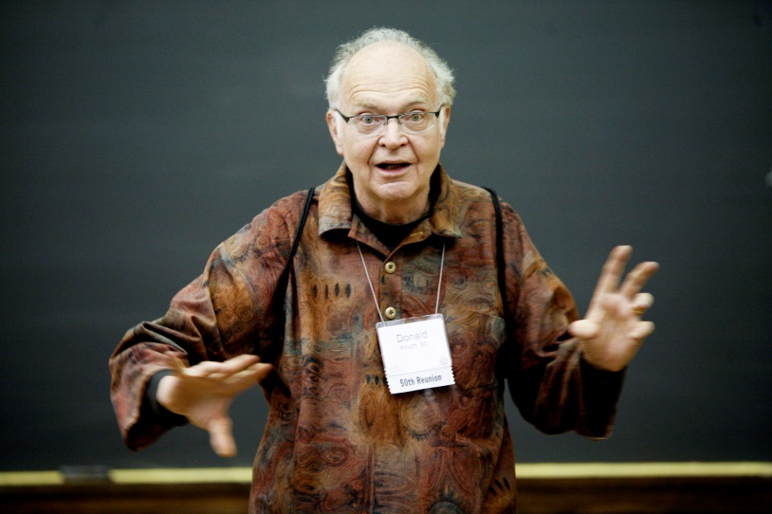
Aside: Bubble Sort – we won’t cover it
"the bubble sort seems to have nothing to recommend it, except a catchy name and the fact that it leads to some interesting theoretical problems” –Donald Knuth, The Art of Computer Programming

Slide 12
Properties To Consider
Worst case running time
In place:
  We only need to use the pre-existing array to do sorting
  Constant extra space (only some additional variables needed)
Adaptive
  The running improves as the given list is closer to being sorted
  It should be linear time for a pre-sorted list, and nearly linear time if the list is nearly sorted
Online
  We can start sorting before we have the entire list.
Stable
  “Tied” elements keep their original order

Slide 13
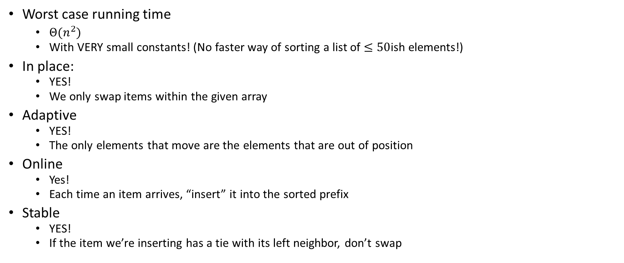
Insertion Sort Properties
Summary: except for its asymptotic running time, it has everything you might want!
Worst case running time
  $Θ(n^{2})$
  With VERY small constants! (No faster way of sorting a list of $≤50$ish elements!)
In place:
  YES!
  We only swap items within the given array
Adaptive
  YES!
  The only elements that move are the elements that are out of position
Online
  Yes!
  Each time an item arrives, “insert” it into the sorted prefix
Stable
  YES!
  If the item we’re inserting has a tie with its left neighbor, don’t swap

Slide 14
Heap Sort
Idea: Build a maxHeap, repeatedly extract the max element from the heap to build sorted list Right-to-Left
10
9
0
6
Max Heap Property: Each node is larger than its children
8
1
7
5
2
2
3
4
5
6
4
1
3
7
8
9
10
9
6
8
7
5
2
4
1
3
0
1
2
3
4
5
6
7
8
9

Slide 15
Heap Sort (Example)
Idea: Build a maxHeap, repeatedly extract the max element from the heap to build sorted list Right-to-Left
10
9
0
6
Max Heap Property: Each node is larger than its children
8
1
7
5
2
2
3
4
5
6
4
1
3
7
8
9
10
9
6
8
7
5
2
4
1
3
0
1
2
3
4
5
6
7
8
9

Slide 16
Heap Sort (First Extract)
Remove the Max element (i.e. the root) from the Heap: replace with last element, call percolateDown(root)
3
9
6
8
7
5
2
4
1
0
1
2
3
4
5
6
7
8
9
3
9
0
6
8
1
7
5
2
2
3
4
5
6
4
1
Percolate Down(node): if node satisfies heap property, done. Else swap with largest child and repeat on that subtree
7
8

Slide 17
Heap Sort (Percolate Down, Swap 1)
Remove the Max element (i.e. the root) from the Heap: replace with last element, call percolateDown(root)
9
3
6
8
7
5
2
4
1
0
1
2
3
4
5
6
7
8
9
9
3
0
6
8
1
7
5
2
2
3
4
5
6
4
1
Percolate Down(node): if node satisfies heap property, done. Else swap with largest child and repeat on that subtree
7
8

Slide 18
Heap Sort (Percolate Down, Swap 2)
Remove the Max element (i.e. the root) from the Heap: replace with last element, call percolateDown(root)
9
8
6
3
7
5
2
4
1
0
1
2
3
4
5
6
7
8
9
9
8
0
6
3
1
7
5
2
2
3
4
5
6
4
1
Percolate Down(node): if node satisfies heap property, done. Else swap with largest child and repeat on that subtree
7
8

Slide 19
Heap Sort (Percolate Down, Swap 3)
Remove the Max element (i.e. the root) from the Heap: replace with last element, call percolateDown(root)
9
8
6
4
7
5
2
3
1
0
1
2
3
4
5
6
7
8
9
9
8
0
6
4
1
7
5
2
2
3
4
5
6
3
1
Percolate Down(node): if node satisfies heap property, done. Else swap with largest child and repeat on that subtree
7
8

Slide 20
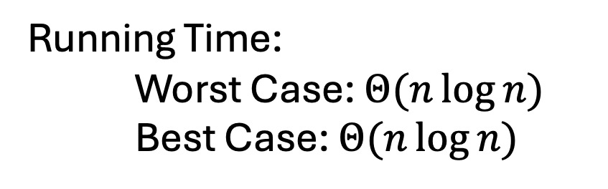
Heap Sort - Summary
Build a max heap
Call extract
Put that at the end of the array
Repeat!
myHeap = buildMaxHeap(a);
for (int i = a.length-1; i>=0; i--){
item = myHeap.extract();
a[i] = item;
}
Running Time:
Worst Case: $Θ(n\log{n})$
Best Case: $Θ(n\log{n})$

Slide 21
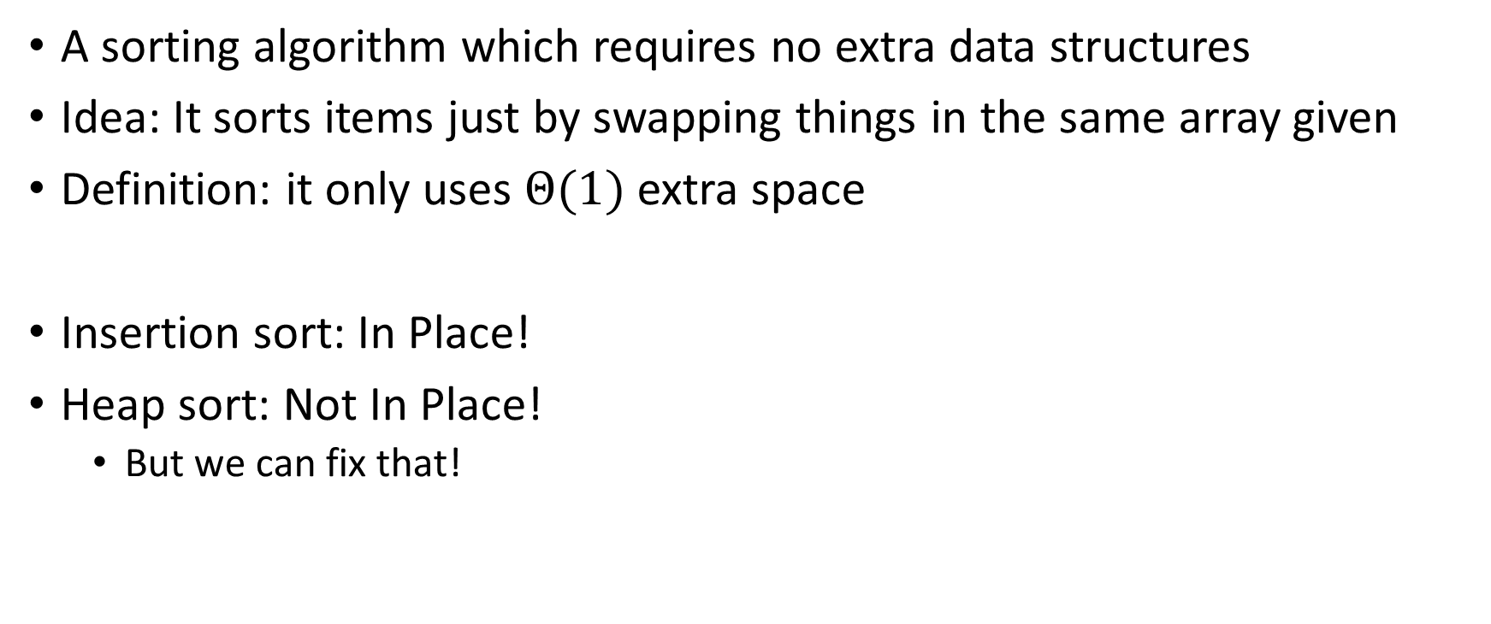
“In Place” Sorting Algorithm
A sorting algorithm which requires no extra data structures
Idea: It sorts items just by swapping things in the same array given
Definition: it only uses $Θ(1)$ extra space
Insertion sort: In Place!
Heap sort: Not In Place!
  But we can fix that!

Slide 22
In Place Heap Sort
Idea: Insert all items into a max heap, extract the largest one-by-one to fill sorted list from end to beginning, all the while the heap and sorted list share the same array
Heap
Heap
List
10
9
6
8
7
5
2
4
1
3
9
8
6
4
7
5
2
3
1
10
0
1
2
3
4
5
6
7
8
9
0
1
2
3
4
5
6
7
8
9
10
9
9
0
6
8
0
6
8
1
7
5
2
2
4
1
7
5
2
2
3
4
5
6
3
4
5
6
4
1
3
3
1
7
8
9
7
8

Slide 23
In Place Heap Sort (First Extract)
Idea: When extracting an element from the heap, swap it with the last item of the heap then “pretend” the heap is one item shorter
3
9
6
8
7
5
2
4
1
10
0
1
2
3
4
5
6
7
8
9
3
9
0
6
8
1
7
5
2
2
3
4
5
6
4
1
7
8

Slide 24
In Place Heap Sort (First Percolate Down)
Idea: When extracting an element from the heap, swap it with the last item of the heap then “pretend” the heap is one item shorter
9
8
6
4
7
5
2
3
1
10
0
1
2
3
4
5
6
7
8
9
9
8
0
6
4
1
7
5
2
2
3
4
5
6
3
1
7
8

Slide 25
In Place Heap Sort (Second Extract)
Idea: When extracting an element from the heap, swap it with the last item of the heap then “pretend” the heap is one item shorter
1
8
6
4
7
5
2
3
9
10
0
1
2
3
4
5
6
7
8
9
1
8
0
6
4
1
7
5
2
2
3
4
5
6
3
7

Slide 26
In Place Heap Sort (Second Percolate Down)
Idea: When extracting an element from the heap, swap it with the last item of the heap then “pretend” the heap is one item shorter
1
8
6
4
7
5
2
3
9
10
0
1
2
3
4
5
6
7
8
9
8
7
0
6
4
1
1
5
2
2
3
4
5
6
3
7

Slide 27
In Place Heap Sort (Third Extract)
Idea: When extracting an element from the heap, swap it with the last item of the heap then “pretend” the heap is one item shorter
3
8
6
4
7
5
2
8
9
10
0
1
2
3
4
5
6
7
8
9
3
7
0
6
4
1
1
5
2
2
3
4
5
6

Slide 28
In Place Heap Sort (Third Percolate Down)
Idea: When extracting an element from the heap, swap it with the last item of the heap then “pretend” the heap is one item shorter
3
8
6
4
7
5
2
8
9
10
0
1
2
3
4
5
6
7
8
9
7
4
0
6
3
1
1
5
2
2
3
4
5
6

Slide 29
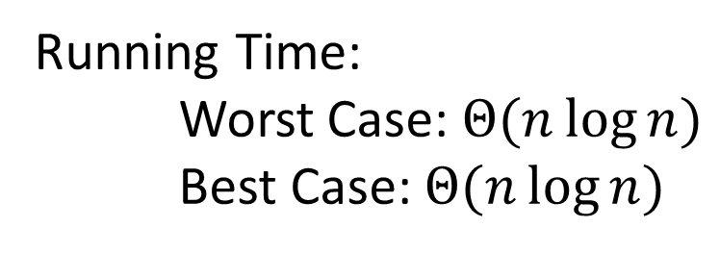
In Place Heap Sort - Summary
Build a heap using the same array (Floyd’s build heap algorithm works)
Call extract
Put that at the end of the array
buildHeap(a);
for (int i = a.length-1; i>=0; i--){
temp=a[i]
a[i] = a[0];
a[0] = temp;
percolateDown(0);
}
Running Time:
Worst Case: $Θ(n\log{n})$
Best Case: $Θ(n\log{n})$

Slide 30
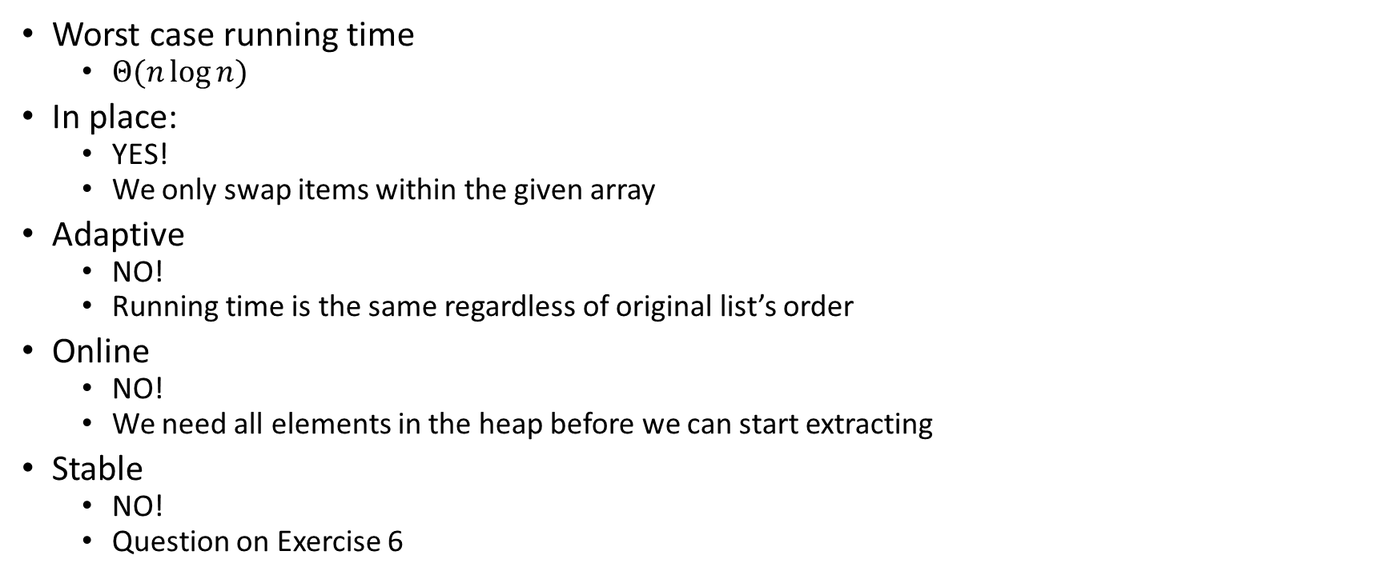
Heap Sort Properties
Worst case running time
  $Θ(n\log{n})$
In place:
  YES!
  We only swap items within the given array
Adaptive
  NO!
  Running time is the same regardless of original list’s order
Online
  NO!
  We need all elements in the heap before we can start extracting
Stable
  NO!
  Question on Exercise 6

Slide 31
Divide And Conquer Sorting
Divide and Conquer:
  Recursive algorithm design technique
  Solve a large problem by breaking it up into smaller versions of the same problem

Slide 32
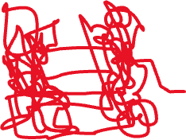

Divide and Conquer
Base Case:
  If the problem is “small” then solve directly and return
Divide:
  Break the problem into subproblem(s), each smaller instances
Conquer:
  Solve subproblem(s) recursively
Combine:
  Use solutions to subproblems to solve original problem
A

Slide 33
Merge Sort
5
8
2
9
4
1
Base Case:
  If the list is of length 1 or 0, it’s already sorted, so just return it
Divide:
  Split the list into two “sublists” of (roughly) equal length
Conquer:
  Sort both lists recursively
Combine:
  Merge sorted sublists into one sorted list
5
5
8
2
9
4
1
2
5
8
1
4
9
2
5
8
1
4
9
1
2
4
5
8
9

Slide 34








Merge Sort In Action!
Sort between indices $low$ and $high$
5
8
2
9
4
1
3
7
$$low$$
$$high$$
Base Case: if $low$ == $high$ then that range is already sorted!
Divide and Conquer: Otherwise call mergesort on ranges $\left(low,\frac{low+high}{2}\right)$ and $\left(\frac{low+high}{2}+1, high\right)$
5
8
2
9
4
1
3
7
$$low$$
$$\frac{low+high}{2}$$
$$\frac{low+high}{2}+1$$
$$high$$
2
5
8
9
1
3
4
7
After Recursion:
$$low$$
$$high$$

Slide 35



Merge (the combine part)
Create a new array to merge into, and 3 pointers/indices:
L_next: the smallest “unmerged” thing on the left
R_next: the smallest “unmerged” thing on the right
M_next: where the next smallest thing goes in the merged array
One-by-one: put the smallest of L_next and R_next into M_next, then advance both M_next and whichever of L/R was used.
2
5
8
9
1
3
4
7
L next
R next
$$\frac{low+high}{2}+1$$
$$low$$
$$\frac{low+high}{2}$$
$$high$$
M next

Slide 36
Merge Sort Pseudocode
mergesort(L):
ms_helper(L, 0, L.length())
mshelper(L, low, high):
IF (low == high) RETURN // Base Case
mid = (low+high)/2
ms_helper(low, mid)
ms_helper(mid+1, high)
merge(L, low, mid, high)

Slide 37
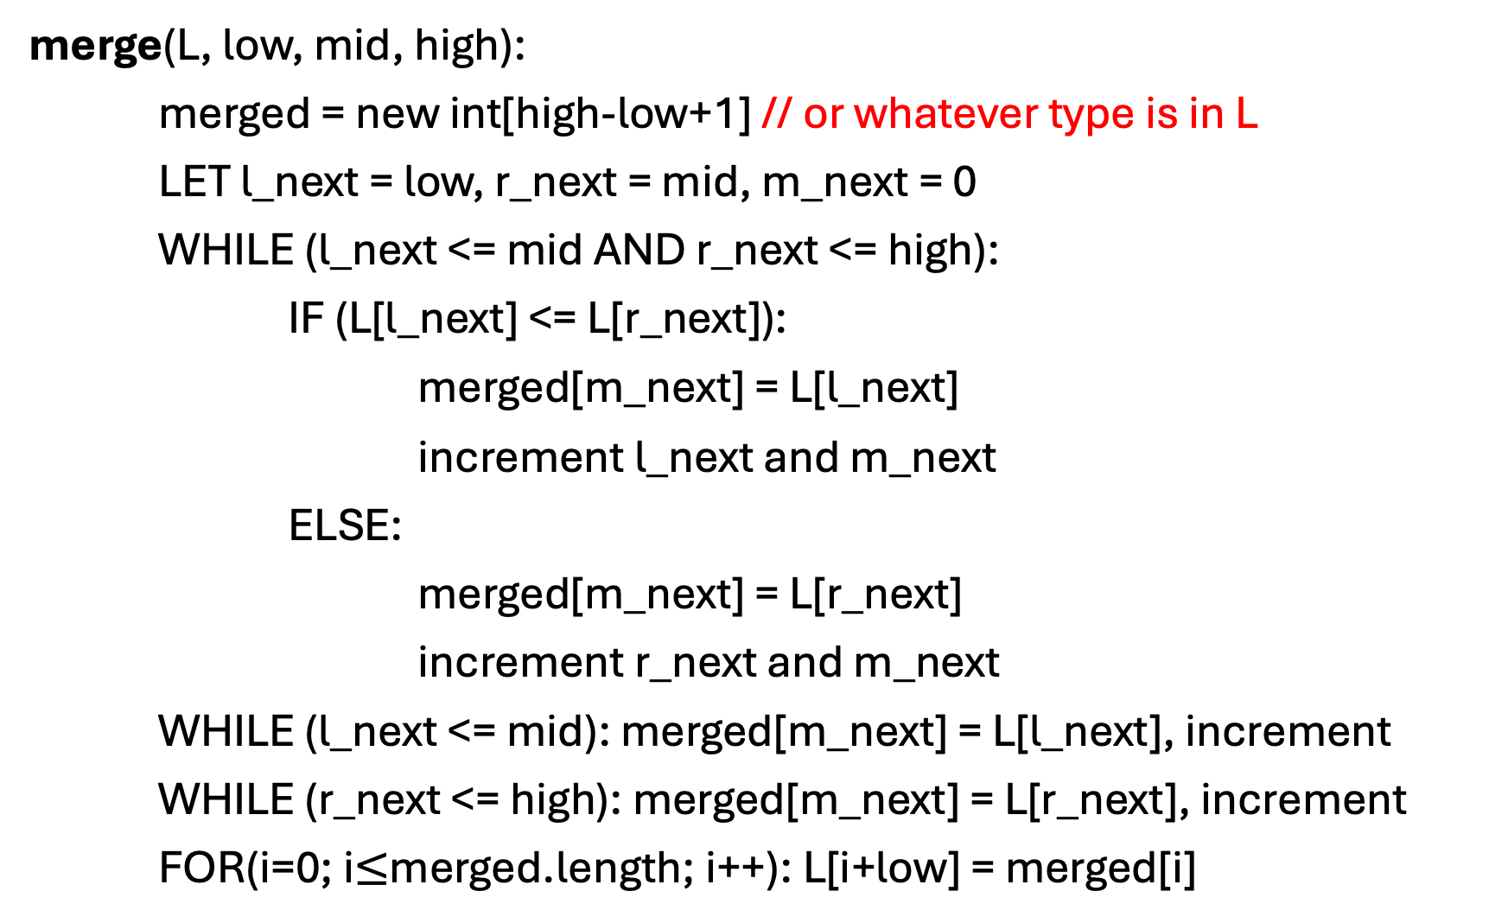
Merge Pseudocode
merge(L, low, mid, high):
merged = new int[high-low+1] // or whatever type is in L
LET l_next = low, r_next = mid, m_next = 0
WHILE (l_next <= mid AND r_next <= high):
IF (L[l_next] <= L[r_next]):
merged[m_next] = L[l_next]
increment l_next and m_next
ELSE:
merged[m_next] = L[r_next]
increment r_next and m_next
WHILE (l_next <= mid): merged[m_next] = L[l_next], increment
WHILE (r_next <= high): merged[m_next] = L[r_next], increment
FOR(i=0; i$≤$merged.length; i++): L[i+low] = merged[i]

Slide 38
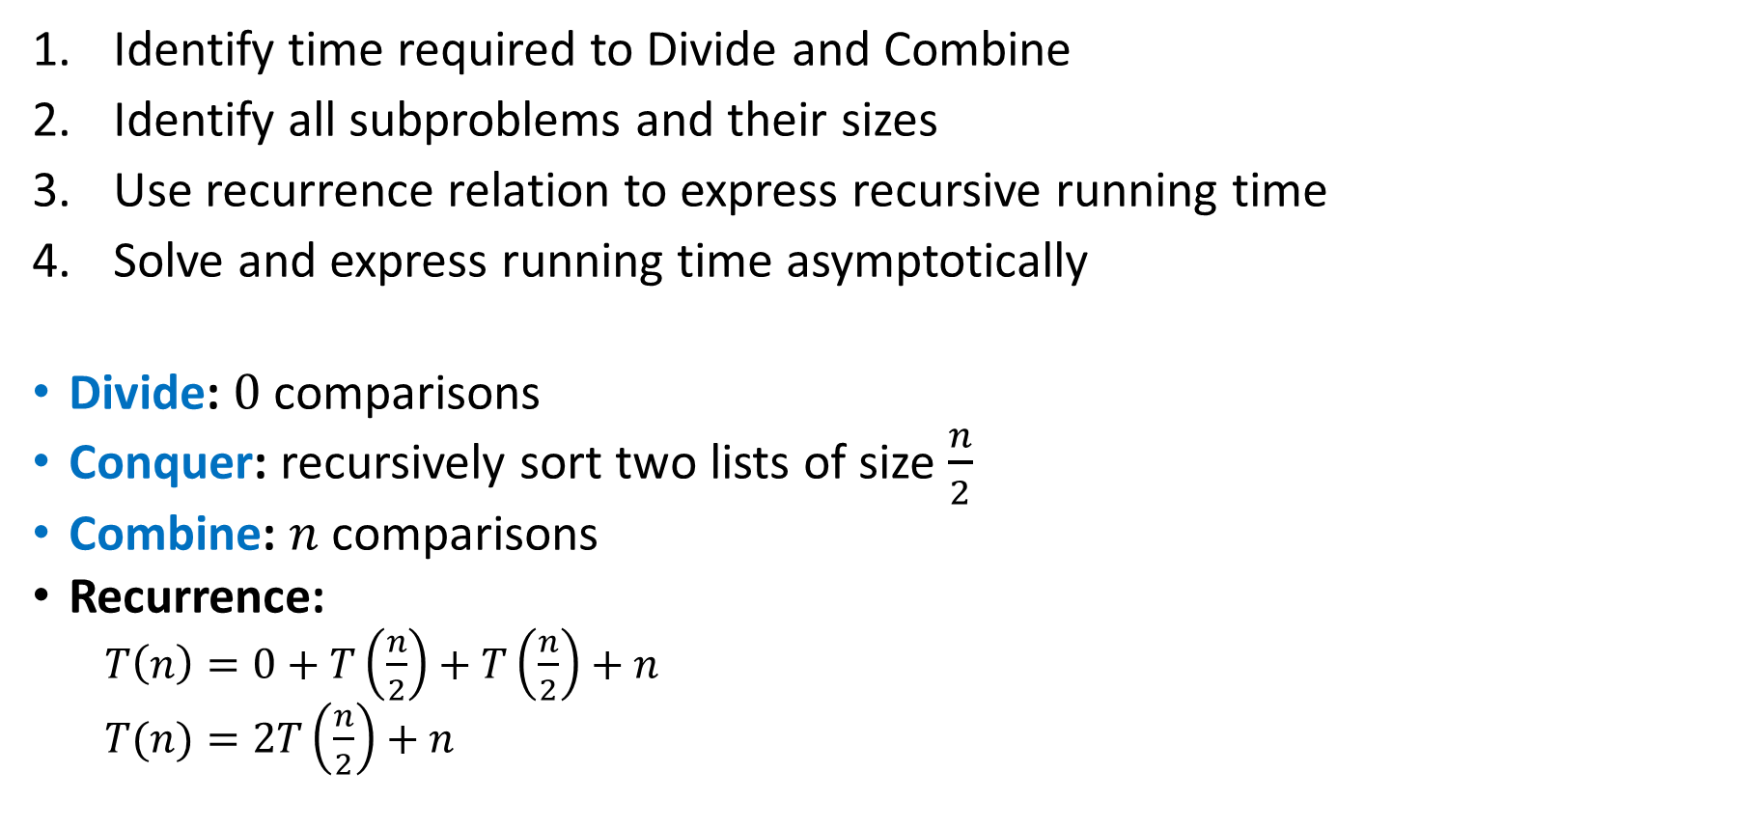
Analyzing Merge Sort
Identify time required to Divide and Combine
Identify all subproblems and their sizes
Use recurrence relation to express recursive running time
Solve and express running time asymptotically
Divide: $0$ comparisons
Conquer: recursively sort two lists of size $\frac{n}{2}$
Combine: $n$ comparisons
Recurrence:
  $T\left(n\right)=0+T\left(\frac{n}{2}\right)+T\left(\frac{n}{2}\right)+n$
  $T(n)=2T\left(\frac{n}{2}\right)+n$

Slide 39

Tree Method $T\left(n\right)=2T\left(\frac{n}{2}\right)+n$

Slide 40












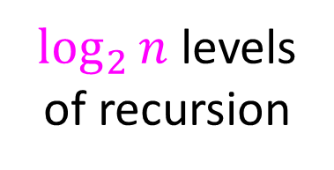






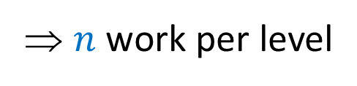







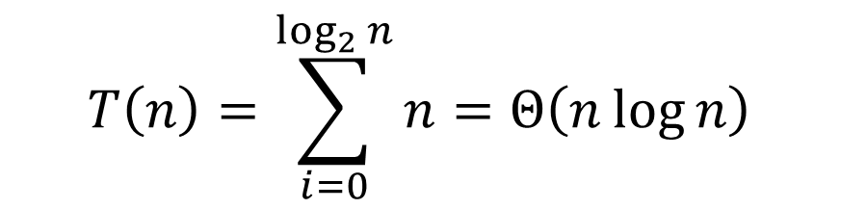
Tree Method $T\left(n\right)=2T\left(\frac{n}{2}\right)+n$
Red box represents a problem instance
$$n$$
⇒ $n$ work per level
$$n$$
Blue value next to each box represents time spent at that level of recursion
$$n/2$$
$$\frac{n}{2}$$
$$n/2$$
$$\frac{n}{2}$$
$\log_{2}⁡n$ levels
of recursion
$$n/4$$
$$\frac{n}{4}$$
$$n/4$$
$$\frac{n}{4}$$
$$n/4$$
$$\frac{n}{4}$$
$$n/4$$
$$\frac{n}{4}$$
…
…
…
…
…
$$1$$
$$1$$
$$1$$
$$1$$
$$1$$
$$1$$
$$1$$
$$1$$
$$1$$
$$1$$
$$1$$
$$1$$
  $$T\left(n\right)=\sum_{i=0}^{\log_{2}{n}}{n}=Θ\left(n\log{n}\right)$$

