Slide 1
CSE 332 Autumn 2026
Lecture 8: AVL Trees, pt. 1
Ruth Anderson
http://www.cs.uw.edu/332

Slide 2
Announcements
“Meet the staff” activity – Come meet us in office hours!
Participate in Section, earn a late day (see Ed Board post)
Exercise 2 Heaps: due TONIGHT, Fri Oct 16
Week 3 Survey in canvas: Due Tuesday Oct 20
Exercise 3 Recurrences: due Fri Oct 23
Exercise 4 AVL Trees, coming soon, Due Friday Oct 30
Midterm: 5-6pm Monday November 9

Slide 3
Dictionary (Map) ADT
Contents:
  Sets of key+value pairs
  Keys must be:
    Unique (always) and Comparable (for many dictionary implementations)
Operations:
  insert(key, value)
    Adds the (key, value) pair into the dictionary
    If the key already has a value, overwrite the old value
      Consequence: Keys cannot be repeated
  find(key)
    Returns the value associated with the given key
  delete(key)
    Remove the key (and its associated value)

Slide 4
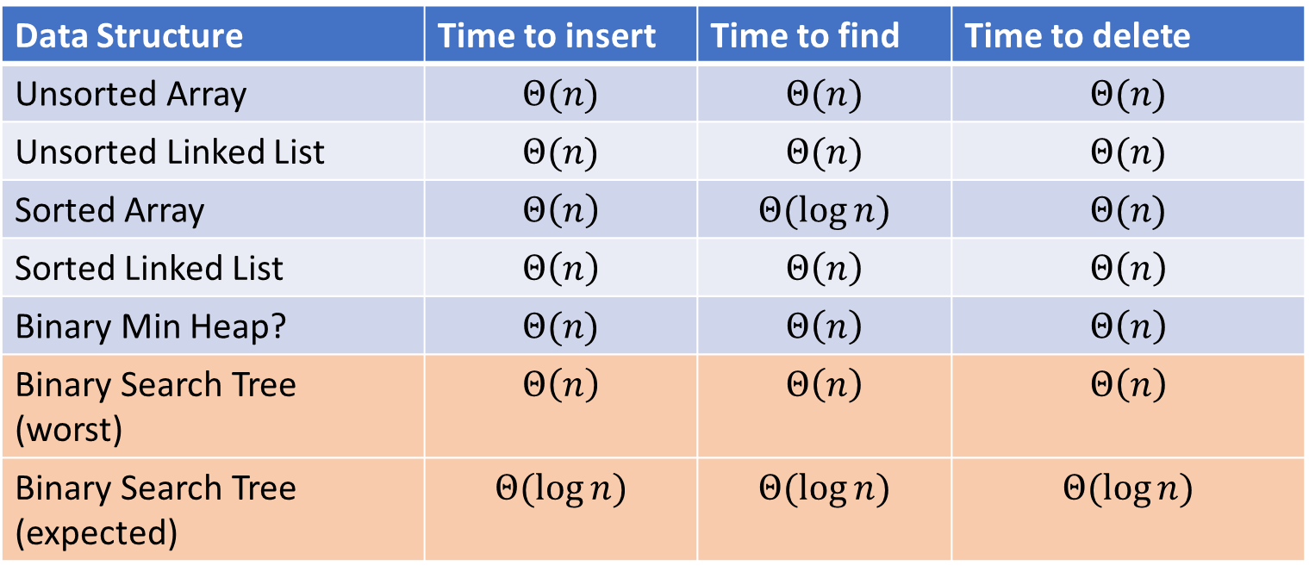
Naïve attempts (Answers)
Data Structure | Time to insert | Time to find | Time to delete
Unsorted Array | $$Θ(n)$$ | $$Θ(n)$$ | $$Θ(n)$$
Unsorted Linked List | $$Θ(n)$$ | $$Θ(n)$$ | $$Θ(n)$$
Sorted Array | $$Θ\left(n\right)$$ | $$Θ(\log{n})$$ | $$Θ(n)$$
Sorted Linked List | $$Θ\left(n\right)$$ | $$Θ\left(n\right)$$ | $$Θ\left(n\right)$$
Binary Min Heap? | $$Θ(n)$$ | $$Θ\left(n\right)$$ | $$Θ\left(n\right)$$
Binary Search Tree (worst) | $$Θ\left(n\right)$$ | $$Θ\left(n\right)$$ | $$Θ\left(n\right)$$
Binary Search Tree (expected) | $$Θ(\log{n})$$ | $$Θ(\log{n})$$ | $$Θ(\log{n})$$

Slide 5
Binary Search Tree
7
3
10
1
6
8
16
Binary Tree
  Definition:
    Tree where each node has at most 2 children
Order Property
  All keys in the left subtree are smaller than the root
  All keys in the right subtree are larger than the root
  Consequence: cannot have repeated values
0
2

Slide 6
Find Operation (recursive)
7
3
10
find(key, root) {
if (root == Null) {
return Null;
{
if (key == root.key) {
return root.value;
}
if (key < root.key) {
return find(key, root.left);
}
if (key > root.key) {
return find(key, root.right);
}
return Null;
}
1
6
16
0

Slide 7
Insert Operation (recursive)
7
3
10
insert(key, value, root) {
root = insertHelper(key, value, root);
}
insertHelper(key, value, root) {
if (root == null)
return new Node(key, value);
if (root.key < key)
root.right = insertHelper(key, value, root.right);
else
root.left = insertHelper(key, value, root.left);
return root;
}
1
6
16
0
Note: Insert happens only at the leaves!

Slide 8
Delete Operation (iterative, incomplete)
9
3
10
delete(key, root) {
while (root != Null && key != root.key) {
if (key < root.key) { root = root.left; }
else if (key > root.key) { root = root.right; }
}
if (root == Null) { return; }
// Now root is the node to delete, what happens next?
}
1
6
16
0
5
7

Slide 9
Delete – 3 Cases
9
3
10
1
6
16
0 Children (i.e. it’s a leaf) (e.g. delete 5)
1 Child (e.g. delete 1)
  Replace the deleted node with its child
2 Children (e.g. delete 3)
  Replace the deleted with the largest node to its left or else the smallest node to its right
0
5
7

Slide 10
Finding the Max and Min
9
3
10
maxNode(root) {
if (root == Null) { return Null; }
while (root.right != Null) {
root = root.right;
}
return root;
}
1
6
16
Max of a BST:
  Right-most Thing
Min of a BST:
  Left-most Thing
0
5
7
minNode(root) {
if (root == Null) { return Null; }
while (root.left != Null) {
root = root.left;
}
return root;
}

Slide 11
Delete Operation (iterative)
9
3
10
delete(key, root) {
while (root != Null && key != root.key) {
if (key < root.key) { root = root.left; }
else if (key > root.key) { root = root.right; }
}
if (root == Null) { return; }
if (root has no children) {
make parent point to Null Instead;
}
if (root has one child) {
make parent point to that child instead;
}
if (root has two children) {
make parent point to either the max from the left or min from the right
}
}
1
6
16
0
5
7

Slide 12
Delete Operation (recursive)
9
3
10
delete(key, root) {
if (root == Null) { return; } // key not present
if (root.key == key) {
if (root has no children) { return Null; }
if (root has one child) { return that child; }
if (root has two children) { return removeMax(root.left);}
}
if (root.key < key) { root.right = delete(key, root.right); }
else { root.left = delete(key, root.left); }
}
1
6
16
0
5
7

Slide 13
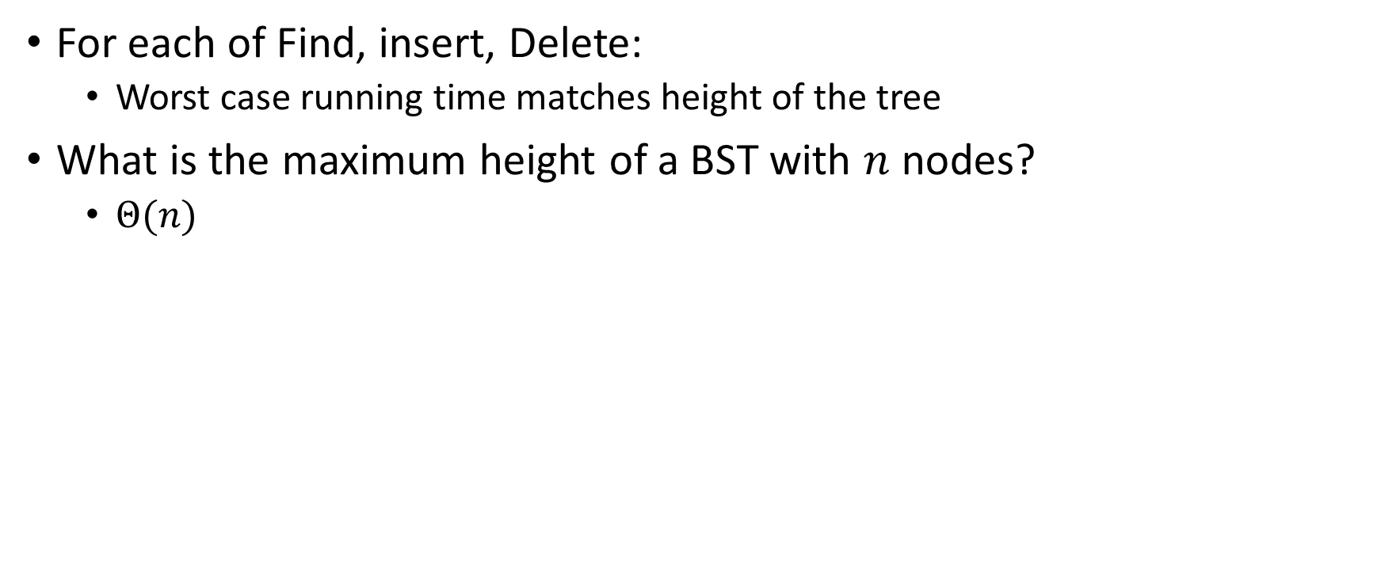
Worst Case Analysis
For each of Find, insert, Delete:
  Worst case running time matches height of the tree
What is the maximum height of a BST with $n$ nodes?
  $Θ(n)$

Slide 14
Binary Trees: Some Numbers (Answers)
Recall: height of a tree = longest path from root to leaf (count edges)
For binary tree of height h:
  max # of leaves:
  max # of nodes:
  min # of leaves:
  min # of nodes:
2^{h}
2^{(h + 1)} - 1
1
h + 1
For n nodes, we cannot do better than O(log n) height,
and we want to avoid O(n) height

Slide 15
Improving the worst case
How can we get a better worst case running time?
  Add rules about the shape of our BST
AVL Tree
  A BST with some shape rules
    Algorithms need to change to accommodate those

Slide 16
“Balanced” Binary Search Trees
We get better running times by having “shorter” trees
Trees get tall due to them being “sparse” (many one-child nodes)
Idea: modify how we insert/delete to keep the tree more “full”
  Encourage Branches!

Slide 17
Idea 1: Both Subtrees of Root have same # Nodes

Slide 18
Idea 1: Both Subtrees of Root have same # Nodes - Issue
16
10
17
7
18
3
19
1
20
0
21

Slide 19
Idea 2: Both Subtrees of Root have same height

Slide 20
Idea 2: Both Subtrees of Root have same height - Issue
16
10
17
7
18
3
19
1
20
0
21

Slide 21
Idea 3: Both Subtrees of every Node have same # Nodes

Slide 22
Idea 3: Both Subtrees of every Node have same # Nodes - Issue
Not all tree sizes are possible!
For example, cannot have a tree of size 2.

Slide 23
Idea 4: Both Subtrees of every Node have same height

Slide 24
Idea 4: Both Subtrees of every Node have same height - Issue
Not all tree sizes are possible!
For example, cannot have a tree of size 2.

Slide 25
AVL Tree
A Binary Search tree that maintains that the left and right subtrees of every node have heights that differ by at most one.
  height of left subtree and height of right subtree differ by at most 1
  Not too weak (ensures trees are short)
  Not too strong (works for any number of nodes)
Idea of AVL Tree:
  When you insert/delete nodes, if tree is “out of balance” then modify the tree
  Modification = “rotation”

Slide 26
Is it an AVL Tree?
Tree A
Tree B
9
9
3
10
3
10
6
16
1
1
6
0
5
0
5
9
Tree C
Tree D
9
3
10
3
10
6
16
1
6
16
5
0
5
7

Slide 27
Is it an AVL Tree? (Answers)
Tree A
Tree B
9
Not Balanced!
9
3
10
“Problem” Node
Its children’s heights differ by more than 1
3
10
1
6
16
1
6
0
5
Balanced!
0
5
9
Tree C
Tree D
9
3
10
3
10
6
16
1
6
16
5
Not Balanced!
0
5
7
Balanced!

Slide 28
Using AVL Trees
Key = 9
Value = “blue”
Height = 3
Left = Node 3
Right = Node 10
Each node has:
  Key
  Value
  Height
  Left child
  Right child
9
3
10
1
6
16
0
5
7

Slide 29
Inserting into an AVL Tree
Starts out the same way as BST:
  “Find” where the new node should go
  Put it in the correct place (it will be a leaf)
Next check the balance
  If the tree is still balanced, you’re done!
  Otherwise we need to do rotations

Slide 30
Insert Example (Insert 10)
10
9
11
3
6
16
1
0
2
7

Slide 31
Insert 10 (After): No rotations needed
Is the tree still balanced?
To confirm we only need to check nodes in the path from root to the new node
Why? We assume the tree was balanced before the insert, so unchanged subtrees cannot be unbalanced.
Height=3
9
Height=2
Height=1
3
11
Height=0
Height=0
1
6
10
16
0
2
7

Slide 32
Insert Example (Insert -1)
-1
9
3
11
1
6
16
0
2
7

Slide 33
Insert -1, BST Insert Step
Not Balanced!
Node 9 is the “problem node” Left and right children of node 9 are different by 2.
Idea: “shorten” the left subtree, “lengthen” the right
Height=4
9
Height=3
Height=1
3
11
Height=2
Height=1
1
6
16
Height=1
Height=0
0
2
7
Height=0
-1
Height=-1

Slide 34
Right Rotation Needed!
Solution:
Take the subtree starting with the problem node,
“Rotate” that tree to the right
9
Height=3
Height=1
3
11
1
6
16
0
2
7
-1

Slide 35
Insert -1, Right rotation process
Solution:
Take the subtree starting with the problem node,
“Rotate” that tree to the right
Result is Balanced!
9
3
Height = 3
Height = 1
3
11
1
9
Right Rotation
1
6
16
0
2
6
11
0
2
7
-1
7
16
-1

Slide 36
After the Right Rotation, Balanced!
3
Height=2
Height=2
1
9
0
2
6
11
-1
7
16

Slide 37
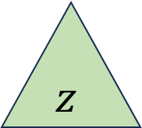

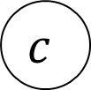
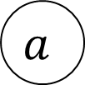

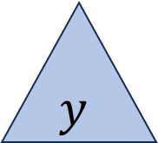


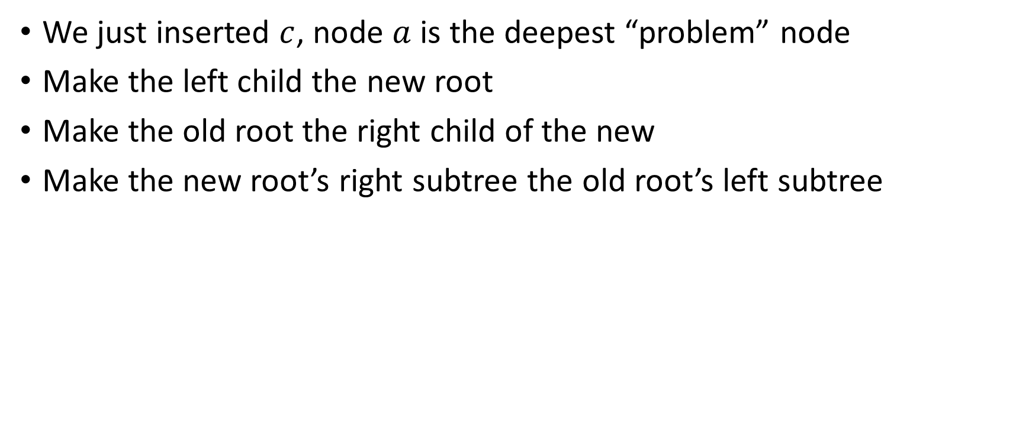








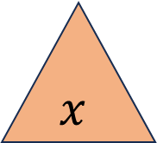

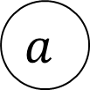



Right Rotation - Definition
We just inserted $c$, node $a$ is the deepest “problem” node
Make the left child the new root
Make the old root the right child of the new
Make the new root’s right subtree the old root’s left subtree
$$h+3$$
$$h+2$$
$$b$$
$$a$$
$$h+2$$
$$h$$
$$h+1$$
$$b$$
$$z$$
$$x$$
$$h+1$$
$$a$$
Right Rotation
$$h+1$$
$$h$$
$$h$$
$$h$$
$$x$$
$$y$$
$$y$$
$$z$$
$$c$$
$$c$$

Slide 38

Right Rotation - Implementation
b = a.left
a.left = b.right
b.right = a
return b
Running time: $Θ(1)$
$$h+3$$
$$h+2$$
$$b$$
$$a$$
$$h+2$$
$$h$$
$$h+1$$
$$b$$
$$z$$
$$x$$
$$h+1$$
$$a$$
Right Rotation
$$h+1$$
$$h$$
$$h$$
$$h$$
$$x$$
$$y$$
$$y$$
$$z$$
$$c$$
$$c$$

Slide 39
Insert Example (Insert 20)
9
20
3
11
1
6
10
16
0
2
18

Slide 40
Insert 20: Not Balanced! Multiple Problem Nodes
Here, nodes 11 and 16 are problem nodes.
There may be multiple places where we can do a rotation to rebalance the tree, but the deepest problem node always works!
9
Height=2
Height=3
3
11
Height=0
Height=2
1
6
10
16
Height=1
0
2
Height=-1
18
Height=0
Height=-1
20

Slide 41
Left Rotation Needed!
Solution:
Take the subtree starting with the problem node,
“Rotate” that tree to the left
9
3
11
1
6
10
16
Height=1
0
2
Height=-1
18
20

Slide 42
Inserting 20, Left rotation process
Solution:
Take the subtree starting with the problem node,
“Rotate” that tree to the left
9
9
Result is Balanced!
3
11
3
11
16
1
6
10
18
1
6
10
Height=1
Left Rotation
Height=0
Height=0
0
2
Height=-1
18
0
2
16
20
20

Slide 43
After the Left Rotation, Balanced!
9
3
11
1
6
10
18
Height=0
Height=0
0
2
16
20

Slide 44


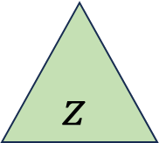





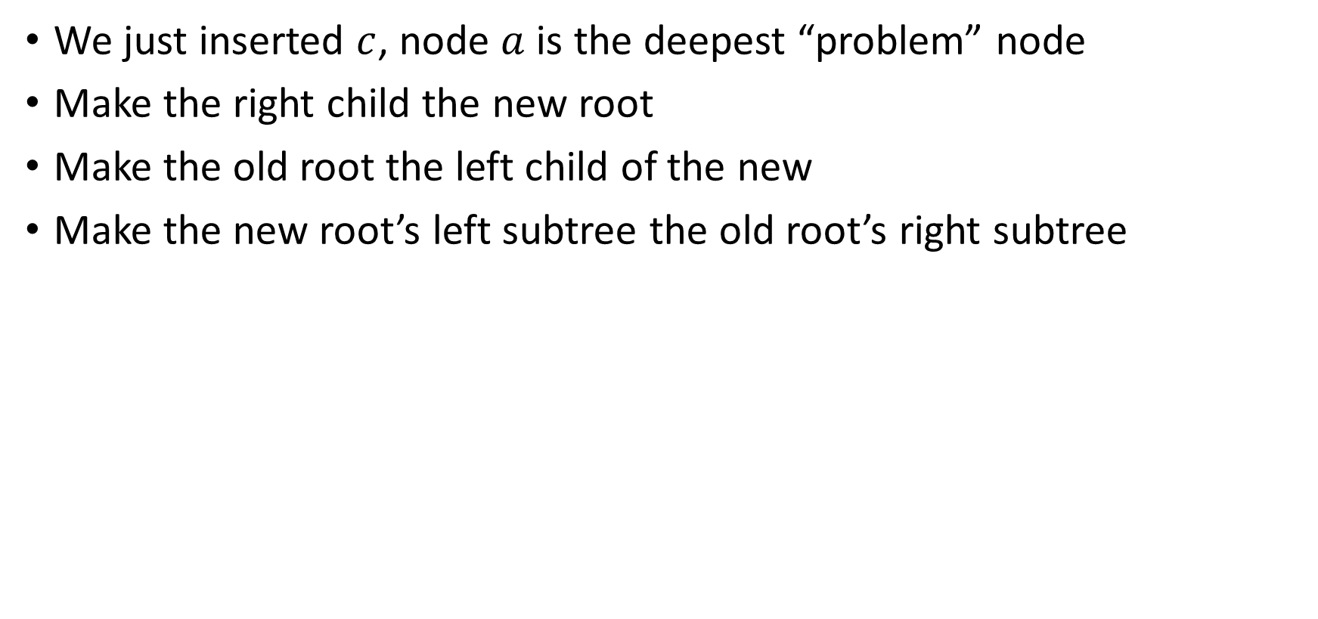






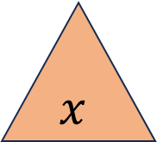







Left Rotation - Definition
We just inserted $c$, node $a$ is the deepest “problem” node
Make the right child the new root
Make the old root the left child of the new
Make the new root’s left subtree the old root’s right subtree
$$h+3$$
$$a$$
$$h+2$$
$$b$$
$$h$$
$$h+1$$
$$h+1$$
$$x$$
$$h+2$$
$$b$$
$$a$$
$$z$$
Left Rotation
$$h$$
$$h+1$$
$$h$$
$$h$$
$$y$$
$$z$$
$$x$$
$$y$$
$$c$$
$$c$$

Slide 45
Left Rotation (Implementation)
b = a.right
a.right = b.left
b.left = a
return b
$$h+3$$
$$a$$
$$h+2$$
$$b$$
$$h$$
$$h+1$$
$$h+1$$
$$x$$
$$h+2$$
$$b$$
$$a$$
$$z$$
Left Rotation
$$h$$
$$h+1$$
$$h$$
$$h$$
$$y$$
$$z$$
$$x$$
$$y$$
$$c$$
$$c$$

Slide 46
Insertion Story So Far
After insertion, update the heights of the node’s ancestors
Check for unbalance
If unbalanced then at the deepest unbalanced root:
  If the left subtree was deeper then rotate right
  If the right subtree was deeper then rotate left
This is incomplete!
There are some cases where this doesn’t work!
9
9
5
Insert 7
Right Rotation
5
5
9
7
7

Slide 47
Insertion Cases
After insertion, update the heights of the node’s ancestors
Check for unbalance
If unbalanced then at the deepest unbalanced root:
  Case LL: If we inserted in the left subtree of the left child then rotate right
  Case RR: If we inserted in the right subtree of the right child then rotate left
  Case LR: If we inserted into the right subtree of the left child then ???
  Case RL: If we inserted into the left subtree of the right child then ???
Cases LR and RL require 2 rotations!

Slide 48
Case LR
From deepest problem node:
  Rotate left at the left child
  Rotate right at the problem node
9
9
9
Insert 7
Rotate Left at 5
5
Rotate Right at 9
7
5
7
7
5
9
5

Slide 49

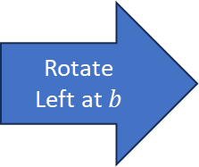


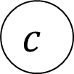
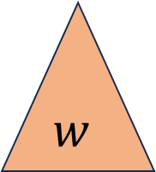


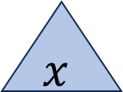
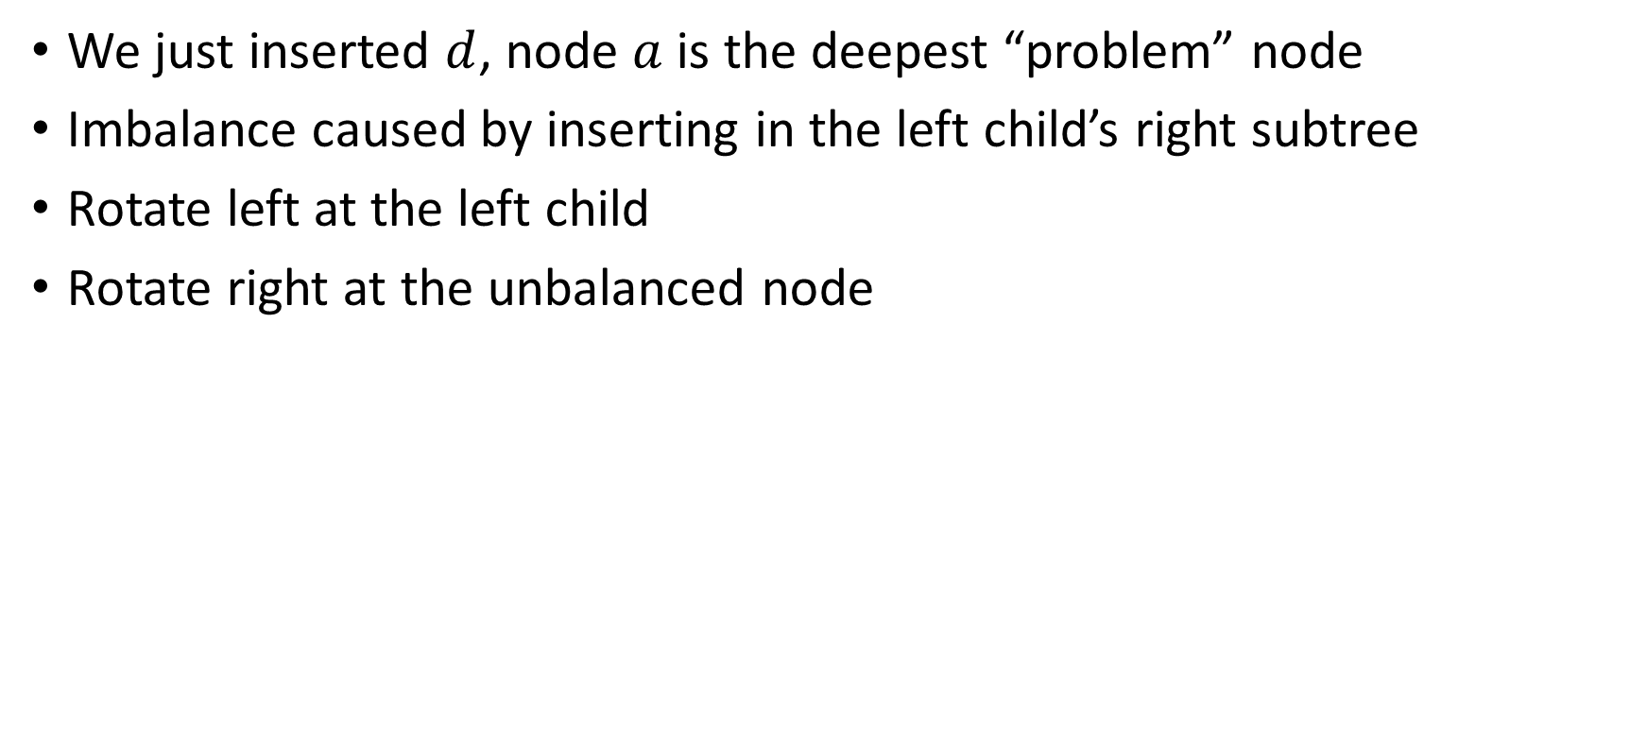

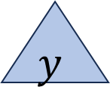








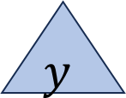


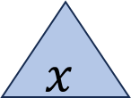







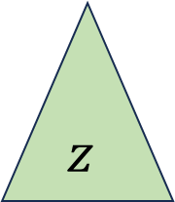








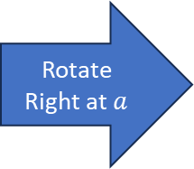




Case LR - Definition
We just inserted $d$, node $a$ is the deepest “problem” node
Imbalance caused by inserting in the left child’s right subtree
Rotate left at the left child
Rotate right at the unbalanced node
$$h+3$$
$$h+3$$
$$a$$
$$h+2$$
$$a$$
$$c$$
Rotate
Left at $b$
Rotate Right at $a$
$$h+2$$
$$h+2$$
$$h$$
$$h+1$$
$$h$$
$$c$$
$$z$$
$$a$$
$$b$$
$$z$$
$$b$$
$$h+1$$
$$h+1$$
$$h$$
$$h+1$$
$$c$$
$$b$$
$$y$$
$$h$$
$$h$$
$$w$$
$$w$$
$$x$$
$$y$$
$$z$$
$$h$$
$$x$$
$$y$$
$$w$$
$$x$$
$$d$$
$$d$$
$$d$$
$$d$$
$$d$$
$$d$$

Slide 50
Case LR Implementation
b = a.left
c = b.right
b.right = c.left
a.left = c.right
c.right = a
c.left = b
return c
$$h+3$$
$$h+3$$
$$a$$
$$h+2$$
$$a$$
$$c$$
Rotate
Left at $b$
Rotate Right at $a$
$$h+2$$
$$h+2$$
$$h$$
$$h+1$$
$$h$$
$$c$$
$$z$$
$$a$$
$$b$$
$$z$$
$$b$$
$$h+1$$
$$h+1$$
$$h$$
$$h+1$$
$$c$$
$$b$$
$$y$$
$$h$$
$$h$$
$$w$$
$$w$$
$$x$$
$$y$$
$$z$$
$$h$$
$$x$$
$$y$$
$$w$$
$$x$$
$$d$$
$$d$$
$$d$$
$$d$$
$$d$$
$$d$$

Slide 51

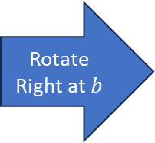

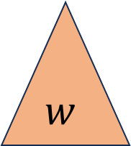

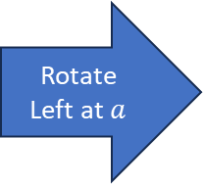

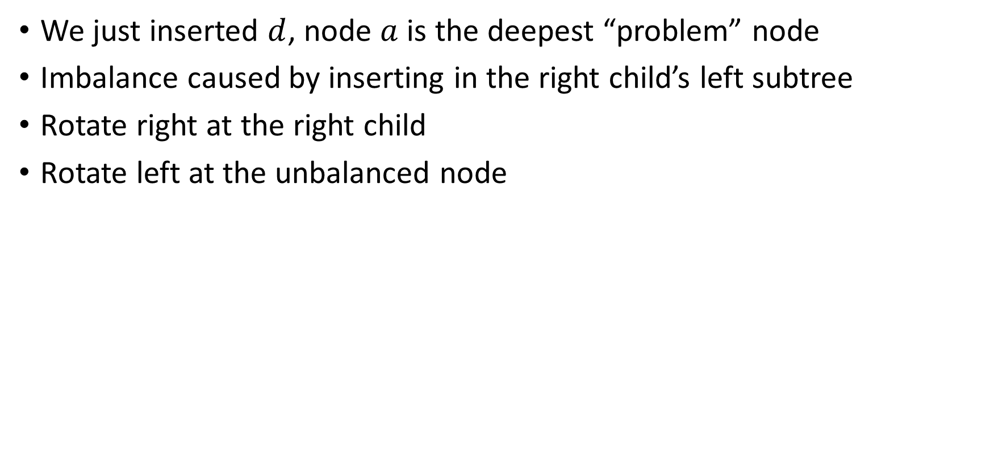








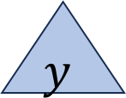








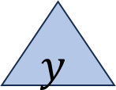
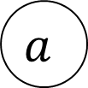
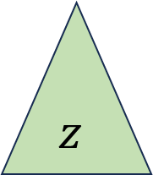





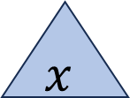
Case RL - Definition
We just inserted $d$, node $a$ is the deepest “problem” node
Imbalance caused by inserting in the right child’s left subtree
Rotate right at the right child
Rotate left at the unbalanced node
$$a$$
$$h+2$$
$$c$$
$$h+3$$
$$h+3$$
$$a$$
Rotate Right at $b$
Rotate Left at $a$
$$h+2$$
$$b$$
$$h$$
$$c$$
$$h+1$$
$$b$$
$$h$$
$$w$$
$$h+2$$
$$a$$
$$h+1$$
$$w$$
$$h+1$$
$$c$$
$$h$$
$$h+1$$
$$b$$
$$h$$
$$h$$
$$z$$
$$x$$
$$w$$
$$x$$
$$y$$
$$z$$
$$h$$
$$x$$
$$y$$
$$y$$
$$z$$
$$d$$
$$d$$
$$d$$
$$d$$
$$d$$
$$d$$

Slide 52
Case RL Implementation
b = a.right
c = b.left
b.left = c.right
a.right = c.left
c.left = a
c.right = b
return c
$$a$$
$$h+2$$
$$c$$
$$h+3$$
$$h+3$$
$$a$$
Rotate Right at $b$
Rotate Left at $a$
$$h+2$$
$$b$$
$$h$$
$$c$$
$$h+1$$
$$b$$
$$h$$
$$w$$
$$h+2$$
$$a$$
$$h+1$$
$$w$$
$$h+1$$
$$c$$
$$h$$
$$h+1$$
$$b$$
$$h$$
$$h$$
$$z$$
$$x$$
$$w$$
$$x$$
$$y$$
$$z$$
$$h$$
$$x$$
$$y$$
$$y$$
$$z$$
$$d$$
$$d$$
$$d$$
$$d$$
$$d$$
$$d$$

Slide 53
Insert Summary
After a BST insertion, update the heights of the node’s ancestors
From leaf to root, check if each node is balanced
If a node is unbalanced then at the deepest unbalanced node:
  Case LL: If we inserted in the left subtree of the left child then: rotate right
  Case RR: If we inserted in the right subtree of the right child then: rotate left
  Case LR: If we inserted into the right subtree of the left child then: rotate left at the left child and then rotate right at the root
  Case RL: If we inserted into the left subtree of the right child then: rotate right at the right child and then rotate left at the root
Done after either reaching the root or applying one of the above cases

Slide 54
Insert Operation (for AVL)
insert(key, value, root) {
root = insertHelper(key, value, root);
}
insertHelper(key, value, root) {
if (root == null)
return new Node(key, value);
if (root.key < key)
root.right = insertHelper(key, value, root.right);
else
root.left = insertHelper(key, value, root.left);
if (isUnbalanced(root))
root = rotate(root);
return root;
}

Slide 55
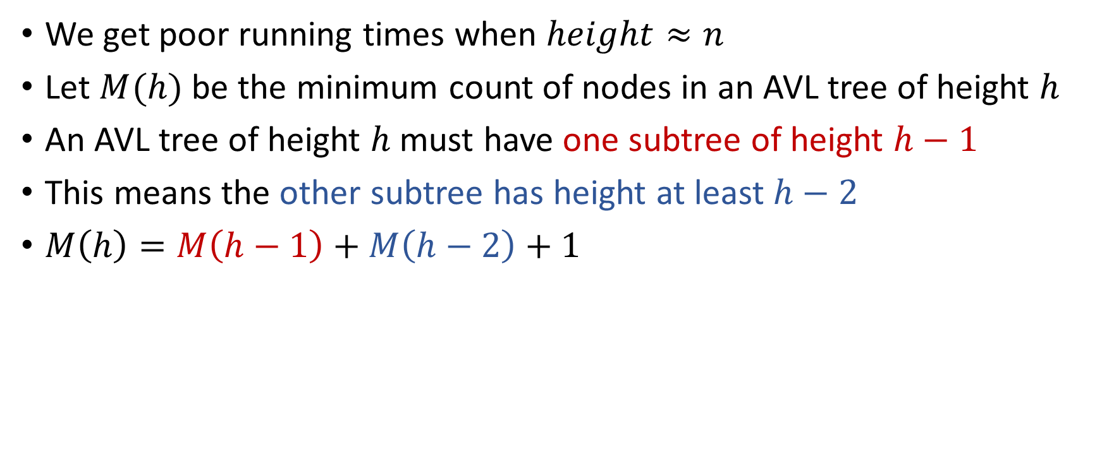

Why is this $Θ(\log{n})$ time?
We get poor running times when $height≈n$
Let $M(h)$ be the minimum count of nodes in an AVL tree of height $h$
An AVL tree of height $h$ must have one subtree of height $h−1$
This means the other subtree has height at least $h−2$
$M\left(h\right)=M\left(h−1\right)+M\left(h−2\right)+1$

Slide 56
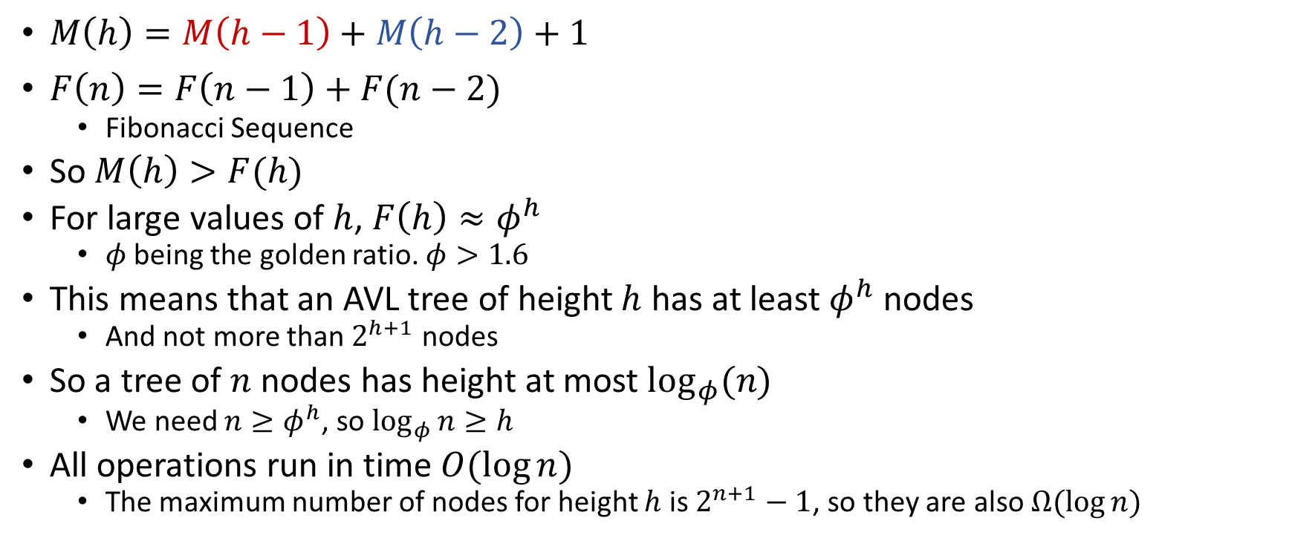
Comparing to Fibonacci Sequence
$M\left(h\right)=M\left(h−1\right)+M\left(h−2\right)+1$
$F\left(n\right)=F\left(n−1\right)+F(n−2)$
  Fibonacci Sequence
So $M\left(h\right)>F(h)$
For large values of $h$, $F\left(h\right)≈φ^{h}$
  $φ$ being the golden ratio. $φ>1.6$
This means that an AVL tree of height $h$ has at least $φ^{h}$ nodes
  And not more than $2^{h+1}$ nodes
So a tree of $n$ nodes has height at most $\log_{φ}(n)$
  We need $n≥φ^{h}$, so $\log_{φ}{n}≥h$
All operations run in time $O(\log{n})$
  The maximum number of nodes for height $h$ is $2^{n+1}−1$, so they are also $Ω(\log{n})$

