Slide 1
CSE 332 Autumn 2026
Lecture 7: Dictionaries, BSTs
Ruth Anderson
http://www.cs.uw.edu/332

Slide 2
Announcements
“Meet the staff” activity – Come meet us in office hours!
Participate in Section, earn a late day (see Ed Board post)
Exercise 1 Running Time: Closes TONIGHT, Closes Wed Oct 14
  Entirely in Gradescope. Save your answers outside of Gradescope and confirm that you have answered/uploaded everything that is needed!
Exercise 2 Heaps: due Fri Oct 16
Exercise 3 Recurrences: due Fri Oct 23
Midterm: 5-6pm Monday November 9
Week 3 Survey in canvas: Due Tuesday Oct 20

Slide 3
Dictionary (Map) ADT
Contents:
  Sets of key+value pairs
  Keys must be:
    Unique (always) and Comparable (for many dictionary implementations)
Operations:
  insert(key, value)
    Adds the (key, value) pair into the dictionary
    If the key already has a value, overwrite the old value
      Consequence: Keys cannot be repeated
  find(key)
    Returns the value associated with the given key
  delete(key)
    Remove the key (and its associated value)

Slide 4
A Modest Few Uses for Dictionaries
Any time you want to store information according to some key and be able to retrieve it efficiently – a dictionary is the ADT to use!
  Lots of programs do that! (see even EX02…)
Networks: router tables
Operating systems: page tables
Compilers: symbol tables
Databases: dictionaries with other nice properties
Search: inverted indexes, phone directories, …
Biology: genome maps
…

Slide 5
Naïve attempts
Data Structure | Time to insert | Time to find | Time to delete
Unsorted Array
Unsorted Linked List
Sorted Array
Sorted Linked List
Binary Min Heap?

Slide 6
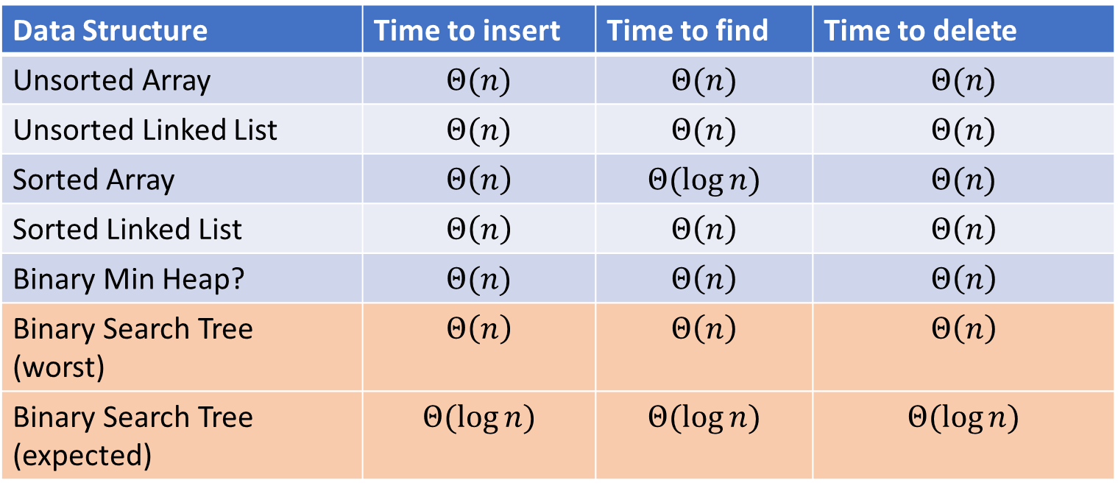
Naïve attempts (Answers)
Data Structure | Time to insert | Time to find | Time to delete
Unsorted Array | $$Θ(n)$$ | $$Θ(n)$$ | $$Θ(n)$$
Unsorted Linked List | $$Θ(n)$$ | $$Θ(n)$$ | $$Θ(n)$$
Sorted Array | $$Θ\left(n\right)$$ | $$Θ(\log{n})$$ | $$Θ(n)$$
Sorted Linked List | $$Θ\left(n\right)$$ | $$Θ\left(n\right)$$ | $$Θ\left(n\right)$$
Binary Min Heap? | $$Θ(n)$$ | $$Θ\left(n\right)$$ | $$Θ\left(n\right)$$
Binary Search Tree (worst) | $$Θ\left(n\right)$$ | $$Θ\left(n\right)$$ | $$Θ\left(n\right)$$
Binary Search Tree (expected) | $$Θ(\log{n})$$ | $$Θ(\log{n})$$ | $$Θ(\log{n})$$

Slide 7
Lazy Deletion (e.g. in a sorted array)
10 | 12 | 24 | 30 | 41 | 42 | 44 | 45 | 50
✓ | ✗ | ✓ | ✓ | ✓ | ✓ | ✗ | ✓ | ✓
A general technique for making delete as fast as find:
  Instead of actually removing the item just mark it deleted
  No need to shift values, etc.
Plusses:
  Simpler
  Can do removals later in batches
  If re-added soon thereafter, just unmark the deletion
Minuses:
  Extra space for the “is-it-deleted” flag
  Data structure full of deleted nodes wastes space
  find O(log m) time where m is data-structure size (m >= n )
  May complicate other operations

Slide 8
Better Dictionary data structures
Will spend the next several lectures looking at dictionaries with two different data structures
AVL trees
  Binary search trees with guaranteed balancing
Hash Tables
  Not tree-like at all
Skipping: Other balanced trees (B-trees, red-black, splay)

Slide 9
Tree Vocabulary
D
U
B
Traversal:
  An algorithm for “visiting/processing” every node in a tree
Pre-Order Traversal:
  Root, Left Subtree, Right Subtree
  D U S 2 B
In-Order Traversal:
  Left Subtree, Root, Right Subtree
  S U 2 D B
Post-Order Traversal
  Left Subtree, Right Subtree, Root
  S 2 U B D
S
2

Slide 10
Name that Traversal!
aOrder(root) {
if (root.left != Null) {
aOrder(root.left);
}
if (root.right != Null) {
aOrder(root.right);
}
process(root);
}
bOrder(root) {
process(root);
if (root.left != Null) {
bOrder(root.left);
}
if (root.right != Null) {
bOrder(root.right);
}
}
cOrder(root) {
if (root.left != Null) {
cOrder(root.left);
}
process(root)
if (root.right != Null) {
cOrder(root.right);
}
}

Slide 11
Name that Traversal! (Answers)
postOrder(root) {
if (root.left != Null) {
postOrder(root.left);
}
if (root.right != Null) {
postOrder(root.right);
}
process(root);
}
preOrder(root) {
process(root);
if (root.left != Null) {
preOrder(root.left);
}
if (root.right != Null) {
preOrder(root.right);
}
}
inOrder(root) {
if (root.left != Null) {
inOrder(root.left);
}
process(root)
if (root.right != Null) {
inOrder(root.right);
}
}

Slide 12
Binary Search Tree
7
3
10
1
6
8
16
Binary Tree
  Definition:
    Tree where each node has at most 2 children
Order Property
  All keys in the left subtree are smaller than the root
  All keys in the right subtree are larger than the root
  Consequence: cannot have repeated values
0
2

Slide 13
Are these BSTs?
7
3
10
7
7
16
1
3
10
0
1
16
16
10
0
7
7
3
10
3
1
8
16
1
0
0

Slide 14
Are these BSTs? (Answers)
7
3
10
7
7
16
1
3
10
0
NO!
1
16
16
YES!
10
0
7
7
3
10
3
YES!
1
8
16
1
NO!
0
0

Slide 15
Binary Trees: Some Numbers
Recall: height of a tree = longest path from root to leaf (count edges)
For binary tree of height h:
  max # of leaves:
  max # of nodes:
  min # of leaves:
  min # of nodes:

Slide 16
Binary Trees: Some Numbers (Answers)
Recall: height of a tree = longest path from root to leaf (count edges)
For binary tree of height h:
  max # of leaves:
  max # of nodes:
  min # of leaves:
  min # of nodes:
2^{h}
2^{(h + 1)} - 1
1
h + 1
For n nodes, we cannot do better than O(log n) height,
and we want to avoid O(n) height

Slide 17
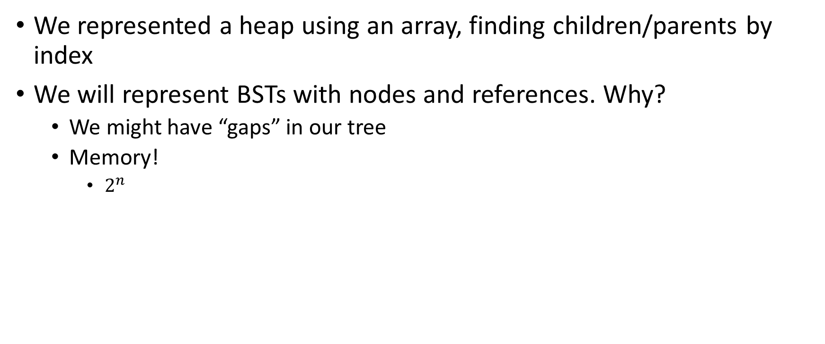
Aside: Why not use an array?
We represented a heap using an array, finding children/parents by index
We will represent BSTs with nodes and references. Why?
  We might have “gaps” in our tree
  Memory!
    $2^{n}$

Slide 18
Find Operation (recursive)
7
3
10
find(key, root) {
if (root == Null) {
return Null;
{
if (key == root.key) {
return root.value;
}
if (key < root.key) {
return find(key, root.left);
}
if (key > root.key) {
return find(key, root.right);
}
return Null;
}
1
6
16
0

Slide 19
Find Operation (iterative)
7
3
10
find(key, root) {
while (root != Null && key != root.key) {
if (key < root.key) {
root = root.left;
}
else if (key > root.key) {
root = root.right;
}
}
if (root == Null) {
return Null;
}
return root.value;
}
1
6
16
0

Slide 20
Insert Operation (recursive)
7
3
10
insert(key, value, root) {
root = insertHelper(key, value, root);
}
insertHelper(key, value, root) {
if (root == null)
return new Node(key, value);
if (root.key < key)
root.right = insertHelper(key, value, root.right);
else
root.left = insertHelper(key, value, root.left);
return root;
}
1
6
16
0
Note: Insert happens only at the leaves!

Slide 21
Insert Operation (iterative)
7
3
10
insert(key, value, root) {
if (root == Null) { this.root = new Node(key, value); }
parent = Null;
while (root != Null && key != root.key) {
parent = root;
if (key < root.key) { root = root.left; }
else if (key > root.key) { root = root.right; }
}
if (root != Null) { root.value = value; }
else if (key < parent.key) { parent.left = new Node(key, value); }
else { parent.right = new Node (key, value); }
}
1
6
16
0
Note: Insert happens only at the leaves!

Slide 22
Delete Operation (iterative, incomplete)
9
3
10
delete(key, root) {
while (root != Null && key != root.key) {
if (key < root.key) { root = root.left; }
else if (key > root.key) { root = root.right; }
}
if (root == Null) { return; }
// Now root is the node to delete, what happens next?
}
1
6
16
0
5
7

Slide 23
Delete – 3 Cases
9
3
10
1
6
16
0 Children (i.e. it’s a leaf) (e.g. delete 5)
1 Child (e.g. delete 1)
  Replace the deleted node with its child
2 Children (e.g. delete 3)
  Replace the deleted with the largest node to its left or else the smallest node to its right
0
5
7

Slide 24
Finding the Max and Min
9
3
10
maxNode(root) {
if (root == Null) { return Null; }
while (root.right != Null) {
root = root.right;
}
return root;
}
1
6
16
Max of a BST:
  Right-most Thing
Min of a BST:
  Left-most Thing
0
5
7
minNode(root) {
if (root == Null) { return Null; }
while (root.left != Null) {
root = root.left;
}
return root;
}

Slide 25
Delete Operation (iterative)
9
3
10
delete(key, root) {
while (root != Null && key != root.key) {
if (key < root.key) { root = root.left; }
else if (key > root.key) { root = root.right; }
}
if (root == Null) { return; }
if (root has no children) {
make parent point to Null Instead;
}
if (root has one child) {
make parent point to that child instead;
}
if (root has two children) {
make parent point to either the max from the left or min from the right
}
}
1
6
16
0
5
7

Slide 26
Delete Operation (recursive)
9
3
10
delete(key, root) {
if (root == Null) { return; } // key not present
if (root.key == key) {
if (root has no children) { return Null; }
if (root has one child) { return that child; }
if (root has two children) { return removeMax(root.left);}
}
if (root.key < key) { root.right = delete(key, root.right); }
else { root.left = delete(key, root.left); }
}
1
6
16
0
5
7

Slide 27
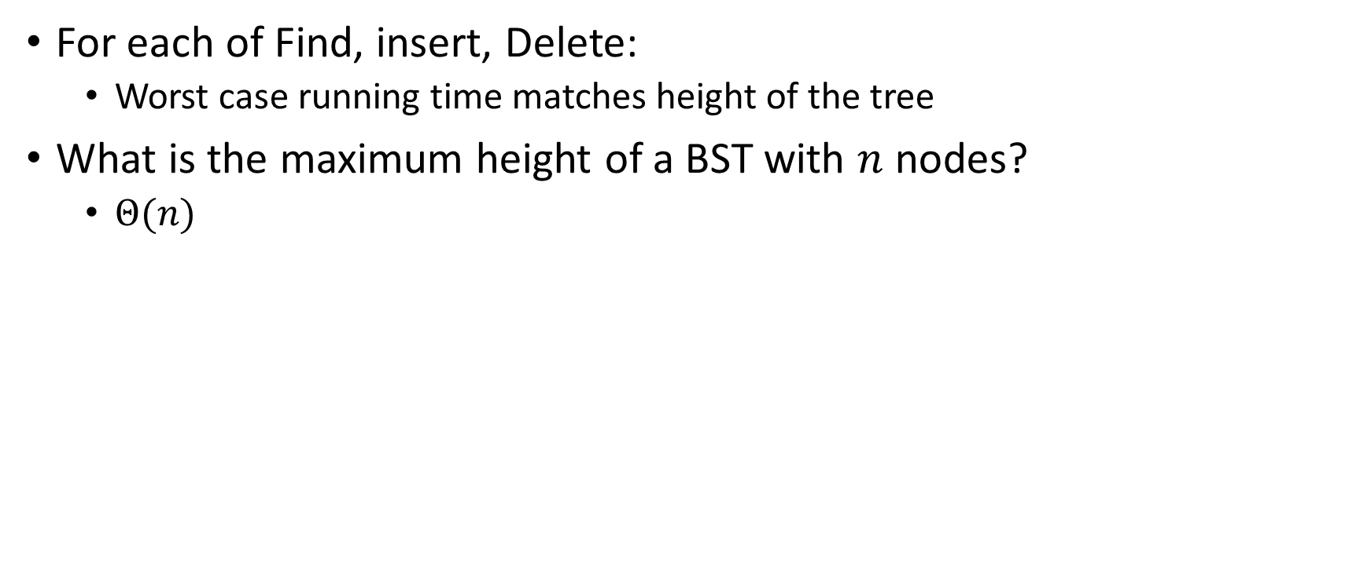
Worst Case Analysis
For each of Find, insert, Delete:
  Worst case running time matches height of the tree
What is the maximum height of a BST with $n$ nodes?
  $Θ(n)$

Slide 28
Improving the worst case
How can we get a better worst case running time?
  Add rules about the shape of our BST
AVL Tree
  A BST with some shape rules
    Algorithms need to change to accommodate those

Slide 29
“Balanced” Binary Search Trees
We get better running times by having “shorter” trees
Trees get tall due to them being “sparse” (many one-child nodes)
Idea: modify how we insert/delete to keep the tree more “full”
  Encourage Branches!

