Slide 1
CSE 332 Autumn 2026
Lecture 6: Recurrences
Ruth Anderson
http://www.cs.uw.edu/332

Slide 2
Announcements
Exercise 0 – was due on Friday, closes tonight
“Meet the staff” activity - Sometime during the first 4 weeks of class.
Participate in Section, earn a late day (see Ed Board post)
Exercise 1 Running Time:
  Due TONIGHT Mon Oct 12, Closes Wed Oct 14
  Entirely in Gradescope. Save your answers outside of Gradescope and confirm that you have answered/uploaded everything that is needed!
Exercise 2 Heaps: due Fri Oct 16
Exercise 3 Recurrences: coming soon, due Fri Oct 23

Slide 3
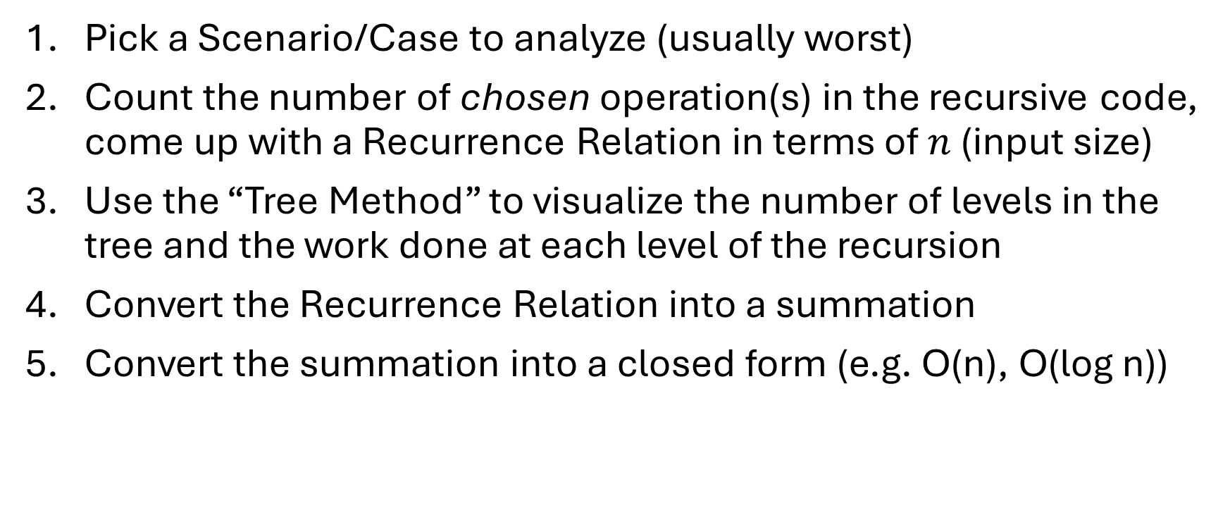
Analyzing Recursive Code
Pick a Scenario/Case to analyze (usually worst)
Count the number of chosen operation(s) in the recursive code, come up with a Recurrence Relation in terms of $n$ (input size)
Use the “Tree Method” to visualize the number of levels in the tree and the work done at each level of the recursion
Convert the Recurrence Relation into a summation
Convert the summation into a closed form (e.g. O(n), O(log n))

Slide 4
Recursive Binary Search
5
8
13
42
75
79
88
90
95
99
0
1
2
3
4
5
6
7
8
9
public static boolean binarySearch(List<Integer> lst, int k){
return binarySearch(lst, k, 0, lst.size());
}
private static boolean binarySearch(List<Integer> lst, int k, int start, int end){
if(start == end)
return false;
int mid = start + (end-start)/2;
if(lst.get(mid) == k){
return true;
} else if(lst.get(mid) > k){
return binarySearch(lst, k, start, mid);
} else{
return binarySearch(lst, k, mid+1, end);
}
}

Slide 5
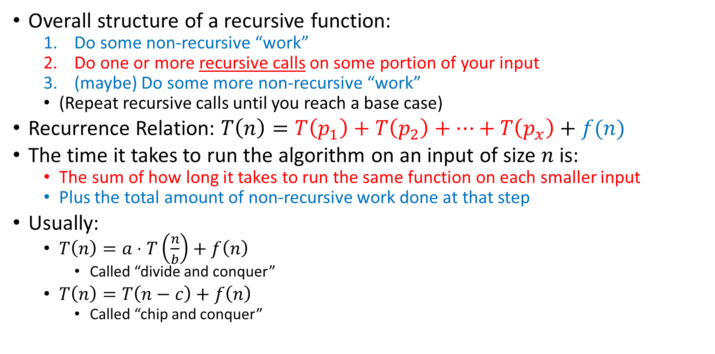
Coming up with a Recurrence Relation
Overall structure of a recursive function:
  Do some non-recursive “work”
  Do one or more recursive calls on some portion of your input
  (maybe) Do some more non-recursive “work”
  (Repeat recursive calls until you reach a base case)
Recurrence Relation: $T\left(n\right)=T\left(p_{1}\right)+T\left(p_{2}\right)+…+T\left(p_{x}\right)+f(n)$
The time it takes to run the algorithm on an input of size $n$ is:
  The sum of how long it takes to run the same function on each smaller input
  Plus the total amount of non-recursive work done at that step
Usually:
  $T\left(n\right)=a⋅T\left(\frac{n}{b}\right)+f\left(n\right)$
    Called “divide and conquer”
  $T\left(n\right)=T\left(n−c\right)+f\left(n\right)$
    Called “chip and conquer”

Slide 6
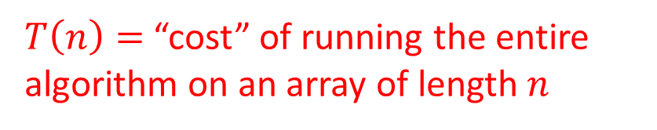
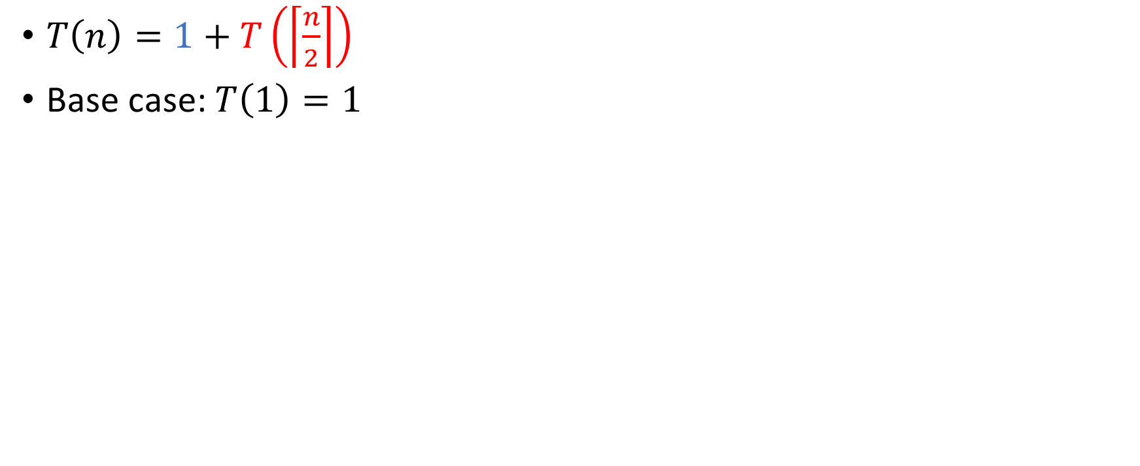
How Efficient Is It?
$T\left(n\right)=$ “cost” of running the entire algorithm on an array of length $n$
$T\left(n\right)=1+T\left(\left\lceil \frac{n}{2}\right\rceil \right)$
Base case: $T\left(1\right)=1$

Slide 7
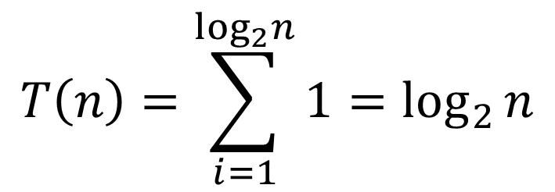

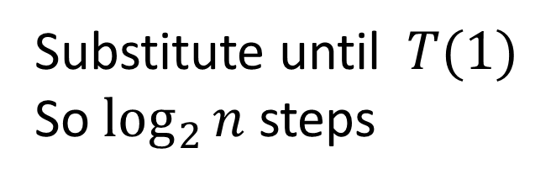





Let’s Solve the Recurrence!
$$T\left(1\right)=1$$
$$T\left(n\right)=1+T(n/2)$$
$$1+T(n/4)$$
Substitute until $T(1)$
So $\log_{2}{n}$ steps
$$1+T(n/8)$$
…
$$1$$
$$T\left(n\right)=\sum_{i=1}^{\log_{2}n}{1}=\log_{2}{n}$$
$$T\left(n\right)∈Θ\left(\log{n}\right)$$

Slide 8

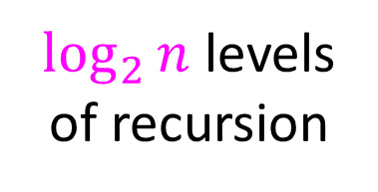



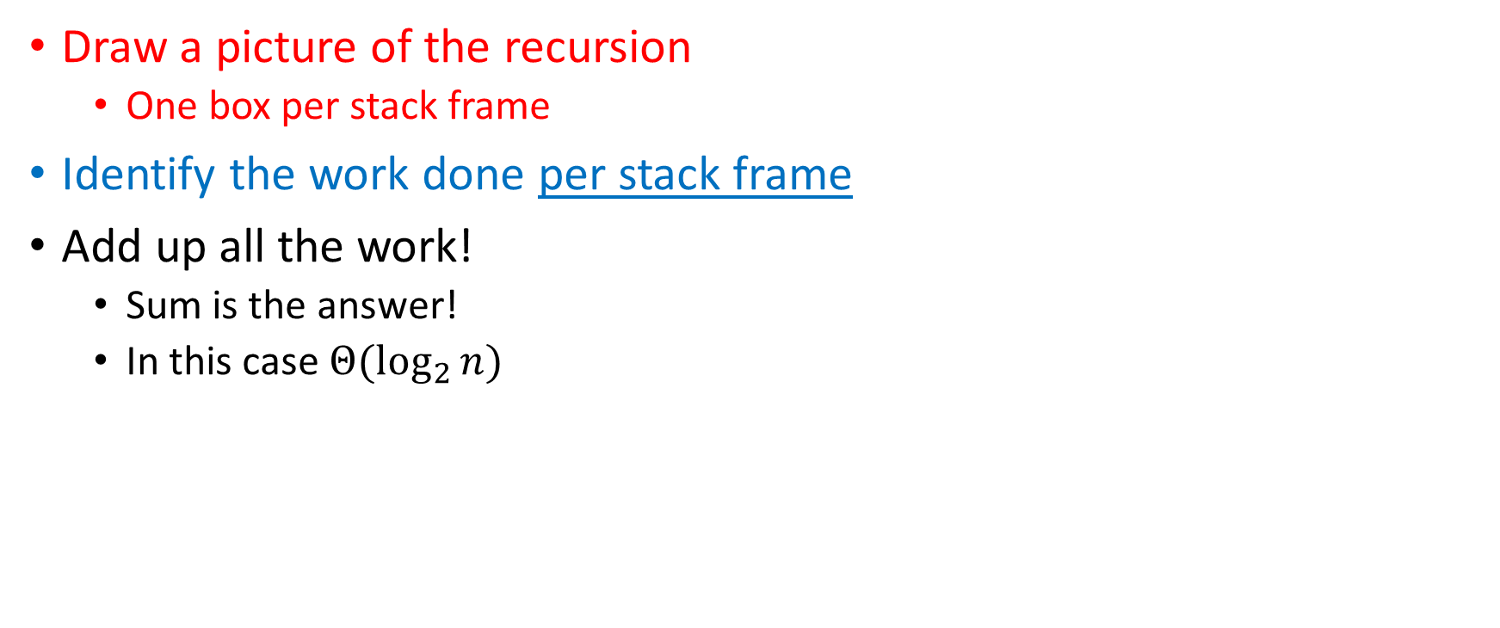







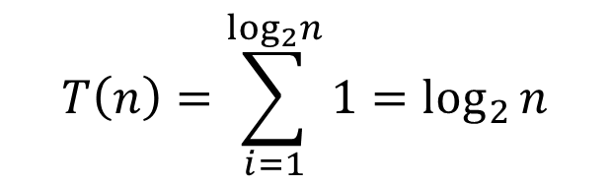
Make our process “prettier”
$$T\left(n\right)=T\left(\frac{n}{2}\right)+1$$
Draw a picture of the recursion
  One box per stack frame
Identify the work done per stack frame
Add up all the work!
  Sum is the answer!
  In this case $Θ(\log_{2}{n})$
$$1$$
$$n$$
$$n/2$$
$$1$$
$$n/4$$
$$1$$
$\log_{2}⁡n$ levels
of recursion
The “Tree Method”
$$n/8$$
$$1$$
…
$$T\left(n\right)=\sum_{i=1}^{\log_{2}n}{1}=\log_{2}{n}$$
$$T\left(n\right)∈Θ\left(\log{n}\right)$$
$$1$$
$$1$$

Slide 9
Recursive Linear Search
5
8
13
42
75
79
88
90
95
99
0
1
2
3
4
5
6
7
8
9
public static boolean linearSearch(List<Integer> lst, int k){
return linearSearch(lst, k, 0, lst.size());
}
private static boolean linearSearch(List<Integer> lst, int k, int start, int end){
if(start == end){
return false;
} else if(lst.get(start) == k){
return true;
} else{
return linearSearch(lst, k, start+1, end);
}
}

Slide 10

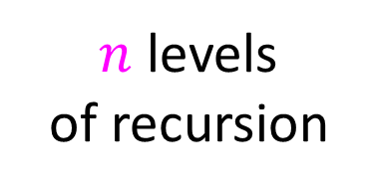









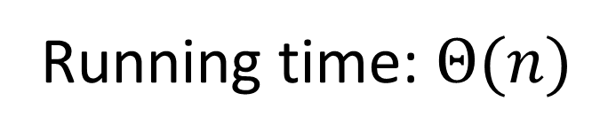

Prettier List Sum Substitution
Draw a picture of the recursion
Identify the work done per stack frame
Add up all the work!
$$T\left(n\right)=T\left(n−1\right)+1$$
$$1$$
$$n$$
$$n−1$$
$$1$$
$$n−2$$
$$1$$
$n$ levels
of recursion
Running time: $Θ(n)$
$$n−3$$
$$1$$
…
$$T\left(n\right)=\sum_{i=1}^{n}{1}=n$$
$$T\left(n\right)∈Θ\left(n\right)$$
$$1$$
$$1$$

Slide 11
Recursive List Summation Code
public int sum(int[] list){
return sum_helper(list, 0, list.size);
}
private int sum_helper(int[] list, int low, int high){
if (low == high){ return 0; }
if (low == high-1){ return list[low]; }
int middle = (high+low)/2;
return sum_helper(list, low, middle) + sum_helper(list, middle, high);
}

Slide 12










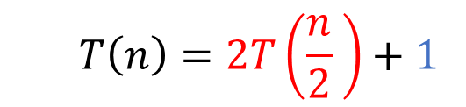


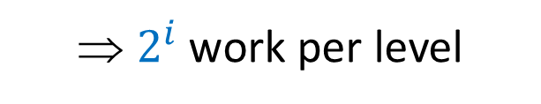














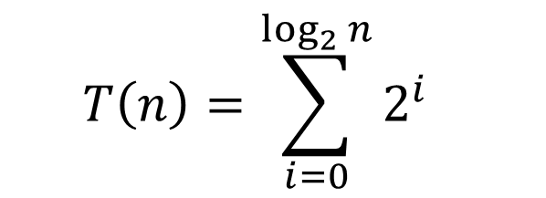
Tree Method for Recursive Summation
Red box represents a problem instance
  $$T\left(n\right)=2T\left(\frac{n}{2} \right)+1$$
Blue value next to each box represents time spent at that recursive call
$$1$$
⇒ $2^{i}$ work per level
$$n$$
$$n/2$$
$$1$$
$$n/2$$
$$1$$
$$1$$
$$1$$
$$1$$
$$1$$
$\log_{2}⁡n$ levels
of recursion
$$n/4$$
$$n/4$$
$$n/4$$
$$n/4$$
…
…
…
…
…
$$1$$
$$1$$
$$1$$
$$1$$
$$1$$
$$1$$
$$1$$
$$1$$
$$1$$
$$1$$
$$1$$
$$1$$
  $$T\left(n\right)=\sum_{i=0}^{\log_{2}{n}}{2^{i}}$$

Slide 13
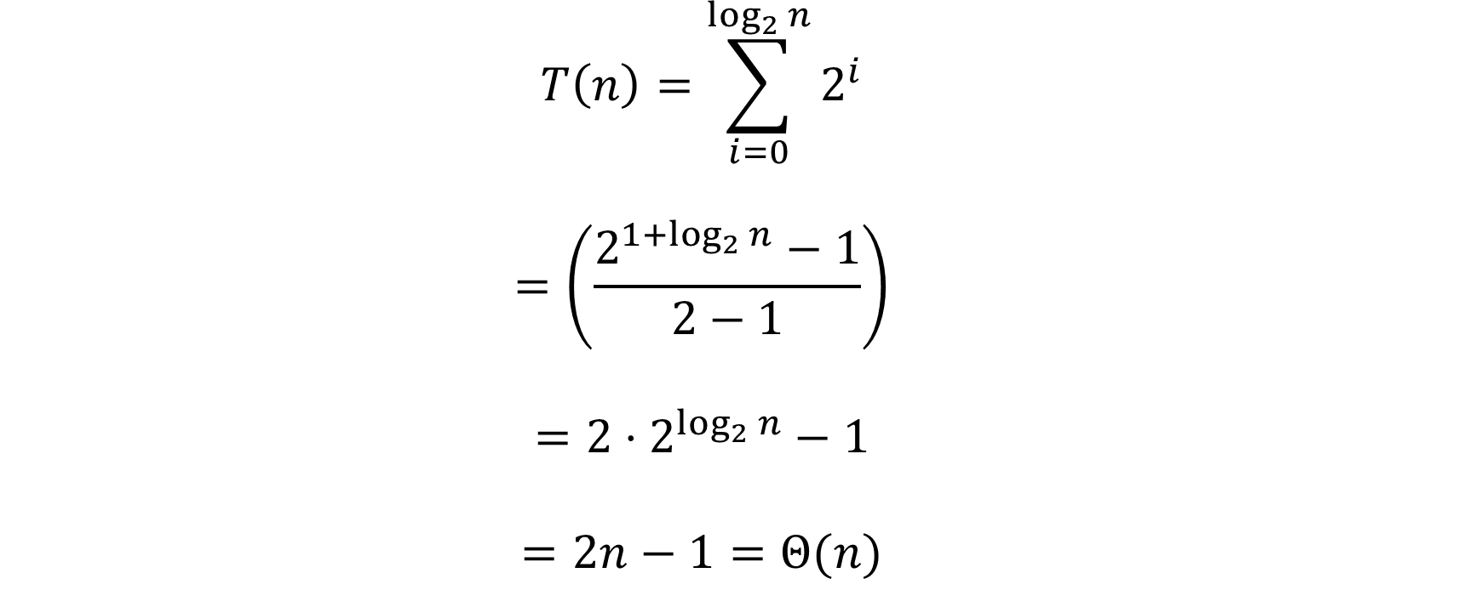
Recursive List Summation – Solving the Series
  $$T\left(n\right)=\sum_{i=0}^{\log_{2}{n}}{2^{i}}$$
  $$=\left(\frac{2^{{1+log}_{2}{n}}−1}{2−1}\right)$$
  $$=2⋅2^{\log_{2}{n}}−1$$
  $$=2n−1=Θ(n)$$
Remember the
Math Identities Reference Sheet
(will be provided on exams)

Slide 14
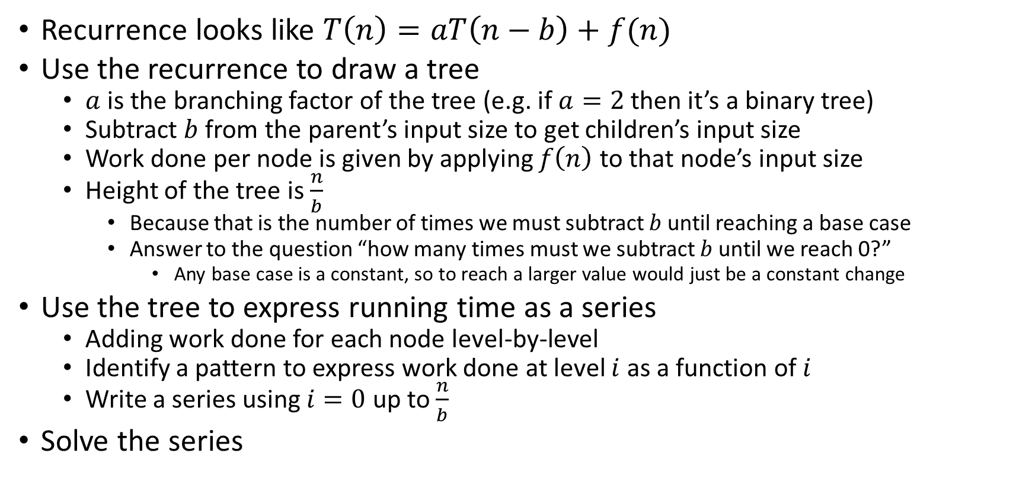
Tree Method Summary: Chip and Conquer
Recurrence looks like $T\left(n\right)=aT\left(n−b\right)+f(n)$
Use the recurrence to draw a tree
  $a$ is the branching factor of the tree (e.g. if $a=2$ then it’s a binary tree)
  Subtract $b$ from the parent’s input size to get children’s input size
  Work done per node is given by applying $f\left(n\right)$ to that node’s input size
  Height of the tree is $\frac{n}{b}$
    Because that is the number of times we must subtract $b$ until reaching a base case
    Answer to the question “how many times must we subtract $b$ until we reach 0?”
      Any base case is a constant, so to reach a larger value would just be a constant change
Use the tree to express running time as a series
  Adding work done for each node level-by-level
  Identify a pattern to express work done at level $i$ as a function of $i$
  Write a series using $i=0$ up to $\frac{n}{b}$
Solve the series

Slide 15
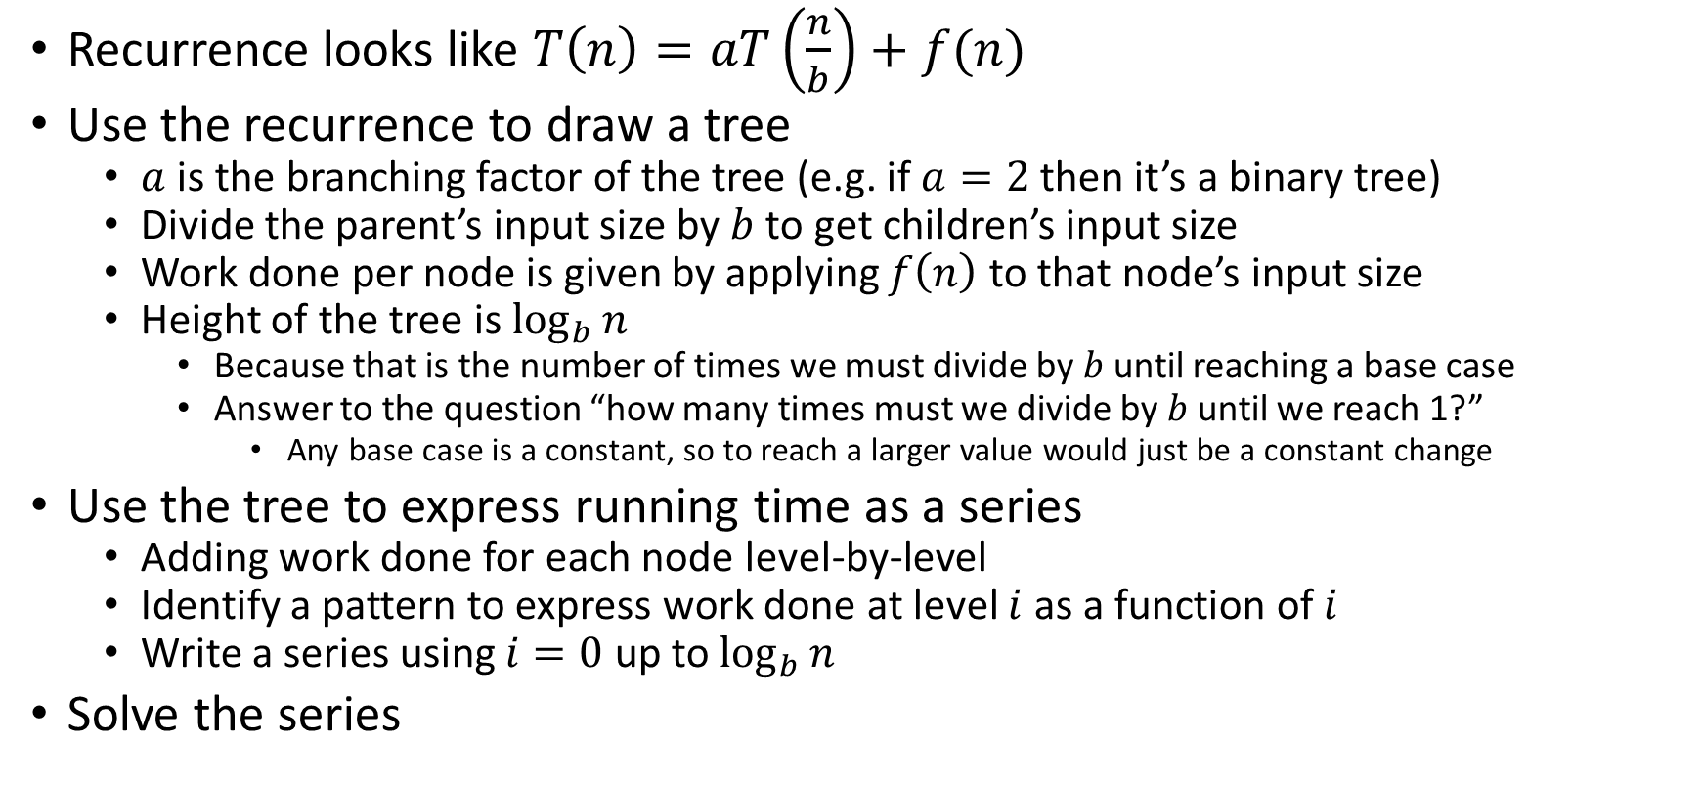
Tree Method Summary: Divide and Conquer
Recurrence looks like $T\left(n\right)=aT\left(\frac{n}{b}\right)+f(n)$
Use the recurrence to draw a tree
  $a$ is the branching factor of the tree (e.g. if $a=2$ then it’s a binary tree)
  Divide the parent’s input size by $b$ to get children’s input size
  Work done per node is given by applying $f\left(n\right)$ to that node’s input size
  Height of the tree is $\log_{b}{n}$
    Because that is the number of times we must divide by $b$ until reaching a base case
    Answer to the question “how many times must we divide by $b$ until we reach 1?”
      Any base case is a constant, so to reach a larger value would just be a constant change
Use the tree to express running time as a series
  Adding work done for each node level-by-level
  Identify a pattern to express work done at level $i$ as a function of $i$
  Write a series using $i=0$ up to $\log_{b}{n}$
Solve the series

Slide 16
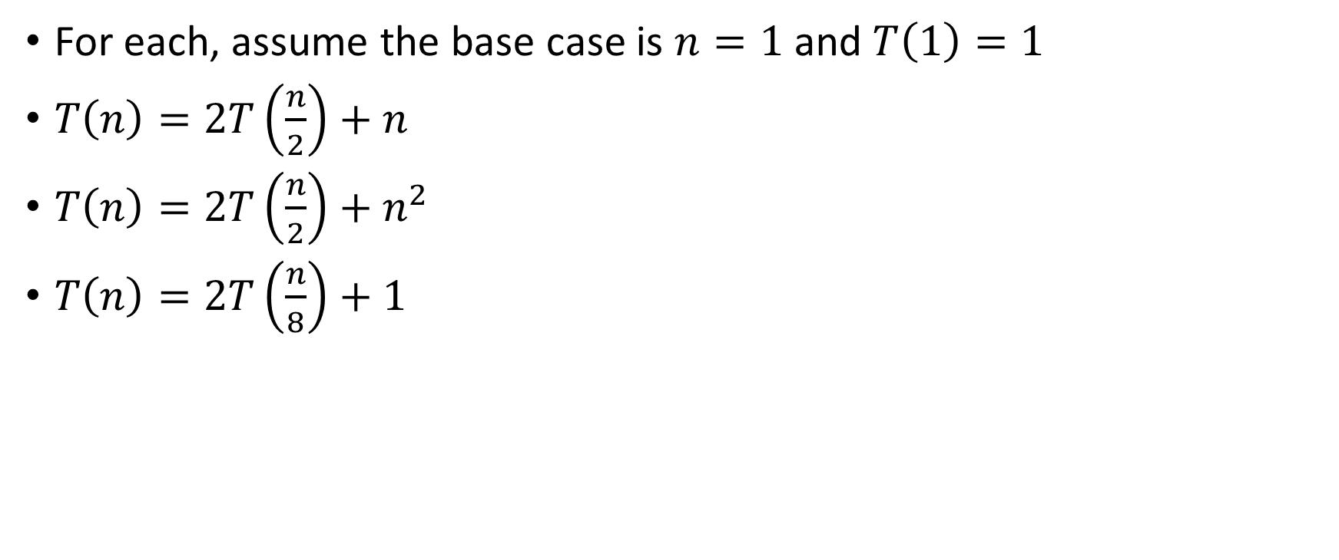
Let’s do some more!
For each, assume the base case is $n=1$ and $T\left(1\right)=1$
$T\left(n\right)=2T\left(\frac{n}{2}\right)+n$
$T\left(n\right)=2T\left(\frac{n}{2}\right)+n^{2}$
$T\left(n\right)=2T\left(\frac{n}{8}\right)+1$

Slide 17




















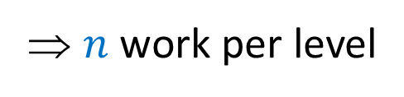








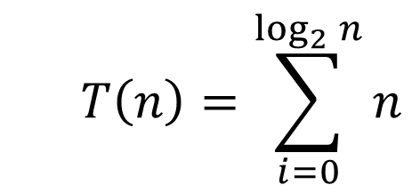
Tree Method $T\left(n\right)=2T\left(\frac{n}{2}\right)+n$
Red box represents a problem instance
Blue value next to each box represents time spent at that recursive call
$$n$$
⇒ $n$ work per level
$$n$$
$$n/2$$
$$\frac{n}{2}$$
$$n/2$$
$$\frac{n}{2}$$
$\log_{2}⁡n$ levels
of recursion
$$n/4$$
$$\frac{n}{4}$$
$$n/4$$
$$\frac{n}{4}$$
$$n/4$$
$$\frac{n}{4}$$
$$n/4$$
$$\frac{n}{4}$$
…
…
…
…
  $$T\left(n\right)=\sum_{i=0}^{\log_{2}{n}}{n}$$
…
$$1$$
$$1$$
$$1$$
$$1$$
$$1$$
$$1$$
$$1$$
$$1$$
$$1$$
$$1$$
$$1$$
$$1$$
$$T\left(n\right)∈Θ\left(nlogn\right)$$

Slide 18




















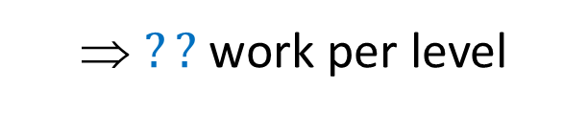







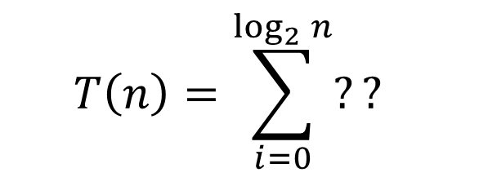
Tree Method $T\left(n\right)=2T\left(\frac{n}{2}\right)+n^{2}$
Red box represents a problem instance
Blue value next to each box represents time spent at that recursive call
$$n^{2}$$
⇒ $??$ work per level
$$n$$
$$n/2$$
$$\frac{n^{2}}{4}$$
$$n/2$$
$$\frac{n^{2}}{4}$$
$\log_{2}⁡n$ levels
of recursion
$$n/4$$
$$\frac{n^{2}}{16}$$
$$n/4$$
$$\frac{n^{2}}{16}$$
$$n/4$$
$$\frac{n^{2}}{16}$$
$$n/4$$
$$\frac{n^{2}}{16}$$
…
…
…
…
…
  $$T\left(n\right)=\sum_{i=0}^{\log_{2}{n}}{??}$$
$$1$$
$$1$$
$$1$$
$$1$$
$$1$$
$$1$$
$$1$$
$$1$$
$$1$$
$$1$$
$$1$$
$$1$$

Slide 19
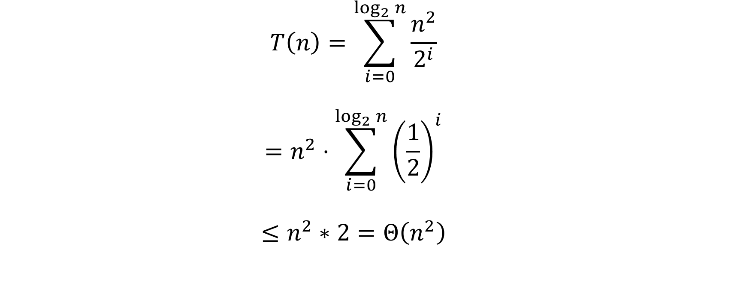

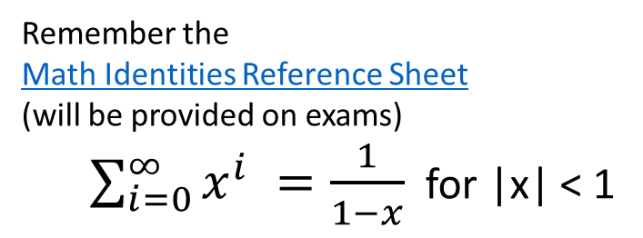
Solving $T\left(n\right)=2T\left(\frac{n}{2}\right)+n^{2}$
  $$T\left(n\right)=\sum_{i=0}^{\log_{2}{n}}{\frac{n^{2}}{2^{i}}}$$
  $$=n^{2}⋅\sum_{i=0}^{\log_{2}{n}}{{\left(\frac{1}{2}\right)}^{i}}$$
  $$≤n^{2}∗2=Θ\left(n^{2}\right)$$
Remember the
Math Identities Reference Sheet
(will be provided on exams)
  $\sum_{i=0}^{∞}{x^{i}} =\frac{1}{1−x}$ for |x| < 1

Slide 20













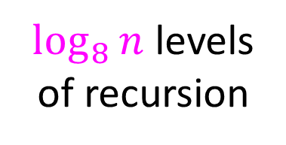






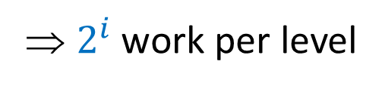







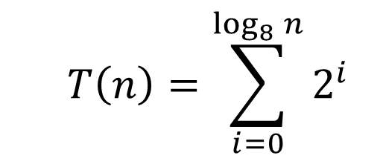
Tree Method $T\left(n\right)=2T\left(\frac{n}{8}\right)+1$
Red box represents a problem instance
Blue value next to each box represents time spent at that recursive call
$$1$$
$$n$$
⇒ $2^{i}$ work per level
$$n/8$$
$$1$$
$$n/8$$
$$1$$
$\log_{8}⁡n$ levels
of recursion
$$n/{64}$$
$$1$$
$$n/{64}$$
$$1$$
$$n/{64}$$
$$1$$
$$n/{64}$$
$$1$$
…
…
…
…
  $$T\left(n\right)=\sum_{i=0}^{\log_{8}{n}}{2^{i}}$$
…
$$1$$
$$1$$
$$1$$
$$1$$
$$1$$
$$1$$
$$1$$
$$1$$
$$1$$
$$1$$
$$1$$
$$1$$

Slide 21
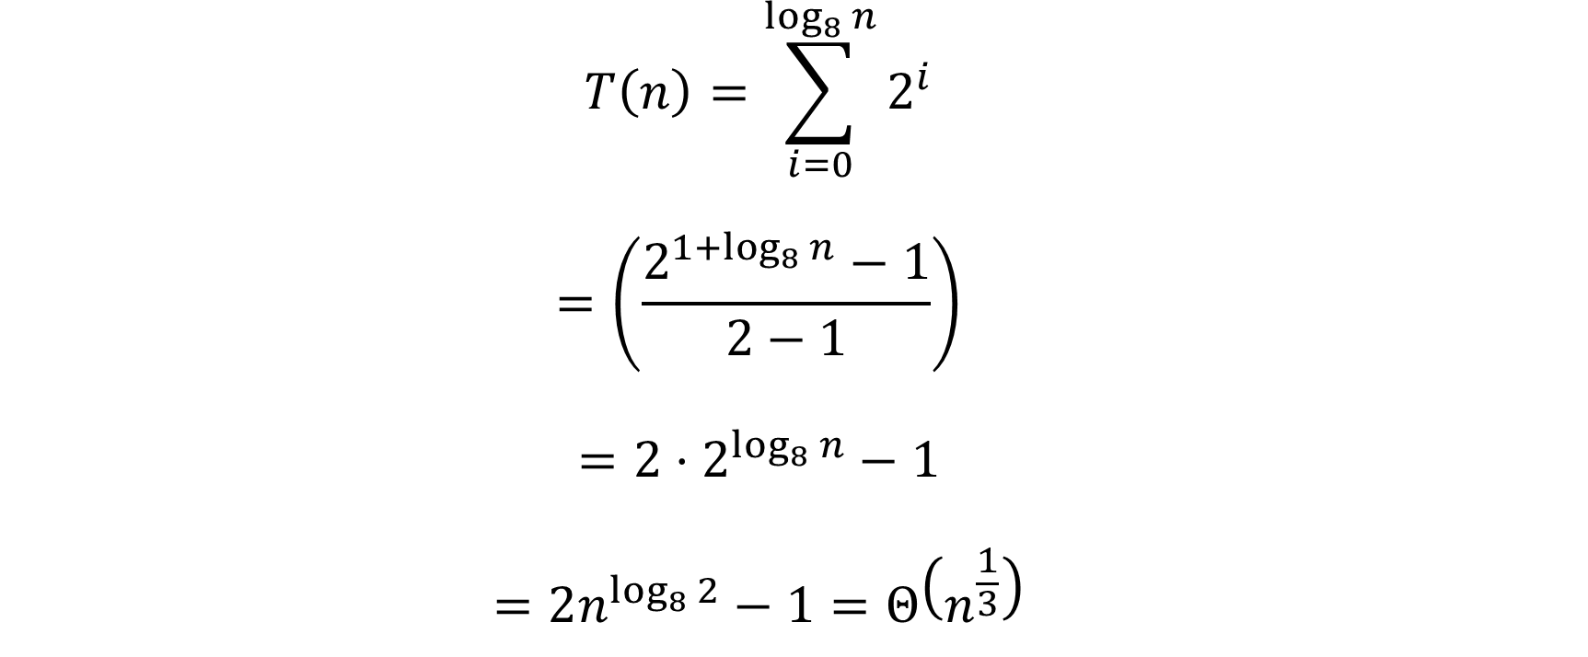

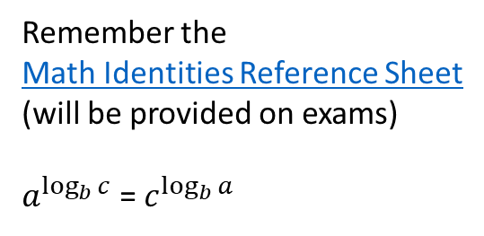
Solving $T\left(n\right)=2T\left(\frac{n}{8}\right)+1$
  $$T\left(n\right)=\sum_{i=0}^{\log_{8}{n}}{2^{i}}$$
  $$=\left(\frac{2^{{1+log}_{8}{n}}−1}{2−1}\right)$$
  $$=2⋅2^{\log_{8}{n}}−1$$
  $$=2n^{\log_{8}{2}}−1=Θ\left(n^{\frac{1}{3}}\right)$$
Remember the
Math Identities Reference Sheet
(will be provided on exams)
$a^{\log_{b}{c}}$ = $c^{\log_{b}{a}}$

Slide 22
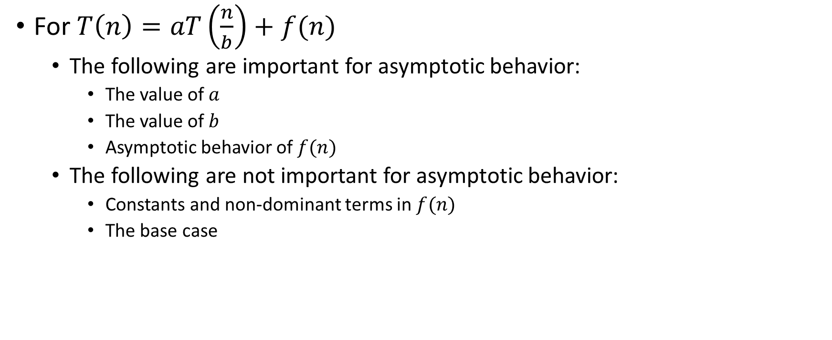
What matters, recursively
For $T\left(n\right)=aT\left(\frac{n}{b}\right)+f(n)$
  The following are important for asymptotic behavior:
    The value of $a$
    The value of $b$
    Asymptotic behavior of $f(n)$
  The following are not important for asymptotic behavior:
    Constants and non-dominant terms in $f(n)$
    The base case

Slide 23
Really common recurrences
Should know how to solve recurrences but also recognize some
really common ones:
T(n) = O(1) + T(n/2) logarithmic O(log n)
T(n) = O(1) + 2T(n/2) linear O(n)
T(n) = O(1) + T(n-1) linear O(n)
T(n) = O(n) + T(n-1) quadratic O(n²)
T(n) = O(1) + 2T(n-1) exponential O(2^{n})
T(n) = O(n) + T(n/2) linear O(n)
T(n) = O(n) + 2T(n/2) loglinear O(n log n)

