Slide 1
CSE 332 Autumn 2026
Lecture 4: Priority Queues, pt 1
Ruth Anderson
http://www.cs.uw.edu/332

Slide 2
Announcements
Exercise 0
  Due Friday 10/09/2026
  There are 2 separate Gradescope submissions
“Meet the staff” activity - Sometime during the first 4 weeks of class.
Participate in Section, earn a late day (see Ed Board post)
Exercise 1 Running Time:
  Due Mon Oct 12
  Entirely in Gradescope. Save your answers outside of Gradescope and confirm that you have answered/uploaded everything that is needed!
Exercise 2 Heaps: coming end of week, due Fri Oct 16

Slide 3
Review: ADT: Queue
What is it?
  A “First In First Out” (FIFO) collection of items
What Operations do we need?
  Enqueue
    Add a new item to the queue
  Dequeue
    Remove the “oldest” item from the queue
  Is_empty
    Indicate whether or not there are items still on the queue

Slide 4
Scenario
What is the difference between waiting for service at a pharmacy versus an ER?
Pharmacies usually follow the rule
First Come, First Served
Emergency Rooms assign priorities
based on each individual's need

Slide 5
Scenario (answer)
What is the difference between waiting for service at a pharmacy versus an ER?
Pharmacies usually follow the rule
First Come, First Served
Emergency Rooms assign priorities
based on each individual's need
Queue
Priority
Queue
Notes:
HIDE

Slide 6
ADT: Priority Queue
What is it?
  A collection of items and their “priorities”
  Allows quick access/removal to the “top priority” thing
    Usually a smaller priority value means the item is “more important”
What Operations do we need?
  insert(item, priority)
    Add a new item to the PQ with indicated priority
  extract
    Remove and return the “top priority” item from the queue
      Usually the item with the smallest priority value
  IsEmpty
    Indicate whether or not there are items still on the queue
Note: the “priority” value can be any type/class so long as it’s comparable (i.e. you can use “<“ or “compareTo” with it)

Slide 7
A priority queue holds compare-able data
Unlike stacks and queues need to compare items
  Given x and y, is x less than, equal to, or greater than y
  What this means can depend on your data
  Much of course will require comparable data: e.g. sorting
Integers are comparable, so will use them in examples
  But the priority queue ADT is much more general
  Typically two fields, the priority and the data
For simplicity in lecture, we’ll often suppose items are just ints and the int is also the priority

Slide 8
Priority Queue Example 1
PriorityQueue PQ = new PriorityQueue();
PQ.insert(5,5)
PQ.insert(6,6)
PQ.insert(1,1)
PQ.insert(3,3)
PQ.insert(8,8)
Print(PQ.extract)
Print(PQ.extract)
Print(PQ.extract)
Print(PQ.extract)
Print(PQ.extract)
Prints:
1
3
5
6
8

Slide 9
Priority Queue Example 2
PriorityQueue PQ = new PriorityQueue();
PQ.insert(5,5)
PQ.insert(6,6)
PQ.insert(3,3)
Print(PQ.extract)
PQ.insert(1,1)
Print(PQ.extract)
Print(PQ.extract)
PQ.insert(8,8)
Print(PQ.extract)
Print(PQ.extract)
Prints:
3
1
5
6
8

Slide 10
Applications?

Slide 11
Some Example Applications
Treat hospital patients in order of severity (or triage)
Run multiple programs in the operating system
  “critical” before “interactive” before “compute-intensive”
  Maybe let users set priority level
Forward network packets in order of urgency
Select most frequent symbols for data compression (see CSE123?)
Will see an example when we study graphs in a few weeks
Sort: insert all, then repeatedly extract

Slide 12
Thinking through implementations
Data Structure | Worst case time to insert | Worst case time to extract
Unsorted Array
Unsorted Linked List
Sorted Array
Sorted Linked List
Binary Search Tree
For simplicity, Assume we know the maximum size of the PQ in advance (otherwise we’d do an amortized analysis, but get the same answers…)

Slide 13
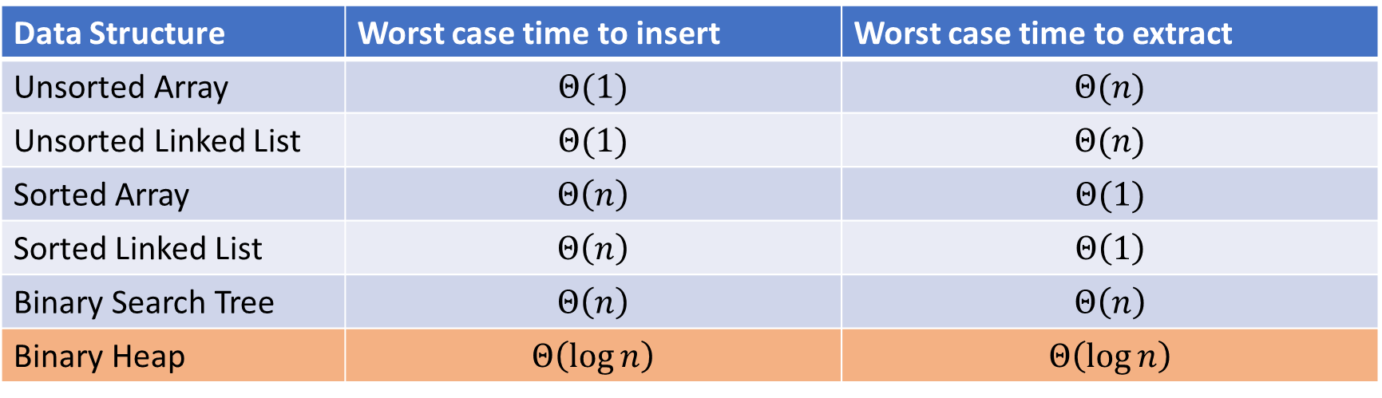
Thinking through implementations (solutions)
Data Structure | Worst case time to insert | Worst case time to extract
Unsorted Array | $$Θ(1)$$ | $$Θ(n)$$
Unsorted Linked List | $$Θ(1)$$ | $$Θ(n)$$
Sorted Array | $$Θ\left(n\right)$$ | $$Θ(1)$$
Sorted Linked List | $$Θ\left(n\right)$$ | $$Θ\left(1\right)$$
Binary Search Tree | $$Θ\left(n\right)$$ | $$Θ\left(n\right)$$
Binary Heap | $$Θ\left(\log{n}\right)$$ | $$Θ\left(\log{n}\right)$$
For simplicity, Assume we know the maximum size of the PQ in advance (otherwise we’d do an amortized analysis, but get the same answers…)

Slide 14
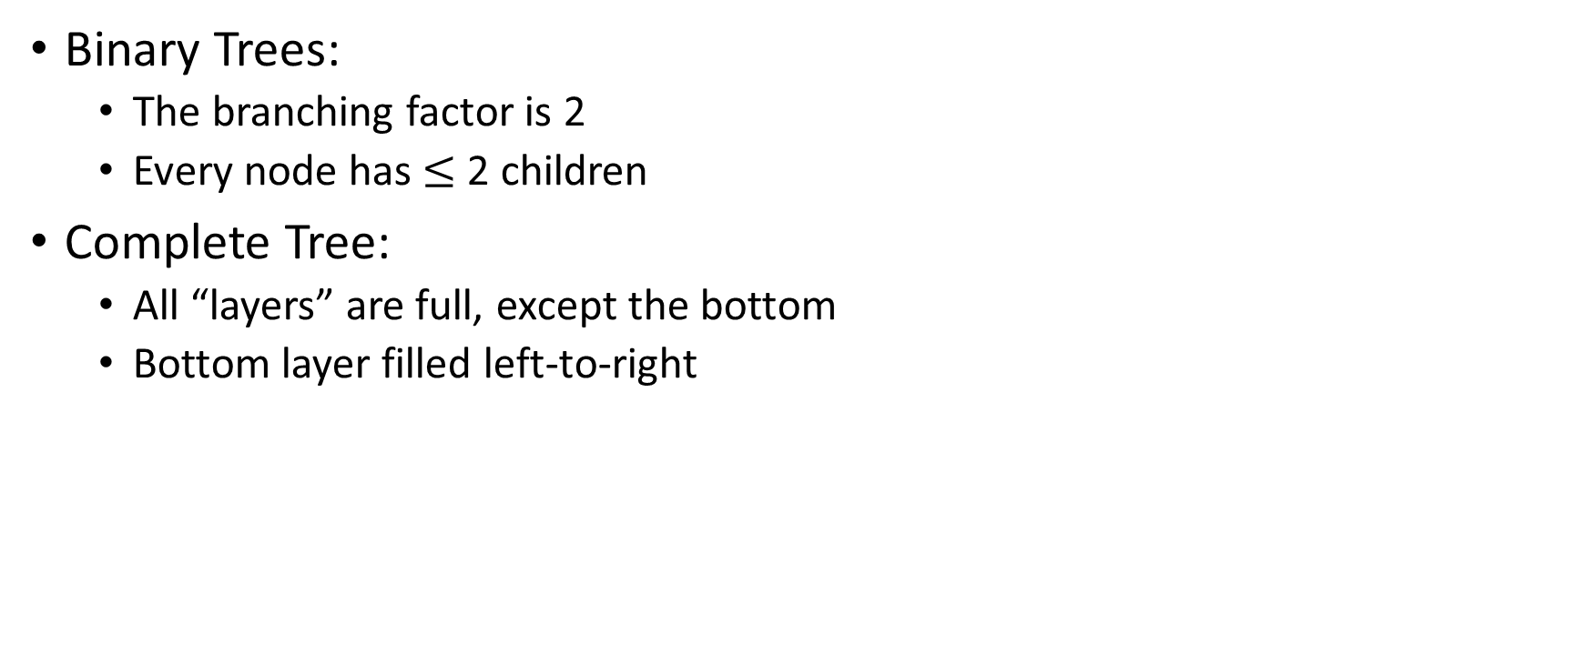
Trees for Heaps
Binary Trees:
  The branching factor is 2
  Every node has $≤$ 2 children
Complete Tree:
  All “layers” are full, except the bottom
  Bottom layer filled left-to-right
1
3
2
4
7
5
6
5
9

Slide 15
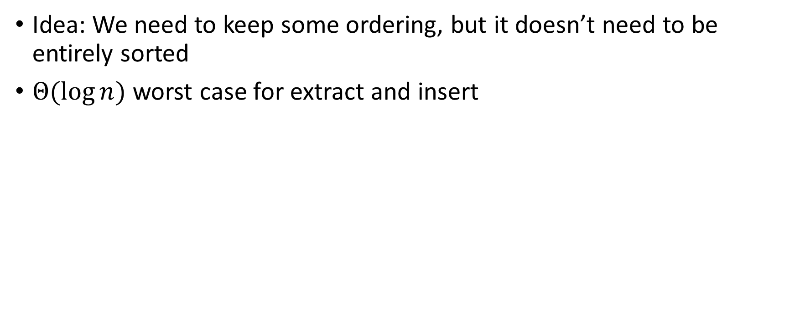
Heap – Priority Queue Data Structure
Idea: We need to keep some ordering, but it doesn’t need to be entirely sorted
$Θ(\log{n})$ worst case for extract and insert
1
1
3
2
4
2
7
5
3
6
4
5
6
7
5
9
8
9

Slide 16
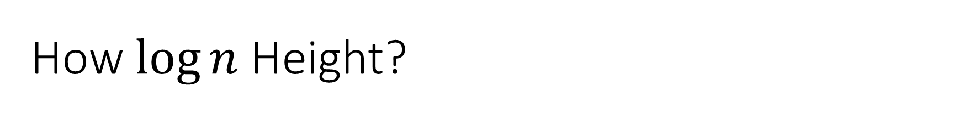
How $\log{n}$ Height?
height – number of edges in path from node to deepest descendent
1
3
2
4
7
5
6
5
9

Slide 17
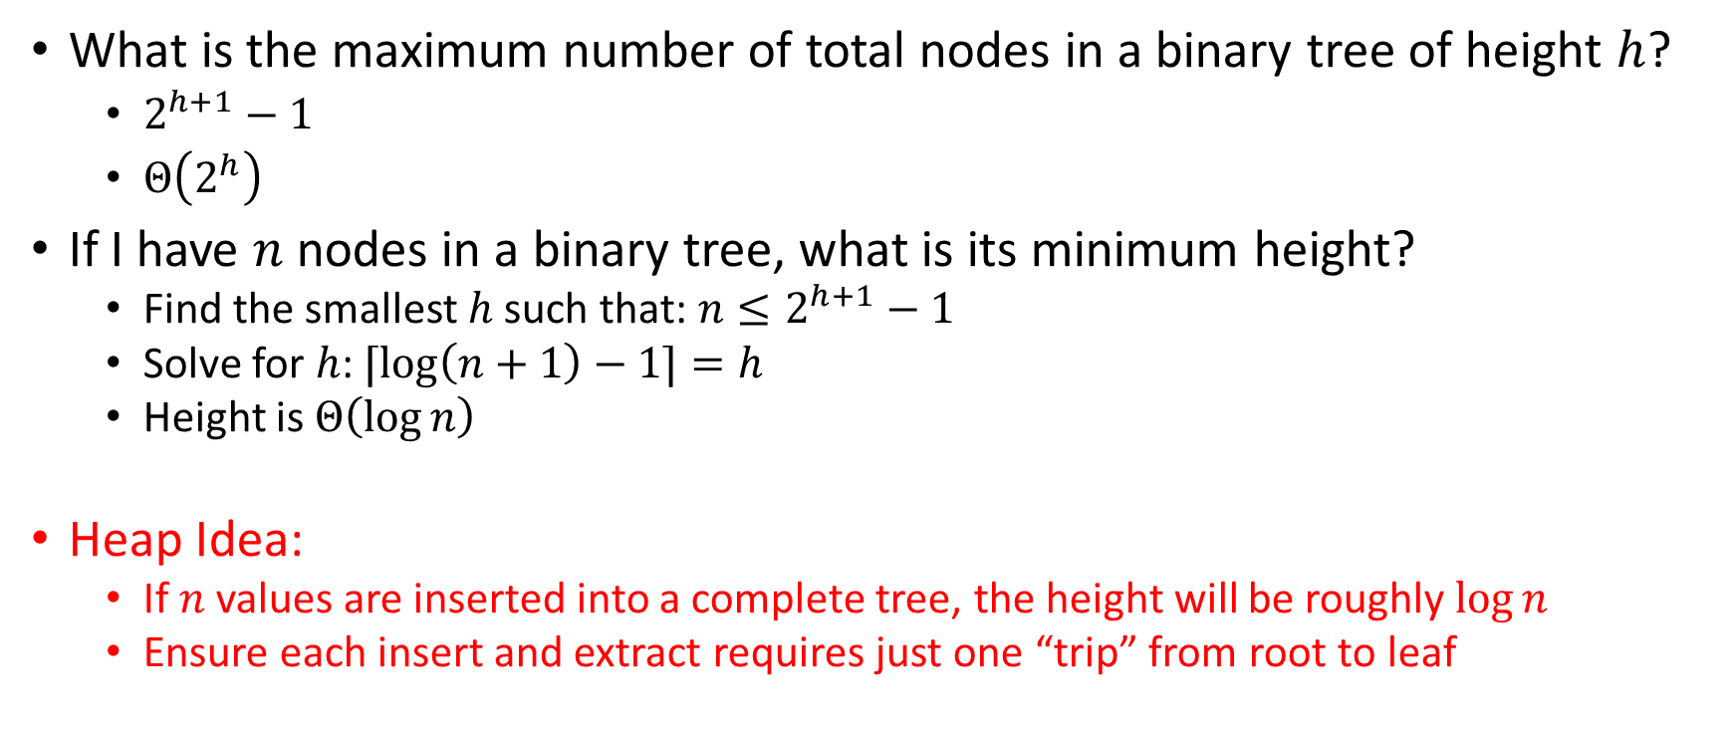

Achieving $\log{n}$ Running Time
What is the maximum number of total nodes in a binary tree of height $h$?
  $2^{h+1}−1$
  $Θ\left(2^{h}\right)$
If I have $n$ nodes in a binary tree, what is its minimum height?
  Find the smallest $h$ such that: $n≤2^{h+1}−1$
  Solve for $h$: $⌈\log\left(n+1\right)−1⌉=h$
  Height is $Θ\left(\log{n}\right)$
Heap Idea:
  If $n$ values are inserted into a complete tree, the height will be roughly $\log{n}$
  Ensure each insert and extract requires just one “trip” from root to leaf

Slide 18
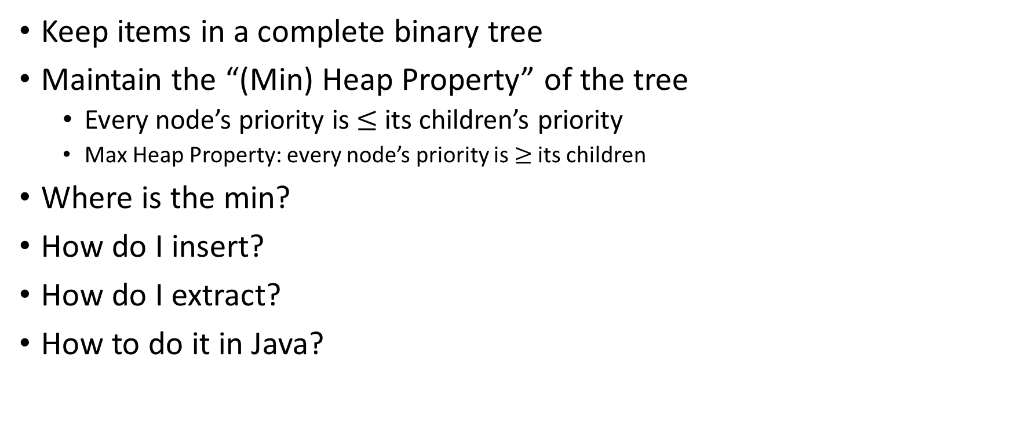
(Min) Heap Data Structure
Keep items in a complete binary tree
Maintain the “(Min) Heap Property” of the tree
  Every node’s priority is $≤$ its children’s priority
  Max Heap Property: every node’s priority is $≥$ its children
Where is the min?
How do I insert?
How do I extract?
How to do it in Java?
1
1
3
2
4
2
7
5
3
6
4
5
6
7
5
9
8
9

Slide 19
Heap Insert Example
1
1.5
3
2
4
7
5
6
5
9
insert(item, priority){
put item in the “next open” spot (keep tree complete)
while (priority < parent’s priority){
swap item with parent
}
}

Slide 20
Heap Insert (New Node)
1
3
2
4
7
5
6
5
9
1.5
insert(item, priority){
put item in the “next open” spot (keep tree complete)
while (priority < parent’s priority){
swap item with parent
}
}

Slide 21
Heap Insert (1st Percolate)
1
3
2
4
1.5
5
6
5
9
7
insert(item, priority){
put item in the “next open” spot (keep tree complete)
while (priority < parent’s priority){
swap item with parent
}
}
Percolate Up

Slide 22
Heap Insert (2nd Percolate)
1
1.5
2
4
3
5
6
5
9
7
insert(item, priority){
put item in the “next open” spot (keep tree complete)
while (priority < parent’s priority){
swap item with parent
}
}
Percolate Up

Slide 23
Heap Insert (Done)
1
1.5
2
4
3
5
6
5
9
7
insert(item, priority){
put item in the “next open” spot (keep tree complete)
while (priority < parent’s priority){
swap item with parent
}
}

Slide 24
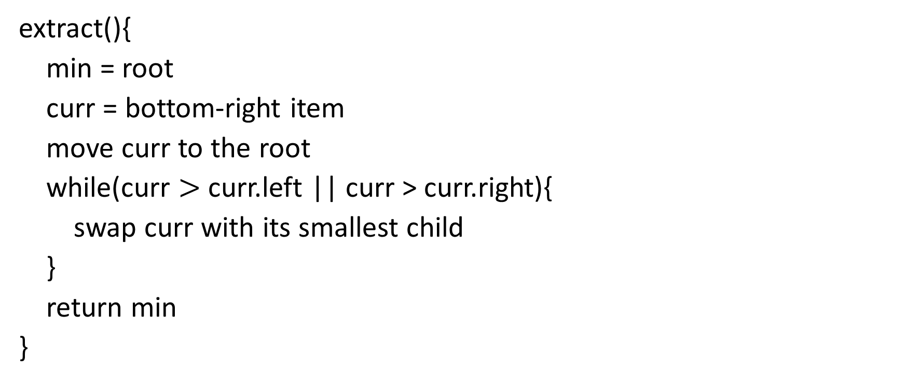
Heap extract Example
1
1.5
2
4
3
5
6
extract(){
min = root
curr = bottom-right item
move curr to the root
while(curr $>$ curr.left || curr > curr.right){
swap curr with its smallest child
}
return min
}
5
9
7

Slide 25
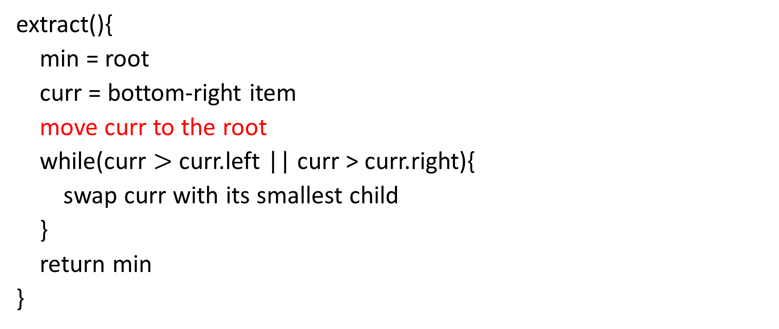
Heap extract (Move Node)
7
1.5
2
4
3
5
6
extract(){
min = root
curr = bottom-right item
move curr to the root
while(curr $>$ curr.left || curr > curr.right){
swap curr with its smallest child
}
return min
}
5
9
7

Slide 26
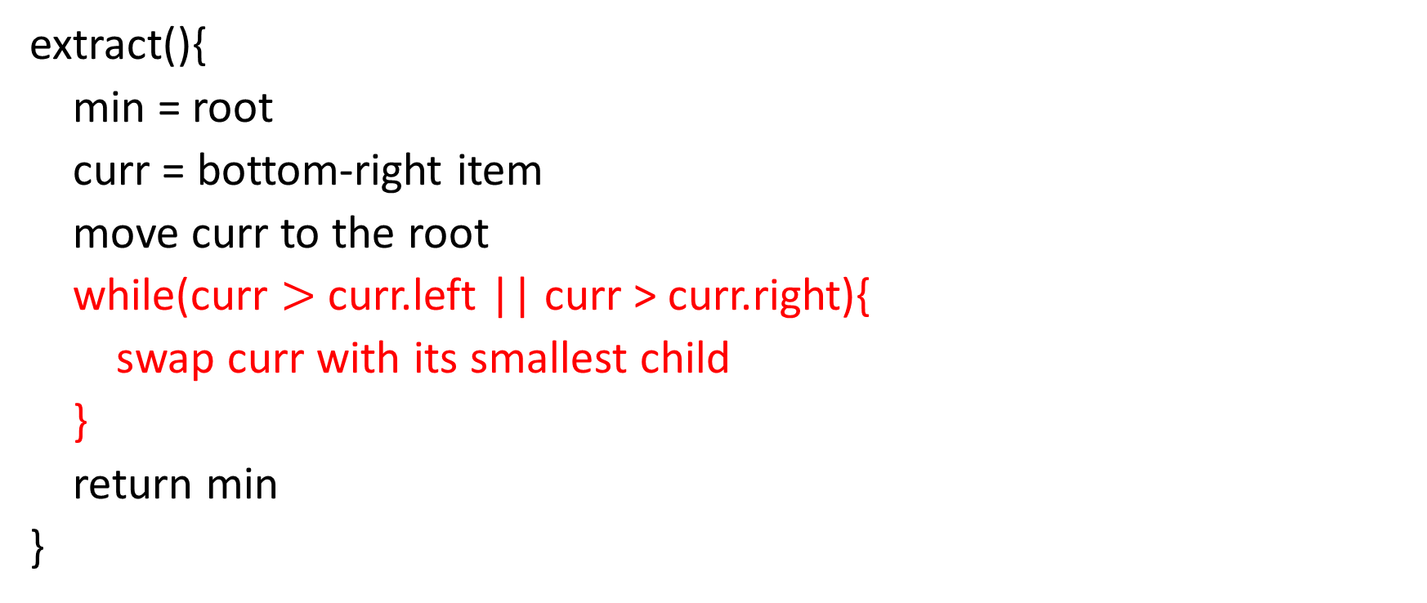
Heap extract (1st Percolate)
1.5
7
2
4
3
5
6
extract(){
min = root
curr = bottom-right item
move curr to the root
while(curr $>$ curr.left || curr > curr.right){
swap curr with its smallest child
}
return min
}
5
9
Percolate Down

Slide 27
Heap extract (2nd Percolate)
1.5
3
2
4
7
5
6
extract(){
min = root
curr = bottom-right item
move curr to the root
while(curr $>$ curr.left || curr > curr.right){
swap curr with its smallest child
}
return min
}
5
9
Percolate Down

Slide 28
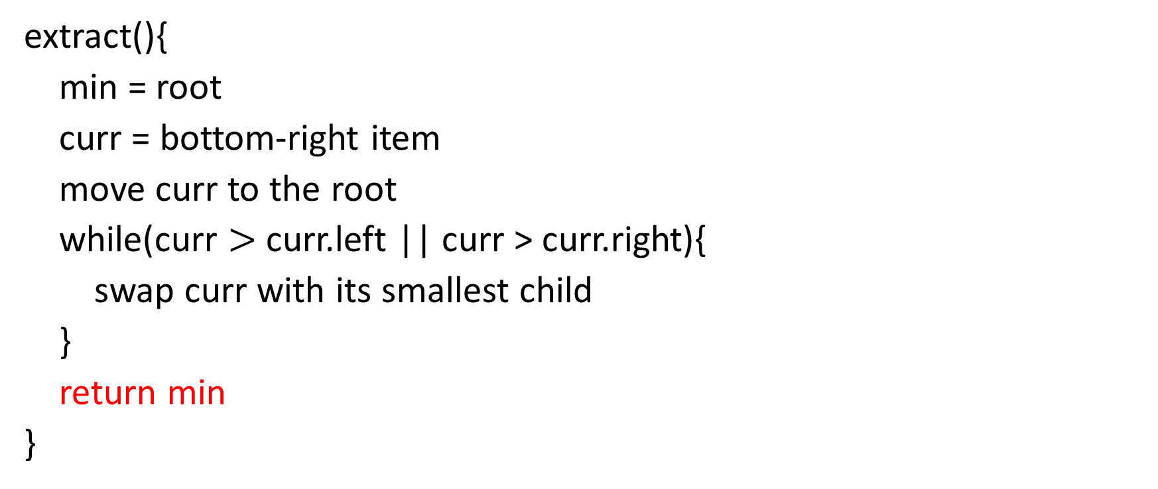
Heap extract (Done)
1.5
3
2
4
7
5
6
extract(){
min = root
curr = bottom-right item
move curr to the root
while(curr $>$ curr.left || curr > curr.right){
swap curr with its smallest child
}
return min
}
5
9

Slide 29
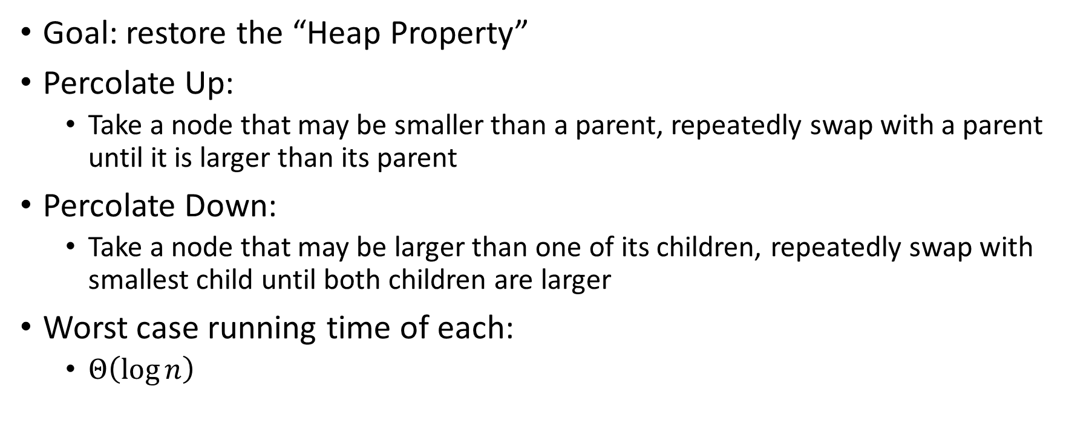
Percolate Up and Down (for a Min Heap)
Goal: restore the “Heap Property”
Percolate Up:
  Take a node that may be smaller than a parent, repeatedly swap with a parent until it is larger than its parent
Percolate Down:
  Take a node that may be larger than one of its children, repeatedly swap with smallest child until both children are larger
Worst case running time of each:
  $Θ\left(\log{n}\right)$

Slide 30
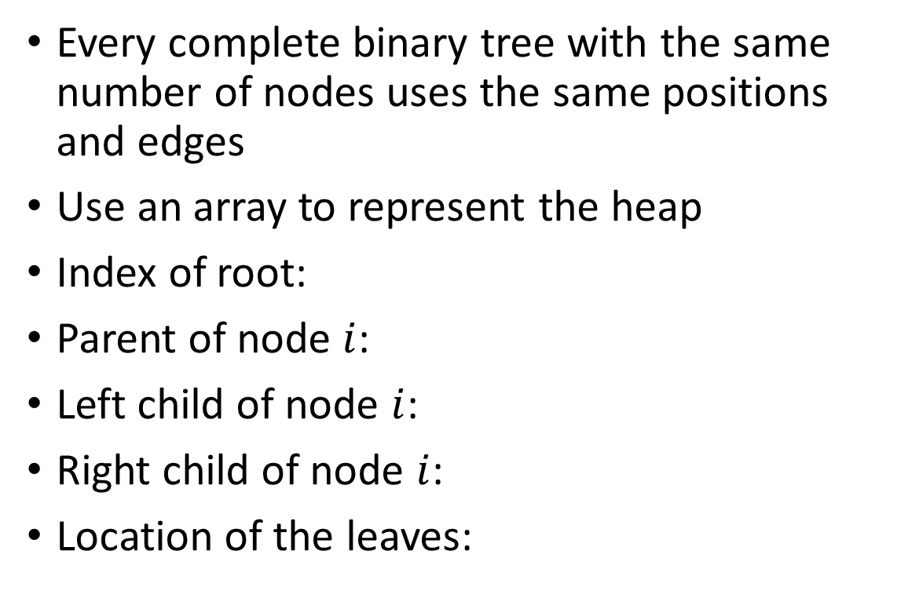
Representing a Heap (Questions)
1
Every complete binary tree with the same number of nodes uses the same positions and edges
Use an array to represent the heap
Index of root:
Parent of node $i$:
Left child of node $i$:
Right child of node $i$:
Location of the leaves:
1
3
2
4
2
7
5
3
6
4
5
6
7
5
9
8
9
1
3
2
4
7
5
6
5
9
0
1
2
3
4
5
6
7
8
9

Slide 31
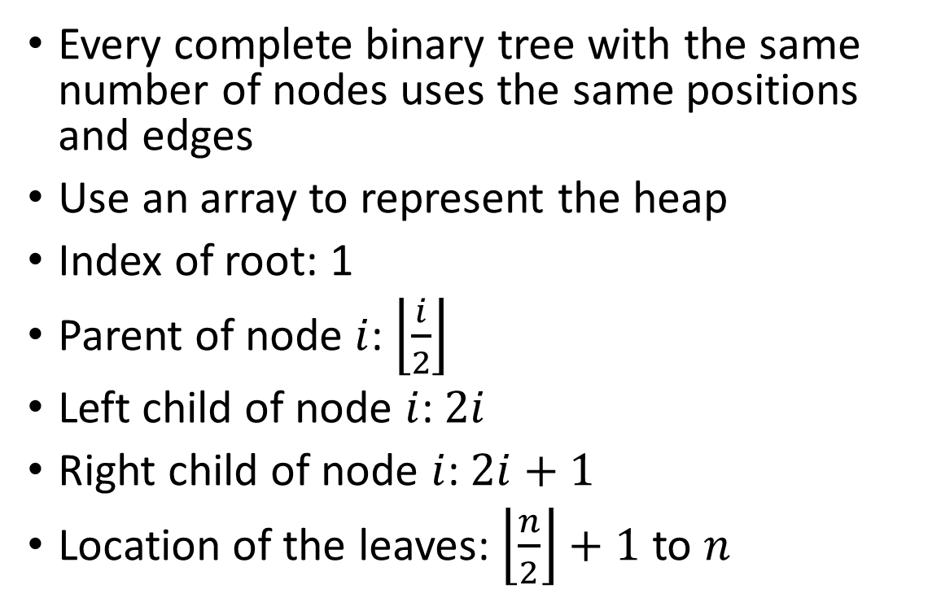
Representing a Heap (Answers)
1
Every complete binary tree with the same number of nodes uses the same positions and edges
Use an array to represent the heap
Index of root: 1
Parent of node $i$: $\left\lfloor \frac{i}{2}\right\rfloor$
Left child of node $i$: $2i$
Right child of node $i$: $2i+1$
Location of the leaves: $\left\lfloor \frac{n}{2}\right\rfloor +1$ to $n$
1
3
2
4
2
7
5
3
6
4
5
6
7
5
9
8
9
1
3
2
4
7
5
6
5
9
0
1
2
3
4
5
6
7
8
9

Slide 32
Insert Pseudocode
1
For simplicity, assume value is the same as priority
1
insert(item){
if(size == arr.length – 1){resize();}
size++;
arr[size] = item;
percolateUp(size)
}
3
2
4
2
7
5
3
6
4
5
6
7
5
9
8
9
1
3
2
4
7
5
6
5
9
0
1
2
3
4
5
6
7
8
9

Slide 33
Percolate Up
percolateUp(int i){
int parent = i/2; \\ index of parent
Item val = arr[i]; \\ value at current location
while(i > 1 && arr[i] < arr[parent]){ \\ until location is root or heap property holds
arr[i] = arr[parent]; \\ move parent value to this location
arr[parent] = val; \\ put current value into parent’s location
i = parent; \\ make current location the parent
parent = i/2; \\ update new parent
}
}

Slide 34
extract Pseudocode
extract(){
theMin = arr[1];
arr[1] = arr[size];
size--;
percolateDown(1);
return theMin;
}

Slide 35
Percolate Down
percolateDown(int i){
int left = i*2; \\ index of left child
int right = i*2+1; \\ index of right child
Item val = arr[i]; \\ value at location
while(left <= size){ \\ until location is leaf
int toSwap = right;
if(right > size || arr[left] < arr[right]){ \\ if there is no right child or if left child is smaller
toSwap = left; \\ swap with left
} \\ now toSwap has the smaller of left/right, or left if right does not exist
if (arr[toSwap] < val){ \\ if the smaller child is less than the current value
arr[i] = arr[toSwap];
arr[toSwap] = val; \\ swap parent with smaller child
i = toSwap; \\ update current node to be smaller child
left = i*2;
right = i*2+1;
}
else{ return;} \\ if we don’t swap, then heap property holds
}
}

Slide 36
Other Operations
Update Key
  Increase Key
    Given the index of an item in the PQ, make its priority value larger
      Min Heap: Then percolate down
      Max Heap: Then percolate up
  Decrease Key
    Given the index of an item in the PQ, make its priority value smaller
      Min Heap: Then percolate up
      Max Heap: Then percolate down
Remove
  Given the item at the given index from the PQ

