Slide 1
CSE 332 Autumn 2026
Lecture 3: Algorithm Analysis pt.2
Ruth Anderson
http://www.cs.uw.edu/332

Slide 2
Announcements
Preliminary Survey
  Due Monday 10/05 – TONIGHT!
  On Canvas
Exercise 0
  Due Friday 10/09/2026
  There are 2 separate Gradescope submissions
“Meet the staff” activity
  Sometime during the first 4 weeks of class, visit a CSE 332 office hour (in person or on zoom)
  Tell the staff member you want to get checked off
  You do not have to have a question about course content
  We just want to meet you!
Exercise 1 Running Time: coming early next week, due Mon Oct 12

Slide 3
Review: Motivation for Algorithm Analysis
We want to define algorithm running times in a way that’s predictive:
  We’re not required to implement & run the algorithms to determine the time
  Our conclusions do not depend on how the algorithm is implemented/run
    E.g. variation in choice of programming language, machine, or other tasks the computer is doing in parallel
  We can use it to compare running times of different algorithms
  We do not need to select an input size in advance

Slide 4
Review: Process for Algorithm Analysis
Identify a function which maps the algorithm’s input size to a measure of resources used
  Domain of the function: sizes of the input
    Number of characters in a string, number of items in a list, number of pixels in an image
  Codomain of the function: counts of resources used
    Typically we think of this as “amount of time” but we will specifically count things like: Number of times the algorithm adds two numbers together, number times the algorithm does a > or < comparison, maximum number of bytes of memory the algorithm uses at any time
Important note: Make sure you know the “units” of your domain and codomain!
  Domain = inputs to the function
  Codomain = outputs to the function

Slide 5
Review: Scenarios to analyze for an algorithm
Worst-case complexity:
  max number of steps algorithm takes on “most challenging” input
Best-case complexity:
  min number of steps algorithm takes on “easiest” input
Average/expected complexity:
  avg number of steps algorithm takes on random inputs (context-dependent)
Amortized complexity:
  max total number of steps algorithm takes on M “most challenging” consecutive inputs, divided by M (i.e., divide the max total sum by M).

Slide 6
Searching in a Sorted List
5
8
13
42
75
79
88
90
95
99
0
1
2
3
4
5
6
7
8
9
public static boolean contains(List<Integer> a, int k){
for(int i=0; i< a.size(); i++){
if (a.get(i) == k)
return true;
}
return false;
}

Slide 7
Faster way?
5
8
13
42
75
79
88
90
95
99
0
1
2
3
4
5
6
7
8
9
Can you think of a faster algorithm to solve this problem?

Slide 8
Binary Search
5
8
13
42
75
79
88
90
95
99
0
1
2
3
4
5
6
7
8
9
public static boolean binary_contains(List<Integer> a, int k){
int start = 0;
int end = a.size();
while(start < end){
int mid = start + (end-start)/2;
if(a.get(mid) == k)
return true;
else if(a.get(mid) < k)
start = mid+1;
else
end = mid;
}
return false;
}

Slide 9
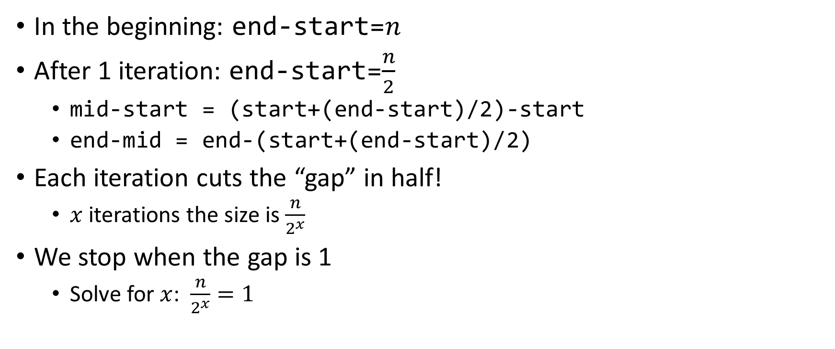

Why is this $\log_{2}{n}$?
In the beginning: end-start=$n$
After 1 iteration: end-start=$\frac{n}{2}$
  mid-start = (start+(end-start)/2)-start
  end-mid = end-(start+(end-start)/2)
Each iteration cuts the “gap” in half!
  $x$ iterations the size is $\frac{n}{2^{x}}$
We stop when the gap is 1
  Solve for $x$: $\frac{n}{2^{x}}=1$

Slide 10
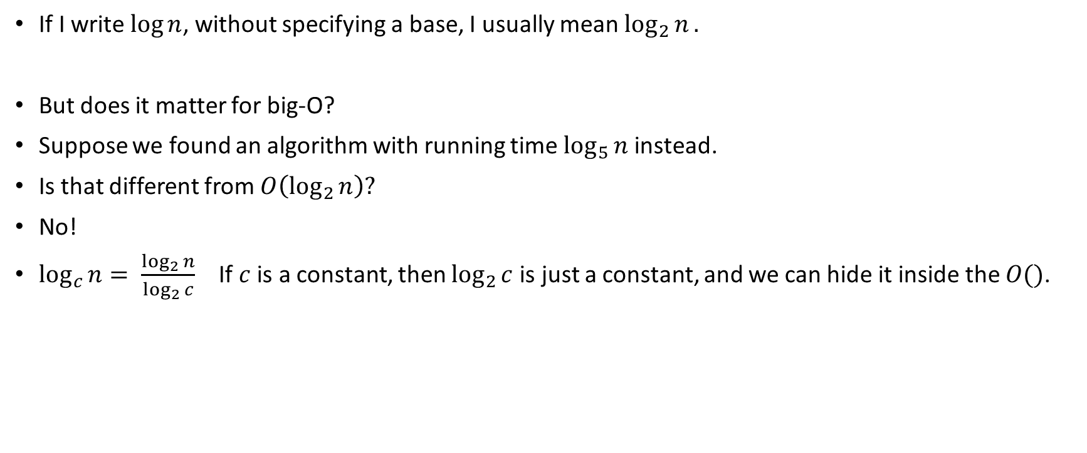
Aside: What’s the base of the log?
If I write $\log{n}$, without specifying a base, I usually mean $\log_{2}{n}.$
But does it matter for big-O?
Suppose we found an algorithm with running time $\log_{5}{n}$ instead.
Is that different from $O\left(\log_{2}{n}\right)?$
No!
$\log_{c}{n}= \frac{\log_{2}{n}}{\log_{2}{c}}$ If $c$ is a constant, then $\log_{2}{c}$is just a constant, and we can hide it inside the $O()$.

Slide 11
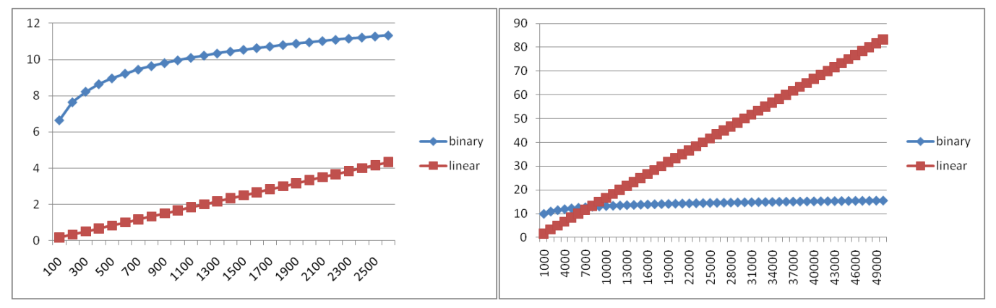
Running Time Graphed

Slide 12
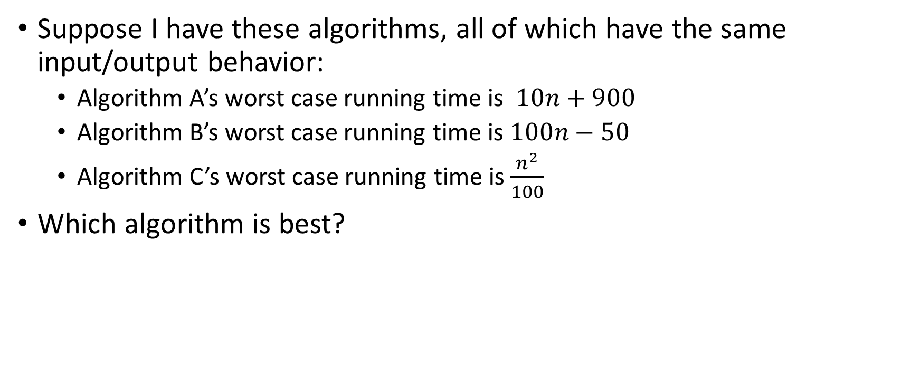
Comparing Running Times
Suppose I have these algorithms, all of which have the same input/output behavior:
  Algorithm A’s worst case running time is $10n+900$
  Algorithm B’s worst case running time is $100n−50$
  Algorithm C’s worst case running time is $\frac{n^{2}}{100}$
Which algorithm is best?

Slide 13
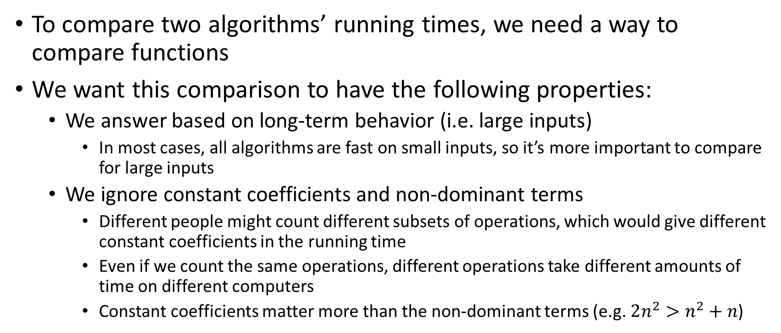
Wish List for Way to Compare Running Times
To compare two algorithms’ running times, we need a way to compare functions
We want this comparison to have the following properties:
  We answer based on long-term behavior (i.e. large inputs)
    In most cases, all algorithms are fast on small inputs, so it’s more important to compare for large inputs
  We ignore constant coefficients and non-dominant terms
    Different people might count different subsets of operations, which would give different constant coefficients in the running time
    Even if we count the same operations, different operations take different amounts of time on different computers
    Constant coefficients matter more than the non-dominant terms (e.g. $2n^{2}>n^{2}+n$)

Slide 14
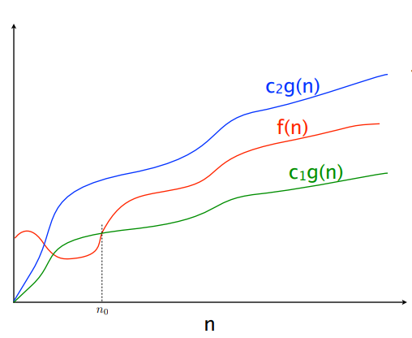

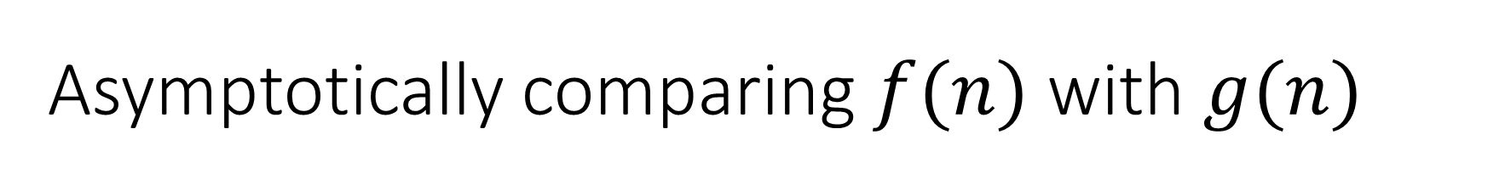


Asymptotically comparing $f(n)$ with $g(n)$
$$f(n)=O(g\left(n\right))$$
$$f(n)=Θ(g\left(n\right))$$
$$f(n)=Ω(g\left(n\right))$$

Slide 15
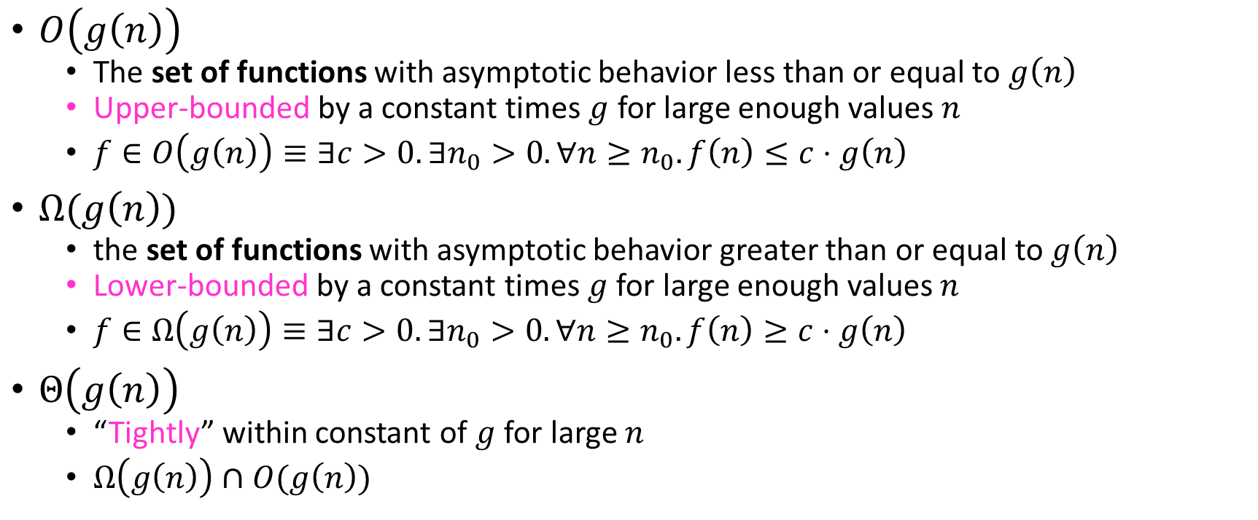
Asymptotic Notation
$O\left(g\left(n\right)\right)$
  The set of functions with asymptotic behavior less than or equal to $g\left(n\right)$
  Upper-bounded by a constant times $g$ for large enough values $n$
  $f∈O\left(g\left(n\right)\right)≡∃c>0. ∃n_{0}>0. ∀n≥n_{0}. f\left(n\right)≤c⋅g\left(n\right)$
$Ω(g\left(n\right))$
  the set of functions with asymptotic behavior greater than or equal to $g\left(n\right)$
  Lower-bounded by a constant times $g$ for large enough values $n$
  $f∈Ω\left(g\left(n\right)\right)≡∃c>0. ∃n_{0}>0. ∀n≥n_{0}. f\left(n\right)≥c⋅g\left(n\right)$
$Θ\left(g\left(n\right)\right)$
  “Tightly” within constant of $g$ for large $n$
  $Ω\left(g\left(n\right)\right)∩O(g\left(n\right))$

Slide 16
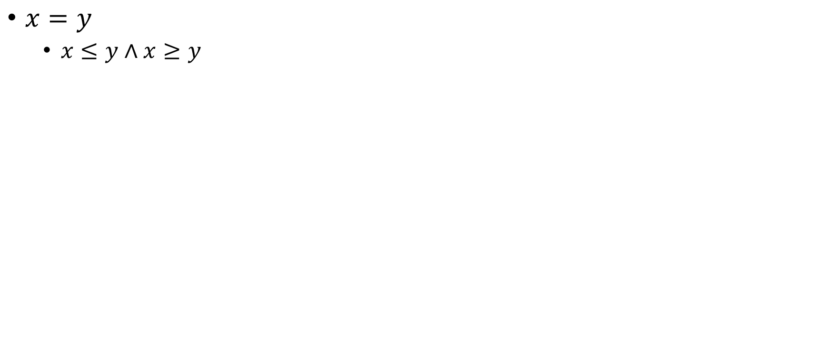

Idea of $Θ$
$x=y$
  $x≤y∧x≥y$

Slide 17
Aside: Big-Oh relates functions
We use O on a function f(n) (for example n²) to mean the set of functions with asymptotic behavior less than or equal to f(n)
So (3n²+17) is in O(n²)
  3n²+17 and n² have the same asymptotic behavior
Confusingly, we also say/write:
  (3n²+17) is O(n²)
  (3n²+17) = O(n²)
But we would never say O(n²) = (3n²+17)

Slide 18

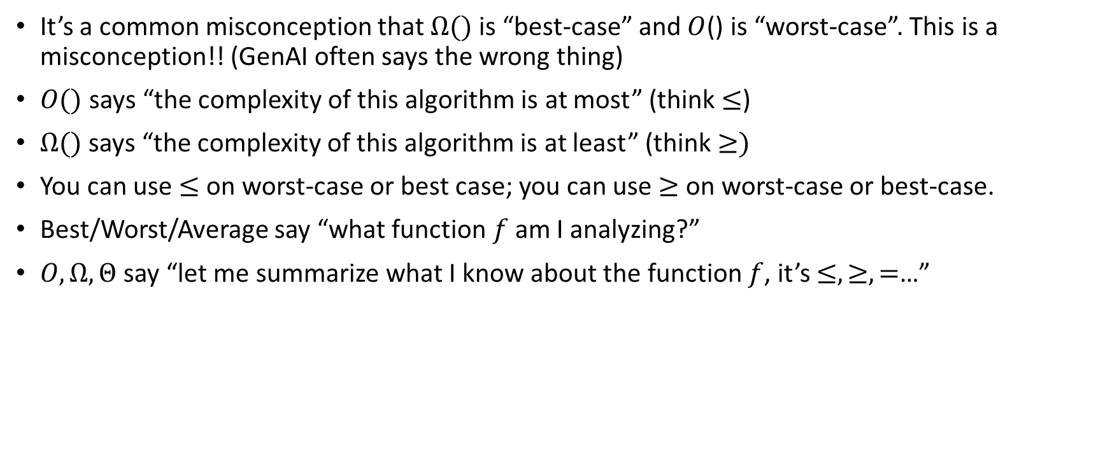
Warning!! $O,Ω,Θ$vs. Best, Worst, Average
It’s a common misconception that $Ω()$ is “best-case” and $O$() is “worst-case”. This is a misconception!! (GenAI often says the wrong thing)
$O()$ says “the complexity of this algorithm is at most” (think $≤$)
$Ω()$ says “the complexity of this algorithm is at least” (think $≥)$
You can use $≤$ on worst-case or best case; you can use $≥$ on worst-case or best-case.
Best/Worst/Average say “what function $f$ am I analyzing?”
$O,Ω,Θ$ say “let me summarize what I know about the function $f$, it’s $≤,≥,=$…”
Notes:
Why would you do that? Sometimes you don’t know if you’ve done the analysis perfectly (you don’t know if you have the big-$Θ$ bound), so you have to use $O$ or $Ω$.
In a few weeks, we’ll want to say “every algorithm for sorting takes at least n log n time in the worst-case” , that’s Omega in a worst-case context
Or we might say “every algorithm for this problem needs to look at all the elements, so will take at least n time, even in the best case. That’s an Omega(n) best-case statement.

Slide 19
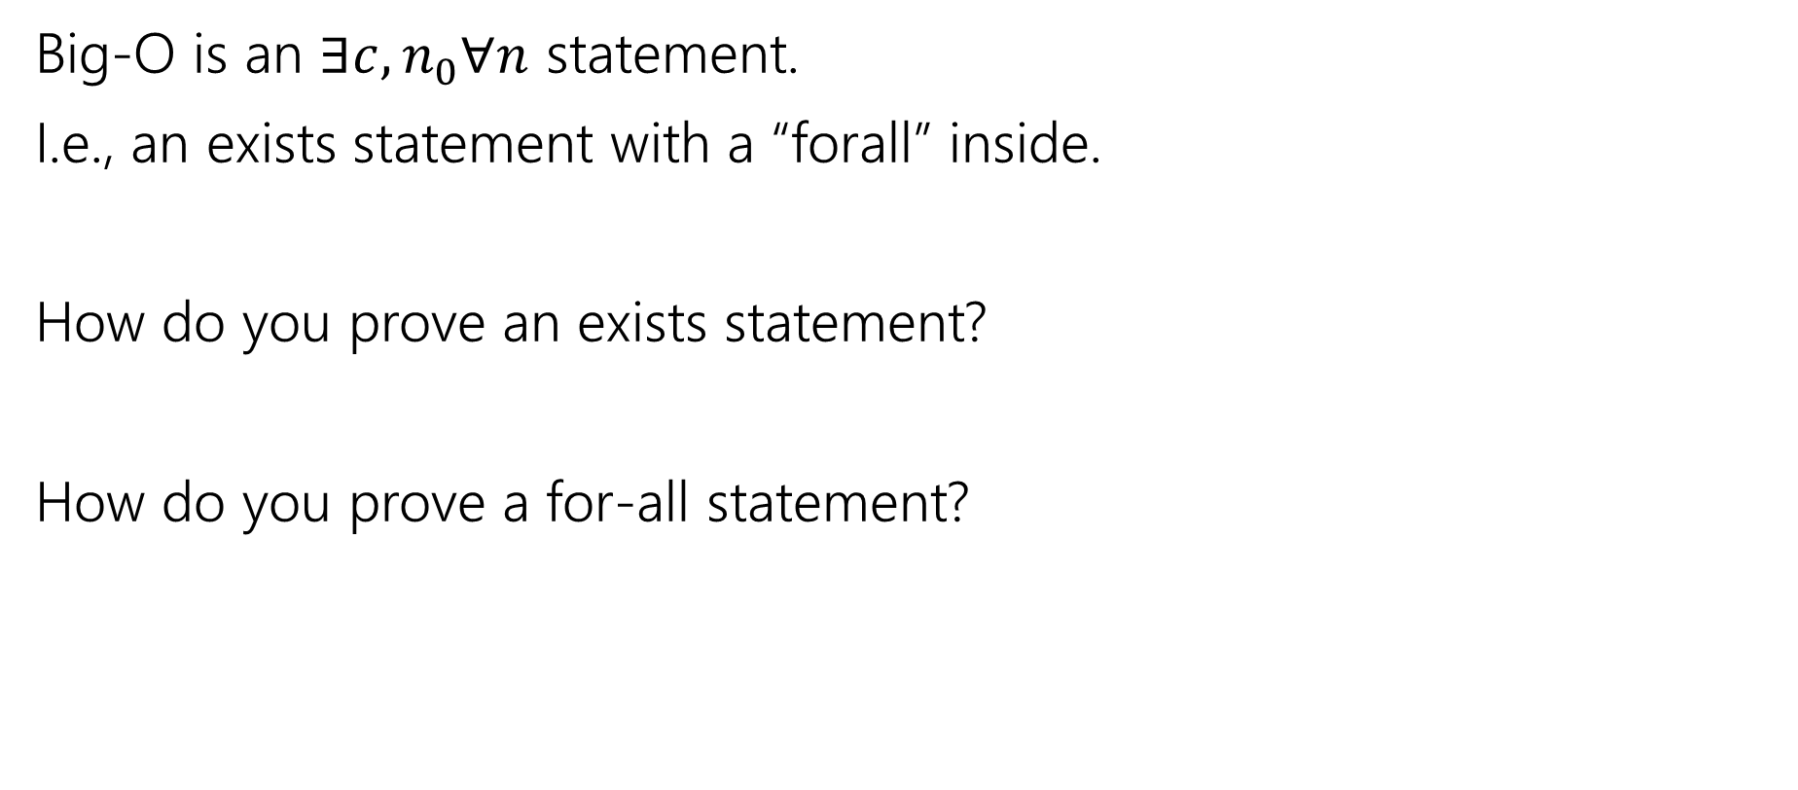
Proving Big-O, Formally
Big-O is an $∃c,n_{0}∀n$ statement.
I.e., an exists statement with a “forall” inside.
How do you prove an exists statement?
How do you prove a for-all statement?

Slide 20
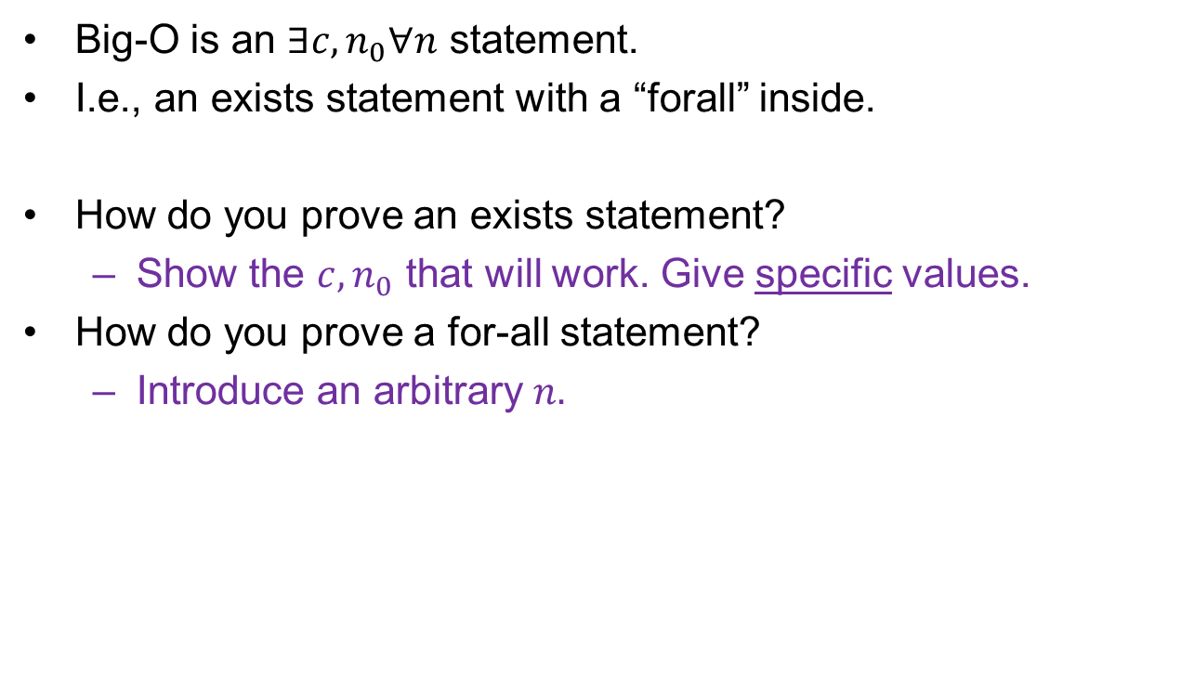
Proving Big-O, Formally (answers)
Big-O is an $∃c,n_{0}∀n$ statement.
I.e., an exists statement with a “forall” inside.
How do you prove an exists statement?
  Show the $c,n_{0}$ that will work. Give specific values.
How do you prove a for-all statement?
  Introduce an arbitrary $n.$

Slide 21
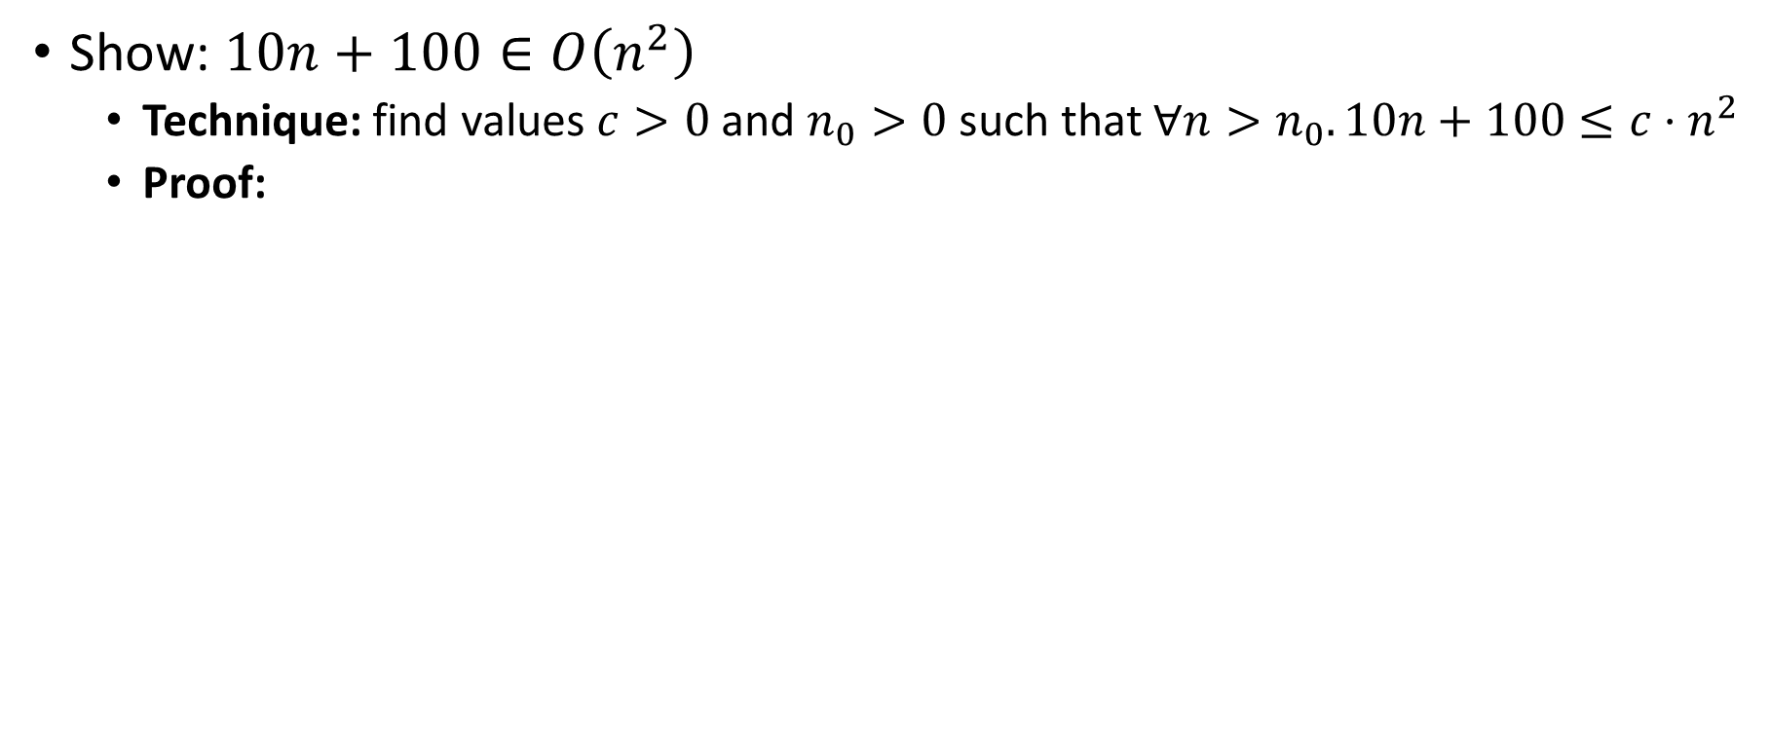
Asymptotic Notation Example 1
Show: $10n+100∈O\left(n^{2}\right)$
  Technique: find values $c>0$ and $n_{0}>0$ such that $∀n>n_{0}. 10n+100≤c⋅n^{2}$
  Proof:

Slide 22
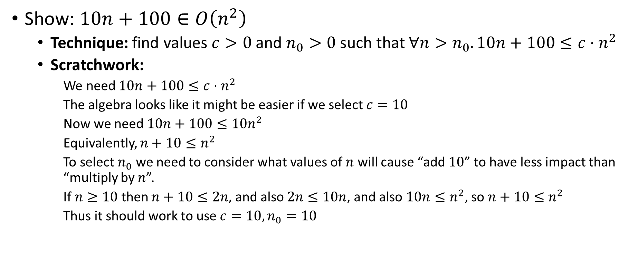
Asymptotic Notation Example 1 (Scratchwork)
Show: $10n+100∈O\left(n^{2}\right)$
  Technique: find values $c>0$ and $n_{0}>0$ such that $∀n>n_{0}. 10n+100≤c⋅n^{2}$
  Scratchwork:
    We need $10n+100≤c⋅n^{2}$
    The algebra looks like it might be easier if we select $c=10$
    Now we need $10n+100≤10n^{2}$
    Equivalently, $n+10≤n^{2}$
    To select $n_{0}$ we need to consider what values of $n$ will cause “add $10$” to have less impact than “multiply by $n$”.
    If $n≥10$ then $n+10≤2n$, and also $2n≤10n$, and also $10n≤n^{2}$, so $n+10≤n^{2}$
    Thus it should work to use $c=10, n_{0}=10$

Slide 23
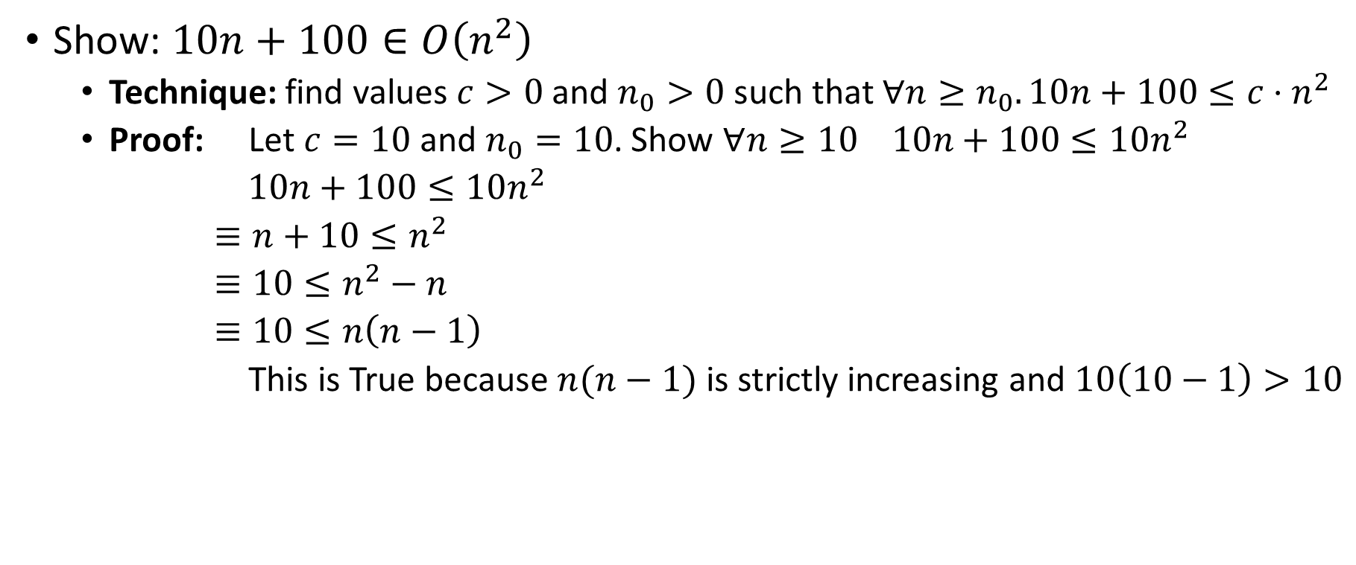
Asymptotic Notation Example 1 (Proof)
Show: $10n+100∈O\left(n^{2}\right)$
  Technique: find values $c>0$ and $n_{0}>0$ such that $∀n≥n_{0}. 10n+100≤c⋅n^{2}$
  Proof: Let $c=10$ and $n_{0}=10$. Show $∀n≥10 10n+100≤10n^{2}$
  $10n+100≤10n^{2}$
  $≡n+10≤n^{2}$
  $≡10≤n^{2}−n$
  $≡10≤n\left(n−1\right)$
  This is True because $n(n−1)$ is strictly increasing and $10\left(10−1\right)>10$

Slide 24
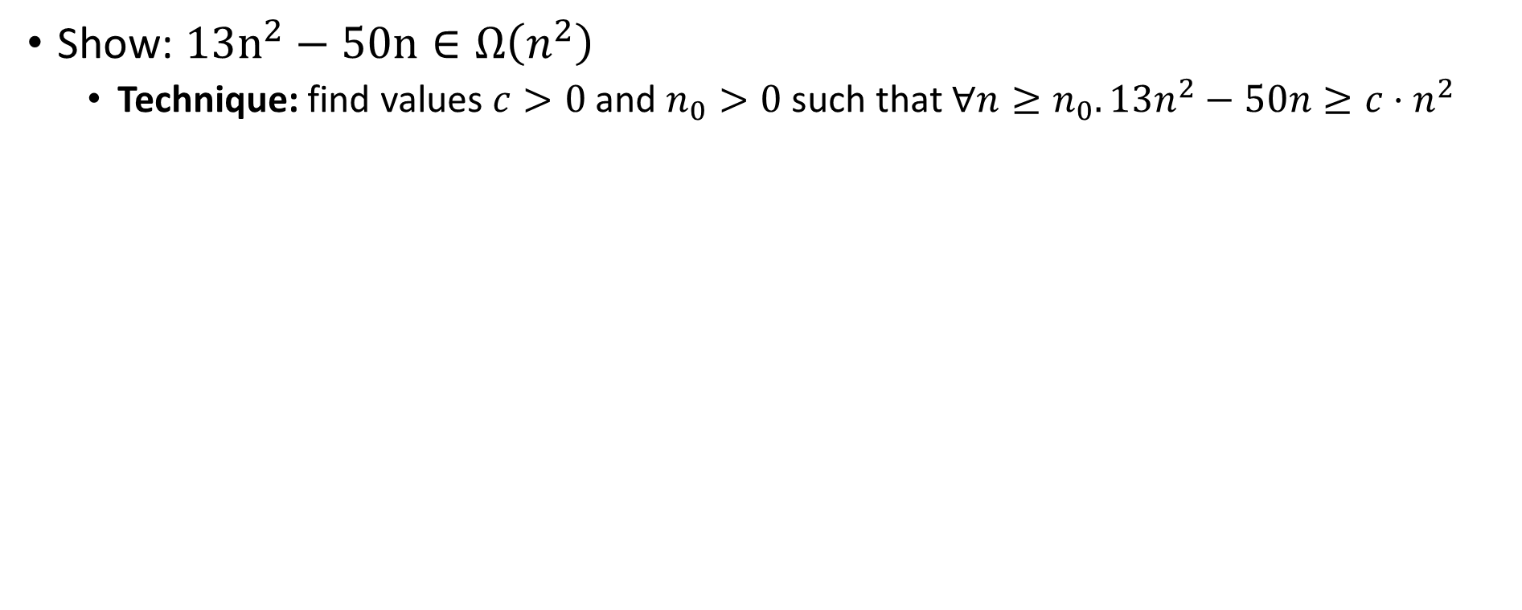
Asymptotic Notation Example 2
Show: $13n^{2}−50n∈Ω\left(n^{2}\right)$
  Technique: find values $c>0$ and $n_{0}>0$ such that $∀n≥n_{0}. 13n^{2}−50n≥c⋅n^{2}$

Slide 25
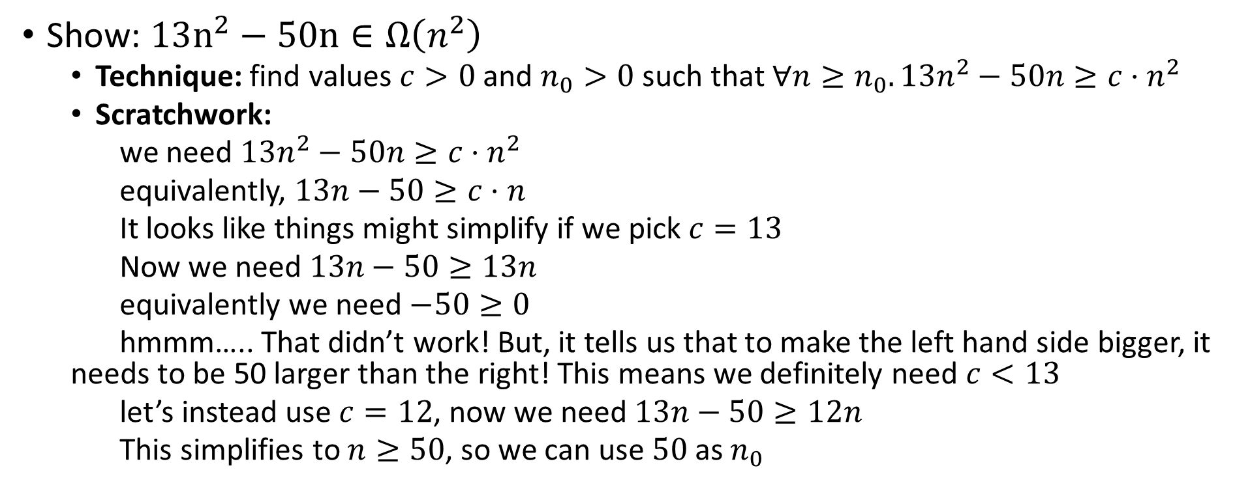
Asymptotic Notation Example 2 (Scratchwork)
Show: $13n^{2}−50n∈Ω\left(n^{2}\right)$
  Technique: find values $c>0$ and $n_{0}>0$ such that $∀n≥n_{0}. 13n^{2}−50n≥c⋅n^{2}$
  Scratchwork:
  we need $13n^{2}−50n≥c⋅n^{2}$
  equivalently, $13n−50≥c⋅n$
  It looks like things might simplify if we pick $c=13$
  Now we need $13n−50≥13n$
  equivalently we need $−50≥0$
  hmmm….. That didn’t work! But, it tells us that to make the left hand side bigger, it needs to be 50 larger than the right! This means we definitely need $c<13$
  let’s instead use $c=12$, now we need $13n−50≥12n$
  This simplifies to $n≥50$, so we can use $50$ as $n_{0}$

Slide 26
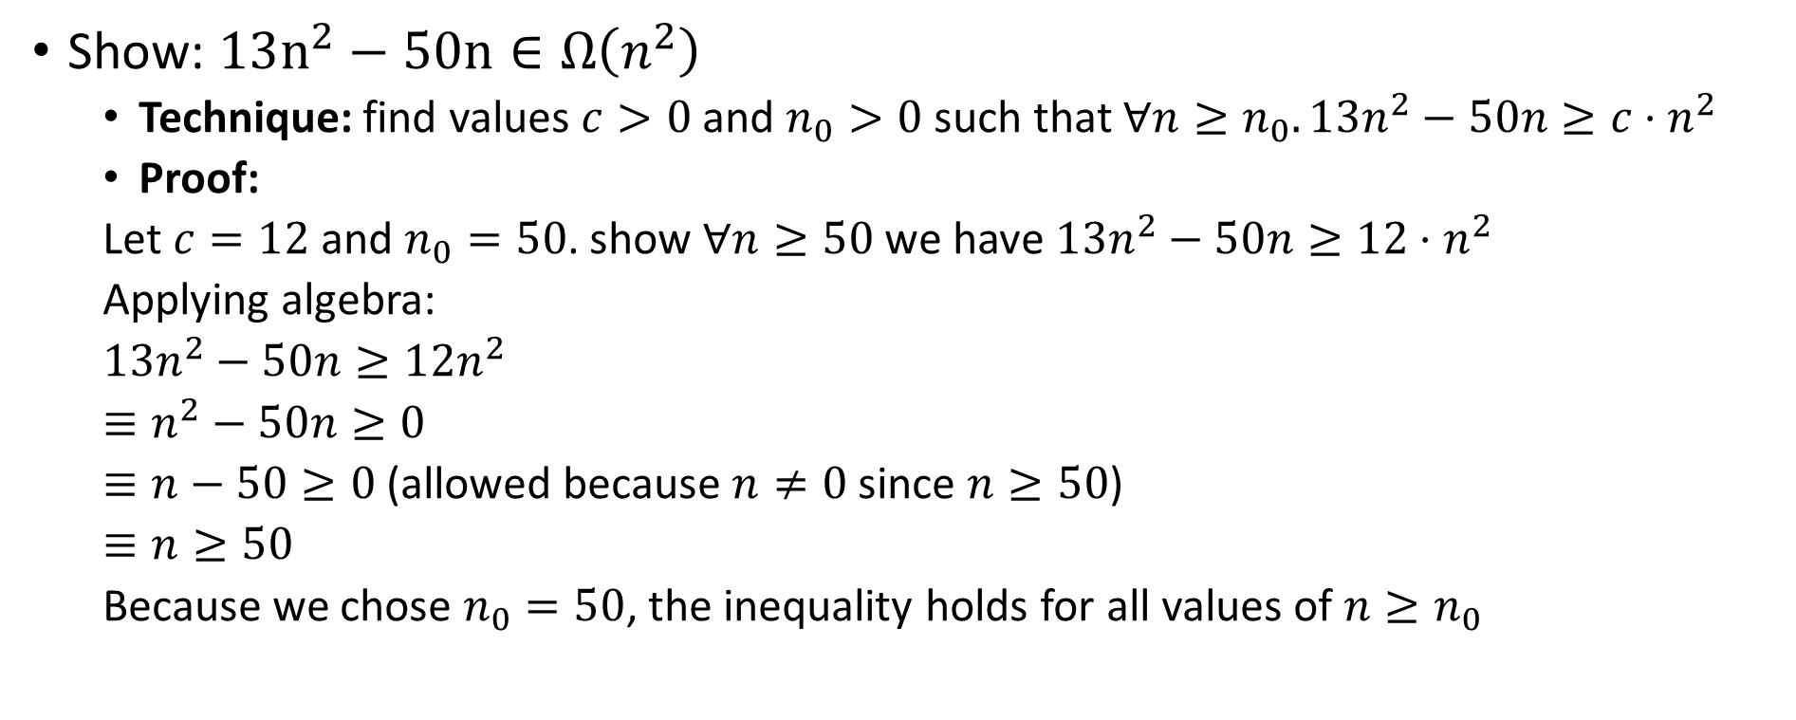
Asymptotic Notation Example 2 (Proof)
Show: $13n^{2}−50n∈Ω\left(n^{2}\right)$
  Technique: find values $c>0$ and $n_{0}>0$ such that $∀n≥n_{0}. 13n^{2}−50n≥c⋅n^{2}$
  Proof:
  Let $c=12$ and $n_{0}=50$. show $∀n≥50$ we have $13n^{2}−50n≥12⋅n^{2}$
  Applying algebra:
  $13n^{2}−50n≥12n^{2}$
  $≡n^{2}−50n≥0$
  $≡n−50≥0$ (allowed because $n≠0$ since $n≥50$)
  $≡n≥50$
  Because we chose $n_{0}=50$, the inequality holds for all values of $n≥n_{0}$

Slide 27
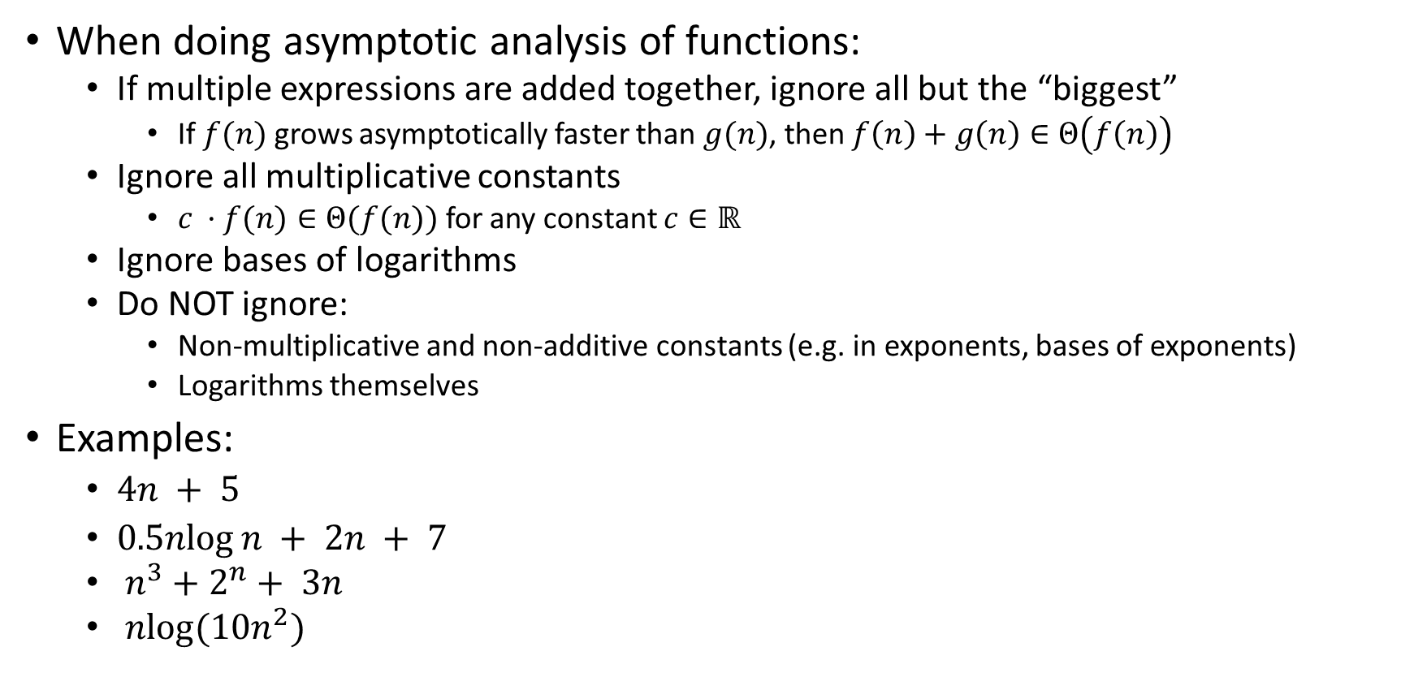
Gaining Intuition
When doing asymptotic analysis of functions:
  If multiple expressions are added together, ignore all but the “biggest”
    If $f(n)$ grows asymptotically faster than $g(n)$, then $f\left(n\right)+g\left(n\right)∈Θ\left(f\left(n\right)\right)$
  Ignore all multiplicative constants
    $c ·f(n)∈Θ(f(n))$ for any constant $c∈ℝ$
  Ignore bases of logarithms
  Do NOT ignore:
    Non-multiplicative and non-additive constants (e.g. in exponents, bases of exponents)
    Logarithms themselves
Examples:
  $4n + 5$
  $0.5nlog⁡n + 2n + 7$
  $n^{3}+2^{n}+ 3n$
  $nlog(10n^{2})$

Slide 28
What you can drop
Eliminate coefficients because we don’t have units anyway
  3n² versus 5n² doesn’t mean anything when we cannot count operations very accurately
Eliminate low-order terms because they have vanishingly small impact as n grows
Do NOT ignore constants that are not multipliers
  n³ is not O(n²)
  3^{n} is not O(2^{n})
(This all follows from the formal definition)

Slide 29
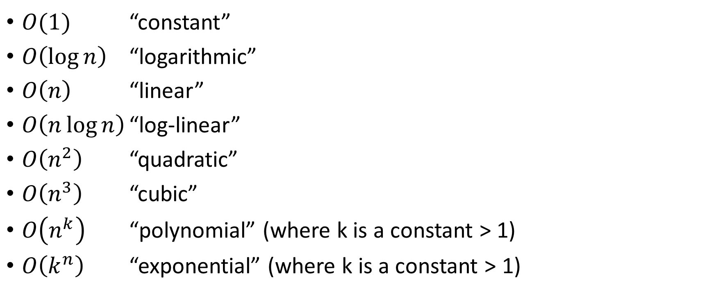
Common Categories
$O(1)$ “constant”
$O\left(\log{n}\right)$ “logarithmic”
$O\left(n\right)$ “linear”
$O\left(n\log{n}\right)$ “log-linear”
$O\left(n^{2}\right)$ “quadratic”
$O\left(n^{3}\right)$ “cubic”
$O\left(n^{k}\right)$ “polynomial” (where k is a constant > 1)
$O\left(k^{n}\right)$ “exponential” (where k is a constant > 1)

Slide 30
Addendum and Caveats

Slide 31
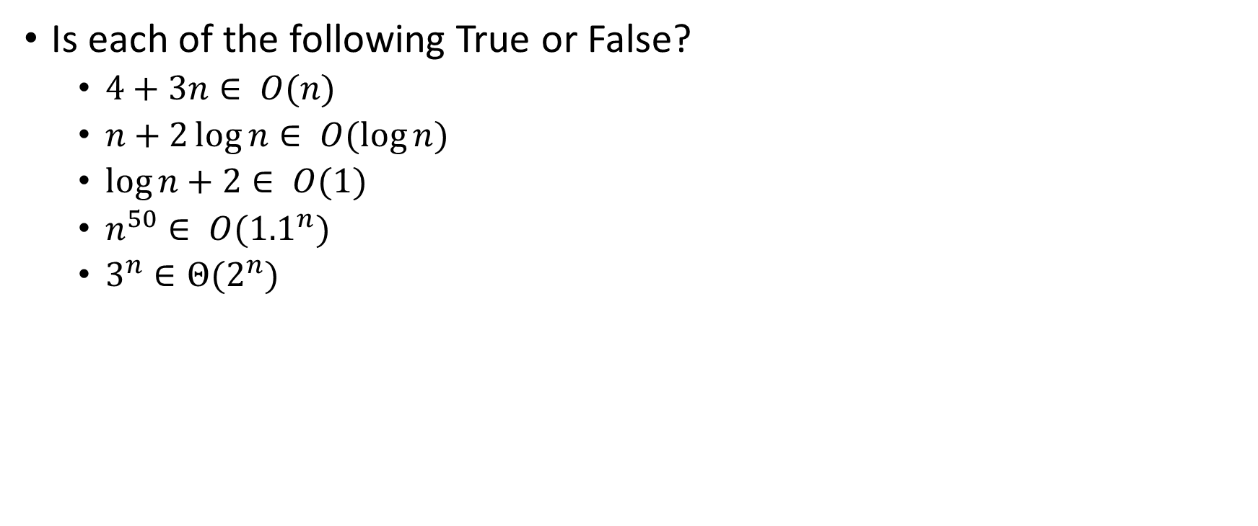
More Examples
Is each of the following True or False?
  $4+3n∈ O(n)$
  $n+2\log{n}∈ O(\log{n})$
  $\log{n}+2∈ O(1)$
  $n^{50}∈ O({1.1}^{n})$
  $3^{n}∈Θ(2^{n})$

Slide 32
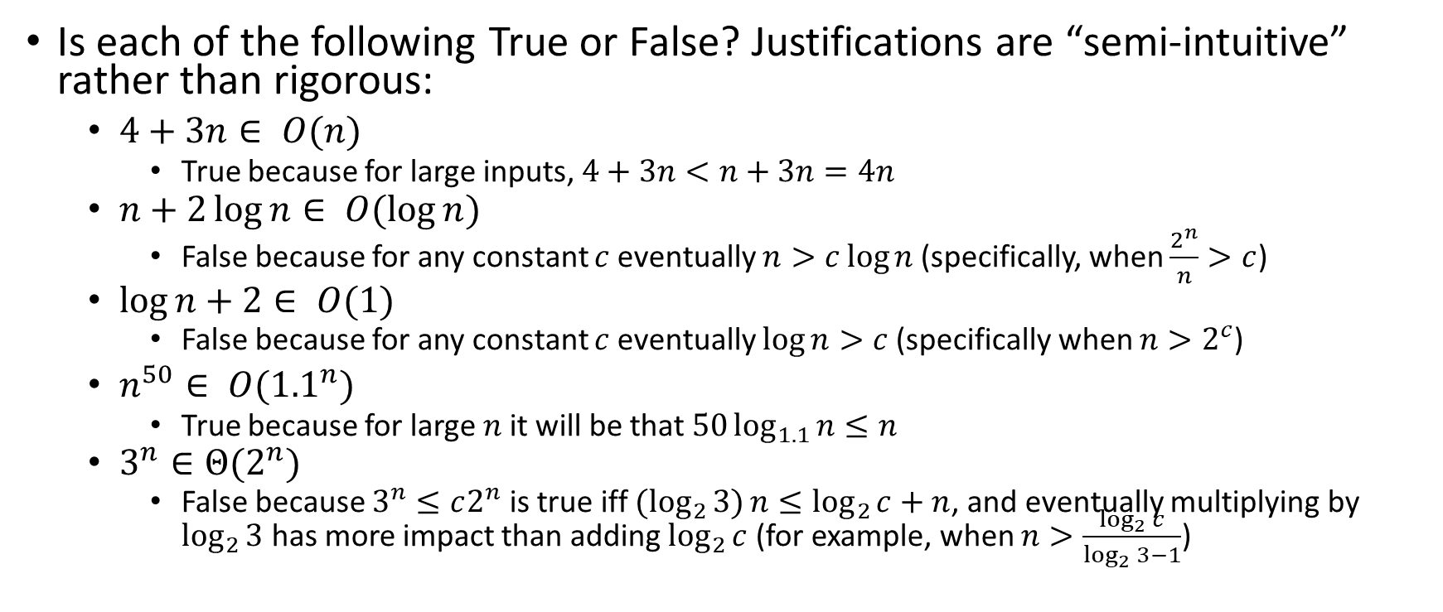
More Examples: Solutions
Is each of the following True or False? Justifications are “semi-intuitive” rather than rigorous:
  $4+3n∈ O(n)$
    True because for large inputs, $4+3n<n+3n=4n$
  $n+2\log{n}∈ O(\log{n})$
    False because for any constant $c$ eventually $n>c\log{n}$ (specifically, when $\frac{2^{n}}{n}>c$)
  $\log{n}+2∈ O(1)$
    False because for any constant $c$ eventually $\log{n}>c$ (specifically when $n>2^{c}$)
  $n^{50}∈ O({1.1}^{n})$
    True because for large $n$ it will be that $50\log_{1.1}{n}≤n$
  $3^{n}∈Θ(2^{n})$
    False because $3^{n}≤c2^{n}$ is true iff ${(log}_{2}{3)}n≤\log_{2}{c}+n$, and eventually multiplying by $\log_{2}{3}$ has more impact than adding $\log_{2}{c}$ (for example, when $n>\frac{\log_{2}{c}}{\log_{2}{3}−1}$)

Slide 33
Regarding use of terms
A common error is to say O( f(n) ) when you mean θ( f(n) )
  People often say O() to mean a tight bound
  Say we have f(n)=n; we could say f(n) is in O(n), which is true, but only conveys the upper-bound
  Since f(n)=n is also O(n⁵),
  it’s tempting to say “this algorithm is exactly O(n)”
  Somewhat incomplete; instead say it is θ(n)
  That means that it is not, for example O(log n)

Slide 34
What we are analyzing
The most common thing to do is give an O or θ bound to the worst-case running time of an algorithm
Example: True statements about binary-search algorithm
  Common: θ(log n) running-time in the worst-case
  Less common: θ(1) in the best-case (item is in the middle)
  Less common: Algorithm is Ω(log log n) in the worst-case (it is not really, really, really fast asymptotically)
  Less common (but good to know): the find-in-sorted-array problem is Ω(log n) in the worst-case
    No algorithm can do better (without parallelism)
    A problem cannot be O(f(n)) since you can always find a slower algorithm, but can mean there exists an algorithm

Slide 35
Summary
Analysis can be about:
The problem or the algorithm (usually algorithm)
Time or space (usually time)
  Or power or dollars or …
Best-, worst-, or average-case (usually worst)
Upper-, lower-, or tight-bound (usually upper or tight)

Slide 36
Big-Oh Caveats
Asymptotic complexity (Big-Oh) focuses on behavior for large n and is independent of any computer / coding trick
  But you can “abuse” it to be misled about trade-offs
  Example: n^{1/10} vs. log n
    Asymptotically n^{1/10} grows more quickly
    But the “cross-over” point is around 5 * 10¹⁷
    So if you have input size less than 2⁵⁸, prefer n^{1/10}
Comparing O() for small n values can be misleading
  Quicksort: O(nlogn) (expected)
  Insertion Sort: O(n²) (expected)
  Yet in reality Insertion Sort is faster for small n’s
  We’ll learn about these sorts later

Slide 37
Addendum: Timing vs. Big-Oh?
At the core of CS is a backbone of theory & mathematics
  Examine the algorithm itself, mathematically, not the implementation
  Reason about performance as a function of n
  Be able to mathematically prove things about performance
Yet, timing has its place
  In the real world, we do want to know whether implementation A runs faster than implementation B on data set C
  Ex: Benchmarking graphics cards
Evaluating an algorithm? Use asymptotic analysis
Evaluating an implementation of hardware/software? Timing can be useful

