Slide 1
CSE 332 Autumn 2026
Lecture 2: Algorithm Analysis pt.1
Ruth Anderson
http://www.cs.uw.edu/332

Slide 2
Announcements
Preliminary Survey
  Due Monday 10/05
  On Canvas
Exercise 0 released
  Due Friday 10/09/2026
  There are 2 separate Gradescope submissions
“Meet the staff” activity
  Sometime during the first 4 weeks of class, visit a CSE 332 office hour (in person or on zoom)
  Tell the staff member you want to get checked off
  You do not have to have a question about course content
  We just want to meet you!
Exercise 1 Running Time: coming early next week, due Mon Oct 12

Slide 3
What do we care about in an algorithm?
Correctness:
  Does the algorithm do what is intended.
Performance:
  Speed time complexity
  Memory space complexity
Why analyze?
  To make good design decisions
  Enable you to look at an algorithm (or code) and identify the bottlenecks, etc.

Slide 4
Pick an algorithm with the best running time

Slide 5
How should we compare two algorithms?
Uh, why NOT just run the program and time it??
  Too much variability, not reliable or portable:
    Hardware: processor(s), memory, etc.
    OS, Java version, libraries, drivers
    Other programs running
    Implementation dependent
  Choice of input
    Testing (inexhaustive) may miss worst-case input
    Timing does not explain relative timing among inputs (what happens when n doubles in size)
Often want to evaluate an algorithm, not an implementation
  Even before creating the implementation (“coding it up”)

Slide 6
Wish list for algorithm comparison method:
So we are not going to run the program and time it…what should we do?
Ideally we want a method to compare two algorithms that is:
Independent of CPU speed, programming language, coding tricks, etc.
Tells us how algorithms compare on large input sizes (Input size = n)
  E.g. any correct sorting algorithm is fast enough if you are only sorting 10 things
We can use without implementing the algorithm and running it

Slide 7
We will do “Resource Analysis”
Allows us to compare algorithms, not implementations
  Using observations necessarily couples the algorithm with its implementation
  If my implementation on my computer takes more time than your implementation on your computer, we cannot conclude your algorithm is better
We can predict an algorithm’s running time before implementing
Understand where the bottlenecks are in our algorithm

Slide 8
Process for Resource Analysis
End Result: A function which maps the algorithm’s input size to count of resources used
  Input of the function: sizes of the input
    Number of characters in a string, number of items in a list, number of pixels in an image
  Output of the function: counts of resources used
    Typically we think of this as “amount of time” but we will specifically count things like: number of times the algorithm adds two numbers together, number times the algorithm does a > or < comparison, maximum number of bytes of memory the algorithm uses at any time
Important note: Make sure you know the “units” of your input and output!

Slide 9
Running Time Analysis
Units of “time”
  Operations
    Whichever operations we pick
How do we express running time?
  Function
    Domain (input): size of the input
      (e.g., number of elements in our array, number of characters in our string)
    Range: count of operations

Slide 10
Scenarios to analyze for an algorithm
Worst-case complexity:
  max number of steps algorithm takes on “most challenging” input
Best-case complexity:
  min number of steps algorithm takes on “easiest” input
Average/expected complexity:
  avg number of steps algorithm takes on random inputs (context-dependent)
Amortized complexity:
  max total number of steps algorithm takes on M “most challenging” consecutive inputs, divided by M (i.e., divide the max total sum by M).

Slide 11
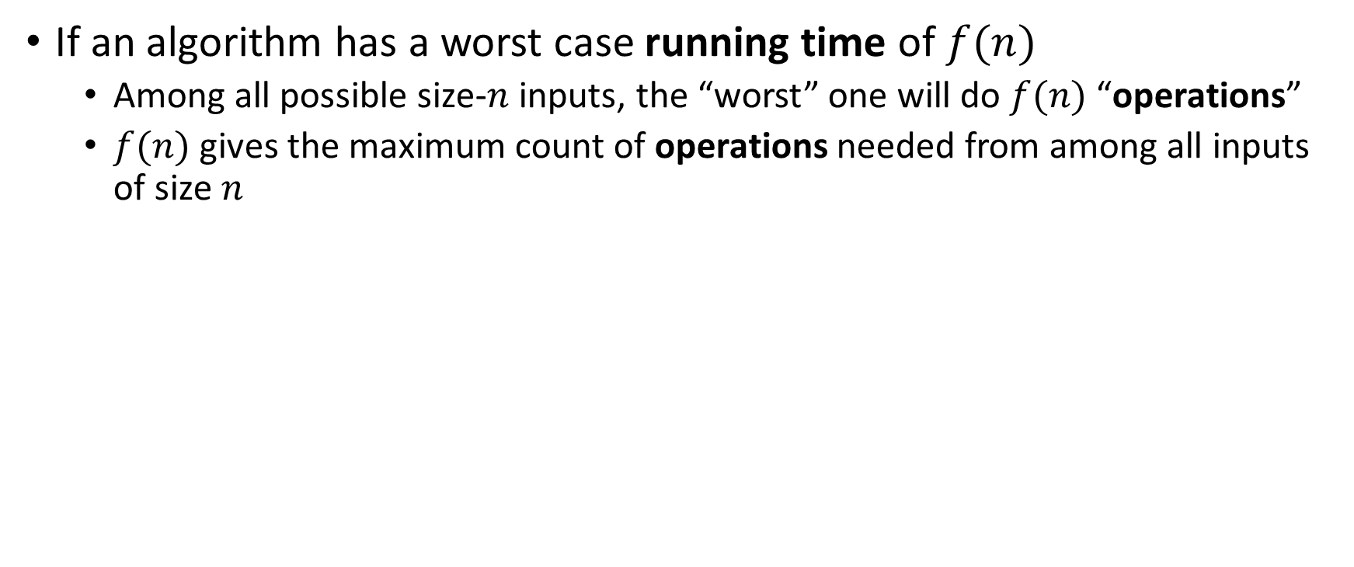
Usually: Worst Case Running Time Analysis
If an algorithm has a worst case running time of $f(n)$
  Among all possible size-$n$ inputs, the “worst” one will do $f(n)$ “operations”
  $f(n)$ gives the maximum count of operations needed from among all inputs of size $n$

Slide 12
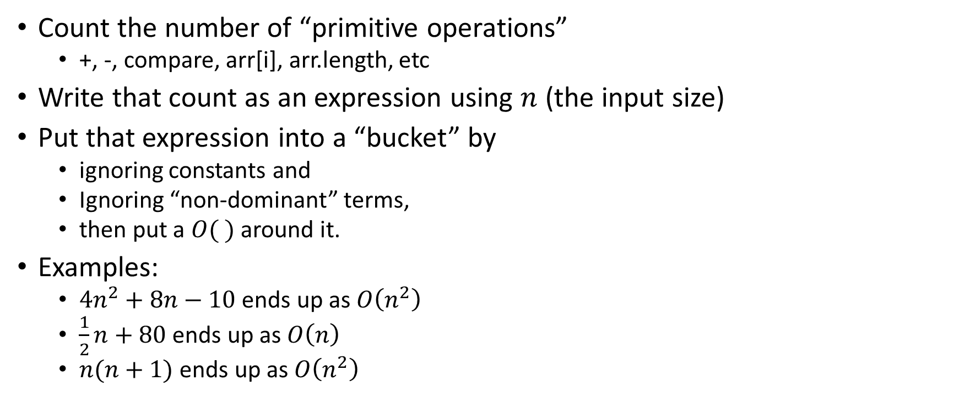
Analysis Process From CSE 123/143
Count the number of “primitive operations”
  +, -, compare, arr[i], arr.length, etc
Write that count as an expression using $n$ (the input size)
Put that expression into a “bucket” by
  ignoring constants and
  Ignoring “non-dominant” terms,
  then put a $O( )$ around it.
Examples:
  $4n^{2}+8n−10$ ends up as $O\left(n^{2}\right)$
  $\frac{1}{2}n+80$ ends up as $O\left(n\right)$
  $n(n+1)$ ends up as $O\left(n^{2}\right)$

Slide 13
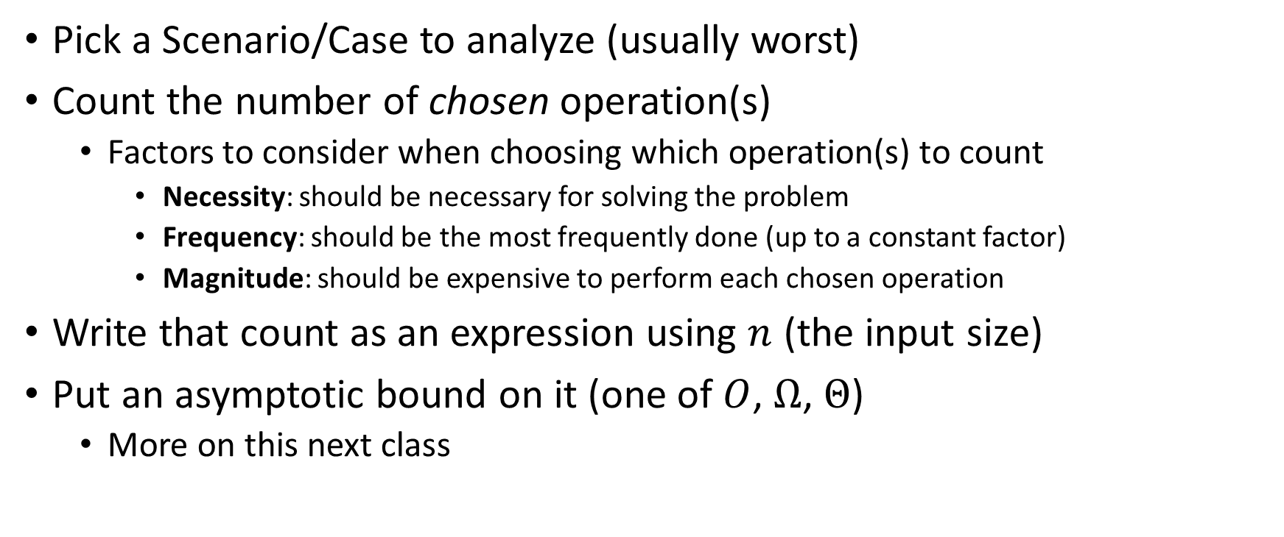
Analysis Process For Us
Pick a Scenario/Case to analyze (usually worst)
Count the number of chosen operation(s)
  Factors to consider when choosing which operation(s) to count
    Necessity: should be necessary for solving the problem
    Frequency: should be the most frequently done (up to a constant factor)
    Magnitude: should be expensive to perform each chosen operation
Write that count as an expression using $n$ (the input size)
Put an asymptotic bound on it (one of $O$, $Ω$, $Θ$)
  More on this next class

Slide 14
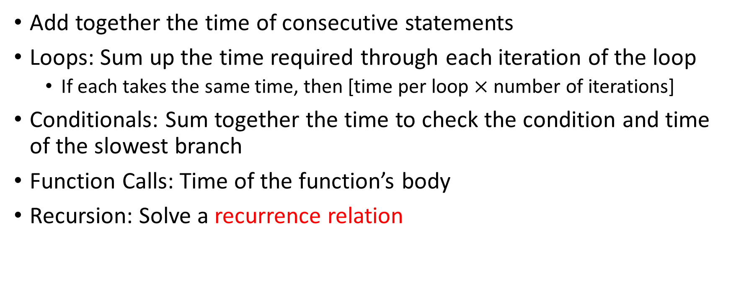
Worst Case Running Time – General Guide
Add together the time of consecutive statements
Loops: Sum up the time required through each iteration of the loop
  If each takes the same time, then [time per loop $×$ number of iterations]
Conditionals: Sum together the time to check the condition and time of the slowest branch
Function Calls: Time of the function’s body
Recursion: Solve a recurrence relation

Slide 15
Worst Case – Example 1 (Questions)
myFunction(List n){
b = 55 + 5;
c = b / 3;
b = c + 100;
for (i = 0; i < n.size(); i++) {
b++;
}
if (b % 2 == 0) {
c++;
}
else {
for (i = 0; i < n.size(); i++) {
c++;
}
}
return c;
}
Questions to ask:
What are the units of the input size?
What are the operations we’re counting?
For each line:
  How many times will it run?
  How long does it take to run?
  Does this change with different inputs?
Answer:

Slide 16
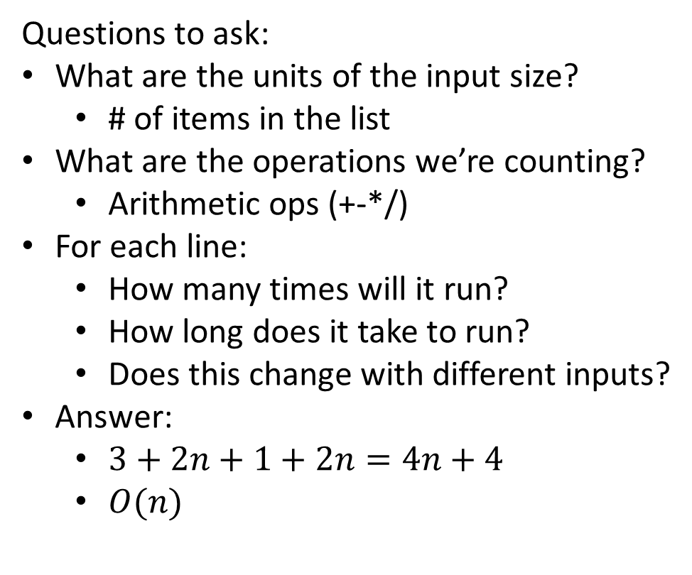
Worst Case – Example 1 (Answers)
myFunction(List n){
b = 55 + 5; // 1
c = b / 3; // 1
b = c + 100; // 1
for (i = 0; i < n.size(); i++) { // 1, n times
b++; // 1
}
if (b % 2 == 0) { // 1
c++; // 1
}
else {
for (i = 0; i < n.size(); i++) { // 1, n times
c++; // 1
}
}
return c;
}
Questions to ask:
What are the units of the input size?
  # of items in the list
What are the operations we’re counting?
  Arithmetic ops (+-*/)
For each line:
  How many times will it run?
  How long does it take to run?
  Does this change with different inputs?
Answer:
  $3+2n+1+2n=4n+4$
  $O(n)$

Slide 17
Worst Case – Example 2 (Questions)
beAnnoying(List n){
List m = [];
for (i=0; i < n.size(); i++){
m.add(n[i]);
for (j=0; j< n.size(); j++){
print (“Hi, I’m annoying”);
}
}
}
Questions to ask:
What are the units of the input size?
What are the operations we’re counting?
For each line:
  How many times will it run?
  How long does it take to run?
  Does this change with the input size?

Slide 18
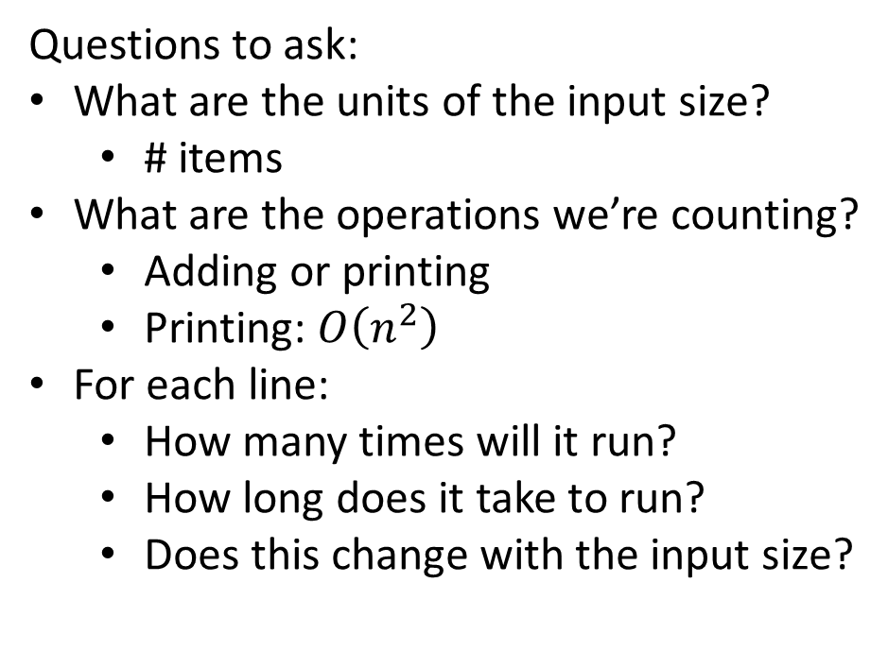
Worst Case – Example 2 (Answers)
beAnnoying(List n){
List m = [];
for (i=0; i < n.size(); i++){ // n times
m.add(n[i]);
for (j=0; j< n.size(); j++){ // n times
print (“Hi, I’m annoying”); // 1
}
}
}
Questions to ask:
What are the units of the input size?
  # items
What are the operations we’re counting?
  Adding or printing
  Printing: $O\left(n^{2}\right)$
For each line:
  How many times will it run?
  How long does it take to run?
  Does this change with the input size?

Slide 19
Reminder: Scenarios for your running time function
Worst-case complexity:
  max number of steps algorithm takes on “most challenging” input
Best-case complexity:
  min number of steps algorithm takes on “easiest” input
Average/expected complexity:
  avg number of steps algorithm takes on random inputs (distribution-dependent)
Amortized complexity:
  max total number of steps algorithm takes on M “most challenging” consecutive inputs, divided by M (i.e., divide the max total sum by M).

Slide 20
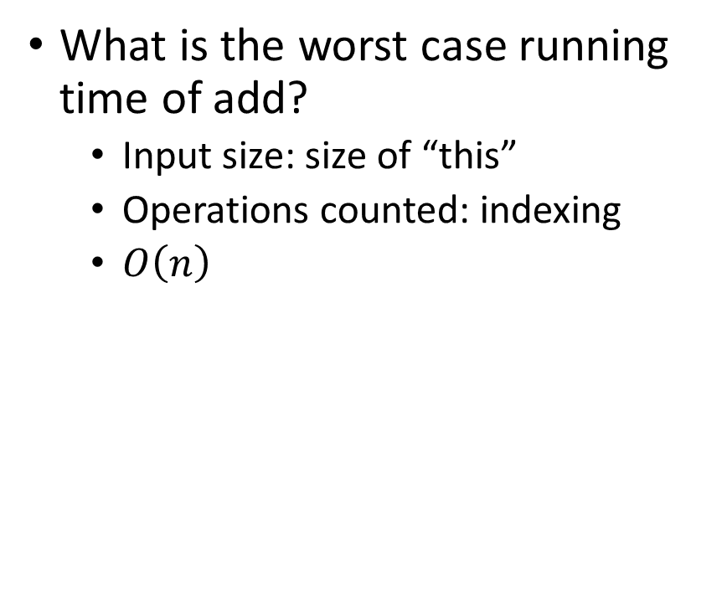
ArrayList - Worst Case Time of Add
public void add(int value){
if(data.length == size)
resize();
data[size] = value;
size++;
}
private void resize(){
int[] oldData = data;
data = new int[data.length*2];
for(int i = 0; i < oldData.length; i++)
data[i] = oldData[i];
}
What is the worst case running time of add?
  Input size: size of “this”
  Operations counted: indexing
  $O\left(n\right)$

Slide 21
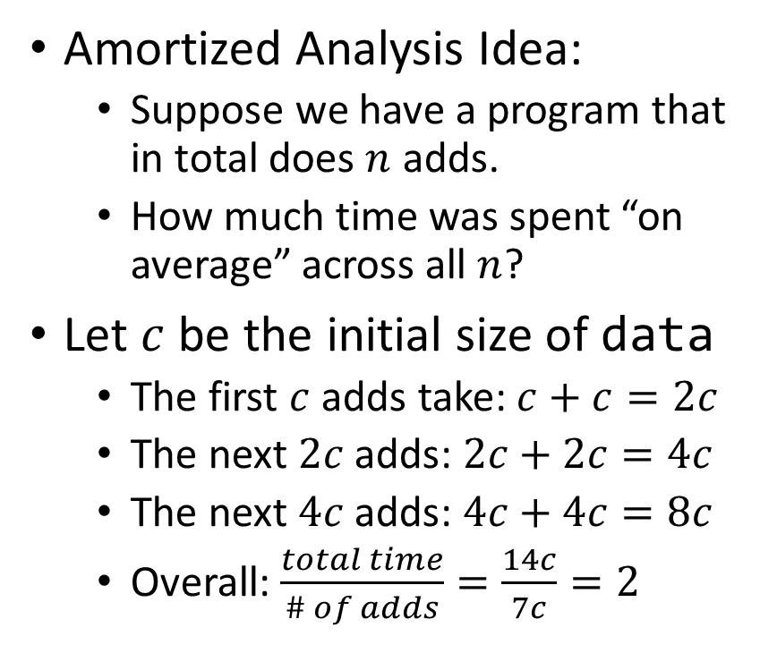
ArrayList – Amortized Time of Add
public void add(int value){
if(data.length == size)
resize();
data[size] = value;
size++;
}
private void resize(){
int[] oldData = data;
data = new int[data.length*2];
for(int i = 0; i < oldData.length; i++)
data[i] = oldData[i];
}
Amortized Analysis Idea:
  Suppose we have a program that in total does $n$ adds.
  How much time was spent “on average” across all $n$?
Let $c$ be the initial size of data
  The first $c$ adds take: $c+c=2c$
  The next $2c$ adds: $2c+2c=4c$
  The next $4c$ adds: $4c+4c=8c$
  Overall: $\frac{total time}{\# of adds}=\frac{14c}{7c}=2$
Every time we resize, we earn data.length more adds before the next resize!
Notes:
Amortized: “running average”

Slide 22
Amortized Analysis Analogy
Suppose I’d like to park in a lot where they charge $10 per day to park
If you are caught in the lot without paying you are given a warning
If you get 3 warnings, you are charged a $25 fine, and your warnings reset.
Should you actually pay to park?
  If you pay every day then you pay an average of $10 per day
  If you do not pay then for every three days parking costs $0+$0+$25, for an average of $8.33 per day
    This is an amortized analysis

Slide 23
Searching in a Sorted List
5
8
13
42
75
79
88
90
95
99
0
1
2
3
4
5
6
7
8
9
public static boolean contains(List<Integer> a, int k){
for(int i=0; i< a.size(); i++){
if (a.get(i) == k)
return true;
}
return false;
}

Slide 24
Faster way?
5
8
13
42
75
79
88
90
95
99
0
1
2
3
4
5
6
7
8
9
Can you think of a faster algorithm to solve this problem?

Slide 25
Binary Search
5
8
13
42
75
79
88
90
95
99
0
1
2
3
4
5
6
7
8
9
public static boolean binary_contains(List<Integer> a, int k){
int start = 0;
int end = a.size();
while(start < end){
int mid = start + (end-start)/2;
if(a.get(mid) == k)
return true;
else if(a.get(mid) < k)
start = mid+1;
else
end = mid;
}
return false;
}

Slide 26
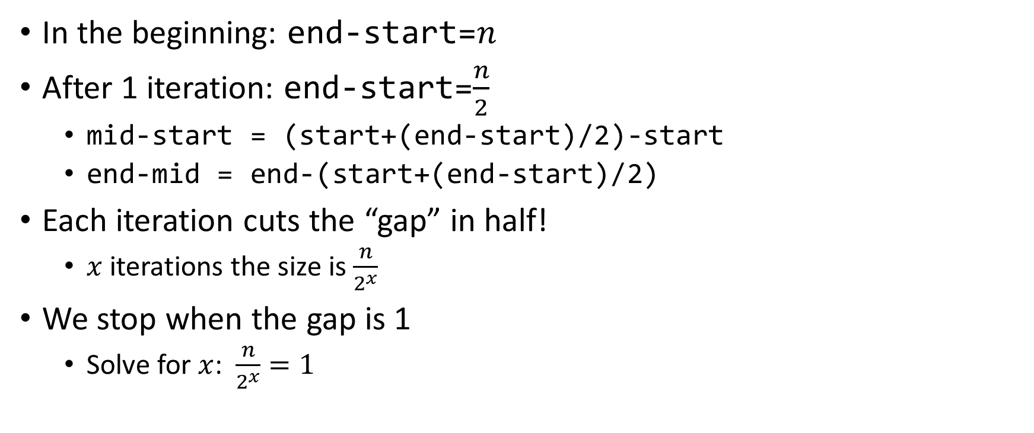

Why is this $\log_{2}{n}$?
In the beginning: end-start=$n$
After 1 iteration: end-start=$\frac{n}{2}$
  mid-start = (start+(end-start)/2)-start
  end-mid = end-(start+(end-start)/2)
Each iteration cuts the “gap” in half!
  $x$ iterations the size is $\frac{n}{2^{x}}$
We stop when the gap is 1
  Solve for $x$: $\frac{n}{2^{x}}=1$

Slide 27
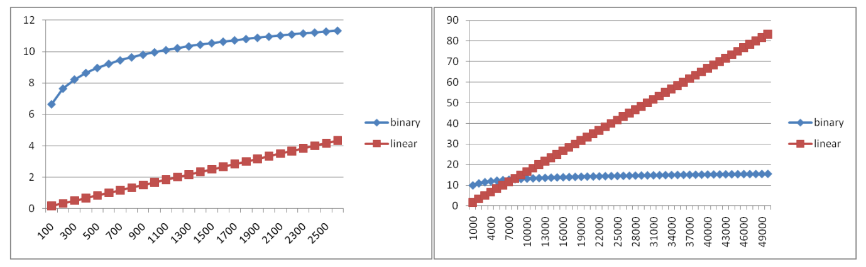
Running Time Graphed

Slide 28
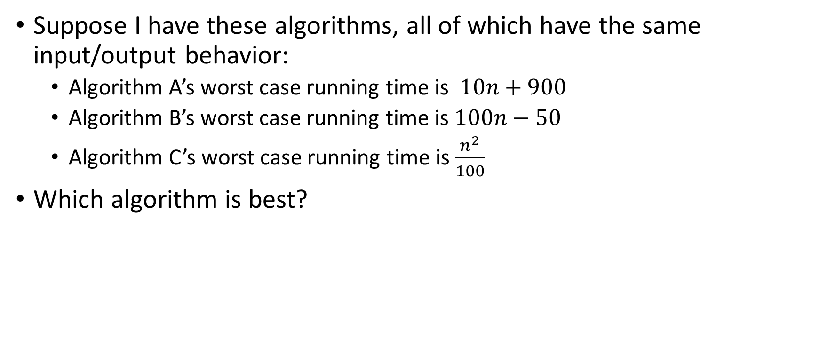
Comparing Running Times
Suppose I have these algorithms, all of which have the same input/output behavior:
  Algorithm A’s worst case running time is $10n+900$
  Algorithm B’s worst case running time is $100n−50$
  Algorithm C’s worst case running time is $\frac{n^{2}}{100}$
Which algorithm is best?

Slide 29
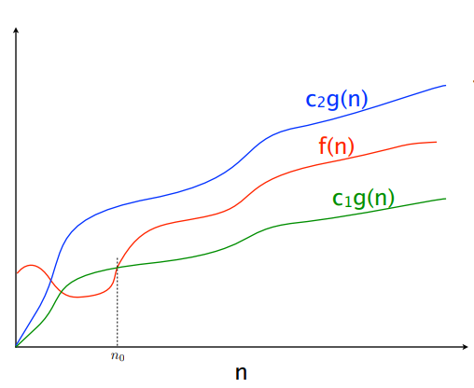

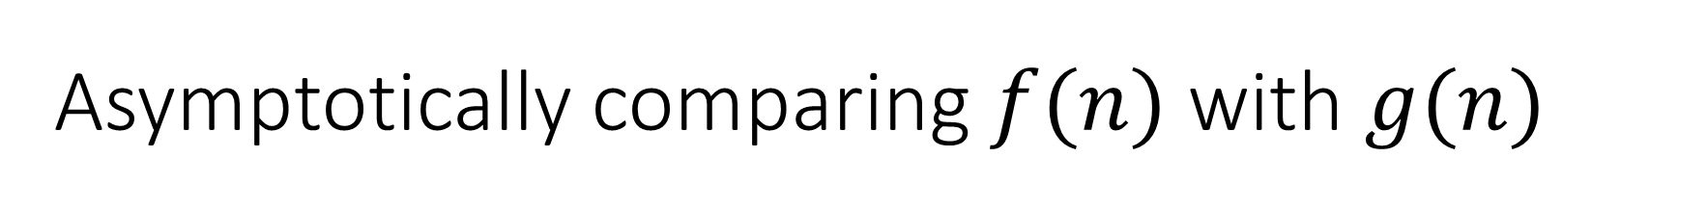


Asymptotically comparing $f(n)$ with $g(n)$
$$f(n)=O(g\left(n\right))$$
$$f(n)=Θ(g\left(n\right))$$
$$f(n)=Ω(g\left(n\right))$$

Slide 30
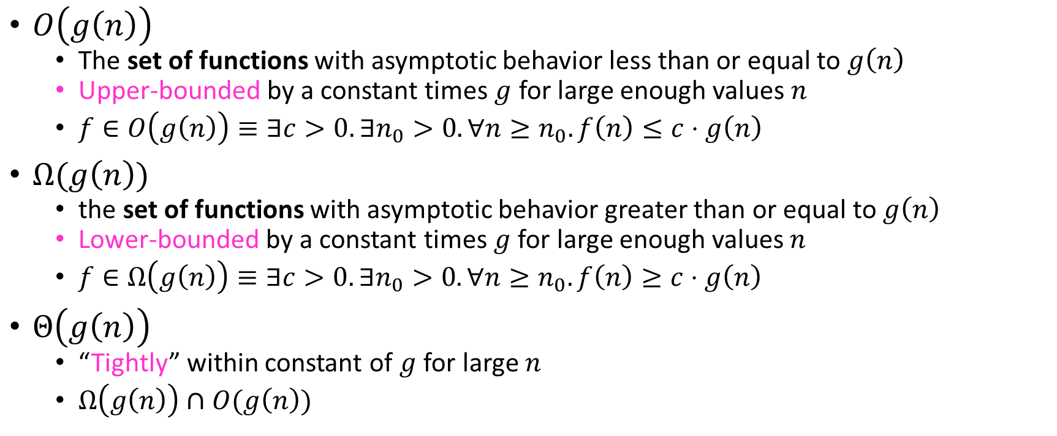
Asymptotic Notation
$O\left(g\left(n\right)\right)$
  The set of functions with asymptotic behavior less than or equal to $g\left(n\right)$
  Upper-bounded by a constant times $g$ for large enough values $n$
  $f∈O\left(g\left(n\right)\right)≡∃c>0. ∃n_{0}>0. ∀n≥n_{0}. f\left(n\right)≤c⋅g\left(n\right)$
$Ω(g\left(n\right))$
  the set of functions with asymptotic behavior greater than or equal to $g\left(n\right)$
  Lower-bounded by a constant times $g$ for large enough values $n$
  $f∈Ω\left(g\left(n\right)\right)≡∃c>0. ∃n_{0}>0. ∀n≥n_{0}. f\left(n\right)≥c⋅g\left(n\right)$
$Θ\left(g\left(n\right)\right)$
  “Tightly” within constant of $g$ for large $n$
  $Ω\left(g\left(n\right)\right)∩O(g\left(n\right))$

Slide 31
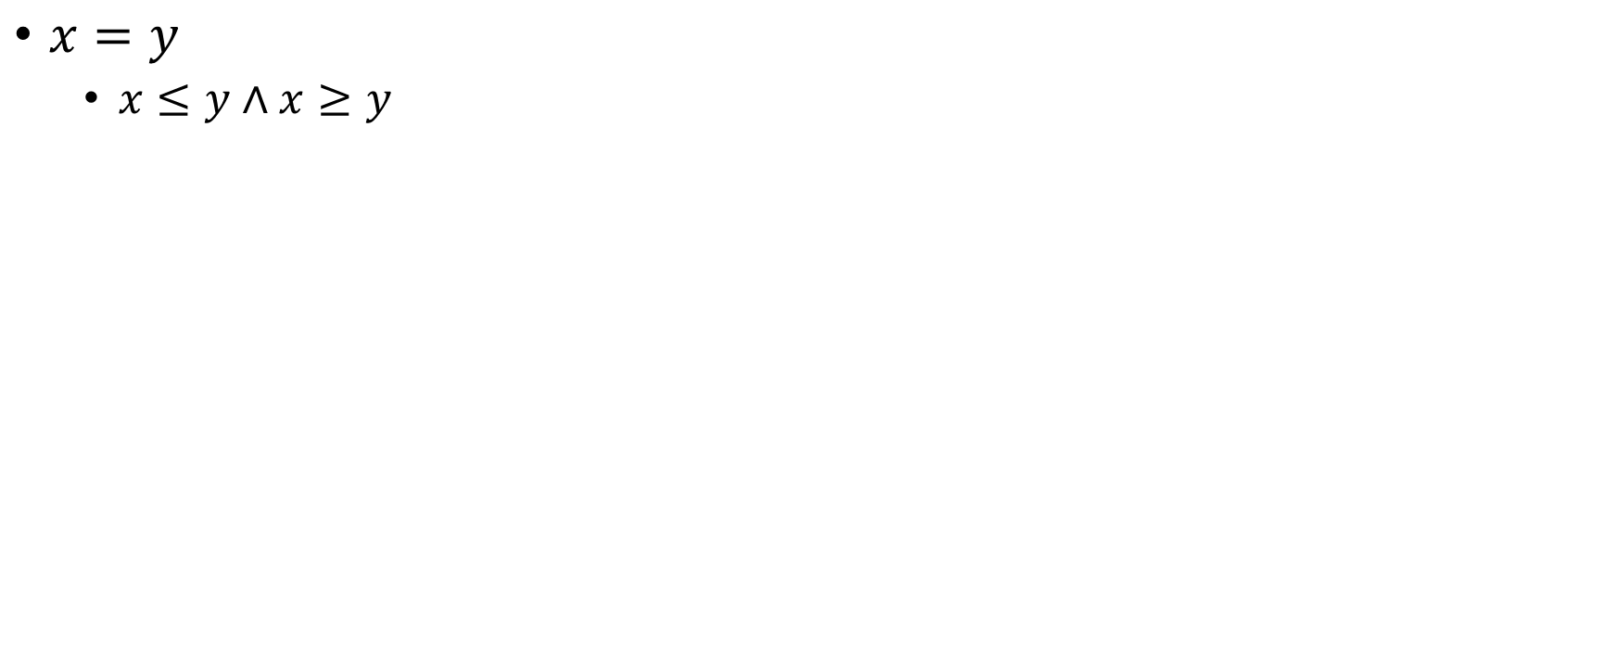

Idea of $Θ$
$x=y$
  $x≤y∧x≥y$

