Slide 1
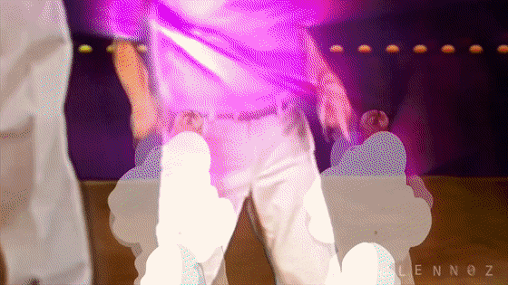
Recurrences
CSE 332 - Section 3

Slide 2

Part 1: Recurrence Relations

Slide 3
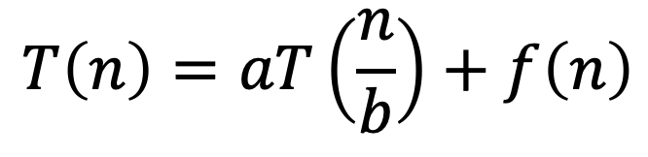
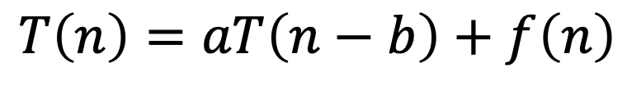
Recurrence Relations Overview
Describes the time complexity of recursive algorithms, often uses T(n)
  Same way that f(n) and g(n) described time complexity of non recursive algorithms last week
Generally in the form:
$$T\left(n\right)=aT\left(\frac{n}{b}\right)+f\left(n\right)$$
“Divide & Conquer”
OR
$$T\left(n\right)=aT\left(n−b\right)+f\left(n\right)$$
“Chip & Conquer”

Slide 4
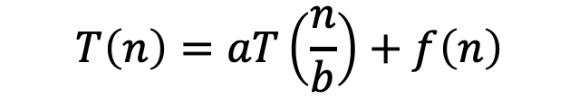

Recurrence Relations Examples
$$T\left(n\right)=aT\left(\frac{n}{b}\right)+f\left(n\right)$$
OR
$$T\left(n\right)=aT\left(n−b\right)+f\left(n\right)$$
n = input size
T(n) = runtime for input size n
b = how input shrinks for next recursive call(s) (reduction factor/ constant)
a = number of recursive calls made per function call (branching factor)
foo(L) { // n = L.size
if (L.size <= 1) {
return 1;
}
L.remove(0); // n = n-1
return foo(L) + foo(L);
}
bar(A, start, n) {
if (n-start <= 1) {
return 1;
}
return 2*bar(A, start, n/2);
}
a = 2
b = 1
a = 1
b = 2
Notes:
`

Slide 5

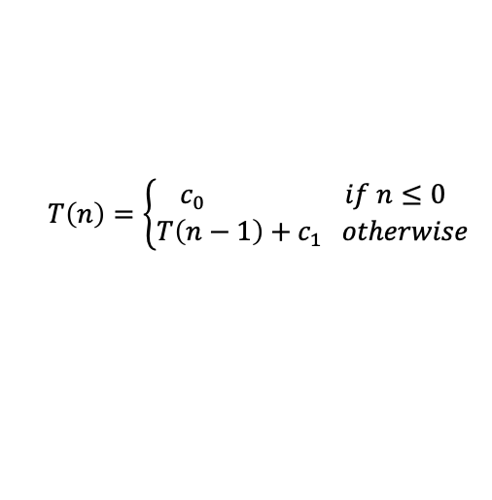
Problem 0a
Recurrence relation forms:
Find a recurrence T(n) modelling the worst-case runtime complexity of f(n)
1 f(stack) { // stack.size = n
2 if (stack.size == 0) {
3 return 0
4 }
5 stack.pop // stack.size --
6 return 2*f(stack)+1
7 }
$$T\left(n\right)=\left\{\begin{aligned}c_{0} if n≤0 \\ T\left(n−1\right)+c_{1} otherwise\end{aligned}\right.$$
When does the base case occur?
What is the branching factor a?
What is the reduction factor / constant b?
What is the amount of non-recursive work f(n)?

Slide 6
Problem 0a
Recurrence relation forms:
Find a recurrence T(n) modelling the worst-case runtime complexity of f(n)
1 f(stack) { // stack.size = n
2 if (stack.size == 0) {
3 return 0
4 }
5 stack.pop // stack.size --
6 return 2*f(stack)+1
7 }
$$T\left(n\right)=\left\{\begin{aligned}c_{0} if n≤0 \\ T\left(n−1\right)+c_{1} otherwise\end{aligned}\right.$$
When does the base case occur?
What is the branching factor a?
What is the reduction factor / constant b?
What is the amount of non-recursive work f(n)?
n ≤ 0
a = 1 since we only make one recursive call
b = 1 since we always reduce input size by 1
constant, which we can denote as c₁

Slide 7
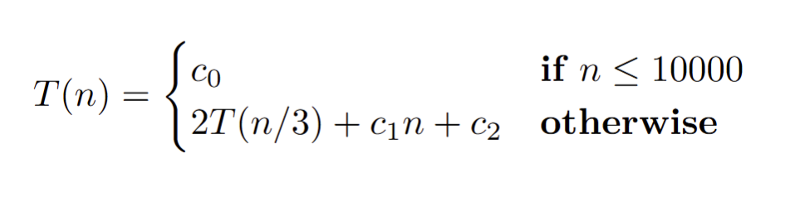
Problem 0b
Recurrence relation forms:
Find a recurrence T(n) modelling the worst-case runtime complexity of bar(n)
1 bar(A, start, n) {
2 if n ≤ 10000 {
3 return 1000
4 }
5 if (bar(A, start, n/3) > 5) {
6 for (int i=0; i<n; i++) {
  7 println("Yay")
  8 }
9 return 5*bar(A, start, n/3)
10 } else {
11 for (int i=0; i<n*n; i++) {
12 println("Yay")
13 }
14 return 4 * bar(A, start, n/3)
15 }
When does the base case occur?
What is the branching factor a?
What is the reduction factor /b?
What is the amount of non-recursive work f(n)?
n ≤ 10000
a = 2
b = 3
c1*n + c2

Slide 8

Tree Method Overview

Slide 9




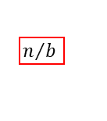























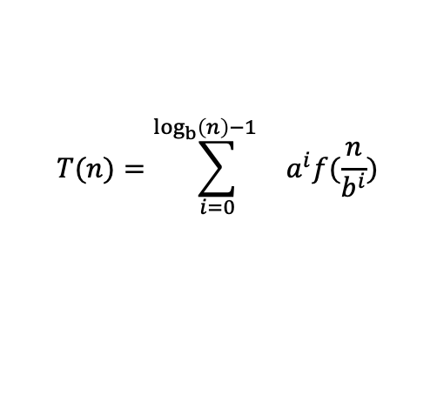


Big Idea: T(n/b)
Asymptotically, these never matter!
Red box represents a problem instance
$⟹a^{i}f(\frac{n}{b^{i}})$ work per level
Blue value next to each box represents time spent at that recursive call
…
…
…
$≈\log_{b}n$ levels
…
…
…
…
…
c
  $$T(n)=\sum_{i=0}^{\log_{b}\left(n\right)−1{}}{a^{i}f(\frac{n}{b^{i}})}$$
Notes:
(might not go here): for teaching number of levels, I like to do the following…
T(n)=aT(n/b)+f(n)
From the tree: root is n
Children are n/b
Grandchildren are n/b^2
At level i the size of the boxes is n/b^i
We reach the base case when n/b^i = 1
Solve for i to get the height of the tree
General: find the patter for the size of the box per level, and then solve for which level gives the base case size

Slide 10
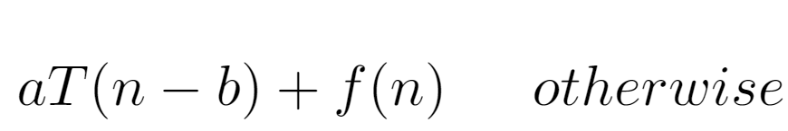
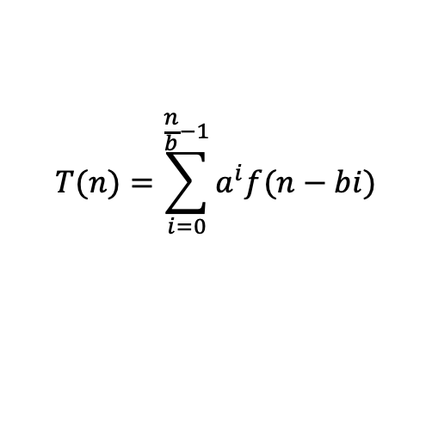


Big Idea: T(n-b)
Asymptotically, these never matter!
Red box represents a problem instance
n
f(n)
$⟹\text{a}\text{i} \text{f}\text{(}\text{n}\text{ − }\text{bi}\text{)}$ work per level
Blue value next to each box represents time spent at that recursive call
n - b
n - b
f(n-b)
f(n-b)
…
f(n-2b)
f(n-2b)
f(n-2b)
f(n-2b)
n - 2b
n - 2b
n - 2b
n - 2b
$≈\frac{n}{b}$ levels
…
…
…
…
c
c
c
c
c
…
x
x
x
x
x
  $$T(n)=\sum_{i=0}^{\frac{n}{b}−1}{a^{i}f(n−bi)}$$
Notes:
(might not go here): for teaching number of levels, I like to do the following…
T(n)=aT(n/b)+f(n)
From the tree: root is n
Children are n/b
Grandchildren are n/b^2
At level i the size of the boxes is n/b^i
We reach the base case when n/b^i = 1
Solve for i to get the height of the tree
General: find the patter for the size of the box per level, and then solve for which level gives the base case size

Slide 11





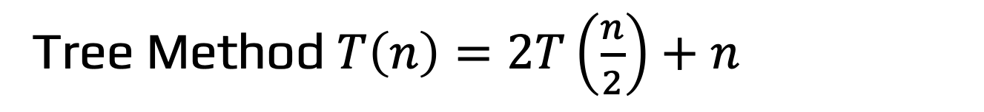







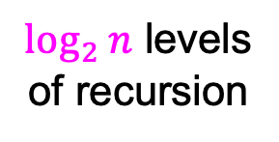






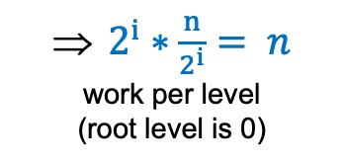







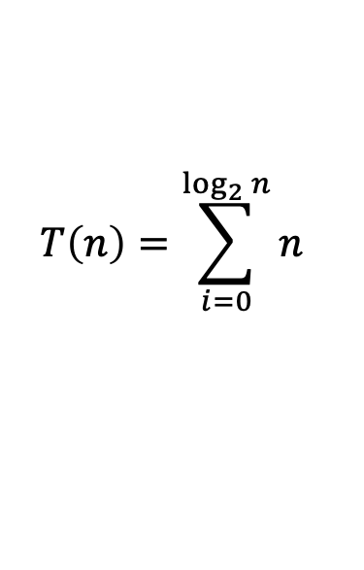
Tree Method $T\left(n\right)=2T\left(\frac{n}{2}\right)+n$
Red box represents a problem instance
Blue value next to each box represents time spent at that recursive call
$$n$$
$2^{i}∗\frac{n}{2^{i}}= n$
work per level
(root level is 0)
$$n$$
$$n/2$$
$$\frac{n}{2}$$
$$n/2$$
$$\frac{n}{2}$$
$\log_{2}⁡n$ levels
of recursion
$$n/4$$
$$\frac{n}{4}$$
$$n/4$$
$$\frac{n}{4}$$
$$n/4$$
$$\frac{n}{4}$$
$$n/4$$
$$\frac{n}{4}$$
…
…
…
…
…
$$1$$
$$1$$
$$1$$
$$1$$
$$1$$
$$1$$
$$1$$
$$1$$
$$1$$
$$1$$
$$1$$
$$1$$
  $$T\left(n\right)=\sum_{i=0}^{\log_{2}{n}}{n}$$

Slide 12
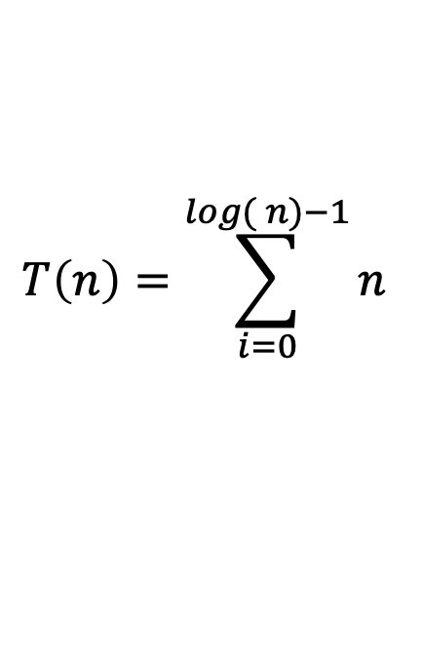
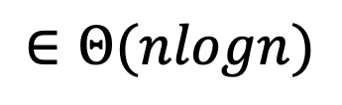
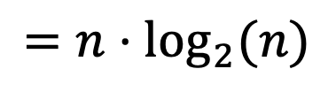
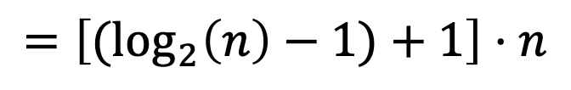
Q1(a) Solving the Summation
  $$T\left(n\right)=\sum_{i=0}^{log({n)−1}}{n}$$
$$=\left[{(log}_{2}\left(n\right)−1)+1\right]⋅n$$
$$=n⋅\log_{2}{(n)}$$
$$∈Θ(nlogn)$$

Slide 13

Your Turn!
Try problems 1b-1f

Slide 14
























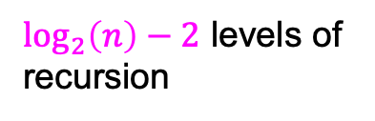

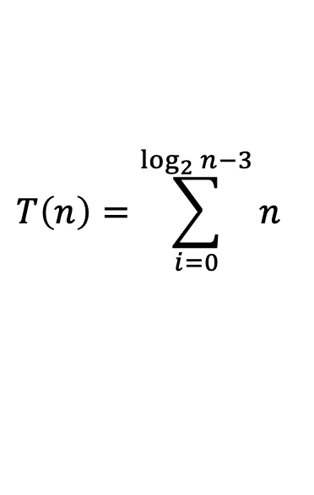
Q1(b) Base Case Doesn’t Matter!
Red box represents a problem instance
Blue value next to each box represents time spent at that recursive call
$⟹2^{i}∗\frac{n}{2^{i}}=n$ work per level
…
…
$\log_{2}\left(n\right)−2$ levels of
recursion
…
…
…
…
  $$T\left(n\right)=\sum_{i=0}^{\log_{2}{n−3}}{n}$$
…

Slide 15
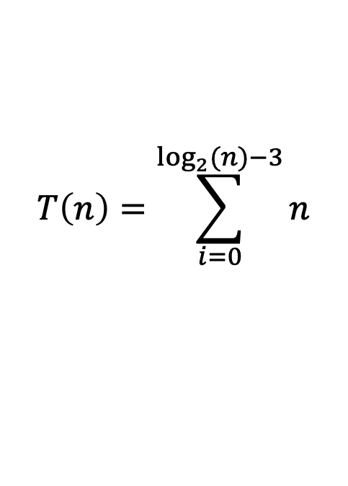
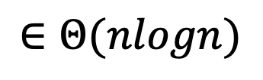
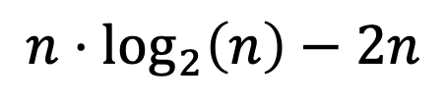
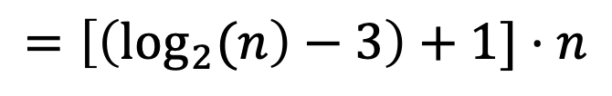
Q1(b) Solving the Summation
  $$T\left(n\right)=\sum_{i=0}^{\log_{2}{(n)−3}}{n}$$
$$=\left[\left(\log_{2}{(n}\right)−3\right)+1]⋅n$$
$$n⋅\log_{2}\left(n\right)−2n$$
$$∈Θ(nlogn)$$

Slide 16



















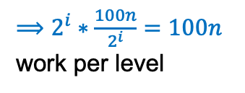
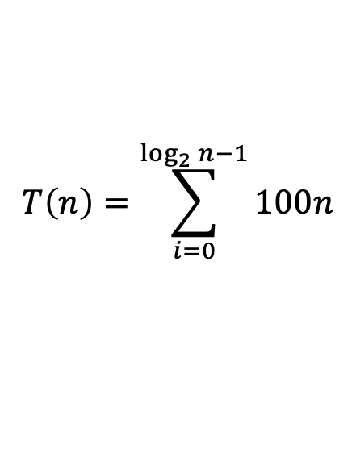
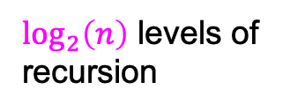
Q1(c) Constants for f(n) Don’t Matter!
Red box represents a problem instance
Blue value next to each box represents time spent at that recursive call
$⟹2^{i}∗\frac{100n}{2^{i}}=100n$ work per level
…
…
$\log_{2}\left(n\right)$ levels of
recursion
…
…
…
…
…
  $$T\left(n\right)=\sum_{i=0}^{\log_{2}{n−1}}{100n}$$

Slide 17
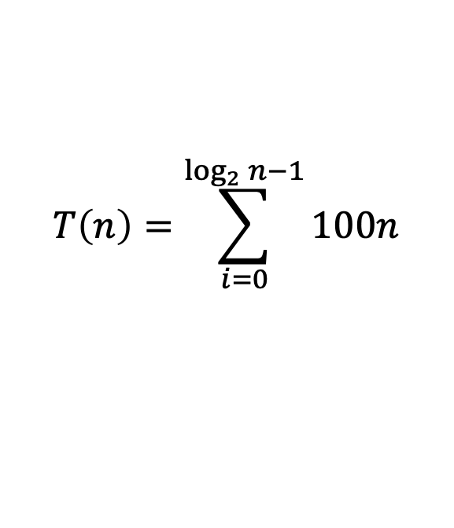
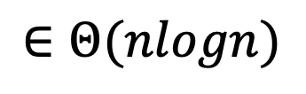
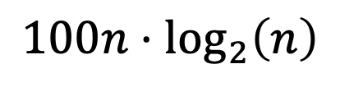
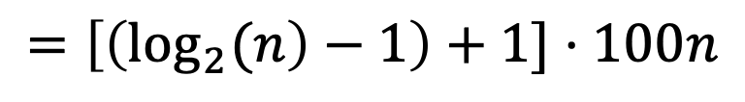
Q(1c) Solving the Summation
  $$T\left(n\right)=\sum_{i=0}^{\log_{2}{n−1}}{100n}$$
$$=\left[\left(\log_{2}{(n}\right)−1\right)+1]⋅100n$$
$$100n⋅\log_{2}\left(n\right)$$
$$∈Θ(nlogn)$$

Slide 18
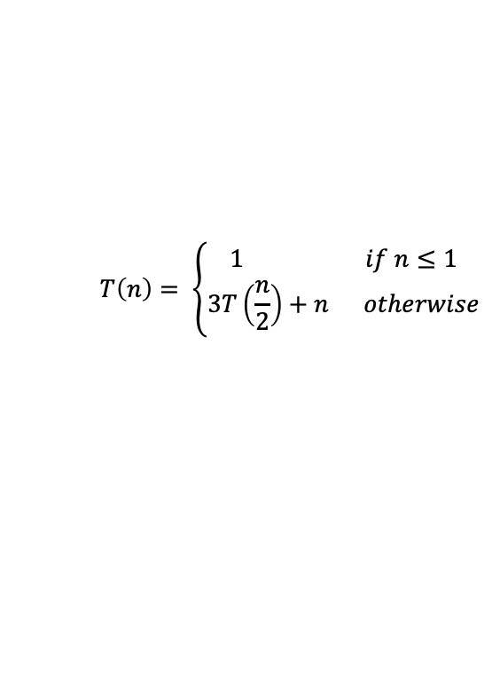
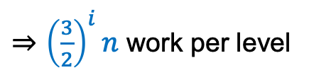



















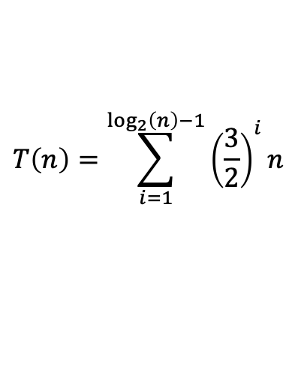
Q1(d) Branching Factor (a) Matters!
Red box represents a problem instance
Blue value represents time spent at that recursive call
…
…
…
…
…
…

Slide 19
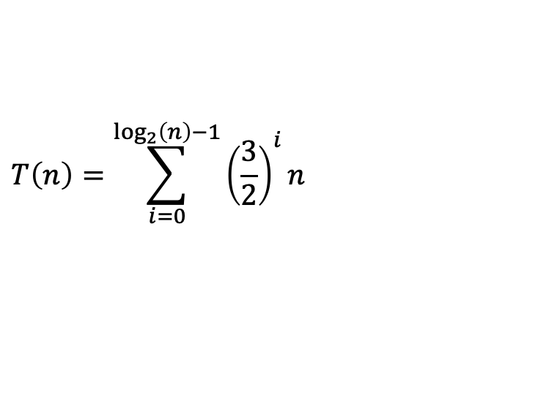
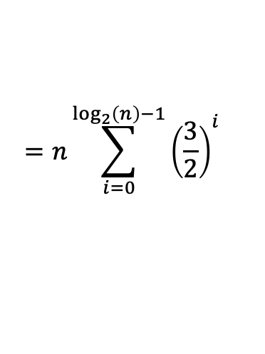
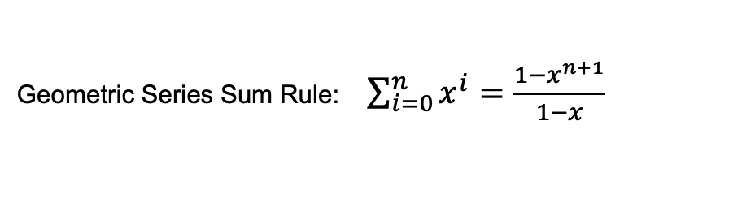




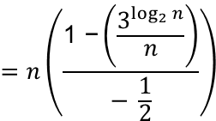
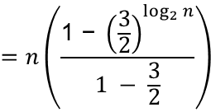
Q(1d) Solving the Summation
can move the n using the constant multiple rule
$$=n\left(\frac{\text{1 − }{\left(\frac{3}{2}\right)}^{\log_{2}{n}}}{1 − \frac{3}{2}}\right)$$
$$=n\left(\frac{\text{1 −}\left(\frac{3^{\log_{2}{n}}}{n}\right)}{− \frac{1}{2}}\right)$$
multiplied by -2 and distributed our n

Slide 20
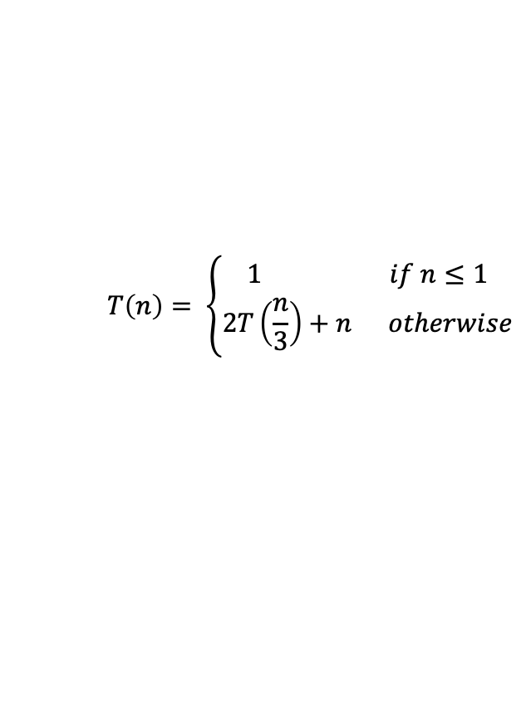
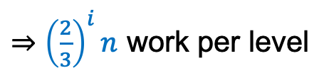


















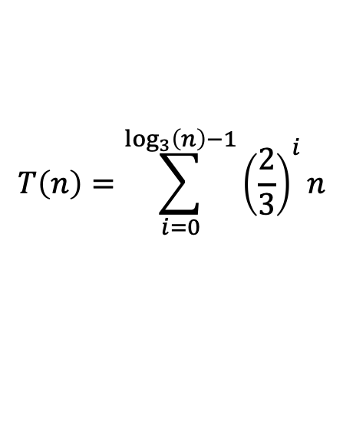
Q1(e) Reduction Factor (/b) Does Matter!
Red box represents a problem instance
Blue value represents time spent at that recursive call
…
…
…
…
…
…
…

Slide 21
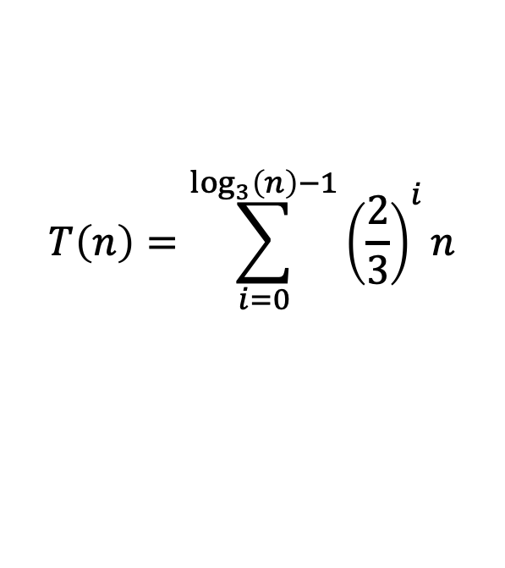
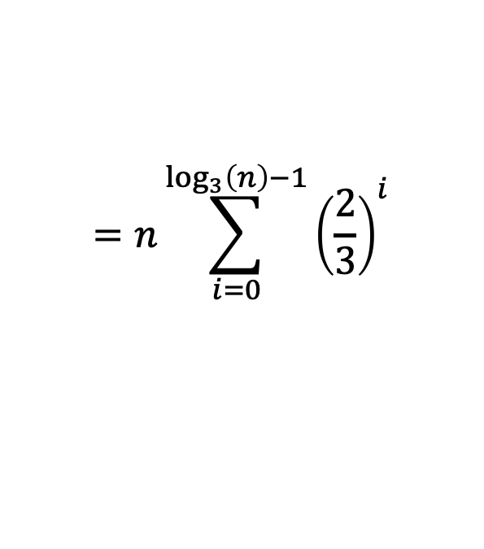
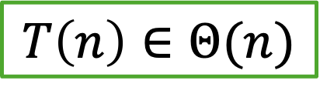
Q(1e) Solving the Summation
can move the n using the constant multiple rule
This is a geometric series with a ratio < 1, so it converges to a constant!

Slide 22
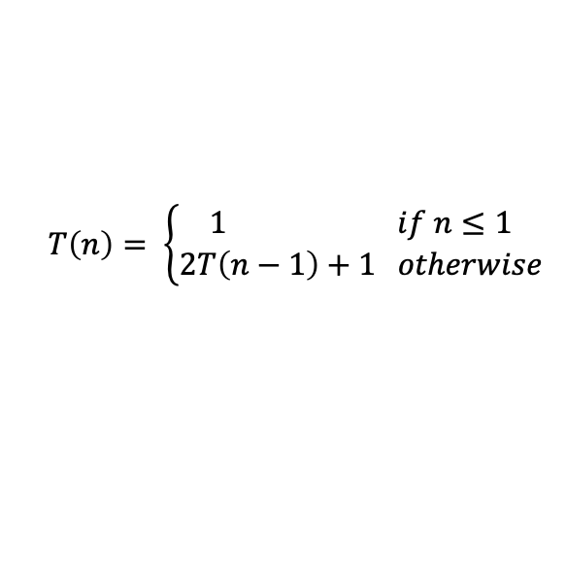
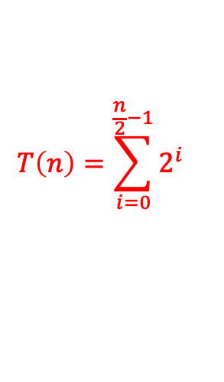
Q1(f): Tree method
n
Work: 1
#children
#levels
work
⇒ 2^{i} work per level
1
n-2
n-2
1
1
1
1
1
n-4
n-4
n-4
n-4
≈ n/2 levels
…
…
…
…
1
1
1
1
1
…
1
1
1
1
1

Slide 23
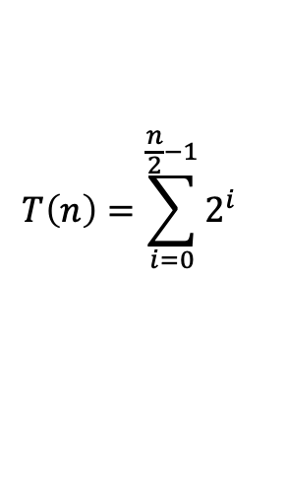
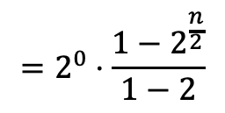
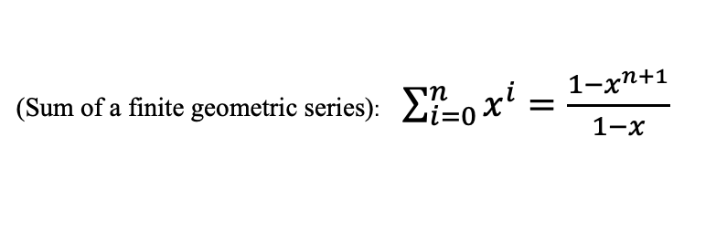





Q1(f): Solving the Summation
Note: formula like this will be provided for exams

Slide 24




Reduction Constant (-b) Matters!
Left/top represents -1 case
Right/bottom represents -2 case
n
1
⇒ 2^{i}
work per level for both cases
1
n-1 or n-2
n-1 or n-2
1
1
1
1
1
n-2 or n-4
n-2 or n-4
n-2 or n-4
n-2 or n-4
≈ n levels for -1
≈ n/2 levels for -2
…
…
…
…
1
1
1
1
1
…
1
1
1
1
1
Hint: Use the Finite Geometric Series (#7 on Math Identities) to solve these summations!

Slide 25

General Advice

Slide 26


Recursive Running Times - Guidance

Slide 27



Slide 28

Only differences between divide and conquer cases highlighted in yellow
Draw a tree such that:
  Each node has a children
  The “size of each node is b less than the size of its parent
  The “work” for each node is f applied to its size
  The height of the tree is n/b
Sum the tree horizontally
  I.e. identify the total work done at each level
Sum the levels’ work vertically
  Given the sum of all work in the entire tree

Slide 29

Putting it All Together

Slide 30

Problem 2(a)
(a) Find a recurrence T(n) modeling the worst-case runtime complexity of f(n).
1 f(L, start, n) {
2 if (n - start <= 1) {
3 return 0
4 }
5 int res = f(L, start, n/2)
6 for (int i=0; i<n; i++) {
7 result *= 4
8 }
9 return res + f(L, start, n/2)
10 }

Slide 31


Problem 2(a)
(a) Find a recurrence T(n) modeling the worst-case runtime complexity of f(n).
1 f(L, start, j) { //n = j - start
2 if (j - start <= 1) {
3 return 0
4 }
5 int res = f(L, start, j/2)
6 for (int i=0; i<j; i++) {
7 result *= 4
8 }
9 return res + f(L, start, j/2)
10 }
$$T\left(n\right)=\left\{\begin{aligned}c_{0},&n=1 \\ 2T\left(\frac{n}{2}\right)+c_{2}n+c_{1},&otherwise\end{aligned}\right.$$
2 function calls -> a = 2
Reducing input size by half -> (n / 2)
Non-recursive work has loop with n iterations and some constant work -> f(n) = c_2n + c_1

Slide 32

Problem 2(b)
$$T\left(n\right)=\left\{\begin{aligned}c_{0},&n=1 \\ 2T\left(n/2\right)+c_{2}n+c_{1},&otherwise\end{aligned}\right.$$
(b) Find a closed form to your answer for (a).

Slide 33
$$T\left(n\right)=\left\{\begin{aligned}c_{0},&n=1 \\ 2T\left(n/2\right)+c_{2}n+c_{1},&otherwise\end{aligned}\right.$$

Slide 34

$$T\left(n\right)=\left\{\begin{aligned}c_{0},&n=1 \\ 2T\left(n/2\right)+c_{2}n+c_{1},&otherwise\end{aligned}\right.$$
Our first call to T(n)
Notes:
Each partial tree on the slide should be made a single group, explain in alt text the difference the previous slide’s partial tree
From the previous tree, we add…. Because …

Slide 35
$$T\left(n\right)=\left\{\begin{aligned}c_{0},&n=1 \\ 2T\left(n/2\right)+c_{2}n+c_{1},&otherwise\end{aligned}\right.$$
Input: n
Our first call to T(n)

Slide 36
$$T\left(n\right)=\left\{\begin{aligned}c_{0},&n=1 \\ 2T\left(n/2\right)+c_{2}n+c_{1},&otherwise\end{aligned}\right.$$
Input: n
Work: c2*n + c1
Our first call to T(n)

Slide 37
$$T\left(n\right)=\left\{\begin{aligned}c_{0},&n=1 \\ 2T\left(n/2\right)+c_{2}n+c_{1},&otherwise\end{aligned}\right.$$
Input: n
Work: c2*n + c1
“2T(...)” = 2 recursive calls
Input: n/2
Input:
n/2

Slide 38
$$T\left(n\right)=\left\{\begin{aligned}c_{0},&n=1 \\ 2T\left(n/2\right)+c_{2}n+c_{1},&otherwise\end{aligned}\right.$$
Input: n
Work: c2*n + c1
Input: n/2
Input: n/2

Slide 39
$$T\left(n\right)=\left\{\begin{aligned}c_{0},&n=1 \\ 2T\left(n/2\right)+c_{2}n+c_{1},&otherwise\end{aligned}\right.$$
Input: n
Work: c2*n + c1
Input: n/2
Work: c2*(n/2)+c1
Input: n/2
Work: c2*(n/2)+c1

Slide 40
$$T\left(n\right)=\left\{\begin{aligned}c_{0},&n=1 \\ 2T\left(n/2\right)+c_{2}n+c_{1},&otherwise\end{aligned}\right.$$
Input: n
Work: c2*n + c1
Input: n/2
Work: c2*(n/2)+c1
Input: n/2
Work: c2*(n/2)+c1
Input: n/4
Input: n/4
Input: n/4
Input: n/4

Slide 41
$$T\left(n\right)=\left\{\begin{aligned}c_{0},&n=1 \\ 2T\left(n/2\right)+c_{2}n+c_{1},&otherwise\end{aligned}\right.$$
Input: n
Work: c2*n + c1
Input: n/2
Work: c2*(n/2)+c1
Input: n/2
Work: c2*(n/2)+c1
Input: n/4
Work: c2*(n/4)+c1
Input: n/4
Work: c2*(n/4)+c1
Input: n/4
Work: c2*(n/4)+c1
Input: n/4
Work: c2*(n/4)+c1

Slide 42
$$T\left(n\right)=\left\{\begin{aligned}c_{0},&n=1 \\ 2T\left(n/2\right)+c_{2}n+c_{1},&otherwise\end{aligned}\right.$$
Input: n
Work: c2*n + c1
Input: n/2
Work: c2*(n/2)+c1
Input: n/2
Work: c2*(n/2)+c1
Input: n/4
Work: c2*(n/4)+c1
Input: n/4
Work: c2*(n/4)+c1
Input: n/4
Work: c2*(n/4)+c1
Input: n/4
Work: c2*(n/4)+c1
Input: 1
Input: 1
Input: 1
Input: 1

Slide 43
$$T\left(n\right)=\left\{\begin{aligned}c_{0},&n=1 \\ 2T\left(n/2\right)+c_{2}n+c_{1},&otherwise\end{aligned}\right.$$
Input: n
Work: c2*n + c1
Input: n/2
Work: c2*(n/2)+c1
Input: n/2
Work: c2*(n/2)+c1
Input: n/4
Work: c2*(n/4)+c1
Input: n/4
Work: c2*(n/4)+c1
Input: n/4
Work: c2*(n/4)+c1
Input: n/4
Work: c2*(n/4)+c1
Input: 1
Work: c0
Input: 1
Work: c0
Input: 1
Work: c0
Input: 1
Work: c0

Slide 44


Since we’re in /b case:
$$T\left(n\right)=\sum_{i=0}^{\log_{b}\left(n\right)−1}{a^{i}f\left(\frac{n}{b^{i}}\right)}$$
Input: n
Work: c2*n + c1
With a, b, and f(n) plugged in:
Input: n/2
Work: c2*(n/2)+c1
Input: n/2
Work: c2*(n/2)+c1
$$T\left(n\right)=\sum_{i=0}^{\log_{2}\left(n\right)−1}{2^{i}\left(c_{2}\left(\frac{n}{2^{i}}\right)+c_{1}\right)}$$
Input: n/4
Work: c2*(n/4)+c1
Input: n/4
Work: c2*(n/4)+c1
Input: n/4
Work: c2*(n/4)+c1
Input: n/4
Work: c2*(n/4)+c1
Input: 1
Work: c0
Input: 1
Work: c0
Input: 1
Work: c0
Input: 1
Work: c0

Slide 45

Thank You!

