Slide 1
Lecture 08: AVL Trees
CSE 332: Data Structures & Parallelism
Yafqa Khan
Summer 2025

Slide 2
Announcements
EX02 Due Tonight
EX03 Due Monday
Exam 1
Friday Week 5 (14 days from now)
https://courses.cs.washington.edu/courses/cse332/25su/exams/midterm.html

Slide 3
Today
Recap: Dictionary ADT
Review: Binary Search Trees
Trees
Basics, Properties, Operations
Balanced BSTs?
AVL Tree
Basics, Properties, Operations

Slide 4
AVL Tree: Data Structure
Structural Property
Each node has $≤2$ children
Left subtree and right subtree of every node heights differ by at most 1
Order Property
All keys in left subtree $<$ node's key
All keys in right subtree $>$ node's key
Notice: BST but with 1 extra property
8
5
11
2
6
10
13
4
7
9
12
14
15

Slide 5
AVL Tree: Is this an AVL Tree?
a)
6
b)
6
4
8
4
8
1
7
11
1
5
7
11
10
12
3
2
c)
5
2
8
1
3
6
11
4
7

Slide 6
AVL Tree: Is this an AVL Tree? (Soln.)
a) Yes
6
3
b) No
4
6
4
1
8
2
3
4
8
1
1
0
0
11
1
2
1
5
0
0
0
7
7
11
0
10
12
0
3
1
0
2
c) Yes
3
5
2
2
2
8
0
1
3
6
0
11
1
1
0
4
0
7

Slide 7
AVL Tree: Node Visualization
10
key
3
…
value
10
3
height
2
2
children
5
20
0
1
1
0
2
9
15
30
0
0
7
17

Slide 8
AVL Tree: Operations
find
Same as BST
insert
BST insert
Check and Fix Balance (4 cases)
delete
Lazy Deletion:
find
Mark as deleted
Non-lazy Deletion:
BST delete
Check and Fix Balance

Slide 9
Today
Recap: AVL Tree
AVL Tree insert
General
Single Rotation
Double Rotation
AVL Tree Conclusions

Slide 10
AVL: Data Structure
Structural Property
Each node has $≤2$ children
Left subtree and right subtree of every node heights differ by at most 1
Order Property
All keys in left subtree $<$ node's key
All keys in right subtree $>$ node's key
Notice: BST but with 1 extra property
8
5
11
2
6
10
13
4
7
9
12
14
15

Slide 11
AVL: Operations
find
Same as BST
insert
BST insert
Check and Fix Balance (4 cases)
delete
Lazy Deletion:
find
Mark as deleted
Non-lazy Deletion:
BST delete
Check and Fix Balance

Slide 12
Today
Recap: AVL Tree
AVL Tree insert
General
Single Rotation
Double Rotation
AVL Tree Conclusions

Slide 13
AVL: insert
Let p be the problem node where an imbalance occurs:
The inserted node is in the
1. Left-Left: left subtree of the left child of p.
2. Right-Left: right subtree of the left child of p.
3. Left-Right: left subtree of the right child of p.
4. Right-Right: right subtree of the right child of p.
Idea:
Cases 1 & 4 are solved by a single rotation
Cases 2 & 3 are solved by a double rotation
p
b
c
w
x
y
z

Slide 14
AVL: insert, Algorithm (finding + fixing p)
BST insert
After: Every node's height in the path to the bottom may have changed
Recursive Backtracking:
Calculate new height
Detect height imbalance
If imbalance: find case + rotate
Notes:
Only 1 deepest imbalanced node (p)
Rebalancing deepest p = everything else is balanced
Conclusion: Only 1 p needs balancing
3
6
2
4
8
1
1
1
5
0
0
7
11
0
3
0

Slide 15
AVL: insert, Only 1 p needs balancing
4
6
3
4
8
1
2
1
5
0
0
7
11
0
3
1
0
2

Slide 16
Today
Recap: AVL Tree
AVL Tree insert
General
Single Rotation
Double Rotation
AVL Tree Conclusions

Slide 17
AVL: insert Case 1 Left-Left Example 1
0
1
2
1. insert(6)
2. insert(3)
3. insert(1) violates balance property
p Happens to be at the root
What is the only way to fix this?
Single Rotation!
6
6
6
0
1
3
3
0
1

Slide 18
AVL: insert, Left-Left Single Rotation
The basic operation we’ll use to rebalance
Move child of p to position of p
p becomes the "other" child
Other subtrees move (based on what BST allows)
2
6
1
3
1
3
0
0
0
1
1
6

Slide 19
Any Questions?

Slide 20
AVL: insert Case 1 Left-Left Example 2
15
insert(16)
8
22
4
10
19
24
3
6
17
20
16

Slide 21
AVL: insert Case 1 Left-Left Example 2 (Soln.)
15
insert(16)
8
22
4
10
19
24
3
6
17
20
16
15
8
19
4
10
17
22
3
6
16
20
24

Slide 22
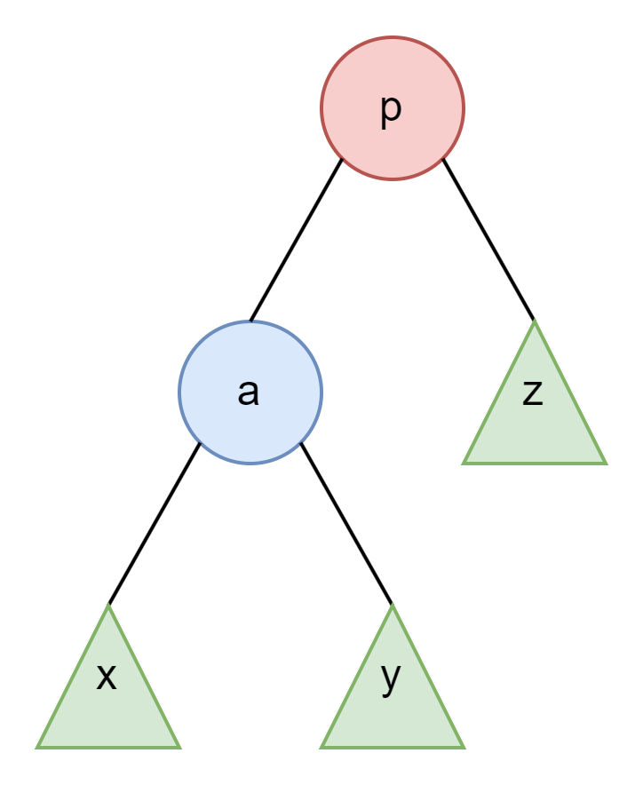
AVL: Single Rotation Pseudocode
Node RotateWithLeft(Node root) {
Node temp = root.left
root.left = temp.right
temp.right = root
root.height = max(root.left.height(),
root.right.height()) + 1
temp.height = max(temp.left.height(),
temp.right.height()) + 1
root = temp
return root
}
h+2
h+1
h
h
h

Slide 23
AVL: insert, Left-Left Single Rotation
Node p imbalanced due to insertion somewhere in Left-Left "Grandchild subtree" increasing height
Insert a node at w: p becomes imbalanced
p
h+2
p
h+3
h+1
h+2
h
h
b
z
b
z
h
h
h+1
h
w
x
w
x

Slide 24
AVL: insert, Left-Left Single Rotation
Node p imbalanced due to insertion somewhere in Left-Left "Grandchild subtree" increasing height
Insert a node at w: p becomes imbalanced
Next, rotate at p, using BST fact: w < b < x < p < z
p
h+3
h+2
b
h+2
h
h+1
h+1
b
z
w
p
h+1
h
h
x
h
z
w
x

Slide 25
Any Questions?

Slide 26
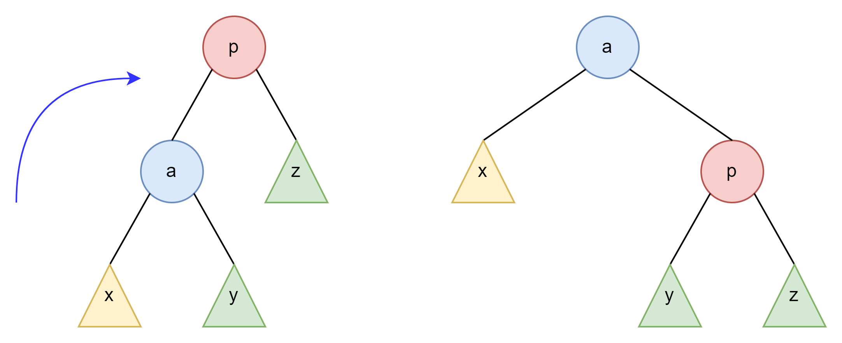
AVL: insert, Case 1 Left-Left
After RotateWithRight

Slide 27
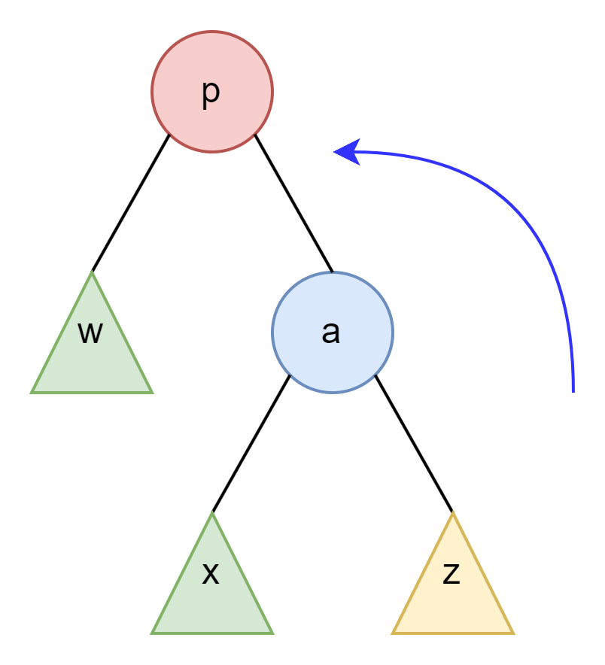
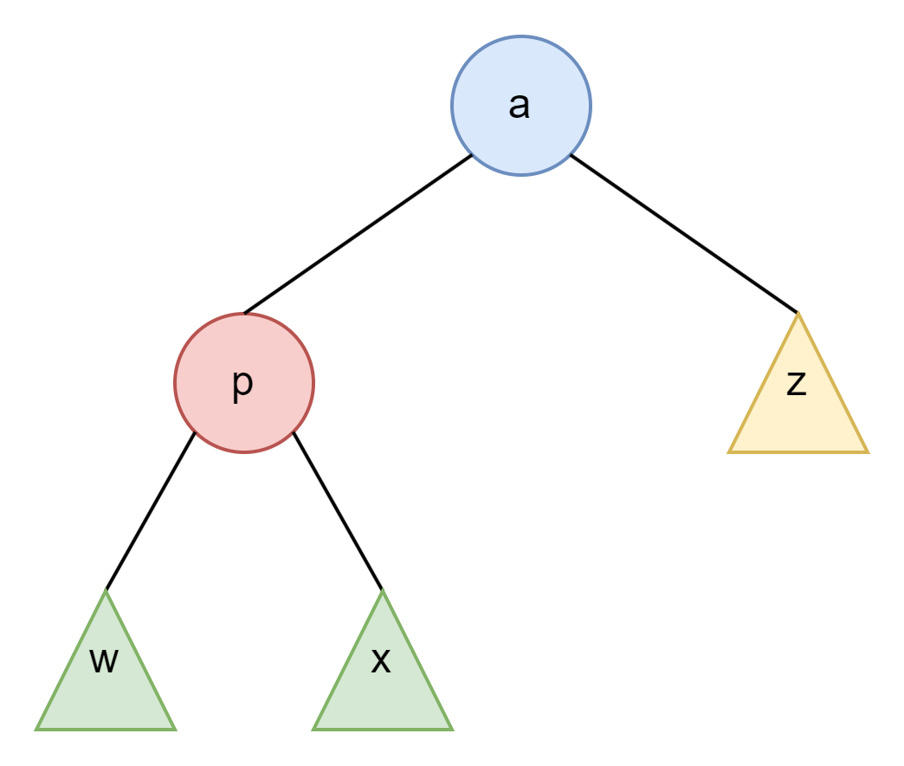
AVL: insert, Case 4 Right-Right
The same but mirrored
After RotateWithLeft

Slide 28
Today
Recap: AVL Tree
AVL Tree insert
General
Single Rotation
Double Rotation
AVL Tree Conclusions

Slide 29
AVL: insert Case 3 Left-Right Example 1
1. insert(1)
2. insert(6)
3. insert(3) violates balance property
p Happens to be at the root
What is the only way to fix this?
Uhh try single rotation (?)
2
1
1
6
0
3

Slide 30
AVL: insert Left-Right Attempted Fix 1
Try Single (Counter ClockWise) Rotation on 1
Is there a problem here? Order Property violated
2
1
1
6
1
6
0
0
0
1
3
3

Slide 31
AVL: insert Left-Right Attempted Fix 2
Try Single (ClockWise) Rotation on 1
Is there a problem here? Balance not fixed!
2
2
1
1
1
1
6
3
0
0
3
6

Slide 32
AVL: insert Left-Right Real Fix
Attempted Fix 1: Order Property violated
Attempted Fix 2: Balance not fixed
Real Fix: Double Rotation!
Rotate p's child and p's grandchild
Rotate p and p's new child
2
2
1
1
1
1
1
3
6
3
0
0
0
1
6
3
0
6

Slide 33
Any Questions?

Slide 34
AVL: insert Case 3 Left-Right Example 2
2
insert(3)
1
5
4
7
3

Slide 35
AVL: insert Case 3 Left-Right Example 2 (Soln.)
2
2
insert(3)
1
5
1
4
4
7
3
5
3
7
4
2
5
1
3
7

Slide 36
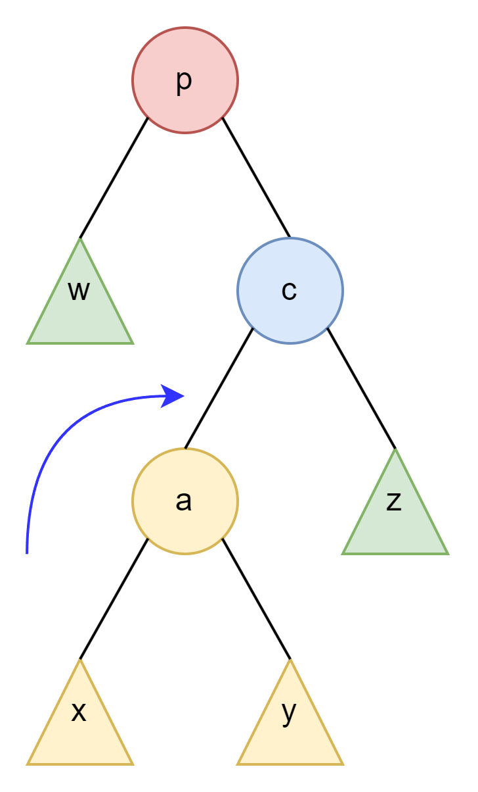
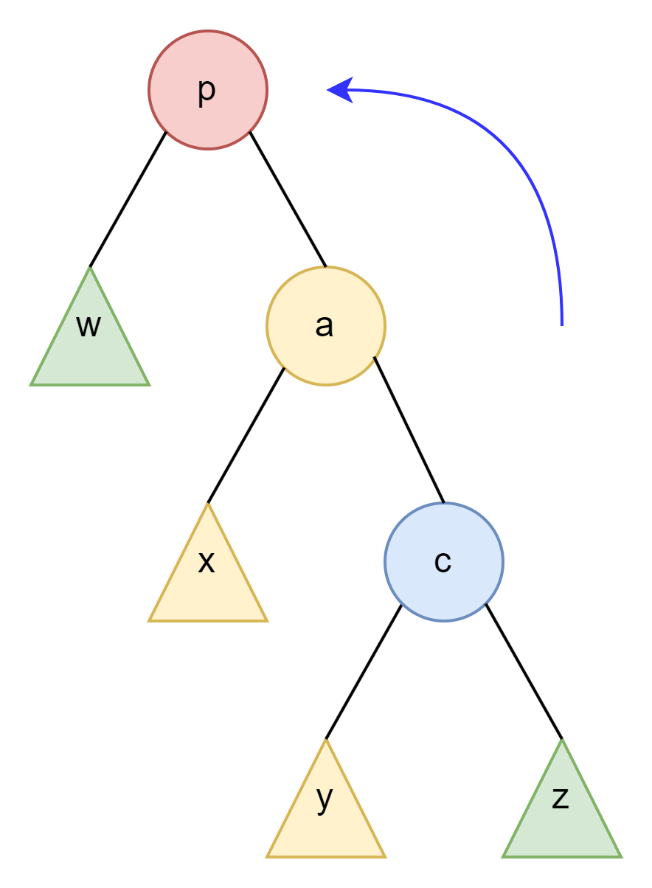
AVL: Double Rotation Pseudocode
Node DoubleRotateWithRight(Node root) {
root.right = RotateWithLeft(root.right)
root = RotateWithRight(root)
return root
}
After RotateWithLeft

Slide 37
Any Questions?

Slide 38
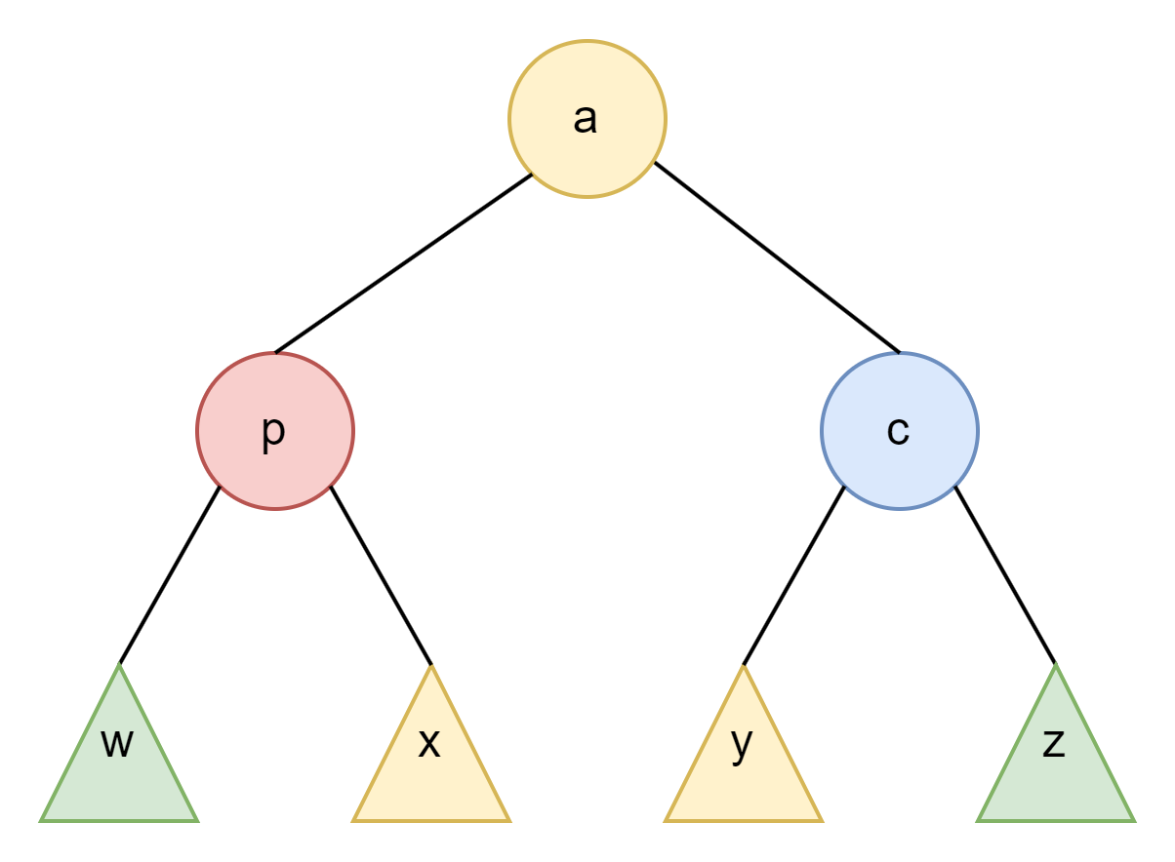
AVL: insert, Case 3 Left-Right
After RotateWithLeft
After RotateWithRight

Slide 39
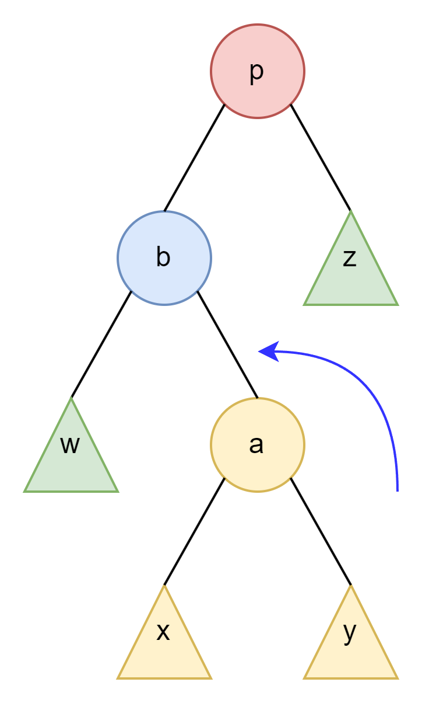
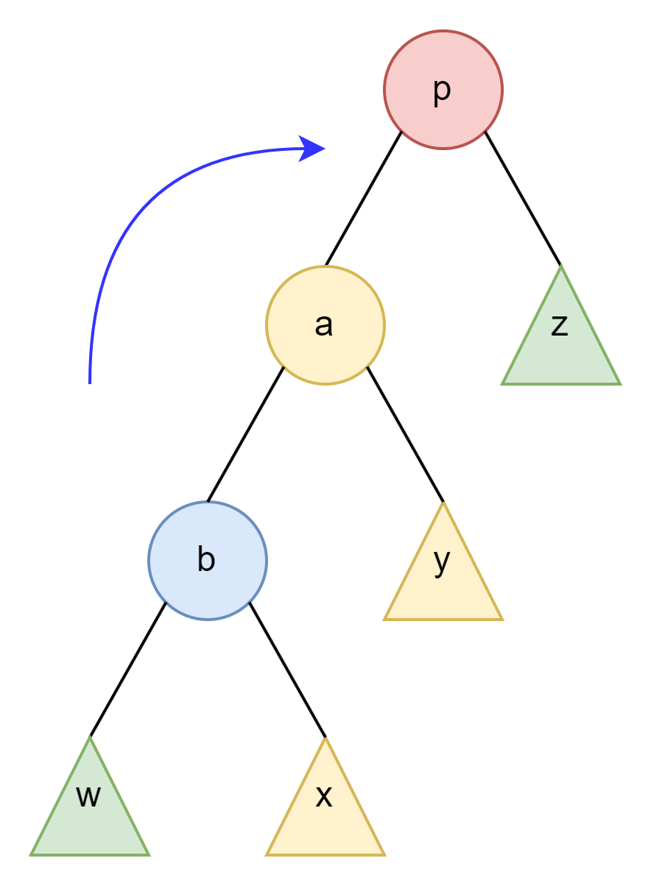
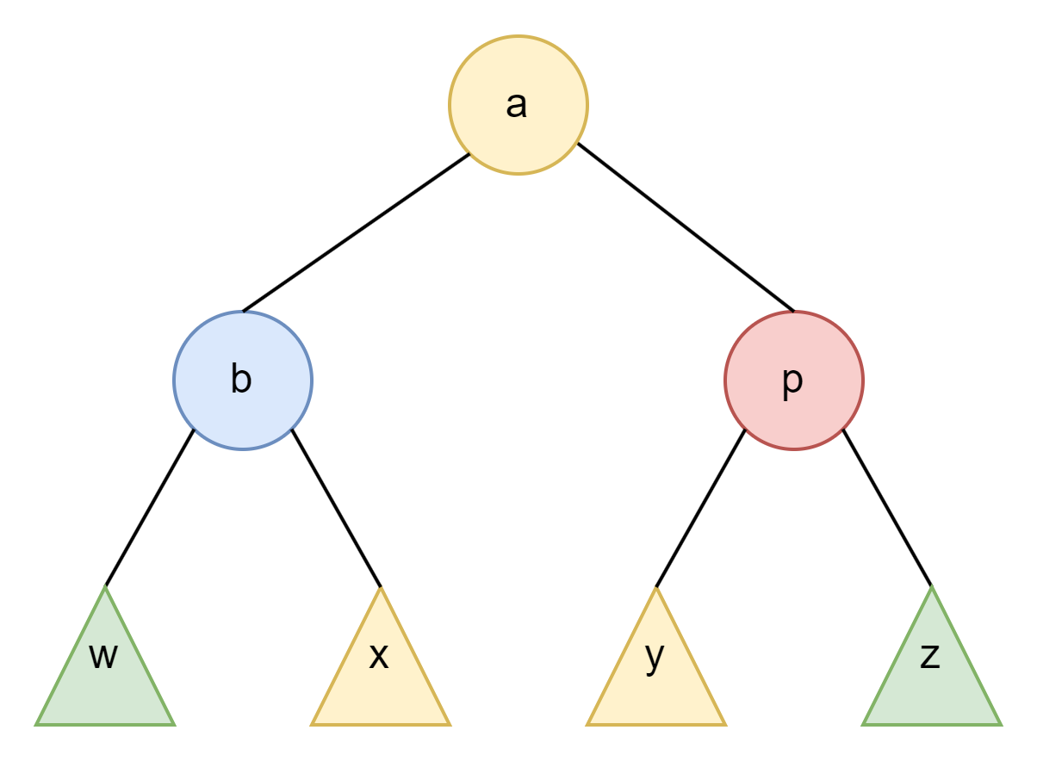
AVL: insert, Case 2 Right-Left
The same but mirrored
After RotateWithRight
After RotateWithLeft

Slide 40
AVL: insert Case 2 Right-Left Example
15
insert(5)
8
17
4
10
16
3
6
5

Slide 41
AVL: insert Case 2 Right-Left Example (Soln.)
15
15
insert(5)
8
17
8
17
4
10
16
6
10
16
3
6
4
5
3
5
15
6
17
4
8
16
3
5
10

Slide 42
AVL: insert.
BST insert
Recursive Backtracking: Detect height imbalance
If imbalance: Find case + Rotate,
Left-Left: left subtree of the left child of p.
Right-Left: right subtree of the left child of p.
Left-Right: left subtree of the right child of p.
Right-Right: right subtree of the right child of p.
Assuming tree was balanced before insert (it is), only one case occurs

Slide 43
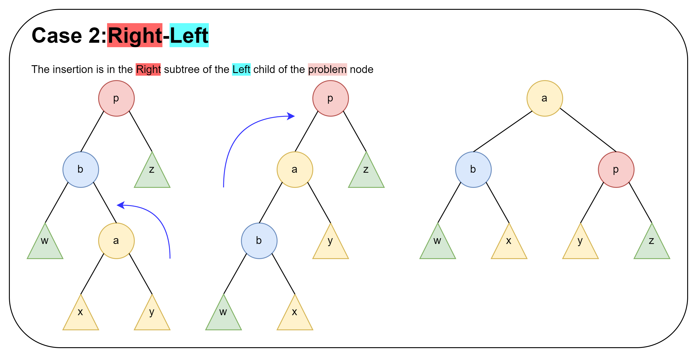
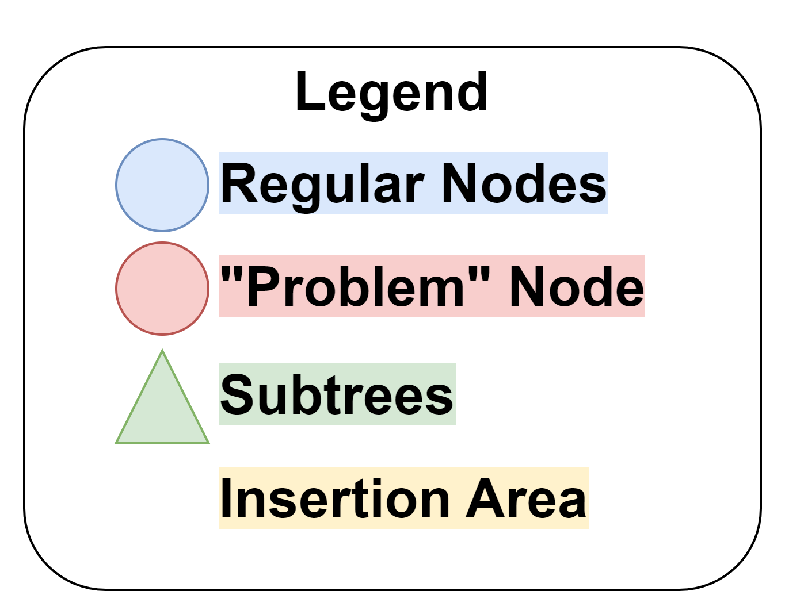
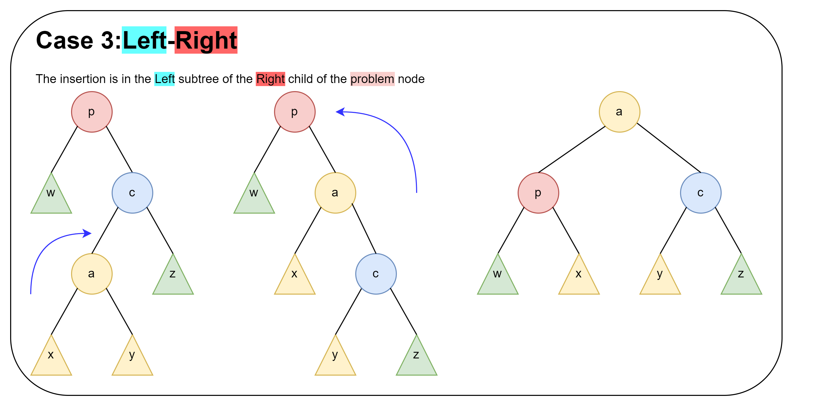
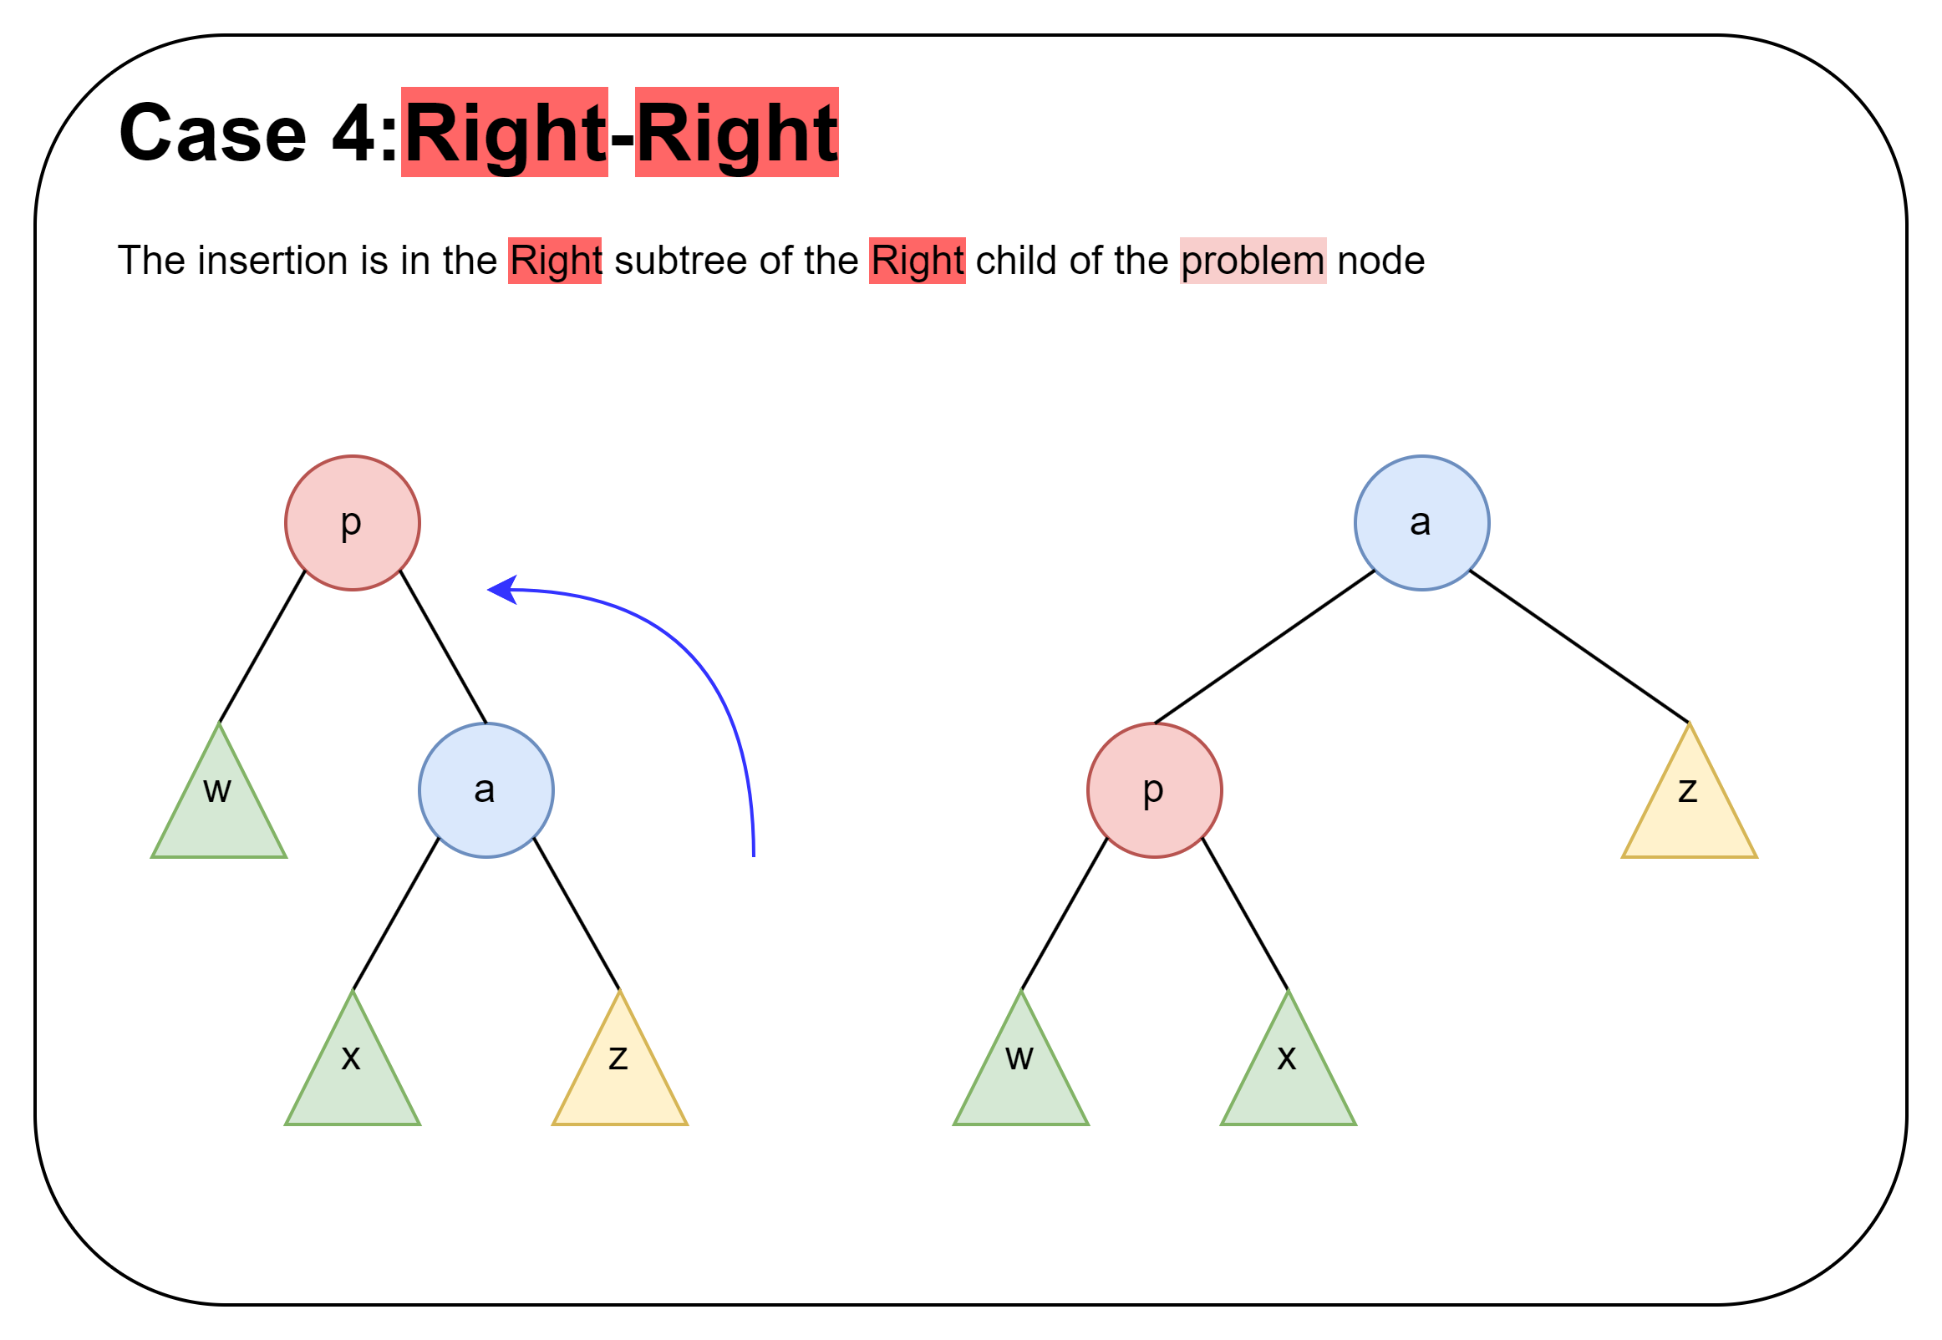

Slide 44
Any Questions?

Slide 45
AVL: insert Exercise: 1 2 5 3 4

Slide 46
Today
Recap: AVL Tree
AVL Tree insert
General
Single Rotation
Double Rotation
AVL Tree Conclusions

Slide 47
Let $S\left(h\right)$be the minimum # of nodes in an AVL tree of height $h$, then:
h Minimal AVL Tree S(h)
$$S\left(h\right)= \left\{\begin{matrix}0 \\ 1 \\ 1+ S\left(h−1\right)+S\left(h−2\right)\end{matrix}\right.\begin{matrix}if h=−1 \\ if h=0 \\ otherwise\end{matrix}$$

Slide 48
AVL: The shallowness bound
Let $S\left(h\right)=$ the minimum number of nodes in an AVL tree of height $h$
If we can prove that $S\left(h\right)$ grows exponentially in $h$, then a tree with $n$ nodes has a logarithmic height
Step 1: Define $S\left(h\right)$ inductively using AVL property
Step 2: Show this recurrence grows really fast
Similar to Fibonacci numbers
Can prove for all $h$, $S\left(h\right)>φ^{h}−1$
Golden ratio $φ=\frac{1+\sqrt{5}}{2}≈1.62$
Growing faster than ${1.62}^{h}$ is “plenty exponential”
h
h-2
h-1
Notes:
If h is a min-size AVL tree, it has to have this structure (diagram) (okay to switch left-right subtrees). Ask why.
Note that each subtree is an AVL tree, by definition. Since the goal is to minimize the size of the tree, might as well choose the minimum h-2 and h-1 trees.
m(h) = m(h-1) + m(h-2) + 1

Slide 49
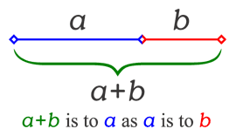
AVL: The Golden Ratio
$$φ=\frac{1+\sqrt{5}}{2}≈1.62$$
This is a special number
Aside: Since the Renaissance, many artists and architects have proportioned their work (e.g., length:height) to approximate the golden ratio: If (a+b)/a = a/b, then a = φb
We will need one special arithmetic fact about φ :
φ²
= ((1+5^{1/2})/2)²
= (1 + 2*5^{1/2} + 5)/4
= (6 + 2*5^{1/2})/4
= (3 + 5^{1/2})/2
= 1 + (1 + 5^{1/2})/2
= 1 + φ

Slide 50
AVL: Height Proof
$$S\left(h\right)= \left\{\begin{matrix}0 \\ 1 \\ 1+S\left(h−1\right)+S\left(h−2\right)\end{matrix}\right.\begin{matrix}if h=−1 \\ if h=0 \\ otherwise\end{matrix}$$
Theorem: For all h ≥ 0, S(h) > φ^{h} – 1
Proof: By induction on h
Base cases:
S(0) = 1 > φ⁰ – 1 = 0 S(1) = 2 > φ¹ – 1 ≈ 0.62
Inductive case (k > 1):
Show S(k+1) > φ^{k+1} – 1 assuming S(k) > φ^{k} – 1 and S(k-1) > φ^{k-1} – 1
S(k+1) = 1 + S(k) + S(k-1) by definition of S
> 1 + φ^{k} – 1 + φ^{k-1} – 1 by induction
= φ^{k} + φ^{k-1} – 1 by arithmetic (1-1=0)
= φ^{k-1} (φ + 1) – 1 by arithmetic (factor φ^{k-1} )
= φ^{k-1} φ² – 1 by special property of φ
= φ^{k+1} – 1 by arithmetic (add exponents)

Slide 51
AVL: Height
TL;DR Last few slides show:
$$h∈Θ\left(\log{n}\right)$$

Slide 52
AVL: Efficiency?
find: $Θ\left(______\right)$
Tree is balanced
insert: $Θ\left(______\right)$
Tree starts balanced
Rotation is $Θ\left(1\right)$, Root->Deepest Descendant: $Θ\left(\log{n}\right)$
Tree ends balanced
buildTree: $Θ\left(______\right)$
delete
Lazy Deletion: $Θ\left(________\right)$
Non-lazy Deletion: $Θ\left(________\right)$

Slide 53
AVL: Efficiency? (Soln.)
find: $Θ\left(\log{n}\right)$
Tree is balanced
insert: $Θ\left(\log{n}\right)$
Tree starts balanced
Rotation is $Θ\left(1\right)$, Root->Deepest Descendant: $Θ\left(\log{n}\right)$
Tree ends balanced
buildTree: $Θ\left(\operatorname{nlog}{n}\right)$
delete
Lazy Deletion: $Θ\left(\log{n}\right)$
Non-lazy Deletion: $Θ\left(\log{n}\right)$

Slide 54
AVL: Tradeoffs
Pros:
All operations logarithmic worst-case because trees are always balanced
Height balancing adds no more than a constant factor to the speed of insert and delete
Cons:
Difficult to program & debug
More space for height field
Asymptotically faster but rebalancing takes a little time
Most large searches are done in database-like systems on disk and use other structures (e.g., B-trees)

Slide 55
Any Questions?

Slide 56
Timeline
AVL Tree
Basics, Properties, Operations
AVL Tree insert
Single Rotation
Double Rotation
AVL Tree Conclusions
Hashing
Hash Function
ChainingHashTable

