Slide 1
Lecture 6:
Recurrences
CSE 332: Data Structures & Parallelism
Yafqa Khan
Summer 2025

Slide 2
Announcements
  EX 1 Due Today
  EX 2 Due Friday
  EX 3 Released Today

Slide 3
Today
Asymptotic Analysis: Recursion
  Writing a Recurrence Relation
  Solving a Recurrence Relation 1: Unrolling
  Solving a Recurrence Relation 2: Tree Method

Slide 4
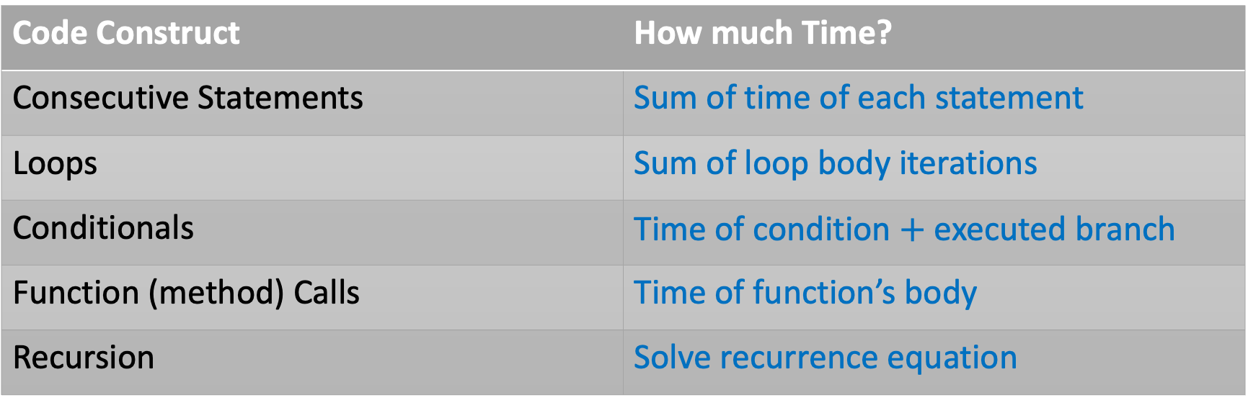
Recap: Counting code constructs
Assume basic operations take some amount of constant time
  Arithmetic (1+1), assignment (int b = 3), array index(arr[i]), etc.
This approximates reality: a very useful "lie"
Code Construct | How much Time?
Consecutive Statements | Sum of time of each statement
Loops | Sum of loop body iterations
Conditionals | Time of condition $+$ executed branch
Function (method) Calls | Time of function’s body
Recursion | Solve recurrence equation

Slide 5

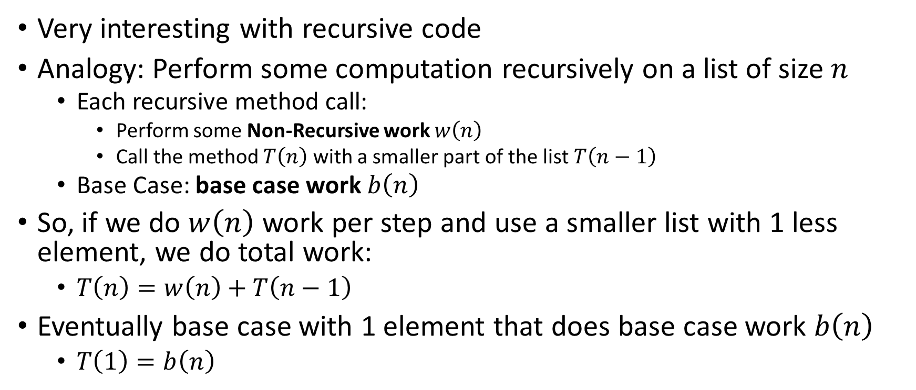

Counting Recursive Code
 |  | ...
$$0$$
$$n$$
Very interesting with recursive code
Analogy: Perform some computation recursively on a list of size $n$
  Each recursive method call:
    Perform some Non-Recursive work $w\left(n\right)$
    Call the method $T\left(n\right)$ with a smaller part of the list $T\left(n−1\right)$
  Base Case: base case work $b\left(n\right)$
So, if we do $w\left(n\right)$ work per step and use a smaller list with 1 less element, we do total work:
  $T\left(n\right)=w\left(n\right)+T\left(n−1\right)$
Eventually base case with 1 element that does base case work $b\left(n\right)$
  $T\left(1\right)=b\left(n\right)$

Slide 6
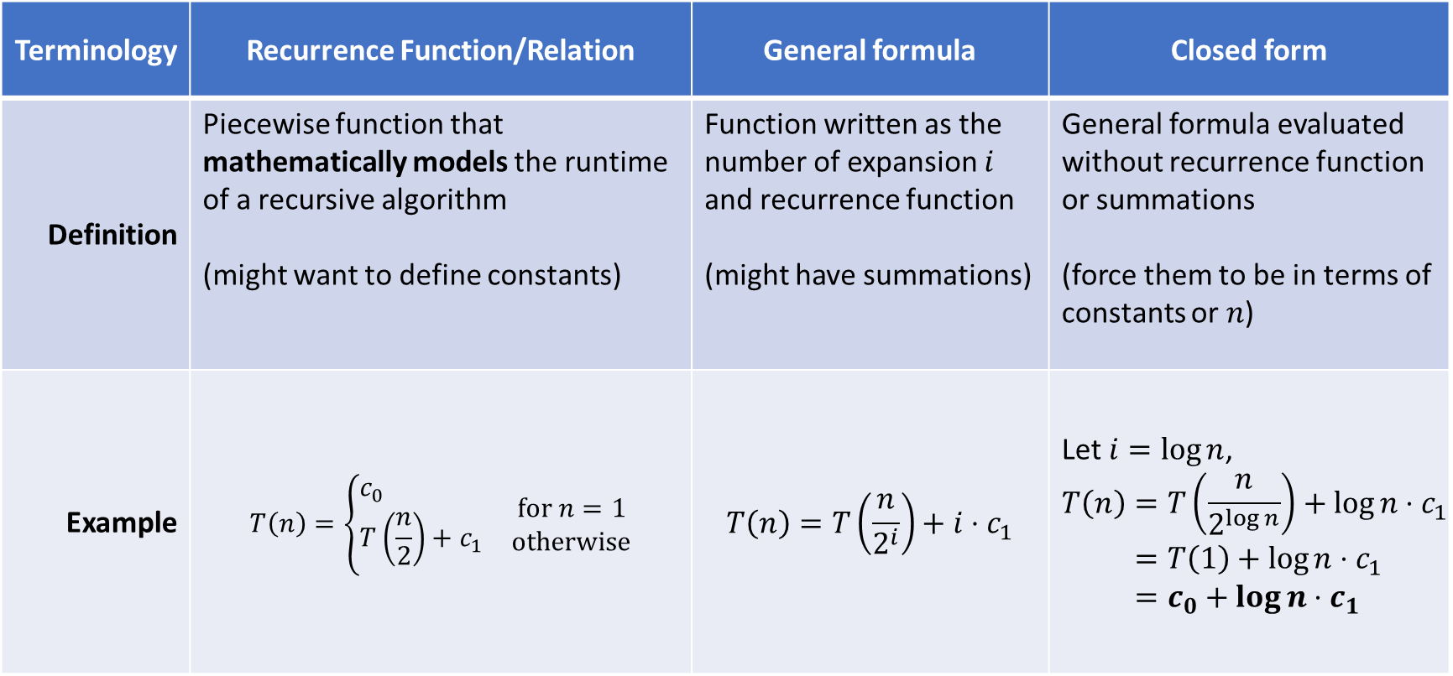
Recurrence: Terminology
Terminology | Recurrence Function/Relation | General formula | Closed form
Definition | Piecewise function that mathematically models the runtime of a recursive algorithm (might want to define constants) | Function written as the number of expansion $i$ and recurrence function (might have summations) | General formula evaluated without recurrence function or summations (force them to be in terms of constants or $n$)
Example | $$T\left(n\right)=\left\{\begin{matrix}\begin{aligned}&c_{0} \\ &T\left(\frac{n}{2}\right)+c_{1}\end{aligned} & \begin{matrix}\text{f}\text{or} n=1 \\ \text{otherwise}\end{matrix}\end{matrix}\right.$$ | $$T\left(n\right)=T\left(\frac{n}{2^{i}}\right)+i⋅c_{1}$$ | Let $i=\log{n}$, $$\begin{aligned}T\left(n\right)&=T\left(\frac{n}{2^{\log{n}}}\right)+\log{n}⋅c_{1} \\ &=T\left(1\right)+\log{n}⋅c_{1} \\ &=c_{0}+\log{n}⋅c_{1}\end{aligned}$$

Slide 7
Writing a Recurrence Function/Relation
int sum(int[]arr,int n) {
if(n==0)
return arr[n];
return arr[n] + sum(arr,n-1);
}
Q: How can we count sum(arr,arr.length);?
A: By using recursive formulas (called recurrence function/relation)!
  Base Case Work
  Non-Recursive Work + Recursive Work

Slide 8
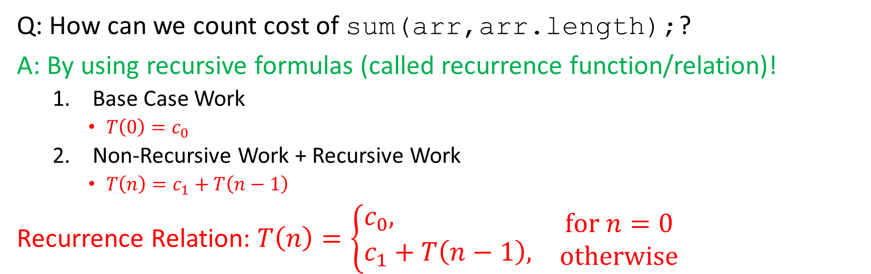
Writing a Recurrence Function/Relation (Soln.)
int sum(int[]arr,int n) {
if(n==0)
return arr[n];
return arr[n] + sum(arr,n-1);
}
Q: How can we count cost of sum(arr,arr.length);?
A: By using recursive formulas (called recurrence function/relation)!
  Base Case Work
    $T\left(0\right)=c_{0}$
  Non-Recursive Work + Recursive Work
    $T\left(n\right)=c_{1}+T\left(n−1\right)$
Recurrence Relation: $T\left(n\right)=\left\{\begin{matrix}\begin{aligned}&c_{0}, \\ &c_{1}+T\left(n−1\right),\end{aligned} & \begin{matrix}\text{f}\text{or} n=0 \\ \text{otherwise}\end{matrix}\end{matrix}\right.$

Slide 9
Any Questions?

Slide 10
Today
Asymptotic Analysis: Recursive
  Writing a Recurrence Relation
  Solving a Recurrence Relation 1: Unrolling
  Solving a Recurrence Relation 2: Tree Method

Slide 11
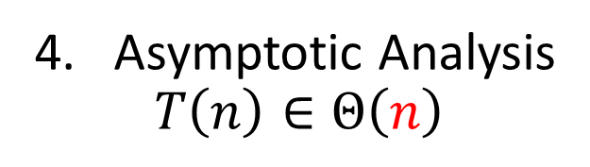
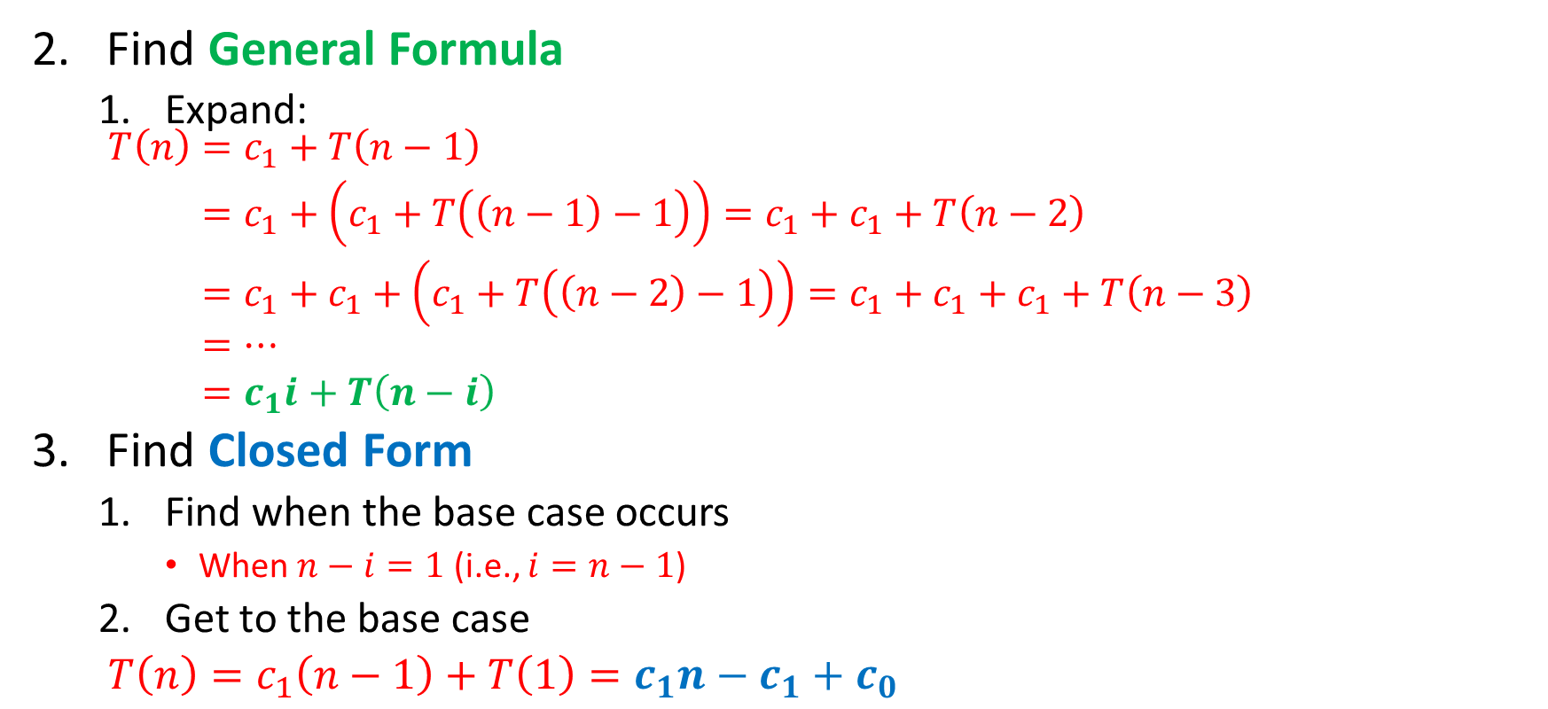
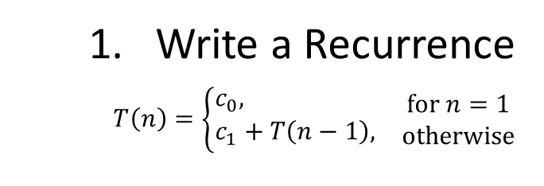
Solving Recurrence 1: Unrolling
Write a Recurrence
$T\left(n\right)=\left\{\begin{matrix}\begin{aligned}&c_{0}, \\ &c_{1}+T\left(n−1\right),\end{aligned} & \begin{matrix}\text{f}\text{or} n=1 \\ \text{otherwise}\end{matrix}\end{matrix}\right.$
Find General Formula
  Expand:
  $\begin{aligned}T\left(n\right)&=c_{1}+T\left(n−1\right) \\ &=c_{1}+\left(c_{1}+T\left(\left(n−1\right)−1\right)\right)=c_{1}+c_{1}+T\left(n−2\right) \\ &=c_{1}+c_{1}+\left(c_{1}+T\left(\left(n−2\right)−1\right)\right)=c_{1}+c_{1}+c_{1}+T\left(n−3\right) \\ &=… \\ &=c_{1}i+T\left(n−i\right)\end{aligned}$
Find Closed Form
  Find when the base case occurs
    When $n−i=1$ (i.e., $i=n−1$)
  Get to the base case
  $T\left(n\right)=c_{1}\left(n−1\right)+T\left(1\right)=c_{1}n−c_{1}+c_{0}$
Asymptotic Analysis
$$T\left(n\right)∈Θ\left(n\right)$$

Slide 12
Any Questions?

Slide 13
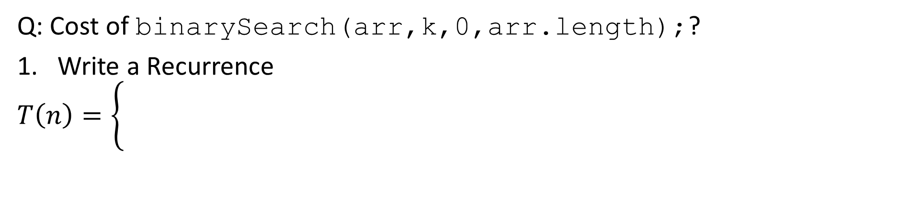
Unrolling: Example, Binary Search
Find an integer in a sorted array
2
3
5
16
37
50
73
75
126
// returns whether k is in array
boolean binarySearch(int[]arr, int k, int lo, int hi) {
int mid = (hi+lo)/2; //i.e., lo+(hi-lo)/2
if(lo==hi) return false;
if(arr[mid]==k) return true;
if(arr[mid]< k) return binarySearch(arr,k,mid+1,hi);
else return binarySearch(arr,k,lo,mid);
}
Q: Cost of binarySearch(arr,k,0,arr.length);?
Write a Recurrence
$$T\left(n\right)=\left\{\begin{matrix} & \\ & \end{matrix}\right.$$

Slide 14
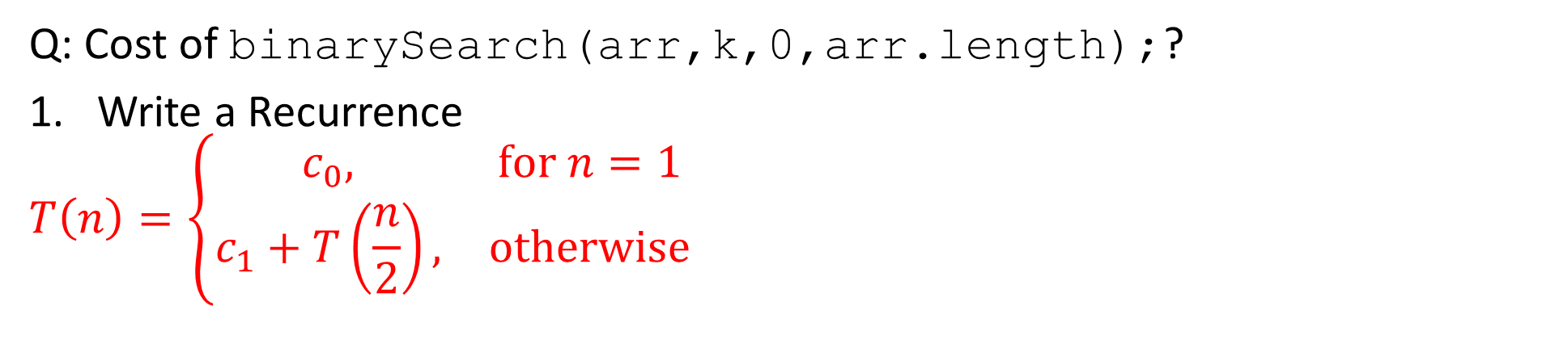
Unrolling: Example, Binary Search (Soln.)
Find an integer in a sorted array
2
3
5
16
37
50
73
75
126
// returns whether k is in array
boolean binarySearch(int[]arr, int k, int lo, int hi) {
int mid = (hi+lo)/2; //i.e., lo+(hi-lo)/2
if(lo==hi) return false;
if(arr[mid]==k) return true;
if(arr[mid]< k) return binarySearch(arr,k,mid+1,hi);
else return binarySearch(arr,k,lo,mid);
}
Q: Cost of binarySearch(arr,k,0,arr.length);?
Write a Recurrence
$$T\left(n\right)=\left\{\begin{matrix}c_{0}, & \text{f}\text{or} n=1 \\ c_{1}+T\left(\frac{n}{2}\right), & \text{otherwise}\end{matrix}\right.$$

Slide 15
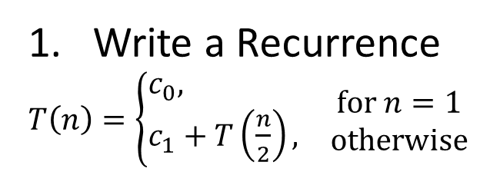

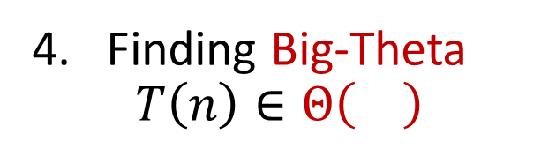
Unrolling: Example
Write a Recurrence
$T\left(n\right)=\left\{\begin{matrix}\begin{aligned}&c_{0}, \\ &c_{1}+T\left(\frac{n}{2}\right),\end{aligned} & \begin{matrix}\text{f}\text{or} n=1 \\ \text{otherwise}\end{matrix}\end{matrix}\right.$
Find General Formula
  Expand:
  $\begin{aligned}T\left(n\right)&=c_{1}+T\left(\frac{n}{2}\right) \\ &= \\ &= \\ &=\end{aligned}$
Find Closed Form
  Find when the base case occurs
  Get to the base case
  $T\left(n\right)=$
Finding Big-Theta
$$T\left(n\right)∈Θ\left(\right)$$

Slide 16
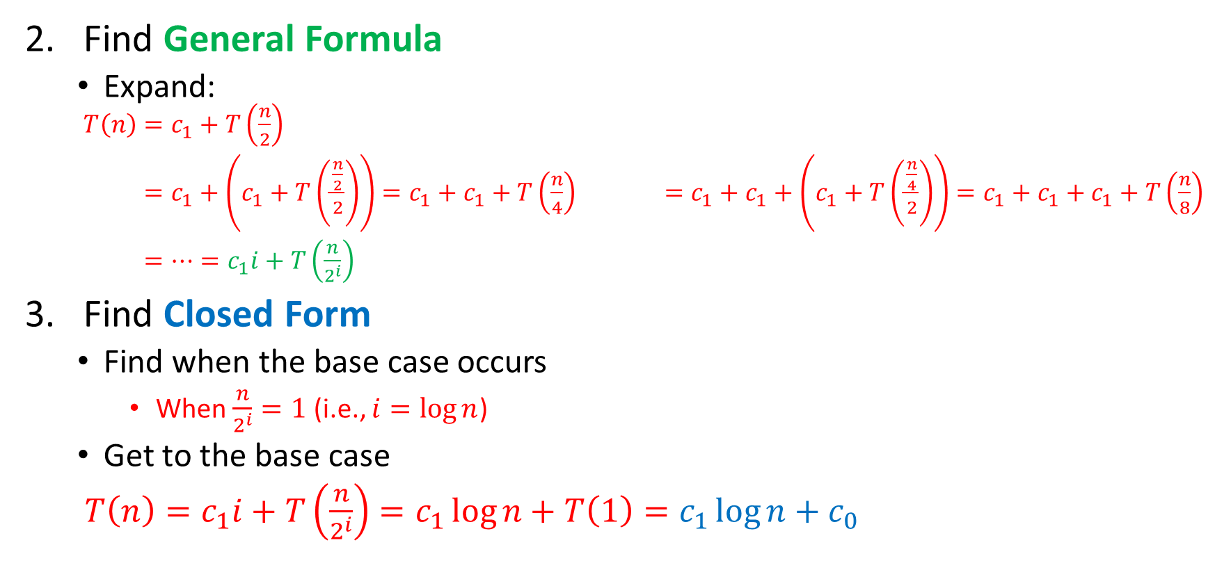
Unrolling: Example (Soln.)
Write a Recurrence
$T\left(n\right)=\left\{\begin{matrix}\begin{aligned}&c_{0}, \\ &c_{1}+T\left(\frac{n}{2}\right),\end{aligned} & \begin{matrix}\text{f}\text{or} n=1 \\ \text{otherwise}\end{matrix}\end{matrix}\right.$
Find General Formula
  Expand:
  $\begin{aligned}T\left(n\right)&=c_{1}+T\left(\frac{n}{2}\right) \\ &=c_{1}+\left(c_{1}+T\left(\frac{\frac{n}{2}}{2}\right)\right)=c_{1}+c_{1}+T\left(\frac{n}{4}\right) =c_{1}+c_{1}+\left(c_{1}+T\left(\frac{\frac{n}{4}}{2}\right)\right)=c_{1}+c_{1}+c_{1}+T\left(\frac{n}{8}\right) \\ &=…=c_{1}i+T\left(\frac{n}{2^{i}}\right)\end{aligned}$
Find Closed Form
  Find when the base case occurs
    When $\frac{n}{2^{i}}=1$ (i.e., $i=\log{n}$)
  Get to the base case
  $T\left(n\right)=c_{1}i+T\left(\frac{n}{2^{i}}\right)=c_{1}\log{n}+T\left(1\right)=c_{1}\log{n}+c_{0}$
Finding Big-Theta
$$T\left(n\right)∈Θ\left(\right)$$

Slide 17

Iterative vs Recursive: sum()
Iterative sum():
  "Obviously" linear
Recursive sum():
  Recurrence is $c_{1}+c_{1}+…+c_{1}+c_{0}$ for $n$ times so linear
int sum(int[] arr){
int ans = 0;
for(int i=0; i<arr.length; ++i)
ans += arr[i];
return ans;
}
int sum(int[]arr,int n) {
if(n==0)
return arr[n];
return arr[n] + sum(arr,n-1);
}

Slide 18
Any Questions?

Slide 19
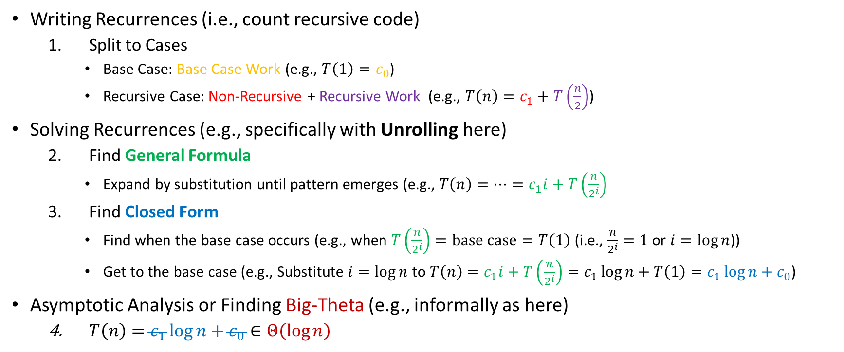
Recap: Algorithm Analysis of Recursive Code
boolean binarySearch(int[]arr, int k, int lo, int hi) {
int mid = (hi+lo)/2;
if(lo==hi) return false;
if(arr[mid]==k) return true;
if(arr[mid]< k) return binarySearch(arr,k,mid+1,hi);
else return binarySearch(arr,k,lo,mid);
}
Writing Recurrences (i.e., count recursive code)
  Split to Cases
    Base Case: Base Case Work (e.g., $T\left(1\right)=c_{0}$)
    Recursive Case: Non-Recursive + Recursive Work (e.g., $T\left(n\right)=c_{1}+T\left(\frac{n}{2}\right)$)
Solving Recurrences (e.g., specifically with Unrolling here)
  Find General Formula
    Expand by substitution until pattern emerges (e.g., $T\left(n\right)=…=c_{1}i+T\left(\frac{n}{2^{i}}\right)$
  Find Closed Form
    Find when the base case occurs (e.g., when $T\left(\frac{n}{2^{i}}\right)=\text{base} \text{case}=T\left(1\right)$ (i.e., $\frac{n}{2^{i}}=1$ or $i=\log{n}$))
    Get to the base case (e.g., Substitute $i=\log{n}$ to $T\left(n\right)=c_{1}i+T\left(\frac{n}{2^{i}}\right)=c_{1}\log{n}+T\left(1\right)=c_{1}\log{n}+c_{0}$)
Asymptotic Analysis or Finding Big-Theta (e.g., informally as here)
  $T\left(n\right)=c_{1}\log{n}+c_{0}∈Θ\left(\log{n}\right)$

Slide 20
Any Questions?

Slide 21

Iterative vs Recursive: sum()
Iterative:
  "Obviously" linear
Recursive:
  Recurrence is $c_{1}+c_{1}+…+c_{1}+c_{0}$ for $n$ times so linear
int sum(int[] arr){
int ans = 0;
for(int i=0; i<arr.length; ++i)
ans += arr[i];
return ans;
}
int sum(int[]arr,int n) {
if(n==0)
return arr[n];
return arr[n] + sum(arr,n-1);
}

Slide 22
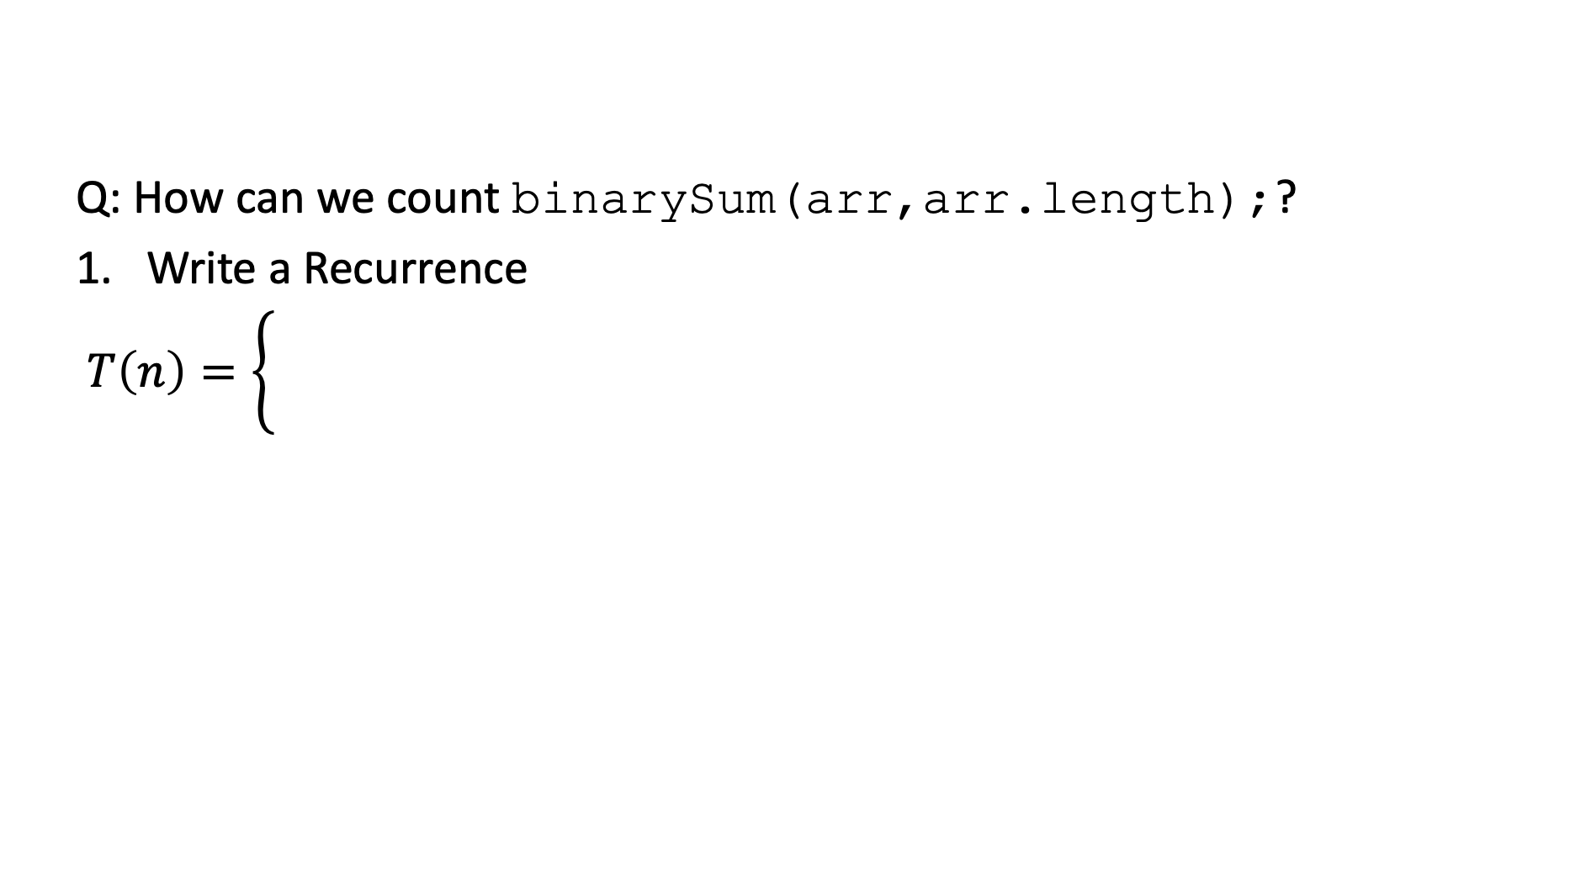
sum but weird (binarySum)
 |  | ...
int binarySum(int[] arr, int lo, int hi) {
if(lo==hi) return 0;
if(lo==hi-1) return arr[lo];
int mid = (hi+lo)/2;
return binarySum(arr,lo,mid) + binarySum(arr,mid,hi);
}
Q: How can we count binarySum(arr,arr.length);?
Write a Recurrence
$T\left(n\right)=\left\{\begin{matrix} & \\ & \end{matrix}\right.$

Slide 23
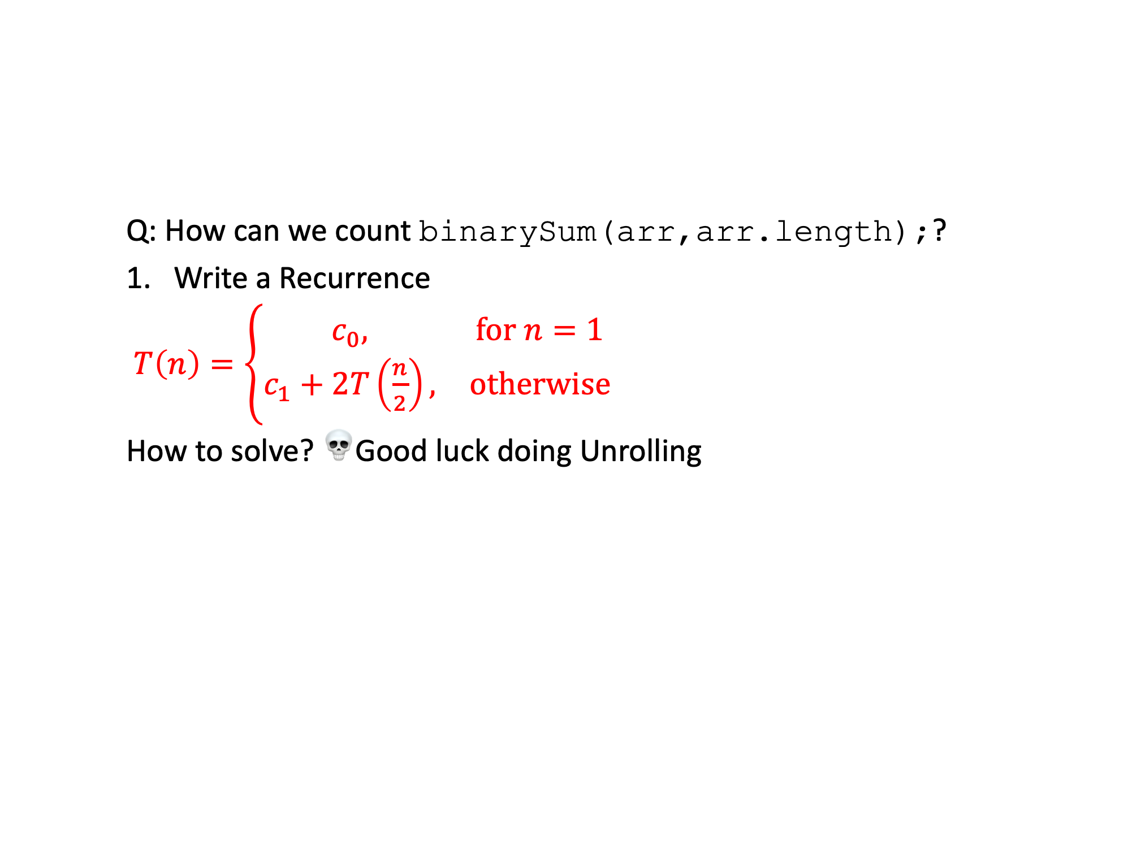
sum but weird (binarySum)
 |  | ...
int binarySum(int[] arr, int lo, int hi) {
if(lo==hi) return 0;
if(lo==hi-1) return arr[lo];
int mid = (hi+lo)/2;
return binarySum(arr,lo,mid) + binarySum(arr,mid,hi);
}
Q: How can we count binarySum(arr,arr.length);?
Write a Recurrence
$T\left(n\right)=\left\{\begin{matrix}c_{0}, & \text{for} n=1 \\ c_{1}+2T\left(\frac{n}{2}\right), & \text{otherwise}\end{matrix}\right.$
How to solve? 💀Good luck doing Unrolling

Slide 24
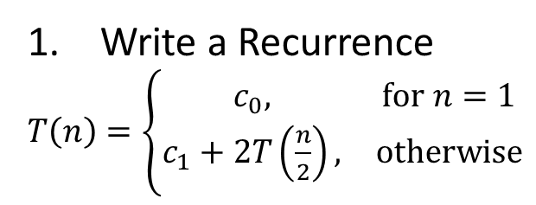
Find General Formula: Draw Tree
Write a Recurrence
$T\left(n\right)=\left\{\begin{matrix}c_{0}, & \text{for} n=1 \\ c_{1}+2T\left(\frac{n}{2}\right), & \text{otherwise}\end{matrix}\right.$
Initialize Table
Draw Actual Tree
Misc. Details
  Recursive Calls, # Nodes, Sum Work, etc.
Base Case
  Find when the base case occurs
Work Calculation
  Total Base Case Work
  Total Non-Recursive + Recursive Work

Slide 25
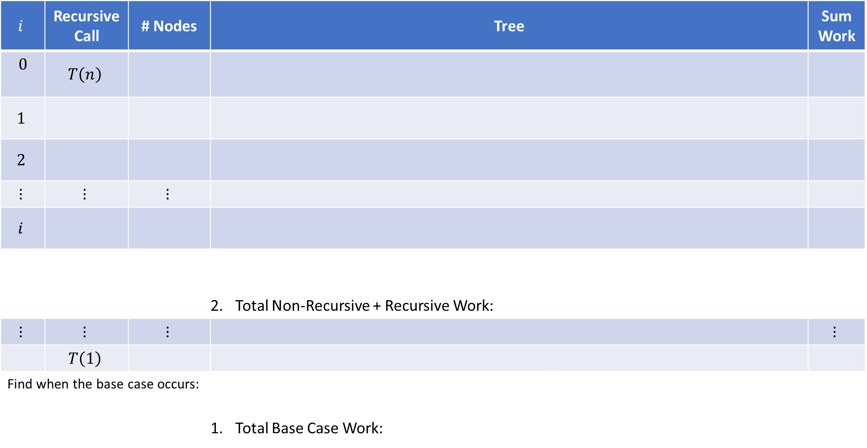
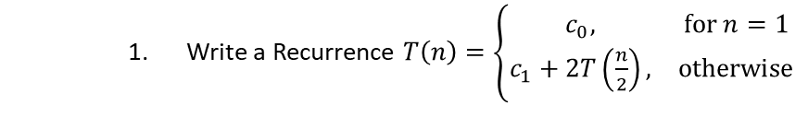

Draw Tree
Write a Recurrence $T\left(n\right)=\left\{\begin{matrix}c_{0}, & \text{for} n=1 \\ c_{1}+2T\left(\frac{n}{2}\right), & \text{otherwise}\end{matrix}\right.$
$$i$$ | Recursive Call | # Nodes | Tree |  | Sum Work
$$0$$ | $$T\left(n\right)$$
$$1$$
$$2$$
$$⋮$$ | $$⋮$$ | $$⋮$$
$$i$$
 |  |  | Total Non-Recursive + Recursive Work: |  | $$c_{1}+2c_{1}+4c_{1}+…+2^{i}c_{1}=\sum_{i=0}^{\log\left(n\right)−1}{2^{i}⋅c_{1}}$$
$$⋮$$ | $$⋮$$ | $$⋮$$ |  |  | $$⋮$$
 | $$T\left(1\right)$$
Find when the base case occurs: |  |  | Total Base Case Work: |  | $$c_{1}+2c_{1}+4c_{1}+…+2^{i}c_{1}=\sum_{i=0}^{\log\left(n\right)−1}{2^{i}⋅c_{1}}$$
$+$

Slide 26





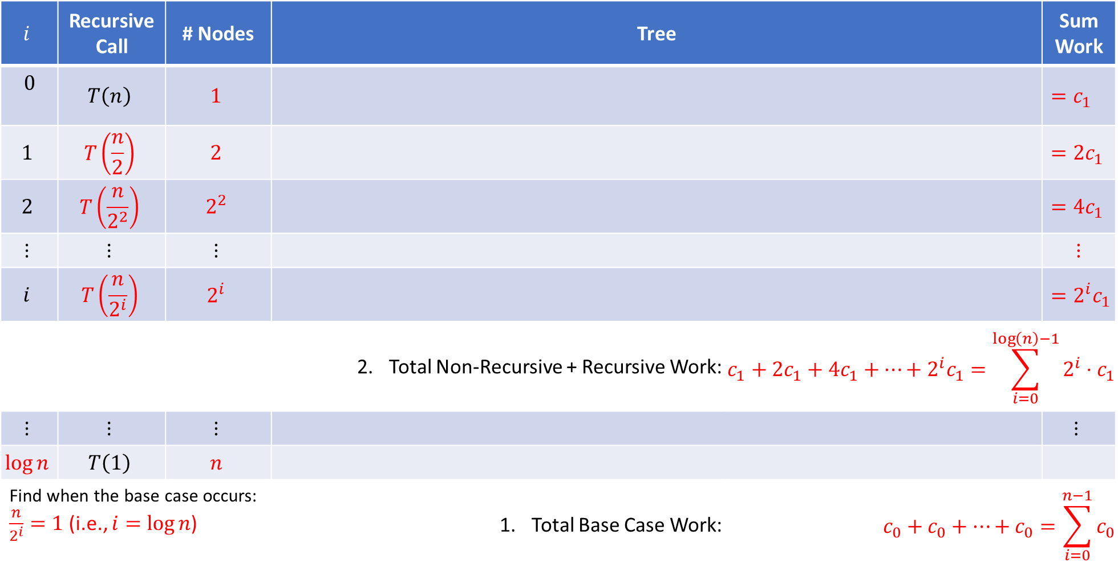










Draw Tree (Soln.)
Write a Recurrence $T\left(n\right)=\left\{\begin{matrix}c_{0}, & \text{for} n=1 \\ c_{1}+2T\left(\frac{n}{2}\right), & \text{otherwise}\end{matrix}\right.$
$$i$$ | Recursive Call | # Nodes | Tree |  | Sum Work
$$0$$ | $$T\left(n\right)$$ | $$1$$ |  |  | $$=c_{1}$$
$$1$$ | $$T\left(\frac{n}{2}\right)$$ | $$2$$ |  |  | $$=2c_{1}$$
$$2$$ | $$T\left(\frac{n}{2^{2}}\right)$$ | $$2^{2}$$ |  |  | $$=4c_{1}$$
$$⋮$$ | $$⋮$$ | $$⋮$$ |  |  | $$⋮$$
$$i$$ | $$T\left(\frac{n}{2^{i}}\right)$$ | $$2^{i}$$ |  |  | $$=2^{i}c_{1}$$
 |  |  | Total Non-Recursive + Recursive Work: | $$c_{1}+2c_{1}+4c_{1}+…+2^{i}c_{1}=\sum_{i=0}^{\log\left(n\right)−1}{2^{i}⋅c_{1}}$$ | $$c_{1}+2c_{1}+4c_{1}+…+2^{i}c_{1}=\sum_{i=0}^{\log\left(n\right)−1}{2^{i}⋅c_{1}}$$
$$⋮$$ | $$⋮$$ | $$⋮$$ |  |  | $$⋮$$
$$\log{n}$$ | $$T\left(1\right)$$ | $$n$$
Find when the base case occurs: $\frac{n}{2^{i}}=1$ (i.e., $i=\log{n}$) |  |  | Total Base Case Work: | $$c_{0}+c_{0}+…+c_{0}=\sum_{i=0}^{n−1}{c_{0}}$$ | $$c_{1}+2c_{1}+4c_{1}+…+2^{i}c_{1}=\sum_{i=0}^{\log\left(n\right)−1}{2^{i}⋅c_{1}}$$
$+$

Slide 27
Any Questions?

Slide 28



Solving Recurrence 2: Tree Method
Find General Formula
  $$\begin{aligned}T\left(n\right)&=\text{Total} \text{Base} \text{Case} \text{Work}&&+\left(\text{Total} \text{Total} \text{Non}\text{−}\text{Recursive}\text{+}\text{Recursive} \text{Work}\right) \\ &=\end{aligned}$$
Find Closed Form
  $$\begin{aligned}T\left(n\right)&= \\ &= \\ &= \\ &=\end{aligned}$$
Finite Geometric Series!
$$\sum_{i=0}^{m}{x^{i}}=\frac{1−x^{m+1}}{1−x}$$
Finding Big-Theta
$$T\left(n\right)∈Θ\left(\right)$$

Slide 29

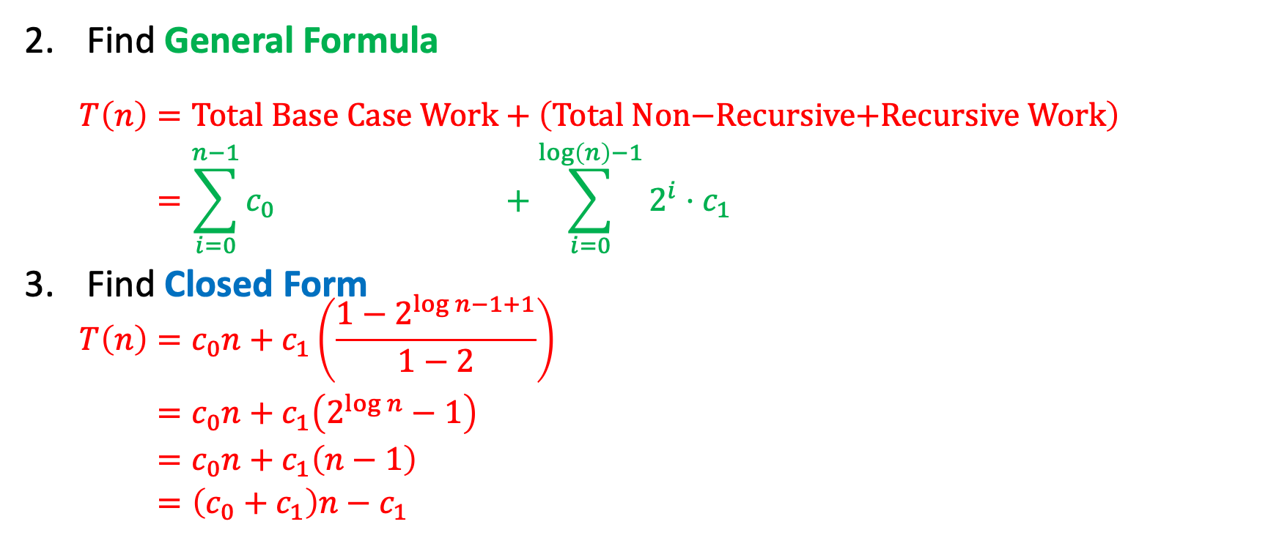
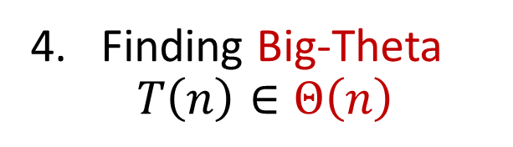
Solving Recurrence 2: Tree Method (Soln.)
Find General Formula
  $$\begin{aligned}T\left(n\right)&=\text{Total} \text{Base} \text{Case} \text{Work}&&+\left(\text{Total} \text{Non}\text{−}\text{Recursive}\text{+}\text{Recursive} \text{Work}\right) \\ &=\sum_{i=0}^{n−1}{c_{0}}&&+\sum_{i=0}^{\log\left(n\right)−1}{2^{i}⋅c_{1}}\end{aligned}$$
Find Closed Form
  $$\begin{aligned}T\left(n\right)&=c_{0}n+c_{1}\left(\frac{1−2^{\log{n−1+1}}}{1−2}\right) \\ &=c_{0}n+c_{1}\left(2^{\log{n}}−1\right) \\ &=c_{0}n+c_{1}\left(n−1\right) \\ &=\left(c_{0}+c_{1}\right)n−c_{1}\end{aligned}$$
Finite Geometric Series!
$$\sum_{i=0}^{m}{x^{i}}=\frac{1−x^{m+1}}{1−x}$$
Finding Big-Theta
$$T\left(n\right)∈Θ\left(n\right)$$

Slide 30
Any Questions?

Slide 31
Common Recurrences (Memorize!)
Common Recurrence Function/Relation | Order of Growth | Example
$T\left(n\right)=T\left(\frac{n}{2}\right)+c$ | $∈Θ\left(\log{n}\right)$ | Binary Search
$T\left(n\right)=2T\left(\frac{n}{2}\right)+n$ | $∈Θ\left(n\log{n}\right)$ | Merge Sort
$T\left(n\right)=T\left(\frac{n}{2}\right)+n$ | $∈Θ\left(n\right)$
$T\left(n\right)=2T\left(\frac{n}{2}\right)+c$ | $∈Θ\left(n\right)$ | Recursive "binary" sum
$T\left(n\right)=T\left(n−1\right)+c$ | $∈Θ\left(n\right)$ | Recursive sum
$T\left(n\right)=T\left(n−1\right)+n$ | $∈Θ\left(n^{2}\right)$
$T\left(n\right)=2T\left(n−1\right)+c$ | $∈Θ\left(2^{n}\right)$

Slide 32
Any Questions?

Slide 33
Timeline
Asymptotic Analysis: Recursive
  Writing a Recurrence Relation
  Solving a Recurrence Relation 1: Unrolling
  Solving a Recurrence Relation 2: Tree Method
Dictionary ADT
Review: Binary Search Trees
  Trees
  Basics, Properties, Operations

