Slide 1
Lecture 4: Priority Queue ADT
CSE 332: Data Structures & Parallelism
Yafqa Khan
Summer 2025

Slide 2
Announcements
EX01 Analysis
  Due Today
EX02 Heaps
  Releases Wednesday
  Due next Friday

Slide 3
Today
Priority Queue ADT
Tree Stuff
Binary Min-Heap Data Structure
  Basics, Properties, Operations
  Array Representation
Floyd's BuildHeap

Slide 4
Priority Queue: Scenario
What is the difference between waiting for service at
  a pharmacy
  VS an ER?
Pharmacies usually follow the rule
  First Come, First Served
Emergency Rooms assign priorities based on everyone's needs

Slide 5
Priority Queue ADT
Chapter 6 of Weiss
The PriorityQueue ADT supports operations:
  insert (enqueue equivalent):
    adds an item at the end
  deleteMin (dequeue equivalent):
    finds, returns, and removes the minimum element in the priority queue
  findMin, isEmpty, etc.
  BUT! Also only holds comparable data
An example of a PriorityQueue data structure is a heap, with its associated algorithms for the operations
One implementation is in the library java.util.PriorityQueue

Slide 6
Priority Queue: ADT
6 2 2
15 23
12 18
45 3 7
insert
deleteMin
Holds comparable data
  Each element has a "priority"
  Lesser priority value = Higher priority
  = Closer to the "front of the priority queue"
  (For a min Priority Queue)
Main operations: insert and deleteMin
  insert (enqueue equivalent):
    adds an item at the end
  deleteMin (dequeue equivalent):
    finds, returns, and removes the minimum element in the priority queue
      break ties arbitrarily
    minimum element/priority value = highest priority

Slide 7
Priority Queue: Example
insert a with priority 5
insert b with priority 3
insert c with priority 4
w = deleteMin()
x = deleteMin()
insert d with priority 2
insert e with priority 6
y = deleteMin()
z = deleteMin()

Slide 8
Priority Queue: Applications
Run multiple programs in the operating system
Treat hospital patients in order of severity
Select print jobs in order of decreasing length?
Forward network packets in order of urgency
Select most frequent symbols for data compression
Sorting
Foreshadowing: Greedy Algorithms (e.g., Dijkstra's)

Slide 9
Priority Queue: Simplifying in Lecture
We will use ints as the data AND the priority
e.g., insert(5) = insert the data 5 with priority value 5
  Remember: lower priority value = closer to the "front of priority queue"

Slide 10
Priority Queue: Preliminary Data Structures
 | insert | deleteMin
Unsorted Array
Unsorted Linked-List
Sorted Circular Array
Sorted Linked-List
Binary Search Tree (BST)
Note: Worst case, assume arrays have enough space

Slide 11
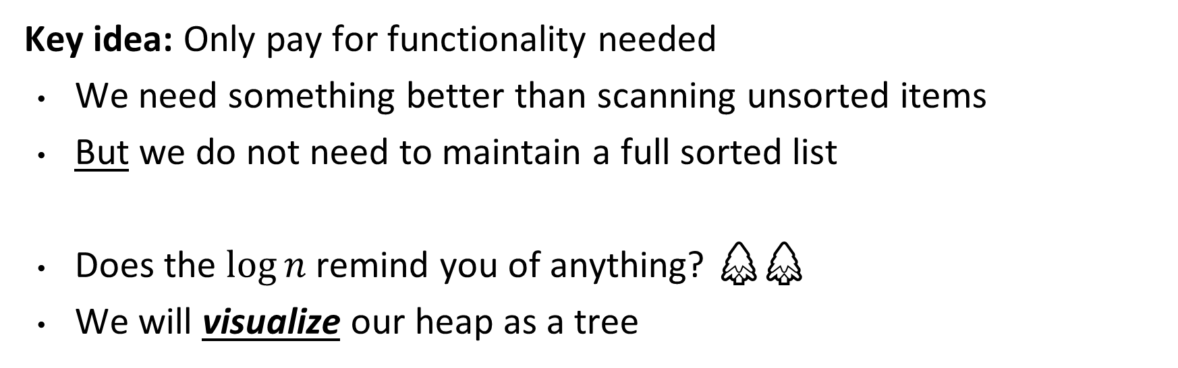
Priority Queue: Heap Data Structure
 | insert | deleteMin
(Binary Min) Heap

Slide 12
Any Questions?

Slide 13
Today
Priority Queue ADT
Tree Stuff
Binary Min-Heap Data Structure
  Basics, Properties, Operations
  Array Representation
Floyd's BuildHeap

Slide 14
🌲Tree🌲 Terminology 1
Tree T
A
root(T):
leaves(T):
children(B):
parent(H):
siblings(E):
ancestors(F):
descendants(G):
subtree(G):
B
C
D
E
F
G
H
I
J
K
L
M
N

Slide 15
🌲Tree🌲 Terminology 1 (Solution)
Tree T
A
root(T): A
leaves(T): D-F, I, J-N
children(B): D, E, F
parent(H): G
siblings(E): D, F
ancestors(F): B, A
descendants(G): H, I, J-N
subtree(G): G and its children
B
C
D
E
F
G
H
I
J
K
L
M
N

Slide 16
🌲Tree🌲 Terminology 2
Tree T
A
depth(B):
height(G):
height(T):
degree(B):
branchingFactor(T):
B
C
D
E
F
G
H
I
J
K
L
M
N

Slide 17
🌲Tree🌲 Terminology 2
Tree T
A
depth(B):
height(G):
height(T):
Height:
  Count the arrows from node to deepest descendent!
Depth:
  Count the arrows from root to node!
B
C
D
E
F
G
H
I
J
K
L
M
N

Slide 18
🌲Tree🌲 Terminology 2 (Solution)
Tree T
A
depth(B): 1
height(G): 2
height(T): 4
degree(B): 3
branchingFactor(T): 0-5
B
C
D
E
F
G
H
I
J
K
L
M
N

Slide 19
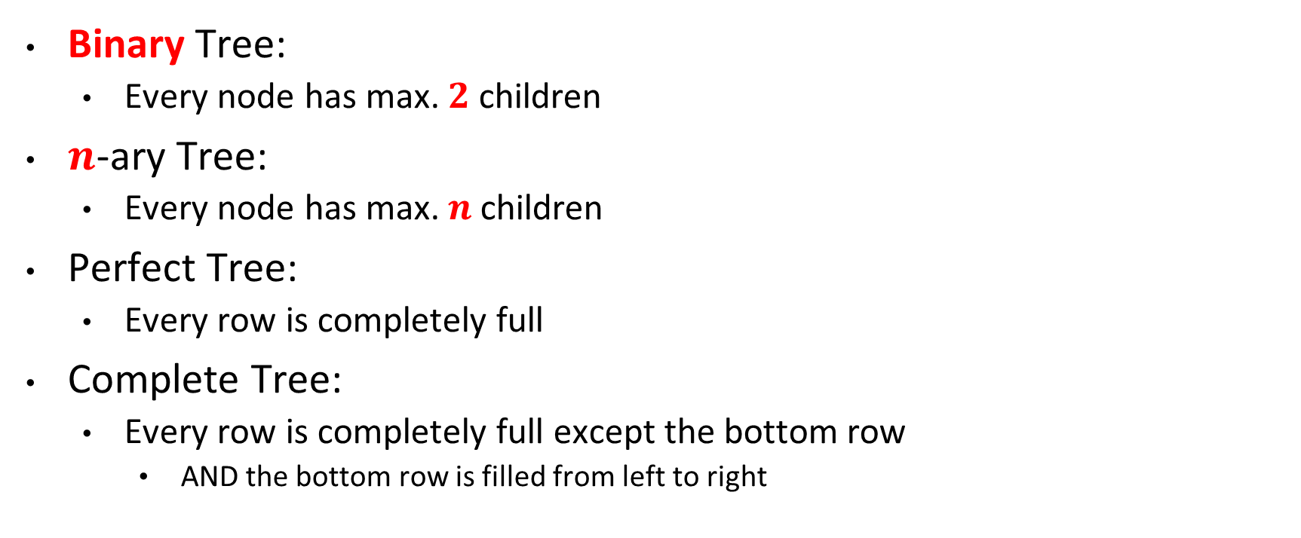
🌲Tree🌲 Types

Slide 20
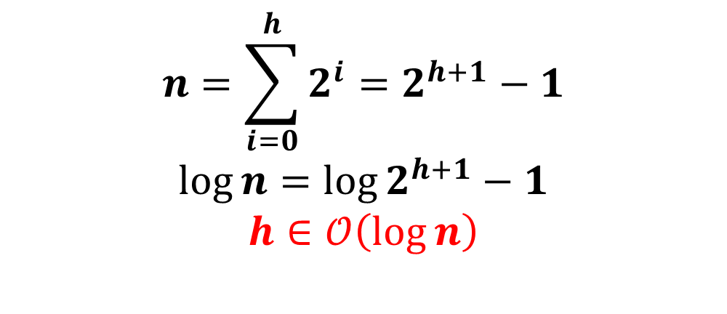
More on Perfect Tree
Perfect Tree:
  Every row is completely full
 |  | # leaves
0 | 1 | 1
1 | 3 | 2
2 | 7 | 4
3 | 15 | 8
 | ?

Slide 21
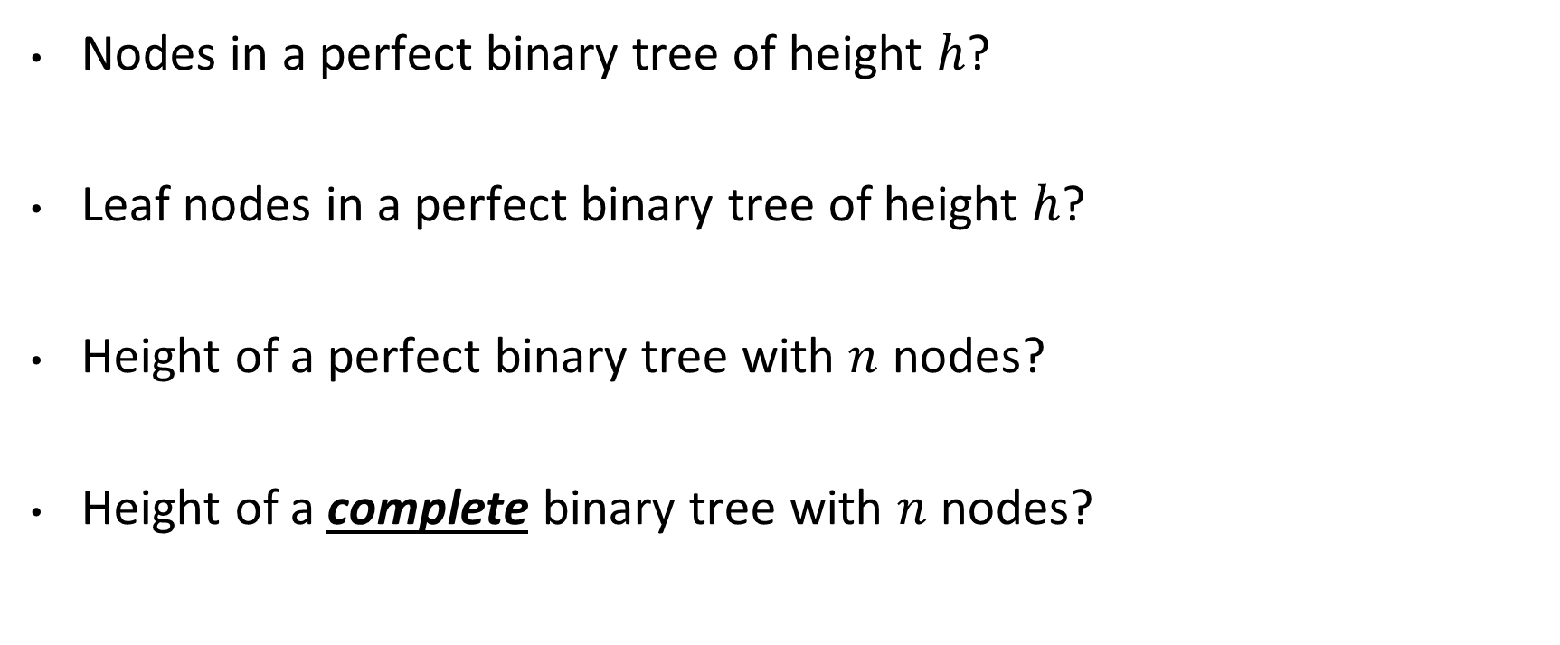
🌲Tree🌲 Properties

Slide 22
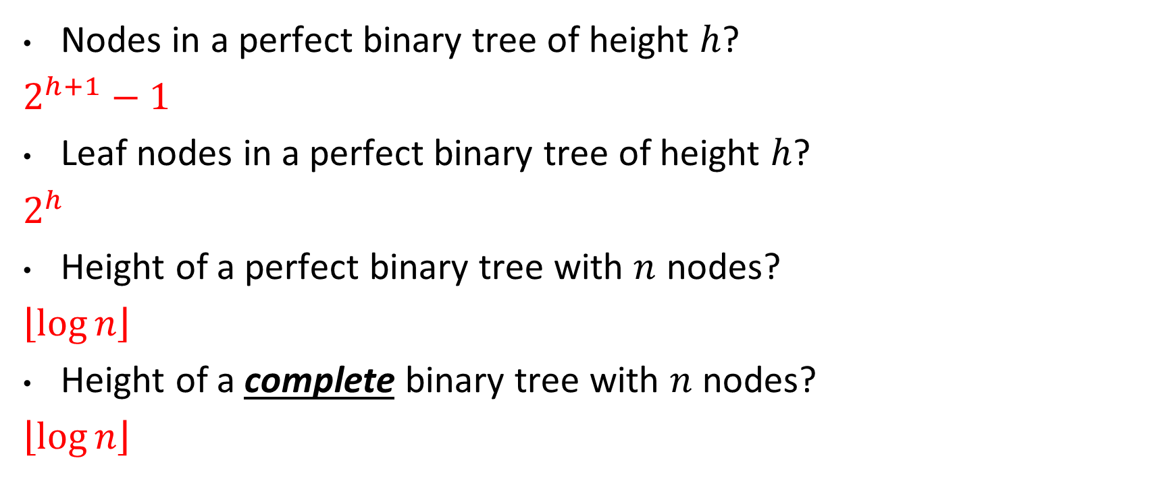
🌲Tree🌲 Properties

Slide 23
Any Questions?

Slide 24
Today
Priority Queue ADT
Tree Stuff
Binary Min-Heap Data Structure
  Basics, Properties, Operations
  Array Representation
Floyd's BuildHeap

Slide 25
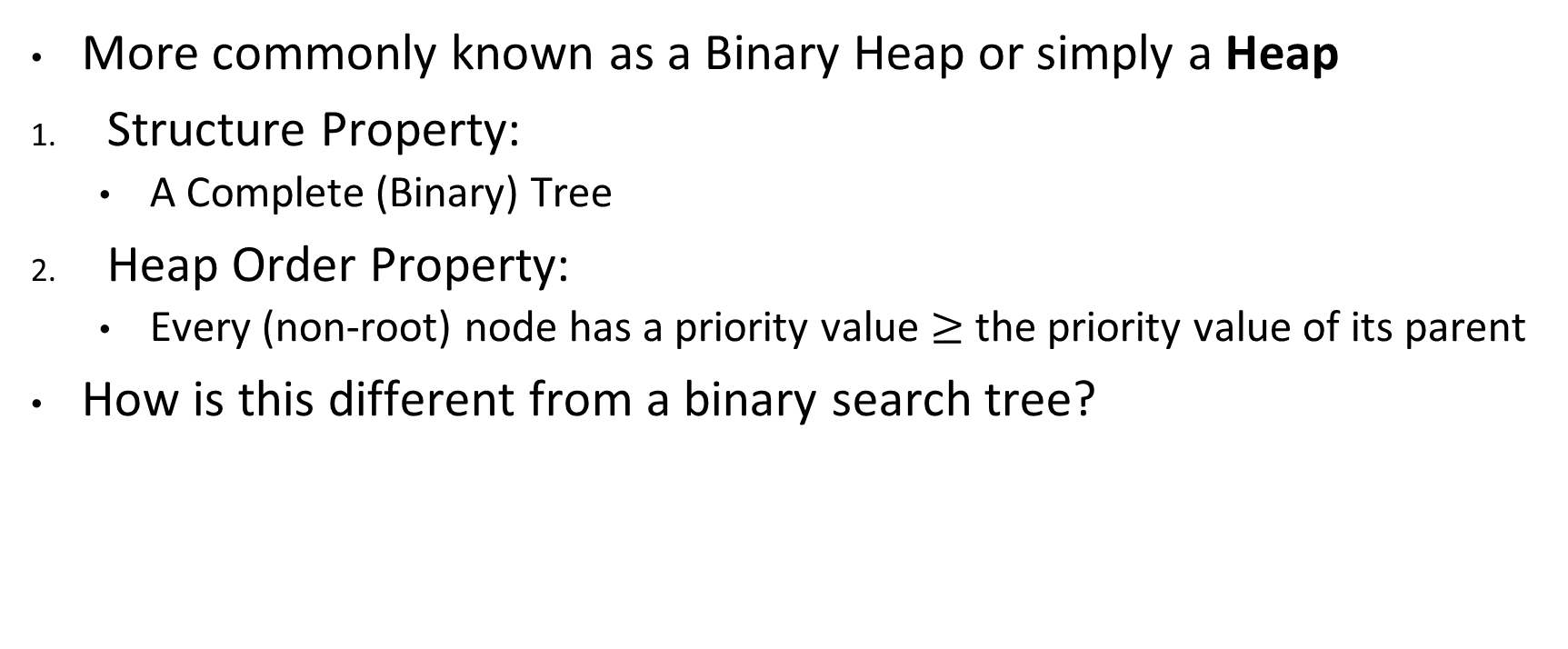
(Binary Min-) Heap: Basics & Properties
A Heap
10
Not a Heap
30
20
80
20
80
40
60
99
85
13
25
700
50
1

Slide 26
Heap or Not a Heap?
a)
b)
3
5
5
4
1
6
c)
d)
5
3
7
6
4
6
8
9
5

Slide 27
Heap or Not a Heap? (Solution)
a)
b)
3
5
5
4
1
6
Heap
Not Heap
c)
d)
5
3
7
6
4
6
8
9
5
Heap
Not Heap

Slide 28
Heap: Properties
Where is the minimum priority item?
What is the height of a heap with n items?

Slide 29
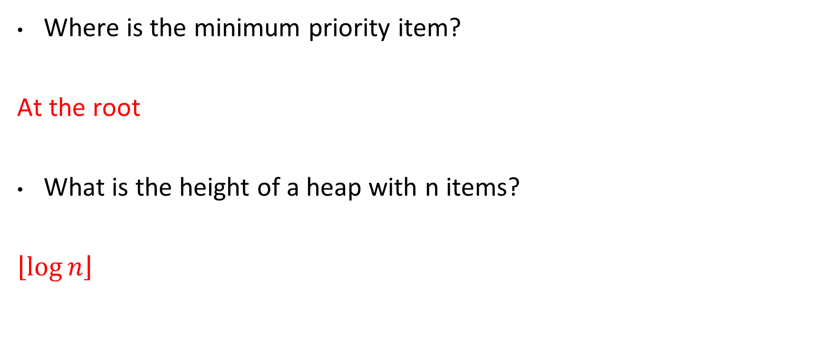
Heap: Properties

Slide 30
Heap: Operations Basic Idea
10
20
80
40
60
99
85
insert:
  Structure Property:
    Put new node in next position on bottom row
  Order Property:
    percolateUp()
deleteMin:
  minElement = root.data
  Structure Property:
    Move right-most node in last row to root
  Heap Order Property:
    percolateDown to restore
70
50
65
Overall strategy:
Preserve Complete Tree Structure Property
This may break Heap Order Property
Percolate to restore Heap Order Property

Slide 31
Heap: Operations (insert)
insert(16)
10
20
80
40
60
99
85
700
50
65

Slide 32
Heap: Operations (deleteMin)
deleteMin()
10
20
80
40
60
99
85
700
50
65

Slide 33
Heap: percolateDown?
Compare all the children
If any child has smaller value, swap child and value
Keep going until all children is bigger
  or leaf node
?
1
1
3
?
3
4
3
4
4
8
7
5
8
9
7
5
8
9
7
5
1
9
1
9
6
11
9
6
1
9
6

Slide 34
Any Questions?

Slide 35
Today
Priority Queue ADT
Tree Stuff
Binary Min-Heap Data Structure
  Basics, Properties, Operations
  Array Representation
Floyd's BuildHeap

Slide 36
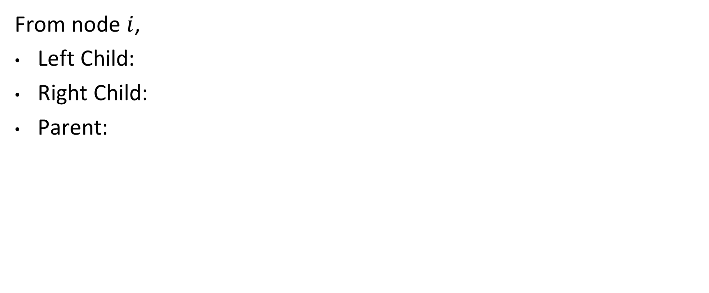
Heap: Array Representation
1
A
2
3
B
C
4
5
6
7
D
E
F
G
8
9
10
11
12
H
I
J
K
L
 | A | B | C | D | E | F | G | H | I | J | K | L
0 | 1 | 2 | 3 | 4 | 5 | 6 | 7 | 8 | 9 | 10 | 11 | 12 | 13
*Index 0 skipped so math is easier

Slide 37
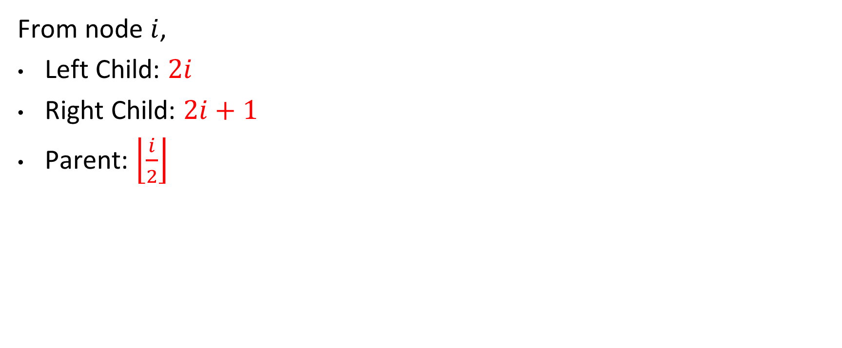
Heap: Array Representation
1
A
2
3
B
C
4
5
6
7
D
E
F
G
8
9
10
11
12
H
I
J
K
L
 | A | B | C | D | E | F | G | H | I | J | K | L
0 | 1 | 2 | 3 | 4 | 5 | 6 | 7 | 8 | 9 | 10 | 11 | 12 | 13
*Index 0 skipped so math is easier

Slide 38
Heap: insert Pseudocode (w/ Array)
void insert(int val) {
if(size==arr.length-1)
resize();
size++;
i=percolateUp(size,val);
arr[i] = val;
}
int percolateUp(int hole,
int val) {
while(hole > 1 &&
val < arr[hole/2]){
arr[hole] = arr[hole/2];
hole = hole / 2;
}
return hole;
}
1
2
8
4
6
8
9
7
5
 | 10 | 20 | 80 | 40 | 60 | 85 | 99 | 700 | 50
0 | 1 | 2 | 3 | 4 | 5 | 6 | 7 | 8 | 9 | 10 | 11 | 12 | 13

Slide 39
Heap: deleteMin Pseudocode (w/ Array)
int deleteMin() {
if(isEmpty()) throw…
ans = arr[1];
hole = percolateDown
(1,arr[size]);
arr[hole] = arr[size];
size--;
return ans;
}
int percolateDown(int hole,
int val) {
while(2*hole <= size) {
left = 2*hole;
right = left + 1;
if(arr[left] < arr[right]
|| right > size)
target = left;
else
target = right;
if(arr[target] < val) {
arr[hole] = arr[target];
hole = target;
} else
break;
}
return hole;
}
1
2
8
4
6
8
9
7
5
 | 1 | 2 | 8 | 4 | 6 | 8 | 9 | 7 | 5
0 | 1 | 2 | 3 | 4 | 5 | 6 | 7 | 8 | 9 | 10 | 11 | 12 | 13

Slide 40
Heap: Operations Array Example (insert)
insert: 16, 32, 4, 57, 80, 43, 2
0 | 1 | 2 | 3 | 4 | 5 | 6 | 7

Slide 41
Heap: Operations Array Example (deleteMin)
deleteMin
2
32
4
57
80
43
16
 | 2 | 32 | 4 | 57 | 80 | 43 | 16
0 | 1 | 2 | 3 | 4 | 5 | 6 | 7

Slide 42
Heap: Operations Array Example (Solution)
deleteMin
4
32
16
57
80
43
0 | 1 | 2 | 3 | 4 | 5 | 6 | 7

Slide 43
Heap: Array Evaluation
Advantages:
Minimal wasted space:
  If a tree node object, need pointers (expensive!)
Fast Lookups
  Quick array lookup
  Calculating index (multiplication + division by 2) is extremely fast
Disadvantages:
Resizing
Conclusion: It's too good so almost always use array

Slide 44
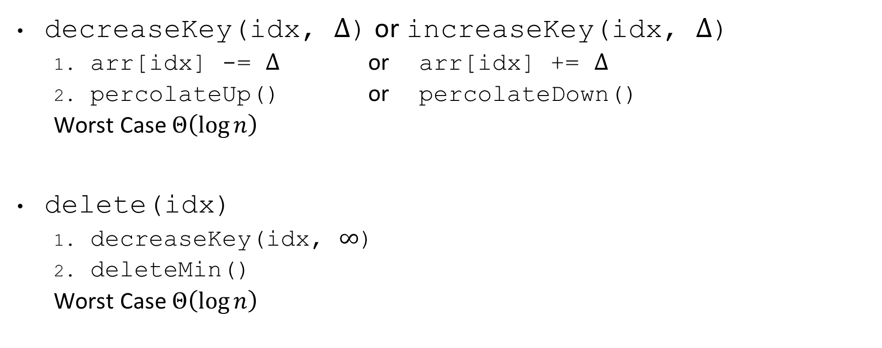
Heap: Other operations

Slide 45
Heap: Note on decrease/increaseKey
MORE COMMONLY CALLED changePriority(key, prio)
  Uses a map to go from key -> idx
  arr[idx] = prio
  percolateUp() or percolateDown()
  (Same as decrease/increaseKey)

Slide 46
Any Questions?

Slide 47
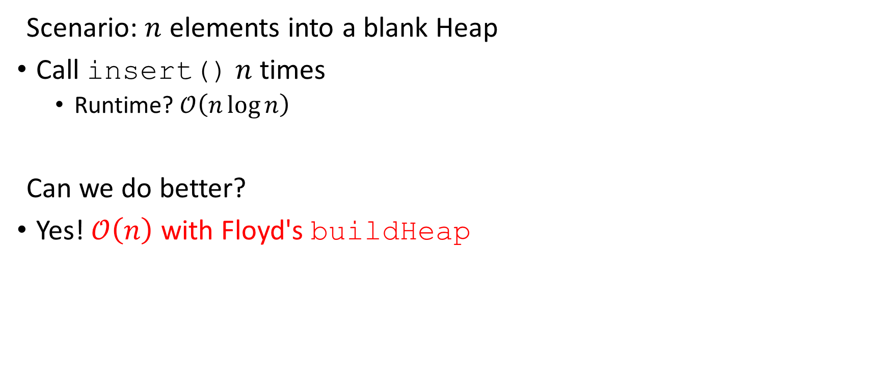
Heap: Building a Heap

Slide 48
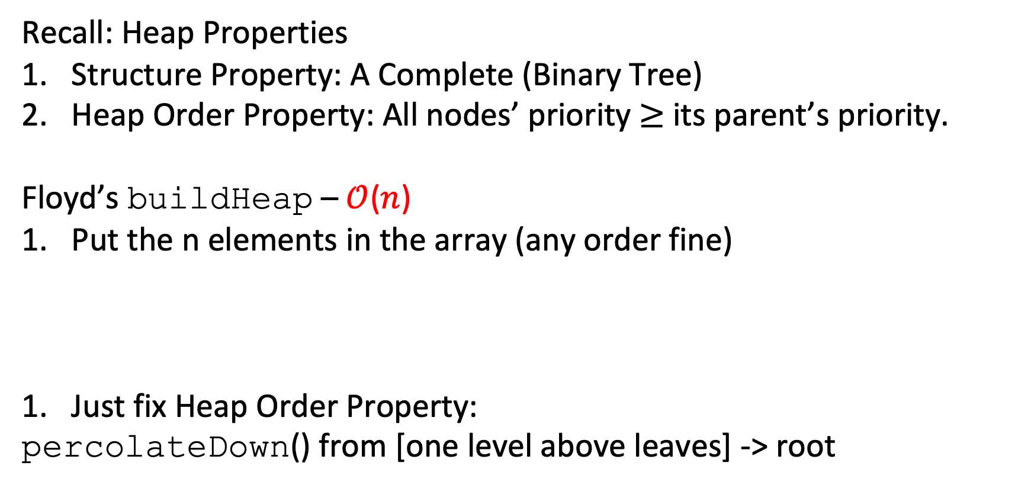
Heap: Floyd's buildHeap
Recall: Heap Properties
Structure Property: A Complete (Binary Tree)
Heap Order Property: All nodes’ priority $≥$ its parent’s priority.
Floyd’s buildHeap – $𝒪$($n$)
Put the n elements in the array (any order fine)
Just fix Heap Order Property:
    percolateDown() from [one level above leaves] -> root
 | 5 | 3 | ... |  | 1 | 7
0 | 1 | 2

Slide 49
Heap: buildHeap Example
percolateDown(), bottom-up:
  Notice: leaves already Heap Order
  Work up to root one at a time
1
5
1
void buildHeap() {
for(i = size/2; i>0; i--) {
val = arr[i];
hole = percolateDown(i,val);
arr[hole] = val;
}
}
3
1
2
9
4
8
1
7
6
 | 12 | 5 | 11 | 3 | 10 | 2 | 9 | 4 | 8 | 1 | 7 | 6
0 | 1 | 2 | 3 | 4 | 5 | 6 | 7 | 8 | 9 | 10 | 11 | 12 | 13 | 14 | 15

Slide 50
Heap: buildHeap Example (Solution 1)
Red = Node that breaks Heap Order Property
12
12
5
11
5
11
3
10
2
9
3
10
2
9
4
8
1
7
6
4
8
1
7
6

Slide 51
Heap: buildHeap Example (Solution 2)
12
12
5
11
5
11
3
10
2
9
3
1
2
9
4
8
1
7
6
4
8
10
7
6

Slide 52
Heap: buildHeap Example (Solution 3)
12
12
5
11
5
11
3
1
2
9
3
1
2
9
4
8
10
7
6
4
8
10
7
6

Slide 53
Heap: buildHeap Example (Solution 4)
12
12
5
11
5
2
3
1
2
9
3
1
6
9
4
8
10
7
6
4
8
10
7
11

Slide 54
Heap: buildHeap Example (Solution 5)
12
12
5
11
1
2
3
1
2
9
3
5
6
9
4
8
10
7
6
4
8
10
7
11

Slide 55
Heap: buildHeap Example (Solution 6)
12
1
1
11
3
2
3
5
2
9
4
5
6
9
4
8
10
7
6
12
8
10
7
11

Slide 56
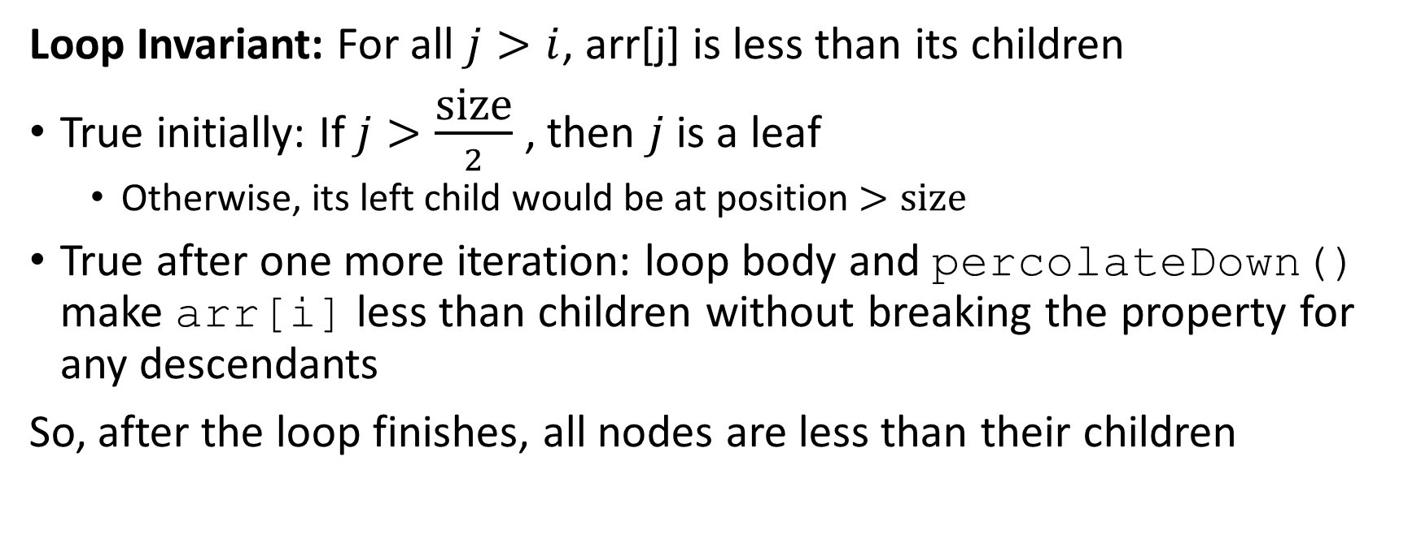
buildHeap Correctness
void buildHeap() {
for(i = size/2; i>0; i--) {
val = arr[i];
hole = percolateDown(i,val);
arr[hole] = val;
}
}

Slide 57
buildHeap Correctness
void buildHeap() {
for(i = size/2; i>0; i--) {
val = arr[i];
hole = percolateDown(i,val);
arr[hole] = val;
}
}

Slide 58
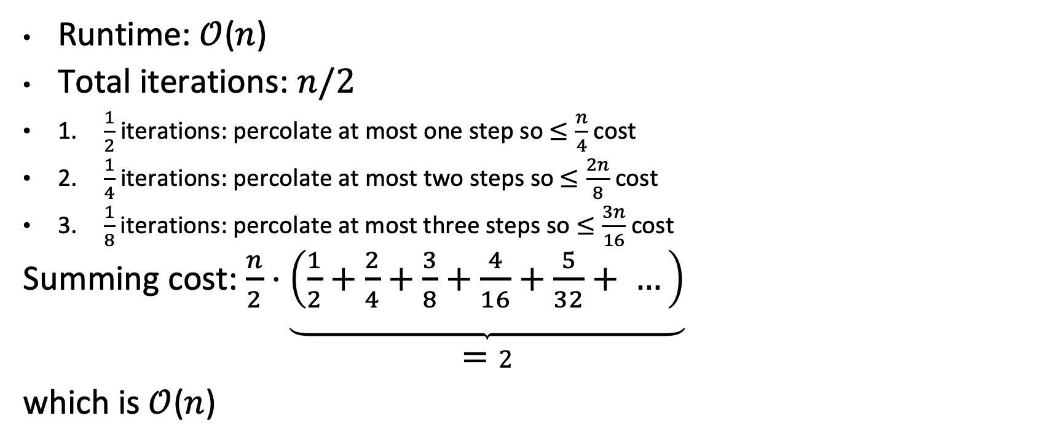
buildHeap Efficiency
void buildHeap() {
for(i = size/2; i>0; i--) {
val = arr[i];
hole = percolateDown(i,val);
arr[hole] = val;
}
}
Runtime: $𝒪$($n$)
Total iterations: $n/2$
1. $\frac{1}{2}$ iterations: percolate at most one step so $≤\frac{n}{4}$ cost
2. $\frac{1}{4}$ iterations: percolate at most two steps so $≤\frac{2n}{8}$ cost
3. $\frac{1}{8}$iterations: percolate at most three steps so $≤\frac{3n}{16}$cost
Summing cost: $\frac{n}{2}⋅\underbrace{\left(\frac{1}{2}+\frac{2}{4}+\frac{3}{8}+\frac{4}{16}+\frac{5}{32}+ …\right)}$
$=2$
which is $𝒪$($n$)
12
5
11
3
10
2
9
4
8
1
7
6
Weiss 6.3.4

Slide 59
Any Questions?

Slide 60
Timeline
Priority Queue ADT
Tree Stuff
Binary Min-Heap Data Structure
  Basics, Properties, Operations
  Array Representation
Floyd's buildHeap
Asymptotic Analysis: Recursive
  Writing a Recurrence Relation
  Solving a Recurrence Relation 1: Unrolling
  Solving a Recurrence Relation 2: Tree Method

