Slide 1
Lecture 3: Algorithm Analysis 2
CSE 332: Data Structures & Parallelism
Yafqa Khan
Summer 2025

Slide 2
Announcements
EX00
Due Monday
EX01
Out later today
Due Monday, July 7

Slide 3
Today
Asymptotic Analysis Review
Big-Oh Summary
Cases vs Asymptotics
Amortization

Slide 4
Recap Summary
// requires array is sorted
// returns whether k is in array
boolean find(int[]arr, int k){
for(int i=0; i < arr.length; ++i)
if(arr[i] == k)
return true;
return false;
}

Slide 5
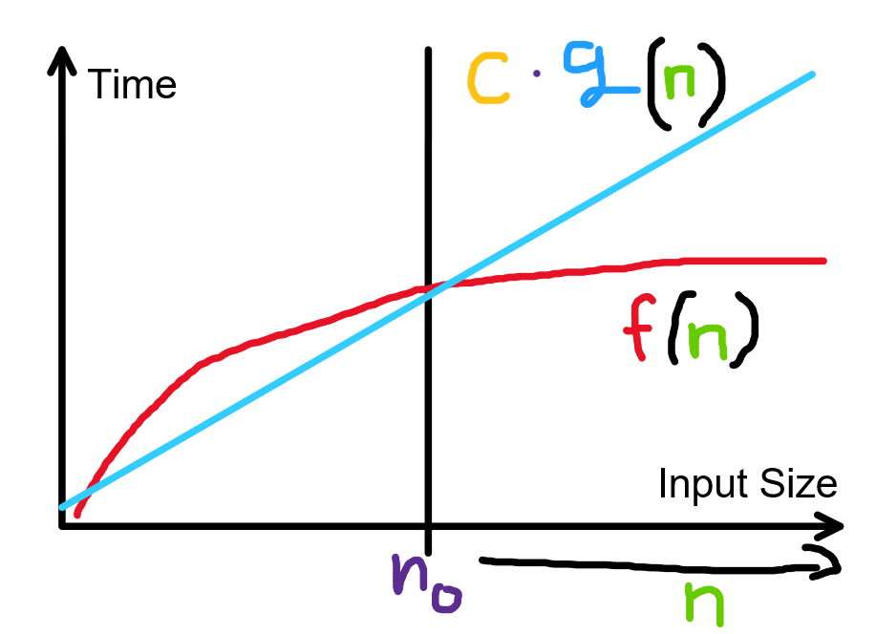
Recap: Formally Big-Oh

Slide 6
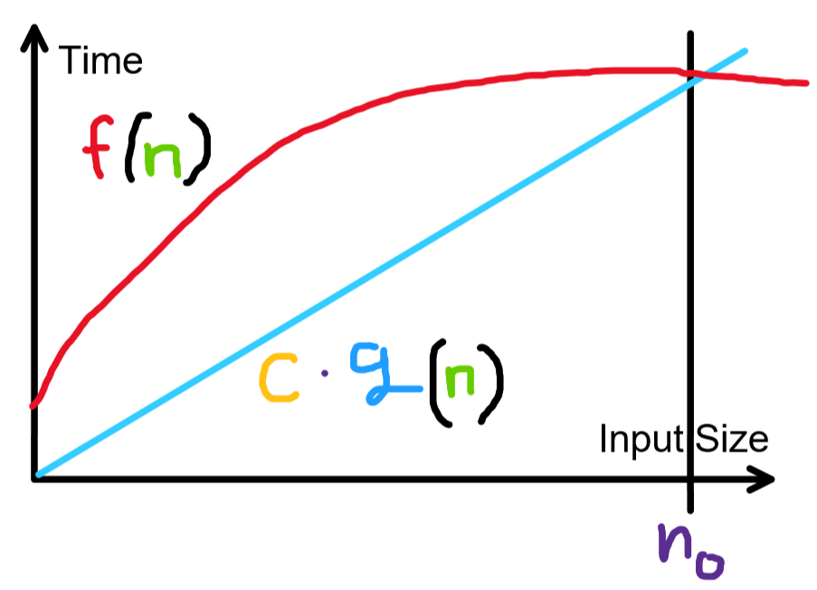
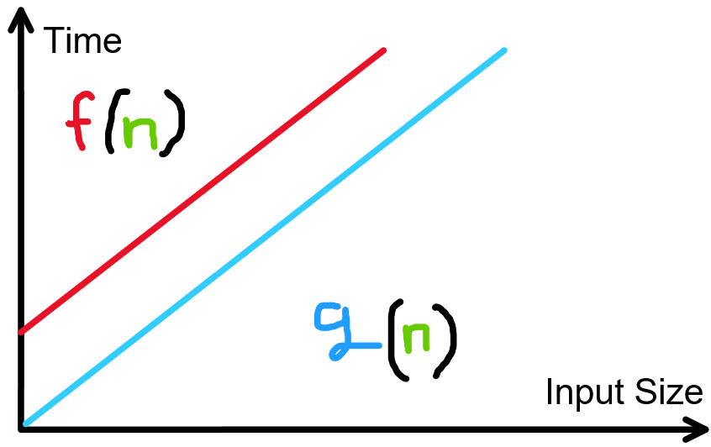

Slide 7
Big-Oh: Example 1

Slide 8
Big-Oh: Example 1
Observe the following:
3n ≤ 3n, ∀ n ≥ 4.
4 ≤ n, ∀ n ≥ 4.
Adding these inequalities, we see that,
3n + 4 ≤ 4n, ∀ n ≥ 4.
Therefore, f(n) ∈ O(g(n)), with c = 4 and n₀ = 4.

Slide 9
Big-Oh: Example 2

Slide 10
Big-Oh: Example 2 (Solution)
Observe the following:
4n² ≤ 4n³, ∀ n ≥ 1.
3n ≤ 3n³, ∀ n ≥ 1.
4 ≤ 4n³, ∀ n ≥ 1.
Adding these inequalities, we get:
4n² + 3n + 4 ≤ 11n³, ∀ n ≥ 1.
Therefore, f(n) ∈ O(g(n)), with c = 11 and n₀ = 1.

Slide 11
Big-Oh: Example 3
Let f(n) = n and g(n) = n - 1. Show that f(n) ∈ O(g(n)).

Slide 12
Big-Oh: Example 3 (scratch work)
Let f(n) = n and g(n) = n - 1. Show that f(n) ∈ O(g(n)).
Want to find c, n₀ so that n ≤ c * (n - 1)
Playing with algebra, we can rearrange this as:
n ≤ c * n - c
c ≤ (c - 1) * n
If we try plugging in c = 2, we get:
2 ≤ n
Which is true for n ≥ 2. (So we should pick c, n₀ = 2)

Slide 13
Big-Oh: Example 3 (Proof)
Observe that
2 ≤ n, ∀ n ≥ 2
We can rewrite this inequality as
2 ≤ 2n - n, ∀ n ≥ 2
Rearranging, this is equivalent to
n ≤ 2 * (n - 1), ∀ n ≥ 2
Therefore, f(n) ∈ O(g(n)), with c = 2 and n₀ = 2.

Slide 14
Big-Oh: Example Exercise

Slide 15
Big-Oh: Example Exercise (Solution)

Slide 16
Today
Asymptotic Analysis Review
Big-Oh Summary
Cases vs Asymptotics
Amortization

Slide 17
What can you drop?

Slide 18
Big-Oh: Common Functions

Slide 19
Beyond Big-Oh: More Asymptotic Notations

Slide 20
Formally Big-Oh

Slide 21
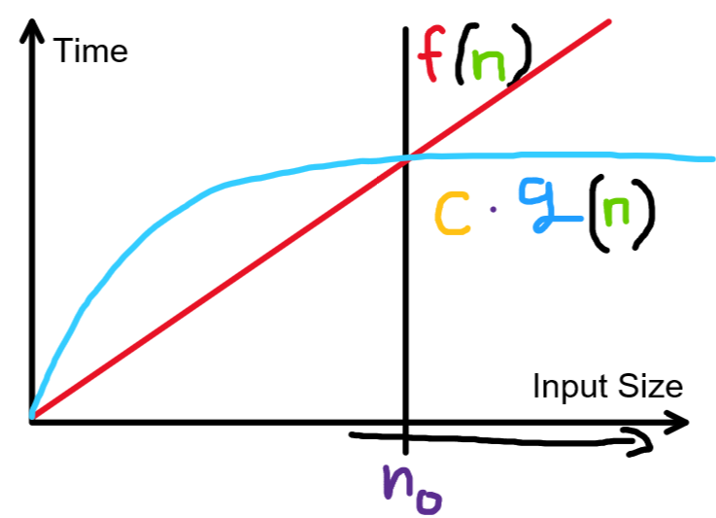

Slide 22
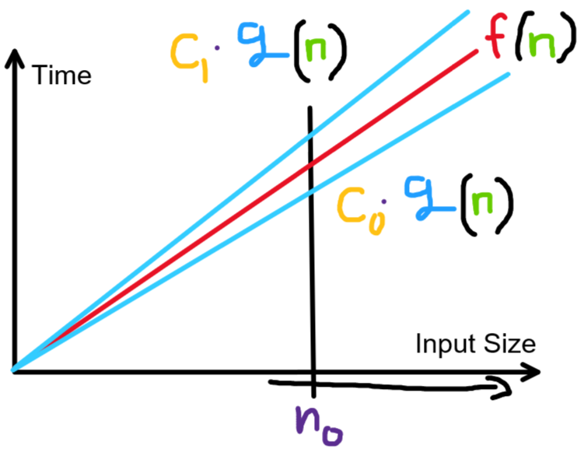
Notes:
This is what we mean by tight bound!

Slide 23
Note on “tight bound”
It’s technically true that n + 2 is O(2^{n})
But that’s not a very good bound
A better bound would be O(n)
It’s the upper bound that’s closest to the actual function
We call the closest (i.e. lowest) asymptotic upper bound the “tight big-oh bound”
Similarly the highest asymptotic lower bound is the “tight big-omega bound”
On Exercises/Exams, we’ll ask for “simplified tight bound”

Slide 24
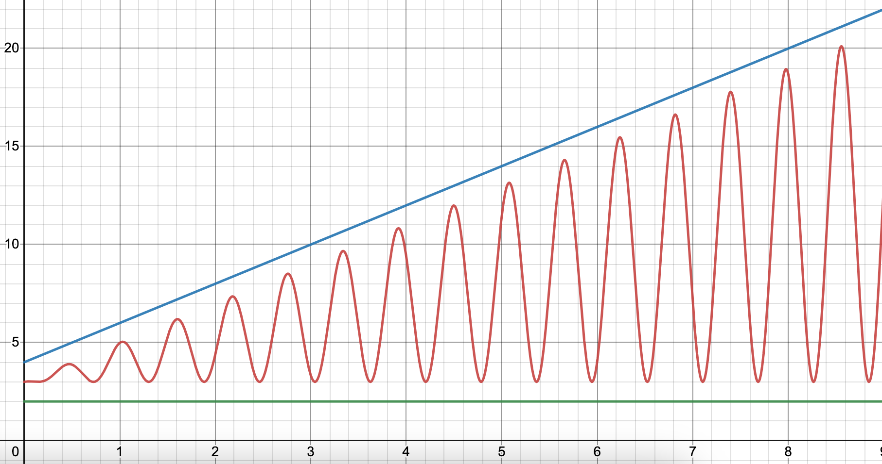
When Big-Oh and Big-Omega differs
Almost never :) https://www.desmos.com/calculator/zo6kikpgay

Slide 25
Today
Asymptotic Analysis Review
Big-Oh Summary
Cases vs Asymptotic
Amortization

Slide 26
Worst/Best-Case vs Asymptotic Analysis
1
2
2
3
4

Slide 27
Analysis: Cases AND Asymptotic Analysis
 |  | Asymptotic Analysis
 |  | Lower | Upper
Cases | Best
 | Worst

Slide 28
Today
Asymptotic Analysis Review
Big-Oh Summary
Cases vs Asymptotics
Amortization

Slide 29
Amortization

Slide 30
Amortization: Example
FYI: Mathematically incorrect but easy to illustrate

Slide 31
Amortization: Why double size?
The most common strategy for increasing array size is doubling. Why not just increase the size by 10 each time we fill up?
Let’s do amortized analysis
Total cost of n insertions:
n [these are normal inserts] + 10 + 20 + 30 + … + n
= O(n²)
Divide by n
Amortized runtime = O(n)
 |  | ...

Slide 32
Summary (wow that was a lot!)
Performance: Time vs Space (usually time)
Counting Code
Best, Worst, Amortized Case (usually worst or amortized)
Asymptotic Analysis (usually tight/Big-Theta)
Confusingly called Big-Oh

Slide 33
Timeline
Asymptotic Analysis
Big-Oh (and Big-) Definition
Big-Oh Summary
Cases vs Asymptotics
Amortization
Priority Queue ADT
Tree Stuff
Binary Min-Heap Data Structure
Basics, Properties, Operations
Array Representation

