Slide 1
Lecture 2: Algorithm Analysis
CSE 332: Data Structures & Parallelism
Yafqa Khan
Summer 2025

Slide 2
Announcements
EX00
due monday
EX01
released friday
Please email me (if you haven’t already) if you need a makeup exam

Slide 3
Today
What do we care about?
Analyzing Code
Counting code constructs
Best Case vs. Worst Case
Asymptotic Analysis
Big-Oh Definition

Slide 4
What do we care about?
Correctness:
Does the algorithm do what is intended?
Performance:
Speed time complexity
Memory space complexity
Why analyze?
To make good design decisions
Enable you to look at an algorithm (or code) and identify the bottlenecks, etc.

Slide 5
Q: How should we compare two algorithms?
Problem: Sort list of all students has ever taken CSE332

Slide 6
A: How should we compare two algorithms?

Slide 7
Today
What do we care about?
Analyzing Code
Counting code constructs
Best Case vs. Worst Case
Asymptotic Analysis
Big-Oh Definition

Slide 8
Analyzing Code: Counting code constructs
Assume basic operations take some amount of constant time
Arithmetic (1+1), assignment (int b = 3), array index(arr[i]), etc.
This approximates reality: a very useful "lie"
Code Construct | How much Time?
Consecutive Statements | Sum of time of each statement
Loops | Sum of time of each iteration
Conditionals | Time to evaluate conditional + whichever branch executes
Function (method) Calls | Time of function’s body
Recursion | Solve recurrence equation

Slide 9
Examples
b = b + 5 c = b / a b = c + 100
for (i = 0; i < n; i++) { sum++; }
if (j < 5) { sum++; } else { for (i = 0; i < n; i++) { sum++; } }

Slide 10
Number of operations? Big Oh?
int coolFunction(int n, int sum) { int i, j; for (i = 0; i < n; i++) { for (j = 0; j < n; j++) sum++; } } print "This program is great!" for (i = 0; i < n; i++) { sum++; } return sum }

Slide 11
Loops: Using Summations
for (i = 0; i < n; i++) { sum++; }

Slide 12
Any Questions?

Slide 13
Complexity Cases (e.g., Worst vs. Best Case)

Slide 14
Other Complexity Cases
Average-case complexity:
What does "average" mean?
What is an "average" dataset?
No agreement on a specific scenario
Amortized-case complexity:
Worst-case in a sequence
Later

Slide 15
Linear search – Best Case & Worst Case
2
3
5
16
37
50
73
75
126
Find an integer in a sorted array
// requires array is sorted
// returns whether k is in array
boolean find(int[]arr, int k){
for(int i=0; i < arr.length; ++i)
if(arr[i] == k)
return true;
return false;
}
Best case:
Worst case:

Slide 16
Remember a faster search algorithm?

Slide 17
Ignoring constant factors

Slide 18
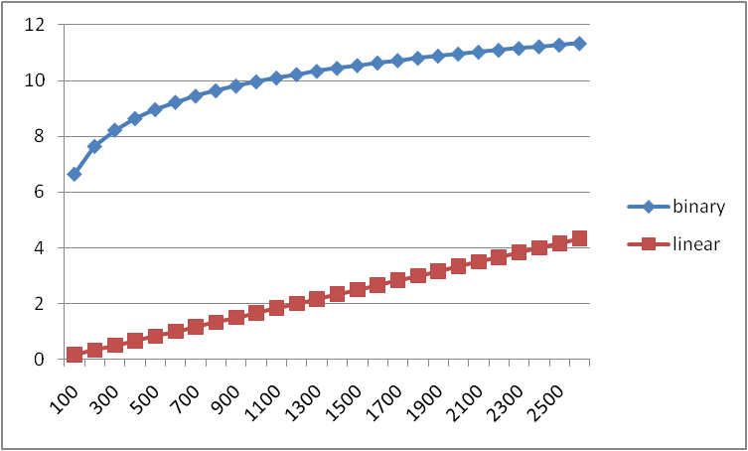
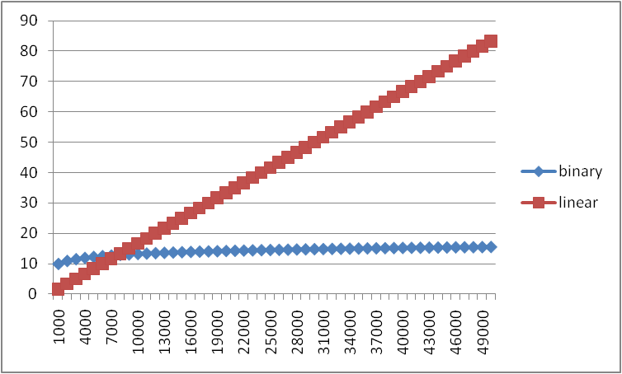
Example - Why we ignore constant factors
time, lower = better
time, lower = better

Slide 19
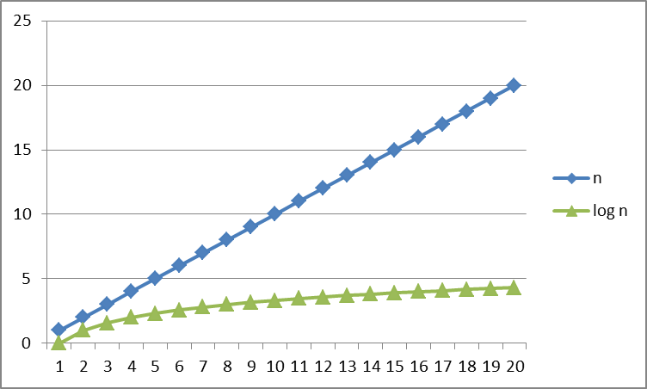
Logarithms and Exponents

Slide 20
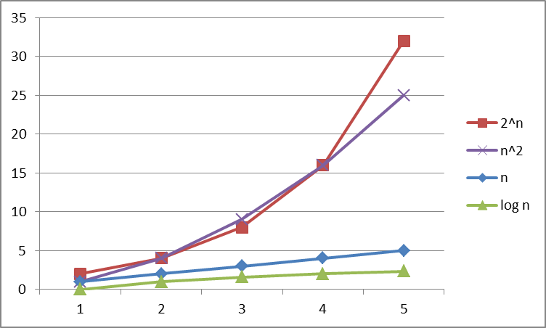
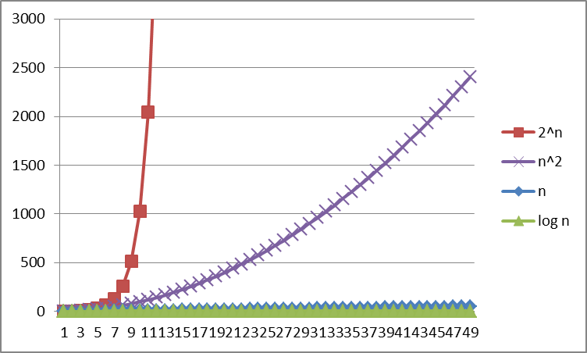
Logarithms and Exponents

Slide 21
Speaking of Logarithms...

Slide 22
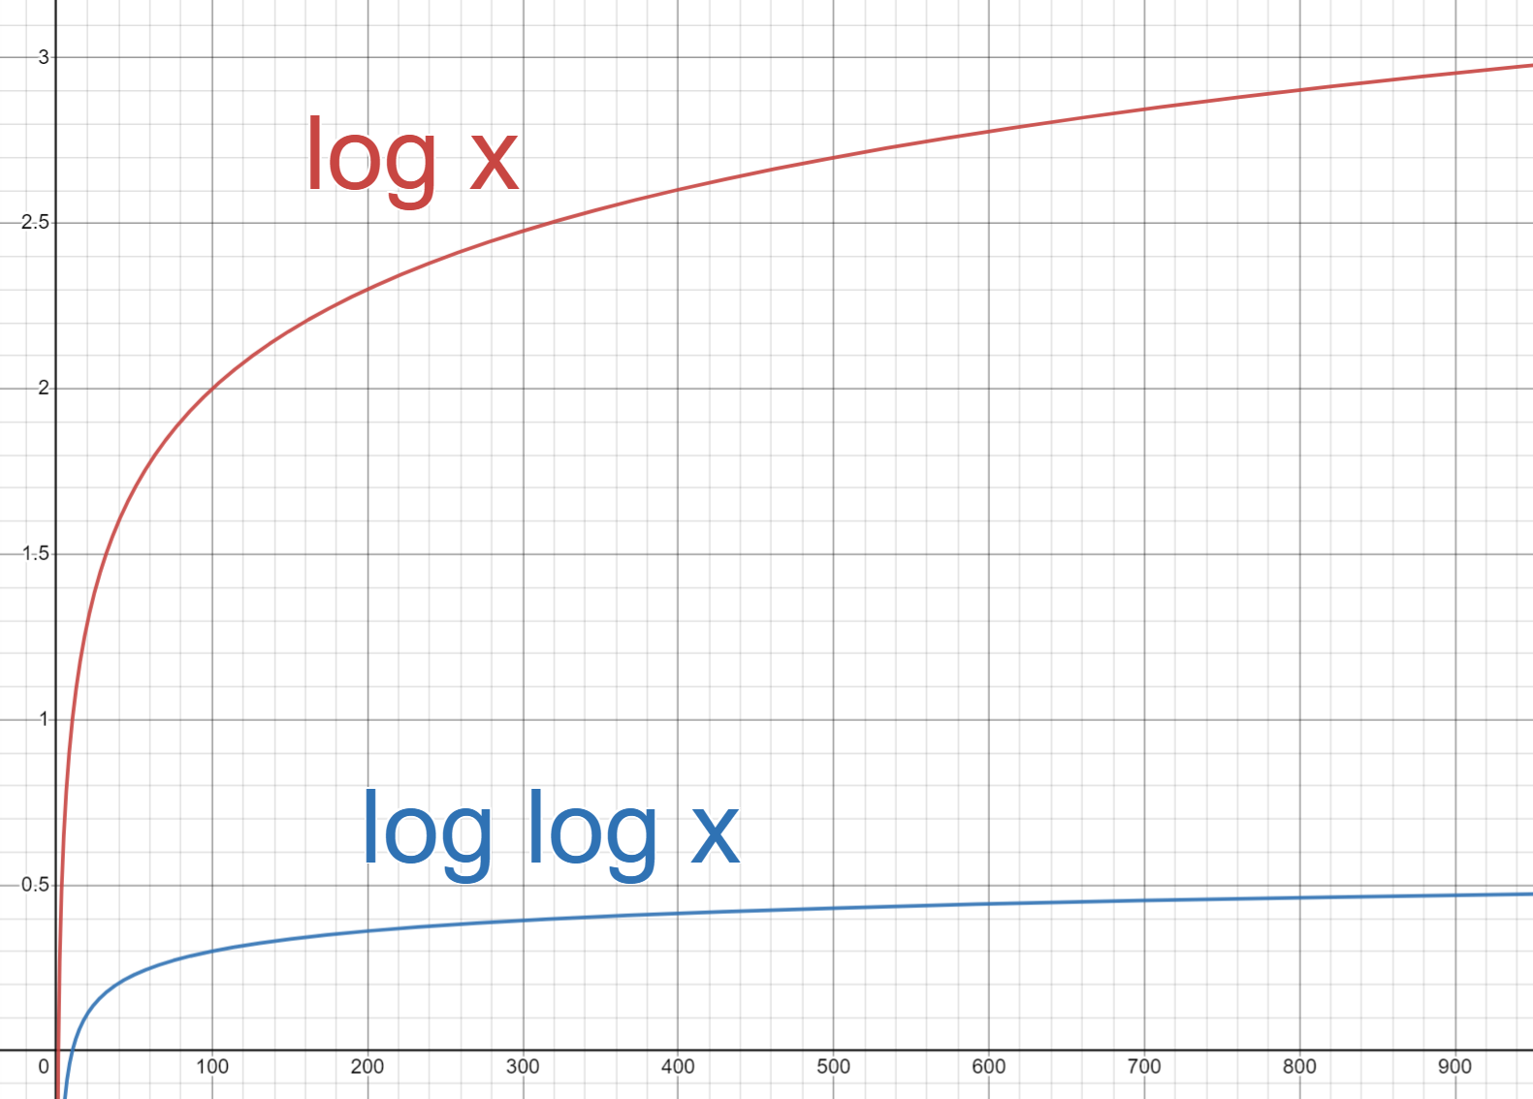
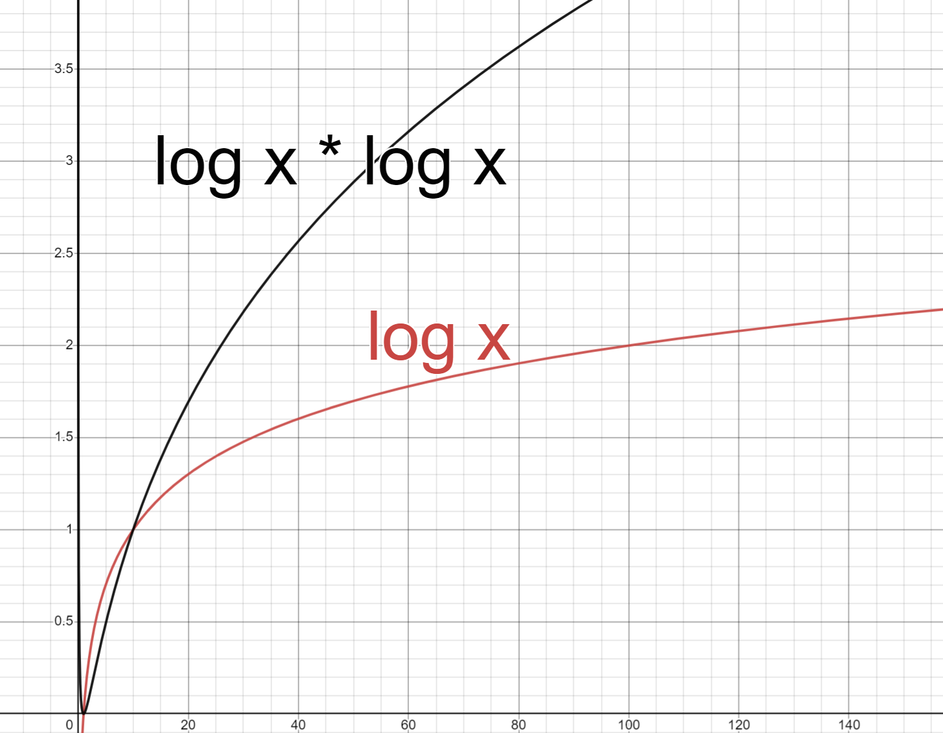
Review: Logarithms

Slide 23
Today
What do we care about?
Analyzing Code
Counting code constructs
Best Case vs. Worst Case
Asymptotic Analysis
Big-Oh Definition

Slide 24
Asymptotic Analysis

Slide 25
Asymptotic Analysis: Big-Oh

Slide 26
Today
What do we care about?
Analyzing Code
Counting code constructs
Best Case vs. Worst Case
Asymptotic Analysis
Big-Oh Definition

Slide 27
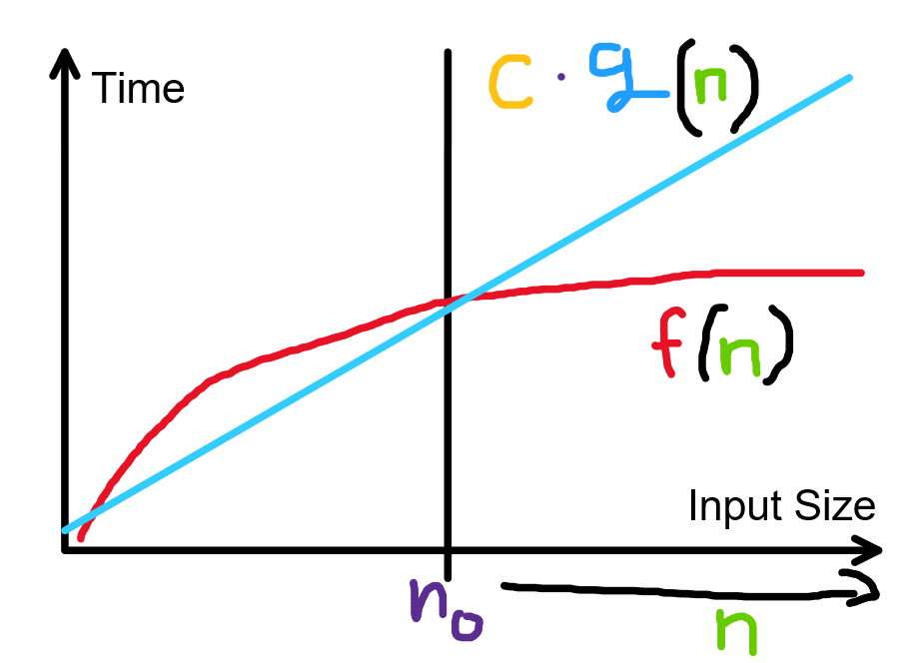
Formally Big-Oh

Slide 28
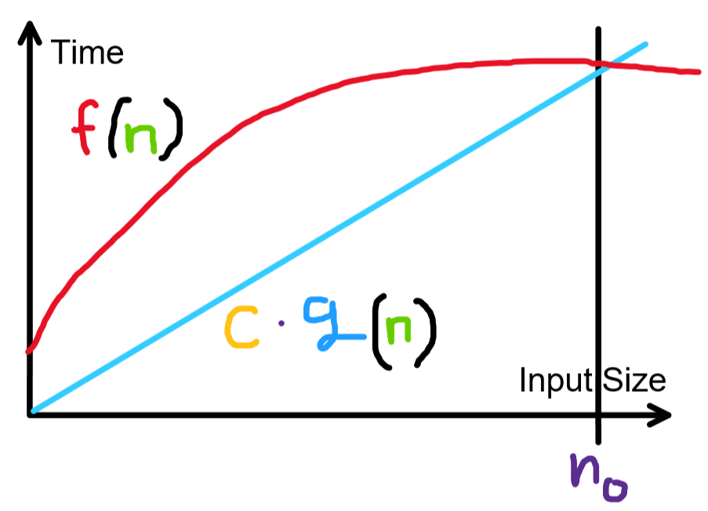
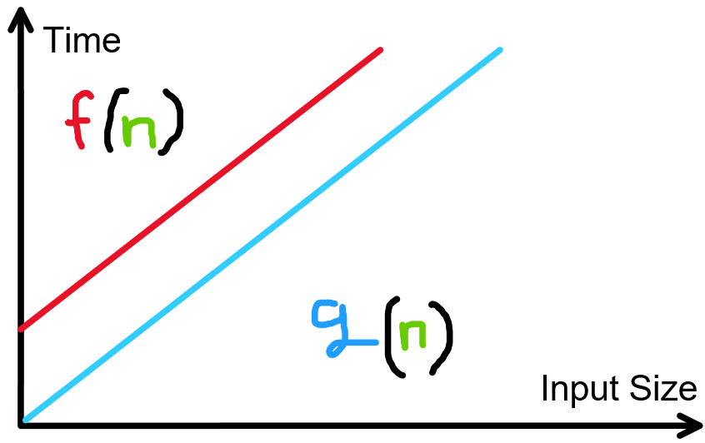

Slide 31
Timeline
What do we care about?
Analyzing Code
Counting code constructs
Best Case vs. Worst Case
Asymptotic Analysis
Big-Oh (and Big-) Definition
Big-Oh Summary
Cases vs Asymptotics
Amortization

