Slide 1
Lecture 1: Intro, Stacks & Queues
CSE 332: Data Structures & Parallelism
Yafqa Khan
Summer 2025

Slide 2
Welcome!
We have 9 weeks to learn fundamental data structures and algorithms for organizing and processing information
“Classic” data structures / algorithms and how to analyze rigorously their efficiency and when to use them
Queues, dictionaries, graphs, sorting, etc.
Parallelism and concurrency (!)
Notes:
0:00
Busy condensed 9 weeks
1. Classic DSA, every school has it
2. Some familiarity from intro course, might have been a while
3. Completely new

Slide 3
Today
Introductions
Administrative Info
What is this course about?
Lecture 01
ADTs, Data Structures (and Algorithm), and Implementation
Review: Queues and stacks
Notes:
1:00
1. intros
2. how this course runs
3. philosophical
4. some review, queues and stacks from intro for P1

Slide 4
CSE 332 23su Course Staff
Instructor:
Yafqa Khan
Teaching Assistants:
Aaron Honjaya
Hana Smahi
Jacklyn Cui
Samarth Venkatesh
Notes:
2:00
Self-intro
Good mix of experienced and fresh TAs
Intros for TAs in section tomorrow (not optional)

Slide 5
Me (Yafqa Khan)
BS/MS Graduate
Too many quarters of TA’ing (14?)
Previously: Amazon
Hobbies: Reading, Anime/Manga, Finding Housing :_(
Notes:
2:30
Intros
BS/MS graduate - P.S. Please don't call me professor, I literally just graduated

Slide 6
Today
Introductions
Administrative Info
What is this course about?
Lecture 01
ADTs, Data Structures (and Algorithm), and Implementation
Review: Queues and stacks
Notes:
3:45
Logistics

Slide 7
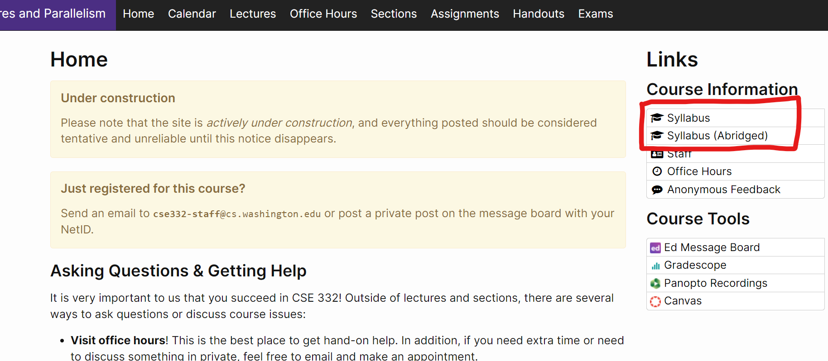
Course Information
Instructor: Yafqa Khan, CSE206
Office Hours: see course web page and by appointment (email me)
yafqak@cs.washington.edu
Course Web Page:
cs.uw.edu/332
Syllabus:
On the website!
Notes:
4:00
I am the instructor, this is my email
Office Hours - TBD
Course Web Page: All the information you need will be in here

Slide 8
Communication (to you)
Course email lists:
cse332a_su25@uw.edu
UW Email!
Ed Discussion Board (to you)
To you: Ed Announcement Emails
Notes:
7:00
So how do we reach you?
1. Should have received an email from me
-> if you didn't, check your UW email
-> I'll email again tonight if you just signed up
2. Ed board
-> reminders, announcements

Slide 9
Communication (to us)
Course staff lists:
cse332-staff@cs.washington.edu
CS Email! Yes, very confusing, weird UW + Allen School infrastructure
Ed Discussion Board (to us)
To us: Ask questions!
Anonymous Feedback Form (feedback.cs.washington.edu)
Nobody sees your name (including me)
CANNOT REPLY
Good + Bad Feedback, if you don't say anything we won't know :(
Notes:
8:00
How do you reach us?
1. Staff Email: Use the staff email! This is a CSE email, not UW
2. Ed board: Use the Ed board to also ask questions!
3. Anonymous Feedback Form: anonymous and I CANNOT HIT REPLY on any messages

Slide 10
Course Meetings
Lecture
Take notes, materials posted (sometimes afterwards)
Ask questions, focus on key ideas (rarely coding details)
Attend synchronously as much as possible and interact with peers!
Section
Practice problems!
Answer Java/project/homework questions, etc.
Occasionally may introduce new material
An important part of the course (not optional)
Office hours
Use them: please visit us!
Notes:
8:30
When are we going to see you?
1. Lecture
Slides posted, inks posted
Will talk in terms of pseudocode, very few Java code but will need to implement in Java
2. Section
Practice!
Materials posted, new mini lectures(Trie)
Not optional
3. OH
Zoom or in-person

Slide 11
Course Material
Lecture and section materials will be posted
They are visual aids, so not always a complete description!
If you must miss, find out what you missed
Textbook: Weiss 3rd Edition in Java
Good read, but only responsible for lecture/section/hw topics
3rd edition improves on 2nd, but 2nd is fine
Parallelism / concurrency topics in separate free resource designed for 332
https://homes.cs.washington.edu/~djg/teachingMaterials/spac/sophomoricParallelismAndConcurrency.pdf
Notes:
11:00
1. Lecture and Section
2. Textbook
-> very readable, lots of Java code example, lectures follow it closely
3. Parallelism
Dan Grossman notes, free pdf online

Slide 12
Course Work
13 individual homework exercises (60%)
5% each, lowest scoring one dropped
2 late days each EXCEPT exercise 12
6 late days TOTAL
2 in-person exams
20% each, both non-cumulative
Check website + syllabus for info
Email me ASAP if cannot make it
Notes:
11:30
What do you need to do?
Two homeworks happening at the same time:
1. Exercises
-> Some conceptual + Some coding + Some math + Some Problem set
2. Projects
-> Writing a lot Java code
-> High level concepts from lectures -> actual code
-> Expect intro course knowledge, could have been a while
-> Almost no homeworks early on -> review intro course material
-> IntelliJ (e.g. 331 uses) + Gitlab
3. Exams (check syllabus)
-> Midterm offset from 312
16:00 Show course web page

Slide 13
Homework :(
Sorry, the class is really condensed
EX 0 out today (spec on website)
due next monday
Check you have access to Ed
Email me if there are problems
https://courses.cs.washington.edu/courses/cse332/25su/calendar/lecturelist.html
Notes:
19:00

Slide 14
Homework :(
Reading (optional)
Weiss textbook - free rent at Ode!
For this week:
(Today) Weiss 3.1-3.7 – Lists, Stacks & Queues (Topic for Project #1)
(Friday) Weiss 2.1-2.4 – Algorithm Analysis
Weiss 1.1-1.6 – Mathematics and Java (NOT covered in lecture, will use some of these baseline facts)

Slide 15
Any Questions?

Slide 16
Today
Introductions
Administrative Info
What is this course about?
Lecture 01
ADTs, Data Structures (and Algorithm), and Implementation
Review: Queues and stacks
Notes:
21:00

Slide 17
Data Structures & Parallelism
About 70% of the course is the “data structures & algorithms course”
What and how of data structures & algorithms
Pick the correct data structures & algorithms (analyze & tradeoffs)
Implement them
+ a serious first treatment of programming with multiple threads
For parallelism: Use multiple processors to finish sooner
For concurrency: Correct access to shared resources
Really should be called
Data Structures & Algorithms and Parallelism & Concurrency 🙃
Notes:
21:30
1. DSA course
Job interviews?
familiar content - binary tree
2. Parallelism & Concurrency
very new stuff
important enough that we put it in a core 300 class instead of optional 400 class

Slide 18
One view on this course
This is the class where you begin to think like a computer scientist
You stop thinking in Java code
You start thinking that this is a hashtable problem, a stack problem, etc.
Feel more comfortable not having one best, correct answer
Make good design choices
Justify and communicate your design choices
Notes:
23:00

Slide 19
Today
Introductions
Administrative Info
What is this course about?
Lecture 01
ADTs, Data Structures (and Algorithm), and Implementation
Review: Queues and stacks
Notes:
24:00

Slide 20
Data Structures?
Clever ways to organize information in order to enable efficient computation over that information
Notes:
25:00

Slide 21
Data Structures (Examples)

Slide 22
Trade-Offs
A data structure strives to provide many useful, efficient operations
But trade-offs!
Time vs. Space
One operation more efficient if another less efficient
Generality vs. Simplicity vs. Performance
That is why there are many data structures

Slide 23
Terminologies
Abstract Data Type (ADT)
Mathematical description of a "thing" with set of operations on that "thing"
Data Structures
A specific organization of data and family of algorithms for implementing an ADT
Implementation of a data structure
The actual code implementation in a specific language
Algorithm
A high level, language-independent description of a step-by-step process

Slide 24
Stacks and Queue ADT
Stack ADT |  | Queue ADT
State: Set of elements |  | State: Set of elements
Operations: push(element) pop() – returns the most recent element that was added to the stack ... etc. |  | Operations: enqueue(element) dequeue() – deletes and returns the element that has been in the queue the longest ... etc.

Slide 25
Terminology Example: Stack
The Stack ADT supports operations:
push: adds an item
pop: raises an error if isEmpty, else returns most-recently pushed item not yet returned by a pop
isEmpty: initially true, later true if there have been same number of pops as pushes
etc.
A Stack data structure could use a linked-list or an array or something else, and associated algorithms for the operations
One implementation is in the library java.util.Stack

Slide 26
Why useful
The Stack ADT is a useful abstraction because:
It arises all the time in programming (see Weiss for more)
Recursive function calls
Balancing symbols (parentheses)
Evaluating postfix notation: 3 4 + 5 *
Clever: Infix ((3+4) * 5) to postfix conversion (see Weiss)
We can code up a reusable library
We can communicate in high-level terms
“Use a stack and push numbers, popping for operators…”
Rather than, “create a linked list and add a node when…”

Slide 27
Any Questions?

Slide 28
Terminology Example: Queue
The Queue ADT supports operations:
enqueue: adds an item at the end
dequeue: raises an error if isEmpty, else returns item at the start
isEmpty: initially true, later true if there have been same number of enqueue as dequeues
etc.
A Queue data structure could use a linked-list or an array or something else, and associated algorithms for the operations
One implementation is in the library java.util.Queue

Slide 29
Circular Array Queue Data Structure
Q:
0
size - 1
b
c
d
e
f
front
back
// Basic idea only!
enqueue(x) {
Q[back] = x;
back = (back + 1) % size
}
What if queue is empty?
Enqueue?
Dequeue?
What if array is full?
How to test for empty?
What is the complexity of the operations?
// Basic idea only!
dequeue() {
x = Q[front];
front = (front + 1) % size;
return x;
}

Slide 30
Linked List Queue Data Structure
b
c
d
e
f
front
back
// Basic idea only!
enqueue(x) {
back.next = new Node(x);
back = back.next;
}
What if queue is empty?
Enqueue?
Dequeue?
Can list be full?
How to test for empty?
What is the complexity of the operations?
// Basic idea only!
dequeue() {
x = front.item;
front = front.next;
return x;
}

Slide 31
Any Questions?

Slide 32
Circular Array vs. Linked List
Array: | List:
May waste unneeded space or run out of space Space per element excellent Operations very simple / fast | Always just enough space But more space per element Operations very simple / fast
Operations not in Queue ADT, but also: | Operations not in Queue ADT, but also:
Constant-time “access to k^{th} element” For operation “insertAtPosition”, must shift all later elements | No constant-time “access to k^{th} element” For operation “insertAtPosition” must traverse all earlier elements

Slide 33
Homework Today :(
Sorry, the class is really condensed
EX 0 out today (spec on website)
due next monday
Check you have access to Ed
Email me if there are problems
https://courses.cs.washington.edu/courses/cse332/25su/calendar/lecturelist.html
Reading (optional)
Notes:
19:00

Slide 34
Timeline
ADTs, Data Structures (and Algorithm), and Implementation
Review: Queues and stacks
What do we care about?
Analyzing Code
Counting code constructs
Best Case vs. Worst Case
Asymptotic Analysis
Big-Oh Definition

