Slide 1
Lecture 19: Analysis of Fork-Join Parallel Programs
CSE 332: Data Structures & Parallelism
Yafqa Khan
Summer 2025

Slide 2
Announcements
EX08 due today
EX09 due Monday
EX10 released today
Exam 2 information posted here:
  https://courses.cs.washington.edu/courses/cse332/25su/exams/final.html
  Note: it will be hard to accommodate makeups; only four days to grade
  If you can’t make proposed makeup dates (e.g., sickness/emergency), some options:
  Option 1: Exam 1 is worth 40% instead of 20% of overall grade
  Option 2: Take the final exam in the next CSE 332 offering

Slide 3
Today
Java Thread Library
Java ForkJoin Library
Simple Parallel Patterns: Map + Reduce
Analyzing Parallel Algorithms
  Work and Span
  Amdahl's Law

Slide 4
Today
Java Thread Library
Java ForkJoin Library
Simple Parallel Patterns: Map + Reduce
Analyzing Parallel Algorithms
  Work and Span
  Amdahl's Law

Slide 5
Today
Java Thread Library
Java ForkJoin Library
Simple Parallel Patterns: Map + Reduce
Analyzing Parallel Algorithms
  Work and Span
  Amdahl's Law

Slide 6
Today
Java Thread Library
Java ForkJoin Library
Simple Parallel Patterns: Map + Reduce
Analyzing Parallel Algorithms
  Work and Span
  Amdahl's Law

Slide 7
Analyzing Algorithms: Work and Span
Let T_{P} be the running time if there are P processors available
Two key measures of run-time:
Work: How long it would take 1 processor = T₁
  Just “sequentialize” the recursive forking
  Cumulative work that all processors must complete
Span: How long it would take infinity processors = T∞
  The hypothetical ideal for parallelization
  This is the longest “dependence chain” in the computation
  Example: O(log n) for summing an array
    Notice in this example having > n/2 processors is no additional help
  Also called “critical path length” or “computational depth”
Notes:
Still going to use N, but we have a new variable, P
We’re going to assume that we have enough processors available for us.
Work includes the start calls as well. So all of the stuff.

Slide 8
The DAG (Directed Acyclic Graph)
A program execution using fork and join can be seen as a DAG
[A DAG is a graph that is directed (edges have direction (arrows)), and those arrows do not create a cycle (ability to trace a path that starts and ends at the same node).]
  Nodes: Pieces of work
  Edges: Source must finish before destination starts
A fork “ends a node” and makes two outgoing edges
  New thread
  Continuation of current thread
A join “ends a node” and makes a node with two incoming edges
  Node just ended
  Last node of thread joined on
Notes:
Nodes are things that need to be done
Arrows show dependencies
With our fork join, well a fork needs to happen before some threads even exist. A join waits for threads to finish before it can continue.

Slide 9
Our simple examples, in more detail
Our fork and join often look like this:
divide
base cases
combine results
  In this context, the span (T∞) is:
    The longest dependence-chain; longest ‘branch’ in parallel ‘tree’
    Example: O(log n) for summing an array; we halve the data down to our cut-off, then add back together; O(log n) steps, O(1) time for each
    Also called “critical path length” or “computational depth”
Notes:
Perfect tree
Log(n)
Log(n)
Every node in a level can be happening at the same time
If we don’t have enough processors, we may have a different kind of bottleneck. Example, P = 2 processors
DAGS are not always this simple

Slide 10
Connecting to performance
Recall: T_{P} = running time if there are P processors available
Work = T₁ = sum of run-time of all nodes in the DAG
  That lonely processor does everything
  Any topological sort is a legal execution
  O(n) for simple maps and reductions
Span = T∞ = sum of run-time of all nodes on the most-expensive path in the DAG
  Note: costs are on the nodes not the edges
  Our infinite army can do everything that is ready to be done, but still has to wait for earlier results
  O(log n) for simple maps and reductions

Slide 11
Definitions
A couple more terms:
Speed-up on P processors: T₁ / T_{P}
If speed-up is P as we vary P, we call it perfect linear speed-up
  Perfect linear speed-up means doubling P halves running time
  Usually our goal; hard to get in practice
Parallelism is the maximum possible speed-up: T₁ / T ∞
  At some point, adding processors won’t help
  What that point is depends on the span
Parallel algorithms is about decreasing span without
increasing work too much

Slide 12
Optimal T_{P}: Thanks ForkJoin library!
So we know T₁ and T ∞ but we want T_{P} (e.g., P=4)
Ignoring memory-hierarchy issues (caching), T_{P} can’t beat
  T₁ / P why not?
  T ∞ why not?
So an asymptotically optimal execution would be:
  T_{P} = O((T₁ / P) + T ∞)
  First term dominates for small P, second for large P
The ForkJoin Framework gives an expected-time guarantee of asymptotically optimal!
  Guarantee requires a few assumptions about your code…

Slide 13
Division of responsibility
Our job as ForkJoin Framework users:
  Pick a good algorithm, write a program
  When run, program creates a DAG of things to do
  Make all the nodes a small-ish and approximately equal amount of work
The framework-writer’s job:
  Assign work to available processors to avoid idling
    Let framework-user ignore all scheduling issues
  Keep constant factors low
  Give the expected-time optimal guarantee assuming framework-user did his/her job
  T_{P} = O((T₁ / P) + T ∞)

Slide 14
Examples
  T_{P} = O((T₁ / P) + T ∞)
In the algorithms seen so far (e.g., sum an array):
  T₁ = O(n)
  T ∞= O(log n)
  So expect (ignoring overheads): T_{P} = O(n/P + log n)
Suppose instead:
  T₁ = O(n²)
  T ∞= O(n)
  So expect (ignoring overheads): T_{P} = O(n²/P + n)

Slide 15
And now for the bad news…
So far: talked about a parallel program in terms of work and span
In practice, it’s common that your program has:
a) parts that parallelize well:
  Such as maps/reduces over arrays and trees
b) …and parts that don’t parallelize at all:
  Such as reading a linked list, getting input, or just doing computations where each step needs the results of previous step
These unparallelized parts can turn out to be a big bottleneck, which brings us to Amdahl’s Law …

Slide 16
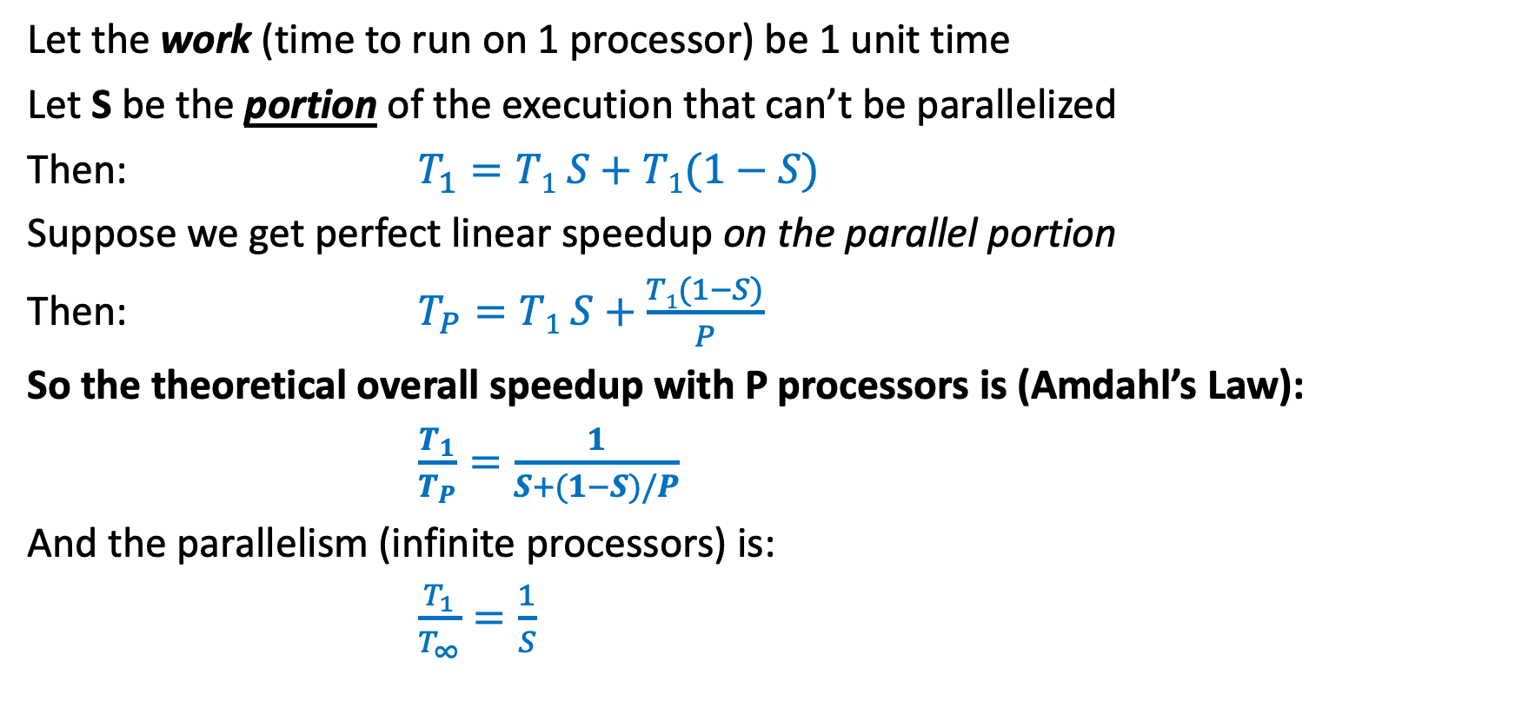
Amdahl’s Law (mostly bad news)
Let the work (time to run on 1 processor) be 1 unit time
Let S be the portion of the execution that can’t be parallelized
Then: $T_{1}=T1 S+$ $T1(1−S)$
Suppose we get perfect linear speedup on the parallel portion
Then: $T_{P}=T1 S+\frac{T1(1−S)}{P}$
So the theoretical overall speedup with P processors is (Amdahl’s Law):
$\frac{T_{1}}{T_{P}}=\frac{1}{S+(1−S)/P}$
And the parallelism (infinite processors) is:
$\frac{T_{1}}{T_{∞}}=\frac{1}{S}$

Slide 17
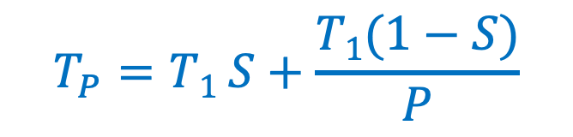
Amdahl’s Law
$$T_{P}=T1 S+\frac{T1(1−S)}{P}$$
Suppose our program takes 100 seconds.
And $S$ is 1/3 (i.e. 33 seconds).
What is the running time with
3 processors
6 processors
22 processors
67 processors
1,000,000 processors (approximately).

Slide 18
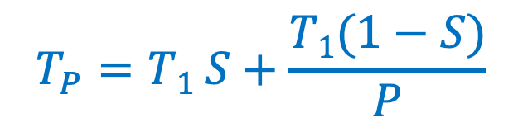
Amdahl’s Law
$$T_{P}=T1 S+\frac{T1(1−S)}{P}$$
Suppose our program takes 100 seconds.
And $S$ is 1/3 (i.e. 33 seconds).
What is the running time with
3 processors: 33 + 67/3 $≈$ 55 seconds
6 processors: 33 + 67/6 $≈$ 44 seconds
22 processors: 33 + 67/22 $≈$ 36 seconds
67 processors 33 + 67/67 $≈$ 34 seconds
1,000,000 processors (approximately). $≈$ 33 seconds

Slide 19
Amdahl’s Law
This is BAD NEWS
If 1/3 of our program can’t be parallelized, we can’t get a speedup better than 3.
No matter how many processors we throw at our problem.
And while the first few processors make a huge difference, the benefit diminishes quickly.

Slide 20
Any Questions?

