Slide 1

CSE 332: Data Structures & Parallelism
Lecture 17: Minimum Spanning Trees
Yafqa Khan
Summer 2025

Slide 2
Announcements
EX07 due today
EX08 due Friday
EX09 released today
Exam 2 information posted here:
  https://courses.cs.washington.edu/courses/cse332/25su/exams/final.html
  Note: it will be hard to accommodate makeups; only four days to grade
  If you can’t make proposed makeup dates (e.g., sickness/emergency), some options:
  Option 1: Exam 1 is worth 40% instead of 20% of overall grade
  Option 2: Take the final exam in the next CSE 332 offering

Slide 3
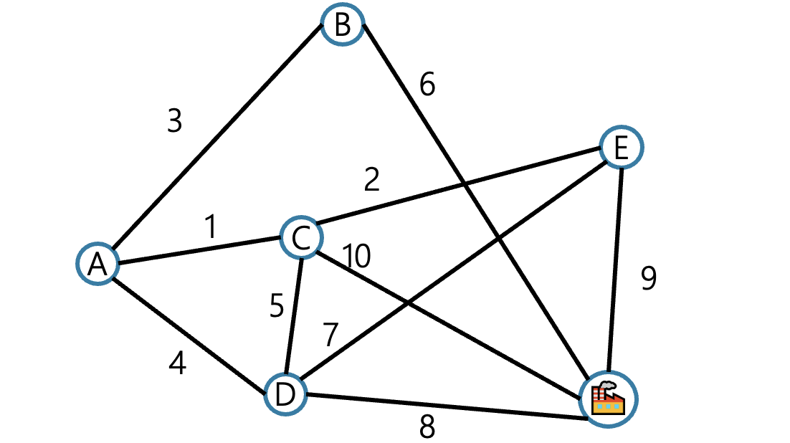
MSTs
It’s 2025! Your friend works at an internet company. They want to know where to build internet cables to connect all cities to the Internet.
They know how much it would cost to lay internet cables, and they want the cheapest way to make sure everyone can reach the server.

Slide 4
Minimum Spanning Trees
Given an undirected graph G=(V,E), find a graph G’=(V, E’) such that:
  E’ is a subset of E
  |E’| = |V| - 1
  G’ is connected
  is minimal
Applications:
Example: Electrical wiring for a house or clock wires on a chip
Example: A road network if you cared about asphalt cost rather than travel time
G’ is a minimum spanning tree.

Slide 5
Find the MST
Student Activity
j
4
7
k
9
n
1
2
5
m
1
A
B
F
6
7
H
5
3
2
12
11
9
C
G
4
10
13
D
4
E

Slide 6
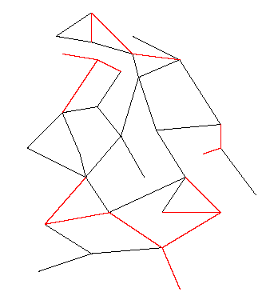
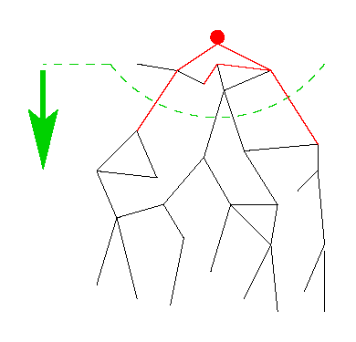
Two Different Approaches
Prim’s Algorithm
Almost identical to Dijkstra’s
Kruskals’s Algorithm
Completely different!

Slide 7
Two Different Approaches
Prim’s Algorithm
Almost identical to Dijkstra’s
Kruskals’s Algorithm
Completely different!
One node, grow greedily
Forest of MSTs,
Union them together.
(Need a new data structure for this)

Slide 8
Prim’s algorithm
Idea: Grow a tree by picking a vertex from the unknown set that has the smallest cost. Here cost = cost of the edge that connects that vertex to the known set. Pick the vertex with the smallest cost that connects “known” to “unknown.”
A node-based greedy algorithm
  Builds MST by greedily adding nodes
G
v
known
Notes:
Pick one node as the root,
Incrementally add edges that connect a “new” vertex to the tree.
Pick the edge (u,v) where u is in the tree, v is not AND
where the edge weight is the smallest of all edges (where u is in the tree and v is not).

Slide 9
Prim’s Algorithm vs. Dijkstra’s
Recall:
Dijkstra picked the unknown vertex with smallest cost where
cost = distance to the source.
Prim’s pick the unknown vertex with smallest cost where
cost = distance from this vertex to the known set (in other words, the cost of the smallest edge connecting this vertex to the known set)
  Otherwise identical
  Compare to slides in Dijkstra lecture!

Slide 10
Prim’s Algorithm for MST
For each node v, set v.cost = ∞ and v.known = false
Choose any node v. (this is like your “start” vertex in Dijkstra)
  Mark v as known
  For each edge (v,u) with weight w:
  set u.cost=w and u.prev=v
While there are unknown nodes in the graph
  Select the unknown node v with lowest cost
  Mark v as known and add (v, v.prev) to output (the MST)
  For each edge (v,u) with weight w, where u is unknown:
  if(w < u.cost) {
  u.cost = w;
  u.prev = v;
  }

Slide 11
Example: Find MST using Prim’s
0
2
2
A
B
1
1
∞
2
5
E
1
1
1
D
3
C
5
2
∞
2
6
G
vertex | known? | cost | prev
A | Y | 0
B |  | 2 | A
C |  | 2 | A
D |  | 1 | A
E |  | ??
F |  | ??
G |  | ??
∞
10
F
Order added to known set:
A

Slide 12
Example: Find MST using Prim’s
0
2
2
A
B
1
1
1
2
5
E
1
1
1
D
3
C
5
1
5
2
6
G
vertex | known? | cost | prev
A | Y | 0
B |  | 2 | A
C |  | 1 | D
D | Y | 1 | A
E |  | 1 | D
F |  | 6 | D
G |  | 5 | D
6
10
F
Order added to known set:
A, D

Slide 13
Example: Find MST using Prim’s
0
2
2
A
B
1
1
1
2
5
E
1
1
1
D
3
C
5
1
5
2
6
G
vertex | known? | cost | prev
A | Y | 0
B |  | 2 | A
C | Y | 1 | D
D | Y | 1 | A
E |  | 1 | D
F |  | 2 | C
G |  | 5 | D
2
10
F
Order added to known set:
A, D, C

Slide 14
Example: Find MST using Prim’s
0
1
2
A
B
1
1
1
2
5
E
1
1
1
D
3
C
5
1
3
2
6
G
vertex | known? | cost | prev
A | Y | 0
B |  | 1 | E
C | Y | 1 | D
D | Y | 1 | A
E | Y | 1 | D
F |  | 2 | C
G |  | 3 | E
2
10
F
Order added to known set:
A, D, C, E

Slide 15
Example: Find MST using Prim’s
0
1
2
A
B
1
1
1
2
5
E
1
1
1
D
3
C
5
1
3
2
6
G
vertex | known? | cost | prev
A | Y | 0
B | Y | 1 | E
C | Y | 1 | D
D | Y | 1 | A
E | Y | 1 | D
F |  | 2 | C
G |  | 3 | E
2
10
F
Order added to known set:
A, D, C, E, B

Slide 16
Example: Find MST using Prim’s
0
1
2
A
B
1
1
1
2
5
E
1
1
1
D
3
C
5
1
3
2
6
G
vertex | known? | cost | prev
A | Y | 0
B | Y | 1 | E
C | Y | 1 | D
D | Y | 1 | A
E | Y | 1 | D
F | Y | 2 | C
G |  | 3 | E
2
10
F
Order added to known set:
A, D, C, E, B, F

Slide 17
Example: Find MST using Prim’s
0
1
2
A
B
1
1
1
2
5
E
1
1
1
D
3
C
5
1
3
2
6
G
vertex | known? | cost | prev
A | Y | 0
B | Y | 1 | E
C | Y | 1 | D
D | Y | 1 | A
E | Y | 1 | D
F | Y | 2 | C
G | Y | 3 | E
2
10
F
Order added to known set:
A, D, C, E, B, F, G

Slide 18
Find MST using Prim’s
Student Activity
Start with V₁
2
v₂
v₁
3
4
1
10
v₃
2
v₄
7
v₅
V | Kwn | Distance | path
v1
v2
v3
v4
v5
v6
v7
5
8
4
6
v₆
1
v₇
Order Declared Known:
V₁
Total Cost:

Slide 19
Prim’s Analysis
Run-time
  Same as Dijkstra
  O(|E|log |V|) using a priority queue

Slide 20
Kruskal’s MST Algorithm
Idea: Grow a forest out of edges that do not create a cycle. Pick an edge with the smallest weight.
G=(V,E)
v

Slide 21
Example: Find MST using Kruskal’s
2
Edges in sorted order:
1: (A,D), (C,D), (B,E), (D,E)
2: (A,B), (C,F), (A,C)
3: (E,G)
5: (D,G), (B,D)
6: (D,F)
10: (F,G)
A
B
1
1
5
2
E
1
1
D
3
C
5
2
6
G
10
F
Output:
Note: At each step, the union/find sets are the trees in the forest

Slide 22
Kruskal’s Algorithm for MST
An edge-based greedy algorithm
  Builds MST by greedily adding edges
Initialize with
  empty MST
  all vertices marked unconnected
  all edges unmarked
While all vertices are not connected
  Pick the lowest cost edge (u,v) and mark it
  If u and v are not already connected, add (u,v) to the MST and mark u and v as connected to each other

Slide 23
Aside: Union-Find aka Disjoint Set ADT
Union(x,y) – take the union of two sets named x and y
  Given sets: {3,5,7} , {4,2,8}, {9}, {1,6}
  Union(5,1)
  Result: {3,5,7,1,6}, {4,2,8}, {9},
  To perform the union operation, we replace sets x and y by (x ∪ y)
Find(x) – return the name of the set containing x.
  Given sets: {3,5,7,1,6}, {4,2,8}, {9},
  Find(1) returns 5
  Find(4) returns 8
We can do Union in constant time.
We can get Find to be amortized constant time
(worst case O(log n) for an individual Find operation).

Slide 24
Kruskal’s pseudo code
void Graph::kruskal(){
int edgesAccepted = 0;
DisjSet s(NUM_VERTICES);
while (edgesAccepted < NUM_VERTICES – 1){
e = smallest weight edge not deleted yet;
// edge e = (u, v)
uset = s.find(u);
vset = s.find(v);
if (uset != vset){
edgesAccepted++;
s.unionSets(uset, vset);
}
}
}
Sort of ignore this loop in calc run-time…

Slide 25
Kruskal’s pseudo code
On heap of edges
Deletemin = log |E|
void Graph::kruskal(){
int edgesAccepted = 0;
DisjSet s(NUM_VERTICES);
while (edgesAccepted < NUM_VERTICES – 1){
e = smallest weight edge not deleted yet;
// edge e = (u, v)
uset = s.find(u);
vset = s.find(v);
if (uset != vset){
edgesAccepted++;
s.unionSets(uset, vset);
}
}
}
|E| heap ops
Sort of ignore this loop in calc run-time…
2|E| finds
One for each vertex in the edge
Find = log |V|
|V| unions
|E| log |E| + 2|E|log|V|+|V|
Union = O(1)
O(|E|log|E|) = O(|E|log|V|)
b/c log |E| < log|V|² = 2log|V|

Slide 26
Example: Find MST using Kruskal’s
2
Edges in sorted order:
1: (A,D), (C,D), (B,E), (D,E)
2: (A,B), (C,F), (A,C)
3: (E,G)
5: (D,G), (B,D)
6: (D,F)
10: (F,G)
A
B
1
1
5
2
E
1
1
D
3
C
5
2
6
G
10
F
Output:
Note: At each step, the union/find sets are the trees in the forest

Slide 27
Example: Find MST using Kruskal’s
2
Edges in sorted order:
1: (A,D), (C,D), (B,E), (D,E)
2: (A,B), (C,F), (A,C)
3: (E,G)
5: (D,G), (B,D)
6: (D,F)
10: (F,G)
A
B
1
1
5
2
E
1
1
D
3
C
5
2
6
G
10
F
Output: (A,D)
Note: At each step, the union/find sets are the trees in the forest

Slide 28
Example: Find MST using Kruskal’s
2
Edges in sorted order:
1: (A,D), (C,D), (B,E), (D,E)
2: (A,B), (C,F), (A,C)
3: (E,G)
5: (D,G), (B,D)
6: (D,F)
10: (F,G)
A
B
1
1
5
2
E
1
1
D
3
C
5
2
6
G
10
F
Output: (A,D), (C,D)
Note: At each step, the union/find sets are the trees in the forest

Slide 29
Example: Find MST using Kruskal’s
2
Edges in sorted order:
1: (A,D), (C,D), (B,E), (D,E)
2: (A,B), (C,F), (A,C)
3: (E,G)
5: (D,G), (B,D)
6: (D,F)
10: (F,G)
A
B
1
1
5
2
E
1
1
D
3
C
5
2
6
G
10
F
Output: (A,D), (C,D), (B,E)
Note: At each step, the union/find sets are the trees in the forest

Slide 30
Example: Find MST using Kruskal’s
2
Edges in sorted order:
1: (A,D), (C,D), (B,E), (D,E)
2: (A,B), (C,F), (A,C)
3: (E,G)
5: (D,G), (B,D)
6: (D,F)
10: (F,G)
A
B
1
1
5
2
E
1
1
D
3
C
5
2
6
G
10
F
Output: (A,D), (C,D), (B,E), (D,E)
Note: At each step, the union/find sets are the trees in the forest

Slide 31
Example: Find MST using Kruskal’s
2
Edges in sorted order:
1: (A,D), (C,D), (B,E), (D,E)
2: (A,B), (C,F), (A,C)
3: (E,G)
5: (D,G), (B,D)
6: (D,F)
10: (F,G)
A
B
1
1
5
2
E
1
1
D
3
C
5
2
6
G
10
F
Output: (A,D), (C,D), (B,E), (D,E)
Note: At each step, the union/find sets are the trees in the forest

Slide 32
Example: Find MST using Kruskal’s
2
Edges in sorted order:
1: (A,D), (C,D), (B,E), (D,E)
2: (A,B), (C,F), (A,C)
3: (E,G)
5: (D,G), (B,D)
6: (D,F)
10: (F,G)
A
B
1
1
5
2
E
1
1
D
3
C
5
2
6
G
10
F
Output: (A,D), (C,D), (B,E), (D,E), (C,F)
Note: At each step, the union/find sets are the trees in the forest

Slide 33
Example: Find MST using Kruskal’s
2
Edges in sorted order:
1: (A,D), (C,D), (B,E), (D,E)
2: (A,B), (C,F), (A,C)
3: (E,G)
5: (D,G), (B,D)
6: (D,F)
10: (F,G)
A
B
1
1
5
2
E
1
1
D
3
C
5
2
6
G
10
F
Output: (A,D), (C,D), (B,E), (D,E), (C,F)
Note: At each step, the union/find sets are the trees in the forest

Slide 34
Example: Find MST using Kruskal’s
2
Edges in sorted order:
1: (A,D), (C,D), (B,E), (D,E)
2: (A,B), (C,F), (A,C)
3: (E,G)
5: (D,G), (B,D)
6: (D,F)
10: (F,G)
A
B
1
1
5
2
E
1
1
D
3
C
5
2
6
G
10
F
Output: (A,D), (C,D), (B,E), (D,E), (C,F), (E,G)
Note: At each step, the union/find sets are the trees in the forest

Slide 35
Find MST using Kruskal’s
Student Activity
2
2
B
3
A
F
H
1
2
4
9
10
1
G
C
4
Total Cost:
2
8
D
E
7
Now find the MST using Prim’s method.
Under what conditions will these methods give the same result?

Slide 36
Correctness
Kruskal’s algorithm is clever, simple, and efficient
  But does it generate a minimum spanning tree?
  How can we prove it?
First: it generates a spanning tree
  Intuition: Graph started connected and we added every edge that did not create a cycle
  Proof by contradiction: Suppose u and v are disconnected in Kruskal’s result. Then there’s a path from u to v in the initial graph with an edge we could add without creating a cycle. But Kruskal would have added that edge. Contradiction.
Second: There is no spanning tree with lower total cost…

Slide 37
The inductive proof set-up
Let F (stands for “forest”) be the set of edges Kruskal has added at some point during its execution.
Claim: F is a subset of one or more MSTs for the graph
(Therefore, once |F|=|V|-1, we have an MST.)
Proof: By induction on |F|
Base case: |F|=0: The empty set is a subset of all MSTs
Inductive case: |F|=k+1: By induction, before adding the (k+1)^{th} edge (call it e), there was some MST T such that F-{e} ⊆ T …

Slide 38
Staying a subset of some MST
Claim: F is a subset of one or more MSTs for the graph
So far: F-{e} ⊆ T:
Two disjoint cases:
If {e} ⊆ T: Then F ⊆ T and we’re done
Else e forms a cycle with some simple path (call it p) in T
  Must be since T is a spanning tree

Slide 39
Staying a subset of some MST
Claim: F is a subset of one or more MSTs for the graph
So far: F-{e} ⊆ T and
e forms a cycle with p ⊆ T
e
There must be an edge e2 on p such that e2 is not in F
  Else Kruskal would not have added e
Claim: e2.weight == e.weight

Slide 40
Staying a subset of some MST
Claim: F is a subset of one or more MSTs for the graph
So far: F-{e} ⊆ T
e forms a cycle with p ⊆ T
e2 on p is not in F
e2
e
Claim: e2.weight == e.weight
  If e2.weight > e.weight, then T is not an MST because T-{e2}+{e} is a spanning tree with lower cost: contradiction
  If e2.weight < e.weight, then Kruskal would have already considered e2. It would have added it since T has no cycles and F-{e} ⊆ T. But e2 is not in F: contradiction

Slide 41
Staying a subset of some MST
Claim: F is a subset of one or more MSTs for the graph
So far: F-{e} ⊆ T
e forms a cycle with p ⊆ T
e2 on p is not in F
e2.weight == e.weight
e2
e
Claim: T-{e2}+{e} is an MST
  It’s a spanning tree because p-{e2}+{e} connects the same nodes as p
  It’s minimal because its cost equals cost of T, an MST
Since F ⊆ T-{e2}+{e}, F is a subset of one or more MSTs
Done.

