Slide 1
Lecture 16:
Graphs Shortest Paths
CSE 332: Data Structures & Parallelism
Yafqa Khan
Summer 2025

Slide 2
Announcements
EX06 due today
EX07 due next Monday
Exam 2 information posted here:
  https://courses.cs.washington.edu/courses/cse332/25su/exams/final.html
  Note: it will be hard to accommodate makeups; only four days to grade
  If you can’t make proposed makeup dates (e.g., sickness/emergency), some options:
  Option 1: Exam 1 is worth 40% instead of 20% of overall grade
  Option 2: Take the final exam in the next CSE 332 offering

Slide 3
Today
Graph Terminologies
  Paths vs Cycles
  Connected vs Unconnected
  Sparse vs dense
Graph Datastructures
  Adjacency Matrix
  Adjacency List
Graph Traversals
  DFS (Iterative + Recursive)
  BFS
Graph Shortest Paths
  Dijkstra's

Slide 4
Today
Graph Traversals
  DFS (Iterative + Recursive)
  BFS
Graph Shortest Paths
  Dijkstra's

Slide 5
Today
Graph Traversals
  DFS (Iterative + Recursive)
  BFS
Graph Shortest Paths
  Dijkstra's

Slide 6
Shortest Path: Applications
Google Maps
Network routing
Driving directions
Cheap flight tickets
Critical paths in project management
(see textbook)
etc.

Slide 7
Shortest Path: Weighted Graphs
New Problem: What is the shortest path from src to specific nodes in a weighted graph?
Why BFS won’t work: Shortest path may not have the fewest edges
  Annoying when this happens with costs of flights
We will assume there are no negative weights
  Problem is ill-defined if there are negative-cost cycles
  Some algorithms are wrong (e.g, Dijkstra's Algorithm) if edges can be negative
100
100
10
5
100
100
-11
7
500

Slide 8

Shortest Path: Dijkstra's Algorithm
0
2
4
$$∞$$
2
2
A
B
F
3
H
1
5
10
2
1
4
9
3
$$∞$$
1
G
2
C
D
11
1
4
E
7
12
Initially, start node (A) has cost 0 and marked “visited”
At each step:
  Pick cheapest visited vertex v not in the cloud
  Add v to the "cloud" of known vertices
  Visit and update distances for nodes with edges from v
That’s it! (Have to prove it produces correct answers)

Slide 9
Dijkstra's: The Algorithm
Dijkstras(Graph G, Node src):
src.cost = 0 // all other costs uninitialized / implicitly “infinity”
mark src as visited
while (there are unknown nodes in G)
v = unknown, visited node with lowest cost
mark v as known
for each edge (v, u) with weight w in G:
potentialBest = v.cost + w // cost of potential best path
to u (through v)
if (u is not visited):
u.cost = potentialBest
u.pred = v
mark u as visited
else if (potentialBest < u.cost):
u.cost = potentialBest
u.pred = v

Slide 10
Dijkstra's: Example
0
◎
◎
◎
2
2
A
B
F
3
H
1
vertex | known? | cost | pred
A
B
C
D
E
F
G
H
5
10
2
1
4
9
3
◎
◎
G
2
C
D
11
1
◎
E
7
◎
Order Added to known Set:

Slide 11
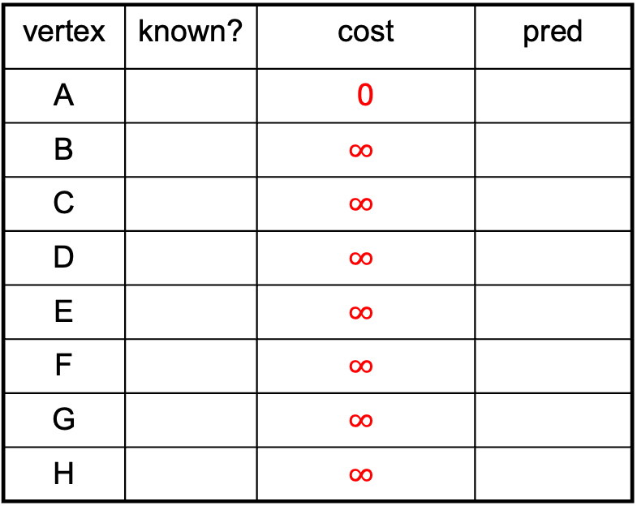
Dijkstra's: Example
0
◎
◎
◎
2
2
A
B
F
3
H
1
vertex | known? | cost | pred
A |  | 0
B |  | $$∞$$
C |  | $$∞$$
D |  | $$∞$$
E |  | $$∞$$
F |  | $$∞$$
G |  | $$∞$$
H |  | $$∞$$
5
10
2
1
4
9
3
◎
◎
G
2
C
D
11
1
◎
E
7
◎
Order Added to known Set:

Slide 12
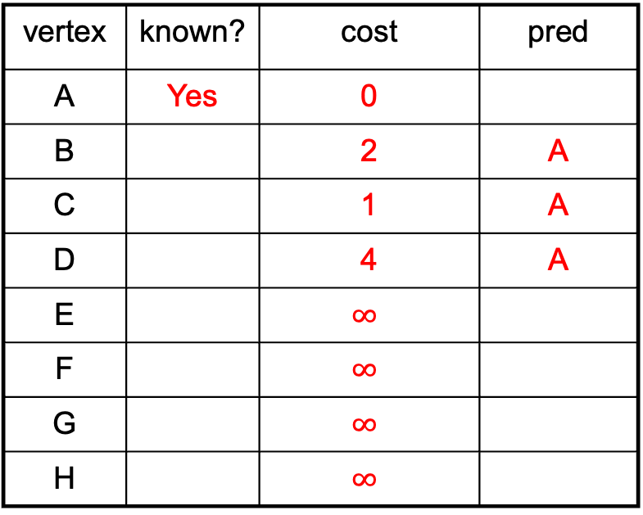
Dijkstra's: Example
0
2
◎
◎
2
2
A
B
F
3
H
1
vertex | known? | cost | pred
A | Yes | 0
B |  | 2 | A
C |  | 1 | A
D |  | 4 | A
E |  | $$∞$$
F |  | $$∞$$
G |  | $$∞$$
H |  | $$∞$$
5
10
2
1
4
9
3
◎
1
G
2
C
D
11
1
4
E
7
◎
Order Added to known Set:
A

Slide 13
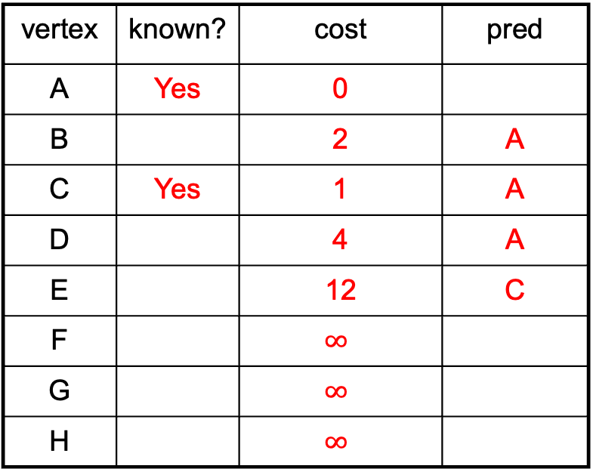
Dijkstra's: Example
0
2
◎
◎
2
2
A
B
F
3
H
1
vertex | known? | cost | pred
A | Yes | 0
B |  | 2 | A
C | Yes | 1 | A
D |  | 4 | A
E |  | 12 | C
F |  | $$∞$$
G |  | $$∞$$
H |  | $$∞$$
5
10
2
1
4
9
3
◎
1
G
2
C
D
11
1
4
E
7
12
Order Added to known Set:
A C

Slide 14
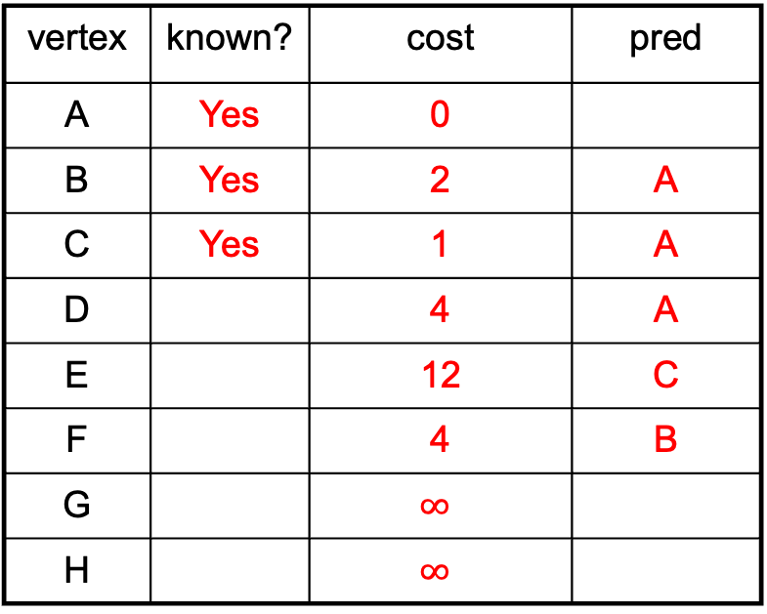
Dijkstra's: Example
0
2
4
◎
2
2
A
B
F
3
H
1
vertex | known? | cost | pred
A | Yes | 0
B | Yes | 2 | A
C | Yes | 1 | A
D |  | 4 | A
E |  | 12 | C
F |  | 4 | B
G |  | $$∞$$
H |  | $$∞$$
5
10
2
1
4
9
3
◎
1
G
2
C
D
11
1
4
E
7
12
Order Added to known Set:
A C B

Slide 15
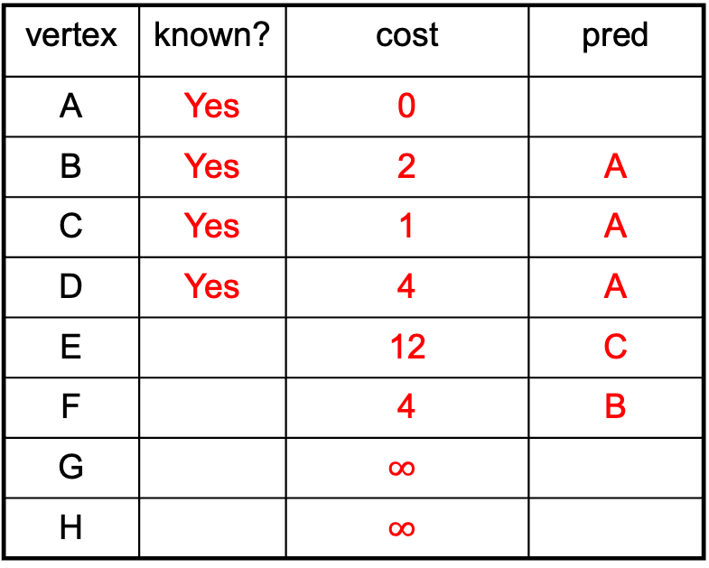
Dijkstra's: Example
0
2
4
◎
2
2
A
B
F
3
H
1
vertex | known? | cost | pred
A | Yes | 0
B | Yes | 2 | A
C | Yes | 1 | A
D | Yes | 4 | A
E |  | 12 | C
F |  | 4 | B
G |  | $$∞$$
H |  | $$∞$$
5
10
2
1
4
9
3
◎
1
G
2
C
D
11
1
4
E
7
12
Order Added to known Set:
A C B D

Slide 16
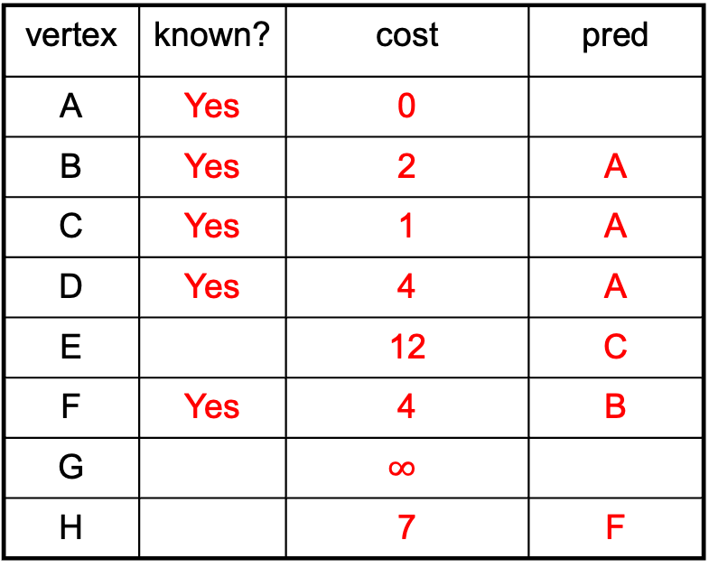
Dijkstra's: Example
0
2
4
7
2
2
A
B
F
3
H
1
vertex | known? | cost | pred
A | Yes | 0
B | Yes | 2 | A
C | Yes | 1 | A
D | Yes | 4 | A
E |  | 12 | C
F | Yes | 4 | B
G |  | $$∞$$
H |  | 7 | F
5
10
2
1
4
9
3
◎
1
G
2
C
D
11
1
4
E
7
12
Order Added to known Set:
A C B D F

Slide 17
Dijkstra's: Example
0
2
4
7
2
2
A
B
F
3
H
1
vertex | known? | cost | pred
A | Yes | 0
B | Yes | 2 | A
C | Yes | 1 | A
D | Yes | 4 | A
E |  | 12 | C
F | Yes | 4 | B
G |  | 8 | H
H | Yes | 7 | F
5
10
2
1
4
9
3
8
1
G
2
C
D
11
1
4
E
7
12
Order Added to known Set:
A C B D F H

Slide 18
Dijkstra's: Example
0
2
4
7
2
2
A
B
F
3
H
1
vertex | known? | cost | pred
A | Yes | 0
B | Yes | 2 | A
C | Yes | 1 | A
D | Yes | 4 | A
E |  | 12 11 | C G
F | Yes | 4 | B
G | Yes | 8 | H
H | Yes | 7 | F
5
10
2
1
4
9
3
8
1
G
2
C
D
11
1
4
E
7
12
Order Added to known Set:
A C B D F H G

Slide 19
Dijkstra's: Example
0
2
4
7
2
2
A
B
F
3
H
1
vertex | known? | cost | pred
A | Yes | 0
B | Yes | 2 | A
C | Yes | 1 | A
D | Yes | 4 | A
E | Yes | 12 11 | C G
F | Yes | 4 | B
G | Yes | 8 | H
H | Yes | 7 | F
5
10
2
1
4
9
3
8
1
G
2
C
D
11
1
4
E
7
11
Order Added to known Set:
A C B D F H G E

Slide 20
Dijkstra's: A Greedy Algorithm
Dijkstra’s algorithm
  For single-source shortest paths in a weighted graph (directed or undirected) with no negative-weight edges
An example of a greedy algorithm:
  At each step, irrevocably does what seems best at that step
    A locally optimal step, not necessarily globally optimal
  Once a vertex is known, it is not revisited
    Turns out to be globally optimal

Slide 21
Dijkstra's: Correctness
v
Next shortest path from
inside the known cloud
Better path to v? No!
The known Cloud
w
Greedy Approach
  Prioritizes nodes closer to the starting point
Optimality of Selected Nodes
  When Dijkstra’s marks a node as known, it has seen all possible paths to that node based on the visited nodes. Since it picks the smallest current cost, it is optimal.
Convergence
  Dijkstra's explores every nodes, so it never accidently picks e.g., the 2nd best path
Source

Slide 22




Dijkstra's: Unoptimal Efficiency
Dijkstras(Graph G, Node src):
src.cost = 0 // all other costs implicitly “infinity”
mark src as visited
while (there are unknown nodes in G)
v = unknown, visited node with lowest cost
mark v as known
for each edge (v, u) with weight w in G:
potentialBest = v.cost + w // cost of potential best path
to u (through v)
if (u is not visited):
u.cost = potentialBest
u.pred = v
mark u as visited
else if (potentialBest < u.cost):
u.cost = potentialBest
u.pred = v
$$\text{𝒪}\left(1\right)$$
$$\text{𝒪}\left({\left|V\right|}^{2}\right)$$
$$\text{𝒪}\left(\left|E\right|\right)$$
$$\text{𝒪}\left({\left|V\right|}^{2}+\left|E\right|\right)$$

Slide 23

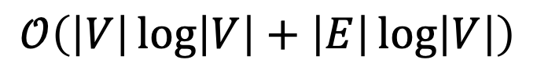


Dijkstra’s: Optimal Efficiency
Dijkstras(Graph G, Node src):
src.cost = 0 // all other costs implicitly “infinity”
mark src as visited
heap = {src}
while (heap is not empty)
v = heap.deleteMin()
mark v as known
for each edge (v, u) with weight w in G:
potentialBest = v.cost + w // cost of potential best path
to u (through v)
if (u is not visited):
u.cost = potentialBest
u.pred = v
mark u as visited
heap.insert(u)
else if (potentialBest < u.cost):
u.cost = potentialBest
u.pred = v
heap.changePriority(u, potentialBest)
$$\text{𝒪}\left(1\right)$$
$$\text{𝒪}\left(\left|V\right| log(|V|)\right)$$
$$\text{𝒪}\left(\left|E\right|log(|V|)\right)$$
$$\text{𝒪}\left(\left|V\right|\log\left|V\right|+\left|E\right|\log\left|V\right|\right)$$

Slide 24
Heap: Other operations
decreaseKey(idx, $Δ$) or increaseKey(idx, $Δ$)
  arr[idx] -= $Δ$ or arr[idx] += $Δ$
  percolateUp() or percolateDown()
  Worst Case $Θ\left(\log{n}\right)$
delete(idx)
  decreaseKey(idx, $∞$)
  deleteMin()
  Worst Case $Θ\left(\log{n}\right)$

Slide 25
Heap: Note on decrease/increaseKey
MORE COMMONLY CALLED changePriority(key, prio)
  Uses a map to go from key -> idx
  arr[idx] = prio
  percolateUp() or percolateDown()
  (Same as decrease/increaseKey)

Slide 26
Any Questions?

