Slide 1
Lecture 14:
Introduction to Graphs
CSE 332: Data Structures & Parallelism
Yafqa Khan
Summer 2025

Slide 2
Announcements
EX05 due today
EX06 due Friday
Don’t talk about Exam 1!
  Still makeups to proctor
Exam 2 information posted on website

Slide 3
Today
Graphs
  Introduction
  Terminologies
Graph Data Structures
  Adjacency Matrix
  Adjacency List

Slide 4
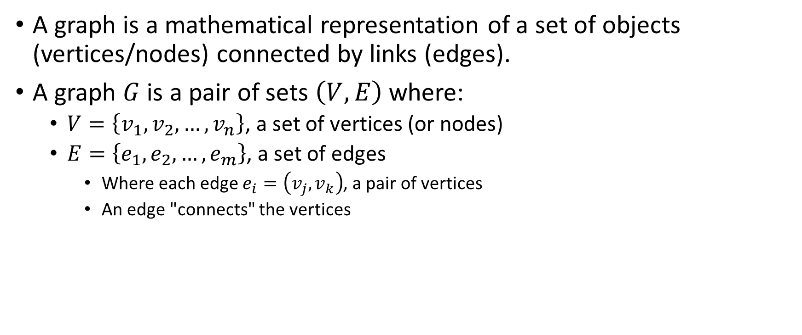
Graphs: Basic Mathematical
A graph is a mathematical representation of a set of objects (vertices/nodes) connected by links (edges).
A graph $G$ is a pair of sets $\left(V,E\right)$ where:
  $V=\left\{v_{1},v_{2},…,v_{n}\right\}$, a set of vertices (or nodes)
  $E=\left\{e_{1},e_{2},…,e_{m}\right\}$, a set of edges
    Where each edge $e_{i}=\left(v_{j},v_{k}\right)$, a pair of vertices
    An edge "connects" the vertices
Han
Luke
Leia
V = {Han,Leia,Luke}
E = {(Luke,Leia),
(Han,Leia),
(Leia,Han)}

Slide 5
Graphs: Basic Intuition
A bunch of circles and arrows
Han
Luke
Leia
V = {Han,Leia,Luke}
E = {(Luke,Leia),
(Han,Leia),
(Leia,Han)}

Slide 6
Graphs: Terminology Vomit (Memorize!)
Vertex (or Nodes)
Edges
Directed vs Undirected
Weighted vs Unweighted
Degree (of a Vertex)
  In-Degree
  Out-Degree
Walk vs Path (or Simple Path) vs Cycles
  Cyclic vs Acyclic
Connected vs Disconnected
Sparse vs Dense
and many more...

Slide 7
Graphs: Yet Another Internet Warning
There are millions of different terminologies, algorithms, etc. with graphs. Use lecture slides.

Slide 8
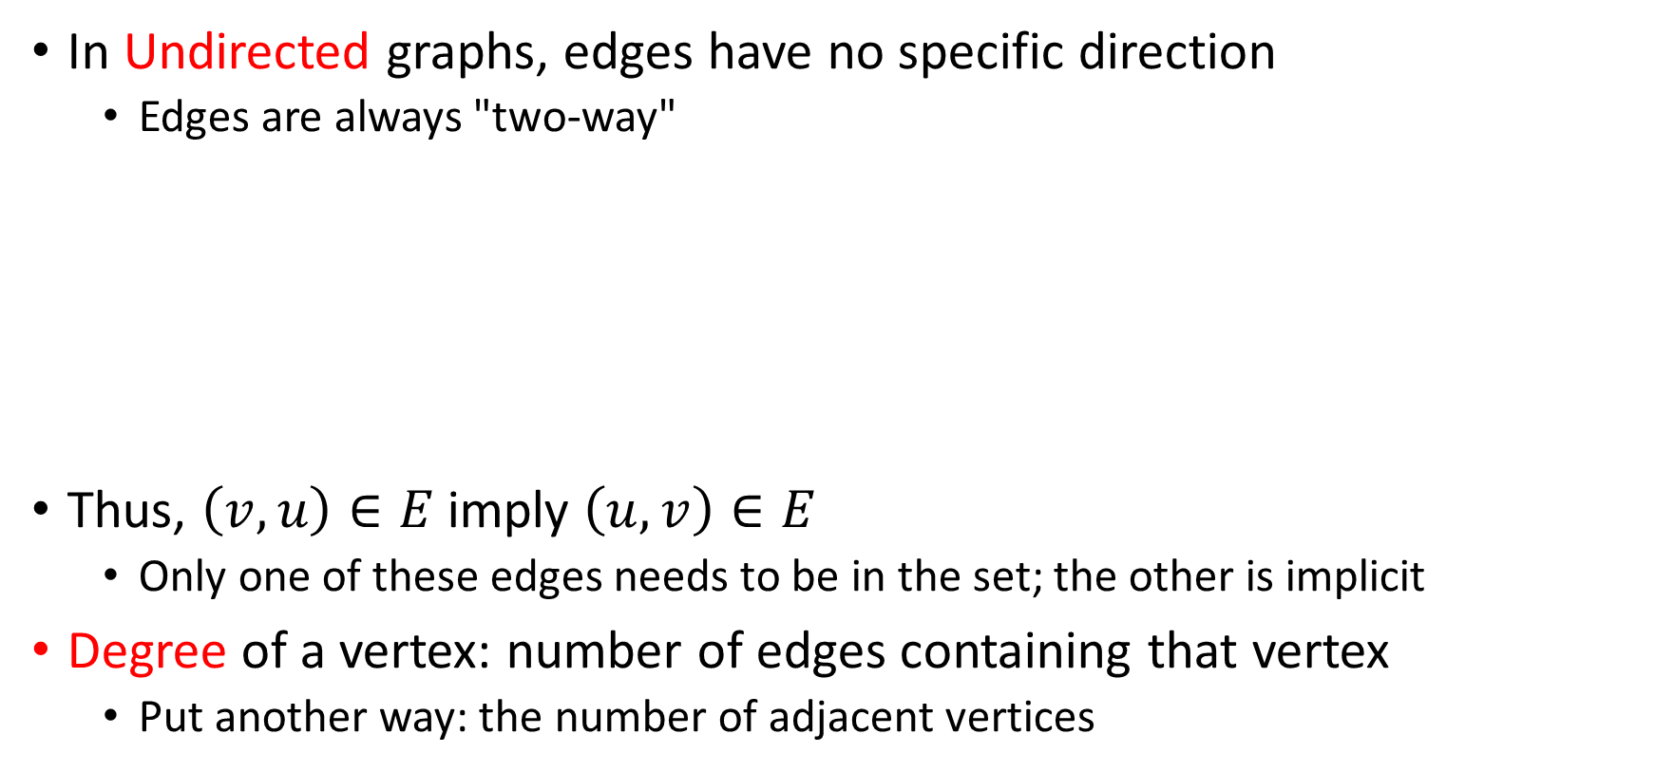
Graphs: Undirected Graphs
In Undirected graphs, edges have no specific direction
  Edges are always "two-way"
Thus, $\left(v,u\right)∈E$ imply $\left(u,v\right)∈E$
  Only one of these edges needs to be in the set; the other is implicit
Degree of a vertex: number of edges containing that vertex
  Put another way: the number of adjacent vertices
D
A
C
B

Slide 9
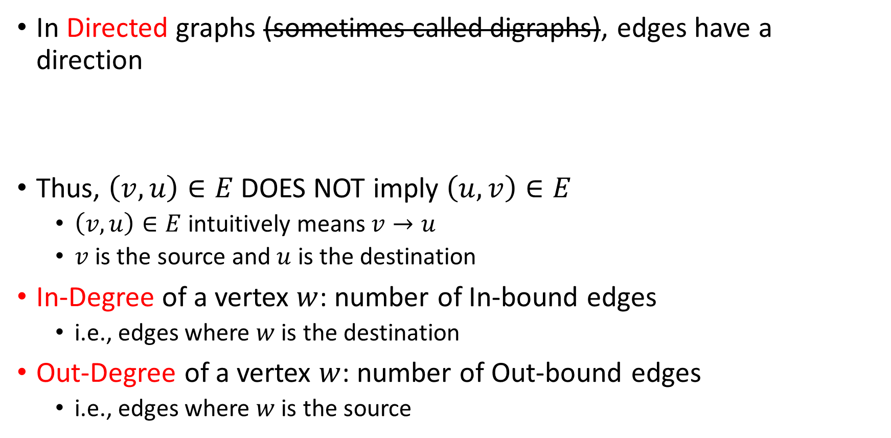
Graphs: Directed Graphs
In Directed graphs (sometimes called digraphs), edges have a direction
Thus, $\left(v,u\right)∈E$ DOES NOT imply $\left(u,v\right)∈E$
  $\left(v,u\right)∈E$ intuitively means $v→u$
  $v$ is the source and $u$ is the destination
In-Degree of a vertex $w$: number of In-bound edges
  i.e., edges where $w$ is the destination
Out-Degree of a vertex $w$: number of Out-bound edges
  i.e., edges where $w$ is the source
D
D
A
or
C
A
C
B
2 edges here
B

Slide 10

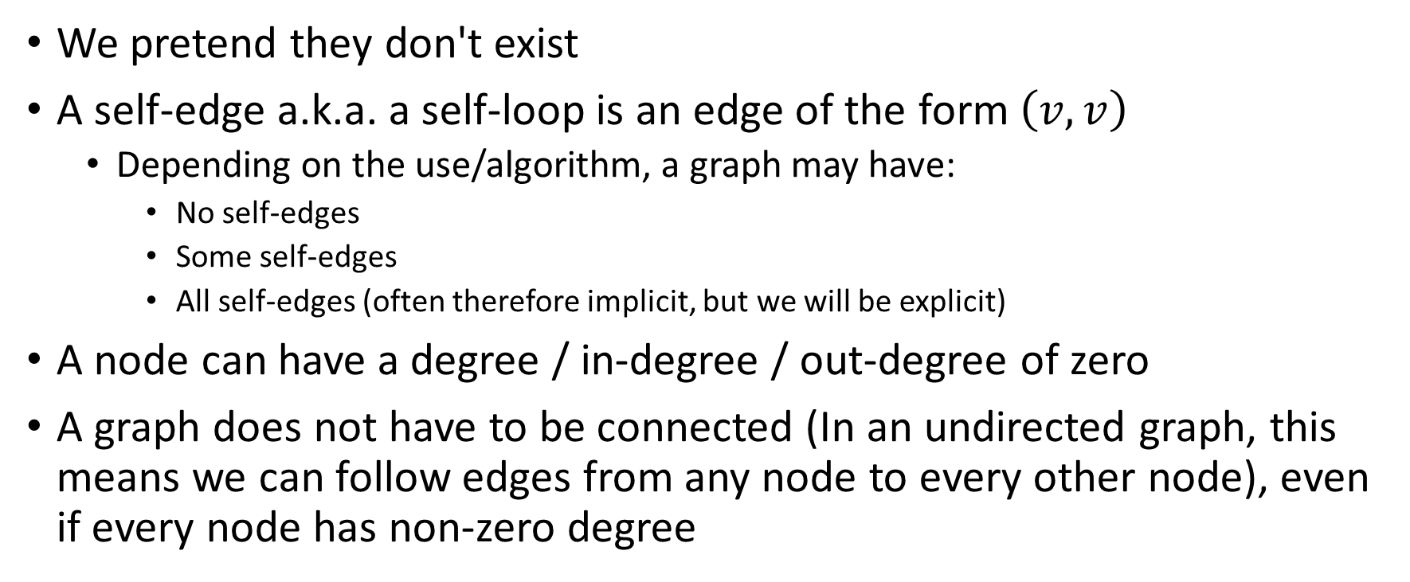
Graphs: Self-Edges
We pretend they don't exist
A self-edge a.k.a. a self-loop is an edge of the form $\left(v,v\right)$
  Depending on the use/algorithm, a graph may have:
    No self-edges
    Some self-edges
    All self-edges (often therefore implicit, but we will be explicit)
A node can have a degree / in-degree / out-degree of zero
A graph does not have to be connected (In an undirected graph, this means we can follow edges from any node to every other node), even if every node has non-zero degree
0.9
$$v$$

Slide 11
Graphs: Weighted Graphs
In a weighted graph, each edge has a weight (or cost)
  Typically, a number (int)
  Negative weights are possible (but rare)
So far, possible graph types:
Undirected Unweighted graphs
Undirected Weighted graphs
Directed Unweighted graphs
Directed Weighted graphs
Clinton
20
Mukilteo
Kingston
30
Edmonds
Bainbridge
35
Seattle
60
Bremerton

Slide 12
Any Questions?

Slide 13
Graphs: (Walks) vs Paths vs Cycles
1
2
1
A
B
C
D
Walk: Sequence of adjacent vertices
  e.g., ABA, ABCD, ABC, etc.
Path (or Simple Path): A walk that doesn't repeat a vertex
  e.g., ABCD, ABC, AB
  NOT ABA
Cycle: A walk that doesn't repeat a vertex except the first and last vertex
  e.g., ABCDA
  NOT ABCD
____ Length: Number of edges in ____
____ Cost: Sum of weights of each edge in ____
3
1

Slide 14
Graphs: Paths vs Cycles Example
Is there a path from A to D?
Does the graph contain any cycles?
What if undirected?
D
A
C
B

Slide 15
Graphs: Paths vs Cycles Example (Soln.)
Is there a path from A to D?
No
Does the graph contain any cycles? No
What if undirected?
Yes, Yes
D
A
C
B

Slide 16
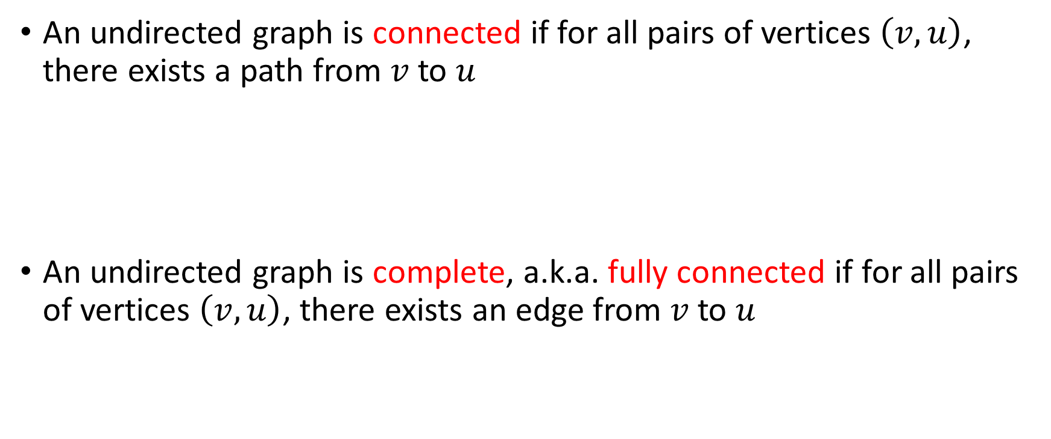
Graphs: Undirected Graph Connectivity
An undirected graph is connected if for all pairs of vertices $\left(v,u\right)$, there exists a path from $v$ to $u$
An undirected graph is complete, a.k.a. fully connected if for all pairs of vertices $\left(v,u\right)$, there exists an edge from $v$ to $u$
Connected graph
Disconnected graph
(plus self-edges)

Slide 17
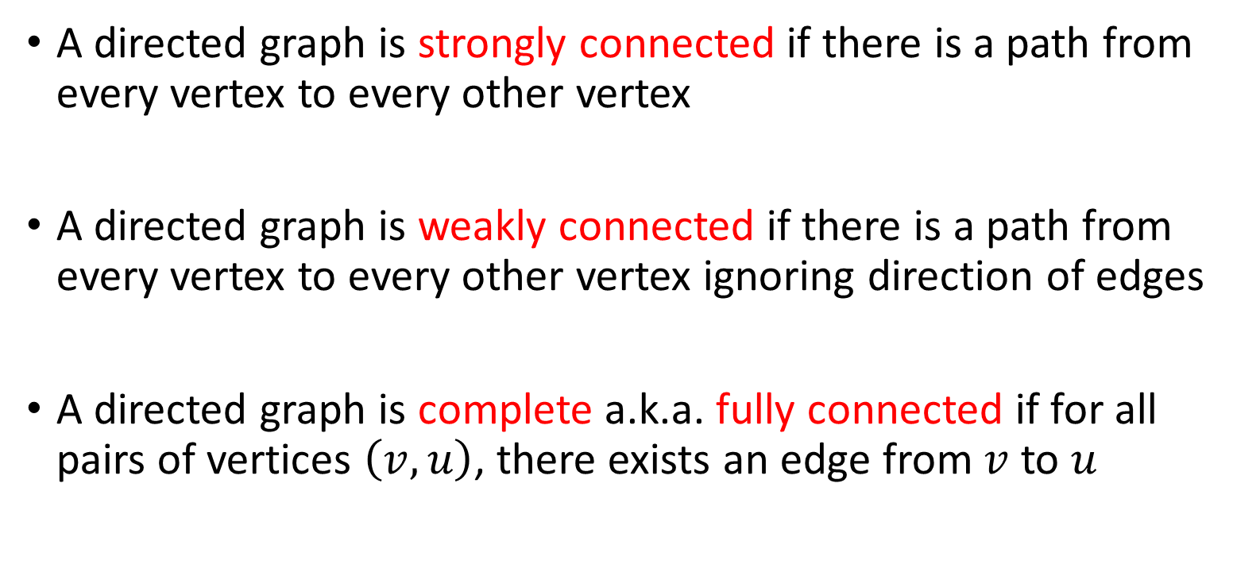
Graphs: Directed Graph Connectivity
A directed graph is strongly connected if there is a path from every vertex to every other vertex
A directed graph is weakly connected if there is a path from every vertex to every other vertex ignoring direction of edges
A directed graph is complete a.k.a. fully connected if for all pairs of vertices $\left(v,u\right)$, there exists an edge from $v$ to $u$
(plus self-edges)

Slide 18
Graphs: Practical Examples
For undirected graphs: connected?
For directed graphs: strongly connected? weakly connected?
weighted?
Web pages with links
Facebook friends
Methods in a program that call each other
Road maps (e.g., Google maps)
Airline routes
Course pre-requisites
…

Slide 19
Graphs: Trees
D
E
When talking about graphs, we say a tree is a graph that is:
  undirected
  acyclic
  connected
So all trees are graphs, but not all graphs are trees
How does this relate to the trees we know and love?...
B
A
C
F
G
H

Slide 20
Graphs: Rooted Trees
We are more accustomed to rooted trees where:
  We identify a unique (“special”) root
  We think of edges as directed: parent to children
Given a tree, once you pick a root, you have a unique rooted tree (just drawn differently and with undirected edges)
D
E
D
E
F
B
A
B
redrawn
G
H
C
A
B
C
A
redrawn
A
C
C
D
E
F
B
F
F
G
H
D
E
G
H
G
H

Slide 21
Graphs: Directed Acyclic Graphs (DAGs)
A DAG is a directed graph with no cycles (Acyclic)
  Every rooted directed tree is a DAG
    But not every DAG is a rooted directed tree:
Every DAG is a directed graph
  But not every directed graph is a DAG:
Not a rooted directed tree,
Has a cycle (in the undirected sense)

Slide 22
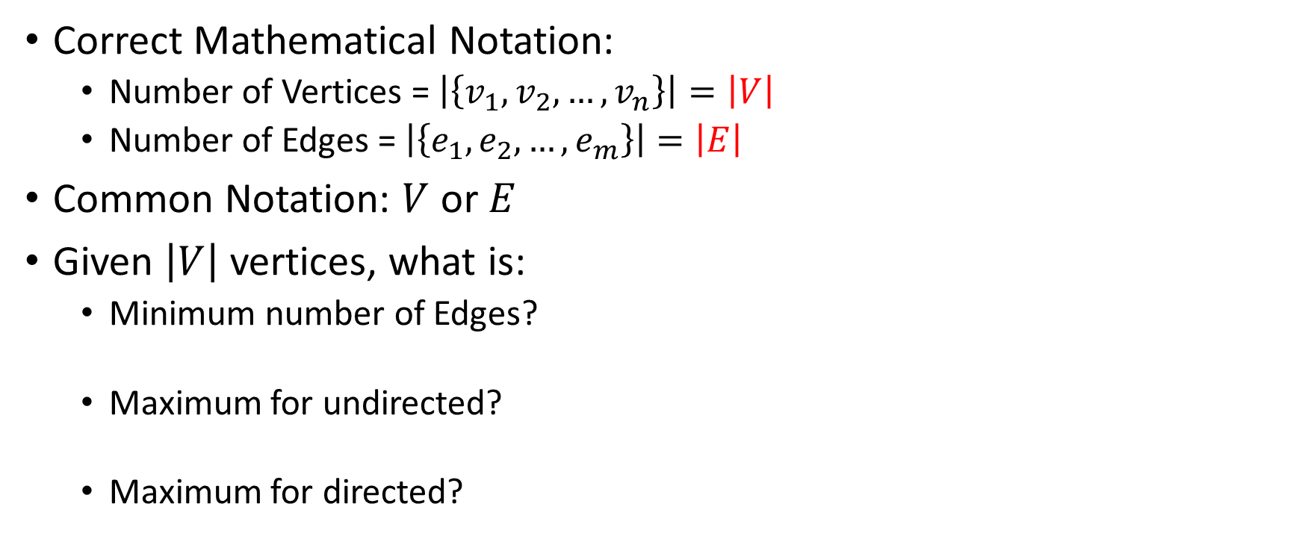
Graphs: Number of Vertices vs Edges (Math)
Correct Mathematical Notation:
  Number of Vertices = $\left|\left\{v_{1},v_{2},…,v_{n}\right\}\right|=\left|V\right|$
  Number of Edges = $\left|\left\{e_{1},e_{2},…,e_{m}\right\}\right|=\left|E\right|$
Common Notation: $V$ or $E$
Given $\left|V\right|$ vertices, what is:
  Minimum number of Edges?
  Maximum for undirected?
  Maximum for directed?

Slide 23
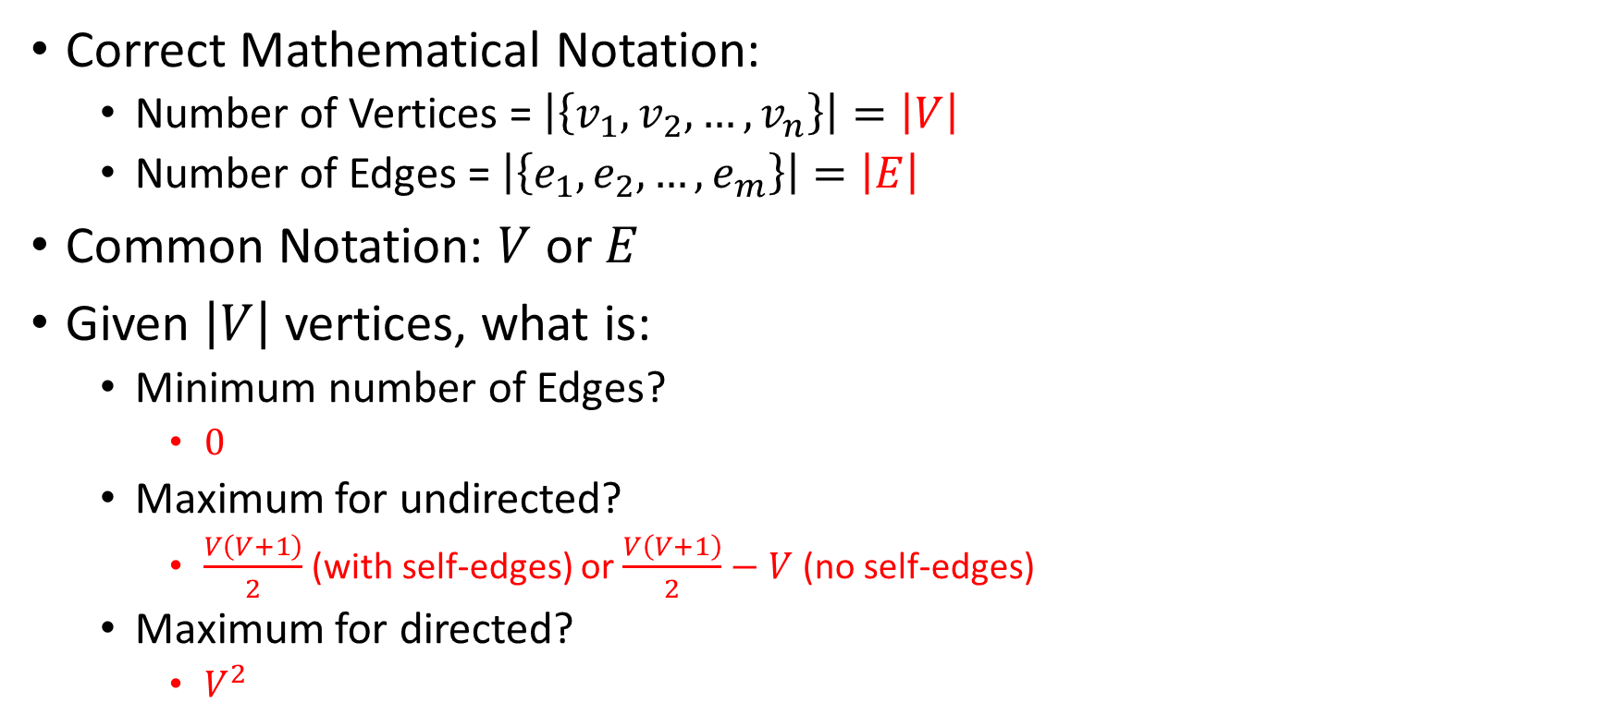
Graphs: Number of Vertices vs Edges (Math)
Correct Mathematical Notation:
  Number of Vertices = $\left|\left\{v_{1},v_{2},…,v_{n}\right\}\right|=\left|V\right|$
  Number of Edges = $\left|\left\{e_{1},e_{2},…,e_{m}\right\}\right|=\left|E\right|$
Common Notation: $V$ or $E$
Given $\left|V\right|$ vertices, what is:
  Minimum number of Edges?
    $0$
  Maximum for undirected?
    $\frac{V\left(V+1\right)}{2}$ (with self-edges) or $\frac{V\left(V+1\right)}{2}−V$ (no self-edges)
  Maximum for directed?
    $V^{2}$

Slide 24
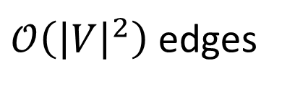
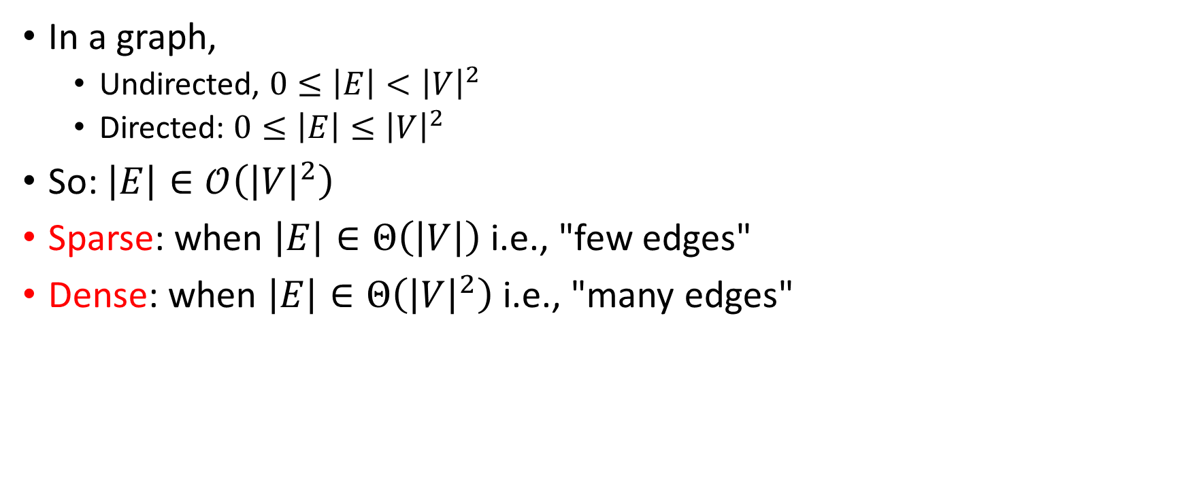
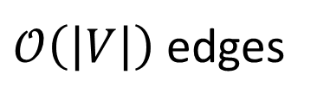
Graphs: Sparse vs Dense Graphs
In a graph,
  Undirected, $0≤\left|E\right|<{\left|V\right|}^{2}$
  Directed: $0≤\left|E\right|≤{\left|V\right|}^{2}$
So: $\left|E\right|∈\text{𝒪}\left({\left|V\right|}^{2}\right)$
Sparse: when $\left|E\right|∈Θ\left(\left|V\right|\right)$ i.e., "few edges"
Dense: when $\left|E\right|∈Θ\left({\left|V\right|}^{2}\right)$ i.e., "many edges"
Sparse
Dense
0 edges
$\text{𝒪}\left(\left|V\right|\right)$ edges
$\text{𝒪}\left({\left|V\right|}^{2}\right)$ edges

Slide 25
Any Questions?

Slide 26

Graphs: The Data Structure
Many data structures, tradeoffs
Exploits graph properties
Common operations:
  "Is $\left(v,u\right)$ an edge?"
  "What are the neighbors of $v$?"
Two standards:
  Adjacency Matrix
  Adjacency List

Slide 27

Graphs: Adjacency Matrix
Assign each node a number from $0$ to $\left|V\right|−1$
A $\left|V\right|$ by $\left|V\right|$ matrix M (2-D array) of Booleans
M[v][u]==true means there is an edge from v to u
 | To
From |  | A | B | C | D
 | A | F | T | F | F
 | B | T | F | F | F
 | C | F | T | F | T
 | D | F | F | F | F
D
A
C
B

Slide 28
Any Questions?

Slide 29
Adjacency Matrix: Properties
 | To
From |  | A | B | C | D
 | A | F | T | F | F
 | B | T | F | F | F
 | C | F | T | F | T
 | D | F | F | F | F
Running time to:
  Get a vertex’s out-bound edges:
  Get a vertex’s in-bound edges:
  Decide if some edge exists:
  Insert an edge:
  Delete an edge:
Space requirements:
Better for Sparse or Dense Graphs?
D
A
C
B

Slide 30
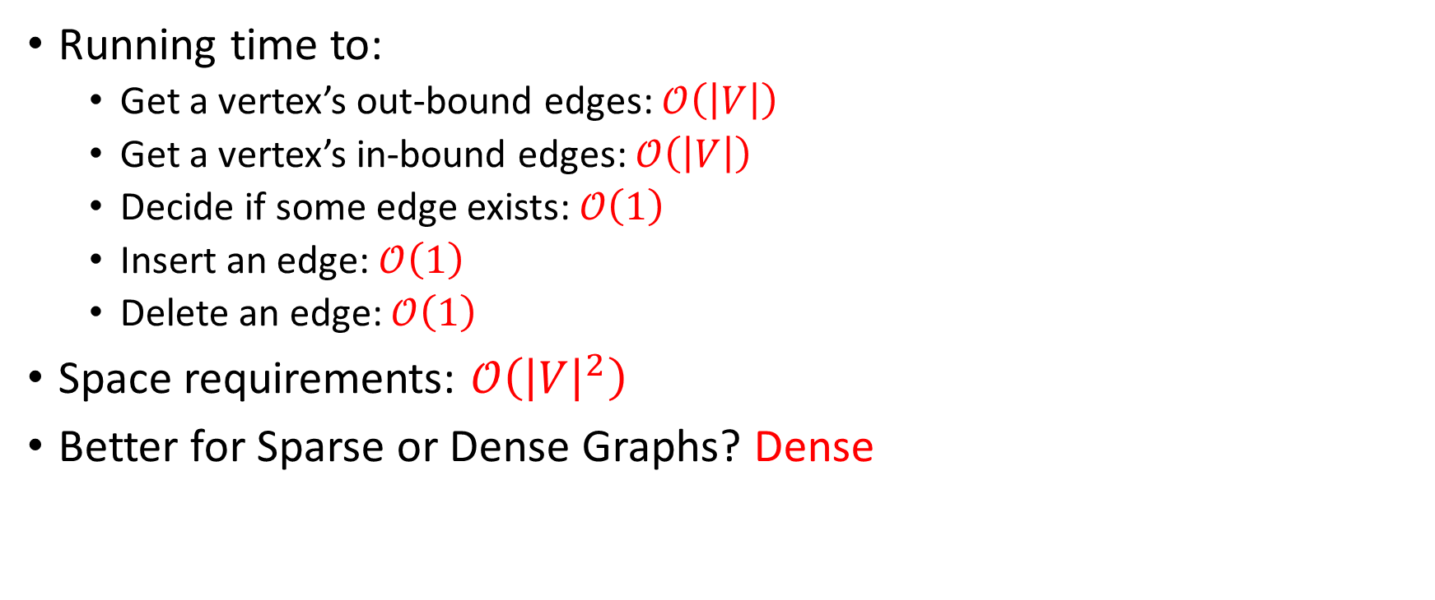
Adjacency Matrix: Properties (Soln.)
 | To
From |  | A | B | C | D
 | A | F | T | F | F
 | B | T | F | F | F
 | C | F | T | F | T
 | D | F | F | F | F
Running time to:
  Get a vertex’s out-bound edges: $\text{𝒪}\left(\left|V\right|\right)$
  Get a vertex’s in-bound edges: $\text{𝒪}\left(\left|V\right|\right)$
  Decide if some edge exists: $\text{𝒪}\left(1\right)$
  Insert an edge: $\text{𝒪}\left(1\right)$
  Delete an edge: $\text{𝒪}\left(1\right)$
Space requirements: $\text{𝒪}\left({\left|V\right|}^{2}\right)$
Better for Sparse or Dense Graphs? Dense
D
A
C
B

Slide 31
Adjacency Matrix: Adaptability
How does it work for undirected graph?
How does it work for weighted graph?

Slide 32
Adjacency Matrix: Adaptability (Soln.)
How does it work for undirected graph?
  Symmetric in diagonal axis (e.g., M[v][u]==true , then M[u][v]==true)
How does it work for weighted graph?
  Instead of boolean, use integer
  "not an edge" can be 0, -1, infinite, etc.

Slide 33

Graphs: Adjacency List
Assign each node a number from $0$ to $\left|V\right|−1$
An array arr of length $\left|V\right|$ where arr[i] stores a (linked) list of all adjacent vertices
D
A
B
/
A
C
B
A
/
B
C
D
B
/
D
/

Slide 34
Any Questions?

Slide 35
Adjacency List: Properties
A
B
/
B
A
/
Running time to:
  Get a vertex’s out-bound edges:
  Get a vertex’s in-bound edges:
  Decide if some edge exists:
  Insert an edge:
  Delete an edge:
Space requirements:
Better for Sparse or Dense Graphs?
C
D
B
/
D
/
D
A
C
B

Slide 36
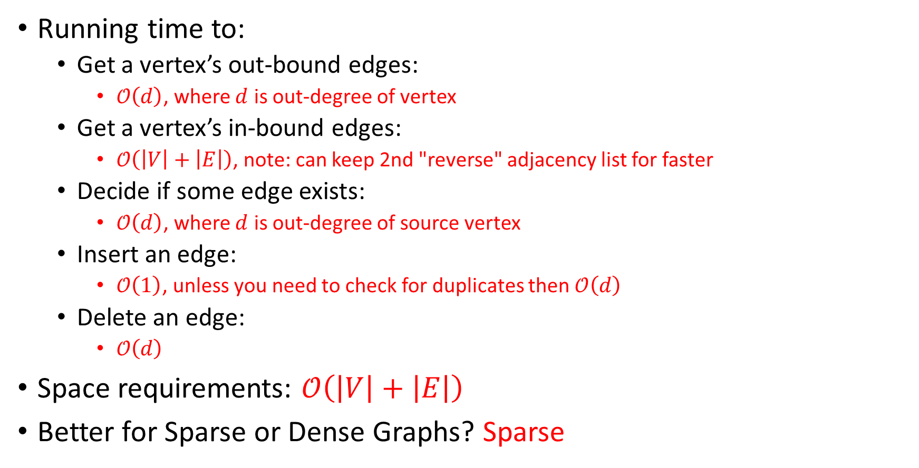
Adjacency List: Properties (Soln.)
A
B
/
B
A
/
Running time to:
  Get a vertex’s out-bound edges:
    $\text{𝒪}\left(d\right)$, where $d$ is out-degree of vertex
  Get a vertex’s in-bound edges:
    $\text{𝒪}\left(\left|V\right|+\left|E\right|\right)$, note: can keep 2nd "reverse" adjacency list for faster
  Decide if some edge exists:
    $\text{𝒪}\left(d\right)$, where $d$ is out-degree of source vertex
  Insert an edge:
    $\text{𝒪}\left(1\right)$, unless you need to check for duplicates then $\text{𝒪}\left(d\right)$
  Delete an edge:
    $\text{𝒪}\left(d\right)$
Space requirements: $\text{𝒪}\left(\left|V\right|+\left|E\right|\right)$
Better for Sparse or Dense Graphs? Sparse
C
D
B
/
D
/
D
A
C
B

Slide 37
Any Questions?

Slide 38
Matrix vs List, which is better?
Graphs are often sparse:
  Streets form grids
    every corner is not connected to every other corner
  Airlines rarely fly to all possible cities
    or if they do it is to/from a hub rather than directly to/from all small cities to other small cities
Adjacency lists should generally be your default choice
  Slower performance compensated by greater space savings

