Slide 1
Lecture 12:
Non-Comparison Sorting
CSE 332: Data Structures & Parallelism
Yafqa Khan
Summer 2025

Slide 2
Announcements
EX04: AVL
  Due Today
EX05: Hashing
  Due next Monday
Exam 1: This Friday!

Slide 3
Today
Special Sorting Algorithm 1: Bucket Sort
Special Sorting Algorithm 2: Radix Sort
Sorting Summary

Slide 4
Special Sorting Algorithm 1: Bucket Sort
Also called Bin Sort
Intuition: Small range of integers, get a tally
Algorithm:
  Find the min and max value
  Make an aux array to represent the range between min and max
  Go through the original array and start tallying each number
  Copy the aux into the original array

Slide 5
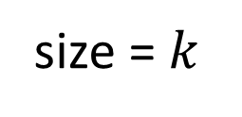
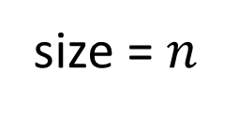
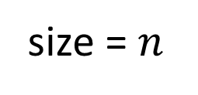
Bucket Sort: Visualization
size = $n$
4 | 3 | 1 | 2 | 1 | 1 | 2 | 3 | 4 | 2
min = 1
max = 4
1 | 2 | 3 | 4
size = $k$
size = $n$
1 | 1 | 1 | 2 | 2 | 2 | 3 | 3 | 4 | 4

Slide 6
Any Questions?

Slide 7

Bucket Sort: Analysis
Stable?
  Yes!
In-Place?
  No
Fast?
  Yes! (in terms of asymptotics)
    Let $k=$ range between min and max value
    Worst Case: $\text{𝒪}\left(n+k\right)$
      Note: $k$ can be bigger than $n$
  Good constant factors!

Slide 8
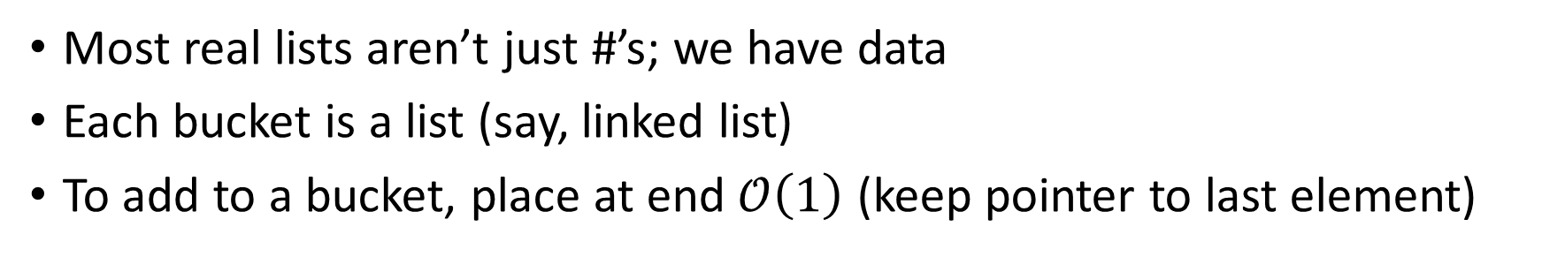
Bucket Sort: Non Integers
Most real lists aren’t just #’s; we have data
Each bucket is a list (say, linked list)
To add to a bucket, place at end $\text{𝒪}\left(1\right)$ (keep pointer to last element)
count array
1
2
3
4
5
Example: Movie ratings:
1=bad,… 5=excellent
Input=
  5: Casablanca
  3: Harry Potter movies
  1: The Bee Movie
  5: Star Wars
The Bee Movie
Harry Potter
Casablanca
Star Wars
Result: 1: Rocky V, 3: Harry Potter, 5: Casablanca, 5: Star Wars
This result is stable; Casablanca still before Star Wars

Slide 9
Today
Special Sorting Algorithm 1: Bucket Sort
Special Sorting Algorithm 2: Radix Sort
Sorting Summary

Slide 10
Special Sorting Algorithm 2: Radix Sort
Intuition: Exploit integer digits
Algorithm:
  For each digit,
  Start from the Least Significant Digit (LSD) to Most Significant Digit (MSD)
    Run bucket sort on just that digit (e.g., just the 1s place)

Slide 11
Radix Sort: Visualization (1s Place)
012 | 234 | 789 | 555 | 678 | 200 | 777 | 562
0 | 1 | 2 | 3 | 4 | 5 | 6 | 7 | 8 | 9

Slide 12
Radix Sort: Visualization (1s Place)
012 | 234 | 789 | 555 | 678 | 200 | 777 | 562
0 | 1 | 2 | 3 | 4 | 5 | 6 | 7 | 8 | 9
200
012
234
555
777
678
789
562
200 | 012 | 562 | 234 | 555 | 777 | 678 | 789

Slide 13
Radix Sort: Visualization (10s Place)
200 | 012 | 562 | 234 | 555 | 777 | 678 | 789
0 | 1 | 2 | 3 | 4 | 5 | 6 | 7 | 8 | 9

Slide 14
Radix Sort: Visualization (10s Place)
200 | 012 | 562 | 234 | 555 | 777 | 678 | 789
0 | 1 | 2 | 3 | 4 | 5 | 6 | 7 | 8 | 9
200
012
234
555
562
777
789
678
200 | 012 | 234 | 555 | 562 | 777 | 678 | 789

Slide 15
Radix Sort: Visualization (100s Place)
200 | 012 | 234 | 555 | 562 | 777 | 678 | 789
0 | 1 | 2 | 3 | 4 | 5 | 6 | 7 | 8 | 9

Slide 16
Radix Sort: Visualization (100s Place)
200 | 012 | 234 | 555 | 562 | 777 | 678 | 789
0 | 1 | 2 | 3 | 4 | 5 | 6 | 7 | 8 | 9
012
200
555
678
777
234
562
789
012 | 200 | 234 | 555 | 562 | 678 | 777 | 789

Slide 17
Any Questions?

Slide 18
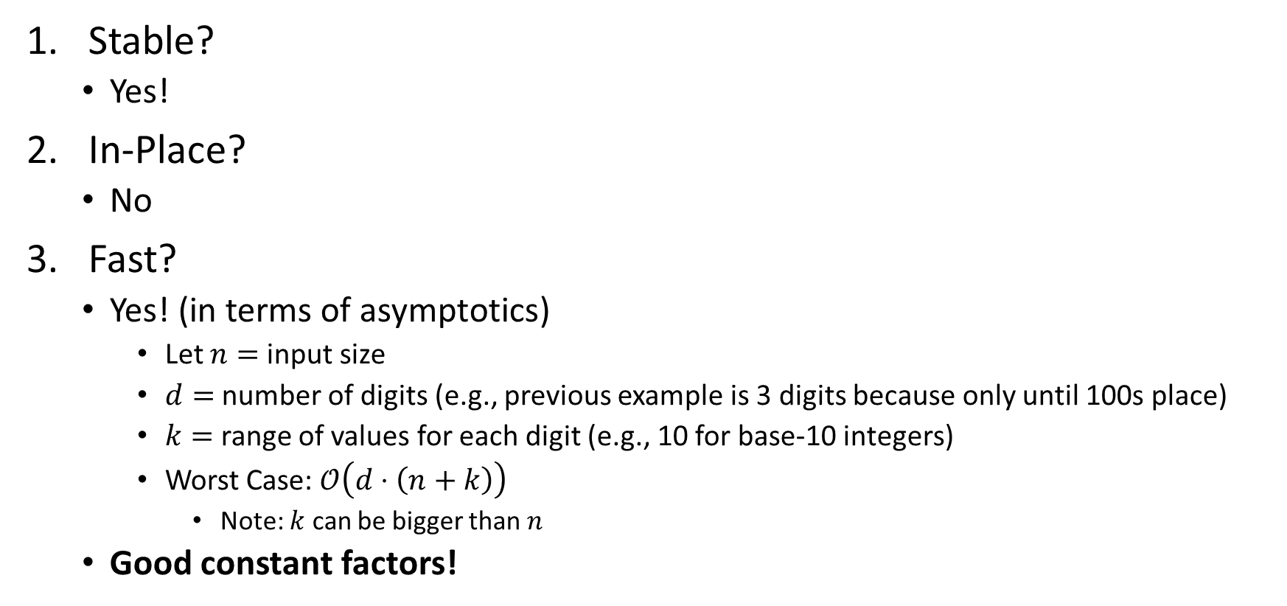
Radix Sort: Analysis
Stable?
  Yes!
In-Place?
  No
Fast?
  Yes! (in terms of asymptotics)
    Let $n=$ input size
    $d=$ number of digits (e.g., previous example is 3 digits because only until 100s place)
    $k=$ range of values for each digit (e.g., 10 for base-10 integers)
    Worst Case: $\text{𝒪}\left(d⋅\left(n+k\right)\right)$
      Note: $k$ can be bigger than $n$
  Good constant factors!

Slide 19
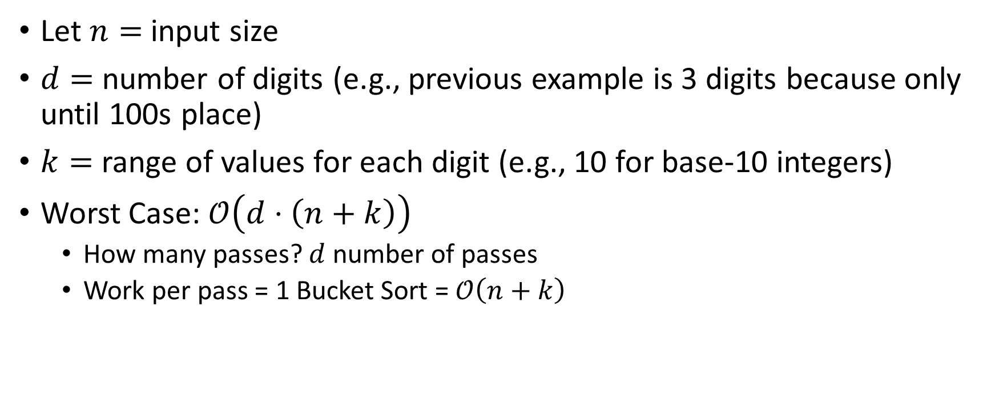
Radix Sort: Runtime
Let $n=$ input size
$d=$ number of digits (e.g., previous example is 3 digits because only until 100s place)
$k=$ range of values for each digit (e.g., 10 for base-10 integers)
Worst Case: $\text{𝒪}\left(d⋅\left(n+k\right)\right)$
  How many passes? $d$ number of passes
  Work per pass = 1 Bucket Sort = $\text{𝒪}\left(n+k\right)$

Slide 20
Today
Special Sorting Algorithm 1: Bucket Sort
Special Sorting Algorithm 2: Radix Sort
Sorting Summary

Slide 21
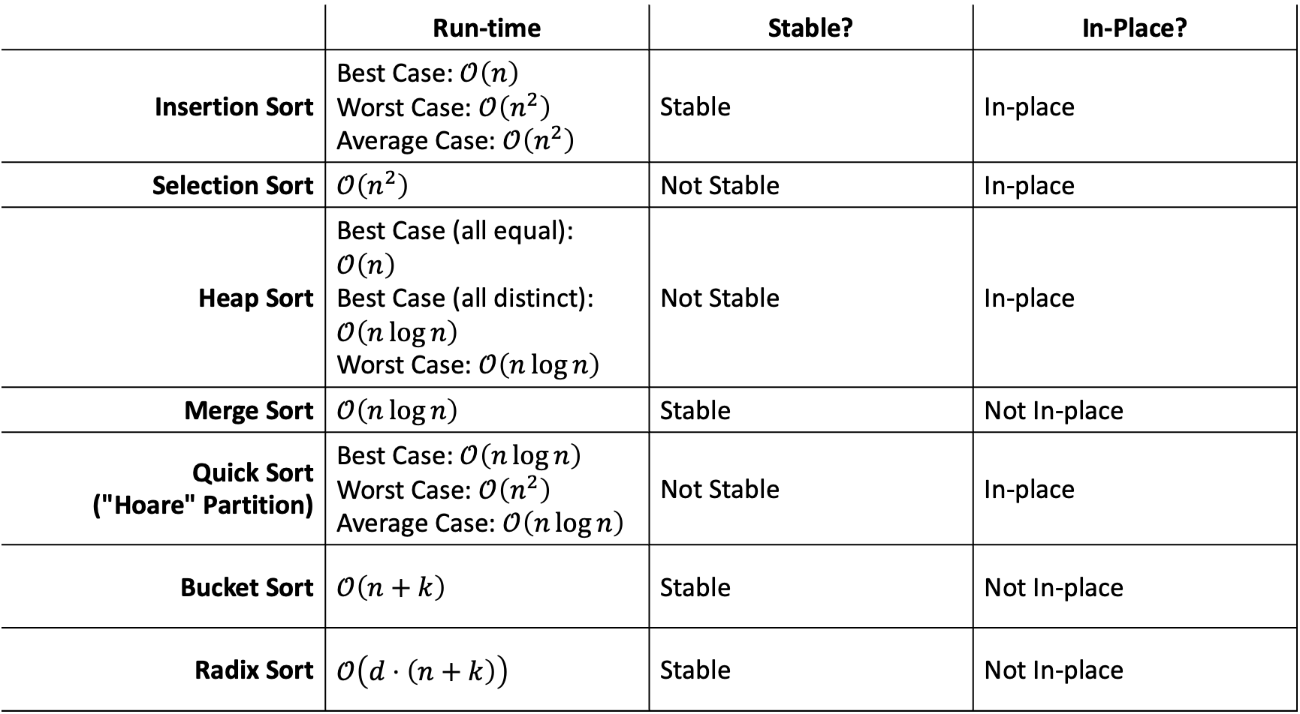
Sorting: Comparisons
 | Run-time | Stable? | In-Place?
Insertion Sort | Best Case: $\text{𝒪}\left(n\right)$ Worst Case: $\text{𝒪}\left(n^{2}\right)$ Average Case: $\text{𝒪}\left(n^{2}\right)$ | Stable | In-place
Selection Sort | $$\text{𝒪}\left(n^{2}\right)$$ | Not Stable | In-place
Heap Sort | Best Case (all equal): $\text{𝒪}\left(n\right)$ Best Case (all distinct): $\text{𝒪}\left(n\log{n}\right)$ Worst Case:$\text{𝒪}\left(n\log{n}\right)$ | Not Stable | In-place
Merge Sort | $$\text{𝒪}\left(n\log{n}\right)$$ | Stable | Not In-place
Quick Sort ("Hoare" Partition) | Best Case: $\text{𝒪}\left(n\log{n}\right)$ Worst Case: $\text{𝒪}\left(n^{2}\right)$ Average Case: $\text{𝒪}\left(n\log{n}\right)$ | Not Stable | In-place
Bucket Sort | $$\text{𝒪}\left(n+k\right)$$ | Stable | Not In-place
Radix Sort | $$\text{𝒪}\left(d⋅\left(n+k\right)\right)$$ | Stable | Not In-place

Slide 22
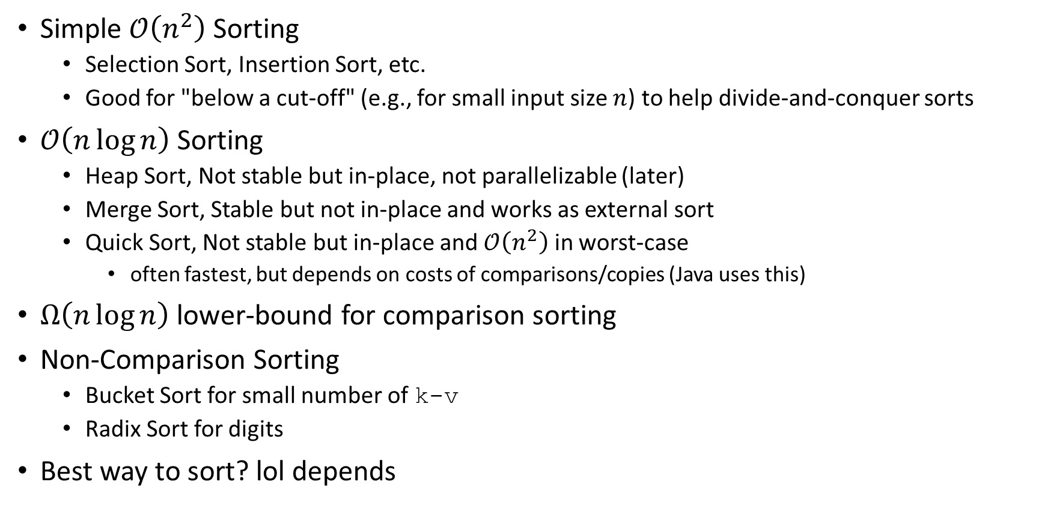
Sorting: Summary
Simple $\text{𝒪}\left(n^{2}\right)$ Sorting
  Selection Sort, Insertion Sort, etc.
  Good for "below a cut-off" (e.g., for small input size $n$) to help divide-and-conquer sorts
$\text{𝒪}\left(n\log{n}\right)$ Sorting
  Heap Sort, Not stable but in-place, not parallelizable (later)
  Merge Sort, Stable but not in-place and works as external sort
  Quick Sort, Not stable but in-place and $\text{𝒪}\left(n^{2}\right)$ in worst-case
    often fastest, but depends on costs of comparisons/copies (Java uses this)
$Ω\left(n\log{n}\right)$ lower-bound for comparison sorting
Non-Comparison Sorting
  Bucket Sort for small number of k-v
  Radix Sort for digits
Best way to sort? lol depends

Slide 23
Any Questions?

