Slide 1
Lecture 11: Comparison Sorts
CSE 332: Data Structures & Parallelism
Yafqa Khan
Summer 2025

Slide 2
Announcements
EX04: AVL
  Due Next Monday
Exam 1 next Friday

Slide 3
Today
Sorting Algorithm 1: Insertion Sort
Sorting Algorithm 2: Selection Sort
Sorting Algorithm 3: Heap Sort
  In-place optimization
Sorting Algorithm 4: Merge Sort
  Merging
Sorting Algorithm 5: Quick Sort
  Picking a pivot
  Partioning
Comparison Sorting Lower Bound

Slide 4
Sorting: An introduction
Why sorting?
  Want to know "all the data items" in some order
  Very common to need data sorted somehow
    Alphabetical list of people
    Population list of countries
    Search engine results by relevance
    Binary search
Why many ways of sorting?
  Tradeoffs...
    Asymptotic vs Constant Factors
    Different properties

Slide 5
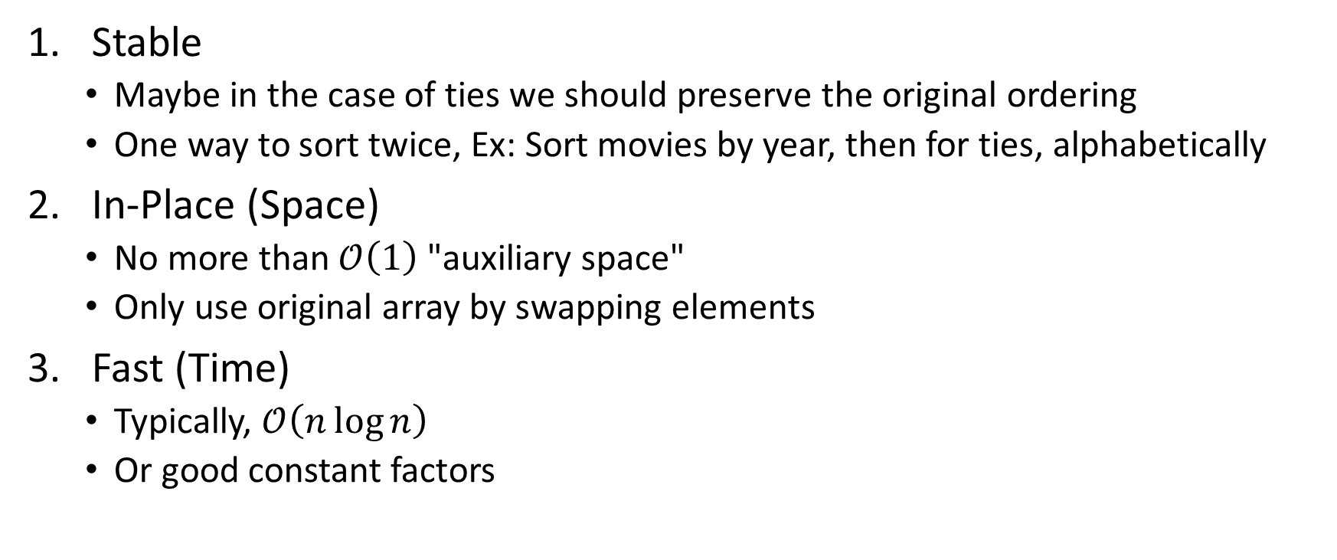
Sorting: Goals (Terminology)
Stable
  Maybe in the case of ties we should preserve the original ordering
  One way to sort twice, Ex: Sort movies by year, then for ties, alphabetically
In-Place (Space)
  No more than $\text{𝒪}\left(1\right)$ "auxiliary space"
  Only use original array by swapping elements
Fast (Time)
  Typically, $\text{𝒪}\left(n\log{n}\right)$
  Or good constant factors

Slide 6
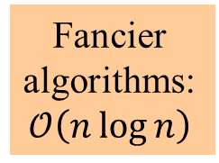
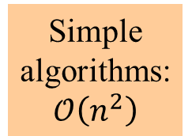
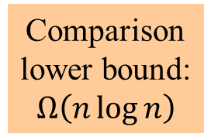
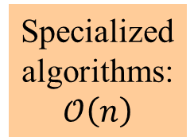
Sorting: The Big Picture
Simple
algorithms:
$$\text{𝒪}\left(n^{2}\right)$$
Fancier
algorithms:
$$\text{𝒪}\left(n\log{n}\right)$$
Comparison
lower bound:
$$Ω\left(n\log{n}\right)$$
Specialized
algorithms:
$$\text{𝒪}\left(n\right)$$
Handling
huge data
sets
Insertion sort
Selection sort
…
Heap sort
Merge sort
Quick sort (avg)
…
Bucket sort
Radix sort
External
sorting

Slide 7
Sorting Algorithm 1: Insertion Sort
Intuition: Given a hand of cards, sort it
Algorithm:
Maintain a sorted subarray
  Sort first 2 elements
  Insert 3rd element in order
  Insert 4th element in order
  ...

Slide 8
Insertion Sort: Pseudocode
insertionSort(int[] arr){
for(i=0; i < arr.length; i++){
int curr = i
while(arr[curr-1] > arr[curr]){
swap(arr[curr-1], arr[curr])
curr -= 1
}
}
}

Slide 9
Insertion Sort: Visual
0 | 1 | 2 | 3 | 4 | 5 | 6 | 7 | 8 | 9
2 | 3 | 6 | 7 | 5 | 8 | 4 | 10 | 2 | 8
Sorted Items
Current Item
Unsorted Items

Slide 10

Insertion Sort: Analysis
Stable?
  Yes!
In-Place?
  Yes!
Fast?
  No :( (in terms of asymptotics)
    Best Case: $\text{𝒪}\left(n\right)$
    Worst Case: $\text{𝒪}\left(n^{2}\right)$
  Good constant factors!

Slide 11
Today
Sorting Algorithm 1: Insertion Sort
Sorting Algorithm 2: Selection Sort
Sorting Algorithm 3: Heap Sort
  In-place optimization
Sorting Algorithm 4: Merge Sort
  Merging
Sorting Algorithm 5: Quick Sort
  Picking a pivot
  Partioning
Comparison Sorting Lower Bound

Slide 12
Sorting Algorithm 2: Selection Sort
Algorithm:
Maintain a sorted subarray
  Find the smallest element remaining in the unsorted subarray
  Append it at the end of the sorted part
  Repeat

Slide 13
Selection Sort: Visual
0 | 1 | 2 | 3 | 4 | 5 | 6 | 7 | 8 | 9
2 | 3 | 6 | 7 | 18 | 10 | 14 | 9 | 11 | 15
Sorted Items
Current Index
Unsorted Items

Slide 14
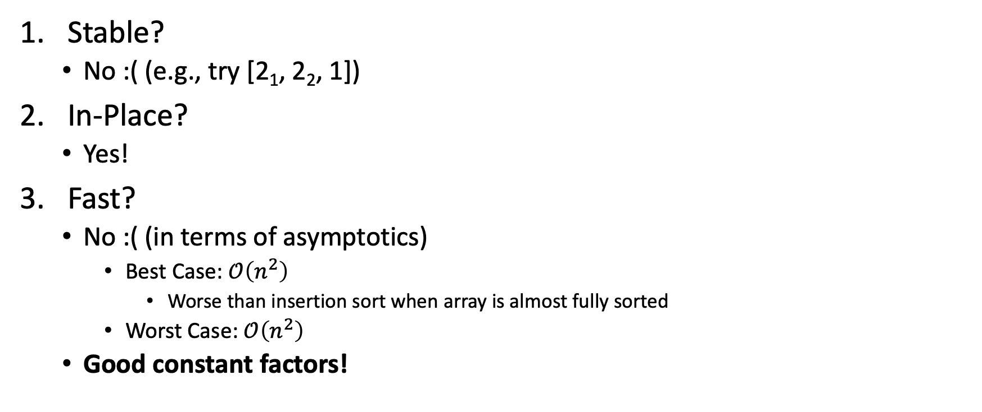
Selection Sort: Analysis
Stable?
  No :( (e.g., try [2₁, 2₂, 1])
In-Place?
  Yes!
Fast?
  No :( (in terms of asymptotics)
    Best Case: $\text{𝒪}\left(n^{2}\right)$
      Worse than insertion sort when array is almost fully sorted
    Worst Case: $\text{𝒪}\left(n^{2}\right)$
  Good constant factors!

Slide 15
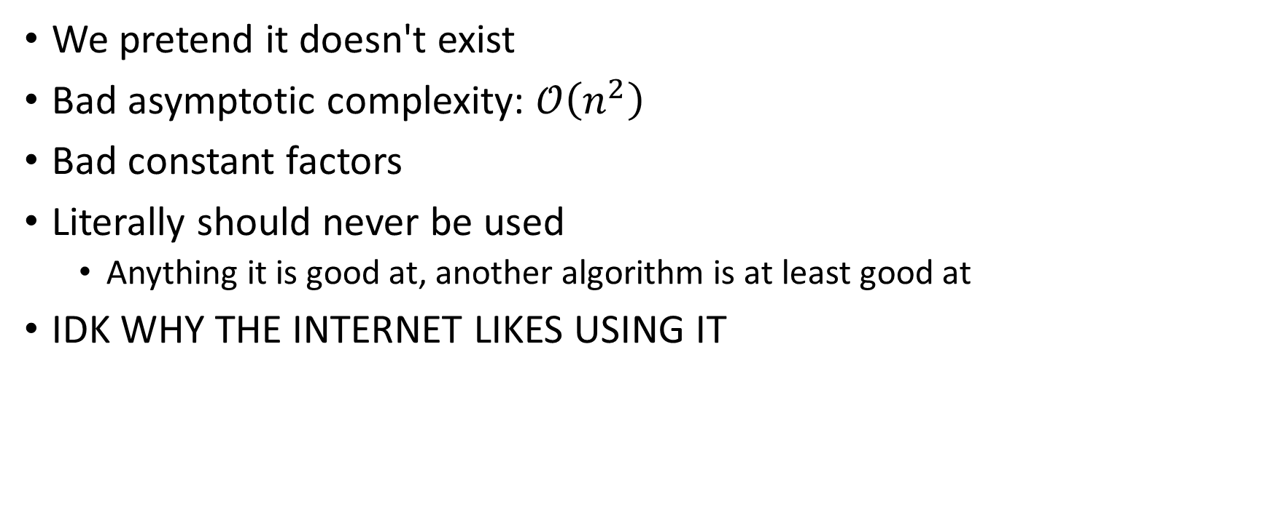
Sorting Algorithm null: Bubble Sort
We pretend it doesn't exist
Bad asymptotic complexity: $\text{𝒪}\left(n^{2}\right)$
Bad constant factors
Literally should never be used
  Anything it is good at, another algorithm is at least good at
IDK WHY THE INTERNET LIKES USING IT

Slide 16
Any Questions?

Slide 17
Today
Sorting Algorithm 1: Insertion Sort
Sorting Algorithm 2: Selection Sort
Sorting Algorithm 3: Heap Sort
  In-place optimization
Sorting Algorithm 4: Merge Sort
  Merging
Sorting Algorithm 5: Quick Sort
  Picking a pivot
  Partioning
Comparison Sorting Lower Bound

Slide 18
Sorting Algorithm 3: Heap Sort
Intuition: Use a heap
Algorithm:
Put all elements into a heap (e.g., with buildHeap)
Remove elements one by one and put back into the array

Slide 19
Heap Sort (unoptimized): Pseudocode
heapSort(int[] arr){
heap = buildHeap(arr)
for(i=0; i < arr.length; i++){
arr[i] = heap.deleteMin()
}
}

Slide 20
(Max) Heap Sort: In-place Optimization
Treat the initial array as a heap (via buildHeap)
When you delete the ith element, put it at arr[n-i] (the back)
  It’s not part of the heap anymore!
8
5
7
1
2
3
1
9
9
10
(Unsorted) Heap Part
Sorted Part
7
5
1
1
2
3
8
9
9
10
arr[n-i] = deleteMax()
Heap Part
Sorted Part

Slide 21
Any Questions?

Slide 22
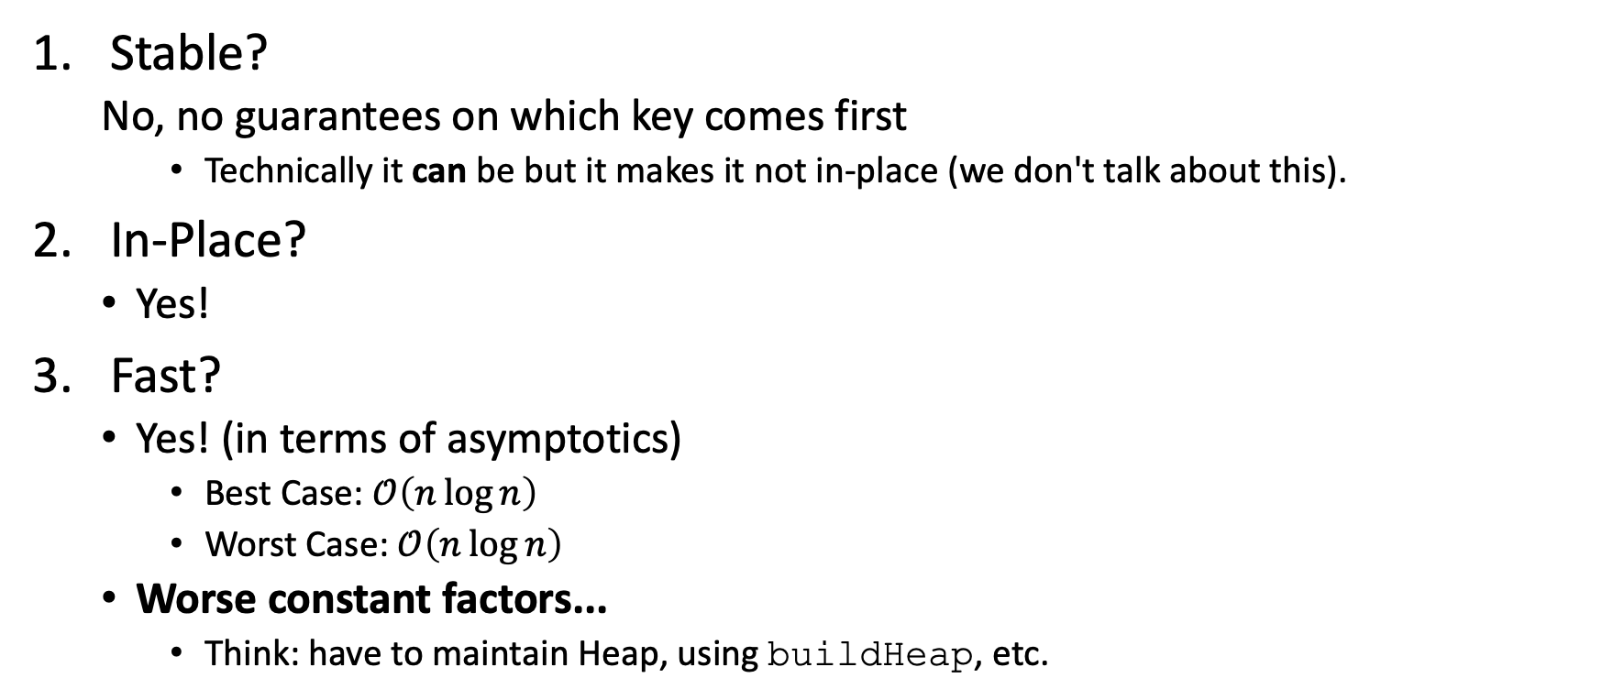
Heap Sort: Analysis
Stable?
  No, no guarantees on which key comes first
    Technically it can be but it makes it not in-place (we don't talk about this).
In-Place?
  Yes!
Fast?
  Yes! (in terms of asymptotics)
    Best Case: $\text{𝒪}\left(n\log{n}\right)$
    Worst Case: $\text{𝒪}\left(n\log{n}\right)$
  Worse constant factors...
    Think: have to maintain Heap, using buildHeap, etc.

Slide 23
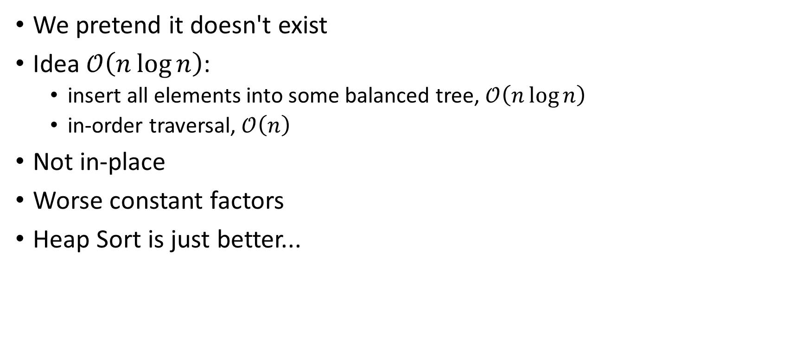
Sorting Algorithm null: AVL Sort
We pretend it doesn't exist
Idea $\text{𝒪}\left(n\log{n}\right)$:
  insert all elements into some balanced tree, $\text{𝒪}\left(n\log{n}\right)$
  in-order traversal, $\text{𝒪}\left(n\right)$
Not in-place
Worse constant factors
Heap Sort is just better...

Slide 24
Today
Sorting Algorithm 1: Insertion Sort
Sorting Algorithm 2: Selection Sort
Sorting Algorithm 3: Heap Sort
  In-place optimization
Sorting Algorithm 4: Merge Sort
  Merging
Sorting Algorithm 5: Quick Sort
  Picking a pivot
  Partioning
Comparison Sorting Lower Bound

Slide 25

Divide and Conquer
Very important technique in algorithm design
Divide problems into smaller parts
Solve each part independently
  Think: recursion, parallelism (later)
Combine each part's solution to produce overall solution
e.g.,
Sort each half of the array, combine together
to sort each half, split into halves
...

Slide 26
Divide and Conquer Sorting
Merge Sort
  Sort the left half of the elements (recursively)
  Sort the right half of the elements (recursively)
  Merge the two sorted halves into a sorted whole
Quick Sort
  Divide elements into those less-than pivot and those greater-than pivot
  Sort the two divisions (recursively on each)
  Merge as [sorted-less-than then pivot then sorted-greater-than]

Slide 27
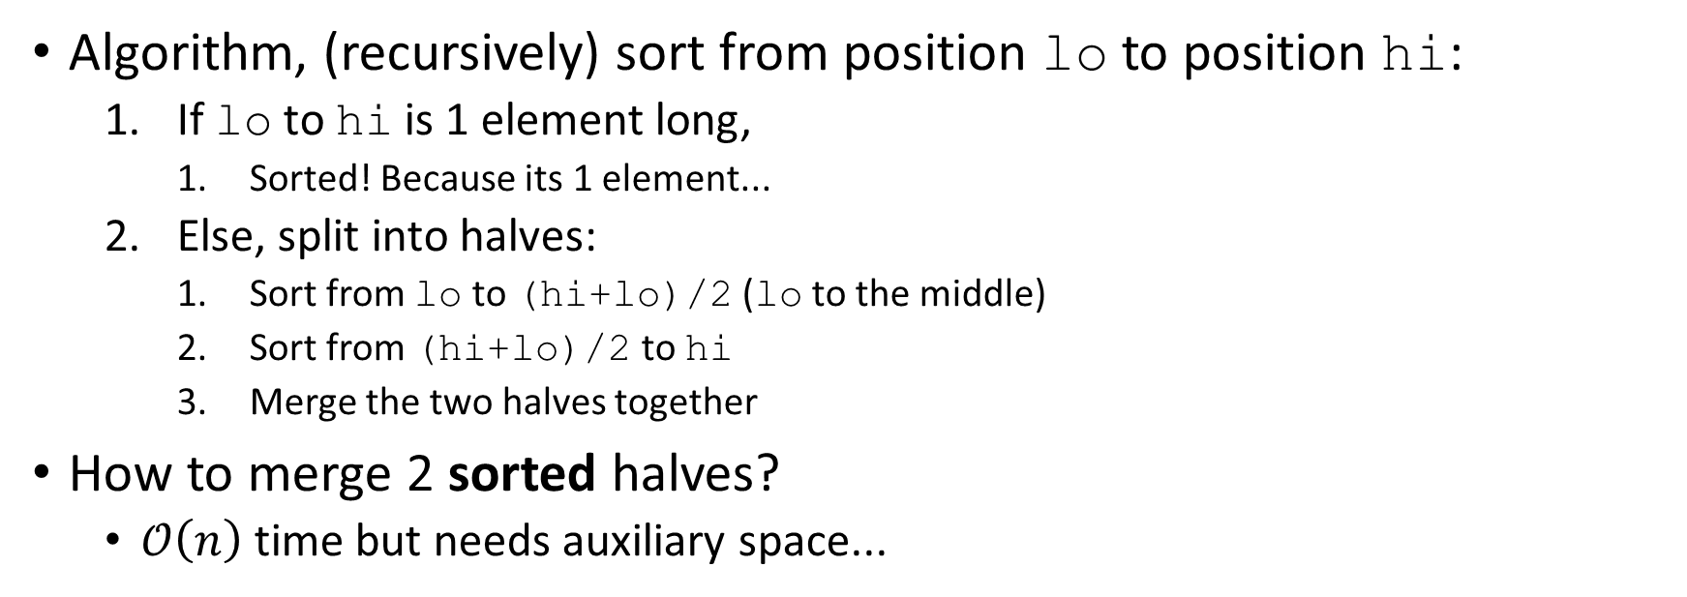
Sorting Algorithm 4: Merge Sort
0 1 2 3 4 5 6 7
8
2
9
4
5
3
1
6
lo
hi
Algorithm, (recursively) sort from position lo to position hi:
  If lo to hi is 1 element long,
    Sorted! Because its 1 element...
  Else, split into halves:
    Sort from lo to (hi+lo)/2 (lo to the middle)
    Sort from (hi+lo)/2 to hi
    Merge the two halves together
How to merge 2 sorted halves?
  $\text{𝒪}\left(n\right)$ time but needs auxiliary space...

Slide 28
Merge Sort: Merging Visualization
Start with:
8
2
9
4
5
3
1
6
After we return from
left and right recursive calls (pretend it works for now)
2
4
8
9
1
3
5
6
Merge:
Use 3 pointers
and 1 more array
aux
(After merge, copy back to original array)

Slide 29
Merge Sort: Merging Visualization (Soln.)
Start with:
8
2
9
4
5
3
1
6
After recursion:
(not magic ☺)
2
4
8
9
1
3
5
6
Merge:
Use 3 “fingers”
and 1 more array
1
(After merge, copy back to original array)

Slide 30
Merge Sort: Merging Visualization (Soln.)
Start with:
8
2
9
4
5
3
1
6
After recursion:
(not magic ☺)
2
4
8
9
1
3
5
6
Merge:
Use 3 “fingers”
and 1 more array
1
2
(After merge, copy back to original array)

Slide 31
Merge Sort: Merging Visualization (Soln.)
Start with:
8
2
9
4
5
3
1
6
After recursion:
(not magic ☺)
2
4
8
9
1
3
5
6
Merge:
Use 3 “fingers”
and 1 more array
1
2
3
(After merge, copy back to original array)

Slide 32
Merge Sort: Merging Visualization (Soln.)
Start with:
8
2
9
4
5
3
1
6
After recursion:
(not magic ☺)
2
4
8
9
1
3
5
6
Merge:
Use 3 “fingers”
and 1 more array
1
2
3
4
(After merge, copy back to original array)

Slide 33
Merge Sort: Merging Visualization (Soln.)
Start with:
8
2
9
4
5
3
1
6
After recursion:
(not magic ☺)
2
4
8
9
1
3
5
6
Merge:
Use 3 “fingers”
and 1 more array
1
2
3
4
5
(After merge, copy back to original array)

Slide 34
Merge Sort: Merging Visualization (Soln.)
Start with:
8
2
9
4
5
3
1
6
After recursion:
(not magic ☺)
2
4
8
9
1
3
5
6
Merge:
Use 3 “fingers”
and 1 more array
1
2
3
4
5
6
(After merge, copy back to original array)

Slide 35
Merge Sort: Merging Visualization (Soln.)
Start with:
8
2
9
4
5
3
1
6
After recursion:
(not magic ☺)
2
4
8
9
1
3
5
6
Merge:
Use 3 “fingers”
and 1 more array
1
2
3
4
5
6
8
(After merge, copy back to original array)

Slide 36
Merge Sort: Merging Visualization (Soln.)
Start with:
8
2
9
4
5
3
1
6
After recursion:
(not magic ☺)
2
4
8
9
1
3
5
6
Merge:
Use 3 “fingers”
and 1 more array
1
2
3
4
5
6
8
9
(After merge, copy back to original array)

Slide 37
Merge Sort: Merging Visualization (Soln.)
Start with:
8
2
9
4
5
3
1
6
After recursion:
(not magic ☺)
2
4
8
9
1
3
5
6
Merge:
Use 3 “fingers”
and 1 more array
1
2
3
4
5
6
8
9
1
2
3
4
5
6
8
9

Slide 38
Merge Sort: Splitting Visualization
8
2
9
4
5
3
1
6
Divide
8 2 9 4
5 3 1 6
Divide
8 2
9 4
5 3
1 6
Divide
1 element
8 2
9 4
5 3
1 6

Slide 39
Merge Sort: Splitting Visualization
8
2
9
4
5
3
1
6
Divide
8 2 9 4
5 3 1 6
Divide
8 2
9 4
5 3
1 6
Divide
1 element
8 2
9 4
5 3
1 6
Merge
2 8
4 9
3 5
1 6
Merge
2 4 8 9
1 3 5 6
Merge
1 2 3 4 5 6 8 9
When a recursive call ends, it’s sub-arrays are each in order; just need to merge them in order together
39

Slide 40
Merge Sort: Copy Array Optimization
First recurse down to lists of size 1
As we return from the recursion, switch off arrays
Merge by 1
Merge by 2
Merge by 4
Merge by 8
Merge by 16
Copy if Needed

Slide 41
Any Questions?

Slide 42
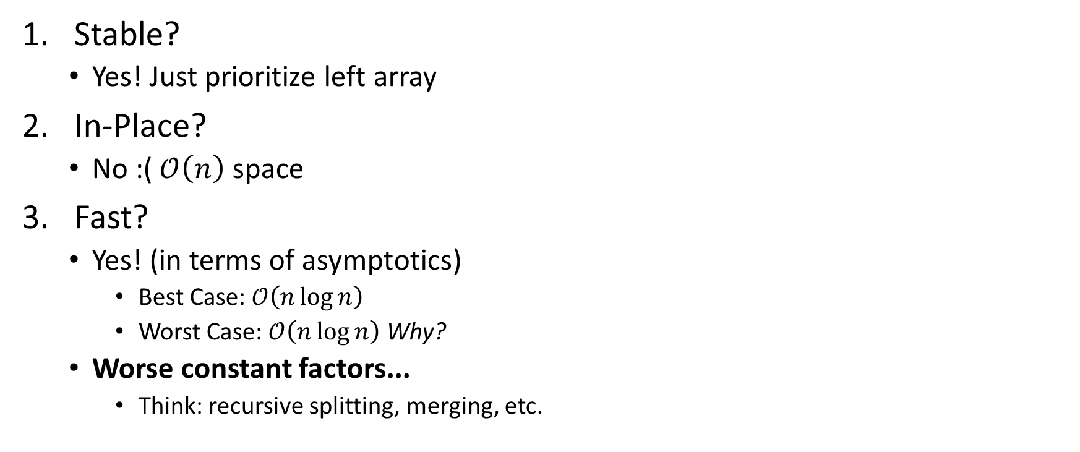
Merge Sort: Analysis
Stable?
  Yes! Just prioritize left array
In-Place?
  No :( $\text{𝒪}\left(n\right)$ space
Fast?
  Yes! (in terms of asymptotics)
    Best Case: $\text{𝒪}\left(n\log{n}\right)$
    Worst Case: $\text{𝒪}\left(n\log{n}\right)$ Why?
  Worse constant factors...
    Think: recursive splitting, merging, etc.

Slide 43

Merge Sort: Runtime Analysis
Recurrence Relation:
$$T\left(n\right)=\left\{\begin{matrix}\begin{aligned}&c_{0} \\ &2T\left(\frac{n}{2}\right)+c_{1}n+c_{2}\end{aligned} & \begin{matrix}\text{f}\text{or} n=1 \\ \text{otherwise}\end{matrix}\end{matrix}\right.$$
Solving:
$$T\left(n\right)=2^{\log{n}}T\left(1\right)+n\log{n}=n+n\log{n}∈\text{𝒪}\left(n\log{n}\right)$$

Slide 44
Today
Sorting Algorithm 1: Insertion Sort
Sorting Algorithm 2: Selection Sort
Sorting Algorithm 3: Heap Sort
  In-place optimization
Sorting Algorithm 4: Merge Sort
  Merging
Sorting Algorithm 5: Quick Sort
  Picking a pivot
  Partioning
Comparison Sorting Lower Bound

Slide 45
Quick Sort Warning
There are millions of versions of Quick Sort on the internet. Use ours.

Slide 46
Sorting Algorithm 5: Quick Sort
Algorithm:
  Pick a pivot element
    Hopefully the ~median element
    Important, performance based on this
  Divide elements into 2 "halves":
    less-than pivot
    the pivot
    greater-than pivot
  Recursively sort A and C
  Sorted output: [sorted-less-than then pivot then sorted-greater-than]

Slide 47
Quick Sort: Visualization 1
S
81
31
57
select pivot value
13
43
75
92
0
65
26
S₁
S₂
partition S
0
31
75
13
43
65
92
81
26
57
S₁
S₂
QuickSort(S₁) and
QuickSort(S₂)
0
13
26
31
43
57
65
75
81
92
S
0
13
26
31
43
57
65
75
81
92
Presto! S is sorted
[Weiss]

Slide 48
Quick Sort: Visualization 2
8
2
9
4
5
3
1
6
Divide
5
2 4 3 1
8 9 6
Divide
3
2 1
4
6
8
9
Divide
1 element
1
2
Conquer
1 2
Conquer
1 2 3 4
6 8 9
Conquer
What's a bad pivot?
1 2 3 4 5 6 8 9

Slide 49
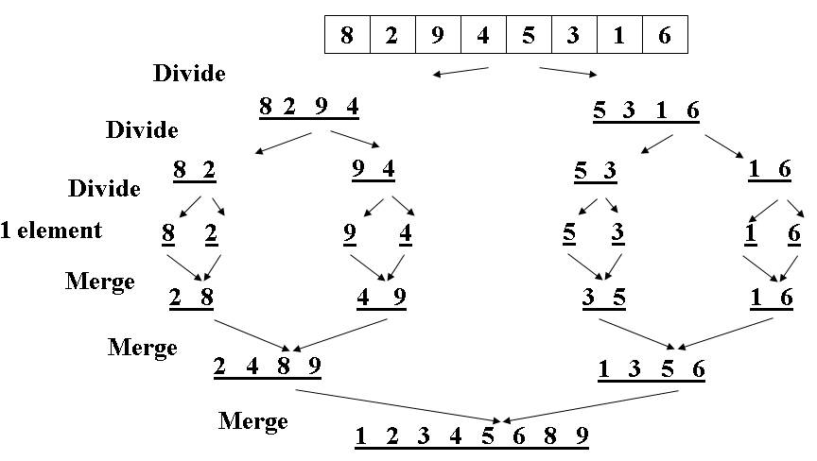
Merge Sort vs Quick Sort
MergeSort Recursion Tree
QuickSort Recursion Tree
8
2
9
4
5
3
1
6
Divide
5
2 4 3 1
8 9 6
Divide
3
8
2 1
4
6
9
Divide
1 element
1
2
Conquer
1 2
Conquer
6 8 9
1 2 3 4
Conquer
1 2 3 4 5 6 8 9

Slide 50
Quick Sort: Picking a (good) Pivot
void quicksort(int[] arr, int lo, int hi)
arr
lo
hi-1
Option 1: Pick arr[lo] or arr[hi-1]
  Fast to pick but likely worst-case (e.g., arr is sorted)
Option 2: Pick random element
  Good. But pseudo-randomness is expensive!
Option 3: Median of 3
  e.g., arr[lo], arr[hi-1], arr[(hi+lo)/2]
  Common, tends to work well

Slide 51

Quick Sort: Partitioning Problem
Problem: Given good pivot, how to split to two?
  e.g., [8, 4, 2, 9, 3, 5, 7] and pivot 5,
    how to split to two - 4, 2, 3 and 8, 9, 7?
Ideals:
  Fast $\text{𝒪}\left(n\right)$ linear time
  In-place
Ideas?

Slide 52
Quick Sort: "Hoare" Partitioning Approach
Swap pivot with arr[lo] (i.e., move it out of the way)
Use 2 pointers l and r, starting at lo+1 and hi-1
  Idea: Move l and r such that:
    arr[l] should be on the right of pivot and arr[r] should be on the left of pivot
while (l < r)
if(arr[l] <= pivot) l++
else if(arr[r] > pivot) r--
else swap arr[l] and arr[r]
Put pivot back in middle (Swap with arr[r])

Slide 53
Quick Sort: Example
Pick pivot 7, median of 3 | 3 | 4 | 9 | 1 | 7 | 0 | 5 | 2 | 6 | 8
Start "Hoare" Partition: | 3 | 4 | 9 | 1 | 7 | 0 | 5 | 2 | 6 | 8
Move 7, init l and r: | 7 | 4 | 9 | 1 | 3 | 0 | 5 | 2 | 6 | 8
 |  | l |  |  |  |  |  |  |  | r
Move l and r: | 7 | 4 | 9 | 1 | 3 | 0 | 5 | 2 | 6 | 8
 |  |  | l |  |  |  |  |  | r
Swap arr[l] and arr[r]: | 7 | 4 | 6 | 1 | 3 | 0 | 5 | 2 | 9 | 8
 |  |  | l |  |  |  |  |  | r

Slide 54
Quick Sort: Example (cont.)
After swap: | 7 | 4 | 6 | 1 | 3 | 0 | 5 | 2 | 9 | 8
 |  |  | l |  |  |  |  |  | r
Move l and r: | 7 | 4 | 6 | 1 | 3 | 0 | 5 | 2 | 9 | 8
 |  |  |  |  |  |  |  | r | l
r <= l, move pivot back | 7 | 4 | 6 | 1 | 3 | 0 | 5 | 2 | 9 | 8
 |  |  |  |  |  |  |  | r | l
"Hoare" Partitioned! | 2 | 4 | 6 | 1 | 3 | 0 | 5 | 7 | 9 | 8

Slide 55
Any Questions?

Slide 56
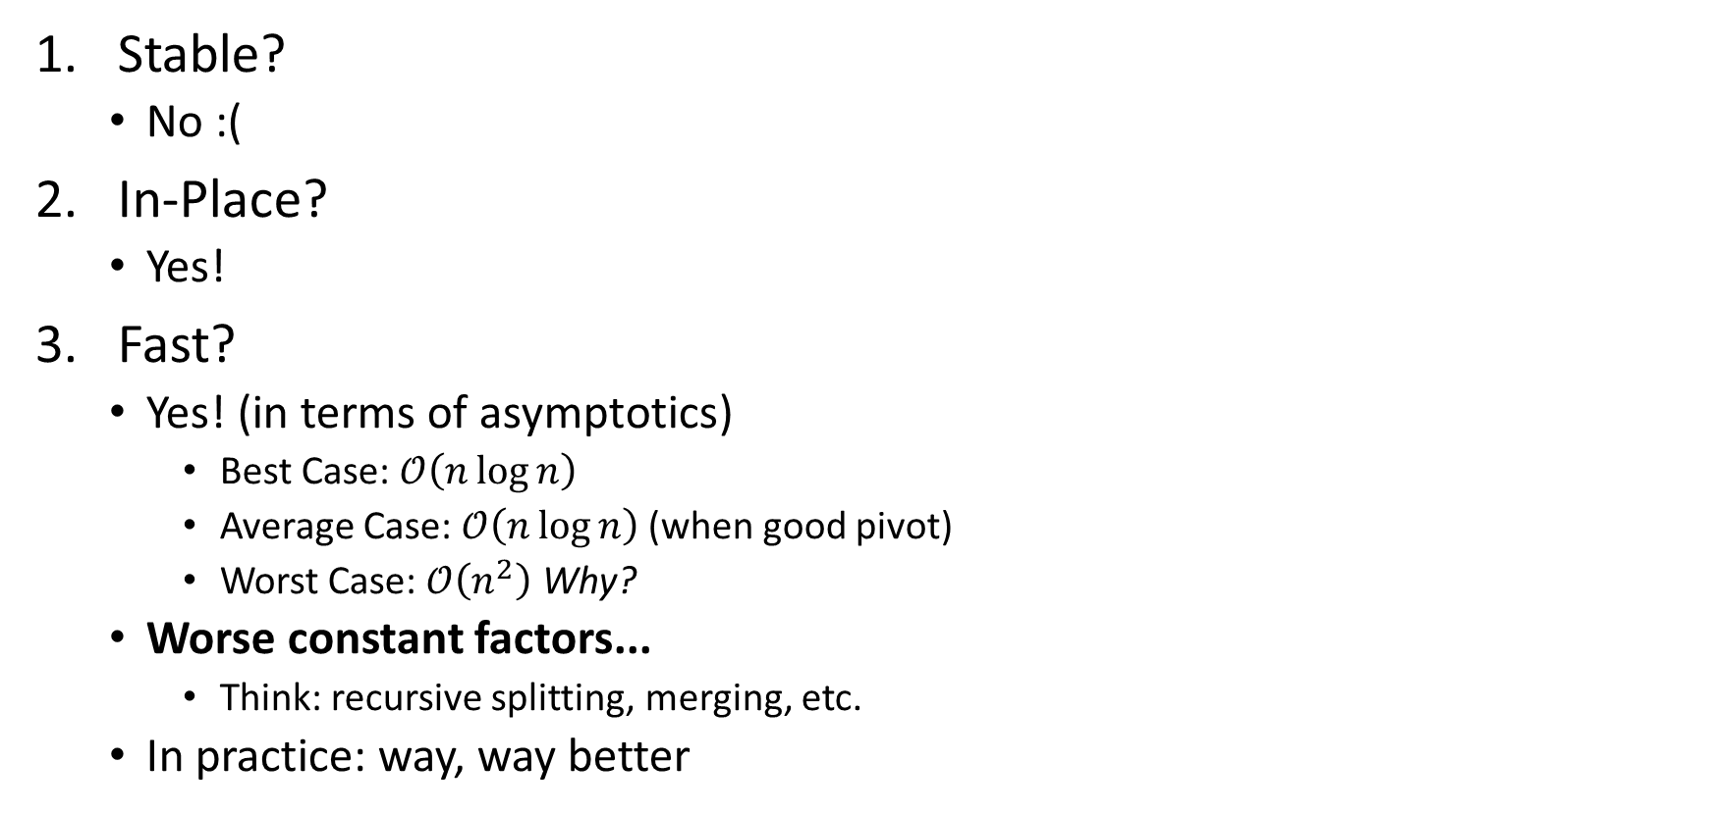
Quick Sort: Analysis
Stable?
  No :(
In-Place?
  Yes!
Fast?
  Yes! (in terms of asymptotics)
    Best Case: $\text{𝒪}\left(n\log{n}\right)$
    Average Case: $\text{𝒪}\left(n\log{n}\right)$ (when good pivot)
    Worst Case: $\text{𝒪}\left(n^{2}\right)$ Why?
  Worse constant factors...
    Think: recursive splitting, merging, etc.
  In practice: way, way better

Slide 57
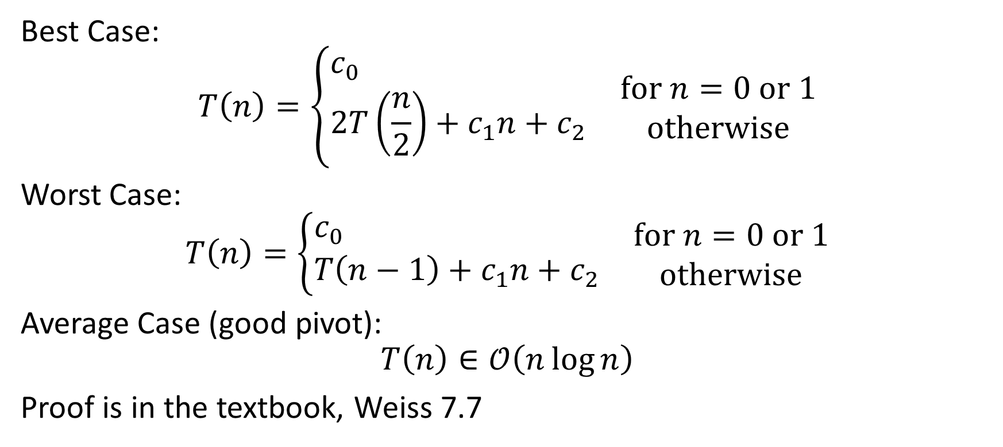
Quick Sort: Runtime Analysis
Best Case:
$$T\left(n\right)=\left\{\begin{matrix}\begin{aligned}&c_{0} \\ &2T\left(\frac{n}{2}\right)+c_{1}n+c_{2}\end{aligned} & \begin{matrix}\text{f}\text{or} n=0 \text{or} 1 \\ \text{otherwise}\end{matrix}\end{matrix}\right.$$
Worst Case:
$$T\left(n\right)=\left\{\begin{matrix}\begin{aligned}&c_{0} \\ &T\left(n−1\right)+c_{1}n+c_{2}\end{aligned} & \begin{matrix}\text{f}\text{or} n=0 \text{or} 1 \\ \text{otherwise}\end{matrix}\end{matrix}\right.$$
Average Case (good pivot):
$$T\left(n\right)∈\text{𝒪}\left(n\log{n}\right)$$
Proof is in the textbook, Weiss 7.7

Slide 58
Comparison Sorting: CUTOFF Strategy
void sort(int[] arr, int lo, int hi) {
if(hi – lo < CUTOFF)
insertionSort(arr,lo,hi); // or Selection Sort
else
quickSort(arr,lo,hi) // or Merge Sort, etc.
}

Slide 59
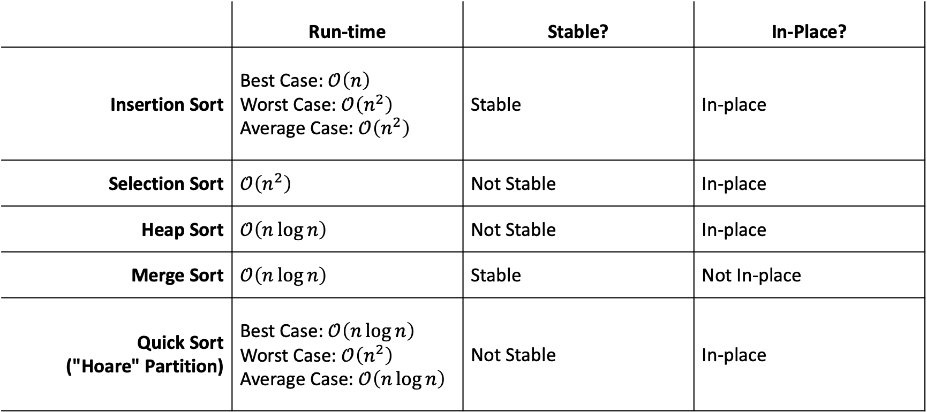
Comparison Sorting: Comparisons
 | Run-time | Stable? | In-Place?
Insertion Sort | Best Case: $\text{𝒪}\left(n\right)$ Worst Case: $\text{𝒪}\left(n^{2}\right)$ Average Case: $\text{𝒪}\left(n^{2}\right)$ | Stable | In-place
Selection Sort | $$\text{𝒪}\left(n^{2}\right)$$ | Not Stable | In-place
Heap Sort | $$\text{𝒪}\left(n\log{n}\right)$$ | Not Stable | In-place
Merge Sort | $$\text{𝒪}\left(n\log{n}\right)$$ | Stable | Not In-place
Quick Sort ("Hoare" Partition) | Best Case: $\text{𝒪}\left(n\log{n}\right)$ Worst Case: $\text{𝒪}\left(n^{2}\right)$ Average Case: $\text{𝒪}\left(n\log{n}\right)$ | Not Stable | In-place

Slide 60
Today
Sorting Algorithm 1: Insertion Sort
Sorting Algorithm 2: Selection Sort
Sorting Algorithm 3: Heap Sort
  In-place optimization
Sorting Algorithm 4: Merge Sort
  Merging
Sorting Algorithm 5: Quick Sort
  Picking a pivot
  Partioning
Comparison Sorting Lower Bound

Slide 61
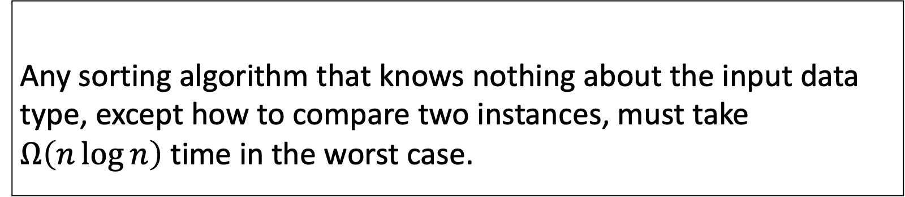
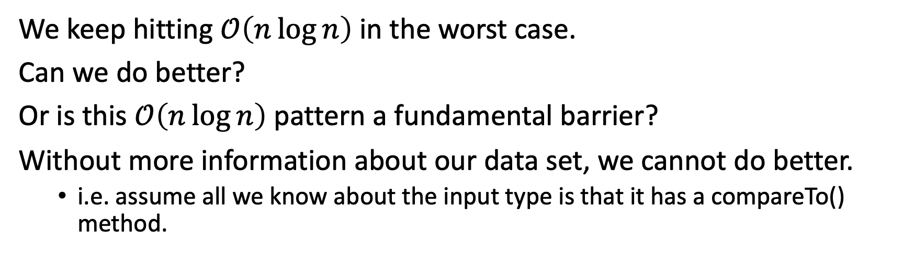
Comparison Sorting Lower Bound
We keep hitting $\text{𝒪}\left(n\log{n}\right)$ in the worst case.
Can we do better?
Or is this $\text{𝒪}\left(n\log{n}\right)$ pattern a fundamental barrier?
Without more information about our data set, we cannot do better.
  i.e. assume all we know about the input type is that it has a compareTo() method.
Any sorting algorithm that knows nothing about the input data type, except how to compare two instances, must take $Ω\left(n\log{n}\right)$ time in the worst case.
Comparison Sorting Lower Bound

Slide 62
Sorting: The Big Picture
Simple
algorithms:
$$\text{𝒪}\left(n^{2}\right)$$
Fancier
algorithms:
$$\text{𝒪}\left(n\log{n}\right)$$
Comparison
lower bound:
$$Ω\left(n\log{n}\right)$$
Specialized
algorithms:
$$\text{𝒪}\left(n\right)$$
Handling
huge data
sets
Insertion sort
Selection sort
…
Heap sort
Merge sort
Quick sort (avg)
…
Bucket sort
Radix sort
External
sorting

Slide 63
Any Questions?

