Slide 1
CSE 332: Data Structures & Parallelism Lecture 10:More Hashing
Yafqa Khan
Summer 2025

Slide 2
Announcements
EX04 Released
Start early!
Exam 1 next Friday

Slide 3
Today
Dictionaries
Finish Hashing

Slide 4
Hash Tables: Review
Aim for constant-time (i.e., O(1)) find, insert, and delete
“On average” under some reasonable assumptions
A hash table is an array of some fixed size
But growable as we’ll see
hash table
0
 | …
client
hash table library
collision?
collision
resolution
E
int
table-index
TableSize –1

Slide 5
Hashing Choices
Choose a Hash function
Choose TableSize
Choose a Collision Resolution Strategy from these:
Separate Chaining
Open Addressing
Linear Probing
Quadratic Probing
Double Hashing
Other issues to consider:
Deletion?
What to do when the hash table gets “too full”?

Slide 6
Open Addressing: Linear Probing
Why not use up the empty space in the table?
Store directly in the array cell (no linked list)
How to deal with collisions?
If h(key) is already full,
try (h(key) + 1) % TableSize. If full,
try (h(key) + 2) % TableSize. If full,
try (h(key) + 3) % TableSize. If full…
Example: insert 38, 19, 8, 109, 10
0
1
2
3
4
5
6
7
8 | 38
9

Slide 7
Open Addressing: Linear Probing
Another simple idea: If h(key) is already full,
try (h(key) + 1) % TableSize. If full,
try (h(key) + 2) % TableSize. If full,
try (h(key) + 3) % TableSize. If full…
Example: insert 38, 19, 8, 109, 10
0 | /
1 | /
2 | /
3 | /
4 | /
5 | /
6 | /
7 | /
8 | 38
9 | 19

Slide 8
Open Addressing: Linear Probing
Another simple idea: If h(key) is already full,
try (h(key) + 1) % TableSize. If full,
try (h(key) + 2) % TableSize. If full,
try (h(key) + 3) % TableSize. If full…
Example: insert 38, 19, 8, 109, 10
0 | 8
1 | /
2 | /
3 | /
4 | /
5 | /
6 | /
7 | /
8 | 38
9 | 19

Slide 9
Open Addressing: Linear Probing
Another simple idea: If h(key) is already full,
try (h(key) + 1) % TableSize. If full,
try (h(key) + 2) % TableSize. If full,
try (h(key) + 3) % TableSize. If full…
Example: insert 38, 19, 8, 109, 10
0 | 8
1 | 109
2 | /
3 | /
4 | /
5 | /
6 | /
7 | /
8 | 38
9 | 19

Slide 10
Open Addressing: Linear Probing
Another simple idea: If h(key) is already full,
try (h(key) + 1) % TableSize. If full,
try (h(key) + 2) % TableSize. If full,
try (h(key) + 3) % TableSize. If full…
Example: insert 38, 19, 8, 109, 10
0 | 8
1 | 109
2 | 10
3 | /
4 | /
5 | /
6 | /
7 | /
8 | 38
9 | 19

Slide 11
Open addressing
Linear probing is one example of open addressing
In general, open addressing means resolving collisions by trying a sequence of other positions in the table.
Trying the next spot is called probing
We just did linear probing:
i^{th} probe: (h(key) + i) % TableSize
In general have some probe function f and :
i^{th} probe: (h(key) + f(i)) % TableSize
Open addressing does poorly with high load factor λ
So want larger tables
Too many probes means no more O(1)

Slide 12
Questions: Open Addressing: Linear Probing
How should find work? If value is in table? If not there?
Worst case scenario for find?
How should we implement delete?
How does open addressing with linear probing compare to separate chaining?

Slide 13
Open Addressing: Other Operations
insert finds an open table position using a probe function
What about find?
Must use same probe function to “retrace the trail” for the data
Unsuccessful search when reach empty position
What about delete?
Must use “lazy” deletion. Why?
Marker indicates “no data here, but don’t stop probing”
As with lazy deletion on other data structures, on insert, spots marked “deleted” can be filled in.
Note: delete with chaining is just calling delete on the bucket (e.g. linked list)

Slide 14
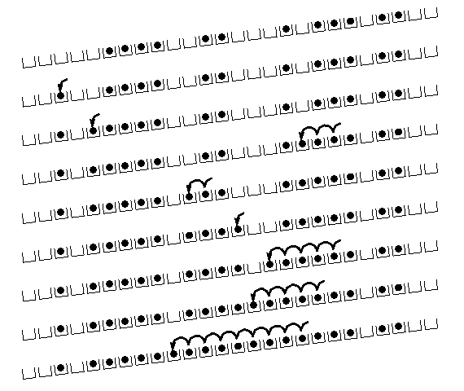
Primary Clustering
It turns out linear probing is a bad idea, even though the probe function is quick to compute (a good thing)
Tends to produce clusters, which lead to long probe sequences
Called primary clustering
Saw the start of a cluster in our linear probing example
[R. Sedgewick]

Slide 15
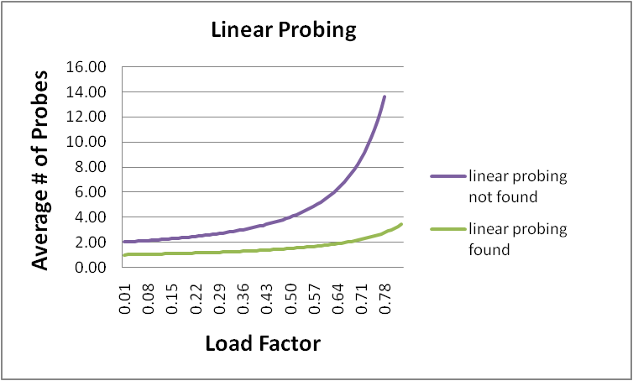
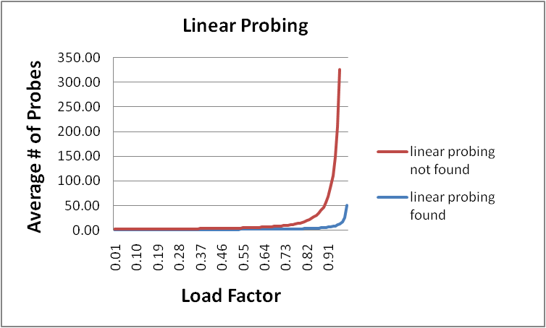
Analysis in chart form
Linear-probing performance degrades rapidly as table gets full
(Formula assumes “large table” but point remains)
By comparison, separate chaining performance is linear in λ and has no trouble with λ>1

Slide 16
Open Addressing: Linear probing
(h(key) + f(i)) % TableSize
For linear probing:
f(i) = i
So probe sequence is:
0th probe: h(key) % TableSize
1st probe: (h(key) + 1) % TableSize
2nd probe: (h(key) + 2) % TableSize
3rd probe: (h(key) + 3) % TableSize
…
i^{th} probe: (h(key) + i) % TableSize

Slide 17
Open Addressing: Quadratic probing
We can avoid primary clustering by changing the probe function…
(h(key) + f(i)) % TableSize
For quadratic probing:
f(i) = i²
So probe sequence is:
0th probe: h(key) % TableSize
1st probe: (h(key) + 1) % TableSize
2nd probe: (h(key) + 4) % TableSize
3rd probe: (h(key) + 9) % TableSize
…
i^{th} probe: (h(key) + i²) % TableSize
Intuition: Probes quickly “leave the neighborhood”

Slide 18
Quadratic Probing Example
ith probe: (h(key) + i²) % TableSize
0
1
2
3
4
5
6
7
8
9
TableSize=10
Insert:
89
18
49
58
79

Slide 19
Quadratic Probing Example
TableSize = 10
insert(89)
0
1
2
3
4
5
6
7
8
9

Slide 20
Quadratic Probing Example
TableSize = 10
insert(89)
insert(18)
0
1
2
3
4
5
6
7
8
9 | 89

Slide 21
Quadratic Probing Example
TableSize = 10
insert(89)
insert(18)
insert(49)
0
1
2
3
4
5
6
7
8 | 18
9 | 89

Slide 22
Quadratic Probing Example
TableSize = 10
insert(89)
insert(18)
insert(49)
49 % 10 = 9 collision!
(49 + 1) % 10 = 0
insert(58)
0 | 49
1
2
3
4
5
6
7
8 | 18
9 | 89

Slide 23
Quadratic Probing Example
TableSize = 10
insert(89)
insert(18)
insert(49)
insert(58)
58 % 10 = 8 collision!
(58 + 1) % 10 = 9 collision!
(58 + 4) % 10 = 2
insert(79)
0 | 49
1
2 | 58
3
4
5
6
7
8 | 18
9 | 89

Slide 24
Quadratic Probing Example
TableSize = 10
insert(89)
insert(18)
insert(49)
insert(58)
insert(79)
79 % 10 = 9 collision!
(79 + 1) % 10 = 0 collision!
(79 + 4) % 10 = 3
0 | 49
1
2 | 58
3 | 79
4
5
6
7
8 | 18
9 | 89

Slide 25
Another Quadratic Probing Example
ith probe: (h(key) + i²) % TableSize
TableSize = 7
Insert:
(76 % 7 = 6)
(40 % 7 = 5)
48 (48 % 7 = 6)
5 ( 5 % 7 = 5)
55 (55 % 7 = 6)
47 (47 % 7 = 5)
0
1
2
3
4
5
6

Slide 26
Another Quadratic Probing Example
ith probe: (h(key) + i²) % TableSize
TableSize = 7
Insert:
76 (76 % 7 = 6)
40 (40 % 7 = 5)
48 (48 % 7 = 6)
5 (5 % 7 = 5)
55 (55 % 7 = 6)
47 (47 % 7 = 5)
0
1
2
3
4
5
6 | 76

Slide 27
Another Quadratic Probing Example
ith probe: (h(key) + i²) % TableSize
TableSize = 7
Insert:
76 (76 % 7 = 6)
40 (40 % 7 = 5)
48 (48 % 7 = 6)
5 (5 % 7 = 5)
55 (55 % 7 = 6)
47 (47 % 7 = 5)
0
1
2
3
4
5 | 40
6 | 76

Slide 28
Another Quadratic Probing Example
ith probe: (h(key) + i²) % TableSize
TableSize = 7
Insert:
76 (76 % 7 = 6)
40 (40 % 7 = 5)
48 (48 % 7 = 6)
5 (5 % 7 = 5)
55 (55 % 7 = 6)
47 (47 % 7 = 5)
0 | 48
1
2
3
4
5 | 40
6 | 76

Slide 29
Another Quadratic Probing Example
ith probe: (h(key) + i²) % TableSize
TableSize = 7
Insert:
(76 % 7 = 6)
(40 % 7 = 5)
48 (48 % 7 = 6)
5 (5 % 7 = 5)
55 (55 % 7 = 6)
47 (47 % 7 = 5)
0 | 48
1
2 | 5
3
4
5 | 40
6 | 76

Slide 30
Another Quadratic Probing Example
ith probe: (h(key) + i²) % TableSize
TableSize = 7
Insert:
76 (76 % 7 = 6)
40 (40 % 7 = 5)
48 (48 % 7 = 6)
5 (5 % 7 = 5)
55 (55 % 7 = 6)
47 (47 % 7 = 5)
0 | 48
1
2 | 5
3 | 55
4
5 | 40
6 | 76

Slide 31
Another Quadratic Probing Example
ith probe: (h(key) + i²) % TableSize
TableSize = 7
Insert:
76 (76 % 7 = 6)
40 (40 % 7 = 5)
48 (48 % 7 = 6)
5 (5 % 7 = 5)
55 (55 % 7 = 6)
47 (47 % 7 = 5)
(47 + 1) % 7 = 6 collision!
(47 + 4) % 7 = 2 collision!
(47 + 9) % 7 = 0 collision!
(47 + 16) % 7 = 0 collision!
(47 + 25) % 7 = 2 collision!
0 | 48
1
2 | 5
3 | 55
4
5 | 40
6 | 76
Will we ever get a 1 or 4?!?

Slide 32
Another Quadratic Probing Example
insert(47) will always fail here. Why?
For all i, (5 + i²) % 7 is 0, 2, 5, or 6
Proof uses induction and
(5 + i²) % 7 = (5 + (i - 7)²) % 7
In fact, for all c and k,
(c + i²) % k = (c + (i - k)²) % k
0 | 48
1
2 | 5
3 | 55
4
5 | 40
6 | 76

Slide 33
From bad news to good news
Bad News:
After TableSize quadratic probes, we cycle through the same indices
Good News:
If TableSize is prime and λ < ½, then quadratic probing will find an empty slot in at most TableSize/2 probes
So: If you keep λ < ½ and TableSize is prime, no need to detect cycles
Proof posted in lecture10.txt (slightly less detailed proof in textbook)
For prime TableSize and 0 ≤ i,j ≤ TableSize/2 where i ≠ j,
(h(key) + i²) % TableSize ≠ (h(key) + j²) % TableSize
That is, if TableSize is prime, the first TableSize/2 quadratic probes map to different locations (and one of those will be empty if the table is < half full).

Slide 34
Clustering reconsidered
Quadratic probing does not suffer from primary clustering: As we resolve collisions we are not merely growing “big blobs” by adding one more item to the end of a cluster, we are looking i² locations away, for the next possible spot.
But quadratic probing does not help resolve collisions between keys that initially hash to the same index
Any 2 keys that initially hash to the same index will have the same series of moves after that looking for any empty spot
Called secondary clustering
Can avoid secondary clustering with a probe function that depends on the key: double hashing…

Slide 35
Open Addressing: Double hashing
Idea: Given two good hash functions h and g, and two different keys k1 and k2, it is very unlikely that: h(k1)==h(k2) and g(k1)==g(k2)
(h(key) + f(i)) % TableSize
For double hashing:
f(i) = i*g(key)
So probe sequence is:
0th probe: h(key) % TableSize
1st probe: (h(key) + g(key)) % TableSize
2nd probe: (h(key) + 2*g(key)) % TableSize
3rd probe: (h(key) + 3*g(key)) % TableSize
…
i^{th} probe: (h(key) + i*g(key)) % TableSize
Detail: Make sure g(key) can’t be 0

Slide 36
Open Addressing: Double Hashing
ith probe:(h(key) + i*g(key)) % TableSize
0
1
2
3
4
5
6
7
8
9
T = 10 (TableSize)
Hash Functions:
h(key) = key mod T
g(key) = 1 + ((key/T) mod (T-1))
Insert these values into the hash table in this order. Resolve any collisions with double hashing:
13
28
33
147
43

Slide 37
Double Hashing
ith probe:(h(key) + i*g(key)) % TableSize
T = 10 (TableSize)
Hash Functions:
h(key) = key mod T
g(key) = 1 + ((key/T) mod (T-1))
0
1
2
3 | 13
4
5
6
7
8
9
Insert these values into the hash table in this order. Resolve any collisions with double hashing:
13
28
33
147
43

Slide 38
Double Hashing
ith probe:(h(key) + i*g(key)) % TableSize
T = 10 (TableSize)
Hash Functions:
h(key) = key mod T
g(key) = 1 + ((key/T) mod (T-1))
0
1
2
3 | 13
4
5
6
7
8 | 28
9
Insert these values into the hash table in this order. Resolve any collisions with double hashing:
13
28
33
147
43

Slide 39
Double Hashing
ith probe:(h(key) + i*g(key)) % TableSize
T = 10 (TableSize)
Hash Functions:
h(key) = key mod T
g(key) = 1 + ((key/T) mod (T-1))
0
1
2
3 | 13
4
5
6
7 | 33
8 | 28
9
Insert these values into the hash table in this order. Resolve any collisions with double hashing:
13
28
33 → g(33) = 1 + 3 mod 9 = 4
147
43

Slide 40
Double Hashing
ith probe:(h(key) + i*g(key)) % TableSize
T = 10 (TableSize)
Hash Functions:
h(key) = key mod T
g(key) = 1 + ((key/T) mod (T-1))
0
1
2
3 | 13
4
5
6
7 | 33
8 | 28
9 | 147
Insert these values into the hash table in this order. Resolve any collisions with double hashing:
13
28
33
147 → g(147) = 1 + 14 mod 9 = 6
43

Slide 41
Double Hashing
ith probe:(h(key) + i*g(key)) % TableSize
T = 10 (TableSize)
Hash Functions:
h(key) = key mod T
g(key) = 1 + ((key/T) mod (T-1))
0
1
2
3 | 13
4
5
6
7 | 33
8 | 28
9 | 147
Insert these values into the hash table in this order. Resolve any collisions with double hashing:
13
28
33
147 → g(147) = 1 + 14 mod 9 = 6
43 → g(43) = 1 + 4 mod 9 = 5
We have a problem:
3 + 0 = 3 3 + 5 = 8 3 + 10 = 13 3 + 15 = 18 3 + 20 = 23

Slide 42
Double-hashing analysis
Intuition: Since each probe is “jumping” by g(key) each time, we “leave the neighborhood” and “go different places from other initial collisions”
But, as in quadratic probing, we could still have a problem where we are not "safe" due to an infinite loop despite room in table:
No guarantee that i*g(key) will let us try all/most indices
It is known that this cannot happen in at least one case:
For primes p and q such that 2 < q < p
h(key) = key % p
g(key) = q – (key % q)

Slide 43
Yet another reason to use a prime TableSize
So, for double hashing
i^{th} probe: (h(key) + i*g(key))% TableSize
Say g(key) divides Tablesize
That is, there is some integer x such that x*g(key)=Tablesize
After x probes, we’ll be back to trying the same indices as before
Ex:
Tablesize=50
g(key)=25
Probing sequence:
h(key)
h(key)+25
h(key)+50=h(key)
h(key)+75=h(key)+25
Only 1 & itself divide a prime

Slide 44
Where are we?
Separate Chaining is easy
find, insert, delete proportional to load factor on average if using unsorted linked list nodes
If using another data structure for buckets (e.g. AVL tree) , runtime is proportional to runtime for that structure.
Open addressing uses probing, has clustering issues as table fills Why use it:
Less memory allocation?
Some run-time overhead for allocating linked list (or whatever) nodes; open addressing could be faster
Easier data representation?
Now:
Growing the table when it gets too full (aka “rehashing”)

Slide 45
Rehashing
As with array-based stacks/queues/lists, if table gets too full, create a bigger table and copy everything over
With separate chaining, we get to decide what “too full” means
Keep load factor reasonable (e.g., < 1)?
Consider average or max size of non-empty chains?
For open addressing, half-full is a good rule of thumb
New table size
Twice-as-big is a good idea, except, uhm, that won’t be prime!
So go about twice-as-big
Can have a list of prime numbers in your code since you probably won’t grow more than 20-30 times, and then calculate after that

Slide 46
A Generally Good hashCode()
int result = 17; // start at a prime
foreach field f
int fieldHashcode =
boolean: (f ? 1: 0)
byte, char, short, int: (int) f
long: (int) (f ^ (f >>> 32))
float: Float.floatToIntBits(f)
double: Double.doubleToLongBits(f), then above
Object: object.hashCode( )
result = 31 * result + fieldHashcode;
return result;

Slide 47
Final word on hashing
The hash table is one of the most important data structures
Efficient find, insert, and delete
Operations based on sorted order are not so efficient!
Useful in many, many real-world applications
Popular topic for job interview questions
Important to use a good hash function
Good distribution, Uses enough of key’s components
Not overly expensive to calculate (bit shifts good!)
Important to keep hash table at a good size
Prime #
Preferable λ depends on type of table
Side-comment: hash functions have uses beyond hash tables
Examples: Cryptography, check-sums

