Slide 1
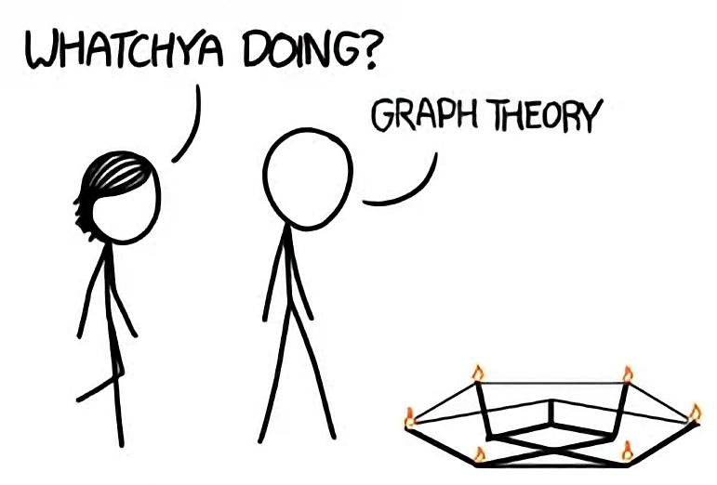
Graphs
CSE 332 – Section 6
Slides by James Richie Sulaeman
Notes:
Animated version.

Slide 2
Graphs

Slide 3
Graphs
A graph is a set of vertices connected by edges
A vertex is also known as a node
An edge is represented as a pair of vertices
A
C
B
D
vertices
F
E
edges
example of a undirected,
unweighted, cyclic graph

Slide 4
Graph Terminology
Degree of vertex V
Number of edges connected to vertex V
In-degree: number of edges going into vertex V
Out-degree: number of edges going out of vertex V
Weight of edge e
Numerical value/cost associated with traversing edge e
Path
A sequence of adjacent vertices connected by edges
Cycle
A path that begins and ends at the same vertex

Slide 5
Graph Terminology
Directed vs. undirected graphs
Edges can have direction (i.e. bidirectional vs. unidirectional)
Weighted vs. unweighted graphs
Edges can have weights/costs (e.g. how many minutes to go from vertex A to B)
Cyclic vs. acyclic graphs
Graph contains a cycle
A
A
A
A
3
7
3
7
1
B
C
B
C
B
C
B
C
5
5
directed, unweighted, acyclic graph
directed, weighted, cyclic graph
undirected, unweighted, acyclic graph
undirected, weighted, cyclic graph

Slide 6
Graph Traversals

Slide 7
Graph Traversals
How do we iterate through a graph?
Depth First Search (DFS)
Explores the graph by going as deep as possible
Implemented using a stack
O(|V| + |E|) runtime
Depth First Search (DFS)
Breadth First Search (BFS)
Explores the graph level by level
Implemented using a queue
Finds the shortest path in an unweighted, acyclic graph
O(|V| + |E|) runtime
Breadth First Search (BFS)
Notes:
DFS: Explore everything you can reach via one neighbor, before exploring another neighbor
BFS: Visits everything in order of distance (distance is number of nodes away from origin)

Slide 8
Depth First Search
DFS(Vertex start):
initialize stack s to hold start
mark start as visited
while s is not empty:
vertex v = s.pop()
for each neighbour u of v:
if u is not visited:
mark u as visited
add u to s
Explores the graph by going as deep as possible
Implemented using a stack
O(|V| + |E|) runtime
Depth First Search (DFS)
Notes:
Recursive way:
dfs(graph, curr):
Mark curr visited
For neighbor of curr:
If unvisited:
dfs(neighbor)

Slide 9
Breadth First Search
BFS(Vertex start):
initialize queue q to hold start
mark start as visited
while q is not empty:
vertex v = q.dequeue()
for each neighbour u of v:
if u is not visited:
mark u as visited
predecessor[u] = v
add u to q
Explores the graph level by level
Implemented using a queue
Finds the shortest path in an unweighted, acyclic graph
O(|V| + |E|) runtime
Breadth First Search (BFS)

Slide 10
Problem 0
DFS(Vertex start):
initialize stack s to hold start
mark start as visited
while s is not empty:
vertex v = s.pop()
for each neighbour u of v:
if u is not visited:
mark u as visited
add u to s

Slide 11
Problem 0
S
Vertex | Visited?
S | No
T | No
X | No
Y | No
Z | No
S
T
Yes
Y
Z
X
Stack:
Initialize stack to hold starting vertex S
S
Mark vertex S as visited
bottom
top

Slide 12
Problem 0
S
T
Vertex | Visited?
S | Yes
T | No
X | No
Y | No
Z | No
S
T
Yes
Y
Z
X
Y
Yes
Stack:
Pop vertex S from the stack
T
Y
Push neighbors T, Y onto the stack
bottom
top

Slide 13
Problem 0
S
T
Vertex | Visited?
S | Yes
T | Yes
X | No
Y | Yes
Z | No
S
T
Yes
Y
Z
X
Y
Y
Z
X
Yes
Stack:
Pop vertex Y from the stack
T
X
Z
Push neighbors X, Z onto the stack
bottom
top

Slide 14
Problem 0
S
T
Vertex | Visited?
S | Yes
T | Yes
X | Yes
Y | Yes
Z | Yes
S
T
Y
Z
X
Y
Z
Z
X
Stack:
Pop vertex Z from the stack
T
X
Push neighbors onto the stack
(nothing happens since all already visited)
bottom
top

Slide 15
Problem 0
S
T
Vertex | Visited?
S | Yes
T | Yes
X | Yes
Y | Yes
Z | Yes
S
T
Y
Z
X
Y
Z
X
X
Stack:
Pop vertex X from the stack
T
Push neighbors onto the stack
(nothing happens since all already visited)
bottom
top

Slide 16
Problem 0
S
T
Vertex | Visited?
S | Yes
T | Yes
X | Yes
Y | Yes
Z | Yes
S
T
T
Y
Z
X
Y
Z
X
Stack:
Pop vertex T from the stack
Push neighbors onto the stack
(nothing happens since all already visited)
bottom
top

Slide 17
Problem 0
S
Vertex | Visited?
S | Yes
T | Yes
X | Yes
Y | Yes
Z | Yes
S
T
T
Y
Z
X
Y
Z
Z
X
X
Stack:
Stack is empty; we are done
bottom
top

Slide 18
Problem 1
BFS(Vertex start):
initialize queue q to hold start
mark start as visited
while q is not empty:
vertex v = q.dequeue()
for each neighbour u of v:
if u is not visited:
mark u as visited
predecessor[u] = v
add u to q

Slide 19
Problem 1
S
Vertex | Predecessor | Visited?
S | – | No
T | – | No
X | – | No
Y | – | No
Z | – | No
S
T
Yes
Y
Z
X
Queue:
Initialize queue to hold starting vertex S
S
Mark vertex S as visited
front
back
Notes:
Can find paths by reverse engineering predecessor

Slide 20
Problem 1
S
S
T
Vertex | Predecessor | Visited?
S | – | Yes
T | – | No
X | – | No
Y | – | No
Z | – | No
S
T
Yes
S
Y
Z
X
Y
S
Yes
Queue:
Dequeue vertex S
T
Y
Add neighbors T, Y to the queue
front
back

Slide 21
Problem 1
S
T
Vertex | Predecessor | Visited?
S | – | Yes
T | S | Yes
X | – | No
Y | S | Yes
Z | – | No
S
T
T
T
Yes
Y
Z
X
Y
Z
X
T
Yes
Queue:
Dequeue vertex T
Y
X
Z
Add neighbors X, Z to the queue
(ignore Y since already visited)
front
back

Slide 22
Problem 1
S
T
Vertex | Predecessor | Visited?
S | – | Yes
T | S | Yes
X | T | Yes
Y | S | Yes
Z | T | Yes
S
T
Y
Z
X
Y
Y
Z
X
Queue:
Dequeue vertex Y
X
Z
Add neighbors to the queue
(nothing happens since all already visited)
front
back

Slide 23
Problem 1
S
T
Vertex | Predecessor | Visited?
S | – | Yes
T | S | Yes
X | T | Yes
Y | S | Yes
Z | T | Yes
S
T
Y
Z
X
Y
Z
X
X
Queue:
Dequeue vertex X
Z
Add neighbors to the queue
(nothing happens since all already visited)
front
back

Slide 24
Problem 1
S
T
Vertex | Predecessor | Visited?
S | – | Yes
T | S | Yes
X | T | Yes
Y | S | Yes
Z | T | Yes
S
T
Y
Z
X
Y
Z
Z
X
Queue:
Dequeue vertex Z
Add neighbors to the queue
(nothing happens since all already visited)
front
back

Slide 25
Problem 1
S
T
Vertex | Predecessor | Visited?
S | – | Yes
T | S | Yes
X | T | Yes
Y | S | Yes
Z | T | Yes
S
T
Y
Z
X
Y
Z
X
Queue:
Queue is empty; we are done
front
back

Slide 26
BFS Table Interpretation

Slide 27
BFS Table Interpretation
A path exists if and only if the target node has a predecessor in the table
How to find a path from the start node to a target node?
Locate the target node in the table
Backtrack through its predecessors until you reach the start node
The sequence of predecessors form a path from the start to the target
Will be the shortest path by edge count (but not necessarily sum of edge costs)
How to check if a path exists from the start node to a target node?
Vertex | Predecessor | Visited?
S | – | Yes
T | S | Yes
X | T | Yes
Y | S | Yes
Z | T | Yes

Slide 28
BFS/DFS Useful Properties

Slide 29
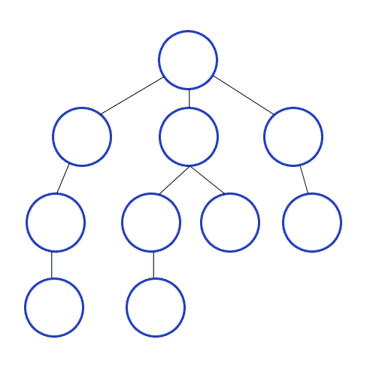
BFS - Shortest Path
BFS always returns the shortest path from source to any other vertex by edge count!
Intuition:
Each step push neighbors that are one edge away, onto a queue.
Because we use a queue, we must process the vertices 1 edge away, before vertices farther away
Each vertex’s predecessor in the table is the one which initially pushes it onto the stack (earliest/shortest path)

Slide 30
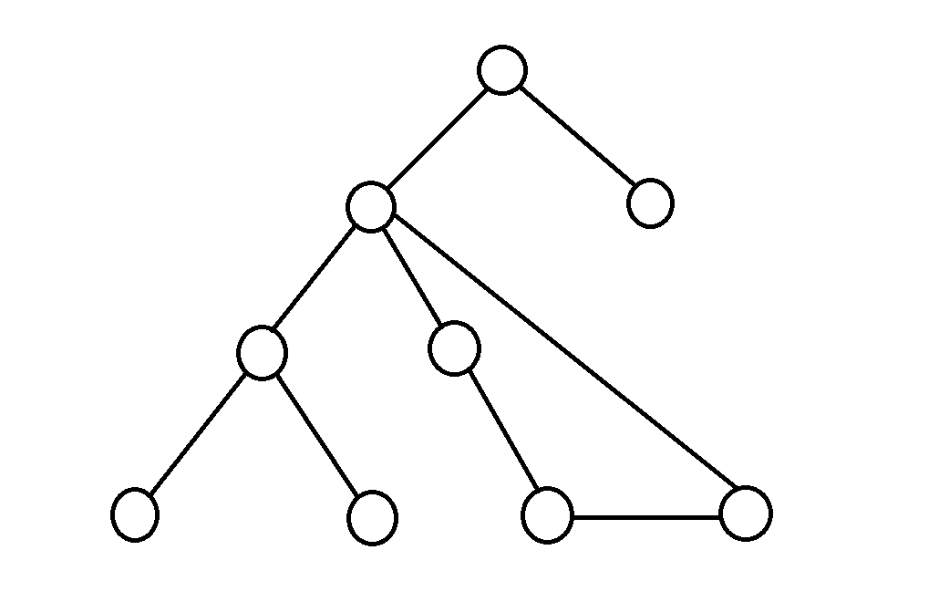
DFS - Finding Cycles
DFS can be used to detect cycles!
Intuition:
DFS tells us to keep moving along a chosen path until we hit a “dead-end”
If the “dead-end” is a null pointer (e.g. no more children/neighbors), no cycle
If the “dead-end” is a visited node, the path is a cycle!

Slide 31
Dijkstra’s Algorithm
(Shortest Path)
Notes:
Dijkstra’s Algorithm won’t be covered until next week! Current + following slides are not relevant to this section, but will be helpful next week.

Slide 32
Dijkstra’s Algorithm
Dijkstra’s algorithm finds the minimum-cost path from a source vertex to every other vertex in a non-negatively weighted graph
O(|V| log |V| + |E| log |V|) runtime
Dijkstra(Vertex source):
for each vertex v:
set v.cost = infinity
mark v as unvisited
set source.cost = 0
while exist unvisited vertices:
select unvisited vertex v with lowest cost
mark v as visited
for each edge (v, u) with weight w:
if u is not visited:
potentialBest = v.cost + w // cost of best path to u through v
currBest = u.cost // cost of current best path to u
if (potentialBest < currBest):
u.cost = potentialBest
u.pred = v
Notes:
Replace with priority queue
Update new priorities (new potential paths) as we find them

Slide 33
Dijkstra(Vertex source):
for each vertex v:
set v.cost = infinity
mark v as unvisited
set source.cost = 0
while exist unvisited vertices:
select unvisited vertex v with lowest cost
mark v as visited
for each edge (v, u) with weight w:
if u is not visited:
potentialBest = v.cost + w
currBest = u.cost
if (potentialBest < currBest):
u.cost = potentialBest
u.pred = v
Problem 2

Slide 34
Problem 2
Initialize each vertex as unvisited with cost ∞
Set cost of source vertex A to 0
F
3
E
Vertex | Visited? | Cost | Predecessor
A |  |  | –
B |  |  | –
C |  |  | –
D |  |  | –
E |  |  | –
F |  |  | –
No
No
No
No
No
No
0
13
∞
∞
∞
∞
∞
∞
1
5
13
50
3
A
D
16
6
8
2
B
C
7

Slide 35
Problem 2
Select unvisited vertex with lowest cost (A)
Mark A as visited
Process each outgoing edge
F
3
E
Vertex | Visited? | Cost | Predecessor
A | No | 0 | –
B | No | ∞ | –
C | No | ∞ | –
D | No | ∞ | –
E | No | ∞ | –
F | No | ∞ | –
13
Yes
1
13
1
5
∞ 8
∞ 16
∞ 50
∞ 13
∞ 1
A
A
A
A
A
13
50
3
A
50
A
D
16
16
6
8
8
2
B
C
7

Slide 36
Problem 2
Select unvisited vertex with lowest cost (F)
Mark F as visited
Process each outgoing edge
3
F
3
F
E
Vertex | Visited? | Cost | Predecessor
A | Yes | 0 | –
B | No | ∞ 8 | A
C | No | ∞ 16 | A
D | No | ∞ 50 | A
E | No | ∞ 13 | A
F | No | ∞ 1 | A
1
13
5
13
3
13
50
A
A
D
16
6
8
2
∞ 13 4
A F
B
C
Yes
7

Slide 37
Problem 2
Select unvisited vertex with lowest cost (E)
Mark E as visited
Process each outgoing edge
F
3
E
F
E
Vertex | Visited? | Cost | Predecessor
A | Yes | 0 | –
B | No | ∞ 8 | A
C | No | ∞ 16 | A
D | No | ∞ 50 | A
E | No | ∞ 13 4 | A F
F | Yes | ∞ 1 | A
1
13
5
5
13
50
3
A
A
D
16
6
∞ 50 9
A E
8
2
Yes
B
C
7

Slide 38
Select unvisited vertex with lowest cost (B)
Problem 2
Mark B as visited
Process each outgoing edge
No outgoing edges; continue
F
3
E
F
E
Vertex | Visited? | Cost | Predecessor
A | Yes | 0 | –
B | No | ∞ 8 | A
C | No | ∞ 16 | A
D | No | ∞ 50 9 | A E
E | Yes | ∞ 13 4 | A F
F | Yes | ∞ 1 | A
1
13
5
Yes
13
50
3
A
A
D
16
6
8
2
B
B
C
7

Slide 39
Problem 2
Select unvisited vertex with lowest cost (D)
Mark D as visited
Process each outgoing edge
(ignore D→B since B is already visited)
F
3
E
F
E
Vertex | Visited? | Cost | Predecessor
A | Yes | 0 | –
B | Yes | ∞ 8 | A
C | No | ∞ 16 | A
D | No | ∞ 50 9 | A E
E | Yes | ∞ 13 4 | A F
F | Yes | ∞ 1 | A
1
13
5
13
50
3
A
A
D
D
∞ 16 11
A D
16
6
Yes
6
8
2
2
B
B
C
7

Slide 40
Select unvisited vertex with lowest cost (C)
Problem 2
Mark C as visited
Process each outgoing edge
(ignore C→B & C→E since B & E are already visited)
No outgoing edges to unvisited nodes; continue
F
3
E
F
E
Vertex | Visited? | Cost | Predecessor
A | Yes | 0 | –
B | Yes | ∞ 8 | A
C | No | ∞ 16 11 | A D
D | Yes | ∞ 50 9 | A E
E | Yes | ∞ 13 4 | A F
F | Yes | ∞ 1 | A
1
13
5
3
13
50
3
A
A
D
D
Yes
16
6
8
2
B
B
C
C
7
7

Slide 41
Problem 2
No more unvisited nodes; we are done
F
3
E
F
E
Vertex | Visited? | Cost | Predecessor
A | Yes | 0 | –
B | Yes | ∞ 8 | A
C | No | ∞ 16 11 | A D
D | Yes | ∞ 50 9 | A E
E | Yes | ∞ 13 4 | A F
F | Yes | ∞ 1 | A
1
13
5
13
50
3
A
A
D
D
Yes
16
6
8
2
B
B
C
C
7

Slide 42
Dijkstra(Vertex source):
for each vertex v:
set v.cost = infinity
mark v as unvisited
set source.cost = 0
while exist unvisited vertices:
select unvisited vertex v with lowest cost
mark v as visited
for each edge (v, u) with weight w:
if u is not visited:
potentialBest = v.cost + w
currBest = u.cost
if (potentialBest < currBest):
u.cost = potentialBest
u.pred = v
Problem 3

Slide 43
Problem 3
Initialize each vertex as unvisited with cost ∞
Set cost of source vertex A to 0
B
3
C
Vertex | Visited? | Cost | Predecessor
A |  |  | –
B |  |  | –
C |  |  | –
D |  |  | –
E |  |  | –
F |  |  | –
No
No
No
No
No
No
0
80
∞
∞
∞
∞
∞
∞
5
-5
70
90
A
D
60
6
4
10
F
E
7

Slide 44
Problem 3
Initialize each vertex as unvisited with cost ∞
Set cost of source vertex A to 0
B
3
C
Vertex | Visited? | Cost of Path | Pred
a | True | 0
b | True | ∞ 05 | a
c | True | ∞ 80 08 | a b
d | True | ∞ 90 03 | a c
e | True | ∞ 60 13 | a d
f | True | ∞ 04 | a
5
80
-5
70
90
A
D
60
6
4
10
F
E
7
Order added to known set: a, f, b, c, d, e

Slide 45
Thank You!

